Slide 1
HAWKES LEARNING
Shifts in Aggregate Demand

Slide 2

Introduction
Consider the economic effects of the COVID-19 pandemic. In what ways does a pandemic directly affect aggregate demand?
HAWKES LEARNING
Notes:
Consider the economic effects of the COVID-19 pandemic. In what ways does a pandemic directly affect aggregate demand?

Slide 3
Introduction
Components of aggregate demand: consumption, investment, government spending, and net exports (exports-imports)
When the AD curve shifts right, at least one component of aggregate demand has increased, so greater spending would occur at every price level.
When the AD curve shifts left, at least one component of aggregate demand has decreased, so less spending would occur at every price level.
Two broad categories cause curves to shift: changes in consumer or business behavior and changes in government tax or spending policy
HAWKES LEARNING
Notes:
Components of aggregate demand: consumption, investment, government spending, and net exports (exports-imports)
When the AD curve shifts right, at least one component of AD has increased, so greater spending would occur at every price level. When the AD curve shifts left, at least one component of AD has decreased, so less spending would occur at every price level.
Two broad categories cause curves to shift: changes in consumer or business behavior and changes in government tax or spending policy

Slide 4
How Changes by Consumers and Firms Can Affect Aggregate Demand
Since a rise in confidence is associated with higher consumption and investment demand, it will cause the AD curve to shift right.
A decline in confidence reduces consumption and investment and shifts AD left.
Consumer and business confidence often reflects macroeconomic realities, like confidence being lower during a recession.
Confidence can sometimes change for reasons that do not have a close connection to the immediate economy, like the risk of war or election results.
HAWKES LEARNING
Notes:
Since a rise in confidence is associated with higher consumption and investment demand, it will cause the AD curve to shift right. A decline in confidence reduces consumption and investment and shifts AD left. Consumer and business confidence often reflects macroeconomic realities, like confidence being lower during a recession. Confidence can sometimes change for reasons that do not have a close connection to the immediate economy, like the risk of war or election results.

Slide 5
How Government Macroeconomic Policy Choices Can Shift Aggregate Demand
Higher government spending will cause AD to shift right.
Tax cuts for individuals tend to increase consumption demand, while tax increases tend to diminish it.
Tax policy can also pump up investment demand by offering lower tax rates for corporations or tax reductions that benefit specific kinds of investment.
During a recession, when unemployment is high and businesses are suffering low profits or even losses, Congress often passes tax cuts.
HAWKES LEARNING
Notes:
Higher government spending will cause AD to shift right. Tax cuts for individuals tend to increase consumption demand, while tax increases tend to diminish it. Tax policy can also pump up investment demand by offering lower tax rates for corporations or tax reductions that benefit specific kinds of investment. During a recession, when unemployment is high and businesses are suffering low profits or even losses, Congress often passes tax cuts.

Slide 6
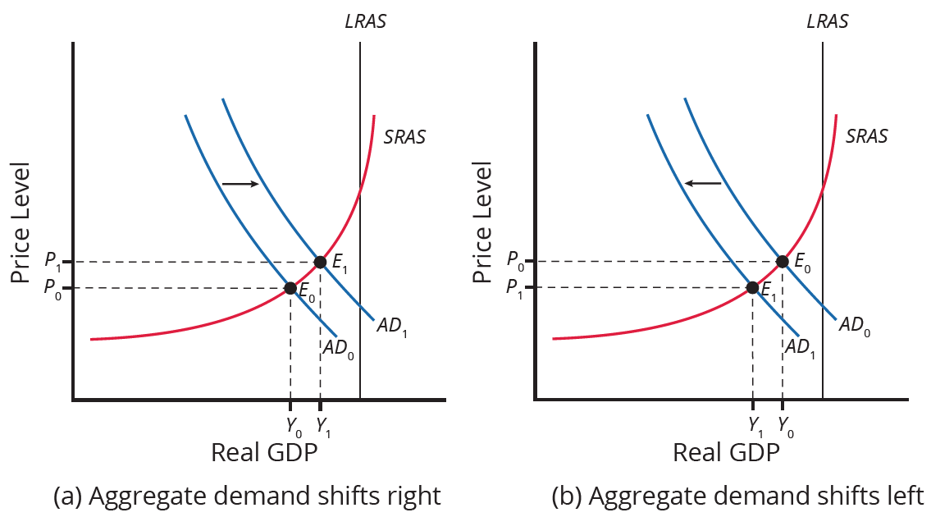
How Changes by Consumers and Firms Can Affect Aggregate Demand
Increased consumer/business confidence, increased government spending, or tax cuts can shift AD to the right. Decreased consumer/business confidence, decreased government spending, or higher taxes can shift AD to the left.
HAWKES LEARNING
Notes:
Increased consumer/business confidence, increased government spending, or tax cuts can shift AD to the right. Decreased consumer/business confidence, decreased government spending, or higher taxes can shift AD to the left.

Slide 7
Federal Reserve Influence
How the Federal Reserve influences interest rates and credit availability can also shift the AD curve.
Higher interest rates discourage borrowing, which reduces household spending on big purchases, and reduces business investment spending.
Lower interest rates stimulate consumption and investment demand.
Interest rates can also affect exchange rates, which influence exports and imports.
HAWKES LEARNING
Notes:
How the Federal Reserve influences interest rates and credit availability can also shift the AD curve. Higher interest rates discourage borrowing, which reduces household spending on big purchases, and reduces business investment spending. Lower interest rates stimulate consumption and investment demand. Interest rates can also affect exchange rates, which influence exports and imports.

Slide 8

On Your Own
You are considering buying a new smartphone for $1,000. In order to buy the phone, you plan to borrow the money and repay the loan and interest on it after one year. How much will your payment be after one year if the interest rate is 4%? How much will your payment be if the interest rate is 7%? How might the difference in interest rates affect your decision to buy a new phone, and how would your decision affect aggregate demand?
Notes:
You are considering buying a new smartphone for $1,000. In order to buy the phone, you plan to borrow the money and repay the loan and interest on it after one year. How much will your payment be after one year if the interest rate is 4%? How much will your payment be if the interest rate is 7%? How might the difference in interest rates affect your decision to buy a new phone, and how would your decision affect aggregate demand?

Slide 9
On Your Own
You are considering buying a new smartphone for $1,000. In order to buy the phone, you plan to borrow the money and repay the loan and interest on it after one year. How much will your payment be after one year if the interest rate is 4%? How much will your payment be if the interest rate is 7%? How might the difference in interest rates affect your decision to buy a new phone, and how would your decision affect aggregate demand?
If the interest rate is 4%, you would repay $1,000 + (.04)($1,000)= $1,000 + $40 = $1,040.
If the interest rate is 7%, you would repay $1,000 + (.07)($1,000)= $1,000 + $70 = $1,070.
The higher interest rate and the larger payment might make you decide not to buy the new phone. If you decrease your consumption by $1,000, this will decrease aggregate demand.
HAWKES LEARNING
Notes:
You are considering buying a new smartphone for $1,000. In order to buy the phone, you plan to borrow the money and repay the loan and interest on it after one year. How much will your payment be after one year if the interest rate is 4%? How much will your payment be if the interest rate is 7%? How might the difference in interest rates affect your decision to buy a new phone, and how would your decision affect aggregate demand?
If the interest rate is 4%, you would repay $1,000+(.04)($1,000)= $1,000+ $40= $1,040.
If the interest rate is 7%, you would repay $1,000+ (.07)($1,000)= $1,000+ $70= $1,070.
The higher interest rate and the larger payment might make you decide not to buy the new phone. If you decrease your consumption by $1,000, this will decrease aggregate demand.

Slide 10
Summary
The AD curve will shift right as the components of aggregate demand (C, I, G, and X−M) rise.
The AD curve will shift back to the left as these components fall.
These factors can change because of personal choices (like those resulting from consumer or business confidence) or from policy choices (like changes in government spending and taxes).
Where the AD curve intersects the AS curve determines whether equilibrium output changes relatively more than the price level or the price level changes relatively more than output.
We illustrate a recession when the intersection of AD and AS is substantially below potential GDP, and we illustrate an expanding economy when the intersection of AS and AD is near potential GDP.
HAWKES LEARNING

Slide 11




HAWKES LEARNING

