Slide 1
HAWKES LEARNING
How the AD/AS Model Incorporates Growth, Unemployment, and Inflation

Slide 2
Introduction
The AD/AS model conveys the interlocking relationships among three macroeconomic goals: growth, low unemployment, and low inflation.
The AD/AS framework is flexible enough to accommodate both the Keynes' law approach and the Say’s law approach.
In the context of the AD/AS model, the three macroeconomic goals arise in ways that are sometimes indirect or incomplete.
In this lesson, we will consider how the AD/AS model illustrates the goals of economic growth, low unemployment, and low inflation.
HAWKES LEARNING
Notes:
The aggregate demand/aggregate supply (AD/AS) model can convey multiple interlocking relationships among three macroeconomic goals: growth, low unemployment, and low inflation. Moreover, the AD/AS framework is flexible enough to accommodate both the Keynes' law approach, which focuses on aggregate demand and the short run, and the Say's law approach, which focuses on aggregate supply and the long run. In the context of the AD/AS model, the three macroeconomic goals arise in ways that are sometimes indirect or incomplete. In this lesson, we will consider how the AD/AS model illustrates the goals of economic growth, low unemployment, and low inflation.

Slide 3
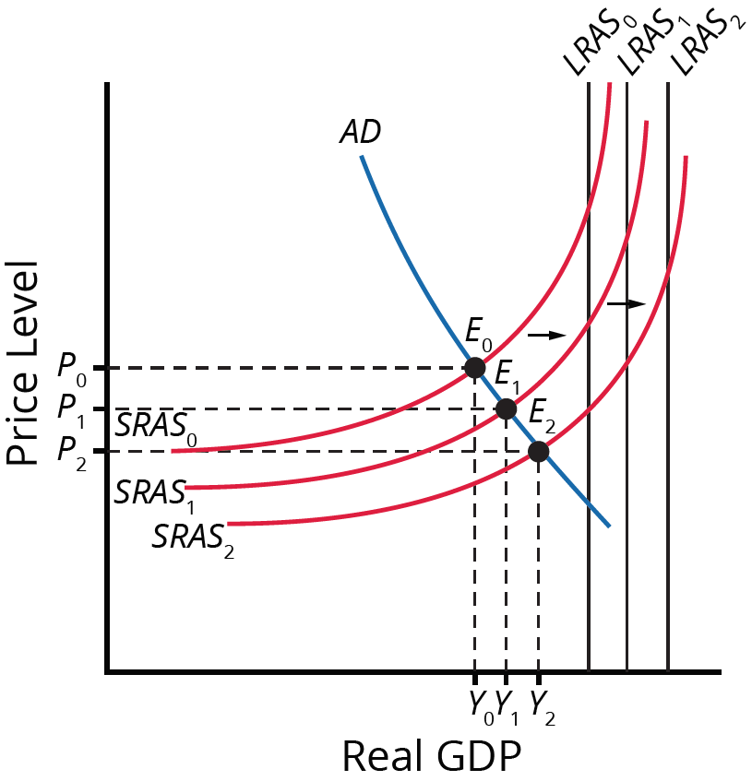
AD/AS Model
Long-run economic growth is represented by a rightward shift in the aggregate supply curve.
Long-run aggregate supply, or potential GDP, shifts over time as well.
The factors that determine the speed of economic growth do not appear directly in the diagram.
Both substitution bias and quality/new goods bias tend to overstate the negative impact of inflation on consumers.
HAWKES LEARNING
Notes:
Long-run economic growth is represented by a rightward shift in the aggregate supply curve. Long-run aggregate supply, or potential GDP, shifts over time as well. The factors that determine speed of economic growth do not directly appear in the diagram.

Slide 4
Unemployment in the AD/AS Diagram
Short-run variations in unemployment (cyclical unemployment) are caused by the business cycle as the economy expands and contracts.
Over the long run, in the United States, the unemployment rate typically hovers around 5% when the economy is healthy.
In many of the national economies across Europe, the unemployment rate in recent decades has only dropped to about 10%, even in good economic years.
We call this baseline level of unemployment that occurs year in and year out the natural rate of unemployment.
HAWKES LEARNING
Notes:
Short-run variations in unemployment (cyclical unemployment) are caused by the business cycle as the economy expands and contracts. Over the long run, in the United States, the unemployment rate typically hovers around 5% when the economy in healthy. In many of the national economies across Europe, the unemployment rate in recent decades has only dropped to about 10%, even in good economic years. We call this baseline level of unemployment that occurs year in and year out the natural rate of unemployment.

Slide 5
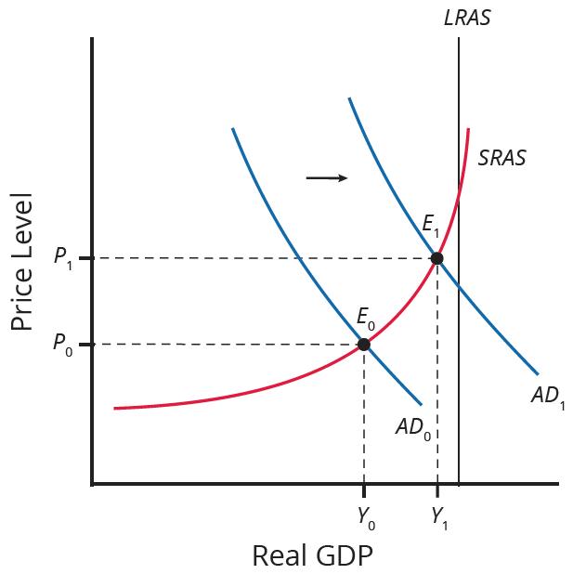
AD/AS Model Fluctuations
Recession occurs when the equilibrium level of real GDP is well below potential GDP (LRAS).
During recessions, cyclical unemployment is higher, while natural unemployment remains unchanged in the long run.
The AD curve shifts rightward as the economy recovers.
HAWKES LEARNING
Notes:
Recession occurs when the equilibrium level of real GDP is well below potential GDP (LRAS). During recessions, cyclical unemployment is higher, while natural unemployment remains unchanged in the long run. The AD curve shifts rightward as the economy recovers.

Slide 6
Inflation in the AD/AS Model
Higher inflation rates have typically occurred either during or just after economic booms.
During the 20th century, the biggest spurts of inflation in the U.S. economy followed the wartime booms of WWI and WWII.
Rates of inflation generally decline during recessions.
As an extreme example, inflation actually became negative—a situation called "deflation"—during the Great Depression.
HAWKES LEARNING
Notes:
Higher inflation rates have typically occurred either during or just after economic booms. During the 20th century, the biggest spurts of inflation in the U.S. economy followed the wartime booms of WWI and WWII. Rates of inflation generally decline during recessions. As an extreme example, inflation actually became negative—a situation called "deflation"—during the Great Depression.

Slide 7
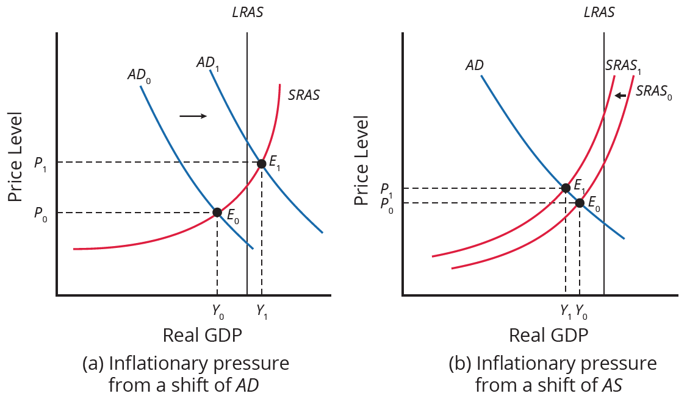
AD/AS Model Inflationary Pressures
When a shift in AD happens in the area of the SRAS curve that is near potential GDP, it will lead to a higher price level and pressure for a higher price level and inflation. A shift in SRAS will lead to a lower real GDP and pressure for a higher price level and inflation.
HAWKES LEARNING
Notes:
When a shift in AD happens in the area of the SRAS curve that is near potential GDP, it will lead to a higher price level and pressure for a higher price level and inflation. A shift in AS will lead to a lower real GDP and pressure for a higher price level and inflation.

Slide 8
Summary
The AD/AS model conveys the relationship between growth, unemployment, and inflation.
Economic growth and recession are conveyed through shifts in the aggregate supply curves.
Cyclical unemployment fluctuates with the trend of business cycles, but natural unemployment remains relatively unchanged.
The AD/AS framework shows pressures for inflation to rise or fall when the movement from one equilibrium to another causes the price level to rise or fall.
HAWKES LEARNING

Slide 9




HAWKES LEARNING

