Slide 1
HAWKES LEARNING
Bank Regulation

Slide 2
Introduction
Maintaining a safe and stable national financial system is a critical concern of the Federal Reserve.
The goal is to protect not only individuals' savings but also the integrity of the financial system itself.
Bank regulation came into public view during the 2008–2009 financial crisis when critical parts of the financial system failed.
Notes:
Maintaining a safe and stable national financial system is a critical concern of the Federal Reserve. The goal is to protect not only individuals' savings but also the integrity of the financial system itself. Bank regulation came into public view during the 2008–2009 financial crisis when critical parts of the financial system failed.

Slide 3
Bank Regulation
Bank regulation is intended to maintain banks’ solvency by avoiding excessive risk.
Regulation falls into several categories:
Reserve requirements
Capital requirements
Restrictions on the types of investments banks may make
HAWKES LEARNING
Notes:
Bank regulation is intended to maintain banks’ solvency by avoiding excessive risk. Regulation falls into several categories: reserve requirements, capital requirements, and restrictions on the types of investments banks may make.

Slide 4
Reserve Requirement
While a portion of bank reserves are held as cash in the bank, the majority are in the bank's account at the Federal Reserve.
Since these funds can't be loaned into the market, the reserve requirement limits a bank's ability to create money.
A loan issued by one bank can become a deposit into another bank, generating further lending throughout the system.
Notes:
While a portion of bank reserves are held as cash in the bank, the majority are in the bank's account at the Federal Reserve. Since these funds can't be loaned into the market, the reserve requirement limits a bank's ability to create money. A loan issued by one bank can become a deposit into another bank, generating further lending throughout the system.

Slide 5
Investment Restrictions
Another part of bank regulation is restriction on the types of investments that banks are allowed to make.
Banks are permitted to make loans to businesses, individuals, and other banks.
To protect depositors, banks are not permitted to invest in the stock market or other assets that are perceived as too risky.
Notes:
Another part of bank regulation is restriction on the types of investments that banks are allowed to make. Banks are permitted to make loans to businesses, individuals, and other banks. To protect depositors, banks are not permitted to invest in the stock market or other assets that are perceived as too risky.

Slide 6
Bank Capital
Bank capital is the difference between a bank's assets and its liabilities, or its net worth.
A bank must have positive net worth; otherwise, it is insolvent or bankrupt, meaning it would not have enough assets to pay back its liabilities.
Regulation requires that banks maintain a minimum net worth, usually expressed as a percent of their assets, to protect their depositors.
Notes:
Bank capital is the difference between a bank's assets and its liabilities, or its net worth. A bank must have positive net worth; otherwise, it is insolvent or bankrupt, meaning it would not have enough assets to pay back its liabilities. Regulation requires that banks maintain a minimum net worth, usually expressed as a percent of their assets, to protect their depositors and other creditors.

Slide 7


Bank Supervision
The Office of the Comptroller of the Currency (OCC) regulates savings and loan institutions.
The National Credit Union Administration (NCUA) supervises credit unions, which are nonprofit banks that their members run and own.
The Federal Reserve also has some responsibility for supervising financial institutions.
Notes:
The Office of the Comptroller of the Currency (OCC) regulates savings and loan institutions. The National Credit Union Administration (NCUA) supervises credit unions, which are nonprofit banks that their members run and own. The Federal Reserve also has some responsibility for supervising financial institutions.

Slide 8
Bank Supervision Problems
Bank supervision can run into both practical and political issues.
Measuring the value of a bank's assets is not always straightforward.
A bank’s assets are its loans, and the value of these assets depends on estimates of the risk that customers will not repay these loans.
The political issue arises because a bank supervisor's decision to require a bank to close or change its financial investments is often controversial.
Notes:
Bank supervision can run into both practical and political issues. Measuring the value of a bank's assets is not always straightforward. A bank’s assets are its loans, and the value of these assets depends on estimates of the risk that customers will not repay these loans. The political issue arises because a bank supervisor's decision to require a bank to close or change its financial investments is often controversial.

Slide 9
Bank Runs
Back in the nineteenth century and during the first few decades of the twentieth century, putting money in the bank could be nerve-wracking.
A bank run occurs when depositors race to the bank to withdraw their deposits.
The risk of bank runs created instability in the banking system.
Even a rumor that a bank might experience negative net worth might trigger a run, which could destroy even healthy banks.
Notes:
Back in the nineteenth century and during the first few decades of the twentieth century, putting money in the bank could be nerve-wracking. A bank run occurs when depositors race to the bank to withdraw their deposits. The risk of bank runs created instability in the banking system. Even a rumor that a bank might experience negative net worth might trigger a run, which could destroy even healthy banks.

Slide 10
Deposit Insurance
Deposit insurance is an insurance system that makes sure depositors do not lose their money, even if the bank goes bankrupt.
About seventy countries around the world, including all the major economies, have deposit insurance programs.
In the United States, the Federal Deposit Insurance Corporation (FDIC) is responsible for deposit insurance.
Even if a bank fails, the government guarantees that depositors will receive up to $250,000 of their money in each account.
Notes:
To protect against bank runs, Congress has put two strategies into place: deposit insurance and the lender of last resort. Deposit insurance is an insurance system that makes sure depositors do not lose their money, even if the bank goes bankrupt. In the United States, the Federal Deposit Insurance Corporation (FDIC) is responsible for deposit insurance. Even if a bank fails, the government guarantees that depositors will receive up to $250,000 of their money in each account.

Slide 11

On Your Own
How would you react to news that your bank was at risk of becoming insolvent?
Notes:
How would you react to news that your bank was at risk of becoming insolvent?

Slide 12
On Your Own
How would you react to news that your bank was at risk of becoming insolvent?
If your bank has FDIC insurance, as most U.S. banks do, you would be guaranteed to recover up to $250,000 in each of your accounts. You would need to be sure not to have more than $250,000 in an account so that you wouldn’t risk losing anything above that amount. However, this news would still be unnerving since you might not get the money immediately from the FDIC.
Notes:
How would you react to news that your bank was at risk of becoming insolvent?
If your bank has FDIC insurance, as most U.S. banks do, you would be guaranteed to recover up to $250,000 in each of your accounts. You would need to be sure not to have more than $250,000 in an account so that you wouldn’t risk losing anything above that amount. However, this news would still be unnerving since you might not get the money immediately from the FDIC.

Slide 13
Lender of Last Resort
The problem with bank runs is that they can cause solvent banks to fail and then spread to the rest of the financial system.
To prevent this, the Fed stands ready to lend to banks and other financial institutions when they cannot obtain funds from anywhere else.
This is known as the lender of last resort role.
For banks, the central bank acting as a lender of last resort reinforces the effect of deposit insurance and reassures customers that they will not lose their money.
Notes:
The problem with bank runs is that they can cause solvent banks to fail and then spread to the rest of the financial system. To prevent this, the Fed stands ready to lend to banks and other financial institutions when they cannot obtain funds from anywhere else. This is known as the lender of last resort role. For banks, the central bank acting as a lender of last resort reinforces the effect of deposit insurance and reassures customers that they will not lose their money.

Slide 14
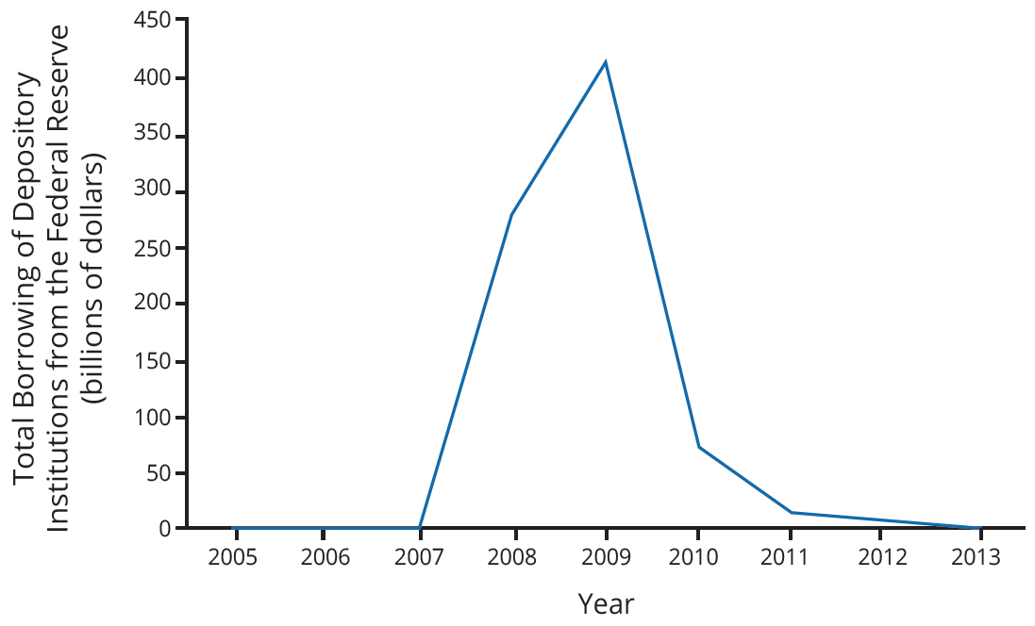
Lender of Last Resort
This graph shows total borrowing of depository institutions from the Federal Reserve in the years surrounding the Great Recession.
Notes:
This graph shows total borrowing of depository institutions from the Federal Reserve in the years surrounding the Great Recession.

Slide 15

Summary
Bank runs occur when there are rumors that the bank is at financial risk of having negative net worth.
The OCC is responsible for supervising banks and inspecting savings and loans.
The FDIC collects deposit insurance premiums from banks and guarantees bank deposits.
Deposit insurance guarantees bank depositors that their deposits will be protected.
A central bank acts as a lender of last resort, making short-term loans available in situations of severe financial panic or stress.
HAWKES LEARNING

Slide 16




HAWKES LEARNING

