Slide 1
HAWKES LEARNING
Exchange Rate Policies

Slide 2
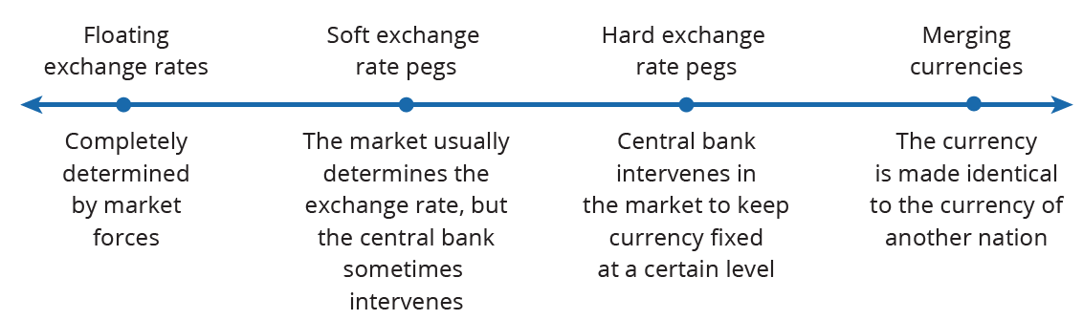
Exchange Rate Policies
Exchange rate policies come in a range of different forms based on the following approaches:
Notes:
Exchange rate policies come in a range of different forms based on the following approaches:
Floating exchange rates are completely determined by market forces
Soft exchange rate pegs refer to when the market determines the exchange rate, but the central bank sometimes intervenes
Hard exchange rate pegs refer to when the central bank intervenes in the market to keep currency fixed at a certain level
Merging currencies refers to when a currency is made identical to the currency of another nation

Slide 3
Floating Exchange Rates
A floating exchange rate is a policy that allows the foreign exchange market to set exchange rates.
The U.S. dollar is a floating exchange rate, as are the currencies of about 40% of the countries in the world economy.
The major concern with this policy is that exchange rates can move a great deal in a short time.
Notes:
A floating exchange rate is a policy that allows the foreign exchange market to set exchange rates. The U.S. dollar is a floating exchange rate, as are the currencies of about 40% of the countries in the world economy. The major concern with this policy is that exchange rates can move a great deal in a short time.

Slide 4
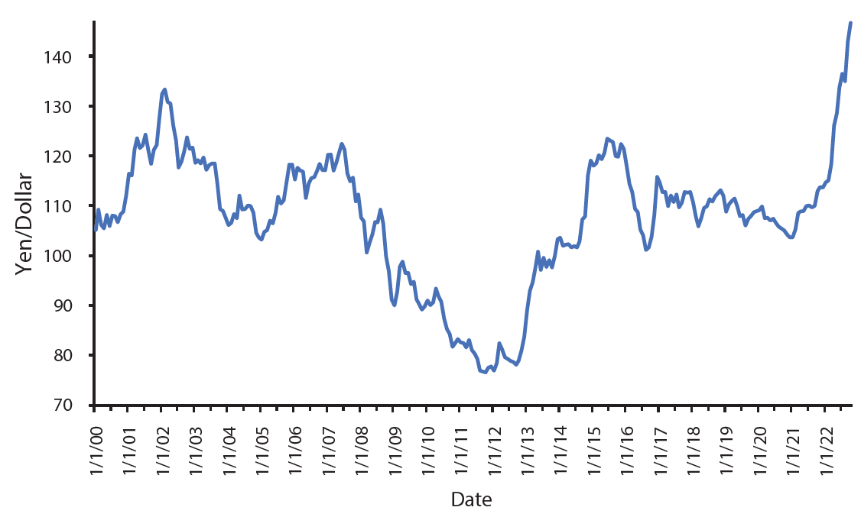
Floating Exchange Rates
Even seemingly stable exchange rates, such as JPY/USD, can vary when closely examined over time. This figure shows a relatively stable rate between 2011 and 2013, before the yen drastically depreciated in 2013 and 2014. The rate was relatively stable between 2017 and 2021, before the yen started to immensely appreciate.
Notes:
Even seemingly stable exchange rates, such as JPY/USD, can vary when closely examined over time. This figure shows a relatively stable rate between 2011 and 2013, before the yen drastically depreciated in 2013 and 2014. The rate was relatively stable between 2017 and 2019.

Slide 5
Floating Exchange Rates
As investor sentiment swings back and forth and drives exchange rates up and down, exporters, importers, and banks involved in international lending are all affected.
At worst, large movements of exchange rates can drive companies into bankruptcy or trigger a nationwide banking collapse.
Exchange rate movements can particularly rattle the economies of smaller countries, where international trade is a large share of GDP.
Advocates of floating exchange rates often argue that if government policies were more predictable and stable, inflation rates and interest rates would be too, and exchange rates would move less.
Notes:
As investor sentiment swings back and forth and drives exchange rates up and down, exporters, importers, and banks involved in international lending are all affected. At worst, large movements of exchange rates can drive companies into bankruptcy or trigger a nationwide banking collapse. Exchange rate movements can particularly rattle the economies of smaller countries, where international trade is a large share of GDP. Advocates of floating exchange rates often argue that if government policies were more predictable and stable, inflation rates and interest rates would be too, and exchange rates would move less.

Slide 6
Using Soft Pegs and Hard Pegs
A government establishes a "peg" for its currency when it intervenes in the foreign exchange market, making the currency's exchange rate different from what the market would have produced.
A soft peg means the government usually allows the market to set the exchange rate, but in some cases the central bank will intervene.
A hard peg means the central bank sets a fixed and unchanging value for the exchange rate.
Notes:
A government establishes a "peg" for its currency when it intervenes in the foreign exchange market, making the currency's exchange rate different from what the market would have produced. A soft peg means the government usually allows the market to set the exchange rate, but in some cases the central bank will intervene. A hard peg means the central bank sets a fixed and unchanging value for the exchange rate.

Slide 7
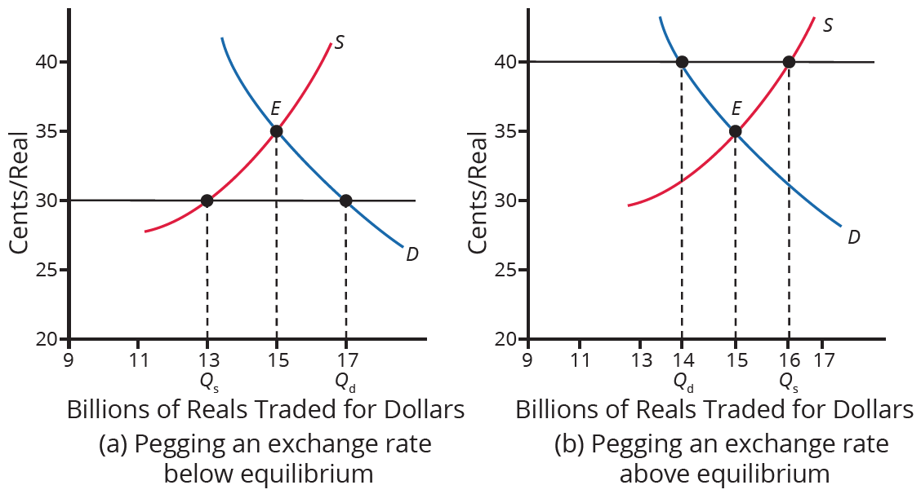
Using Soft Pegs and Hard Pegs
If an exchange rate is pegged below what would otherwise be the equilibrium, the currency's quantity demanded will exceed the quantity supplied. If an exchange rate is pegged above what would otherwise be the equilibrium, the currency's quantity supplied will exceed the quantity demanded.
Notes:
If an exchange rate is pegged below what would otherwise be the equilibrium, the currency's quantity demanded will exceed the quantity supplied. If an exchange rate is pegged above what would otherwise be the equilibrium, the currency's quantity supplied will exceed the quantity demanded.

Slide 8
Weakening the Exchange Rate
A central bank can weaken its exchange rate in two ways:
  Use expansionary monetary policy to lower interest rates
  Trade directly in the foreign exchange market
Expansionary monetary policy would lower interest rates in foreign exchange markets, decreasing demand and increasing supply of the currency, leading to depreciation.
A country can also trade directly in the foreign exchange market, expanding supply by creating currency.
Notes:
A central bank can weaken its exchange rate in two ways:
Use expansionary monetary policy to lower interest rates
Trade directly in the foreign exchange market
Expansionary monetary policy would lower interest rates in foreign exchange markets, decreasing demand and increasing supply of the currency, leading to depreciation. A country can also trade directly in the foreign exchange market, expanding supply by creating currency.

Slide 9
Strengthening the Exchange Rate
A central bank could strengthen its exchange rate in two ways:
  Use contractionary monetary policy to raise interest rates
  Trade directly in the foreign exchange market
Contractionary monetary policy would raise interest rates in foreign exchange markets, increasing demand and decreasing supply, leading to appreciation.
If the central bank trades directly in the foreign exchange market, it will have an excess supply of domestic currency.
The bank will use its reserves of foreign currency to demand the domestic currency, leading to appreciation.
Notes:
A central bank could strengthen its exchange rate in two ways:
Use contractionary monetary policy to raise interest rates
Trade directly in the foreign exchange market
Contractionary monetary policy would raise interest rates in foreign exchange markets, increasing demand and decreasing supply, leading to appreciation. If the central bank trades directly in the foreign exchange market, it will have an excess supply of domestic currency. The bank will use its reserves of foreign currency to demand the domestic currency, leading to appreciation.

Slide 10
Tradeoffs of Soft Pegs and Hard Pegs
When a country decides to alter the market exchange rate, it faces some tradeoffs.
If it uses monetary policy to alter the exchange rate, it cannot simultaneously use monetary policy to address inflation or recession.
If it uses direct purchases and sales of foreign currencies in exchange rate markets, it must consider how to handle its reserves of foreign currency.
A pegged exchange rate can actually create additional movements of the exchange rate.
HAWKES LEARNING
Notes:
When a country decides to alter the market exchange rate, it faces some tradeoffs. If it uses monetary policy to alter the exchange rate, it cannot simultaneously use monetary policy to address inflation or recession. If it uses direct purchases and sales of foreign currencies in exchange rate markets, it must consider how to handle its reserves of foreign currency. A pegged exchange rate can actually create additional movements of the exchange rate.

Slide 11
A Merged Currency
A final approach to exchange rate policy is a merged currency, a common currency shared between two or more nations.
A merged currency approach eliminates foreign exchange risk altogether.
Like a hard peg, a merged currency means that a nation has given up altogether on domestic monetary policy and instead has put its interest rate policies in other hands.
HAWKES LEARNING
Notes:
A final approach to exchange rate policy is a merged currency, a common currency shared between two or more nations. A merged currency approach eliminates foreign exchange risk altogether. Like a hard peg, a merged currency means that a nation has given up altogether on domestic monetary policy and instead has put its interest rate policies in other hands.

Slide 12
Four Approaches
The lines between the four exchange rate policies can blend together.
Soft peg policy may look very similar to a floating exchange rate if the government rarely intervenes in the exchange rate market.
Soft peg policy may look similar to hard peg policy if the government intervenes often to keep the exchange rate near a specific level.
Merging currencies with other countries is similar to having a hard peg exchange rate because it is, in effect, a decision to have a permanently fixed exchange rate with those countries.
HAWKES LEARNING
Notes:
The lines between the four exchange rate policies can blend together. Soft peg policy may look very similar to a floating exchange rate if the government rarely intervenes in the exchange rate market. Soft peg policy may look similar to hard peg policy if the government intervenes often to keep the exchange rate near a specific level. Merging currencies with other countries is similar to having a hard peg exchange rate because it is, in effect, a decision to have a permanently fixed exchange rate with those countries.

Slide 13

On Your Own
Suppose that you are an economic advisor to the U.S. president. The economy is near its potential GDP, but the president is pressuring the Federal Reserve to decrease interest rates. If asked, what would you tell the president about this policy’s effect on aggregate demand and exchange rates?
HAWKES LEARNING
Notes:
Suppose that you are an economic advisor to the U.S. president. The economy is near its potential GDP, but the president is pressuring the Federal Reserve to decrease interest rates. If asked, what would you tell the president about this policy’s effect on aggregate demand and exchange rates?

Slide 14
On Your Own
Suppose that you are an economic advisor to the U.S. president. The economy is near its potential GDP, but the president is pressuring the Federal Reserve to decrease interest rates. If asked, what would you tell the president about this policy’s effect on aggregate demand and exchange rates?
If the Fed decreases interest rates, the consumption and investment components of aggregate demand will increase. If interest rates are lower in the U.S., foreign investors will sell dollars and buy currencies of countries with higher interest rates. This will cause the dollar to depreciate since the U.S. has a floating exchange rate policy. If the dollar depreciates, U.S. exports will increase, and imports will decrease, which will also add to aggregate demand. If pursued when the economy is close to potential GDP, this policy, which will increase aggregate demand, could cause inflation.
HAWKES LEARNING
Notes:
Suppose that you are an economic advisor to the U.S. president. The economy is near its potential GDP, but the president is pressuring the Federal Reserve to decrease interest rates. If asked, what would you tell the president about this policy’s effect on aggregate demand and exchange rates?
If the Fed decreases interest rates, the consumption and investment components of aggregate demand will increase. If interest rates are lower in the U.S., foreign investors will sell dollars and buy currencies of countries with higher interest rates. This will cause the dollar to depreciate since the U.S. has a floating exchange rate policy. If the dollar depreciates, U.S. exports will increase, and imports will decrease, which will also add to aggregate demand. If pursued when the economy is close to potential GDP, this policy, which will increase aggregate demand, could cause inflation.

Slide 15
Summary
With a floating exchange rate policy, a government determines its country's exchange rate in the foreign exchange market.
With a soft peg exchange rate policy, the foreign exchange market usually determines a country's exchange rate, but the government sometimes intervenes to strengthen or weaken it.
With a hard peg exchange rate policy, the government chooses an exchange rate.
With merged currency, exchange rate movements don’t affect trade.
The lines between the four exchange rate policies can blend together.
HAWKES LEARNING

Slide 16




HAWKES LEARNING

