Slide 1
HAWKES LEARNING
Government Spending

Slide 2
Introduction
All levels of government—federal, state, and local—have budgets that show how much revenue the government expects to receive in taxes and other income and how it plans to spend it.
Budgets can shift dramatically within a few years as policy decisions and unexpected events disrupt earlier tax and spending plans.
Fiscal policy is one of two policy tools for fine-tuning the economy.
The discussion of fiscal policy focuses on how federal government spending and taxes affect aggregate demand (AD).
Notes:
All levels of government—federal, state, and local—have budgets that show how much revenue the government expects to receive in taxes and other income and how it plans to spend it. Budgets can shift dramatically within a few years as policy decisions and unexpected events disrupt earlier tax and spending plans. Fiscal policy is one of two policy tools for fine-tuning the economy. The discussion of fiscal policy focuses on how federal government spending and taxes affect aggregate demand (AD).

Slide 3
Government Spending
Government spending covers a range of services that federal, state, and local governments provide.
Budget Deficit - When the federal government spends more money than it receives in taxes in a given year
Budget Surplus - When the federal government receives more money in taxes than it spends in a given year
Balanced Budget - When the federal government spending and taxes are equal
For example, in 2020, the U.S. government experienced its largest budget deficit ever: the federal government spent $3.1 trillion more than it collected in taxes.
Notes:
Government spending covers a range of services that federal, state, and local governments provide.
Budget Deficit - When the federal government spends more money than it receives in taxes in a given year
Budget Surplus - When the federal government receives more money in taxes than it spends in a given year
Balanced Budget - When the federal government spending and taxes are equal
For example, in 2020, the U.S. government experienced its largest budget deficit ever: the federal government spent $3.1 trillion more than it collected in taxes.

Slide 4
Total U.S. Government Spending
Federal spending in nominal dollars (that is, dollars not adjusted for inflation) has grown by a multiple of more than 68 over the last six decades, from $92.2 billion in 1960 to $6.27 trillion in 2022.
Comparing spending over time in nominal dollars is misleading because it does not account for inflation or growth in population and the real economy.
A more useful method of comparison is to examine government spending as a percent of GDP over time.
Notes:
Federal spending in nominal dollars (that is, dollars not adjusted for inflation) has grown by a multiple of more than forty-four over the last four decades, from $92.2 billion in 1960 to $4.1 trillion in 2018. Comparing spending over time in nominal dollars is misleading because it does not account for inflation or growth in population and the real economy. A more useful method of comparison is to examine government spending as a percent of GDP over time.

Slide 5
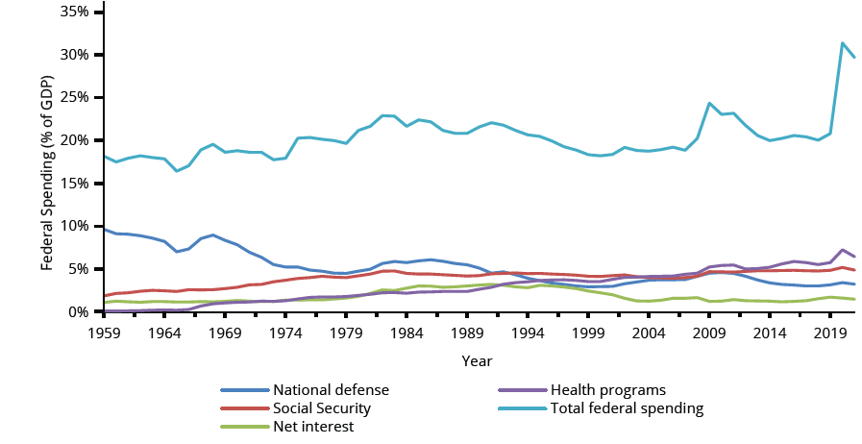
Total U.S. Government Spending
Since 1960 to 2019, total federal spending has ranged from about 18% to 22% of GDP. It climbed above that level in 2009 but quickly dropped back down by 2013. It increased drastically in 2020, reaching 31.37% of GDP. The share that the government has spent on national defense has generally declined, while the share it has spent on Social Security and health care expenses (mainly Medicare and Medicaid) has increased.
Notes:
Since 1960, total federal spending has ranged from about 18% to 22% of GDP. It climbed above that level in 2009 but quickly dropped back down by 2013. The share that the government has spent on national defense has generally declined, while the share it has spent on Social Security and health care expenses (mainly Medicare and Medicaid) has increased.

Slide 6
Patterns of U.S. Government Spending
Each year, the government borrows funds from U.S. citizens and foreigners to cover its budget deficits.
It does this by selling securities (Treasury bonds, notes, and bills)—in essence, borrowing from the public and promising to repay with interest in the future.
From 1961 to 1997, the U.S. government ran budget deficits, and thus borrowed funds, almost every year.
It had budget surpluses from 1998 to 2001 and then returned to deficits.
Notes:
Each year, the government borrows funds from U.S. citizens and foreigners to cover its budget deficits. It does this by selling securities (Treasury bonds, notes, and bills)—in essence, borrowing from the public and promising to repay with interest in the future. From 1961 to 1997, the U.S. government ran budget deficits, and thus borrowed funds, almost every year. It had budget surpluses from 1998 to 2001 and then returned to deficits.

Slide 7
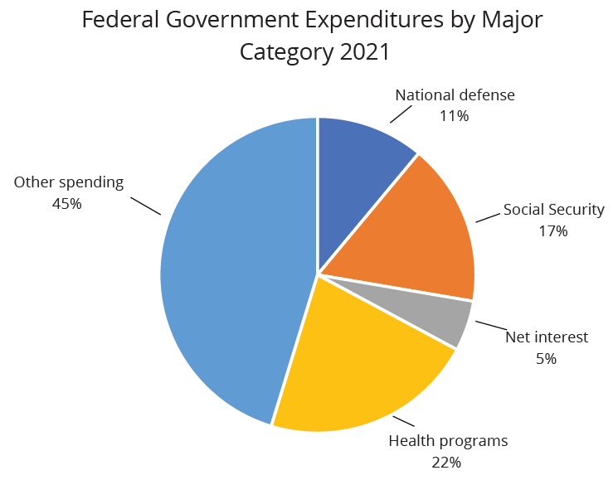
Federal Government Expenditures in 2021
This pie chart shows the division of federal government spending by category in 2021. Notice that 55% of government spending goes to four major areas: national defense, Social Security, health care, and interest payments on past borrowing.
Notes:
This pie chart shows the division of federal government spending by category in 2021. Notice that 55% of government spending goes to four major areas: national defense, Social Security, health care, and interest payments on past borrowing.

Slide 8
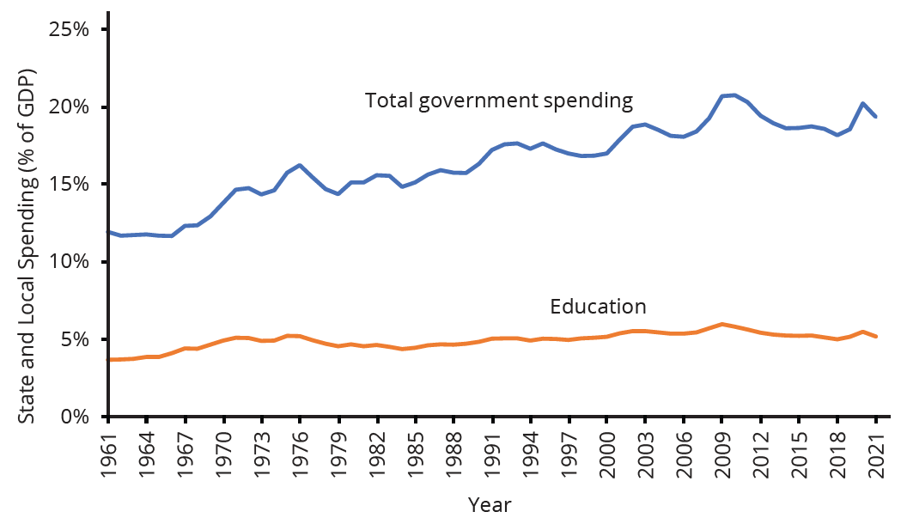
State and Local Government Spending
State and local government spending is also substantial—at about $4.4 trillion in 2021. Spending by state and local government increased from about 12% of nominal GDP in the early 1960s to around 20% by 2021. The single biggest spending item is education.
Notes:
State and local government spending is also substantial—at about $4.4 trillion in 2021. Spending by state and local government increased from about 12% of nominal GDP in the early 1960s to around 20% by 2021. The single biggest spending item is education.

Slide 9

On Your Own
Suppose you are buying a house and need to borrow $400 per month in order to pay it off in fifteen years. What is your annual deficit? How much debt did you accumulate in order to pay for your house?
Notes:
Suppose you are buying a house and need to borrow $400 per month in order to pay it off in fifteen years. What is your annual deficit? How much debt did you accumulate in order to pay for your house?

Slide 10
On Your Own
Suppose you are buying a house and need to borrow $400 per month in order to pay it off in fifteen years. What is your annual deficit? How much debt did you accumulate in order to pay for your house?
annual deficit = $400 per month × 12 months = $4,800
debt = $4,800 × 15 years = $72,000
Notes:
Suppose you are buying a house and need to borrow $400 per month in order to pay it off in fifteen years. What is your annual deficit? How much debt did you accumulate in order to pay for your house?
annual deficit = $400 per month × 12 months = $4,800
debt = $4,800 × 15 years = $72,000

Slide 11
Summary
Fiscal policy is the set of policies that relate to federal government spending, taxation, and borrowing.
In recent decades, the level of federal government spending and taxes, expressed as a share of GDP, has not changed much.
However, the level of state spending and taxes as a share of GDP has risen.
The four main areas of federal spending are national defense, Social Security, health care, and interest payments, which together account for about 55% of all federal spending.
When a government spends more than it collects in taxes, it has a budget deficit.
When a government collects more in taxes than it spends, it has a budget surplus.
The sum of all past deficits and surpluses make up government debt.

Slide 12




HAWKES LEARNING

