Slide 1
HAWKES LEARNING
Using Fiscal Policy to Fight Recession, Unemployment, and Inflation

Slide 2
Introduction
Fiscal policy is the use of government spending and tax policy to influence the path of the economy over time.
Fiscal policy, whether through changes in spending or taxes, shifts the AD curve outward in the case of expansionary fiscal policy and inward in the case of contractionary fiscal policy.
As an economy's population and resources grow, the labor force gets larger, businesses invest new capital, and technology improves.
These components of economic growth cause the aggregate supply (AS) curve to shift to the right.
Notes:
Fiscal policy is the use of government spending and tax policy to influence the path of the economy over time. Fiscal policy, whether through changes in spending or taxes, shifts the AD curve outward in the case of expansionary fiscal policy and inward in the case of contractionary fiscal policy. As an economy's population and resources grow, the labor force gets larger, businesses invest new capital, and technology improves. These components of economic growth cause the aggregate supply (AS) curve to shift to the right.

Slide 3
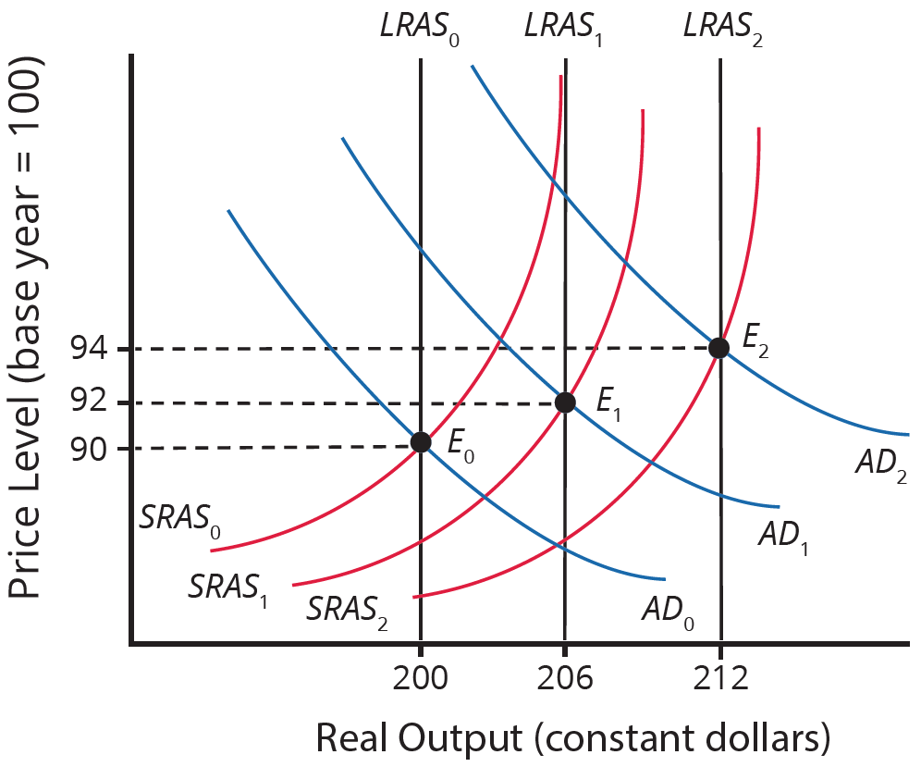
Fiscal Policy
The original equilibrium occurs at E₀, the intersection of AD curve AD₀ and SRAS curve SRAS₀, at an output level of 200 and a price level of 90.
One year later, AS has shifted right to SRAS₁ in the process of long-term economic growth, and AD has also shifted right to AD₁, keeping the economy operating at the new level of potential GDP. The new equilibrium, E₁, is an output level of 206 and a price level of 92.
One more year later, AS has again shifted right, now to SRAS₂, and AD shifts right as well to AD₂. Now, the equilibrium is E₂, with an output level of 212 and a price level of 94.
Notes:
The original equilibrium occurs at E0, the intersection of AD curve AD0 and SRAS curve SRAS0, at an output level of 200 and a price of 90. One year later, AS has shifted right to SRAS1 in the process of long-term economic growth, and AD has also shifted right to AD1, keeping the economy operating at the new level of potential GDP. The new equilibrium, E1, is an output level of 206 and a price of 92. One more year later, AS has again shifted right, now to SRAS2, and AD shifts right as well to AD2. Now, the equilibrium is E2, with an output level of 212 and a price of 94.

Slide 4
AD and AS Shifts
Aggregate demand and aggregate supply do not always move neatly together.
As aggregate supply increases, incomes tend to go up.
This tends to increase consumer and investment spending, shifting the aggregate demand curve right, but in any given period it may not shift the same amount as aggregate supply.
Notes:
Aggregate demand and aggregate supply do not always move neatly together. As aggregate supply increases, incomes tend to go up. This tends to increase consumer and investment spending, shifting the aggregate demand curve right, but in any given period it may not shift the same amount as aggregate supply.

Slide 5
Government Spending
Government pays for typical items such as national defense, social security, and health care.
Tax revenues, in part, pay for these expenditures.
The result may be an increase in AD that is more or less than the increase in AS.
AD may fail to increase along with AS, or the AD curve may even shift left, for a number of possible reasons:
Households become hesitant about consuming
Firms decide against investing as much
The demand for exports from other countries diminishes
Notes:
Government pays for typical items such as national defense, social security, and health care. Tax revenues, in part, pay for these expenditures. The result may be an increase in AD that is more or less than the increase in AS. AD may fail to increase along with AS, or the AD curve may even shift left, for a number of possible reasons: Households become hesitant about consuming, Firms decide against investing as much, or The demand for exports from other countries diminishes

Slide 6
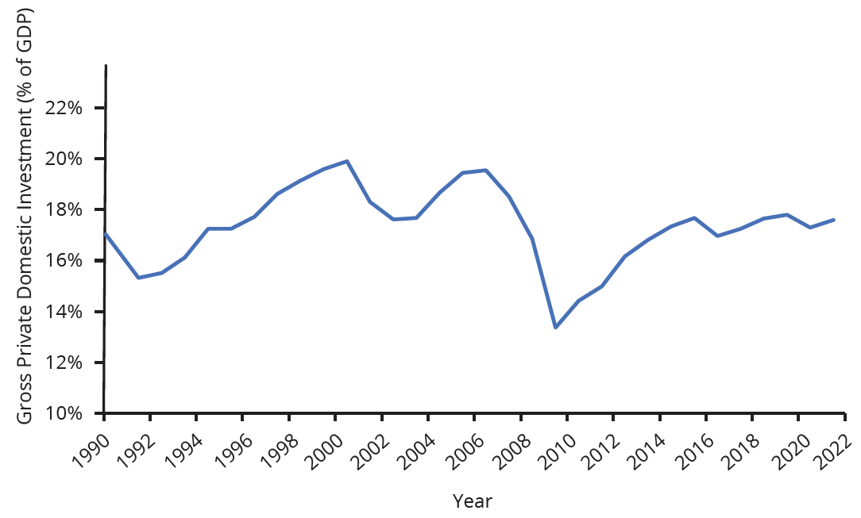
Gross Private Domestic Investment
The following figure shows the movement of gross private domestic investment, or investment by private firms in physical capital, from 1990 to 2018. In the U.S. economy, gross private domestic investment boomed during the late 1990s and early 2000s, reaching 19.6% of GDP in 2006 before falling to 13.4% of GDP in 2009 with the Great Recession.
Notes:
The following figure shows the movement of gross private domestic investment, or investment by private firms in physical capital, from 1990 to 2018. In the U.S. economy, gross private domestic investment boomed during the late 1990s and early 2000s, reaching 19.6% of GDP in 2006 before falling to 13.4% of GDP in 2009 with the Great Recession.

Slide 7
Countercyclical Actions
A central bank can engage in countercyclical actions if either aggregate demand or supply run too far ahead of the other.
If recession threatens, the central bank uses expansionary monetary policy to increase the money supply, increase the quantity of loans, reduce interest rates, and shift the AD curve to the right.
If inflation threatens, the central bank uses contractionary monetary policy to reduce the money supply, reduce the quantity of loans, raise interest rates, and shift the AD curve to the left.
Fiscal policy is another macroeconomic policy tool for adjusting AD by using either government spending or taxation policy.
Notes:
A central bank can engage in countercyclical actions if either aggregate demand or supply run too far ahead of the other.
If recession threatens, the central bank uses expansionary monetary policy to increase the money supply, increase the quantity of loans, reduce interest rates, and shift the AD curve to the right.
If inflation threatens, the central bank uses contractionary monetary policy to reduce the money supply, reduce the quantity of loans, raise interest rates, and shift the AD curve to the left.
Fiscal policy is another macroeconomic policy tool for adjusting AD by using either government spending or taxation policy.

Slide 8
Expansionary vs. Contractionary Fiscal Policy
Expansionary Fiscal Policy
Contractionary Fiscal Policy
Increases the level of AD, either through increasing government spending or reducing tax rates
Increases consumption
Increases investment
Decreases the level of AD, either through decreasing government spending or increasing tax rates
Decreases consumption
Decreases investment
vs
HAWKES LEARNING
Notes:
Expansionary Policy: Increases level of aggregate demand, either through increasing government spending or reducing tax rates
Can increase consumption by raising disposable income through income or payroll tax cuts
Can increase investment spending by raising after-tax profits through corporate tax cuts
Can increase government purchases of final goods/services and raising grants to local and state governments to increase their purchases
Contractionary Policy: Decreases level of aggregate demand, either through decreasing government spending or increasing tax rates
Decreases consumption
Decreases investment

Slide 9
Politics of Taxes
The choice between whether to use tax or spending tools often has a political tinge.
As a general statement, conservatives and Republicans prefer to see expansionary fiscal policy carried out by tax cuts, while liberals and Democrats prefer that the government implement expansionary fiscal policy through spending increases.
In a bipartisan effort to address the extreme situation, the Obama administration and Congress passed an $830 billion expansionary policy in early 2009 that involved both tax cuts and increases in government spending.
Notes:
The choice between whether to use tax or spending tools often has a political tinge. As a general statement, conservatives and Republicans prefer to see expansionary fiscal policy carried out by tax cuts, while liberals and Democrats prefer that the government implement expansionary fiscal policy through spending increases. In a bipartisan effort to address the extreme situation, the Obama administration and Congress passed an $830 billion expansionary policy in early 2009 that involved both tax cuts and increases in government spending.

Slide 10
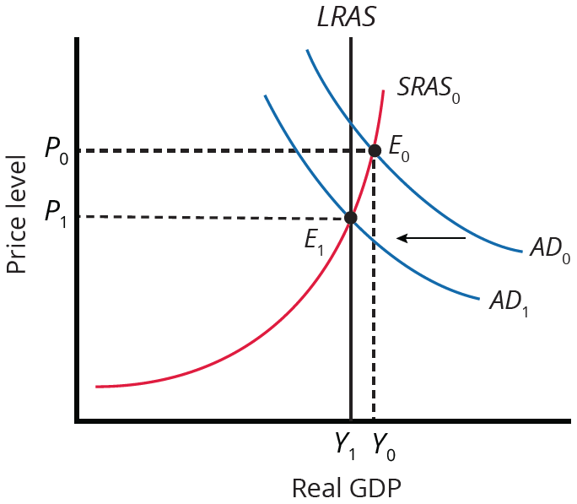
Contractionary Fiscal Policy
Fiscal policy can also contribute to pushing AD beyond potential GDP in a way that leads to inflation.
A very large budget deficit pushes up the AD curve so that the intersection of AD₀ and SRAS₀ occurs at E₀, which is an output level above potential GDP. Economists sometimes call this an “overheating economy.”
In this situation, contractionary fiscal policy involving federal spending cuts or tax increases can help reduce the upward pressure on the price level by shifting the AD curve left, to AD₁, and causing the new equilibrium E₁ to be at potential GDP, where AD intersects the LRAS curve.
Notes:
Fiscal policy can also contribute to pushing AD beyond potential GDP in a way that leads to inflation. A very large budget deficit pushes up the AD curve so that the intersection of AD0 and SRAS0 occurs at E0, which is an output level above potential GDP, an “overheating economy”. In this situation, contractionary fiscal policy involving federal spending cuts or tax increases can help reduce the upward pressure on the price level by shifting the AD curve left, to AD1, and causing the new equilibrium E1 to be at potential GDP, where AD intersects the LRAS curve.

Slide 11
Summary
Expansionary Fiscal Policy
Contractionary Fiscal Policy
Increases the level of aggregate demand, either through government spending increases or tax reductions
Most appropriate when the economy is in a recession and producing below its potential GDP
Decreases the level of aggregate demand, either through government spending cuts or tax increases
Most appropriate when the economy is producing above its potential GDP
vs

Slide 12




HAWKES LEARNING

