Slide 1
HAWKES LEARNING
How Government Borrowing Affects Private Saving

Slide 2
Reaction to Government Budget Changes
A change in government budgets may impact private saving.
If consumers watch government budgets in order to adjust their own budgets, they will likely have different reactions depending on if the government is running a deficit or surplus.
A higher government budget deficit could lead consumers to believe they will owe more taxes in the future in order to pay for the government borrowing, incentivizing increased savings.
The CPI is subject to two types of bias: substitution bias and quality/new goods bias.
Both substitution bias and quality/new goods bias tend to overstate the negative impact of inflation on consumers.
A budget surplus could lead consumers to believe that since interest rates are falling, saving is less attractive.
HAWKES LEARNING
Notes:
A change in government budgets may impact private saving. If consumers watch government budgets in order to adjust their own budgets, they will likely have different reactions depending on if the government is running a deficit or surplus. A higher government budget deficit could lead consumers to believe they will owe more taxes in the future in order to pay for the government borrowing, incentivizing increased savings. A budget surplus could lead consumers to believe that since interest rates are falling, saving is less attractive.

Slide 3
Ricardian Equivalence
The theory that rational private households might shift their saving to offset government saving or borrowing is known as Ricardian equivalence.
The national saving and investment identity would hold that any change in budget deficits or surpluses would be completely offset by a corresponding change in private saving.
Changes in government borrowing would have no effect on either physical capital investment or trade balances.
The CPI is subject to two types of bias: substitution bias and quality/new goods bias.
Both substitution bias and quality/new goods bias tend to overstate the negative impact of inflation on consumers.
HAWKES LEARNING
Notes:
The theory that rational private households might shift their saving to offset government saving or borrowing is known as Ricardian equivalence. The national saving and investment identity would hold that any change in budget deficits or surpluses would be completely offset by a corresponding change in private saving. Changes in government borrowing would have no effect on either physical capital investment or trade balances.

Slide 4
Ricardian Equivalence in Practice
In reality, the private sector only partially adjusts its saving behavior to offset government budget deficits and surpluses.
Since 1980, there has been no sustained and obvious connection between the U.S. government budget deficit or surplus level and the rate of private saving.
In the mid 1980s, there were large government budget deficits with no surges in private saving, while in 2008 and 2009, there were large budget deficits and signs of high corresponding levels of saving.
The CPI is subject to two types of bias: substitution bias and quality/new goods bias.
Both substitution bias and quality/new goods bias tend to overstate the negative impact of inflation on consumers.
Some studies suggest that when U.S. government borrowing increases by $1, private saving rises by about $0.30.
HAWKES LEARNING
Notes:
In reality, the private sector only partially adjusts its saving behavior to offset government budget deficits and surpluses. Since 1980, there has been no sustained and obvious connection between the U.S. government budget deficit or surplus level and the rate of private saving. In the mid 1980s, there were large government budget deficits with no surges in private saving, while in 2008 and 2009, there were large budget deficits and signs of high corresponding levels of saving. Some studies suggest that when U.S. government borrowing increases by $1, private saving rises by about $0.30.

Slide 5
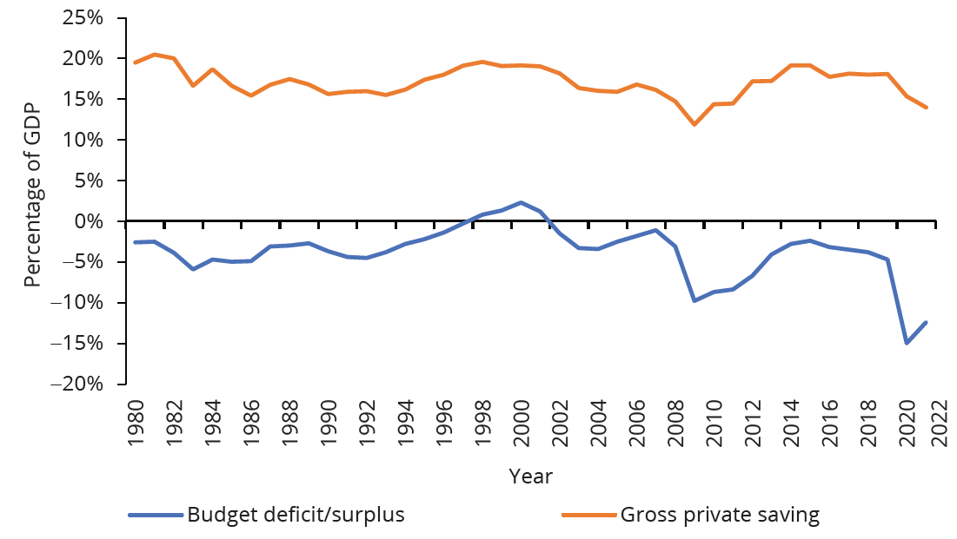
Ricardian Equivalence
The theory of Ricardian equivalence suggests that additional private saving will offset any increase in government borrowing, while reduced private saving will offset any decrease in government borrowing. Sometimes this theory holds true, and sometimes it does not.
HAWKES LEARNING
Notes:
The theory of Ricardian equivalence suggests that additional private saving will offset any increase in government borrowing, while reduced private saving will offset any decrease in government borrowing. Sometimes this theory holds true, and sometimes it does not.

Slide 6
Ricardian Equivalence in Practice
To some extent, private saving does rise when governments run large budget deficits and fall when governments reduce deficits.
The offsetting effects of private saving compared to government borrowing are much less than one to one.
This effect can vary a great deal from country to country, from time to time, and over the short run and long run.
The CPI is subject to two types of bias: substitution bias and quality/new goods bias.
Both substitution bias and quality/new goods bias tend to overstate the negative impact of inflation on consumers.
HAWKES LEARNING
Notes:
To some extent, private saving does rise when governments run large budget deficits and fall when governments reduce deficits. The offsetting effects of private saving compared to government borrowing are much less than one to one. This effect can vary a great deal from country to country, from time to time, and over the short run and long run.

Slide 7

National Saving and Investment Identity
Consider the national saving and investment identity:
$$\text{quantity} \text{of} \text{financial} \text{capital} \text{supplied}\text{ = }\text{quantity} \text{of} \text{financial} \text{capital} \text{demanded} \\ \text{private} \text{saving}\text{ + }\text{trade} \text{deficit}\text{ = }\text{private} \text{investment}\text{ + }\text{budget} \text{deficit} \\ \text{S}\text{ + }(\text{M}\text{−}\text{X})\text{ = }\text{I}\text{ + }(\text{G}\text{−}\text{T})$$
If the Ricardian equivalence was a one-to-one relationship, changes in the budget deficit would be exactly offset by changes in private saving while trade deficit and private investment would not change.
Empirical evidence shows that the relationship is not one-to-one and that changes in the government deficit will also impact the trade deficit and private investment.
HAWKES LEARNING
Notes:
Consider the national saving and investment identity:
"quantity of financial capital supplied = quantity of financial capital demanded"
" private saving + trade deficit = private investment + budget deficit"
“S + "("M−X")" = I + "("G−T")
If the Ricardian equivalence was a one-to-one relationship, changes in the budget deficit would be exactly offset by changes in private saving while trade deficit and private investment would not change. Empirical evidence shows that the relationship is not one-to-one and that changes in the government deficit will also impact trade deficit and private investment.

Slide 8

Ricardian Equivalence in Practice
Think about your saving habits now. Do you think the amount you save shifts with movements in the economy? Suppose the government mentions that all prices are going to increase by 1% next year. Will this affect your current saving habits? What if prices increase by 50%? Do you think you will start saving more now?
HAWKES LEARNING
Notes:
Think about your saving habits now. Do you think the amount you save shifts with movements in the economy? Suppose the government mentions that all prices are going to increase by 1% next year. Will this affect your current saving habits? What if prices increase by 50%? Do you think you will start saving more now?

Slide 9
Summary
The theory of Ricardian equivalence holds that changes in private saving will offset changes in government borrowing or saving.
Increased private saving will offset higher budget deficits, while increased private borrowing will offset higher budget surpluses.
If the theory holds true, changes in government borrowing or saving would not impact private investment in physical capital or the trade balance.
Empirical evidence shows that Ricardian equivalence is only partially true.
HAWKES LEARNING

Slide 10




HAWKES LEARNING

