Slide 1
HAWKES LEARNING
The Relatively Recent Arrival of Economic Growth

Slide 2
Introduction
Every country worries about economic growth.
In the U.S. and other high-income countries, the question is whether economic growth continues to provide the same remarkable gains in our standard of living as it did during the twentieth century.
About 639 million people in the world are scraping by on incomes that average less than $2 per day, which is not that different from the standard of living two thousand years ago.
HAWKES LEARNING
Notes:
Every country worries about economic growth. In the U.S. and other high-income countries, the question is whether economic growth continues to provide the same remarkable gains in our standard of living as it did during the twentieth century. About 639 million people in the world are scraping by on incomes that average less than $2 per day, which is not that different from the standard of living two thousand years ago.

Slide 3
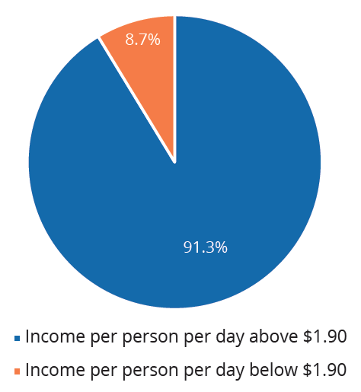
Poverty in the World
In 2018, roughly 8.7% of the world's population lived on an income that averaged less than $1.90 per day.
Notes:
Roughly 8.7% of the world's population lives on an income that averages less than $2 per day.

Slide 4
Period of Modern Economic Growth
Rapid and sustained economic growth has only been prevalent since around the early 1800s onward.
Before this time period, the average person’s standard of living was relatively poor and stagnant.
Positive economic and institutional changes started around the world with the Industrial Revolution.
Notes:
Rapid and sustained economic growth has only been prevalent since around the early 1800s onward. Before this time period, the average person’s standard of living was relatively poor and stagnant. Positive economic and institutional changes started around the world with the Industrial Revolution.

Slide 5
Industrial Revolution
The Industrial Revolution refers to the widespread use of power-driven machinery and the economic and social changes that resulted in the first half of the 1800s.
Machines performed the tasks that otherwise would have required many workers.
Industrial jobs were dangerous, but also higher paying and offered workers a chance for social mobility.
The new inventions and investments resulting from industrialization made profits, which allowed for further investment and inventions.
HAWKES LEARNING
Notes:
The Industrial Revolution refers to the widespread use of power-driven machinery and the economic and social changes that resulted in the first half of the 1800s. Machines performed the tasks that otherwise would have required many workers. Industrial jobs were dangerous, but also higher paying and offered workers a chance for social mobility. The new inventions and investments resulting from industrialization made profits, which allowed for further investment and inventions.

Slide 6
GDP Growth After Industrial Revolution
Since the Industrial Revolution, GDP growth per capita in leading industrialized countries has been about 2% per year.
The Industrial Revolution increased inequality among nations.
Some economies (mostly Western) took off, others (like many in Asia and Africa) remained close to subsistence standard of living.
HAWKES LEARNING
Notes:
Since Industrial Revolution, GDP growth per capita in leading industrialized countries has been about 2% per year. The Industrial Revolution increased inequality among nations. Some economies (mostly Western) took off, others (like many in Asia and Africa) remained close to subsistence standard of living.

Slide 7
Mid-Twentieth Century
By the mid-20th century, some countries were catching up to the industrialized nations.
Japan: GDP per capita growth rate averaged 11% per year in the ’60s and ’70s
Brazil: GDP per capita growth rate averaged 11.1% per year from 1968–1973
South Korea: GDP per capita increased by more than 6% per year in the years following the Korean War
China: grew at a per-capita rate of 9% per year from 1984 into the 2000s
India: GDP per capita grew at 4% during the 1990s and 7% to 8% in the 2000s
Notes:
By the mid-20th century, some countries were catching up to the industrialized nations. Japan: grew in 1960s and 70s, GDP growth per capita averaged 11% per year. Brazil: economy boomed in the 1960s, GDP growth per capita averaged 11.1% per year from 1968–1973. South Korea: economy grew post-Korean War, GDP per capita increased by more than 6% per year. China: boomed in the 1980s and 90s. India: economy grew in 1990s and 2000s.

Slide 8
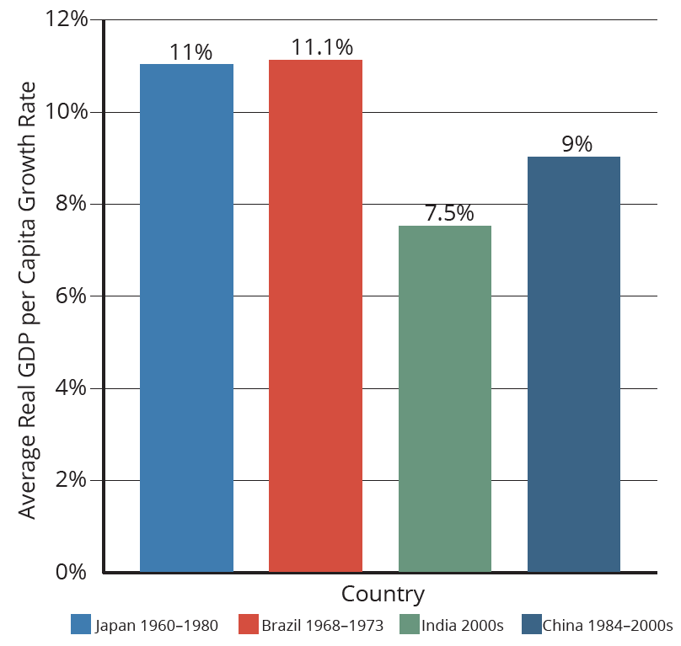
Worldwide Growth Rates
The average annual growth rates of countries that showed it was possible to catch up to other countries that jumped ahead with the Industrial Revolution.
Notes:
The average annual growth rates of countries that showed it was possible to catch up to other countries that jumped ahead with the Industrial Revolution.

Slide 9
Rule of Law and Economic Growth
The rule of law, especially the protection of property and contractual rights, is vital to an economy working effectively and efficiently, leading to growth.
Property rights are the rights of individuals and firms to own property (physical, intellectual, and financial) and to use it as they see fit.
One must have property to enter into a contract.
Contractual rights allow individuals to enter into agreements with others regarding use of their property, providing recourse through the legal system in the event of noncompliance.
Notes:
The rule of law, especially the protection of property and contractual rights, is vital to economy working effectively and efficiently, leading to growth. Property rights are the rights of individuals and firms to own property (physical, intellectual, and financial) and to use it as they see fit. One must have property to enter into a contract. Contractual rights allow individuals to enter into agreements with others regarding use of their property, providing legal recourse for noncompliance.

Slide 10
Rule of Law and Economic Growth
Without a legal system that enforces contracts, people are unlikely to enter into them.
Without contracts, business transactions are difficult and economic growth would be slow.
The protection of physical, financial, and intellectual property creates incentives to invest in the production of capital and innovation.
Notes:
Without a legal system that enforces contracts, people are unlikely to enter into them. Without contracts, business transactions are difficult and economic growth would be slow. The protection of physical, financial, and intellectual property creates incentives to invest in the production of capital and innovation.

Slide 11
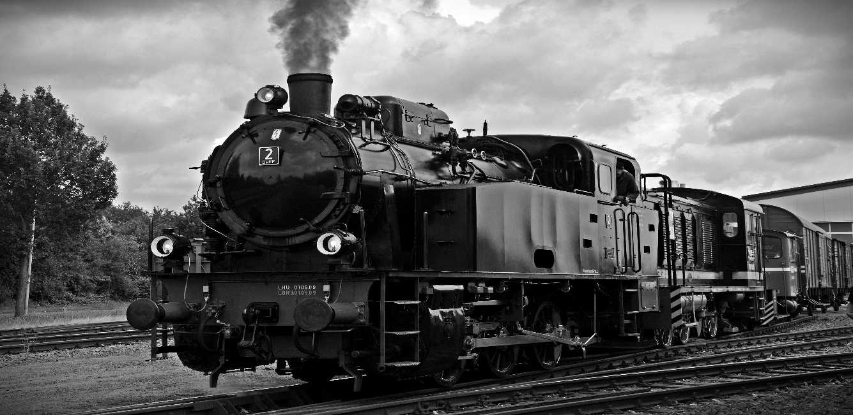
Real World Example
When the steam engine was invented in the 1800s, workers were freed from jobs previously done by hand to be productive in other areas of the economy, leading to economic growth. How do you think advances in communications and information technology will affect economic growth today?
Notes:
When the steam engine was invented in the 1800s, workers were freed from jobs previously done by hand to be productive in other areas of the economy, leading to economic growth. How do you think advances in communications and information technology will affect economic growth today?

Slide 12
Real World Example
When the steam engine was invented in the 1800s, workers were freed from jobs previously done by hand to be productive in other areas of the economy, leading to economic growth. How do you think advances in communications and information technology will affect economic growth today?
Technological advances in communications and information technology will leave some workers out of a job, such as bank tellers, telephone operators, customer service representatives, and clerks in retail stores that lose in-store sales to online sales. However, advances in communications and information technology also contribute substantially to economic growth by increasing productivity.
Notes:
When the steam engine was invented in the 1800s, workers were freed from jobs previously done by hand to be productive in other areas of the economy, leading to economic growth. How do you think advances in communications and information technology will affect economic growth today?
Technological advances in communications and information technology will leave some workers out of a job, such as bank tellers, telephone operators, customer service representatives, and clerks in retail stores that lose in-store sales to online sales. However, advances in communications and information technology also contribute substantially to economic growth by increasing productivity.

Slide 13
Summary
Since the early nineteenth century, there has been a spectacular process of long-run economic growth.
The Industrial Revolution started the modern economic growth period by increasing productivity and trade and developing governance and market institutions.
Since then, the world’s leading economies (mostly Western) expanded GDP per capita at an average rate of 2% per year.
Since the 1960s, countries like Japan, South Korea, and China have shown the potential to catch up.

Slide 14




HAWKES LEARNING

