Slide 1
HAWKES LEARNING
How the U.S. and Other Countries Experience Inflation

Slide 2
Historical Inflation in the U.S.
Inflation in the U.S. has been relatively consistent at around 2% to 4% per year.
Throughout the 20th century, there were instances where the price level rose at double digit rates, though nothing close to hyperinflation.
There were also two cases of deflation—severe negative inflation—in the 20th century: after the 1920-1921 recession and during the Great Depression.
From 1900 to about 1960, the major inflations and deflations nearly balanced each other out, so the average annual rate of inflation over these years was only about 1% per year.
HAWKES LEARNING
Notes:
Inflation in the U.S. has been relatively consistent at around 2-4% per year. Throughout the 20th century, there were instances where the price level rose at double digit rates, though nothing close to hyperinflation. There were also two cases of deflation in the 20th century, after the 1920-1921 recession and during the Great Depression. From 1900 to about 1960, the major inflations and deflations nearly balanced each other out, so the average annual rate of inflation over these years was only about 1% per year.

Slide 3
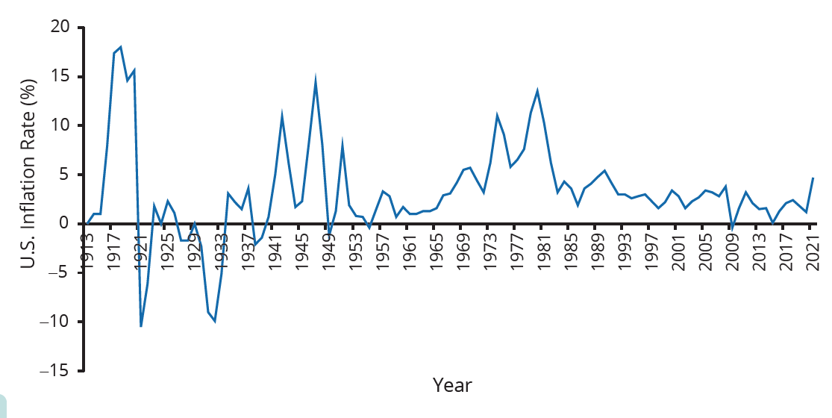
Historical Inflation in the U.S.
Inflation in the U.S. has risen and fallen periodically but tends to return to about 2% to 4% a year.
HAWKES LEARNING
Notes:
Inflation in the U.S. has been relatively consistent over the last century.

Slide 4
Recessions and Depressions
During recessions and depressions, the inflation rate often seems lower.
This happened in the recession of 1920–21, the Great Depression, the recession of 1980–82, and the Great Recession.
High unemployment usually happens in recessions, and total demand for goods falls, pulling the price level down.
Inflation often (but not always) seems to move up when the economy is growing strongly, like after wartime or during the 1960s.
HAWKES LEARNING
Notes:
During recessions and depressions, the inflation rate often seems lower. This happened in recession of 1920–21, the Great Depression, the recession of 1980–82, and the Great Recession. High unemployment usually happens in recessions, and total demand for goods falls, pulling the price level down. Inflation often (but not always) seems to move up when the economy is growing strongly, like after wartime or during the 1960s.

Slide 5
Inflation around the World
Many industrialized countries had high inflation in the 1970s, which came down in the 1980s and mostly stayed level.
Countries with controlled economies in the 1970s, like the Soviet Union and China, had low rates of inflation because of laws against raising prices.
As these countries transitioned toward more market-oriented economies, they also experienced outbursts of inflation.
HAWKES LEARNING
Notes:
Many industrialized countries had high inflation in the 1970s, which came down in the 1980s and mostly stayed level. Countries with controlled economies in the 1970s (China and Soviet Union) had low rates of inflation because of laws against raising prices. As these countries transitioned toward more market-oriented economies, they also experienced outbursts of inflation.

Slide 6
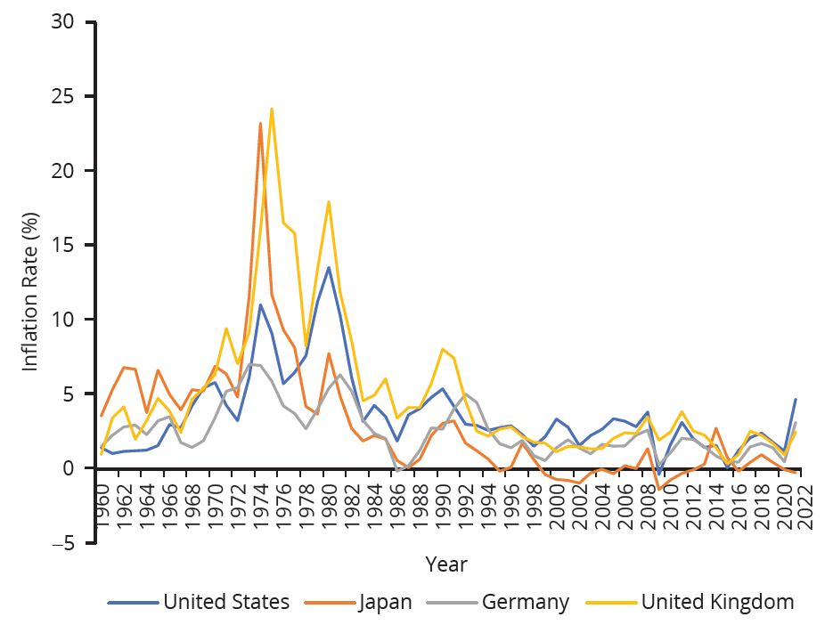
Inflation around the World
This chart shows the annual percentage change in consumer prices compared with the previous year's consumer prices in the United States, the United Kingdom, Japan, and Germany.
Notes:
This chart shows the annual percentage change in consumer prices compared with the previous year's consumer prices in the United States, the United Kingdom, Japan, and Germany.

Slide 7
Inflation around the World
Russia experienced hyperinflation—an outburst of high inflation—of 2,500% per year in the early 1990s.
In 1990, both Brazil and Argentina saw inflation climb above 2,000%.
In 1995, Nigeria had an inflation rate of 75%.
the
In recent years, the world’s worst case of hyperinflation was in Zimbabwe, where the government was printing $100 trillion bills that were almost worthless.
HAWKES LEARNING
Notes:
Many industrialized countries had high inflation in the 1970s, which came down in the 1980s and mostly stayed level. Countries with controlled economies in the 1970s (China and Soviet Union) had low rates of inflation because of laws against raising prices. As these countries transitioned toward more market-oriented economies, they also experienced outbursts of inflation.

Slide 8
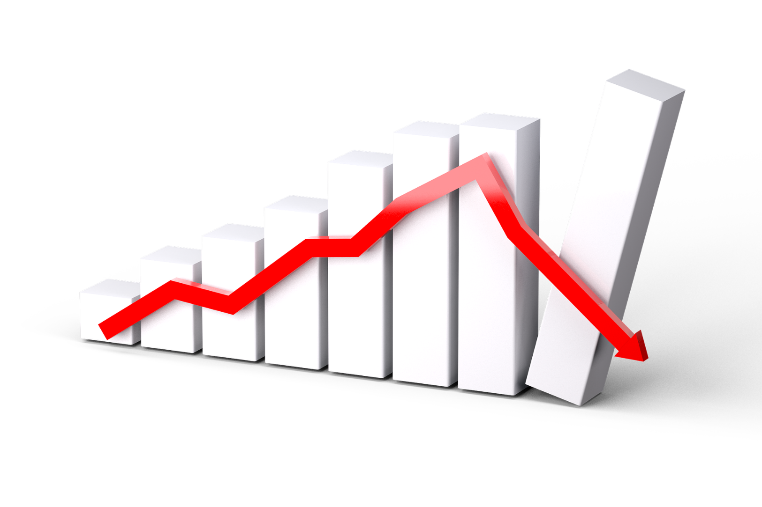
On Your Own
Why is inflation usually low during a recession?
HAWKES LEARNING

Slide 9
On Your Own
Why is inflation usually low during a recession?
During a recession, unemployment is usually high so that aggregate demand for goods and services decreases. When aggregate demand decreases, the prices of goods and services usually don’t increase
very much, resulting in a decrease in the inflation rate. The prices of goods and services could even decrease, which would result in deflation.
HAWKES LEARNING
Notes:
Why is inflation usually low during a recession?
During a recession, unemployment is usually high so that aggregate demand for goods and services decreases. When aggregate demand decreases, the prices of goods and services usually don’t increase
very much, resulting in a decrease in the inflation rate. The prices of goods and services could even decrease, which would result in deflation

Slide 10
Summary
In the U.S., the annual inflation rate in the last two decades has been between 2%–4%.
In the 20th century, the periods of highest inflation in the U.S. were after World Wars I and II and in the 1970s.
A period of deflation happened both during the Great Depression and during the recession of 1920-1921.
In the U.S., improved knowledge of stabilization policies helps avoid higher-than-anticipated inflation and deflation.
Inflation has had mixed patterns of occurrences in the U.S. and throughout other parts of the world.
HAWKES LEARNING

Slide 11




HAWKES LEARNING

