Slide 1
HAWKES LEARNING
Basics of Percent
Notes:
In this lesson, you will learn about percents and their relationship with decimals.

Slide 2
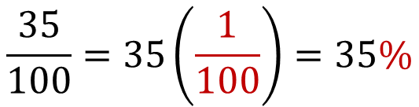

Percent
"per hundred"
$$\frac{35}{100}=35\left(\frac{1}{100}\right)=35\%$$
$$\frac{60}{100}=60\left(\frac{1}{100}\right)=60\%$$
Notes:
Percent means “per hundred,” so it is the ratio of a number to hundred. 35% is 35 over 100, and 60% is 60 over 100. The percentage symbol is called the percent sign.

Slide 3
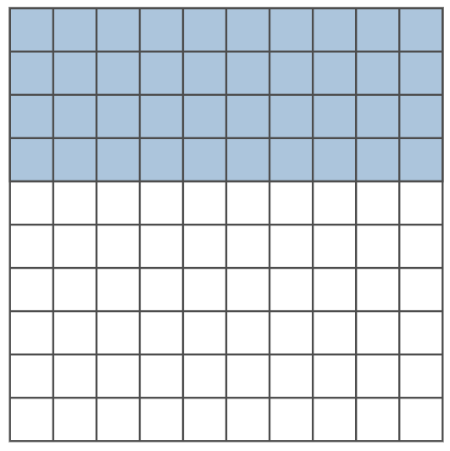
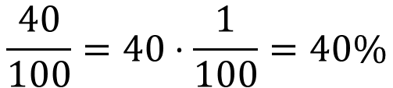
Percent cont’d
Counting Squares
$$\frac{40}{100}=40⋅\frac{1}{100}=40\%$$
of the large square
Notes:
This figure displays 100 squares; 40 of them are shaded blue, thus 40% of the figure is blue.

Slide 4
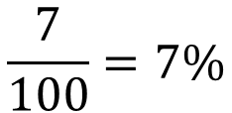
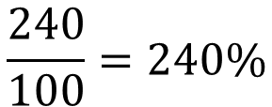
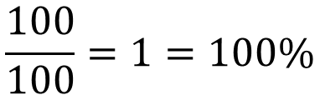
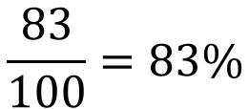
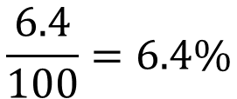
Fractions
Fraction to Percent
100%
$$\frac{7}{100}=7\%$$
$$\frac{100}{100}=1=100\%$$
All of something is 100% of that thing
$$\frac{83}{100}=83\%$$
$$\frac{240}{100}=240\%$$
$$\frac{6.4}{100}=6.4\%$$
Notes:
Fractions can simply be changed into percentages. Any number, even a decimal, over 100 will be that number percent. All of something is 100% of that thing. If the numerator is larger than 100, the number is larger than one and is more than 100%.

Slide 5
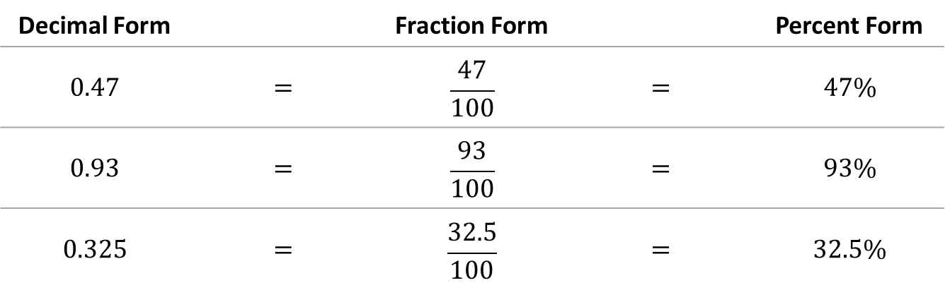
Decimals
Decimal to Percent
Decimal Form |  | Fraction Form |  | Percent Form
$$0.47$$ | $$=$$ | $$\frac{47}{100}$$ | $$=$$ | $$47\%$$
$$0.93$$ | $$=$$ | $$\frac{93}{100}$$ | $$=$$ | $$93\%$$
$$0.325$$ | $$=$$ | $$\frac{32.5}{100}$$ | $$=$$ | $$32.5\%$$
Notes:
To change a decimal to a percent, move the decimal point two places to the right, then add a percent sign. For example, 0.47 is 47%, and 0.325 is 32.5%.

Slide 6
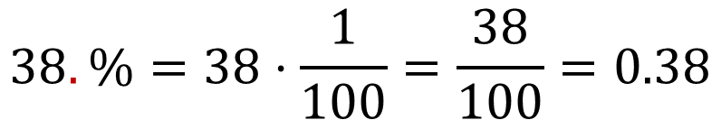
Decimals
Percent to Decimal
$$38.\%=38⋅\frac{1}{100}=\frac{38}{100}=0.38$$
Understood decimal point
Notes:
To change percents to decimal numbers, we reverse the procedure of changing decimals to percents. Move the decimal point two places to the left and delete the percent sign.

Slide 7
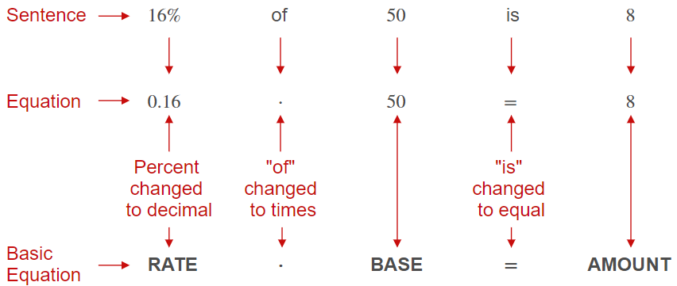
$$Rate×Base=Amount$$
Notes:
The equation rate times base equals amount allows us to calculate percentages of a number. For example, 16% of 50, or 0.16 times 50, is equal to 8. The three basic types of percent problems will have you calculate the amount, the base, and the rate, or percent.

Slide 8
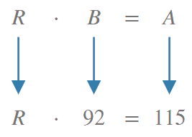

Rate
Percent
What percent of 92 is 115?
$$R=125\%$$
Notes:
Find the rate or percent given a base of 92 and an amount of 115: 115 divided by 92 is 1.25, which is 125%. 115 is 125% of 92.

Slide 9
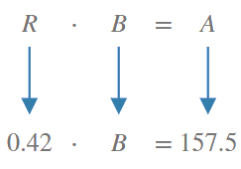
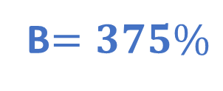
Base
42% of what number is 157.5?
B$=375\%$
Notes:
Find the base that 157.5 is 42% of. 157.5 is the amount divided by the rate 0.42, which equals the base, 375.

Slide 10
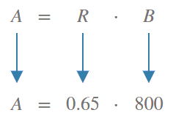
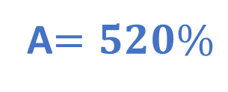
Amount
What is 65% of 800?
A$=520\%$
Notes:
Lastly, find the amount of 65% of 800. 0.65 (the rate) times 800 (the base) equals 520 (the amount).

Slide 11
Sales
Discounts
sale price is the reduced price
discount is the difference between the original price and the sale price
rate of discount is a percent of the original price to be discounted
Notes:
Knowing how to calculate and use percentage is important in business and sales. To attract customers or to sell goods that have been in stock for some time, retailers and manufacturers offer a discount, a reduction in the original selling price of an item. The new, reduced price is called the sale price. The discount is the difference between the original price and the sale price. The rate of discount, or percent of discount, is a percent of the original price to be discounted.

Slide 12

Sales cont’d
Discount
$1,200 fridge on sale with a 20% discount
Save: $240
Notes:
For example, if a refrigerator that regularly sells for $1200 is on sale at a 20% discount, we can calculate the discount by finding what 20% of $1,200 is. That is, 1,200 times 0.20 equals $240. The buyer of the refrigerator is getting a good deal and saving $240.

Slide 13

Sales cont’d
Sales Tax
Tax charged on the actual selling price of goods sold by retailers
Notes:
Sales tax is a tax charged on the actual selling price of goods sold by retailers. The rate of the sales tax, a percent of the actual selling price, varies.

Slide 14

Sales cont’d
Sales Tax
6% sales tax on an $899 laptop computer
Total: $952.94
Notes:
If the sales tax rate is 6%, what would be the final cost of a laptop computer priced at $899? We must multiply 0.06 by 899 to calculate the sales tax of $53.94. To find the final cost of the computer, we must then add the sales tax to the original price, which is 899 plus 53.94, which equals $952.94.

Slide 15
Percent Change
APPRECIATION
DEPRECIATION
Notes:
A percent increase in value is called appreciation, and a percent decrease in value is called depreciation.

Slide 16


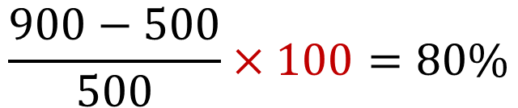
Percent Change: Appreciation
$$\frac{900−500}{500}×100=80\%$$
Notes:
For example, if a firm sells 500 units of a good last year and sells 900 units this year, there is a percent increase of 900 minus 500, which is 400. Divide 400 by 500 and multiply by 100. The appreciated sales value is 80%.

Slide 17
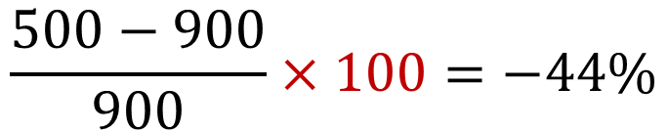
Percent Change: Depreciation
$$\frac{500−900}{900}×100=−44\%$$
Notes:
If the opposite had happened--the firm sold 900 last year and only sold 500 this year--there is a percent decrease of 500 minus 900, which is -400, divided by 900, multiplied by 100. The depreciated sales value is -44%. Now, you are able to convert decimals to percents and vice versa and understand how to use percentages in various scenarios.

Slide 18




HAWKES LEARNING

