Slide 1
HAWKES LEARNING
Calculating Area
Notes:
Calculating Area. By the end of this lesson, you will be able to find the area of a polygon.

Slide 2
Area
From the Metric System
Measurement | Abbreviation
square millimeters | mm²
square centimeters | cm²
square kilometers | km²
square meters | m²
From the U.S. Customary System
Measurement | Abbreviation
square inches | in.²
square feet | ft²
square yards | yd²
square miles | mi²
Notes:
Area is a measure of the interior of (or surface enclosed by) a plane figure and is measured in square units. This table lists basic units of area and the corresponding abbreviations.

Slide 3
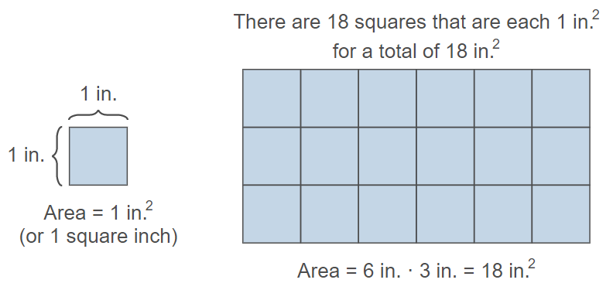
Area cont’d
width
length
Notes:
This figure shows 18 squares that are each 1 inch squared. In order to calculate the area, we can either count the number of squares or multiply the length and width of the figure. If we count, we find that the total area is 18 inches squared. If we multiply the length of 6 inches by the width of 3 inches, we find that the total area is also 18 inches squared. Using a formula to calculate area, rather than counting squares, is going to provide the most accurate area, especially for irregularly-shaped polygons, as we will soon encounter.

Slide 4
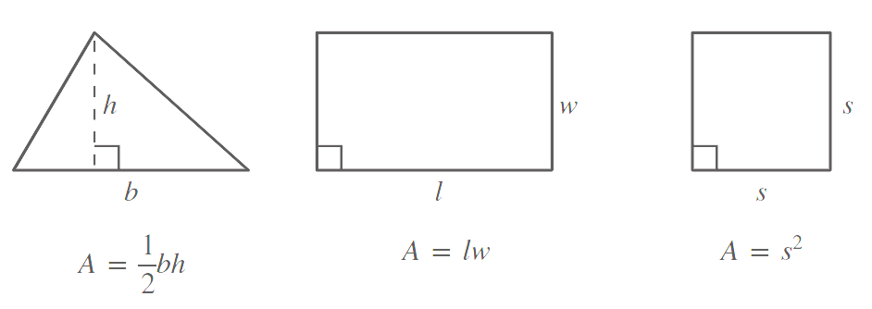
Formulas: Triangle
Notes:
The area of a triangle is equal to base times height, divided by two. Height is also called the altitude and is perpendicular to the base.

Slide 5
Formulas: Rectangle
Notes:
The area of a rectangle is equal to length times width.

Slide 6
Formulas: Square
Notes:
The area of a square is equal to the side-length squared. It can also be calculated as length times width like a rectangle, but since a square is a rectangle with equal sides, side-length squared is a faster calculation.

Slide 7
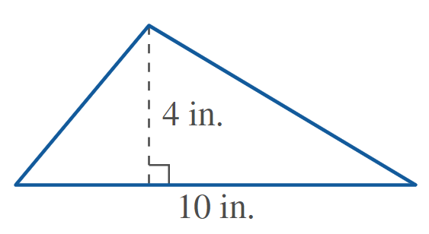
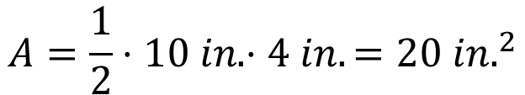
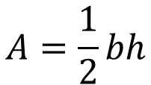
Irregular Polygons: Triangle
$$A=\frac{1}{2}bh$$
$$A=\frac{1}{2}⋅10 in. ⋅4 in.={20 in.}^{2}$$
Notes:
The area of a triangle with a ten-inch base and a four-inch height, divided by two, is 20 inches squared.

Slide 8
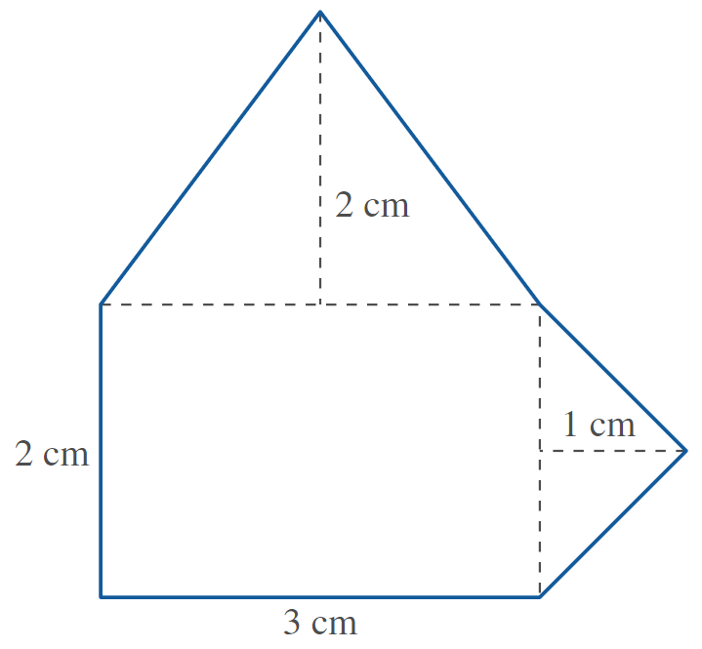






Irregular Polygons: Triangle cont’d
$$A=lw$$
Rectangle
10 cm²
$$A=2 cm⋅3 cm={6 cm}^{2}$$
$$A=\frac{1}{2}bh$$
Larger Triangle
$$A=\frac{1}{2}⋅3 cm ⋅2 cm={3 cm}^{2}$$
$$A=\frac{1}{2}bh$$
Smaller Triangle
$$A=\frac{1}{2}⋅2 cm⋅1 cm={1 cm}^{2}$$
Notes:
To find the area of this composite figure, we should identify that is created from two triangles and a rectangle. We will calculate the area of the individual shapes, then add the areas together to calculate the total area. Don’t forget the units! Starting off with the area of the rectangle, length times width, 2 times 3 centimeters equals 6 centimeters squared. Next, the area of the larger triangle on top is base times height divided by two, that is 3 times 2 centimeters, divided by 2, which equals 3 centimeters squared. Finally, the area of the smaller triangle on the side is base times height divided by two, that is 2 times 1, divided by 2, which equals 1 centimeter squared. Adding these three sections together, we get that the total area of the composite figure is 6 plus 3 plus 1 centimeter squared, which is 10 centimeters squared.

Slide 9
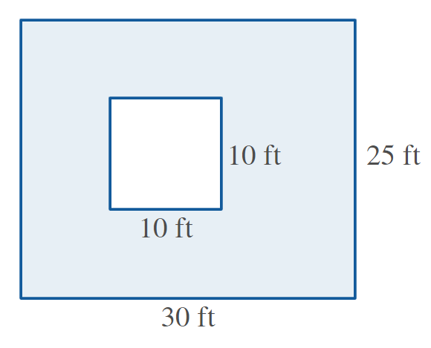




Irregular Polygons: Rectangle
Step 1: Find the area of the rectangle.
$$A=lw$$
$$A=30 ft⋅25 ft={750 ft}^{2}$$
Step 2: Find the area of the square.
$$A=s^{2}$$
$$A={(10 ft)}^{2}={100 ft}^{2}$$
Step 3: Find the difference between the two areas.
$$remaining area=750−100={650 ft}^{2}$$
Notes:
This is an image of a square within a rectangle. To calculate the area of the blue-shaded polygon, we will calculate the area of the rectangle and subtract the area of the square from it. The area of the rectangle is length times width, 30 feet times 25 feet is 750 feet squared. The area of the square is side-length squared, 10 feet squared is 100 feet squared. The area of the shaded polygon is 750 minus 100 equals 650 feet squared.

Slide 10
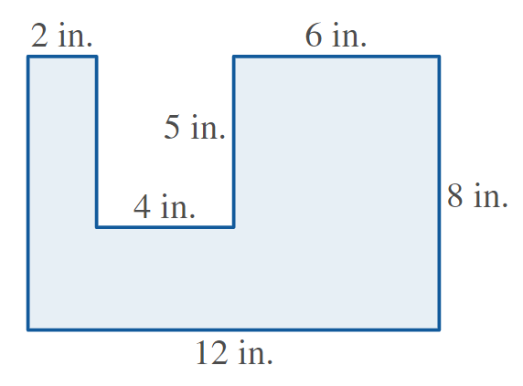



Irregular Polygons: Rectangle cont’d
$$A_{1}=2⋅5={10 in.}^{2}$$
$$A_{2}=5⋅6={30 in.}^{2}$$
$$A_{3}=12⋅3={36 in.}^{2}$$
$$A_{Total}=10+30+36={76 in.}^{2}$$
Notes:
The polygon displayed is another irregular polygon. To calculate its area, we have to break it up into three separate rectangles. First, Rectangle A1 has an area of length times width, 5 times 2 inches equals 10 inches squared. Rectangle A2 has an area of length times width, 6 time 5 inches equals 30 inches squared. Rectangle A3 has an area of length times width, 12 times 3 inches equals 36 inches squared. Now, you are able to calculate the area of a variety of polygons.

Slide 11




HAWKES LEARNING

