Slide 1
HAWKES LEARNING
The Difference between Level of Trade and the Trade Balance

Slide 2
Level and Balance of Trade
At first, a nation's level of trade may sound like the same issue as the balance of trade, but these two concepts are actually distinct.
The level of trade is measured by a country's exports of goods and services as a share of its gross domestic product (GDP).
The level of trade indicates how much of its production the country exports and the degree of the country's globalization.
The balance of trade is measured by the gap between a nation's exports and imports.
The balance of trade indicates whether the country is running a trade deficit or a trade surplus.
HAWKES LEARNING
Notes:
At first, a nation's level of trade may sound like the same issue as the balance of trade, but these two concepts are actually distinct. The level of trade is measured by a country's exports of goods and services as a share of its gross domestic product (GDP). The level of trade indicates how much of its production the country exports and the degree of the country's globalization. The balance of trade is measured by the gap between a nation's exports and imports. The balance of trade indicates whether the country is running a trade deficit or a trade surplus.

Slide 3
Level and Balance of Trade
It is absolutely possible for a country to have both a very high level of trade and a near balance between exports and imports.
It is also possible for a country to have both a low level of trade and a large imbalance between exports and imports.
For example, in 2017, the United States only exported 12% of GDP, but it had a trade deficit of $550 billion.
HAWKES LEARNING
Notes:
It is absolutely possible for a country to have both a very high level of trade and a near balance between exports and imports. It is also possible for a country to have both a low level of trade and a large imbalance between exports and imports. For example, in 2017, the United States only exported 12% of GDP, but it had a trade deficit of $550 billion.

Slide 4
Level of Trade Influencers
Three factors strongly influence a nation's level of trade:
Economy size
Geographic location
Trade history
HAWKES LEARNING
Notes:
Three factors strongly influence a nation's level of trade: economy size, geographic location, and trade history.

Slide 5
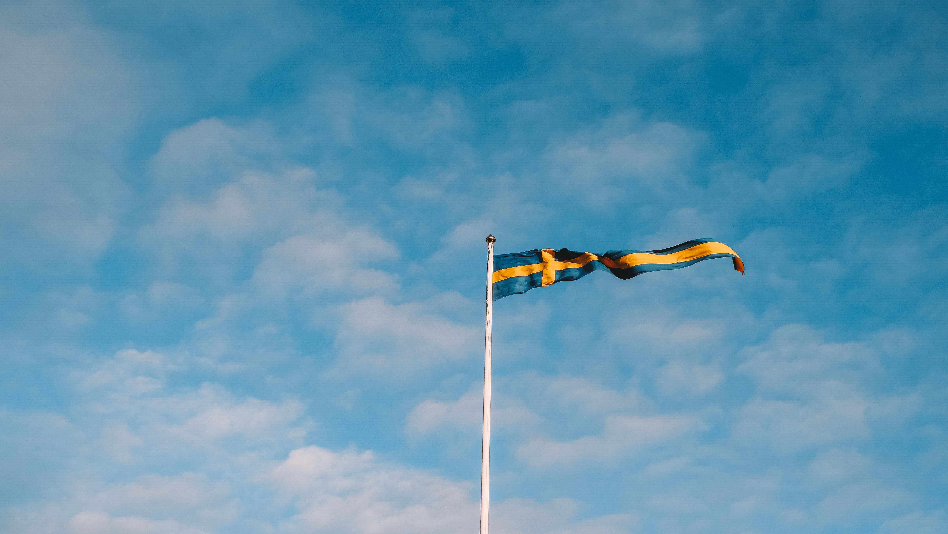
Economy Size
Large economies, like the United States, can do much of their trading internally.
Small economies, like Sweden, have less ability to provide what they want internally.
Small economies tend to have higher ratios of exports and imports to GDP.
HAWKES LEARNING
Notes:
Large economies, like the United States, can do much of their trading internally. Small economies, like Sweden, have less ability to provide what they want internally. Small economies tend to have higher ratios of exports and imports to GDP.

Slide 6
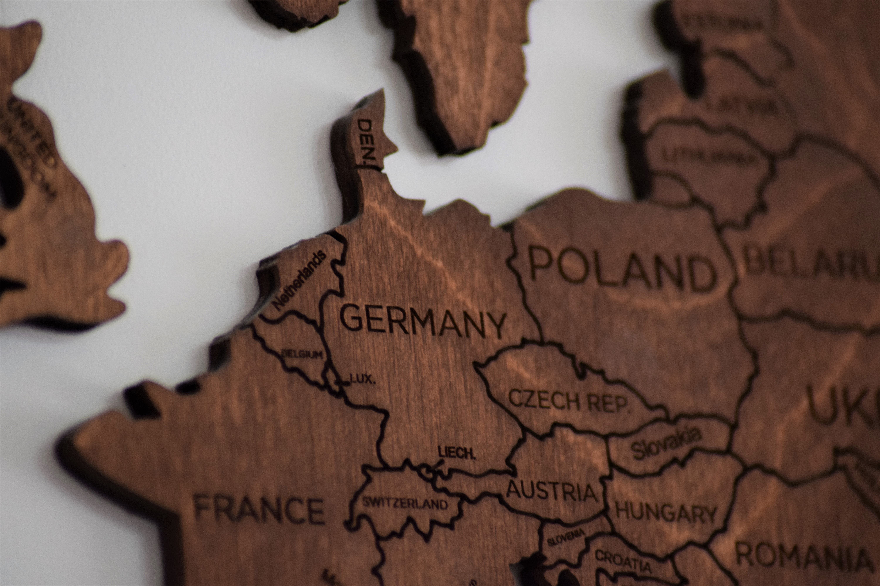
Geographic Location
Nations that are neighbors tend to trade more since costs of transportation and communication are lower.
For example, countries in Europe tend to trade with one another due to their close proximity.
HAWKES LEARNING
Notes:
Nations that are neighbors tend to trade more since costs of transportation and communication are lower. For example, countries in Europe tend to trade with one another due to their close proximity.

Slide 7
Trade History
Some nations have long and established patterns of international trade, while others do not.
Neighboring countries tend to have some form of trade history.
HAWKES LEARNING
Notes:
Some nations have long and established patterns of international trade, while others do not. Neighboring countries tend to have some form of trade history.

Slide 8
Real World Examples
The balance of trade is a separate issue from the level of trade.
For instance, the U.S. has a low level of trade, but it had enormous trade deficits most years from the mid-1980s into the 2000s.
Japan also has a low level of trade by world standards, but it has typically shown large trade surpluses in recent decades.
In 2017, Sweden had a high level of trade and a moderate trade surplus, while the UAE had a high level of trade and a moderate trade deficit.
Notes:
The balance of trade is a separate issue from the level of trade. For instance, the U.S. has a low level of trade, but it had enormous trade deficits most years from the mid-1980s into the 2000s. Japan also has a low level of trade by world standards, but it has typically shown large trade surpluses in recent decades. In 2017, Sweden had a high level of trade and a moderate trade surplus, while the UAE had a high level of trade and a moderate trade deficit.

Slide 9
Final Thoughts about Trade Balances
Both trade deficits and trade surpluses can be a good or bad sign for an economy.
Even a trade balance of zero—which means that a nation is neither a net borrower nor lender—can be a good or bad sign.
The fundamental economic question is whether borrowing or lending makes sense in the specific economic conditions of that nation.
Notes:
Both trade deficits and trade surpluses can be a good or bad sign for an economy. Even a trade balance of zero—which means that a nation is neither a net borrower nor lender—can be a good or bad sign. The fundamental economic question is whether borrowing or lending makes sense in the specific economic conditions of that nation.

Slide 10

On Your Own
Imagine you are a policy maker for a large economy that has been running large trade deficits, such as the United States. Would you consider running long-term trade deficits to be dangerous? How would you promote economic growth?
HAWKES LEARNING
Notes:
Imagine you are a policy maker for a large economy that has been running large trade deficits, such as the United States. Would you consider running long-term trade deficits to be dangerous? How would you promote economic growth?

Slide 11
On Your Own
Imagine you are a policy maker for a large economy that has been running large trade deficits, such as the United States. Would you consider running long-term trade deficits to be dangerous? How would you promote economic growth?
Economies can run trade deficits and still experience growth. Trade deficits result in an inflow of foreign capital. Economies can use this capital to invest in ways to increase productivity, which will allow the economy to grow. However, with these financial loans comes the liability of debt and interest payments that must be paid. If the foreign nations suddenly decide to withdraw their money, there would be a shock to the economy’s money supply, ultimately driving the economy into recession.
HAWKES LEARNING
Notes:
Imagine you are a policy maker for a large economy that has been running large trade deficits, such as the United States. Would you consider running long-term trade deficits to be dangerous? How would you promote economic growth?
Economies can run trade deficits and still experience growth. Trade deficits result in an inflow of foreign capital. Economies can use this capital to invest in ways to increase productivity, which will allow the economy to grow. However, with these financial loans comes the liability of debt and interest payments that must be paid. If the foreign nations suddenly decide to withdraw their money, there would be a shock to the economy’s money supply, ultimately driving the economy into recession.

Slide 12
Summary
A country's balance of trade is the dollar difference between its exports and imports while the level of trade depends on a country's history of trade, its geography, and the size of its economy.
Small economies that have nearby trading partners and a history of international trade tend to have higher levels of trade.
Large economies with few nearby trading partners and a limited history of international trade tend to have lower levels of trade.
When a country borrows money and invests it in ways that boost productivity, the trade deficit can lead to an improvement in long-term economic growth.
HAWKES LEARNING

Slide 13




HAWKES LEARNING

