Slide 1
HAWKES LEARNING
The Building Blocks of Keynesian Analysis

Slide 2
Introduction
Keynesian economics focuses on explaining why recessions occur and how to best minimize their effects.
Aggregate demand is not always high enough to incentivize firms to hire workers and reach full employment.
The economy adjusts very slowly to changes in aggregate demand due to sticky wages and prices.
HAWKES LEARNING
Notes:
Keynesian economics focuses on explaining why recessions occur and how to best minimize their effects. Aggregate demand is not always high enough to incentivize firms to hire workers and reach full employment. The economy adjusts very slowly to changes in aggregate demand due to sticky wages and prices.

Slide 3
The Role of AD in Recessions
Recessions occur when the level of demand for goods and services is less than what is produced when labor is fully employed.
The economy is in recession whenever the intersection of AS and AD occurs at a level of output less than that of full potential GDP.
Real GDP is often less than potential GDP because producers are unable to sell their output.
HAWKES LEARNING
Notes:
Recessions occur when the level of demand for goods and services is less than what is produced when labor is fully employed. The economy is in recession whenever the intersection of AS and AD occurs at a level of output less than that of full potential GDP. Real GDP is often less than potential GDP because producers are unable to sell their output.

Slide 4
Wage and Price Stickiness
When AD changes, wages and prices are "sticky" and do not immediately adjust to bring the economy back to full employment.
The first reason is the coordination argument, which requires perfect information about the level of lower compensation acceptable to other laborers and market participants.
The second reason is that firms often try to avoid wage cuts because they depress morale and lower worker productivity.
Prices can be sticky since they involve menu costs—like the costs of printing a new set of menus with different prices in a restaurant.
Customers may be confused or unhappy about price changes, especially if the new price is higher than what they were expecting to spend.
Notes:
When AD changes, wages and prices are "sticky" and do not immediately adjust to bring the economy back to full employment. The first reason is the coordination argument, which requires perfect information about the level of lower compensation acceptable to other laborers and market participants. The second reason is that firms often try to avoid wage cuts because they depress morale and lower worker productivity. Prices can be sticky since they involve menu costs—like the costs of printing a new set of menus with different prices in a restaurant. Customers may be confused or unhappy about price changes, especially if the new price is higher than what they were expecting to spend.

Slide 5
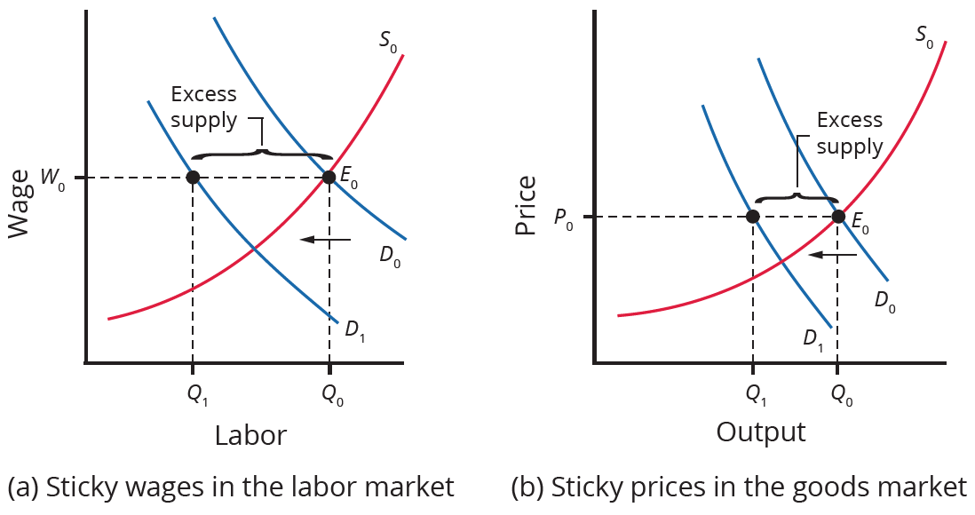
Wage and Price Stickiness
When demand shifts left, wages and prices do not immediately decline. This results in an excess supply of labor and an excess supply of goods. Thus, sticky wages and sticky prices, combined with a decrease in demand, cause unemployment and recession.
HAWKES LEARNING
Notes:
When demand shifts left, wages and prices do not immediately decline. This results in an excess supply of labor and an excess supply of goods. Thus, sticky wages and sticky prices, combined with a decrease in demand, cause unemployment and recession.

Slide 6
Keynesian Assumptions in the AD/AS Model
There are two main Keynesian assumptions in the AD/AS model.
Price level remains constant regardless of any leftward shift in AD.
First, aggregate demand is important in causing recessions.
Leads to a macroeconomic externality, when what happens at the macro level differs from the micro level.
Second, wages and prices are sticky and do not change immediately.
All adjustment occurs through real GDP since price level remains constant.
HAWKES LEARNING
Notes:
There are two main Keynesian assumptions in the AD/AS model. First, aggregate demand is important in causing recessions. Second, wages and prices are sticky and do not change immediately.

Slide 7
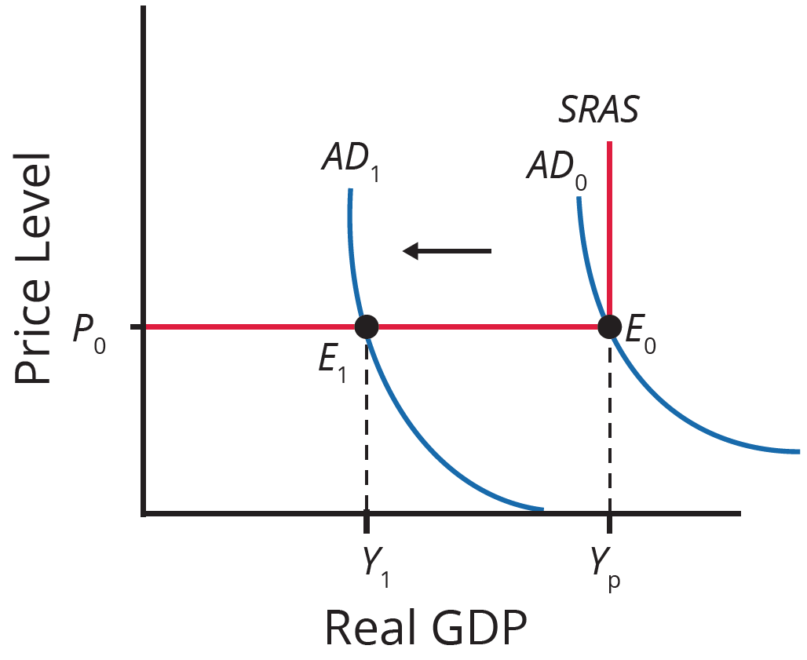
Keynesian Assumptions in the AD/AS Model
Wages and prices are so sticky that the price level remains constant regardless of any leftward shift in AD.
Leads to a macroeconomic externality, when what happens at the macro level differs from the micro level.
All adjustment occurs through real GDP since price level remains constant.
HAWKES LEARNING
Notes:
Wages and prices are so sticky that the price level remains constant regardless of any leftward shift in AD. Leads to a macroeconomic externality, when what happens at the macro level differs from the micro level. All adjustment occurs through real GDP since price level remains constant.

Slide 8
Expenditure Multiplier
The expenditure multiplier describes how a change in spending causes a more-than-proportionate change in GDP.
Price level remains constant regardless of any leftward shift in AD.
Leads to a macroeconomic externality, when what happens at the macro level differs from the micro level.
One person’s spending becomes another’s income, leading to additional spending and income.
All adjustment occurs through real GDP since price level remains constant.
The multiplier operates in both a positive and negative direction.
HAWKES LEARNING
Notes:
The expenditure multiplier describes how a change in spending causes a more-than-proportionate change in GDP. One person’s spending becomes another’s income, leading to additional spending and income. The multiplier operates in both a positive and negative direction.

Slide 9

On Your Own
Suppose that you go to work part time for the 2020 Census, and the federal government pays you a wage of $1,000 per week. Explain how you would contribute to the multiplier effect.
Price level remains constant regardless of any leftward shift in AD.
HAWKES LEARNING
Notes:
Suppose that you go to work part time for the 2020 Census, and the federal government pays you a wage of $1,000 per week. Explain how you would contribute to the multiplier effect.

Slide 10
On Your Own
Suppose that you go to work part time for the 2020 Census, and the federal government pays you a wage of $1,000 per week. Explain how you would contribute to the multiplier effect.
Out of the $1,000 of income that the government spending created, you would likely spend some of it to pay rent, buy groceries, and buy gasoline for your car. Your rent, grocery, and gasoline purchases would generate income for your landlord, the grocery store owner, and the gas station owner, who in turn would spend the income they received from your spending on more goods and services, generating new income and new spending for others throughout the economy. The total increase in spending is much larger than the original $1,000.
Price level remains constant regardless of any leftward shift in AD.
Leads to a macroeconomic externality, when what happens at the macro level differs from the micro level.
All adjustment occurs through real GDP since price level remains constant.
HAWKES LEARNING
Notes:
Suppose that you go to work part time for the 2020 Census, and the federal government pays you a wage of $1,000 per week. Explain how you would contribute to the multiplier effect.
Out of the $1,000 of income that the government spending created, you would likely spend some of it to pay rent, buy groceries, and buy gasoline for your car. Your rent, grocery, and gasoline purchases would generate income for your landlord, the grocery store owner, and the gas station owner, who in turn would spend the income they received from your spending on more goods and services, generating new income and new spending for others throughout the economy. The total increase in spending is much larger than the original $1,000.

Slide 11
Summary
Keynesian economics is based on two main building blocks.
Aggregate demand is more likely than aggregate supply to be the cause of short-run economic events.
Wages and prices are often sticky, leading to labor and supply shortages.
Surpluses cause prices to fall at the micro level, but they do not necessarily do the same at the macro level, resulting in a macroeconomic externality.
Exports and imports change according to relative growth rates and prices between two economies.
Both substitution bias and quality/new goods bias tend to overstate the negative impact of inflation on consumers.
HAWKES LEARNING

Slide 12




HAWKES LEARNING

