Slide 1
HAWKES LEARNING
Defining Money by Its Functions

Slide 2
Defining Money
Money is not an end in itself, as you cannot eat dollar bills or wear your bank account.
Ultimately, the usefulness of money is in exchanging it for goods or services.
Money is what people regularly use when purchasing or selling goods and services; thus, both buyers and sellers must widely accept money.
This concept of money is intentionally flexible because money has taken a wide variety of forms in different cultures.
HAWKES LEARNING
Notes:
Money is not an end in itself, as you cannot eat dollar bills or wear your bank account. Ultimately, the usefulness of money is in exchanging it for goods or services. Money is what people regularly use when purchasing or selling goods and services; thus, both buyers and sellers must widely accept money. This concept of money is intentionally flexible because money has taken a wide variety of forms in different cultures.

Slide 3
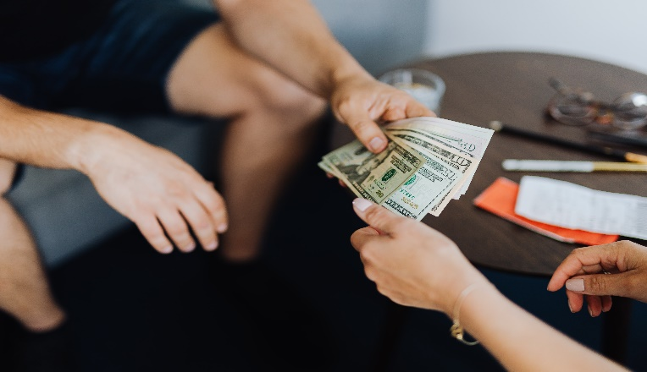


On Your Own
Take a few minutes to reflect on what money is to you. What role does it play in your life? How does it impact your daily decisions? To what extent do you prioritize money compared to other values, like time and friendship?
HAWKES LEARNING
Notes:
Take a few minutes to reflect on what money is to you. What role does it play in your life? How does it impact your daily decisions? To what extent do you prioritize money compared to other values, like time and friendship?

Slide 4
Barter and the Double Coincidence of Wants
Barter—trading one good or service for another—is highly inefficient in a modern, advanced economy.
In an economy without money, an exchange between two people must involve a double coincidence of wants: a situation in which two people each want some good or service that the other person can provide.
The barter system does not allow participants to easily enter into future contracts for purchasing many goods and services.
The time that individuals would otherwise spend producing goods and services and enjoying leisure time is spent bartering instead.
HAWKES LEARNING
Notes:
Barter—trading one good or service for another—is highly inefficient in a modern, advanced economy. In an economy without money, an exchange between two people must involve a double coincidence of wants: a situation in which two people each want some good or service that the other person can provide. The barter system does not allow participants to easily enter into future contracts for purchasing many goods and services. The time that individuals would otherwise spend producing goods and services and enjoying leisure time is spent bartering instead.

Slide 5
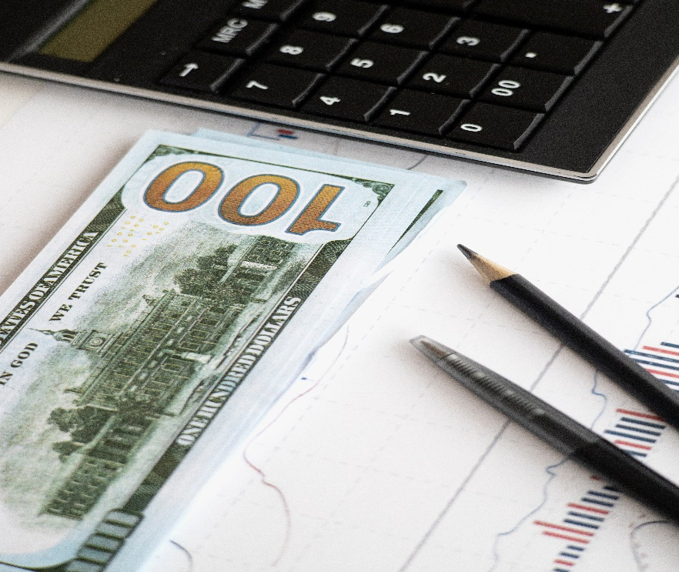
Functions of Money: Medium of Exchange
Money serves as a medium of exchange, which means that it acts as an intermediary between the buyer and the seller. For example, instead of exchanging accounting services for shoes, an accountant can exchange accounting services for money.
HAWKES LEARNING
Notes:
Money serves as a medium of exchange, which means that it acts as an intermediary between the buyer and the seller. For example, instead of exchanging accounting services for shoes, an accountant can exchange accounting services for money.

Slide 6
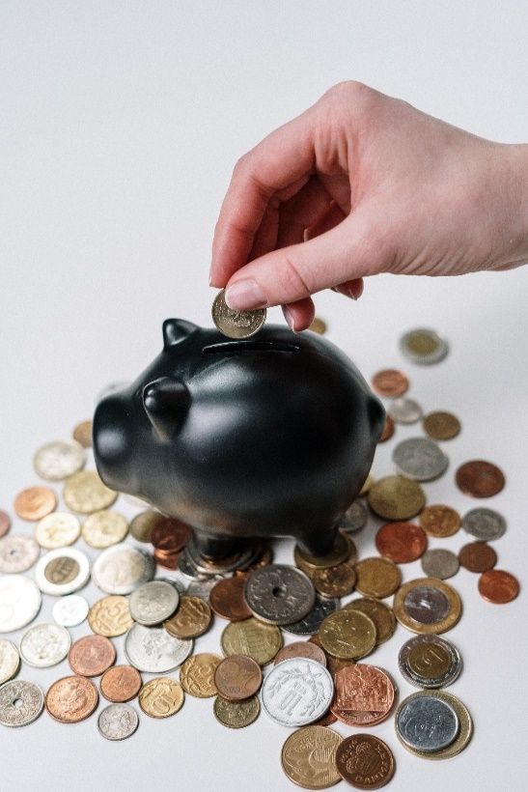
Functions of Money: Store of Money
Second, money must serve as a store of value, which preserves economic value that one can spend or consume in the future. For example, storing money by purchasing shoes is risky, as one risks the shoes going out of style and decreasing in value.
HAWKES LEARNING
Notes:
Second, money must serve as a store of value, which preserves economic value that one can spend or consume in the future. For example, storing money in shoe purchases is risky, as one risks the shoes going out of style and decreasing in value.

Slide 7
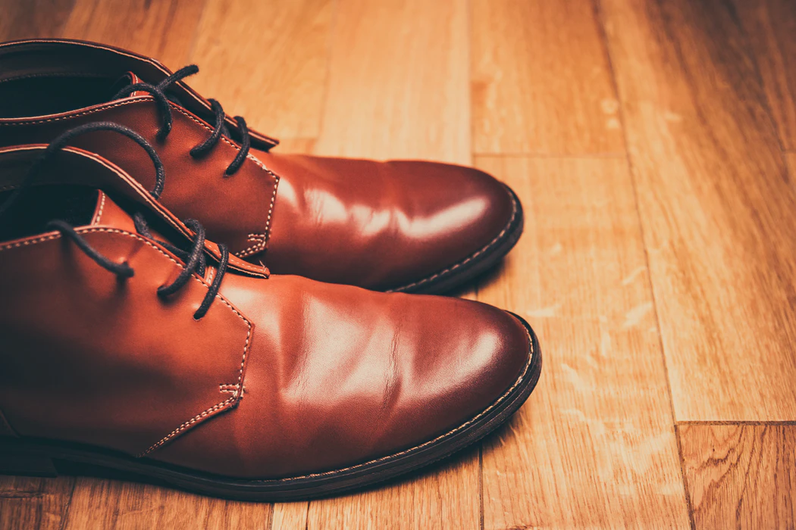
Functions of Money: Unit of Account
Third, money serves as a unit of account: it is the ruler by which we measure values. For example, an accountant may charge $100 to file your tax return. That $100 can purchase two pairs of shoes at $50 a pair. Money acts as a common denominator, an accounting method that simplifies thinking about tradeoffs.
HAWKES LEARNING
Notes:
Third, money serves as a unit of account: it is the ruler by which we measure values. For example, an accountant may charge $100 to file your tax return. That $100 can purchase two pairs of shoes at $50 a pair. Money acts as a common denominator, an accounting method that simplifies thinking about tradeoffs.

Slide 8

Functions of Money: Standard of Deferred Payment
Finally, money serves as a standard of deferred payment. If money is usable today to make purchases, it must also be acceptable to make purchases today that the purchaser will pay in the future. Loans and future agreements are stated in monetary terms, and the standard of deferred payment is what allows us to buy goods and services today and pay in the future.
HAWKES LEARNING
Notes:
Finally, money serves as a standard of deferred payment. If money is usable today to make purchases, it must also be acceptable to make purchases today that the purchaser will pay in the future. Loans and future agreements are stated in monetary terms, and the standard of deferred payment is what allows us to things today and pay in the future.

Slide 9
Two Types of Money
Commodity Money
Fiat Money
Type of money that has a use other than as money, like gold
Money that has no intrinsic value but is declared by a government to be a country’s legal tender
&
Commodity-backed currencies: currencies with values backed up by gold or other commodities held at a bank
HAWKES LEARNING
Notes:
There are two main types of money. Commodity money is a type of money that has a use other than as money, like gold. Commodity-backed currencies are currencies with values backed up by gold or other commodities held at a bank. Fiat money is money that has no intrinsic value but is declared by a government to be a country’s legal tender.

Slide 10
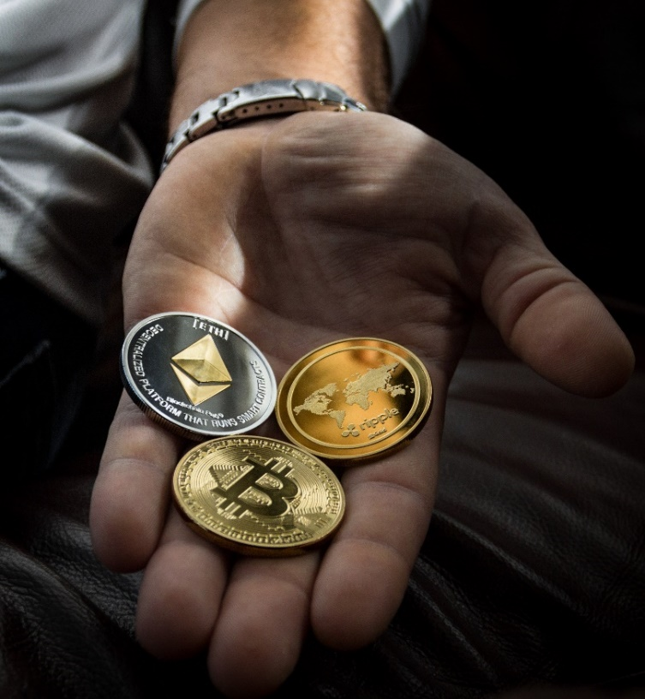
On Your Own
Suppose that you are the leader of a country. You are responsible for creating the currency for the country. What would you choose as the currency? How does it satisfy each of the four functions of money? Would you consider it to be commodity or fiat money?
HAWKES LEARNING
Notes:
Suppose that you are the leader of a country. You are responsible for creating the currency for the country. What would you choose as the currency? How does it satisfy each of the four functions of money? Would you consider it to be commodity or fiat money?

Slide 11
Summary
Money is what people in a society regularly use when purchasing or selling goods and services.
If money was not available, people would have to barter with each other, meaning that each person would need to identify others with whom they have a double coincidence of wants: a specific good or service that the other desires.
Money serves several functions: a medium of exchange, a unit of account, a store of value, and a standard of deferred payment.
Commodity money is an item that is used as money but also has value for other uses.
Fiat money has no intrinsic value but is declared by a government to be a country's legal tender.
HAWKES LEARNING

Slide 12




HAWKES LEARNING

