Slide 1
HAWKES LEARNING
How a Profit-Maximizing Monopoly Chooses Output and Price
Notes:
By the end of this lesson, you will be able to explain how a profit-maximizing monopoly calculates marginal revenue and marginal cost and struggles with inefficiency.

Slide 2

How a Profit-Maximizing Monopoly Chooses Output and Price
Consider a monopoly firm, with barriers to entry so that it need not fear competition from other producers. How will this monopoly choose its profit-maximizing quantity of output, and what price will it charge?
Notes:
Consider a monopoly firm, with barriers to entry so that it need not fear competition from other producers. How will this monopoly choose its profit-maximizing quantity of output, and what price will it charge?

Slide 3
Demand Curves Perceived by a Perfectly Competitive Firm and by a Monopoly
Perfect Competition
Monopoly
Firm takes the market price and determines the optimal quantity
Firm determines the optimal price and quantity combination
Notes:
In perfect competition, a firm takes the market price and determines the optimal quantity. In a monopoly, the lone firm determines the optimal price and quantity combination.

Slide 4
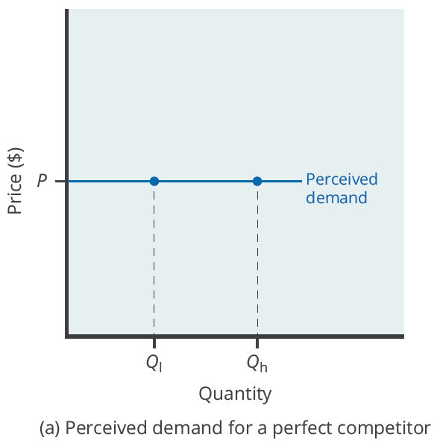
Demand Curve Perceived by a Perfectly Competitive Firm
A perfectly competitive firm perceives the demand curve that it faces to be flat.
The flat shape means that the firm can sell either a low quantity or a high quantity at exactly the same price.
Notes:
A perfectly competitive firm perceives the demand curve that it faces to be flat. The flat shape means that the firm can sell either a low quantity or a high quantity at exactly the same price.

Slide 5
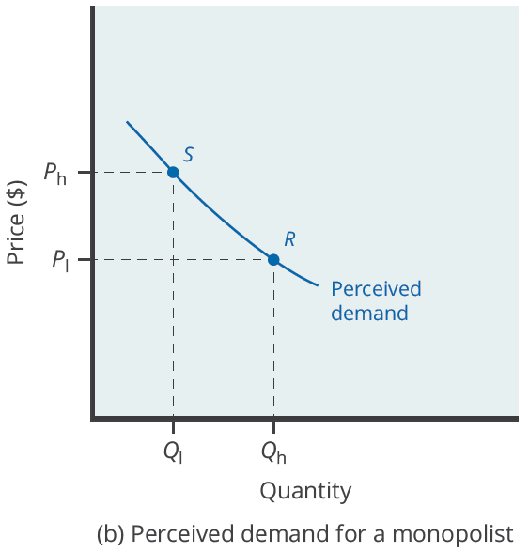
Demand Curve Perceived by a Monopoly
A monopolist perceives the demand curve that it faces to be the same as the market demand curve, which for most goods is downward-sloping.
If the monopolist chooses a high level of output, it can charge only a relatively low price.
Conversely, if the monopolist chooses a low level of output, it can then charge a higher price.
Notes:
A monopolist perceives the demand curve that it faces to be the same as the market demand curve, which for most goods is downward-sloping. If the monopolist chooses a high level of output, it can charge only a relatively low price. Conversely, if the monopolist chooses a low level of output, it can then charge a higher price.

Slide 6
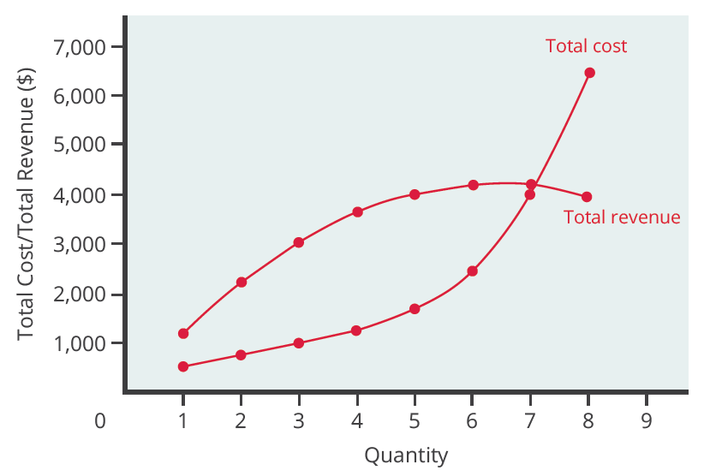
Total Cost and Total Revenue for a Monopolist
Low levels of output bring in relatively little total revenue because the quantity is low.
High levels of output bring in relatively less revenue because the high quantity pushes down the market price.
The total cost curve is upward-sloping.
Profits will be highest at the quantity of output where total revenue is most above total cost.
Notes:
Low levels of output bring in relatively little total revenue because the quantity is low. High levels of output bring in relatively less revenue because the high quantity pushes down the market price. The total cost curve is upward-sloping. Profits will be highest at the quantity of output where total revenue is most above total cost.

Slide 7
Marginal Revenue and Marginal Cost for a Monopolist
In the real world, a monopolist often does not have enough information to analyze its entire total revenue or total cost curves.
However, a monopolist often has experience with how changing output by small amounts will affect marginal revenue and marginal cost.
A monopolist can use information on marginal revenue and marginal cost to seek out the profit-maximizing combination of quantity and price.
Notes:
the real world, a monopolist often does not have enough information to analyze its entire total revenue or total cost curves. However, a monopolist often has experience with how changing output by small amounts will affect MR and MC. A monopolist can use information on MR and MC to seek out the profit-maximizing combination of quantity and price.

Slide 8
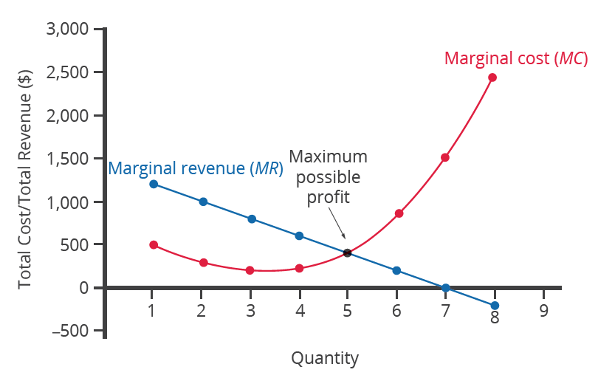
Marginal Revenue and Marginal Cost for a Monopolist
For a monopoly, marginal revenue decreases as it sells additional units of output.
The marginal cost curve is upward-sloping.
The profit-maximizing choice for a monopoly is to produce at the quantity where marginal revenue is equal to marginal cost.
Notes:
For a monopoly, marginal revenue decreases as it sells additional units of output. The marginal cost curve is upward-sloping. The profit-maximizing choice for a monopoly is to produce at the quantity where marginal revenue is equal to marginal cost.

Slide 9
Profit Maximization
If marginal revenue is greater than marginal cost, the monopolist should increase output.
If marginal revenue equals marginal cost, the monopolist is maximizing profit at this level of output.
If marginal revenue is less than marginal cost, the monopolist should decrease output.
Notes:
If marginal revenue is greater than marginal cost, the monopolist should increase output. If marginal revenue equals marginal cost, the monopolist is maximizing profit at this level of output. If marginal revenue is less than marginal cost, the monopolist should decrease output.

Slide 10
On Your Own
When price is equal to $125, a monopolist can sell 10 units of output, and when price is equal to $100, a monopolist can sell 20 units of output.
What is the firm's marginal revenue?
Notes:
When price is equal to $125, a monopolist can sell 10 units of output, and when price is equal to $100, a monopolist can sell 20 units of output. What is the firm's marginal revenue?

Slide 11
On Your Own
1. Calculate total revenue at each price by multiplying price and quantity:
2. Recall that marginal revenue is calculated as follows:
3. Plug in the given values into the marginal revenue equation:

Slide 12
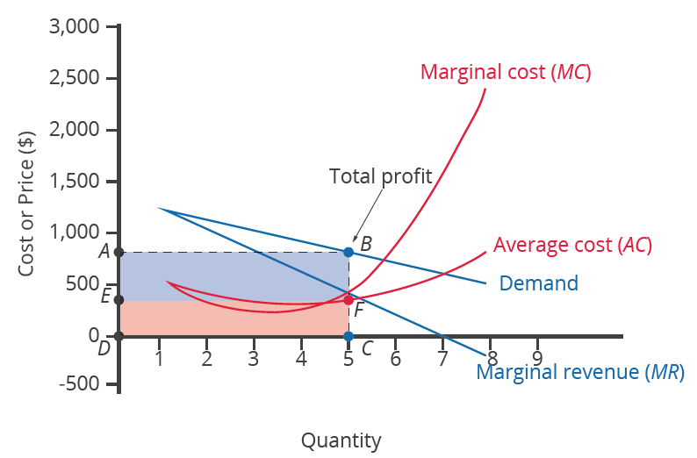
Illustrating Monopoly Profits
A monopolist first chooses the quantity where MR = MC.
The monopolist then decides what price to charge by looking at the demand curve it faces.
If the price charged is above average cost, the monopoly is earning positive profits.
Notes:
A monopolist first chooses the quantity where MR=MC. The monopolist then decides what price to charge by looking at the demand curve it faces. If the price charged is above average cost, the monopoly is earning positive profits.

Slide 13
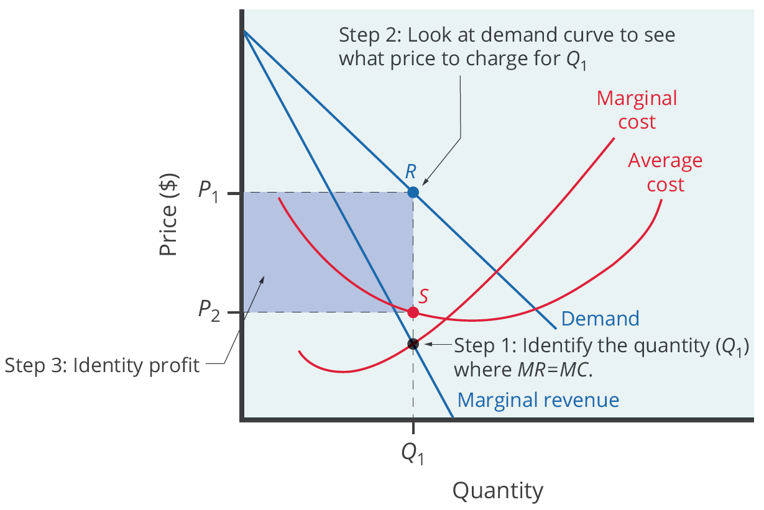
Three-Step Process

Slide 14
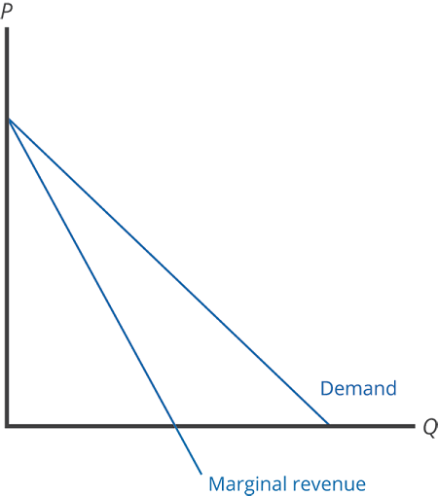
Marginal Revenue and Demand
When quantity sold increases by one unit, marginal revenue is affected in two ways.
First, one additional unit is sold at the new market price. Second, all the previous units, which were sold at the higher price, now sell for less.
Because of the lower price on all units sold, the marginal revenue of selling a unit is less than the price of that unit, and the marginal revenue curve is below the demand curve.
Notes:
When quantity sold increases by one unit, marginal revenue is affected in two ways. First, one additional unit is sold at the new market price. Second, all the previous units, which were sold at the higher price, now sell for less. Because of the lower price on all units sold, the marginal revenue of selling a unit is less than the price of that unit, and the marginal revenue curve is below the demand curve.

Slide 15
The Inefficiency of Monopoly
Economists object to the fact that monopolies often do not supply enough output to be allocatively efficient.
Allocative efficiency is an economic concept regarding efficiency at the social or societal level.
Allocative efficiency refers to the quantity where the marginal benefit to society of one more unit just equals the marginal cost.
In the case of monopoly, price is always greater than marginal cost at the profit-maximizing level of output, so it is not allocatively efficient.
Notes:
Economists object to the fact that monopolies often do not supply enough output to be allocatively efficient. Allocative efficiency is an economic concept regarding efficiency at the social or societal level. Allocative efficiency refers to the quantity where the marginal benefit to society of one more unit just equals the marginal cost. In the case of monopoly, price is always greater than marginal cost at the profit-maximizing level of output, so it is not allocatively efficient.

Slide 16
Real-World Discussion
What is a company that you would consider to be a monopoly? Why do you think it is a monopoly? How do you think this company determines how much to produce?
Notes:
What is a company that you would consider to be a monopoly? Why do you think it is a monopoly? How do you think this company determines how much to produce?

Slide 17
Summary
A monopolist is not a price taker because when it decides what quantity to produce, it also determines the market price.
Total revenue for a monopolist will start low, rise, and then decline.
Each additional unit a monopolist sells will push down the overall market price, and as it sells more units, this lower price applies to increasingly more units.
The monopolist will select the profit-maximizing level of output where MR = MC and then charge the price for that quantity of output as determined by the market demand curve.
Monopolists are not allocatively efficient because they do not produce at the quantity where P = MC.
HAWKES LEARNING

Slide 18




HAWKES LEARNING

