Slide 1
HAWKES LEARNING
International Environmental Issues
Notes:
No matter how many environmental regulations a country has, some issues spill over borders. In this lesson, titled “International Environmental Issues,” we’ll explore those and how countries must work together on them.

Slide 2
International Environmental Issues
Even if most nations took steps to address their environmental issues, no nation acting alone can solve worldwide environment issues.
Countries often have an issue with preserving biodiversity, which includes the full spectrum of animal and plant genetic material.
Global warming and biodiversity are examples of international externalities.
High-income countries have historically been the primary contributors to greenhouse warming by burning fossil fuels—and still are today.

Slide 3

Global Warming
One prominent example of an international externality is global warming.
No one country can reduce their carbon dioxide emissions enough to solve the problem by themselves.
Notes:
One prominent example of an international externality is global warming. No one country can reduce their carbon dioxide emissions enough to solve the problem by themselves.

Slide 4
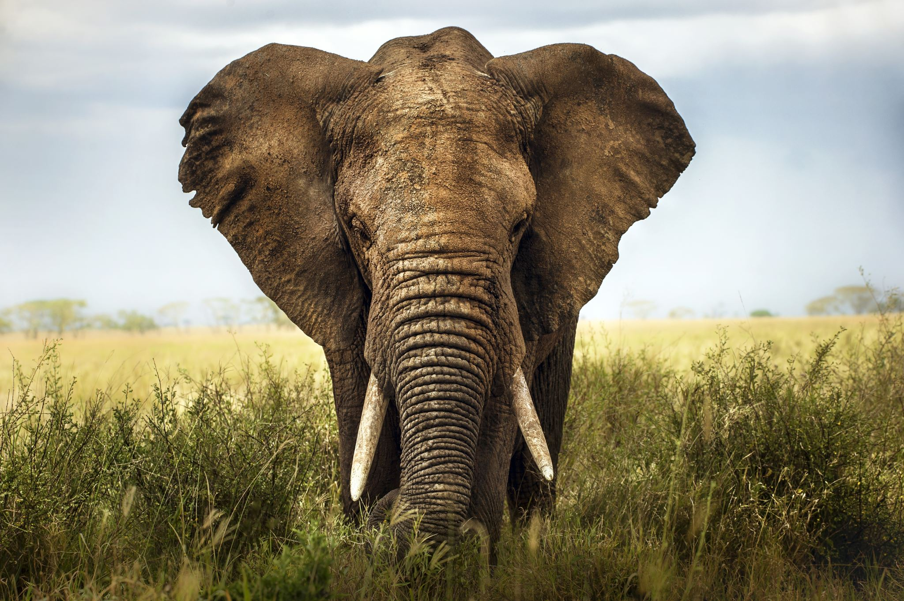
Biodiversity
Biodiversity includes the full spectrum of animal and plant genetic material.
Although a nation can protect biodiversity within its own borders, no nation acting alone can protect biodiversity everywhere.
Notes:
Biodiversity includes the full spectrum of animal and plant genetic material. Although a nation can protect biodiversity within its own borders, no nation acting alone can protect biodiversity everywhere.

Slide 5
Difficulty in Negotiation
Bringing the nations of the world together to address environmental issues requires a difficult set of negotiations between countries.
Low-income countries point out that high-income countries do not have much moral standing to lecture them on the environment.
It is hard to tell people in a low-income country that they should sacrifice an improved quality of life for a cleaner environment.
Notes:
Bringing the nations of the world together to address environmental issues requires a difficult set of negotiations between countries. Low-income countries point out that high-income countries do not have much moral standing to lecture them on the environment. It is hard to tell people in a low-income country that they should sacrifice an improved quality of life for a cleaner environment

Slide 6
Durban Climate Conference
The Durban climate conference in 2011 launched negotiations to develop a new international climate change agreement.
The outcome of these negotiations was the Paris Climate Agreement, passed in 2016.
The Paris Agreement committed participating countries to significant limits on CO₂ emissions.
Nearly 200 nations have signed on, including the two biggest emitters of greenhouse gases: China and the United States.
Notes:
The Durban climate conference in launched negotiations to develop a new international climate change agreement. The outcome of these negotiations was the Paris Climate Agreement, passed in 2016. The Paris Agreement committed participating countries to significant limits on CO2 emissions. Nearly 200 nations have signed on, including the two biggest emitters of greenhouse gases: China and the United States.

Slide 7
Solution
If high-income countries want low-income countries to reduce their emissions, the high-income countries may need to pay the costs.
Perhaps some of these payments will happen through private markets, like high amounts of ecotourism.
It is unlikely that some form of world government will impose a detailed system of environmental regulation around the world.
A decentralized and market-oriented approach may be the only way to address international issues such as global warming and biodiversity.
Notes:
If high-income countries want low-income countries to reduce their emissions, the high-income countries may need to pay the costs. Perhaps some of these payments will happen through private markets, like high amounts of ecotourism. It is unlikely that some form of world government will impose a detailed system of environmental regulation around the world. A decentralized and market-oriented approach may be the only way to address international issues such as global warming and biodiversity.

Slide 8
Real-World Discussion
Suppose Switzerland and Somalia want to reduce their greenhouse gas emissions. Switzerland is generally considered a higher-income country. What are some ways that Switzerland can help solve the international externality?
Notes:
Suppose Switzerland and Somalia want to reduce their greenhouse gas emission. Switzerland is generally considered a higher-income country. What are some ways that Switzerland can help solve the international externality?

Slide 9
Summary
Certain global environmental issues, such as global warming and biodiversity, spill over national borders and require addressing with some form of international agreement.
A decentralized and market-oriented approach may be the only way to address international issues such as global warming and biodiversity.
HAWKES LEARNING

Slide 10




HAWKES LEARNING

