Slide 1
HAWKES LEARNING
How Governments Can Encourage Innovation

Slide 2

Introduction
A number of different government policies can increase the incentives to innovate, including guaranteeing intellectual property rights, government assistance with the costs of research and development (R&D), and cooperative research ventures between universities and companies.
Notes:
A number of different government policies can increase the incentives to innovate, including guaranteeing intellectual property rights, government assistance with the costs of research and development (R&D), and cooperative research ventures between universities and companies.

Slide 3
Intellectual Property Rights
One way to increase new technology is to guarantee the innovator an exclusive right to that new product or process.
Intellectual property rights include patents, trademarks, and copyrights.
Notes:
One way to increase new technology is to guarantee the innovator an exclusive right to that new product or process. Intellectual property rights include patents, trademarks, and copyrights.

Slide 4
Copyright Laws
Copyright laws give an author the exclusive legal right over works of literature, music, film/video, and pictures.
For example, in 2003, copyright protection for Mickey Mouse was scheduled to run out.
Once the copyright had expired, anyone would be able to copy Mickey Mouse cartoons or draw and sell new ones.
In 1998, however, the Sonny Bono Copyright Term Extension Act extended the copyright from 75 years to 95 years after publication.
Notes:
Copyright laws give an author the exclusive legal right over works of literature, music, film/video, and pictures. For example, in 2003, copyright protection for Mickey Mouse was scheduled to run out. Once the copyright had expired, anyone would be able to copy Mickey Mouse cartoons or draw and sell new ones. In 1998, however, the Sonny Bono Copyright Term Extension Act extended the copyright from 75 years to 95 years after publication.

Slide 5
Patents
Patents give an inventor the exclusive legal right to make, use, or sell their invention for a limited time.
For example, if a pharmaceutical firm has a patent on a new drug, no other firm can manufacture or sell that drug for 20 years.
Without a patent, the pharmaceutical firm would have to face competition and could earn no more than a normal rate of profit.
With a patent, a firm is able to earn monopoly profits on its product for a period of time.
Notes:
Patents give an inventor the exclusive legal right to make, use, or sell their invention for a limited time. For example, if a pharmaceutical firm has a patent on a new drug, no other firm can manufacture or sell that drug for 20 years. Without a patent, the pharmaceutical firm would have to face competition and could earn no more than a normal rate of profit. With a patent, a firm is able to earn monopoly profits on its product for a period of time.

Slide 6
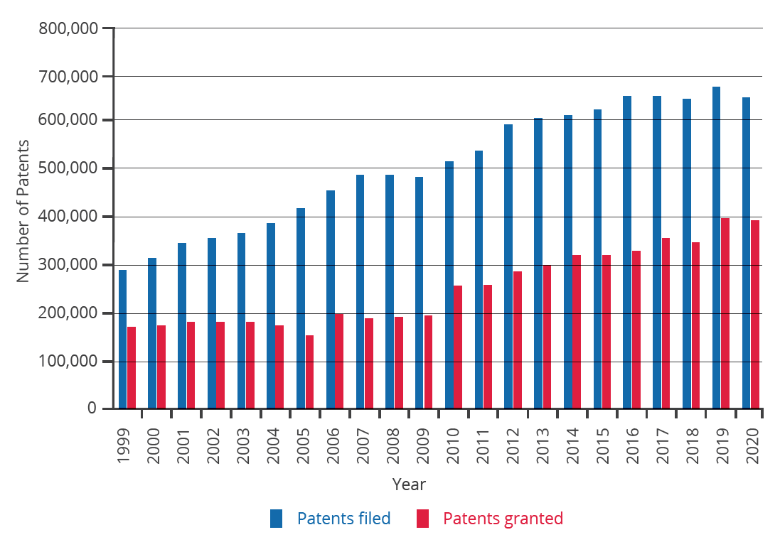
Patents
The number of applications filed for patents increased substantially in the late 1990s, due in part to the invention of the internet.
Notes:
The number of applications filed for patents increased substantially beginning in the 1990s, due in part to the invention of the internet.

Slide 7
Imperfections of Patents
In countries that already have patents, economic studies show that inventors receive only one-third to one-half of the total economic value of their inventions.
In a fast-moving, high-technology industry like biotechnology or semiconductor design, patents may be almost irrelevant because technology is advancing so quickly.
Not every new idea can be protected with a patent or a copyright, like a new way of organizing a factory or a new way of training employees.
Patents may sometimes cover too much or be granted too easily.
The 20-year time period for a patent is somewhat arbitrary. Ideally, a patent should cover a long enough period of time for the inventor to earn a good return but not so long that it allows the inventor to charge a monopoly price permanently.
HAWKES LEARNING
Notes:
While patents provide an incentive to innovate by protecting the innovator, they are not perfect. For example:In countries that already have patents, economic studies show that inventors receive only one-third to one-half of the total economic value of their inventions. In a fast-moving, high-technology industry like biotechnology or semiconductor design, patents may be almost irrelevant because technology is advancing so quickly. Not every new idea can be protected with a patent or a copyright, like a new way of organizing a factory or a new way of training employees. Patents may sometimes cover too much or be granted too easily. In the early 1970s, Xerox had received over 1,700 patents on various elements of the photocopy machine. Every time Xerox improved the photocopier, it received a patent on the improvement. The 20-year time period for a patent is somewhat arbitrary. Ideally, a patent should cover a long enough period of time for the inventor to earn a good return but not so long that it allows the inventor to charge a monopoly price permanently.

Slide 8



Alternative Policies to Encourage Research & Development
Because patents are imperfect and do not apply well to all situations, alternative methods of improving the rate of return for inventors of new technology are desirable.
Possible alternative policies:
Policy #1: Government Spending on Research and Development
Policy #2: Tax Breaks for Research and Development
Policy #3: Cooperative Research
Notes:
While patents and copyright laws are…. laws, there are also other policies that the government can put in place to increase innovation.

Slide 9
Policy #1: Government Spending on Research and Development
If the private sector does not have sufficient incentive to carry out R&D, one possibility is for the government to fund such work directly.
While government spending on R&D produces technology that is broadly available for firms to use, it costs taxpayers money.
Government spending on R&D can sometimes be directed more for political than scientific or economic reasons.
Notes:
If the private sector does not have sufficient incentive to carry out R&D, one possibility is for the government to fund such work directly. While government spending on R&D produces technology that is broadly available for firms to use, it costs taxpayers money. Government spending on R&D can sometimes be directed more for political than scientific or economic reasons.

Slide 10
Policy #2: Tax Breaks for Research and Development
A complementary approach to supporting R&D is to give firms a reduction in taxes depending on how much R&D they do.
The federal government refers to this policy as the research and experimentation (R&E) tax credit.
Tax breaks for research and development
Incentive to invest in research and development
Notes:
A complementary approach to supporting R&D is to give firms a reduction in taxes depending on how much R&D they do. The federal government refers to this policy as the research and experimentation (R&E) tax credit. Tax breaks for research and development give firms an incentive to invest in research and development.

Slide 11

Policy #3: Cooperative Research
Cooperation between government-funded universities and the private sector can spur product innovation and create whole new industries.
For example, the National Academy of Scientists and the National Academy of Engineers receive federal grants for innovative projects.
Notes:
Cooperation between government-funded universities and the private sector can spur product innovation and create whole new industries. For example, the National Academy of Scientists and the National Academy of Engineers receive federal grants for innovative projects.

Slide 12
Real-World Example
Suppose you are a technology company, and you are trying to develop a unique method to deliver faster internet services at a lower price point than ever before. What are some ways the government can provide incentives for you to develop this new technology, which would obviously provide social benefits?
HAWKES LEARNING
Notes:
Suppose you are a technology company, and you are trying to develop a unique method to deliver faster internet services at a lower price point than ever before. What are some ways the government can provide incentives for you to develop this new technology, which would obviously provide social benefits?

Slide 13
Real-World Example
Suppose you are a technology company, and you are trying to develop a unique method to deliver faster internet services at a lower price point than ever before. What are some ways the government can provide incentives for you to develop this new technology, which would obviously provide social benefits?
The government could use a variety of policy tools at its disposal, including granting a patent on the technology, providing tax incentives to your company for developing the technology, directly funding the R&D, and helping to form collaborations if they are helpful to your project.
HAWKES LEARNING
Notes:
Suppose you are a technology company, and you are trying to develop a unique method to deliver faster internet services at a lower price point than ever before. What are some ways the government can provide incentives for you to develop this new technology, which would obviously provide social benefits?
The government could use a variety of policy tools at its disposal, including granting a patent on the technology, providing tax incentives to your company for developing the technology, directly funding the R&D, and helping to form collaborations if they are helpful to your project.

Slide 14
Summary
Public policy with regard to technology must often strike a balance. For example, patents provide an incentive for inventors, but they should be limited to genuinely new inventions and not extend forever.
Government has a variety of policy tools for increasing the rate of return for new technology and encouraging its development, including direct government funding of R&D, tax incentives for R&D, protection of intellectual property, and forming cooperative relationships between universities and the private sector.
HAWKES LEARNING

Slide 15




HAWKES LEARNING

