Slide 1
HAWKES LEARNING
Public Goods

Slide 2
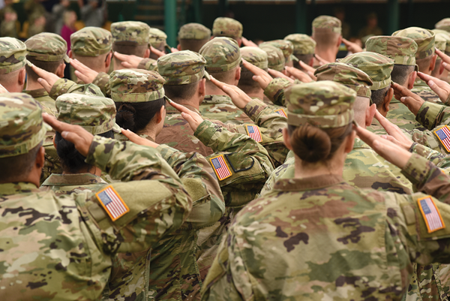
Public Goods
While new technology creates positive externalities that spill over to others, the inventor still receives some private return. What about a situation where the positive externalities are so extensive that private firms could not expect to receive any of the social benefit? We call this kind of good a public good.
Notes:
While new technology creates positive externalities that spill over to others, the inventor still receives some private return. What about a situation where the positive externalities are so extensive that private firms could not expect to receive any of the social benefit? We call this kind of good a public good.

Slide 3
The Definition of a Public Good
Economists have a strict definition of a public good, and it does not necessarily include all goods financed through taxes.
The first characteristic, that a public good is nonexcludable, means that it is costly or impossible to exclude someone from using the good.
The second characteristic of a public good, that it is nonrival, means that when one person uses the public good, another can also use it.
Notes:
Economists have a strict definition of a public good, and it does not necessarily include all goods financed through taxes. The first characteristic, that a public good is nonexcludable, means that it is costly or impossible to exclude someone from using the good. The second characteristic of a public good, that it is nonrival, means that when one person uses the public good, another can also use it.

Slide 4

Public Goods: Nonexcludable
It is costly or impossible to exclude someone from using the good.
Example: National defense protects everyone, and no one in the country is excluded.
Notes:
Nonexcludable means that it is impossible, or at least cost-prohibitive, to exclude someone from using the good. Using the earlier example of national defense, it protects everyone in a nation, no one is excluded.

Slide 5



Public Goods: Nonrival
People can use the good without taking away use from anyone else - no two people are rivals to consume that good.
Example: One person’s use of national defense does not reduce the amount left for another to use.
Notes:
Nonrival means that people can use it without taking away use from anyone else - no two people are rivals to consume that good. In other words, my use of national defense doesn’t mean there is less for you to use.

Slide 6
Public Goods: Positive Externalities
Positive externalities and public goods are closely related concepts.
Public goods have positive externalities, like police protection or public health funding.
Not all goods and services with positive externalities, however, are public goods.
Private companies can invest in new inventions, such as the iPad, and reap profits that may not capture all the social benefits.
Notes:
Positive externalities and public goods are closely related concepts. Public goods have positive externalities, like police protection or public health funding. Not all goods and services with positive externalities, however, are public goods. Private companies can invest in new inventions, such as the iPad, and reap profits that may not capture all the social benefits.

Slide 7
The Free Rider Problem of Public Goods
Private companies find it difficult to produce public goods.
When individuals make decisions about buying a public good, a free rider problem can arise.
People may have an incentive to let others pay for the public good and "free ride" on the purchases of others.
The free rider problem can be reduced by government actions, social pressures, and specific actions, such as collecting payments.
Notes:
Private companies find it difficult to produce public goods. When individuals make decisions about buying a public good, a free rider problem can arise. People may have an incentive to let others pay for the public good and "free ride" on the purchases of others. The free rider problem can be reduced by government actions, social pressures, and specific actions, such as collecting payments.

Slide 8
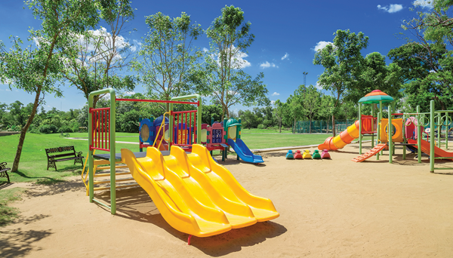
The Free Rider Problem of Public Goods
Suppose a group of neighbors decided to improve the neighborhood playground by purchasing and installing new equipment. Other neighbors who use the park but did not contribute to the new equipment are considered free riders.
Notes:
Suppose a group of neighbors decided to improve the neighborhood playground by purchasing and installing new equipment. Other neighbors who use the park but did not contribute to the new equipment are considered free riders.

Slide 9
Real-World Example
Suppose you are a resident of a community with a public park and playground. To prevent excessive wear and tear on the land and resources, a quota regulates the number of hours you can spend at the park. Despite these quotas, the local government believes people are not abiding by the rules and that there is excessive wear and tear on this community resource. What is the likely approach the government would take in this situation?
HAWKES LEARNING
Notes:
Suppose you are a resident of a community with a public park and playground. To prevent excessive wear and tear on the land and resources, a quota regulates the number of hours you can spend at the park. Despite these quotas, the local government believes people are not abiding by the rules and that there is excessive wear and tear on this community resource. What is the likely approach the government would take in this situation?

Slide 10
Real-World Example
Suppose you are a resident of a community with a public park and playground. To prevent excessive wear and tear on the land and resources, a quota regulates the number of hours you can spend at the park. Despite these quotas, the local government believes people are not abiding by the rules and that there is excessive wear and tear on this community resource. What is the likely approach the government would take in this situation?
Most likely, the government would ban using the park completely for a period of time to try to ensure that the land could recover and that any needed repairs to the playground could be performed.
HAWKES LEARNING
Notes:
Suppose you are a resident of a community with a public park and playground. To prevent excessive wear and tear on the land and resources, a quota regulates the number of hours you can spend at the park. Despite these quotas, the local government believes people are not abiding by the rules and that there is excessive wear and tear on this community resource. What is the likely approach the government would take in this situation?

Slide 11
The Role of Government in Paying for Public Goods
The key elements of paying for public goods are ensuring that everyone will make a contribution and preventing free riders.
For example, if people agree to pay taxes and make decisions about the quantity of public goods, they can defeat the free rider problem.
However, government spending and taxes are not the only way to provide public goods.
In some cases, markets can produce public goods.
Notes:
The key insights in paying for public goods are to find a way of ensuring that everyone will contribute and to prevent free riders. For example, if people agree to pay taxes and make decisions about the quantity of public goods, they can defeat the free rider problem. However, government spending and taxes are not the only way to provide public goods. In some cases, markets can produce public goods.

Slide 12
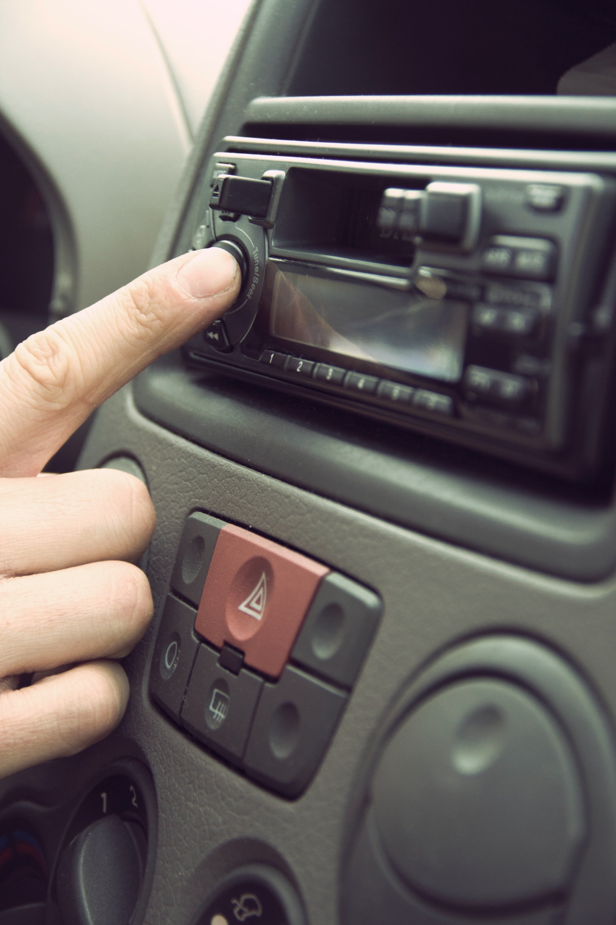
The Role of Government in Paying for Public Goods
Radio is nonexcludable since it would be very difficult to stop someone from receiving the signal once it is broadcast. It is nonrival since one person listening to the signal does not prevent others from listening as well. Because of these features, it is practically impossible to charge listeners directly for listening to conventional radio broadcasts.
Notes:
Radio is nonexcludable since it would be very difficult to stop someone from receiving the signal once it is broadcast. It is nonrival since one person listening to the signal does not prevent others from listening as well. Because of these features, it is practically impossible to charge listeners directly for listening to conventional radio broadcasts.

Slide 13
Common Resources and the "Tragedy of the Commons"
There are some goods that do not fall neatly into the categories of private good or public good.
While it is easy to classify a pizza as a private good and a city park as a public good, what about an item that is nonexcludable and rivalrous?
We call goods that are nonexcludable and rivalrous common resources.
For example, in the Caribbean, the queen conch is a large marine mollusk that lives in shallow waters of sea grass and is considered a common resource.
Notes:
There are some goods that do not fall neatly into the categories of private good or public good. While it is easy to classify a pizza as a private good and a city park as a public good, what about an item that is nonexcludable and rivalrous? We call goods that are nonexcludable and rivalrous common resources. For example, in the Caribbean, the queen conch is a large marine mollusk that lives in shallow waters of sea grass.

Slide 14


Common Resources
The queen conch is free, available to most everyone, making it nonexcludable.
But if I get a conch out of the ocean, you can't get that conch, making it rivalrous.
Difficult to categorize!
Notes:
In the Caribbean, the queen conch is a large marine mollusk that lives in shallow waters of sea grass. These waters are so shallow and clear that a single diver may harvest many conch in a single day. Not only is conch meat a local delicacy and an important part of the local diet, but artists use the large ornate shells, and craftsmen transform them. Because almost anyone with a small boat, snorkel, and mask can participate in the conch harvest, it is essentially nonexcludable. At the same time, fishing for conch is rivalrous. Once a diver catches one conch, another diver cannot catch it.

Slide 15


Overharvesting
Can lead to populations being wiped out.
Ways to reduce:
Requiring fishing licenses
Limiting harvests
Shortening fishing season
Notes:
Common resources can lead to overharvesting or overuse, wiping out the population. Typical fixes in cases like the conchs would be the government requiring fishing licenses, limiting harvests or shortening the fishing season.

Slide 16
Positive Externalities in Public Health Programs
Public goods + positive externalities (clean water, public behavior, medicine, etc.)
Longer life expectancy + healthier lives
Notes:
The rise in life expectancy seems to stem from three primary factors. First, systems for providing clean water and disposing of human waste helped to prevent the transmission of many diseases. Second, changes in public behavior have advanced health. Third, medicine has played a large role.

Slide 17
On Your Own
Choose the answer that best completes each of the following sentences.
Advances in public health are linked to:
☐ Positive externalities
☐ Public goods
☐ Negative externalities
☐ Private goods
☐ Both positive externalities and public goods
The rise in life expectancy stems from the following primary factors:
☐ Systems of providing clean water
☐ Changes in public behavior
☐ Advances in medicine
☐ All of the above
☐ None of the above

Slide 18
On Your Own
Choose the answer that best completes each of the following sentences.
Advances in public health are linked to:
☐ Positive externalities
☐ Public goods
☐ Negative externalities
☐ Private goods
☐ Both positive externalities and public goods
The rise in life expectancy stems from the following primary factors:
☐ Systems of providing clean water
☐ Changes in public behavior
☐ Advances in medicine
☐ All of the above
☐ None of the above

Slide 19
Summary
A public good has two key characteristics: it is nonexcludable and nonrival.
Nonexcludable means that it is costly or impossible for one user to exclude others from using the good.
Nonrival means that when one person uses the good, it does not prevent others from using it.
Markets often have a difficult time producing public goods because free riders will attempt to use the public good without paying for it.
HAWKES LEARNING

Slide 20




HAWKES LEARNING

