Slide 1
HAWKES LEARNING
Immigration

Slide 2
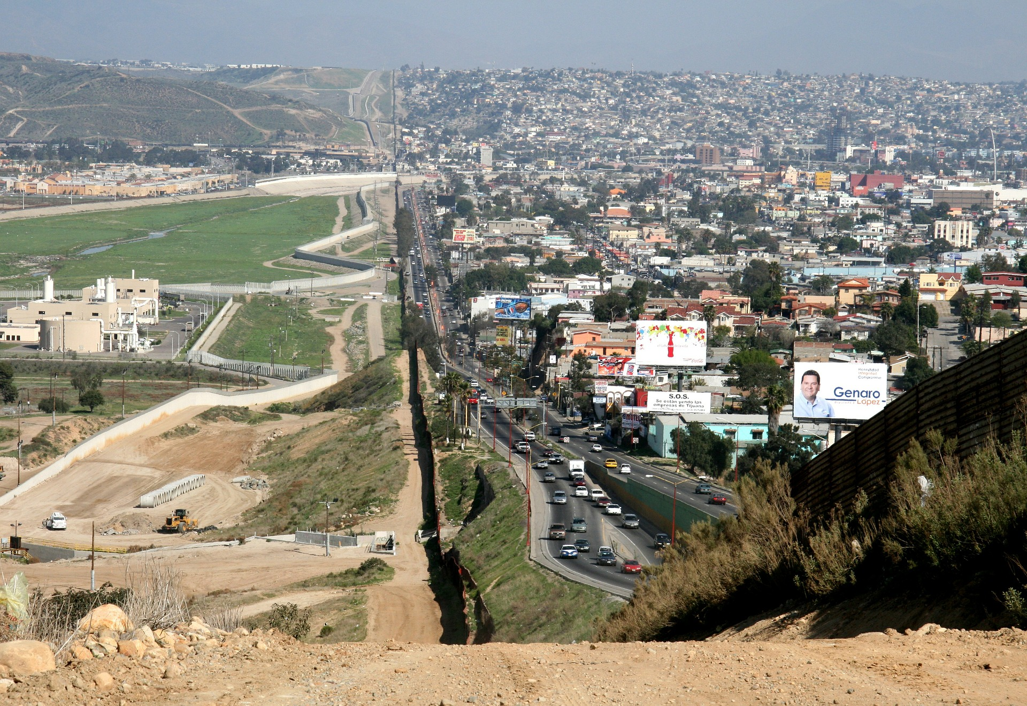
Introduction
Some of the tensions over immigration stem from worries over how it might affect a country's culture, including differences in language and patterns of family, authority, or gender relationships. Economics does not have much to say about such cultural issues. Some of the worries about immigration do, however, have to do with its effects on wages, income levels, and government taxes and spending. On those topics, economists have insights and research to offer.
Notes:
Immigration is a complex and sensitive topic. Frequently, much of the tension surrounding immigration has to do with cultural issues, but economics is more concerned with immigration’s effects on wages, income levels, and government taxes and spending.

Slide 3
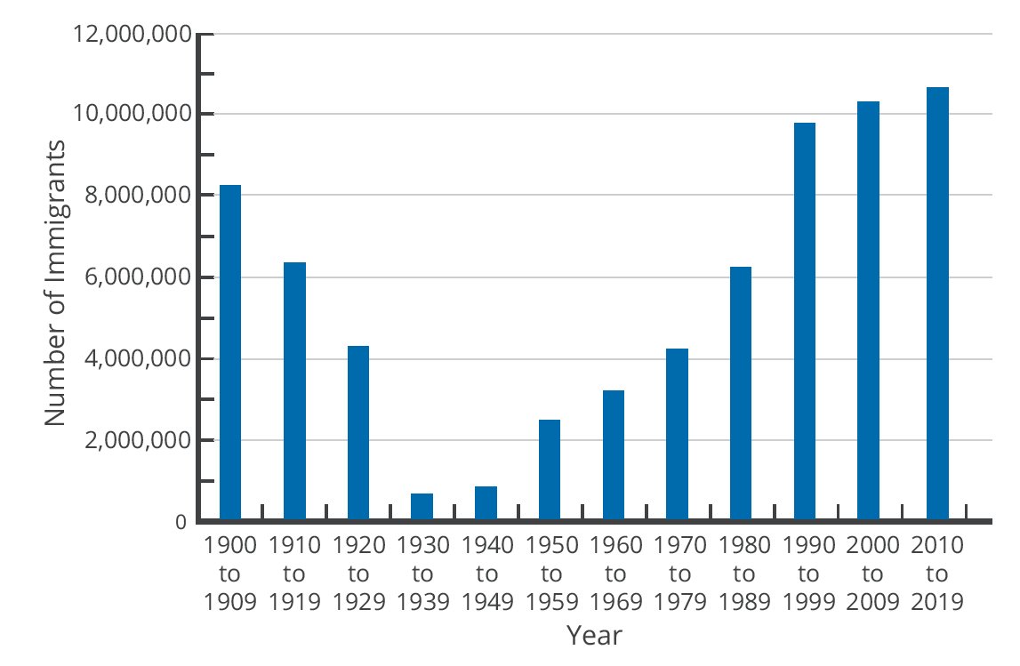
Historical Patterns
The number of immigrants in each decade declined between 1900 and the 1940s, rose sharply through 1999, and started to plateau since 2000.
As far as demographics, Europeans made up 90% of immigrants in the first decade of the twentieth century but less than 20% by the end of the century. By the 2000s, about half of U.S. immigrants came from South and Central America, especially Mexico, and about a quarter came from various countries in Asia.
Notes:
The number of immigrants in each decade declined between 1900 and the 1940s, rose sharply through 1999, and started to plateau since 2000.
As far as demographics, Europeans made up 90% of immigrants in the first decade of the twentieth century but less than 20% by the end of the century. By the 2000s, about half of U.S. immigrants came from South and Central America, especially Mexico, and about a quarter came from various countries in Asia.

Slide 4

Economic Effects: Imaginary Scenario
How would it affect the U.S. economy if immigrants entering the United States exactly matched the existing U.S. population in age range, education, skill levels, family size, and occupations?
Notes:
Let’s cover the economic consequences of immigration. How would it affect the U.S. economy if immigrants entering the United States exactly matched the existing U.S. population in age range, education, skill levels, family size, and occupations?

Slide 5
Economic Effects: Imaginary Scenario
How would it affect the U.S. economy if immigrants entering the United States exactly matched the existing U.S. population in age range, education, skill levels, family size, and occupations?
Immigrants would be better off because their standard of living would be higher in the United States. They would also contribute to increased production and increased consumption. Given enough time for adjustment, the range of jobs performed, income earned, taxes paid, and public services needed would not be much affected by this kind of immigration. It would simply be as if the population had increased.
Notes:
Let’s cover the economic consequences of immigration. How would it affect the U.S. economy if immigrants entering the United States exactly matched the existing U.S. population in age range, education, skill levels, family size, and occupations? Immigrants would be better off because their standard of living would be higher in the United States. They would also contribute to increased production and increased consumption. Given enough time for adjustment, the range of jobs performed, income earned, taxes paid, and public services needed would not be much affected by this kind of immigration. It would simply be as if the population had increased.

Slide 6
Economic Effects: Reality
Immigrants are not identical to the rest of the U.S. population.
About one-third of immigrants over the age of 25 lack a high school diploma.
Many of the recent immigrants end up in jobs like restaurant and hotel work, lawn care, and janitorial work.
This kind of immigration represents a shift to the right in the supply of unskilled labor for a number of jobs, which will lead to lower wages for these jobs.
Notes:
Now, consider the reality of recent immigration to the United States. Immigrants are not identical to the rest of the U.S. population. About one-third of immigrants over the age of 25 lack a high school diploma. As a result, many of the recent immigrants end up in jobs like restaurant and hotel work, lawn care, and janitorial work. This kind of immigration represents a shift to the right in the supply of unskilled labor for a number of jobs, which will lead to lower wages for these jobs. The middle- and upper-income households that purchase the services of these unskilled workers will benefit from these lower wages. However, low-skilled U.S. workers who must compete with low-skilled immigrants for jobs will tend to suffer from immigration.

Slide 7

Economic Effects: Reality
The difficult policy questions about immigration are not so much about the overall gains to the rest of the economy, which seem to be real but small in the context of the U.S. economy, as they are about the disruptive effects of immigration in specific labor markets.
Recent immigration to the U.S. is skewed towards unskilled labor, which makes it harder for low-skilled U.S. citizens to find work or earn a higher wage.
Notes:
Recent immigration to the U.S. is skewed towards unskilled labor, which makes it harder for low-skilled U.S. citizens to find work or earn a higher wage. The middle- and upper-income households that purchase the services of these unskilled workers will benefit from these lower wages. However, low-skilled U.S. workers who must compete with low-skilled immigrants for jobs will tend to suffer from immigration.

Slide 8
Disruptive Effects of Immigration
A study by Michael S. Clune found that for each 10% rise in the number of employed immigrants with no more than a high school diploma in the labor market, high school students reduced their annual number of hours worked by 3%.
10%
3%
number of employed immigrants
hours worked by high school students
Notes:
Overall, immigration does create gains for the economy, though these gains are small in the context of the U.S. However, policy questions tend to focus more on how immigration disrupts specific labor markets. We’ve already noted that an increase in low-skill immigrant workers tends to reduce wages for domestic low-skill workers. A study by Michael S. Clune found that for each 10% rise in the number of employed immigrants with no more than a high school diploma, the number of hours worked by high school students fell by 3%. Overall, the effects on the wages of low-skill workers are not large—perhaps in the range of decline of about 1%.

Slide 9
Disruptive Effects of Immigration
Immigrants are thought to contribute to increased demand for local goods and services, which can stimulate the low-skilled labor market.
Employers may choose production processes that are more labor-intensive given the increased supply of low-skill workers.
These various factors would explain the small negative wage effect that the native low-skill workers observed as a result of immigration.
Notes:
Immigrants are thought to contribute to increased demand for local goods and services, which can stimulate the low-skilled labor market. Employers may choose production processes that are more labor-intensive given the increased supply of low-skill workers. These various factors would explain the small negative wage effect that the native low-skill workers observed as a result of immigration.

Slide 10
Effect on Budgets
Many of the costs imposed by immigrants arise in state-run programs, like public schooling and welfare benefits.
Many of the taxes that immigrants pay are federal taxes, like income taxes and Social Security taxes.
According to the nonprofit Rand Corporation, the effects of immigration on taxes are generally positive at the federal level.
In places where there are many low-skilled immigrants, the effects are negative at the state and local levels.
Notes:
Another potential disruption is the impact on state and local government budgets. Many of the costs imposed by immigrants arise in state-run programs, like public schooling and welfare benefits. However, many of the taxes that immigrants pay are federal taxes, like income taxes and Social Security taxes. Many immigrants do not own property (such as homes and cars), so they do not pay property taxes, which are one of the main sources of state and local tax revenue. However, if they’re renters, their landlords pay property taxes. Additionally, immigrants do pay sales taxes, which are state and local. In summary, according to the nonprofit Rand Corporation, the effects of immigration on taxes are generally positive at the federal level. However, in places where there are many low-skilled immigrants, the effects are negative at the state and local levels.

Slide 11
Congressional Jordan Commission
The Congressional Jordan Commission of the 1990s had two goals: reduce overall levels of immigration and give priority to high-skilled immigrants.
In the labor market, focusing on high-skilled immigrants would help prevent decreases in the wages of low-skilled workers.
It would also benefit government budgets since higher-skilled workers find jobs more quickly, earn higher wages, and thus pay more in taxes.
Notes:
Over the years, there have been proposals for immigration reform. In the 1990s, the Congressional Jordan Commission had two primary goals: reduce overall levels of immigration and give priority to high-skilled immigrants. In the labor market, focusing on high-skilled immigrants would help prevent decreases in the wages of low-skilled workers. It would also benefit government budgets since higher-skilled workers find jobs more quickly, earn higher wages, and thus pay more in taxes.

Slide 12
DREAM Act
The Obama Administration proposed the DREAM Act legislation, which would have offered a path to citizenship for illegal immigrants brought to the United States before the age of sixteen.
Despite bipartisan support, the legislation failed to pass at the federal level.
Some state legislatures, such as California, have passed their own Dream Acts.
Notes:
The Obama Administration proposed the DREAM Act legislation, which would have offered a path to citizenship for illegal immigrants brought to the United States before the age of 16. Despite bipartisan support, the legislation failed to pass at the federal level. However, some state legislatures, such as California, have passed their own Dream Acts.

Slide 13
Real-World Discussion
DACA (Deferred Action for Childhood Arrivals) is a hotly contested topic in the United States. Make an economic argument either for or against the DACA immigration program.
Notes:
DACA (Deferred Action for Childhood Arrivals) is a hotly contested topic in the United States. Make an economic argument either for or against the DACA immigration program.

Slide 14
Summary
The recent level of U.S. immigration is at a historically high level if we measure it in absolute numbers, but not if we measure it as a share of population.
The overall gains to the U.S. economy from immigration are real but relatively small.
However, immigration also causes effects like slightly lower wages for low-skill workers and budget problems for certain state and local governments.
HAWKES LEARNING

Slide 15




HAWKES LEARNING

