Slide 1
HAWKES LEARNING
What Happens When a Country Has an Absolute Advantage in All Goods
Notes:
What Happens When a Country Has Absolute Advantage in All Goods. By the end of this lesson, you will be able to show the relationship between production costs and comparative advantage, identify situations of mutually beneficial trade, and identify trade benefits by considering opportunity costs.

Slide 2
Introduction
Sometimes, one country has an absolute advantage in everything.
This is typical for high-income countries that often have well-educated workers and technologically advanced equipment.
Many high-income countries can produce all products with fewer resources than a low-income country.
Even when one country has an absolute advantage in all products, trade can still benefit both sides.
Gains from trade come from specializing in one's comparative advantage.
Notes:
Sometimes, one country has an absolute advantage in everything. This is typical for high-income countries that often have well-educated workers and technologically advanced equipment. These high-income countries can produce all products with fewer resources than a low-income country. Even when one country has an absolute advantage in all products, trade can still benefit both sides. This is because gains from trade come from specializing in one's comparative advantage.

Slide 3
Production Possibilities and Comparative Advantage
Resources Needed to Produce Shoes and Refrigerators
Country | Number of Workers Needed to Produce 1,000 Units: Shoes | Number of Workers Needed to Produce 1,000 Units: Refrigerators
United States | 4 workers | 1 worker
Mexico | 5 workers | 4 workers
The United States has an absolute advantage in productivity with regard to both shoes and refrigerators; that is, it takes fewer workers in the United States than in Mexico to produce both a given number of shoes and a given number of refrigerators.
Notes:
Consider the example of trade between the United States and Mexico:
The United States has an absolute advantage in productivity with regard to both shoes and refrigerators; that is, it takes fewer workers in the United States than in Mexico to produce both a given number of shoes and a given number of refrigerators.

Slide 4


Absolute Advantage
Absolute advantage asks:
“How many inputs do I need to produce this good?”
Comparative advantage asks:
“How much am I giving up to produce this good?”
Notes:
While absolute advantage asks, “how many inputs do I need to produce a good?”, comparative advantage asks, “how much am I giving up to produce this good?”

Slide 5
Production Possibilities
Production Possibilities before Trade with Complete Specialization
Country | Shoe Production Using 40 Workers | Refrigerator Production Using 40 Workers
United States | 10,000 shoes | 40,000 refrigerators
Mexico | 8,000 shoes | 10,000 refrigerators
If the United States divides its labor so that 40 workers are making shoes, since it takes four workers in the United States to make 1,000 shoes, a total of 10,000 shoes will be produced. If the 40 workers in the United States are making refrigerators, and each worker can produce 1,000 refrigerators, a total of 40,000 refrigerators will be produced.
Notes:
If the United States divides its labor so that 40 workers are making shoes, since it takes four workers in the United States to make 1,000 shoes, a total of 10,000 shoes will be produced. If the 40 workers in the United States are making refrigerators, and each worker can produce 1,000 refrigerators, a total of 40,000 refrigerators will be produced.

Slide 6
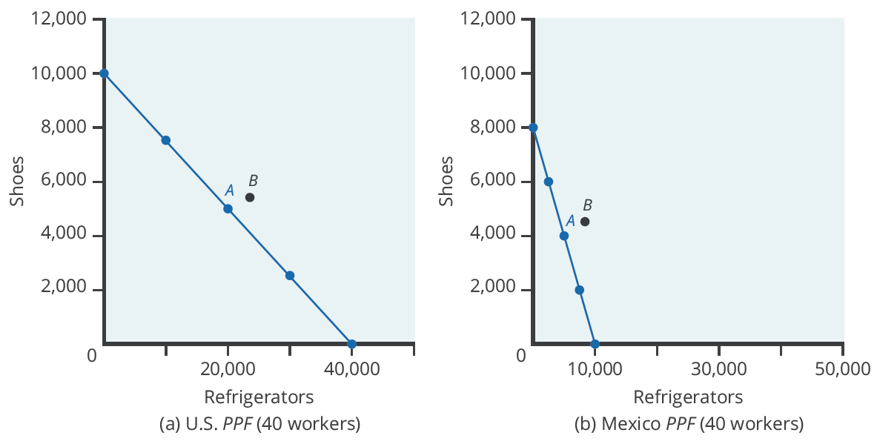
Production Possibilities Frontier
With 40 workers, the United States can produce either 10,000 shoes and zero refrigerators or 40,000 refrigerators and zero shoes. With 40 workers, Mexico can produce either 8,000 shoes and zero refrigerators or 10,000 refrigerators and zero shoes. Point A is where the countries start producing and consuming before trade. Point B is where they end up after trade.
Notes:
When nations increase production in their area of comparative advantage and trade with each other, both countries can benefit. Again, the production possibility frontier is a useful tool to visualize this benefit. With 40 workers, the United States can produce either 10,000 shoes and zero refrigerators or 40,000 refrigerators and zero shoes. With 40 workers, Mexico can produce a maximum of 8,000 shoes and zero refrigerators, or 10,000 refrigerators and zero shoes. Point A on both graphs is where the countries start producing and consuming before trade. Point B is where they end up after trade.

Slide 7
Mutually Beneficial Trade with Comparative Advantage
Let's say that, in the situation before trade, each nation prefers to produce a combination of shoes and refrigerators that is shown at Point A on the PPFs.
Total Production at Point A before Trade
Country | Current Shoe Production | Current Refrigerator Production
United States | 5,000 | 20,000
Mexico | 4,000 | 5,000
Total | 9,000 | 25,000
Notes:
Let's say that, in the situation before trade, each nation prefers to produce a combination of shoes and refrigerators that is shown at Point A on the PPFs.

Slide 8
Mutually Beneficial Trade with Comparative Advantage
Now, assume the countries shift production toward the good for which they have a comparative advantage in producing.
Shifting Production Toward Comparative Advantage Raises Total Output
Country | Current Shoe Production | Current Refrigerator Production
United States | 3,500 | 26,000
Mexico | 6,000 | 2,500
Total | 9,500 | 28,500
Notes:
Now, assume the countries shift production toward the good for which they have a comparative advantage in producing.

Slide 9
Mutually Beneficial Trade with Comparative Advantage
When both countries shift production toward each of their comparative advantages, the combined production rises.
Even when one country has an absolute advantage in all goods, both countries can still benefit from trade.
Even though the U.S. has an absolute advantage in producing both goods, it makes economic sense for it to specialize.
The United States will export refrigerators and in return import shoes.
Notes:
When both countries shift production toward each of their comparative advantages, the combined production rises. Even when one country has an absolute advantage in all goods, both countries can still benefit from trade. Even though the U.S. has an absolute advantage in producing both goods, it makes economic sense for it to specialize. The United States will export refrigerators and in return import shoes.

Slide 10
Real World Example
Suppose a group of friends goes camping. Jethro is an experienced camper and has an absolute advantage in all aspects of camping, such as pitching tents, making fires, cooking, and cleaning up. Since Jethro has the absolute advantage in everything, based on what you know about comparative advantage and specialization, should he do all the work? If not, how will the friends decide which tasks they will do and which tasks Jethro should do?
HAWKES LEARNING
Notes:
Suppose a group of friends goes camping. Jethro is an experienced camper and has an absolute advantage in all aspects of camping, such as pitching tents, making fires, cooking, and cleaning up. Since Jethro has the absolute advantage in everything, based on what you know about comparative advantage and specialization, should he do all the work? If not, how will the friends decide which tasks they will do and which tasks Jethro should do?

Slide 11
Real World Example
Suppose a group of friends goes camping. Jethro is an experienced camper and has an absolute advantage in all aspects of camping, such as pitching tents, making fires, cooking, and cleaning up. Since Jethro has the absolute advantage in everything, based on what you know about comparative advantage and specialization, should he do all the work? If not, how will the friends decide which tasks they will do and which tasks Jethro should do?
No, Jethro should not do all of the work because his output alone will be less than what can be accomplished by dividing up the tasks. Jethro should do the tasks for which his productivity advantage is the greatest. The five other friends should do the tasks for which their productivity disadvantage is the lowest.
HAWKES LEARNING
Notes:
Suppose a group of friends goes camping. Jethro is an experienced camper and has an absolute advantage in all aspects of camping, such as pitching tents, making fires, cooking, and cleaning up. Since Jethro has the absolute advantage in everything, based on what you know about comparative advantage and specialization, should he do all the work? If not, how will the friends decide which tasks they will do and which tasks Jethro should do?
No, Jethro should not do all of the work because his output alone will be less than what can be accomplished by dividing up the tasks. Jethro should do the tasks for which his productivity advantage is the greatest. The five other friends should do the tasks for which their productivity disadvantage is the lowest.

Slide 12
Summary
Even when a country has high levels of productivity in all goods, it can still benefit from trade.
Gains from trade come about as a result of comparative advantage.
By specializing in a good that it gives up the least to produce, a country can produce more and offer that additional output for sale.
If other countries specialize in the area of their comparative advantage as well and trade, the highly productive country is able to benefit from a lower opportunity cost of production in other countries.
HAWKES LEARNING

Slide 13




HAWKES LEARNING
Notes:
Now you are able to show the relationship between production costs and comparative advantage, identify situations of mutually beneficial trade, and identify trade benefits by considering opportunity costs.

