Slide 1
HAWKES LEARNING
Intra-industry Trade between Similar Economies
Notes:
By the end of this lesson, you will be able to identify advantages of intra-industry trading and explain the relationship between economies of scale and intra-industry trade.

Slide 2

Introduction
About half of all world trade happens between similar high-income economies, such as the United States and the European Union.
Notes:
About half of all world trade happens between similar high-income economies, such as the United States and the European Union.

Slide 3
Comparative Advantage
Economies with large differences in opportunity costs should trade.
Each economy should specialize in producing certain goods and trade.
Notes:
The theory of comparative advantage suggests that trade should happen between economies with large differences in opportunity costs of production. It also suggests that each economy should specialize to a degree in certain products, and then exchange those products.

Slide 4

The Prevalence of Intra-industry Trade between Similar Economies
Roughly half of all world trade involves shipping goods between the similar high-income economies in the following locations:
The United States
Japan
Canada
Mexico
The European Union
China
Notes:
Roughly half of all world trade involves shipping goods between the similar high-income economies in the following locations: the United States, Canada, the European Union, Japan, Mexico, and China.

Slide 5
Intra-industry Trade
The theory of comparative advantage suggests that economies should specialize in certain products and then exchange those products.
A high proportion of trade, however, is intra-industry trade: trade of goods within the same industry from one country to another.
For example, the United States produces and exports cars and imports cars.
Notes:
The theory of comparative advantage suggests that economies should specialize in certain products and then exchange those products. A high proportion of trade, however, is intra-industry trade: trade of goods within the same industry from one country to another. For example, the United States produces and exports autos and imports autos.

Slide 6
Intra-industry Trade
Why do similar high-income economies engage in intra-industry trade? What can be the economic benefit of having workers of fairly similar skills making cars, computers, machinery, and other products, which are then shipped across the oceans to and from the United States, the European Union, and Japan?
The division of labor leads to learning, innovation, and unique skills
Economies of scale
&
Notes:
Why do similar high-income economies engage in intra-industry trade? What can be the economic benefit of having workers of fairly similar skills making cars, computers, machinery and other products which are then shipped across the oceans to and from the United States, the European Union, and Japan? The division of labor leads to learning, innovation, and unique skills. Economies of scale

Slide 7

On Your Own
When you graduate from college and start your career, suppose that you will need to trade in your current car for a newer one. Explain how you will benefit from intra-industry trade.
HAWKES LEARNING
Notes:
When you graduate from college and start your career, suppose that you will need to trade in your current car for a newer one. Explain how you will benefit from intra-industry trade.

Slide 8
On Your Own
When you graduate from college and start your career, suppose that you will need to trade in your current car for a newer one. Explain how you will benefit from intra-industry trade.
Since intra-industry trade allows auto manufacturers to take advantage of economies of scale, which means that the average cost per car is as low as possible, lower costs should be passed on to consumers. Intra-industry trade increases competition by bringing foreign cars into the U.S. market, which also lowers prices for consumers. Finally, consumers have more choices available with intra-industry trade with auto manufacturers from other countries, especially Japan and Germany.
HAWKES LEARNING
Notes:
When you graduate from college and start your career, suppose that you will need to trade in your current car for a newer one. Explain how you will benefit from intra-industry trade.
Since intra-industry trade allows auto manufacturers to take advantage of economies of scale, which means that the average cost per car is as low as possible, lower costs should be passed on to consumers. Intra-industry trade increases competition by bringing foreign cars into the U.S. market, which also lowers prices for consumers. Finally, consumers have more choices available with intra-industry trade with auto manufacturers from other countries, especially Japan and Germany.

Slide 9
Gains from Specialization and Learning
While working on very specific and particular products, firms in certain countries develop unique and different skills.
Specialization in the world economy can be finely split.
Recent years have seen a trend in international trade, which economists call splitting up the value chain.
The value chain describes how a good is produced in stages.
Notes:
While working on very specific and particular products, firms in certain countries develop unique and different skills. Specialization in the world economy can be finely split. Recent years have seen a trend in international trade, which economists call splitting up the value chain. The value chain describes how a good is produced in stages.

Slide 10
Value Chain: iPhone
Producing the iPhone involves the following phases:
Designing and engineering the phone in the United States
Supplying parts from Korea
Assembling the parts in China
Advertising and marketing in the United States
Notes:
Specialization in the world economy can be very finely split in international trade, which economists call splitting up the value chain. The value chain describes how a good is produced in stages. Thanks in large part to improvements in communication technology, sharing information, and transportation, it has become easier to split up the value chain.

Slide 11
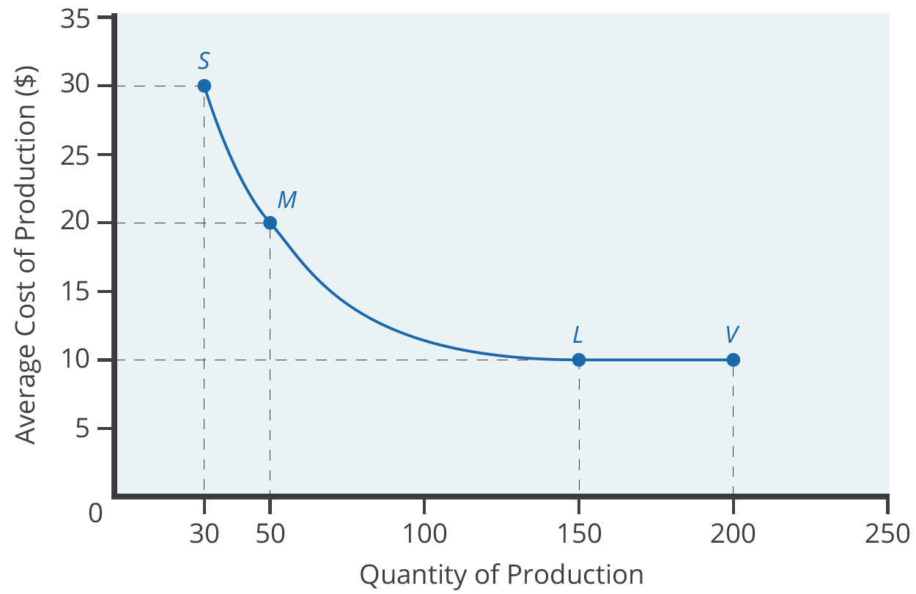
Economies of Scale, Competition, Variety
A second reason that intra-industry trade between similar nations produces economic gains involves economies of scale.
The concept of economies of scale means that as the scale of output goes up, average costs of production decline.
In this example, Plant M can produce output more cheaply than Plant S because of economies of scale.
Notes:
A second broad reason that intra-industry trade between similar nations produces economic gains involves economies of scale. The concept of economies of scale means that as the scale of output goes up, average costs of production decline—at least up to a point. In this example, Plant M can produce output more cheaply than Plant S because of economies of scale.

Slide 12
Economies of Scale, Competition, Variety
The concept of economies of scale becomes relevant to international trade when it enables one or two large producers to supply the entire country.
For example, a single large automobile factory could probably supply all the cars consumers purchase in a smaller economy like the UK.
If a country has only one or two large factories and no international trade, consumers in that country would have little variety in choices.
International trade allows a combination of lower average production costs from economies of scale and increased variety from trade.
Notes:
The concept of economies of scale becomes relevant to international trade when it enables one or two large producers to supply the entire country. For example, a single large automobile factory could probably supply all the cars consumers purchase in a smaller economy like the UK. If a country has only one or two large factories and no international trade, consumers in that country would have little variety in choices. International trade allows a combination of lower average production costs from economies of scale and increased variety from trade.

Slide 13
Dynamic Comparative Advantage
The sources of gains from intra-industry trade between similar economies help to broaden the concept of comparative advantage.
In intra-industry trade, climate or geography do not determine the level of worker productivity.
How firms engage in specific learning about specialized products determines the level of worker productivity.
Comparative advantage can be dynamic: it can evolve as one develops new skills and manufacturers split the value chain in new ways.
Notes:
The sources of gains from intra-industry trade between similar economies help to broaden the concept of comparative advantage. In intra-industry trade, climate or geography do not determine the level of worker productivity. How firms engage in specific learning about specialized products determines the level of worker productivity. Comparative advantage can be dynamic: it can evolve as one develops new skills and manufacturers split the value chain in new ways.

Slide 14
Summary
A large share of global trade happens between high-income economies that are quite similar in having well-educated workers and advanced technology.
These countries practice intra-industry trade, in which they import and export the same products at the same time, like cars, machinery, and computers.
In the case of intra-industry trade between economies with similar income levels, the gains from trade come from specialized learning in very particular tasks and from economies of scale.
Splitting up the value chain means that several stages of producing a good take place in different countries around the world.
HAWKES LEARNING

Slide 15




HAWKES LEARNING

