Slide 1
HAWKES LEARNING
Behavioral Economics:
An Alternative Framework for Consumer Choices

Slide 2
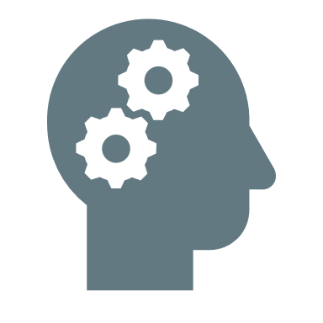
Traditional Economics
consistent and informed decisions that are in people’s best interest
Rationality
Notes:
The traditional economic models assume rationality, which means that people take all available information and make consistent and informed decisions that are in their best interest. However, some economists believe that a traditional look at this study negates one important factor: the human state of mind.

Slide 3



Economics + Psychology
Understanding decision-making by integrating psychology
Notes:
Behavioral economics aims at understanding decision-making by integrating psychology into economics. It considers how given dollar amounts can mean different things to individuals in different situations.

Slide 4
Behavioral Economics
People sometimes make decisions that seem irrational and not in their best interest.
Their decisions can seem inconsistent from one day to another, and sometimes, people deliberately ignore ways to save money and time.
Traditional economics assumes that people take all available information and make decisions that are in their best interest.
Behavioral economists argue that the traditional method omits something important: people's state of mind.
Behavioral economics seeks to enrich our understanding of decision-making by integrating the insights of psychology into economics.
Notes:
People sometimes make decisions that seem irrational and not in their best interest. Their decisions can seem inconsistent from one day to another, and sometimes, people deliberately ignore ways to save money and time. Traditional economics assumes that that people take all available information and make decisions that are in their best interest. Behavioral economists argue that the traditional method omits something important: people's state of mind. Behavioral economics seeks to enrich our understanding of decision-making by integrating the insights of psychology into economics.

Slide 5
Behavioral Economics
Behavioral economics investigates how given dollar amounts can mean different things to individuals depending on the situation.
Traditional Economics
If you lose a $10 bill today and also receive an extra $10 in your paycheck, you should feel perfectly neutral.
Behavioral Economics
If you lose a $10 bill today and also receive an extra $10 in your paycheck, you will still feel negative emotion.
Behavioral economists believe we tend to focus more on the loss than the gain.
Notes:
Behavioral economics investigates how given dollar amounts can mean different things to individuals depending on the situation. Traditional economics holds that if you lose a $10 bill today and also receive an extra $10 in your paycheck, you should feel perfectly neutral. Behavioral economics holds that if you lose a $10 bill today and also receive an extra $10 in your paycheck, you will still feel negative emotion. Behavioral economists believe we tend to focus more on the loss than the gain.

Slide 6
Mental Accounting
Mental accounting refers to the process of putting dollars in different mental categories where they take different values.
Economists typically consider dollars to be fungible, or having equal value to the individual, regardless of the situation.
Dollars, however, are not always fungible, as you may think of $25 you found in the street differently than $25 you earned from working.
You might treat the street money as "mad money," with little rational regard to getting the best value.
Notes:
Mental accounting refers the process of putting dollars in different mental categories where they take different values. Economists typically consider dollars to be fungible, or having equal value to the individual, regardless of the situation. Dollars, however, are not always fungible, as you may think of $25 you found in the street differently than $25 you earned from working. You might treat the street money as "mad money," with little rational regard to getting the best value.

Slide 7
Which View Is More Accurate?
Both views have their advantages and apply accurately to different real-world scenarios.
Traditional theory often ignores people’s state of mind or feelings, which can strongly influence behavior.
Behavioral economists are at least trying to describe and explain behavior that economists have historically dismissed as irrational.
If most of us are engaged in some "irrational behavior," perhaps there are deeper underlying reasons for this behavior in the first place.
Notes:
So the question becomes: which view of economics is more accurate? While both have some merit, at the least, behavioral economists have tried to identify and understand decisions that traditional economics have historically deemed irrational. People regularly make decisions that seem less than rational. This is because traditional theory ignores people’s state of mind or feelings, which can strongly influence behavior.

Slide 8

Real-World Discussion
Unemployment spiked during the COVID-19 pandemic. How do you think this impacted the demand for higher education compared to when the economy is not in a recession?
Notes:
Unemployment spiked during the COVID-19 pandemic. How do you think this impacted the demand for higher education compared to when the economy is not in a recession?

Slide 9
Summary
People regularly make decisions that seem less than rational, decisions that contradict traditional consumer theory.
Traditional theory ignores people's state of mind or feelings, which can influence behavior.
For example, people tend to value a dollar lost more than a dollar gained even though the amounts are the same.
HAWKES LEARNING

Slide 10




HAWKES LEARNING

