Slide 1
HAWKES LEARNING
Utility-Maximizing with Indifference Curves

Slide 2
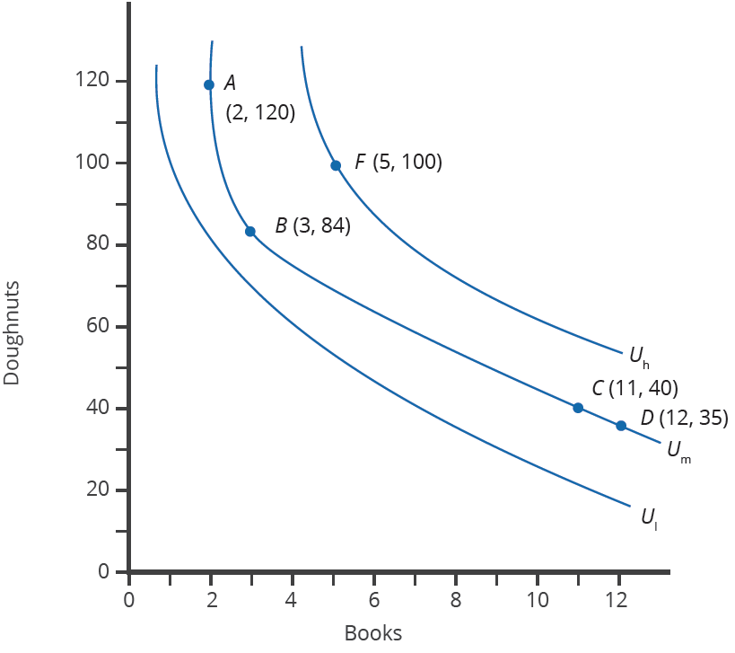
Indifference Curves
Indifference curves show combinations of goods that provide an equal amount of utility, or satisfaction.
Lily receives equal amounts of satisfaction from the combinations of doughnuts and books A, B, C, and D on indifference curve U_{m}.
Any point on the highest indifference curve (U_{h}) provides greater utility than any point on the middle indifference curve (U_{m}).
Similarly, any point on the middle indifference curve (U_{m}) provides greater utility than any point on the lowest indifference curve (U_{l}).
HAWKES LEARNING
Notes:
Indifference curves show combinations of goods that provide an equal amount of utility, or satisfaction.
Lily receives equal amounts of satisfaction from the combinations of doughnuts and books A, B, C, and D on indifference curve U_{M.}
Any point on the highest indifference curve (U_{h}) provides greater utility than any point on the middle indifference curve (U_{m}).
Similarly, any point on the middle indifference curve (U_{m}) provides greater utility than any point on the lowest indifference curve (U_{l}).

Slide 3
The Shape of an Indifference Curve
All indifference curves are downward-sloping and convex to the origin.
The slope of the indifference curve reflects the marginal rate of substitution, which is the rate at which Lilly will trade one good for another, keeping utility the same.
Indifference curves reflect diminishing marginal utility. If Lilly moves from Point A to B, she is willing to give up 36 doughnuts to get one more book, but from Point C to D, she is only willing to give up 4 doughnuts to get one more book.
HAWKES LEARNING
Notes:
All indifference curves are downward sloping and convex to the origin.
The slope of the indifference curve reflects the marginal rate of substitution, which is the rate at which Lilly will trade one good for another, keeping utility the same
Indifference curves reflect diminishing marginal utility.
Indifference curves reflect diminishing marginal utility. If Lilly moves from Point A to B, she is willing to give up 36 doughnuts to get one more book, but from Point C to D, she is only willing to give up 4 doughnuts to get one more book.
The slope of an indifference curve will be steeper at the top and flatter at the bottom because of diminishing marginal utility.

Slide 4
The Field of Indifference Curves
Each indifference curve shows choices that provide a single level of utility to a specific person. Indifference curves further from the origin represent more utility.
Indifference curve U_{h} represents more utility than U_{m} and U_{l}. Indifference curve U_{m} shows more utility than U_{l}.
Every level of utility will have its own indifference curve. Lilly’s preferences will include an infinite number of indifference curves. The graph only displays three indifference curves, representing three levels of utility.
HAWKES LEARNING
Notes:
Each indifference curve shows choices that provide a single level of utility to a specific person.
Indifference curves further from the origin represent more utility.
Indifference curve U_{h} represents more utility than U_{m} and U_{l}. Indifference curve U_{m} shows more utility than U_{l}.
Every level of utility will have its own indifference curve. Lilly’s preferences will include an infinite number of indifference curves. The graph only displays three indifference curves, representing three levels of utility.

Slide 5
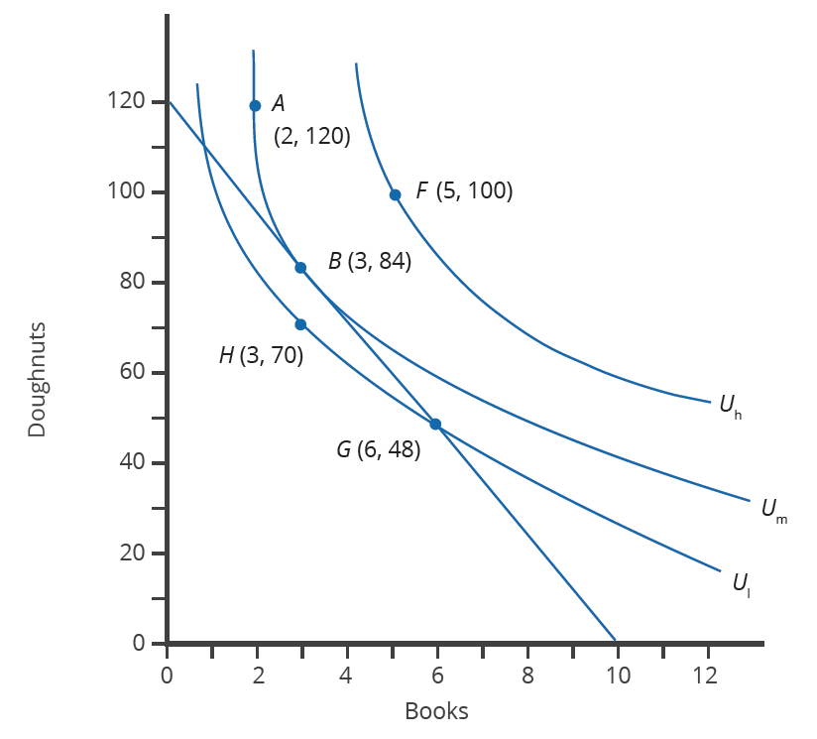
Maximizing Utility at the Highest Indifference Curve
People want to maximize their utility, which means they want to be on the highest possible indifference curve.
If Lilly has $120 to spend on doughnuts and books, and doughnuts cost $1 each and books cost $12 each, the straight line is Lilly’s budget constraint.
Lilly maximizes utility at Point B, which is on the budget constraint, so she can afford the 3 books and 84 doughnuts with $120. She would prefer Point A or F, but points beyond the budget constraint are unaffordable.
HAWKES LEARNING
Notes:
People want to maximize their utility, which means they want to be on the highest possible indifference curve.
If Lilly has $120 to spend on doughnuts and books, and doughnuts cost $1 each and books cost $12 each, the straight line is Lilly’s budget constraint.
Lilly maximizes utility at point B, which is on the budget constraint, so she can afford the 3 books and 84 doughnuts with $120.
She would prefer point A or F, but points beyond the budget constraint are unaffordable.

Slide 6




HAWKES LEARNING

