Slide 1
HAWKES LEARNING
Responses to Changes in Income and Prices
Notes:
In this lesson we will use indifference curves to analyze how consumers react to changes in income and prices.
For price changes, we will identify and explain the substitution and income effects.

Slide 2
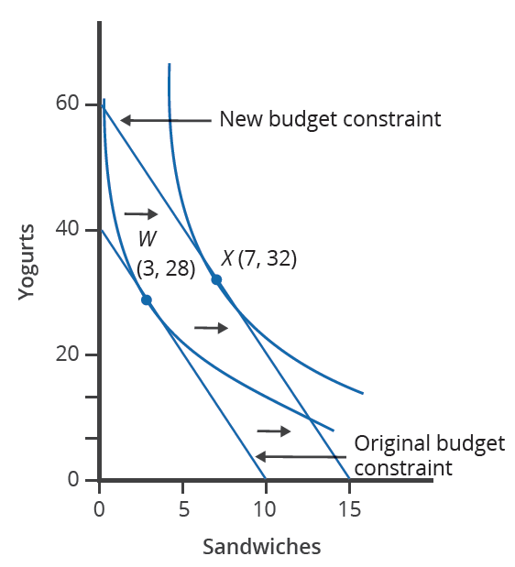
Changes in Income
Suppose Manuel initially has $80 to spend on yogurt, which costs $2 each, and sandwiches, which cost $8 each. Manuel maximizes his utility at Point W, buying 3 sandwiches and 28 yogurts.
If Manuel’s income increases to $120, his budget line shifts out because he can afford more of both goods, and he will buy more of both goods if they are normal goods.
With the $40 increase in income, Manuel will maximize his utility at Point X, buying 7 sandwiches and 32 yogurts.
Notes:
Suppose Manuel initially has $80 to spend on yogurt, which costs $2 each, and sandwiches, which cost $8 each. Manuel maximizes his utility at Point W, buying 3 sandwiches and 28 yogurts.
If Manuel’s income increases to $120, his budget line shifts out because he can afford more of both goods, and he will buy more of both goods if they are normal goods.
With the $40 increase in income, Manuel will maximize his utility at Point X, buying 7 sandwiches and 32 yogurts.

Slide 3
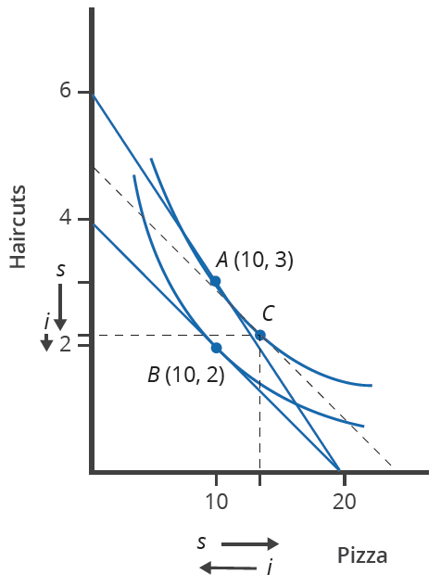
Responses to Changes in Prices
Suppose Ogden has $120 to spend on haircuts, which cost $20 each, and pizzas, which cost $6 each. Ogden maximizes his utility at Point A, buying 3 haircuts and 10 pizzas.
If the price of haircuts increases to $30, his budget constraint rotates to the left, indicating a change in the relative prices of haircuts and pizza and showing that he can only afford 4 haircuts if he buys only haircuts. Before the price increase, his $120 would buy 6 haircuts.
After the price increase, Ogden maximizes utility at Point B, buying 2 haircuts and 10 pizzas. He buys fewer of the more expensive haircuts and the same amount of pizza.
Notes:
Suppose Ogden has $120 to spend on haircuts, which cost $20 each, and pizzas, which cost $6 each.
Ogden maximizes his utility at Point A, buying 3 haircuts and 10 pizzas.
If the price of haircuts increases to $30, his budget constraint rotates to the left, indicating a change in the relative prices of haircuts and pizza and showing that he can only afford 4 haircuts if he buys only haircuts. Before the price increase, his $120 would buy 6 haircuts.
After the price increase, Ogden maximizes utility at Point B, buying 2 haircuts and 10 pizzas. He buys fewer of the more expensive haircuts and the same amount of pizza.

Slide 4
The Substitution Effect
The increase in the price of haircuts from $20 to $30 changes relative prices, making pizza less expensive, which results in an increase in pizza and a decrease in haircuts purchased.
The move along the original indifference curve from Point A to Point C is the substitution effect due to the change in relative prices of the two goods.
The dashed budget constraint shows the change in relative prices but keeps buying power constant. The substitution effect is the difference in the new utility-maximizing combination of haircuts and pizzas on the original indifference curve and the initial utility-maximizing combination before the price change.
Notes:
The increase in the price of haircuts from $20 to $30 changes relative prices, making pizza less expensive, which results in an increase in pizza and a decrease in haircuts purchased.
The move along the original indifference curve from Point A to Point C is the substitution effect due to the change in relative prices of the two goods.
The dashed budget constraint shows the change in relative prices but keeps buying power constant.
The substitution effect is the difference in the new utility-maximizing combination of haircuts and pizzas on the original indifference curve and the initial utility-maximizing combination before the price change.

Slide 5
The Income Effect
The increase in the price of haircuts from $20 to $30 decreases the purchasing power of the $120 of income.
The decrease in purchasing power causes the consumption of both goods, as well as utility, to decrease.
The change in consumption from Point C to Point B represents the income effect.
The income effect is the difference in the combination of haircuts and pizzas after the price increase compared to the combination that would be purchased at the new relative prices if the purchasing power of income could be held constant.
Notes:
The increase in the price of haircuts decreases the purchasing power of the $120 of income
The decrease in purchasing power causes the consumption of both goods, as well as utility, to decrease.
The change in consumption from Point C to Point B represents the income effect.
The income effect is the difference in the combination of haircuts and pizzas after the price increase compared to the combination that would be purchased at the new relative prices if the purchasing power of income could be held constant.

Slide 6




HAWKES LEARNING

