Slide 1
HAWKES LEARNING
Indifference Curves with Labor-Leisure and Intertemporal Choices
Notes:
In this lesson we will use indifference curves and budget constraints to explain the choice between labor and leisure.
We will also use the indifference curves and budget constraints to explain intertemporal choices, which is the choice between present and future consumption.

Slide 2
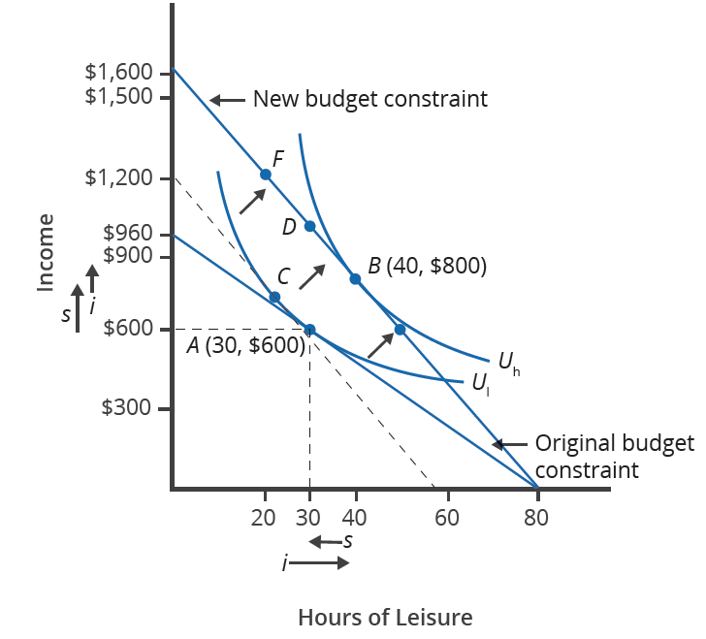
Labor-Leisure Choice
Petunia has 80 hours a week available for leisure and work, where she initially makes $12 per hour. At $12 per hour, she maximizes her utility at Point A, working 50 hours to earn $600, leaving 30 hours for leisure.
Petunia gets a raise at work to $20 an hour, which rotates her budget constraint to the right so that the vertical intercept, which is the maximum amount she could earn for 80 hours of work, is 80 x $20 = $1,600, compared to a maximum of $960 before her raise.
After her raise, Petunia will maximize her utility at Point B on a higher indifference curve, working 40 hours at $20 per hour to earn $800, and taking 40 hours of leisure.
Notes:
Petunia has 80 hours a week available for leisure and work, where she initially makes $12 per hour. At $12 per hour, she maximizes her utility at Point A, working 50 hours to earn 50 x $12 = $600, leaving 30 hours for leisure.
Petunia gets a raise at work to $20 an hour, which rotates her budget constraint to the right so that the vertical intercept, which is the maximum amount she could earn for 80 hours of work, is 80 x $20 = $1600, compared to a maximum of $960 before her raise.
After her raise, Petunia will maximize her utility at Point B on a higher indifference curve, working 40 hours at $20 per hour to earn $800, and taking 40 hours of leisure.

Slide 3
Labor-Leisure Choice: Substitution Effect
The increase in her wage from $12 to $20 per hour increases Petunia’s opportunity cost of leisure.
Since leisure is more expensive, the hours of work increase, and the hours of leisure decrease, so Petunia moves from Point A to Point C due to the substitution effect.
To find the substitution effect, construct the dotted budget line, which shows the change in the wage rate, but keeps purchasing power and utility constant.
After the substitution effect, Petunia is working more and enjoying less leisure at Point C.
Notes:
The increase in her wage from $12 to $20 per hour increases Petunia’s opportunity cost of leisure.
Since leisure is more expensive, the hours of work increase, and the hours of leisure decrease, so Petunia moves from Point A to Point C due to the substitution effect.
To find the substitution effect, construct the dotted budget line, which shows the change in the wage rate, but keeps purchasing power and utility constant.
After the substitution effect, Petunia is working more and enjoying less leisure at Point C.

Slide 4
Labor-Leisure Choice: Income Effect
The increase in her wage from $12 to $20 per hour increases Petunia’s buying power of an hour at work.
The increase in purchasing power causes the consumption of both work and leisure to increase.
The income effect of the wage increase will increase utility so that Petunia will be on a higher indifference curve U_{h}.
After both the substitution and income effects, Petunia is maximizing utility at Point B, working 40 hours. She earns 40 x $20 = $800 and enjoys 40 hours of leisure.
Notes:
The increase in her wage from $12 to $20 per hour increases Petunia’s buying power of an hour at work.
The increase in purchasing power causes the consumption of both work and leisure to increase.
The income effect of the wage increase will increase utility so that Petunia will be on a higher indifference curve U_{h}.
After both the substitution and income effects, Petunia is maximizing utility at Point B, working 40 hours. She earns 40 x $20 = $800 and enjoys 40 hours of leisure.

Slide 5
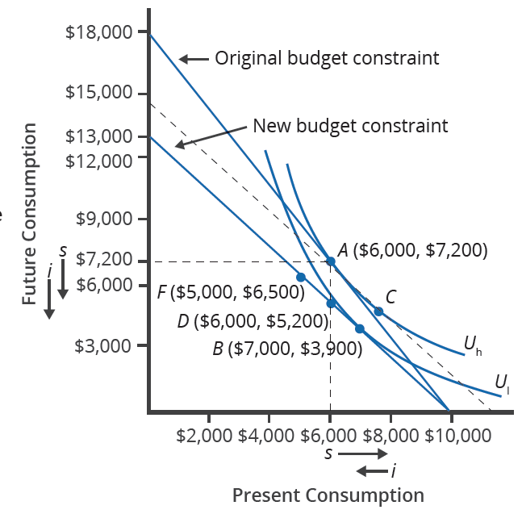
Intertemporal Choice
Quentin has saved $10,000, and he is trying to decide how much he wants to spend on a vacation now and how much he wants to save for the next 5 years. He expects to earn 80% on his savings.
Initially Quentin is maximizing utility at Point A, spending $6,000 now and saving $4,000, which will generate $4,000 x 1.8 = $7,200 for future consumption in 5 years.
Quentin revises his estimate of his return on saving from 80% to 30% for the 5-year period. This rotates his budget line downward, giving him less future consumption ($3,900) and more current consumption ($7,000) when he maximizes his utility.
Notes:
Quentin has saved $10,000, and he is trying to decide how much he wants to spend on a vacation now and how much he wants to save for the next 5 years. He expects to earn 80% on his savings.
Initially Quentin is maximizing utility at Point A, spending $6000 now and saving $4000, which will generate $4000 x 1.8 = $7200 for future consumption in 5 years.
Quentin revises his estimate of his return on saving from 80% to 30% for the 5-year period.
This rotates his budget line downward, giving him less future ($3900) and more current consumption ($7000) when he maximizes his utility.

Slide 6
Intertemporal Choice: Substitution Effect
The decrease in the rate of return from 80% to 30% makes present consumption less expensive and future consumption relatively more expensive.
Since the cost of present consumption is less, present consumption increases and future consumption decreases to Point C.
The substitution effect is the combination of present and future consumption that Quentin chooses after the change in the rate of return from 80% to 30%, but with purchasing power and utility held constant.
The substitution effect is the movement from Point A to Point C.
Notes:
The decrease in the rate of return from 80% to 30% makes present consumption less expensive and future consumption relatively more expensive.
Since the cost of present consumption is less, present consumption increases and future consumption decreases
The substitution effect is the combination of present and future consumption that Quentin chooses after the change in the rate of return from 80% to 30%, but with purchasing power and utility held constant.
The substitution effect is the movement from Point A to Point C.

Slide 7
Intertemporal Choice: Income Effect
The income effect of the decrease in the rate of return will decrease both present and future consumption.
The income effect of the decrease in the rate of return will decrease the level of utility from U_{l} to U_{h}.
The income effect is the movement from Point C to Point B.
After both the substitution and income effects, Quentin is maximizing utility by spending $7,000 now and saving $3,000, which grows to $3,000 x 1.3 = $3,900 for future consumption.
Notes:
The income effect of the decrease in the rate of return will decrease both present and future consumption.
The income effect of the decrease in the rate of return will also decrease the level of utility from U_{l} to U_{h}.
The income effect is the movement from Point C to Point B.
After both the substitution and income effects, Quentin is maximizing utility by spending $7000 now and saving $3000, which grows to $3000 x 1.3 = $3900 for future consumption.

Slide 8




HAWKES LEARNING

