Slide 1
HAWKES LEARNING
How Perfectly Competitive Firms Make Output Decisions
Notes:
By the end of this lesson, you will be able to calculate profits by comparing total revenue and total cost; identify profits and losses with the average cost curve; explain the shutdown point; determine the price at which a firm should continue producing in the short run.

Slide 2

Perfectly Competitive Firms
Though perfectly competitive firms are unable to set their own price, they still have decisions to make in order to maximize productivity and profit.
Notes:
Though perfectly competitive firms are unable to set their own price, they still have decisions to make in order to maximize productivity and profit.

Slide 3
Output Decisions
A perfectly competitive firm has only one major decision to make—what quantity to produce.
The price of the product is determined by market, or total, demand and supply of the product.
The firm's demand curve is perfectly elastic because buyers are willing to buy any quantity of output at the market price.
Notes:
A perfectly competitive firm has only one major decision to make—what quantity to produce. The price of the product is determined by market, or total, demand and supply of the product. This means that the firm's demand curve is perfectly elastic because buyers are willing to buy any quantity of output at the market price.

Slide 4
Output Decisions
To understand the fact that quantity is the only decision that a competitive firm faces, consider a different way of writing out the basic definition of profit:
profit$=total revenue−total cost$
=(price)(quantity produced)−(average cost)(quantity produced)
When the perfectly competitive firm chooses what quantity to produce, this quantity—along with the prices prevailing in the market for output and inputs—will determine the firm's total revenue, total costs, and ultimately, level of profits.
Notes:
To understand the fact that quantity is the only decision that a competitive firm faces, consider a different way of writing out the basic definition of profit:
profit=total revenue-total cost.
=(price)(quantity produced)-(average cost)(quantity produced)
When the perfectly competitive firm chooses what quantity to produce, this quantity—along with the prices prevailing in the market for output and inputs—will determine the firm's total revenue, total costs, and ultimately, level of profits.

Slide 5
Determining the Highest Profit by Comparing Total Revenue and Total Cost
A perfectly competitive firm can sell as large a quantity as it wishes as long as it accepts the prevailing market price.
Total revenue depends on the quantity sold and the price charged.
If the firm sells a higher quantity of output, total revenue will increase.
If the market price of the product increases, total revenue also increases.
Notes:
A perfectly competitive firm can sell as large a quantity as it wishes as long as it accepts the prevailing market price. Total revenue depends on the quantity sold and the price charged. If the firm sells a higher quantity of output, total revenue will increase. If the market price of the product increases, total revenue also increases.

Slide 6
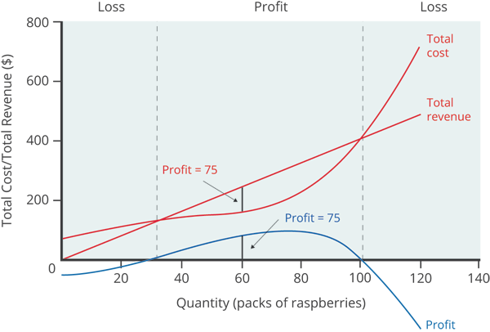
Determining the Highest Profit by Comparing Total Revenue and Total Cost
Total revenue, total cost, and profit can be compared graphically.
Total revenue for a perfectly competitive firm is a straight line sloping up, with the slope equal to the price of the good.
Total cost also slopes up, but with some curvature. At higher levels of output, total cost begins to slope upward more steeply because of diminishing marginal returns.
Notes:
Total revenue, total cost, and profit can be compared graphically. Total revenue for a perfectly competitive firm is a straight line sloping up, with the slope equal to the price of the good. Total cost also slopes up, but with some curvature. At higher levels of output, total cost begins to slope upward more steeply because of diminishing marginal returns.

Slide 7
Determining the Highest Profit by Comparing Total Revenue and Total Cost
Based on its total revenue and total cost curves, a perfectly competitive firm can calculate the quantity of output that will provide the highest level of profit.
At any given quantity, total revenue minus total cost will equal profit.
One way to determine the most profitable quantity to produce is to see at what quantity total revenue exceeds total cost by the largest amount.
Highest profit: largest difference between revenue and cost
Notes:
Based on its total revenue and total cost curves, a perfectly competitive firm can calculate the output that will provide the highest level of profit. At any given quantity, total revenue minus total cost will equal profit. One way to determine the most profitable quantity to produce is to see at what quantity total revenue exceeds total cost by the largest amount.

Slide 8
Profit
When total revenue exceeds total cost, the firm earns profit.
If total cost exceeds total revenue, the firm will suffer losses.
A profit-maximizing firm will prefer the quantity of output where total revenue exceeds total cost by the greatest amount.
Notes:
When total revenue exceeds total cost, the firm earns profit. If total cost exceeds total revenue, the firm will suffer losses. A profit-maximizing firm will prefer the quantity of output where total revenue exceeds total cost by the greatest amount.

Slide 9
Comparing Marginal Revenue and Marginal Costs
Firms often do not have the necessary data they need to draw a complete total cost curve for all levels of production.
Instead, firms experiment, like producing a slightly greater or lower quantity and observing how it affects profits.
This practical approach to maximizing profits means examining how changes in production affect marginal revenue and marginal cost.
Notes:
Firms often do not have the necessary data they need to draw a complete total cost curve for all levels of production. Instead, firms experiment, like producing a slightly greater or lower quantity and observing how it affects profits. This practical approach to maximizing profits means examining how changes in production affect marginal revenue and marginal cost.

Slide 10
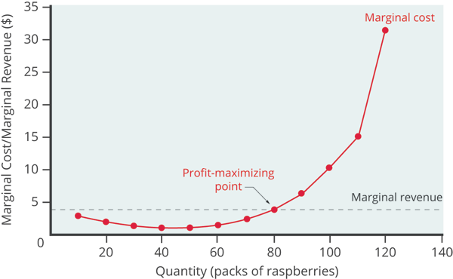
Comparing Marginal Revenue and Marginal Costs
For a perfectly competitive firm, the marginal revenue (MR) curve is horizontal because it is equal to the price of the good.
The marginal cost (MC) curve can be downward-sloping if there is a region of increasing marginal returns at low levels of output, but it is eventually upward-sloping at higher levels of output as diminishing marginal returns kick in.
Notes:
For a perfectly competitive firm, the marginal revenue (MR) curve is horizontal because it is equal to the price of the good. The marginal cost (MC) curve can be downward-sloping if there is a region of increasing marginal returns at low levels of output, but it is eventually upward-sloping at higher levels of output as diminishing marginal returns kick in.

Slide 11
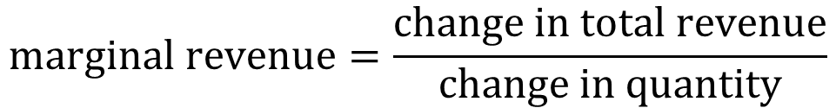

Marginal Revenue
The marginal revenue curve shows the additional revenue gained from selling one more unit.
A firm in perfect competition faces a perfectly elastic demand curve for its product—a horizontal line drawn at the market price level.
This also means that the firm's marginal revenue curve is the same as the firm's demand curve.
$$marginal revenue=\frac{change in total revenue}{change in quantity}$$
$$marginal revenue=price$$
Notes:
The marginal revenue curve shows the additional revenue gained from selling one more unit. A firm in perfect competition faces a perfectly elastic demand curve for its product—a horizontal line drawn at the market price level. This also means that the firm's marginal revenue curve is the same as the firm's demand curve.

Slide 12
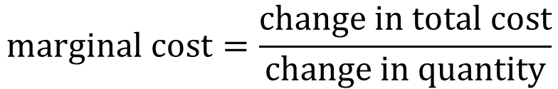
Marginal Cost
Marginal cost, the cost per additional unit sold, is calculated by dividing the change in total cost by the change in quantity.
As production increases, marginal cost at first declines, representing the area of increasing marginal returns at low levels of production.
At some point, though, marginal costs start to increase, displaying the typical pattern of diminishing marginal returns.
$$marginal cost=\frac{change in total cost}{change in quantity}$$
Notes:
Marginal cost, the cost per additional unit sold, is calculated by dividing the change in total cost by the change in quantity. As production increases, marginal cost at first declines, representing the area of increasing marginal returns at low levels of production. At some point, though, marginal costs start to increase, displaying the typical pattern of diminishing marginal returns.

Slide 13
Profit-Maximization
The perfectly competitive firm’s profit-maximizing choice of output will occur where marginal revenue equals marginal cost, MR = MC.
Because the MR received by a perfectly competitive firm is equal to the price, a firm can also maximize profit where price equals MC.
If a firm is producing at a quantity where MR > MC, it can increase profit by increasing output.
If a firm is producing at a quantity where MC > MR, it can increase profit by reducing output.
Notes:
The perfectly competitive firm’s profit-maximizing choice of output will occur where marginal revenue equals marginal cost. Because the MR received by a perfectly competitive firm is equal to the price, a firm can also maximize profit where price equals MC. If a firm is producing at a quantity where MR>MC, it can increase profit by increasing output. If a firm is producing at a quantity where MC>MR, it can increase profit by reducing output.

Slide 14
Profits and Losses with the Average Cost Curve
Does maximizing profit (producing where MR = MC) imply an actual economic profit? The answer depends on the relationship between price and average total cost, which is the average profit or profit margin.
If P > ATC, the profit margin is positive, and the firm earns economic profits.
If P < ATC, the profit margin is negative, and the firm incurs economic losses.
If P = ATC, the profit margin is zero, and the firm breaks even.
Notes:
Does maximizing profit (producing where MR=MC) imply an actual economic profit? The answer depends on the relationship between price and average total cost, which is the average profit or profit margin. If P>ATC, the profit margin is positive, and the firm earns economic profits. If P<ATC, the profit margin is negative, and the firm incurs economic losses. If P=ATC, the profit margin is zero, and the firm breaks even.

Slide 15
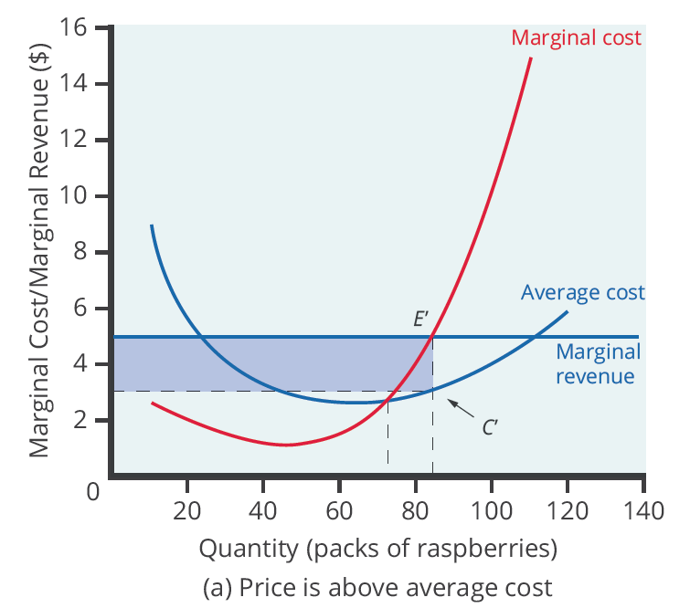
P > ATC
When price intersects marginal cost above the average cost curve, price is greater than average cost, meaning the firm is making a profit.
Notes:
When price intersects marginal cost above the average cost curve, price is greater than average cost, meaning the firm is making a profit.

Slide 16
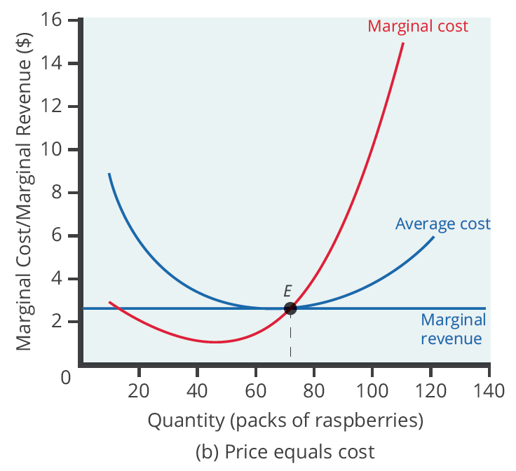
P = ATC
When price intersects marginal cost at the minimum point of average cost, price is equal to average cost, meaning the firm is breaking even, or at the break-even point.
Notes:
When price intersects marginal cost at the minimum point of average cost, price is equal to average cost, meaning the firm is breaking even, or at the break even point.

Slide 17
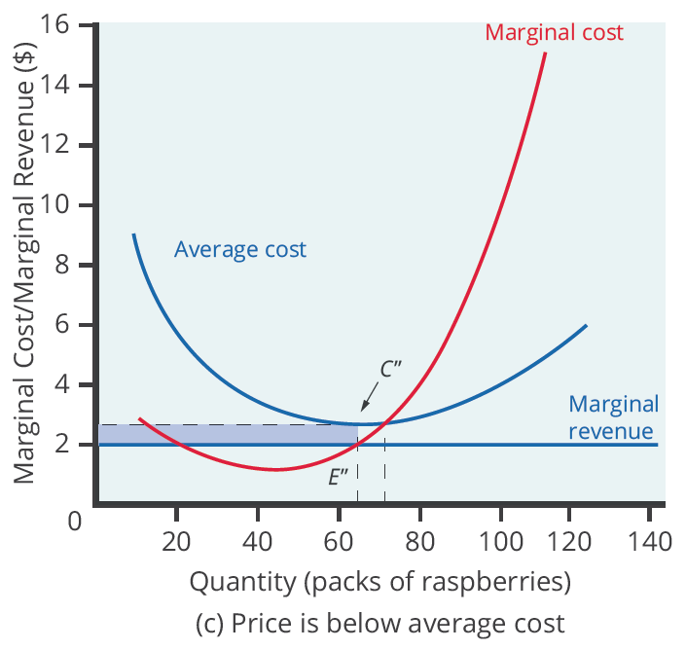
P < ATC
When price intersects marginal cost below the average cost curve, price is less than average cost, meaning the firm is incurring a loss.
Notes:
When price intersects marginal cost below the average cost curve, price is less than average cost, meaning the firm is incurring a loss.

Slide 18
The Shutdown Point
It is possible that a firm is unable to avoid losses by shutting down and not producing at all.
Shutting down can reduce variable costs to zero, but in the short run, the firm has already paid for fixed costs.
As a result, if the firm produces a quantity of zero, it would still make losses because it would still need to pay for its fixed costs.
Therefore, when a firm is experiencing losses, it faces the question of whether it should continue producing or shut down.
Notes:
It is possible that a firm is unable to avoid losses by shutting down and not producing at all. Shutting down can reduce variable costs to zero, but in the short run, the firm has already paid for fixed costs. As a result, if the firm produces a quantity of zero, it would still make losses because it would still need to pay for its fixed costs. Therefore, when a firm is experiencing losses, it faces the question of whether it should continue producing or shut down.

Slide 19
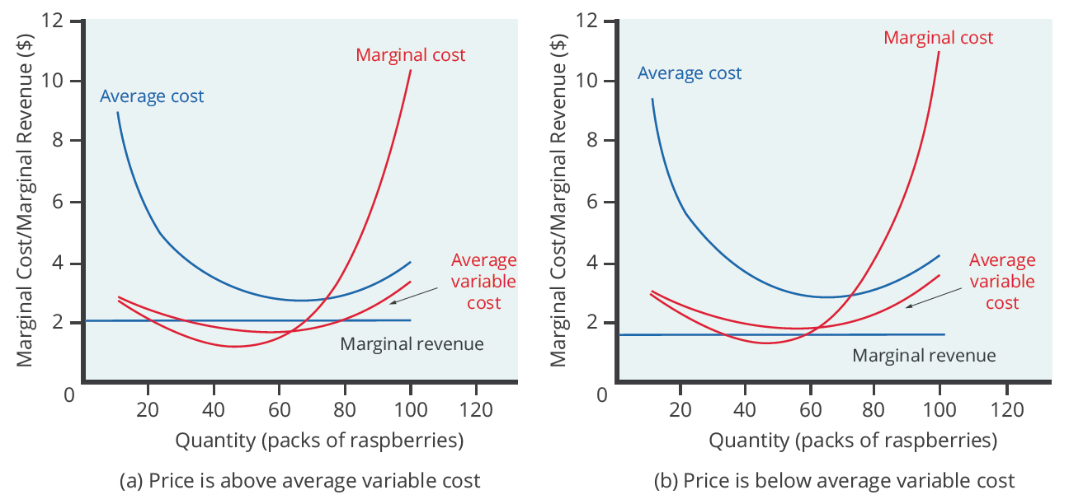
The Shutdown Point
The intersection of the average variable cost curve and the marginal cost curve, which shows the price below which the firm would lack enough revenue to cover its variable costs, is called the shutdown point.
Notes:
The intersection of the average variable cost curve and the marginal cost curve, which shows the price below which the firm would lack enough revenue to cover its variable costs, is called the shutdown point.

Slide 20
The Shutdown Point
In the short run, the decision to shut down varies depending on the level of losses and whether the firm can cover its variable costs.
If a firm is shutting down eventually, but can still temporarily cover variable costs, it should continue production in the short run.
If a firm cannot cover variable costs with revenue from continued operation, it should shut down immediately.
Even when facing an inevitable losses, a firm should try to minimize total losses as much as possible.
Notes:
In the short run, the decision to shut down varies depending on the level of losses and whether the firm can cover its variable costs. If a firm is shutting down eventually, but can still temporarily cover variable costs, it should continue production in the short run. If a firm cannot cover variable costs with revenue from continued operation, it should shut down immediately. Even when facing an inevitable losses, a firm should try to minimize total losses as much as possible.

Slide 21
On Your Own
Define the shutdown point for a firm that appears on a graph.
The shutdown decision for a firm can be summarized as:
If price < minimum average variable cost, then the firm ______.
If price > minimum average variable cost, then the firm ______.
Notes:
Define the shutdown point for a firm that appears on a graph.
The shutdown decision for a firm can be summarized as:
If price < minimum average variable cost, then the firm ______.
If price > minimum average variable cost, then the firm ______.

Slide 22
On Your Own
Define the shutdown point for a firm that appears on a graph.
Graphically, the shutdown point occurs where the firm’s average variable cost curve and marginal cost curve intersect.
The shutdown decision for a firm can be summarized as:
If price < minimum average variable cost, then the firm shuts down.
If price > minimum average variable cost, then the firm stays in business.
Notes:
Define the shutdown point for a firm that appears on a graph.
Graphically, the shutdown point occurs where the firm’s average variable cost curve and marginal cost curve intersect.
The shutdown decision for a firm can be summarized as:
If price < minimum average variable cost, then the firm shuts down.
If price > minimum average variable cost, then the firm stays in business.

Slide 23
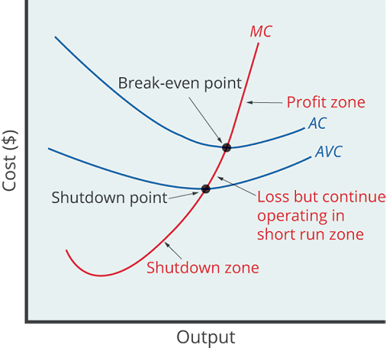
Short-Run Outcomes for Perfectly Competitive Firms
The average cost and average variable cost curves divide the marginal cost curve into three segments.
At the market price, which the perfectly competitive firm must accept, the profit-maximizing firm chooses the output level where price or MR equals MC.
The three segments of the marginal cost curve show the three possible short-run outcomes for a firm in perfect competition.
Notes:
The average cost and average variable cost curves divide the marginal cost curve into three segments. At the market price, which the perfectly competitive firm must accept, the profit-maximizing firm chooses the output level where price or MR equals MC. The three segments of the marginal cost curve show the three possible short-run outcomes for a firm in perfect competition.

Slide 24
Summary
As a perfectly competitive firm produces a greater quantity of output, its total revenue steadily increases at a constant rate determined by the given market price.
Profits will be highest at the quantity of output where total revenue exceed total cost by the greatest amount and where marginal revenue equals marginal cost.
If the market price faced by a perfectly competitive firm is above average cost at the profit-maximizing quantity of output, the firm is making profits.
If the market price that a perfectly competitive firm faces is below average variable cost at the profit-maximizing quantity of output, the firm should shut down.
The shutdown point is the point where the marginal cost curve crosses the average variable cost curve.
HAWKES LEARNING

Slide 25




HAWKES LEARNING

