Slide 1
HAWKES LEARNING
Trade Policy
Principles of Microeconomics
Notes:
By the end of this lesson, you will be able to explain the origin and role of the World Trade Organization, discuss the significance of regional trading agreements, analyze trade policy at the national level, and evaluate long-term trends in barriers to trade.

Slide 2
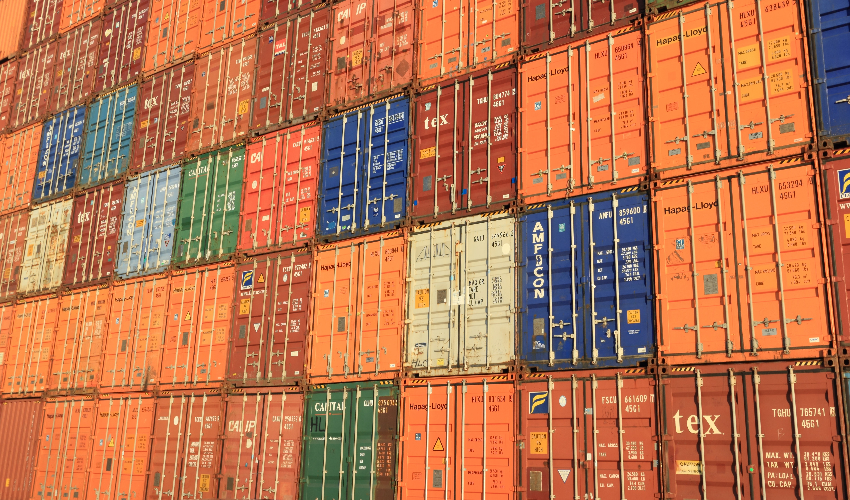
Introduction
These public policy arguments about how nations should react to globalization and trade are fought at several levels: the global level (through the World Trade Organization) and through regional trade agreements between pairs or groups of countries.
Notes:
These public policy arguments about how nations should react to globalization and trade are fought at several levels: the global level (through the World Trade Organization) and through regional trade agreements between pairs or groups of countries.

Slide 3
GATT & WTO
GATT: General Agreement on Tariffs and Trade
Credibility
WTO: World Trade Organization
Free trade agreements
Common markets
Economic union
Notes:
Twenty-seven nations signed the General Agreement on Tariffs and Trade (GATT) in 1947 to provide a forum in which nations could come together to negotiate reductions in tariffs and other barriers to trade. In 1995, the GATT transformed into the World Trade Organization (WTO). There are different types of economic integration across the globe, ranging from free trade agreements, in which participants allow each other’s imports without tariffs or quotas; to common markets, in which participants have a common external trade policy as well as free trade within the group; to full economic unions, in which, in addition to a common market, monetary and fiscal policies are coordinated.

Slide 4
Regional Trading Agreements
There are different types of economic integration across the globe.
Free trade agreements are agreements in which participants allow each other's imports without tariffs or quotas.
Common markets have a common external trade policy as well as free trade within the group.
Economic unions are agreements where, in addition to a common market, monetary and fiscal policies are coordinated.
Notes:
There are different types of economic integration across the globe. Free trade agreements are agreements in which participants allow each other's imports without tariffs or quotas. Common markets have a common external trade policy as well as free trade within the group. Economic unions are agreements where, in addition to a common market, monetary and fiscal policies are coordinated.

Slide 5
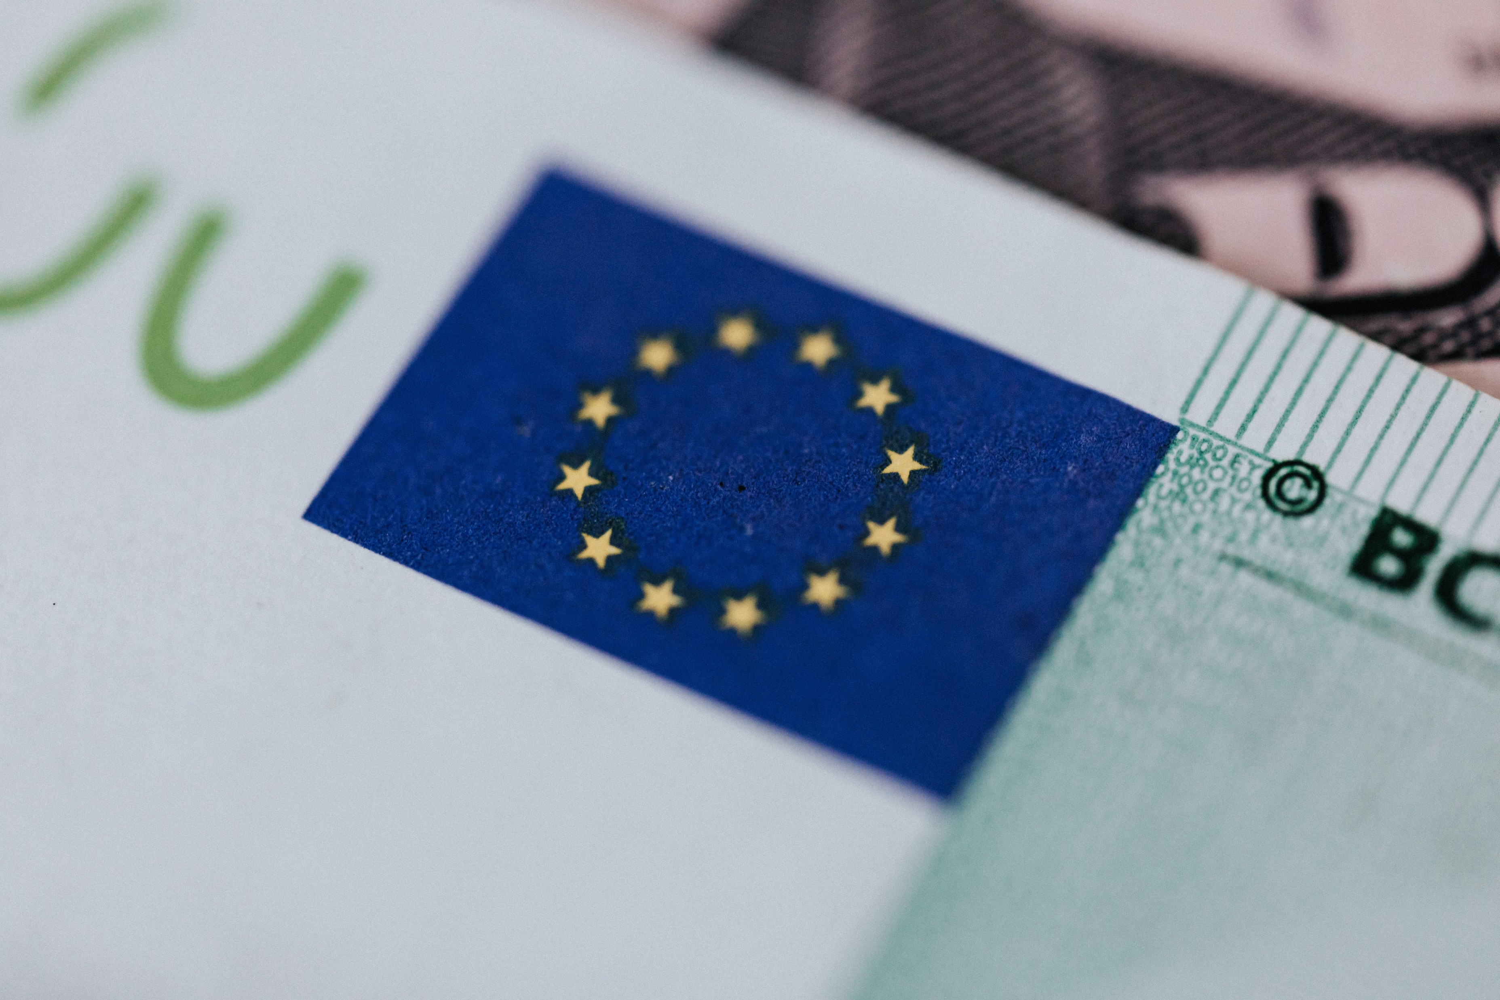
European Union
European Union
Introduced the euro as a common currency and eliminated barriers to the mobility of goods across Europe
Notes:
Many nations belong both to the World Trade Organization and to regional trading agreements. The best known of these regional trading agreements is the European Union, the EU. The EU introduced the euro as a common currency and eliminates barriers to the mobility of goods, labor, and capital across Europe.

Slide 6

NAFTA
North American Free Trade Agreement
For the United States, perhaps the best-known regional trading agreement is the North American Free Trade Agreement (NAFTA), which promotes free trade between the U.S., Canada, and Mexico.
Notes:
For the United States, perhaps the best-known regional trading agreement is the North American Free Trade Agreement (NAFTA), which promotes free trade between the US, Canada, and Mexico.

Slide 7



Other Trade Agreements
Asian Pacific Economic Cooperation (APEC)
Latin American Integration Association (LAIA)
Southern African Development Community (SADC)
Association of Southeast Asian Nations (ASEAN)
Notes:
Some other trade agreements include the Asian Pacific Economic Cooperation (APEC), the Latin American Integration Association (LAIA), the Association of Southeast Asian Nations (ASEAN), and the Southern African Development Community (SADC).

Slide 8
Trade Policy at the National Level
Yet another dimension of trade policy, along with international and regional trade agreements, happens at the national level.
The U.S. imposes import quotas on sugar for fear that such imports would drive down the price of sugar and injure domestic producers.
One of the jobs of the United States Department of Commerce is to determine if there is import dumping from other countries.
The United States International Trade Commission determines whether the dumping has substantially injured domestic industries.
Notes:
Yet another dimension of trade policy, along with international and regional trade agreements, happens at the national level. The U.S. imposes import quotas on sugar for fear that such imports would drive down the price of sugar and injure domestic producers. One of the jobs of the United States Department of Commerce is to determine if there is import dumping from other countries. The United States International Trade Commission determines whether the dumping has substantially injured domestic industries.

Slide 9
Long-Term Trends in Barriers to Trade
Countries are almost constantly threatening to challenge other nations' "unfair" trading practices.
Cases are brought to the dispute settlement procedures of the WTO, the European Union, NAFTA, and other regional trading agreements.
Through all the controversy, the general trend in the last 60 years is clearly toward lower barriers to trade.
Advances in transportation, communication, and information management have led to a powerful surge of international trade.
Notes:
Countries are almost constantly threatening to challenge other nations' "unfair" trading practices. Cases are brought to the dispute settlement procedures of the WTO, the European Union, NAFTA, and other regional trading agreements. Through all the controversy, the general trend in the last 60 years is clearly toward lower barriers to trade. Advances in transportation, communication, and information management have led to a powerful surge of international trade.

Slide 10
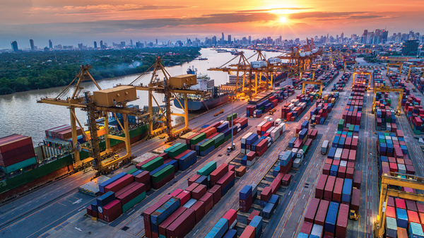
The Tradeoffs of Trade Policy
While there is always a tradeoff with international trade, economists generally believe the gains outweigh the costs.
Notes:
While there is always a tradeoff with international trade, economists generally believe the gains outweigh the costs.

Slide 11
The Tradeoffs of Trade Policy
Economists readily acknowledge that international trade is not all sunshine, roses, and happy endings.
Over time, the average person gains from international trade.
It is a concern of public policy to focus not just on the average or the success stories but also those who have been less fortunate.
It is better to embrace the gains from trade and deal with the costs and tradeoffs with other policy tools than to cut off trade entirely.
Notes:
Economists readily acknowledge that international trade is not all sunshine, roses, and happy endings. Over time, the average person gains from international trade. It is a concern of public policy to focus not just on the average or the success stories but also those who have been less fortunate. It is better to embrace the gains from trade and deal with the costs and tradeoffs with other policy tools than to cut off trade entirely.

Slide 12
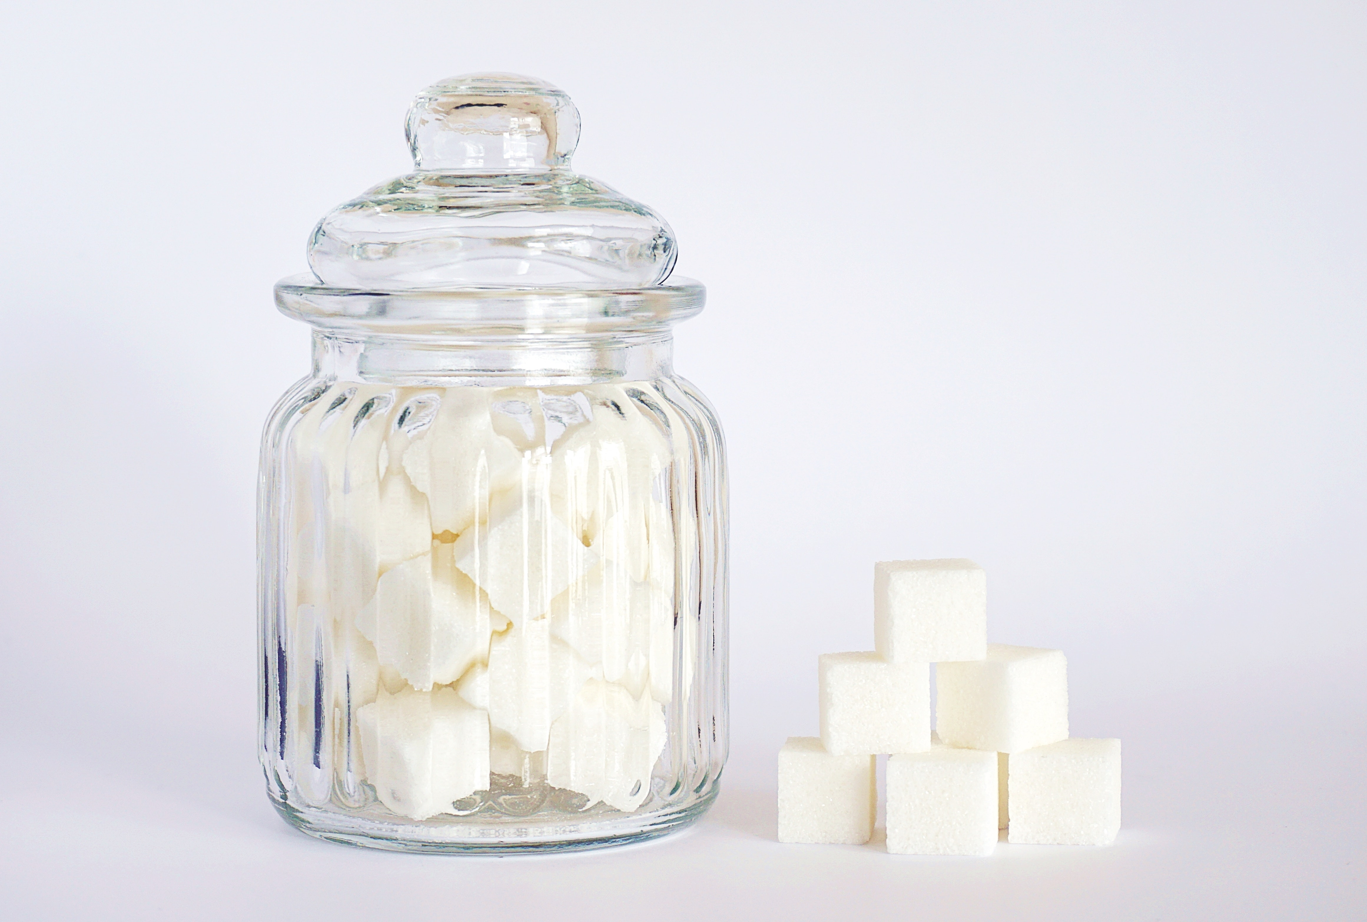
Real World Example
The quotas imposed on sugar imported to the U.S. make the price of sugar and goods that contain sugar much higher. The quota protects relatively few domestic sugar producers at the expense of all U.S. consumers. As consumers, why don’t we fight this quota?
HAWKES LEARNING
Notes:
The quotas imposed on sugar imported to the U.S. make the price of sugar and goods that contain sugar much higher. The quota protects relatively few domestic sugar producers at the expense of all U.S. consumers. As consumers, why don’t we fight this quota?

Slide 13
Real World Example
The quotas imposed on sugar imported to the U.S. make the price of sugar and goods that contain sugar much higher. The quota protects relatively few domestic sugar producers at the expense of all U.S. consumers. As consumers, why don’t we fight this quota?
Since there are relatively few sugar producers, it’s easier for them to organize and influence legislators with paid lobbyists for the industry than it is for many consumers with many different interests to organize an effort to fight the quota.
HAWKES LEARNING
Notes:
The quotas imposed on sugar imported to the U.S. make the price of sugar and goods that contain sugar much higher. The quota protects relatively few domestic sugar producers at the expense of all U.S. consumers. As consumers, why don’t we fight this quota?
Since there are relatively few sugar producers, it’s easier for them to organize and influence legislators with paid lobbyists for the industry than it is for many consumers with many different interests to organize an effort to fight the quota.

Slide 14
Summary
Governments determine trade policy at many different levels: administrative agencies within government, laws passed by the legislature, regional negotiations between a small group of nations (sometimes just two), and global negotiations through the World Trade Organization.
International trade certainly has income distribution effects; they cause companies and industries to rise and fall.
Government has a role to play in cushioning workers against the disruptions of the market.
Just as it would be unwise in the long term to clamp down on new technology and other causes of disruption in domestic markets, it would be unwise to clamp down on foreign trade.
HAWKES LEARNING

Slide 15




HAWKES LEARNING

