Slide 1
HAWKES LEARNING
Polar Cases of Elasticity and Constant Elasticity
Principles of Microeconomics
Notes:
By the end of this lesson, you will be able to differentiate between infinite and zero elasticity and analyze graphs in order to classify elasticity as constant unitary, infinite, or zero.

Slide 2
Elasticity
There are two extreme cases of elasticity: when elasticity equals zero and when it is infinite.
A third case is that of constant unitary elasticity.
Infinite elasticity refers to the case where either Q_{d} or Q_{s} changes by an infinite amount in response to any change in price at all.
Zero elasticity refers to the case in which a percentage change in price, no matter how large, results in zero change in Q_{d} or Q_{s}.
Notes:
There are two extreme cases of elasticity: when elasticity equals zero and when it is infinite. A third case is that of constant unitary elasticity. Infinite elasticity refers to the case where either QD or QS changes by an infinite amount in response to any change in price at all. Zero elasticity refers to the case in which a percentage change in price, no matter how large, results in zero change in QD or QS.

Slide 3
Infinite or Perfect Elasticity
Infinite elasticity, or perfect elasticity, is depicted with a horizontal demand or supply curve.
Perfectly elastic supply curves can occur with goods with readily available inputs and whose production can easily expand.
Examples of goods with perfectly elastic supply could include pizza, bread, books, and pencils.
Luxury goods, items that take a large share of individuals' income, and goods with many substitutes can have highly elastic demand curves.
An example of a luxury good is a Caribbean cruise, while an example of a good with many substitutes is a particular brand of bottled water.
Notes:
While perfectly elastic supply curves are for the most part unrealistic, goods with readily available inputs and whose production can easily expand will feature highly elastic supply curves. Examples include pizza, bread, books, and pencils. Similarly, perfectly elastic demand is an extreme example. However, luxury goods, items that take a large share of individuals' income, and goods with many substitutes are likely to have highly elastic demand curves. Examples of such luxury goods are Caribbean cruises and sports vehicles. An example of a good with many substitutes is a particular brand of bottled water.

Slide 4
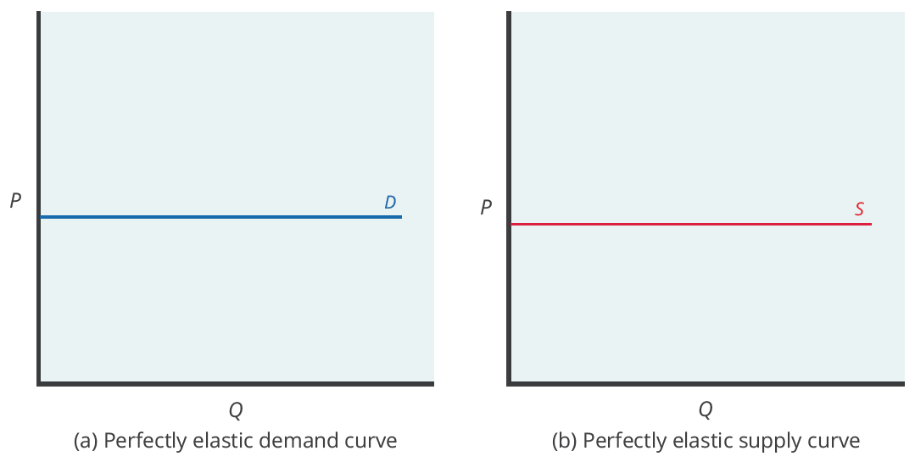
Infinite or Perfect Elasticity
The horizontal lines show that an infinite quantity will be demanded or supplied at a specific price. This illustrates the cases of a perfectly (or infinitely) elastic demand curve and supply curve. The quantity demanded or supplied is extremely responsive to price changes, moving from zero for prices close to P to infinite when prices reach P.
Notes:
The horizontal lines show that an infinite quantity will be demanded or supplied at a specific price. This illustrates the cases of a perfectly (or infinitely) elastic demand curve and supply curve. The quantity supplied or demanded is extremely responsive to price changes, moving from zero for prices close to P to infinite when prices reach P.

Slide 5

Infinite or Perfect Elasticity
Goods like a particular brand of bottled water have nearly perfectly elastic demand curves. This is the case because there are many different brands of bottled water, and people can easily substitute away from one brand should it become too expensive.
Notes:
Goods like a particular brand of bottled water have nearly perfectly elastic demand curves. This is the case because there are many different brands of bottled water, and people can easily substitute away from one brand should it become too expensive.

Slide 6
Zero or Perfect Inelasticity
While a perfectly inelastic supply is an extreme example, it can occur with goods that have a limited supply of inputs.
Examples include diamond rings or housing in prime locations, such as apartments facing Central Park in New York City.
Necessities with no close substitutes are likely to have highly inelastic demand curves.
Since individuals often have no choice but to buy life-saving drugs or gasoline, these goods have highly inelastic demand curves.
Notes:
While a perfectly inelastic supply is an extreme example, it can occur with goods that have a limited supply of inputs. Examples include diamond rings or housing in prime locations, such as apartments facing Central Park in New York City. Necessities with no close substitutes are likely to have highly inelastic demand curves. Since individuals often have no choice but to buy life-saving drugs or gasoline, these goods have highly inelastic demand curves.

Slide 7
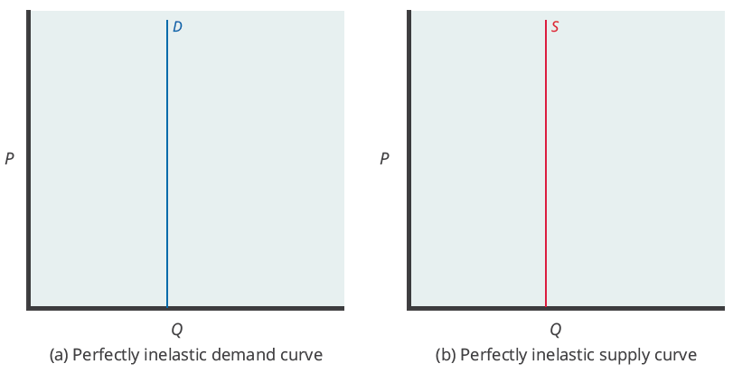
Zero or Perfect Inelasticity
The vertical demand curve and vertical supply curve show that there will be zero percentage change in quantity (a) demanded or (b) supplied, regardless of the price.
Notes:
The vertical supply curve and vertical demand curve show that there will be zero percentage change in quantity (a) demanded or (b) supplied, regardless of the price.

Slide 8

Zero or Perfect Inelasticity
Goods that are necessities with no close substitutes, such as insulin, have highly inelastic demand curve. Individuals who demand insulin need it to survive, meaning that they will demand the same quantity regardless of price.
Notes:
Goods like a particular brand of bottled water have nearly perfectly elastic demand curves. This is the case because there are many different brands of bottled water, and people can easily substitute away from one brand should it become too expensive.

Slide 9
Constant Unitary Elasticity
Constant unitary elasticity occurs when the percentage change in price and the percentage change in quantity are equal and offsetting.
Constant unitary elasticity is also known as unit elasticity.
A demand curve with unit elasticity moves from a steeper slope on the left to a flatter slope on the right—and a curved shape overall.
Unlike the demand curve with unitary elasticity, the supply curve with unitary elasticity is represented by a straight line.
Notes:
Constant unitary elasticity occurs when the percentage change in price and the percentage change in quantity are equal and offsetting. Constant unitary elasticity is also known as unit elasticity. A demand curve with unit elasticity moves from a steeper slope on the left to a flatter slope on the right—and a curved shape overall. Unlike the demand curve with unitary elasticity, the supply curve with unitary elasticity is represented by a straight line.

Slide 10
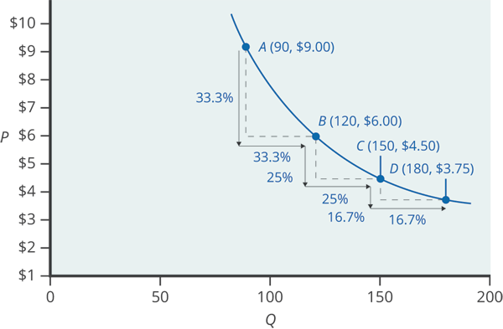
Constant Unitary Elasticity of Demand
A demand curve with constant unitary elasticity will be a curved line. Notice how price and quantity demanded change by an identical percentage amount between each pair of points on the demand curve.
Notes:
A demand curve with constant unitary elasticity will be a curved line. Notice how price and quantity demanded change by an identical percentage amount between each pair of points on the demand curve.

Slide 11
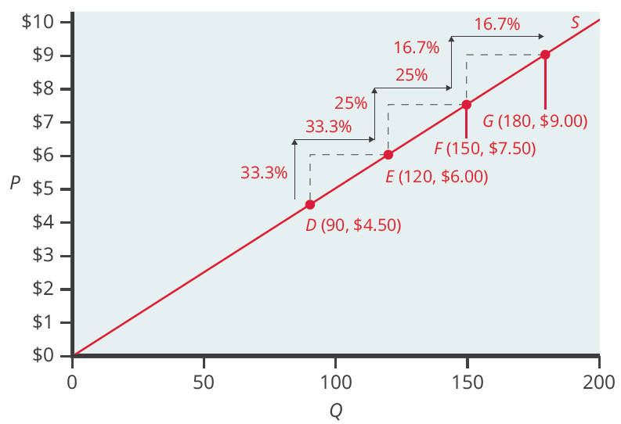
Constant Unitary Elasticity of Supply
A constant unitary elasticity supply curve is a straight line reaching up from the origin. Between each pair of points, the percentage increase in quantity supplied is the same as the percentage increase in price.
Notes:
Unlike the demand curve with unitary elasticity, the supply curve with unitary elasticity is represented by a straight line, and that line goes through the origin. Along the constant unitary elasticity supply curve, the percentage quantity increases on the horizontal axis exactly match the percentage price increases on the vertical axis—so the supply curve has a constant unitary elasticity at all points. Now, you can differentiate between infinite elasticity, zero elasticity, and constant unitary elasticity and analyze their respective graphs.

Slide 12
Real-World Discussion
Demand for goods that are luxuries and goods that claim a large portion of a consumer’s budget are most likely to be elastic. Demand for goods that are necessities and goods that have few, if any, substitutes are most likely to be inelastic. For which goods and services is your demand elastic? For which goods and services is your demand inelastic?
Notes:
Demand for goods that are luxuries and goods that claim a large portion of a consumer’s budget are most likely to be elastic. Demand for goods that are necessities and goods that have few, if any, substitutes are most likely to be inelastic. For which goods and services is your demand elastic? For which goods and services is your demand inelastic?

Slide 13
Summary
Infinite or perfect elasticity refers to the extreme case where either the percentage change in quantity demanded or supplied changes by an infinite amount in response to any percentage change in price.
Perfect inelasticity refers to the extreme case in which a percentage change in price, no matter how large, results in no percentage change in quantity demanded or supplied.
Constant unitary elasticity in either a supply or demand curve refers to a situation where a price change of one percent results in an equal and offsetting percentage change in quantity.
HAWKES LEARNING

Slide 14




HAWKES LEARNING

