Slide 1
HAWKES LEARNING
How Changes in Income and Prices Affect Consumption Choices
Principles of Microeconomics
Notes:
The price of goods and the amount you have to spend affect what and how much you purchase. In this lesson, titled “How Changes in Income and Prices Affect Consumption Choices,” we’ll explore that in detail.

Slide 2
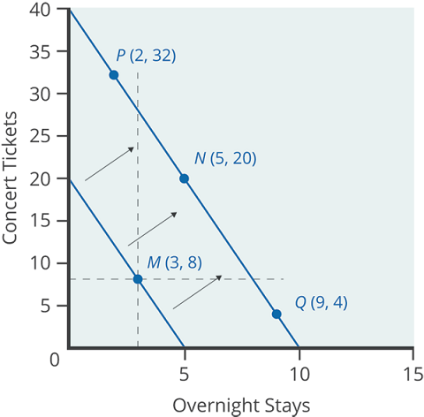
How Changes in Income Affect Consumer Choices
An increase in income shifts the budget constraint to the right.
Following the change, consumers will again consider the utility and marginal utility received from the two goods to make the utility-maximizing choice.
Notes:
An increase in income shifts the budget constraint to the right. Following the change, consumers will again consider the utility and marginal utility received from the two goods to make the utility-maximizing choice.

Slide 3
Normal and Inferior Goods
When income rises, the most common reaction is to purchase more of both goods on the budget constraint.
Goods and services are normal goods when a rise in income leads to a rise in the quantity consumed of that good, and vice versa.
A rise in income could, however, cause consumption of one good to increase while consumption of the other good declines.
Goods where demand declines as income rises (or conversely, where the demand rises as income falls) are called inferior goods.
Notes:
When income rises, the most common reaction is to purchase more of both goods on the budget constraint. Goods and services are normal goods when a rise in income leads to a rise in the quantity consumed of that good, and vice versa. A rise in income could, however, cause consumption of one good to increase while consumption of the other good declines. Goods where demand declines as income rises (or conversely, where the demand rises as income falls) are called inferior goods.

Slide 4
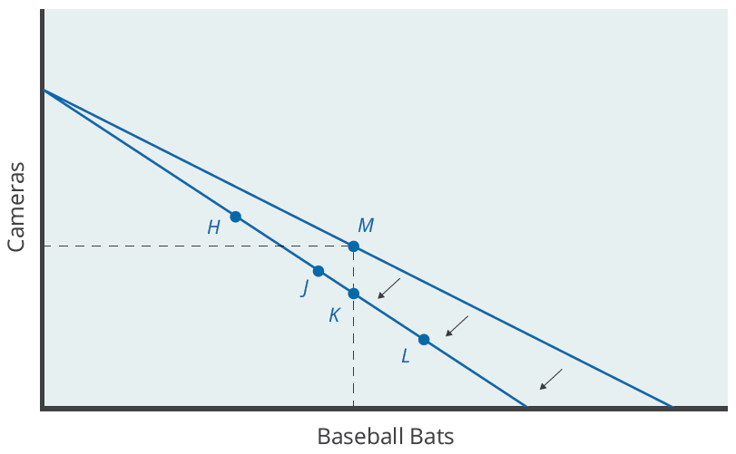
How Price Changes Affect Consumer Choices
An increase in the price of a good means less of the good can be bought with any given budget.
If the good on the horizontal axis of a budget constraint has an increase in price, the budget constraint will shift inward from the vertical axis.
Notes:
An increase in the price of a good means less of the good can be bought with any given budget. If the good on the horizontal axis of a budget constraint has an increase in price, the budget constraint will shift inward from the vertical axis.

Slide 5
Real-World Discussion
Suppose you get your lawn mowed by a lawn service, and the government just imposed sales tax on lawn mowing services. What is the likely impact of the new tax on your budget constraint?
Notes:
Suppose you get your lawn mowed by a lawn service, and the government just imposed sales tax on lawn mowing services. What is the likely impact of the new tax on your budget constraint?

Slide 6
Real-World Discussion
Suppose you get your lawn mowed by a lawn service, and the government just imposed sales tax on lawn mowing services. What is the likely impact of the new tax on your budget constraint?
The budget constraint would pivot inward for lawn services since the price is likely to be higher, making the amount of lawn mowing that can be purchased lower. At the same time, you might choose to consume less of other goods so that you can allocate more money to lawn care.
Notes:
Suppose you get your lawn mowed by a lawn service, and the government just imposed sales tax on lawn mowing services. What is the likely impact of the new tax on your budget constraint? The budget constraint would pivot inward for lawn services since the price is likely to be higher, making the amount of lawn mowing that can be purchased lower. At the same time, you might choose to consume less of other goods so that you can allocate more money to lawn care.

Slide 7
Substitution and Income Effect
The typical response to higher prices is that a person chooses to consume less of the product with the higher price. This occurs for two reasons, and both effects can occur simultaneously.
Substitution Effect
Income Effect
When a price changes and consumers have an incentive to substitute some of the good with a relatively lower-priced good.
A higher price means the buying power of income has been reduced (even though actual income has not changed), which leads to buying less of the good.
Notes:
The typical response to higher prices is that a person chooses to consume less of the product with the higher price. This occurs for two reasons, and both effects can occur simultaneously. The substitute effect states that a higher price means the buying power of income has been reduced (even though actual income has not changed), which leads to buying less of the good. The income effect states that when a price changes and consumers have an incentive to substitute some of the good with a relatively lower-priced good.

Slide 8
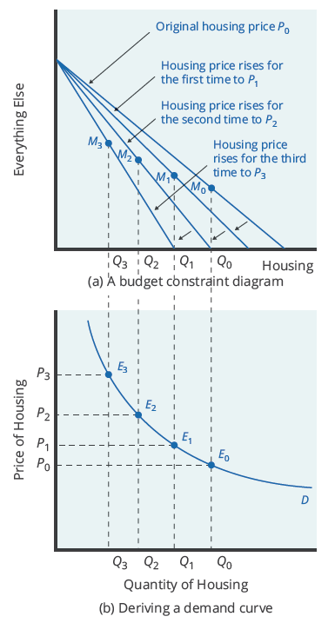
The Foundations of Demand Curves
Changes in the price of a good lead the budget constraint to rotate.
Budget constraint rotations mean that when individuals are seeking their highest utility, the quantity demanded of that good will change.
In this way, the logical foundations of demand curves are based on the underlying idea of individuals seeking utility.
Notes:
Changes in the price of a good lead the budget constraint to rotate. Budget constraint rotations mean that when individuals are seeking their highest utility, the quantity demanded of that good will change. In this way, the logical foundations of demand curves are based on the underlying idea of individuals seeking utility.

Slide 9
Applications in Government and Business
The budget constraint framework for making utility-maximizing choices offers a reminder that people can react to a change in price or income in a range of different ways.
Higher prices for natural gas and electricity due to Hurricanes Katrina and Rita
Taxes on alcohol
Many people turned down their thermostats and decreased energy consumption.
Since a tax increases the price of alcohol, many people decrease their consumption of alcohol.
People also adjusted their consumption of other goods.
Consumers may decrease their purchases of other goods and services due to the income effect.
Notes:
The budget constraint framework for making utility-maximizing choices offers a reminder that people can react to a change in price or income in a range of different ways. Real life examples include the aftermath of Hurricanes Katrina and Rita and taxes on alcohol.

Slide 10
The Unifying Power of the Utility-Maximizing Budget Set Framework
An interaction between prices, budget constraints, and personal preferences determines household choices.
The flexible and powerful terminology of utility-maximization gives economists a vocabulary for bringing these elements together.
Not even economists believe people constantly measure their utility before making decisions.
However, economists do believe that people often decide to try a little less of one thing and a little more of another to maximize satisfaction.
Notes:
Changes in the price of a good lead the budget constraint to rotate. Budget constraint rotations mean that when individuals are seeking their highest utility, the quantity demanded of that good will change. In this way, the logical foundations of demand curves are based on the underlying idea of individuals seeking utility.

Slide 11
Summary
The budget constraint framework suggests that when income or price changes, a range of responses are possible.
When income rises, households will demand a higher quantity of normal goods but a lower quantity of inferior goods.
When the price of a good rises, households will typically demand less of that good—but whether they will demand a much lower quantity or only a slightly lower quantity will depend on personal preferences.
Utility refers to the satisfaction that a good or service provides, which diminishes as a person receives more of a good, known as diminishing marginal utility.
A higher price for one good can lead to more or less demand for other goods.
HAWKES LEARNING
Notes:
The budget constraint framework suggests that when income or price changes, a range of responses are possible.
When income rises, households will demand a higher quantity of normal goods but a lower quantity of inferior goods.
When the price of a good rises, households will typically demand less of that good—but whether they will demand a much lower quantity or only a slightly lower quantity will depend on personal preferences.
Utility refers to the satisfaction that a good or service provides, which diminishes as a person receives more of a good, known as diminishing marginal utility.
A higher price for one good can lead to more or less demand for other goods.

Slide 12




HAWKES LEARNING

