Slide 1
Section 1.1
The Real Number Line and Absolute Value

Slide 2
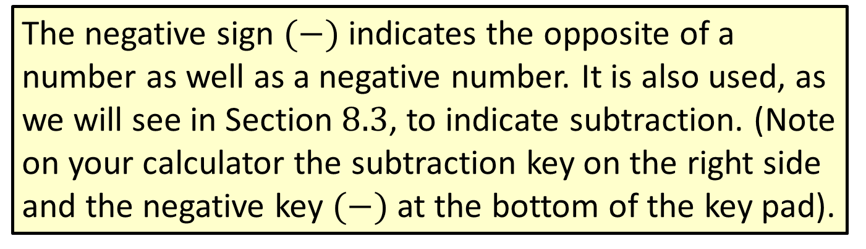
Note
The negative sign $(−)$indicates the opposite of a number as well as a negative number. It is also used, as we will see in Section $8.3$, to indicate subtraction. (Note on your calculator the subtraction key on the right side and the negative key $(−)$ at the bottom of the key pad).

Slide 3
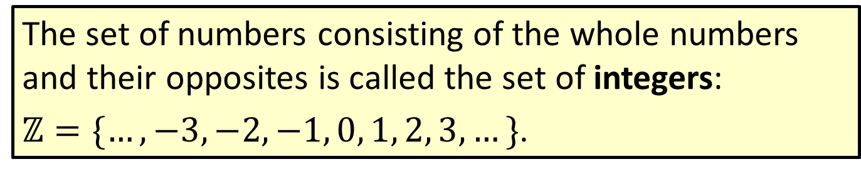
Definition: Integers
The set of numbers consisting of the whole numbers and their opposites is called the set of integers:
$ℤ=\{…,−3,−2,−1, 0, 1, 2, 3,…\}$.

Slide 4

Example 1: Finding the Opposite of an Integer
Find the opposite of each integer.​
a. $+7$
​$−4$
Solution
a. $−7$
b. $−\left(−4\right)$ or $+4$ In words, the opposite of $−4$ is$+4.$

Slide 5



Example 2: Graphing Integers on a Number Line
Graph each set of integers.
a. $\{−3,−1, 1, 3\}​$
b. $\left\{−4,−2,−1, 0, 2\right\}$
Solution
a.
b.
​

Slide 6
Definition: Variables
A variable is a symbol (generally a letter of the alphabet) that is used to represent an unknown number or any one of several numbers.

Slide 7
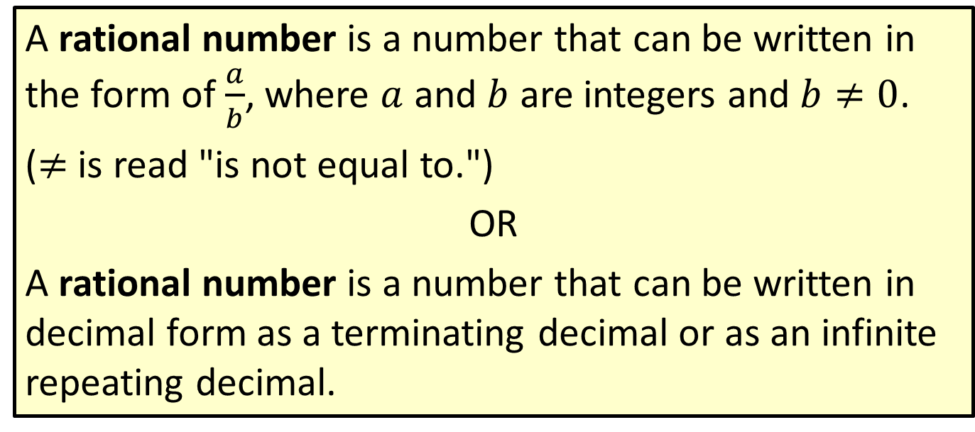
Definition: Rational Numbers
A rational number is a number that can be written in the form of $\frac{a}{b}$, where $a$ and $b$ are integers and $b≠0$.
(≠ is read "is not equal to.")
OR
A rational number is a number that can be written in decimal form as a terminating decimal or as an infinite repeating decimal.

Slide 8
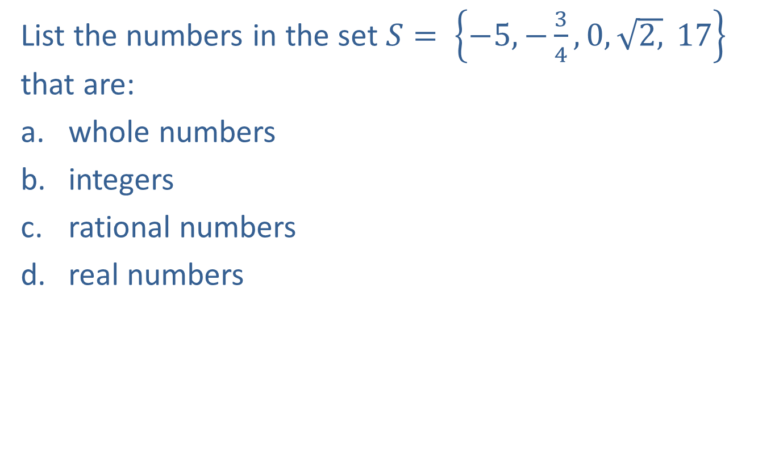
Example 3: Identifying Types of Numbers
List the numbers in the set $S= \left\{−5, −\frac{3}{4}, 0, \sqrt{2,} 17\right\}$ that are:
​whole numbers
​integers
rational numbers
​real numbers

Slide 9
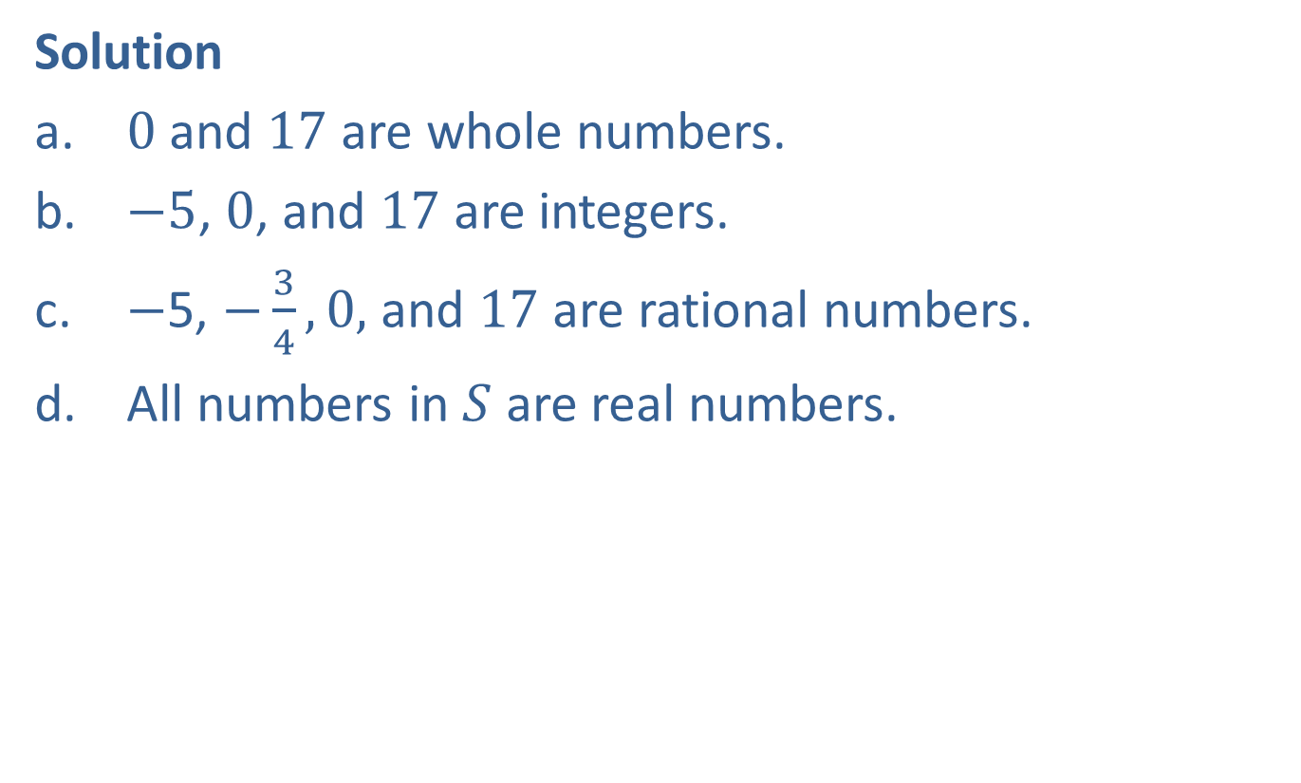
Example 3: Identifying Types of Numbers (cont.)
Solution
$​0$and $17$ are whole numbers.
$−5$, $0$, and $17$ are ​integers.
$−$5, $−\frac{3}{4}, 0,$ and $17$ are rational numbers.
​All numbers in $S$ are real numbers.

Slide 10
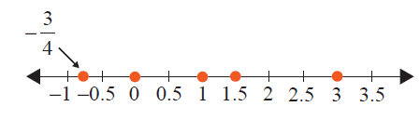

Example 4: Graphing Sets of Numbers
Graph the set of real numbers $\left\{−\frac{3}{4},0, 1, 1.5, 3\right\}.$
Solution

Slide 11


Example 5: Graphing Sets of Numbers
Graph all natural numbers less than or equal to $3$.
Solution
Remember that the natural numbers are $1, 2, 3, 4, ….$

Slide 12
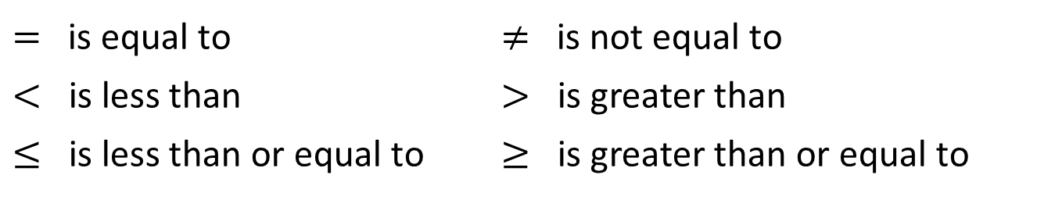
Symbols of Equality and Inequality
Reading from left to right:
$=$ is equal to | $≠$ is not equal to
$<$ is less than | $>$ is greater than
$≤$ is less than or equal to | $≥$ is greater than or equal to

Slide 13
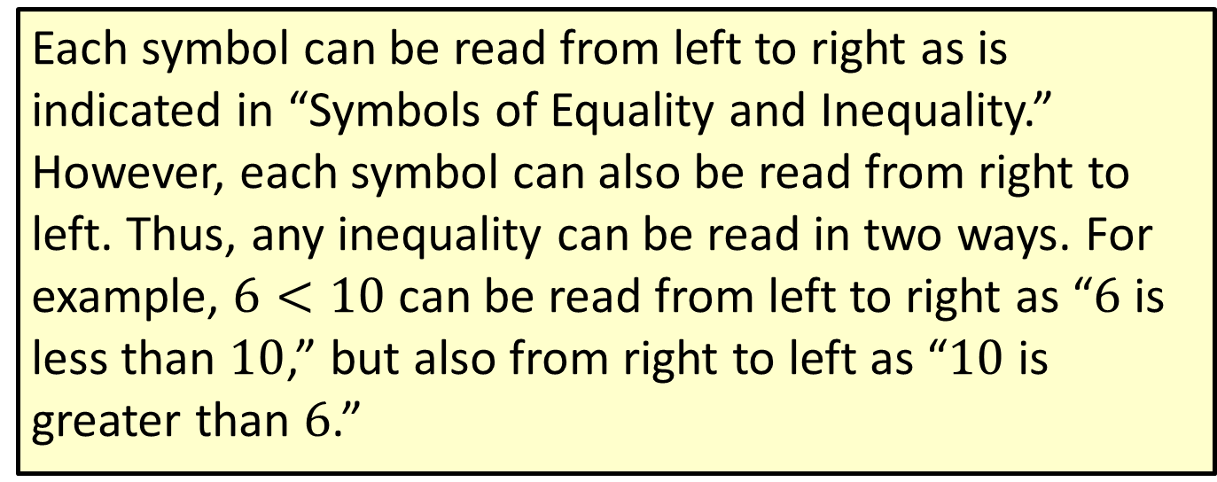
Note
Each symbol can be read from left to right as is indicated in “Symbols of Equality and Inequality.” However, each symbol can also be read from right to left. Thus, any inequality can be read in two ways. For example, $6<10$ can be read from left to right as “$6$ is less than $10$,” but also from right to left as “$10$ is greater than $6$.”

Slide 14

Example 6: Verifying Inequalities
Determine whether each statement is true or false.
​$7<15$
​$3>−1$
​$−\frac{1}{2}≤−\frac{1}{4}$
​$2.7≥2.7$
​$−5>−6$

Slide 15
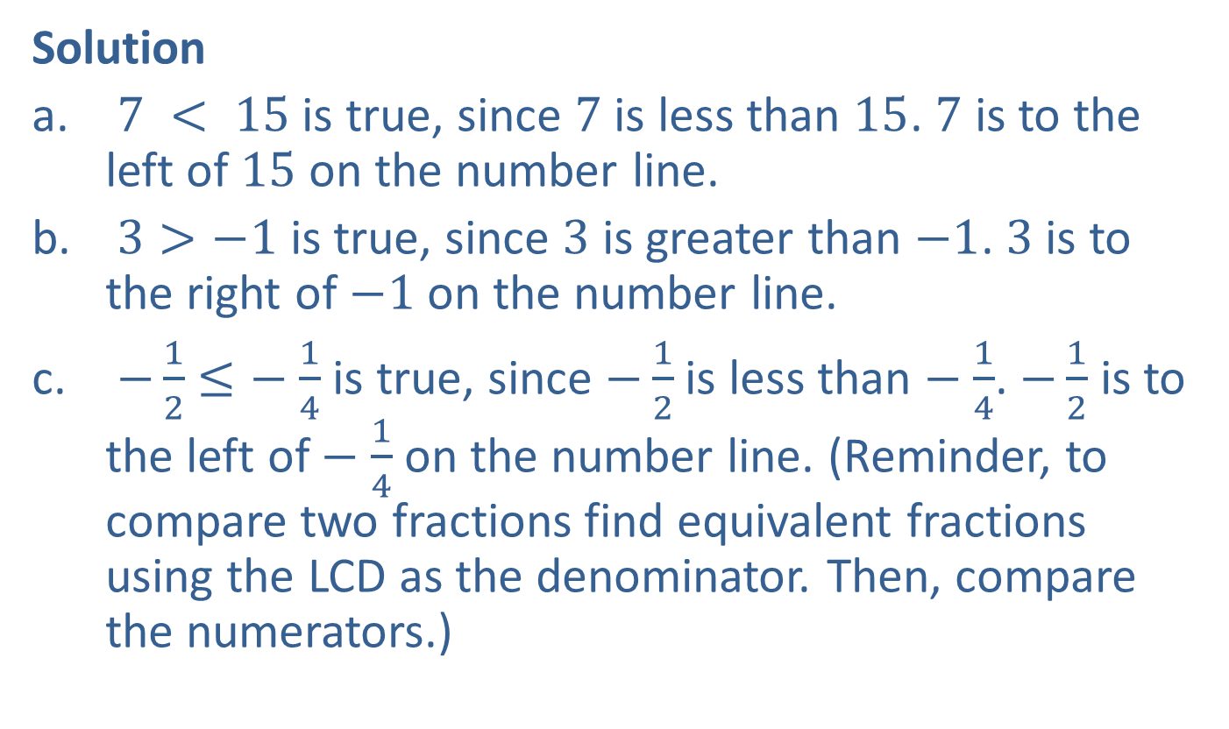
Example 6: Verifying Inequalities (cont.)
Solution
$7 < 15$is true, since $7$ is less than $15$. $7$ is to the left of $15$ on the number line.
$3>−1$ is true, since $3$ is greater than $−1$. $3$ is to the right of $−1$on the number line.
$−\frac{1}{2}$ $≤−$ $\frac{1}{4}$ is true, since $−\frac{1}{2}$ is less than $−$ $\frac{1}{4}$. $−\frac{1}{2}$ is to the left of $−$ $\frac{1}{4}$ on the number line. (Reminder, to compare two fractions find equivalent fractions using the LCD as the denominator. Then, compare the numerators.)

Slide 16

Example 6: Verifying Inequalities (cont.)
d. $2.7≥2.7$is true, since $2.7$ is equal to $2.7.$
e. $−5>−6$ is true, since $−5$ is greater than $−6$.

Slide 17
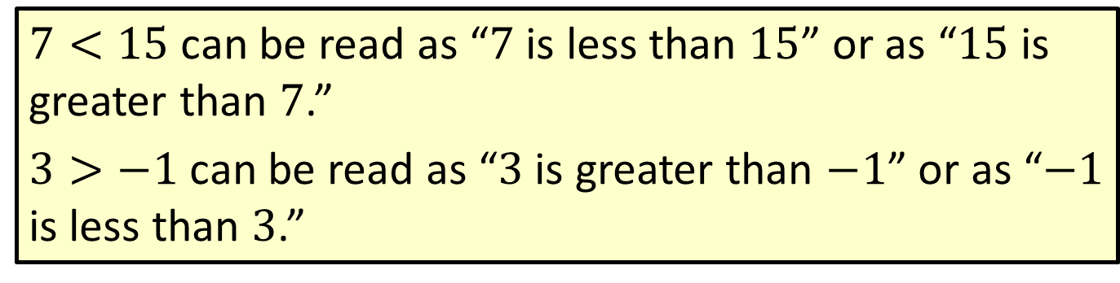
Note
$7<15$ can be read as “$7$ is less than $15$” or as “$15$ is greater than $7$.”
$3>−1$ can be read as “$3$ is greater than $−1$” or as “$−1$ is less than $3$.”

Slide 18
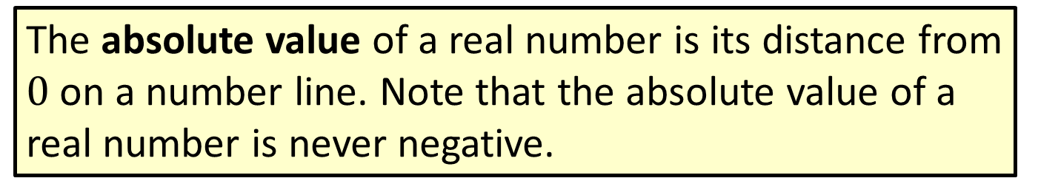
Definition: Absolute Value
The absolute value of a real number is its distance from $0$ on a number line. Note that the absolute value of a real number is never negative.

Slide 19
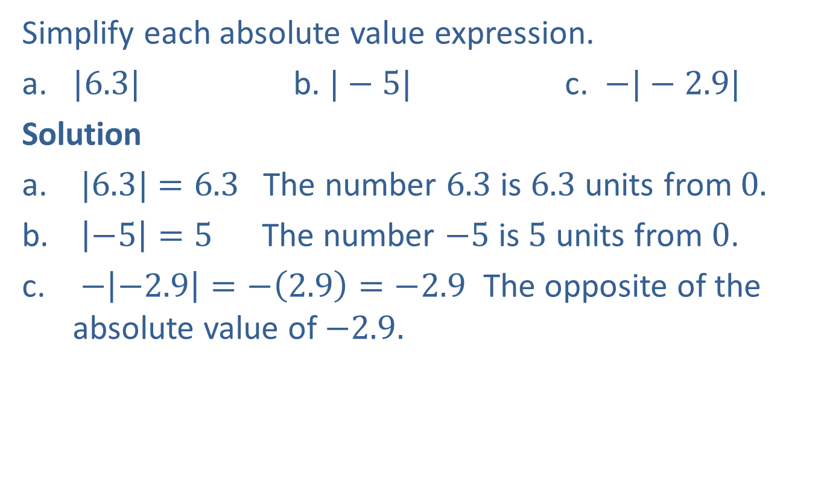
Example 7: Finding Absolute Values
Simplify each absolute value expression.
​​$|6.3|$​ b. ​​$|−5|$ c. $−|−2.9|$
Solution
$|6.3|$​ $=6.3$ The number $6.3$ is $6.3$ units from $0.$
$\left|−5\right|=5$ The number $−5$ is $5$ units from $0$.
$−\left|−2.9\right|=−\left(2.9\right)=−2.9$ The opposite of the absolute value of $−2.9.$

Slide 20

Example 8: Verifying Absolute Value Inequalities
True or false: $|−4|≥4$?
Solution
True, since $\left|−4\right|=4$ and $4$ $≥4$.

Slide 21

Example 9: Solving Absolute Value Equations
If $|x|=7$, what are the possible values for $x$?
Solution
$x=7$ or $x=−7$ since $|7|=7$ and $\left|−7\right|=7.$

Slide 22

Example 10: Solving Absolute Value Equations
If $|x|=−3$, what are the possible values for $x$?
Solution
There are no values of $x$ for which $|x|=−3$. The absolute value can never be negative. There is no solution.

Slide 23
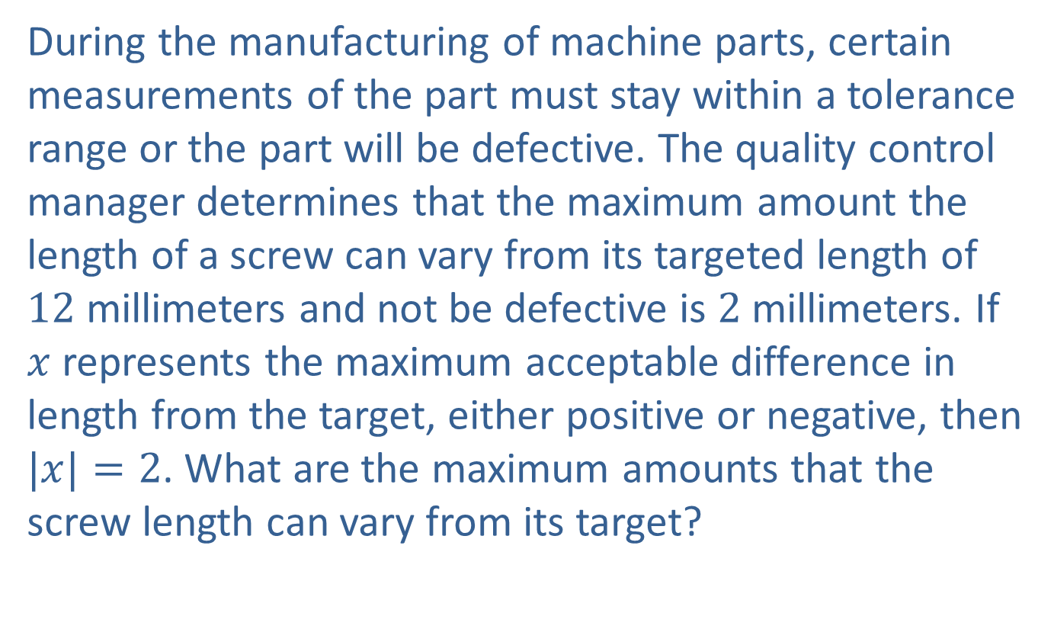
Example 11: Application: Solving Absolute Value Equations
During the manufacturing of machine parts, certain measurements of the part must stay within a tolerance range or the part will be defective. The quality control manager determines that the maximum amount the length of a screw can vary from its targeted length of $12$ millimeters and not be defective is $2$ millimeters. If $x$ represents the maximum acceptable difference in length from the target, either positive or negative, then $|x|=2$. What are the maximum amounts that the screw length can vary from its target?

Slide 24
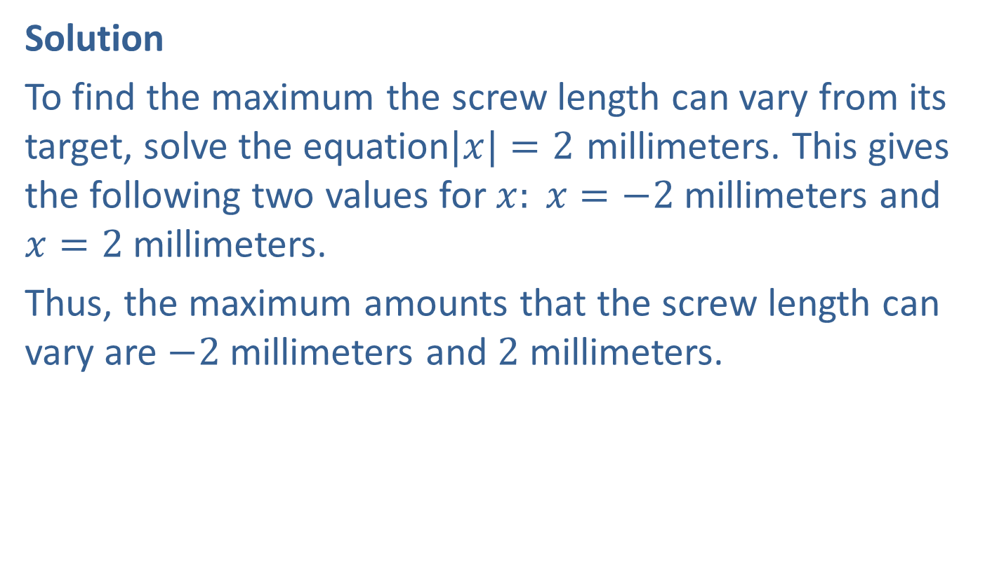
Example 11: Application: Solving Absolute Value Equations (cont.)
Solution
To find the maximum the screw length can vary from its target, solve the equation$|x|=2$ millimeters. This gives the following two values for $x: x=−2$ millimeters and $x=2$ millimeters.
Thus, the maximum amounts that the screw length can vary are $−2$ millimeters and $2$ millimeters.

