Slide 1
Section 1.2
Operations with Real Numbers

Slide 2
Procedure: Rules for Addition with Real Numbers
​To add two real numbers with like signs,
​add their absolute values and
​use the common sign.
​To add two real numbers with unlike signs,
​subtract their absolute values (the smaller from the larger), and
​use the sign of the number with the larger absolute value.

Slide 3
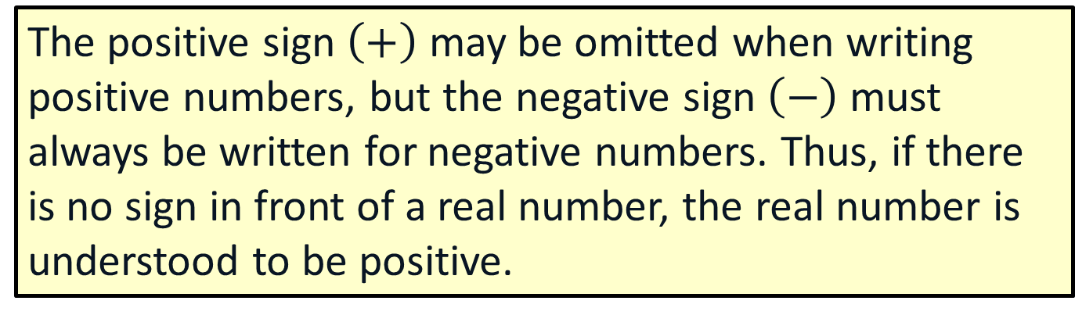
Note
The positive sign $\left(+\right)$ may be omitted when writing positive numbers, but the negative sign $\left(−\right)$ must always be written for negative numbers. Thus, if there is no sign in front of a real number, the real number is understood to be positive.

Slide 4
Note
If a negative number occurs after an addition symbol then we must place the number in parentheses so that the two operation symbols are not next to each other.

Slide 5

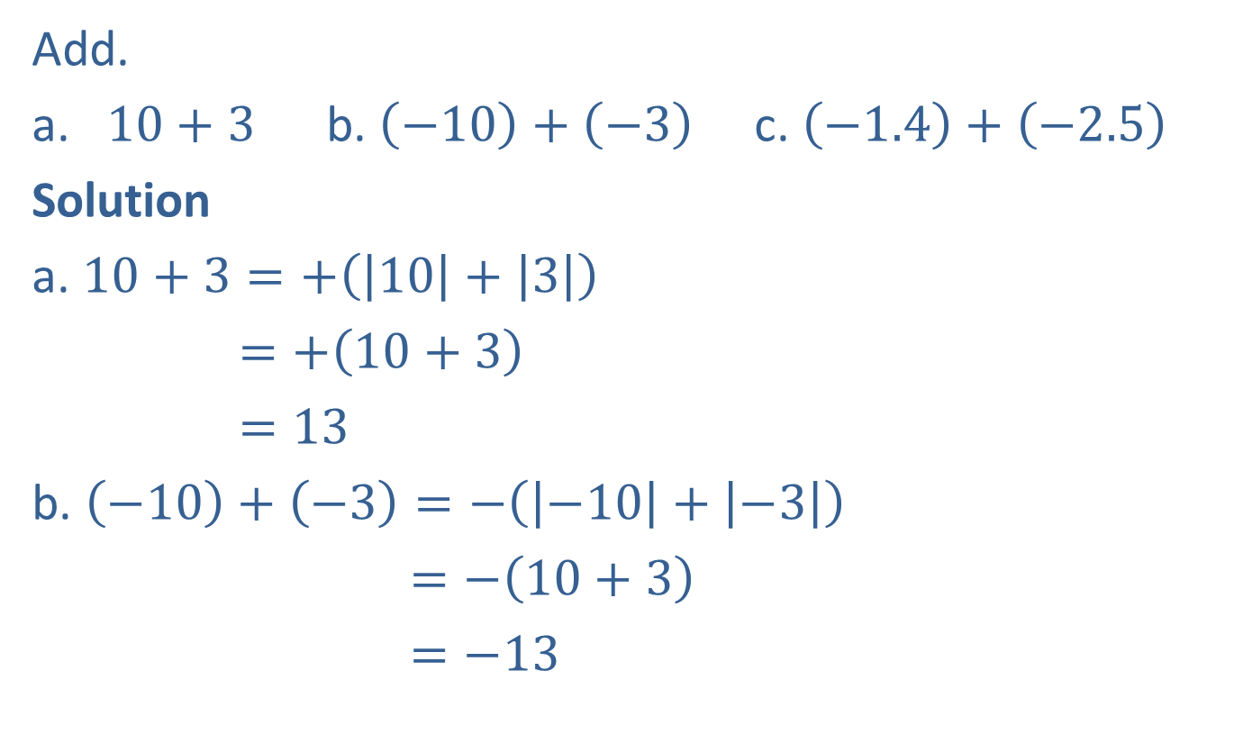

Example 1: Addition with Like Signs
Add.
a. $10+3$ b. $\left(−10\right)+\left(−3\right)$ c. $\left(−1.4\right)+\left(−2.5\right)$
Solution
a. $10+3=+\left(\left|10\right|+\left|3\right|\right)$
$=+\left(10+3\right)$
$=13$
b. $\left(−10\right)+\left(−3\right)=−\left(\left|−10\right|+\left|−3\right|\right)$
$=−\left(10+3\right)$
$=−13$
Add the absolute values, $+$is the common sign.
Add the absolute values, $−$ is the common sign.

Slide 6


Example 1: Addition with Like Signs (cont.)
c. $\left(−1.4\right)+\left(−2.5\right)$ $=−\left(\left|−1.4\right|+\left|−2.5\right|\right)$
$=−\left(1.4+2.5\right)$
$=−3.9$
Add the absolute values, $−$ is the common sign.

Slide 7



Example 2: Addition with Unlike Signs
Add.
a. $\left(−10\right)+3$ b. $10+\left(−3\right)$ c. $−\frac{7}{11}+\frac{5}{11}$
Solution
a. $\left(−10\right)+3=−\left(\left|−10\right|−\left|3\right|\right)$
$=−\left(10−3\right)=−7$
b. $10+\left(−3\right)=+\left(\left|10\right|−\left|−3\right|\right)$
$=+\left(10−3\right)$ $=7$
Subtract the absolute values.
Use $−$ because $\left|−10\right|>\left|3\right|.$
Subtract the absolute values.
Use $+$ because $\left|10\right|>\left|−3\right|.$

Slide 8
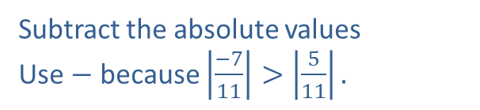

Example 2: Addition with Unlike Signs (cont.)
c. $−\frac{7}{11}+\frac{5}{11}=−\left(\left|−\frac{7}{11}\right|−\left|\frac{5}{11}\right|\right)$
$=−\left(\frac{7}{11}−\frac{5}{11}\right)=−\frac{2}{11}$
Subtract the absolute values
Use $−$ because $\left|\frac{−7}{11}\right|>\left|\frac{5}{11}\right|.$

Slide 9
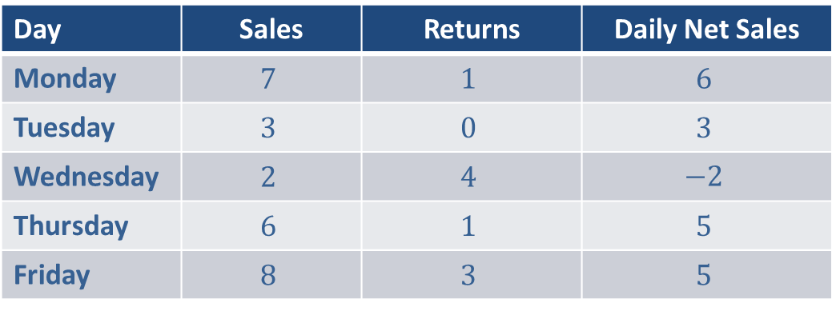
Example 3: Application: Reading a Table
Susan is a salesperson for a shoe store. Last week her sales of pairs of shoes were as follows.
What were Susan's net sales for last week?
Day | Sales | Returns | Daily Net Sales
Monday | $$7$$ | $$1$$ | $$6$$
Tuesday | $$3$$ | $$0$$ | $$3$$
Wednesday | $$2$$ | $$4$$ | $$−2$$
Thursday | $$6$$ | $$1$$ | $$5$$
Friday | $$8$$ | $$3$$ | $$5$$

Slide 10

Example 3: Application: Reading a Table (cont.)
Solution
$$6+3+\left(−2\right)+5+5=17$$
Susan’s net sales for the week were $17$ pairs of shoes.

Slide 11
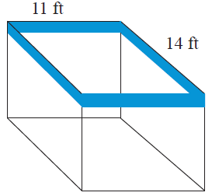

Example 4: Application: Calculating the Perimeter of a Rectangle
Barbara is redecorating and wants to put a wallpaper border around the top edge of her dining room. The dining room is in the shape of a rectangle and the dimensions are $11 ft$ by $14 ft$. How many feet of wallpaper border will she need?

Slide 12

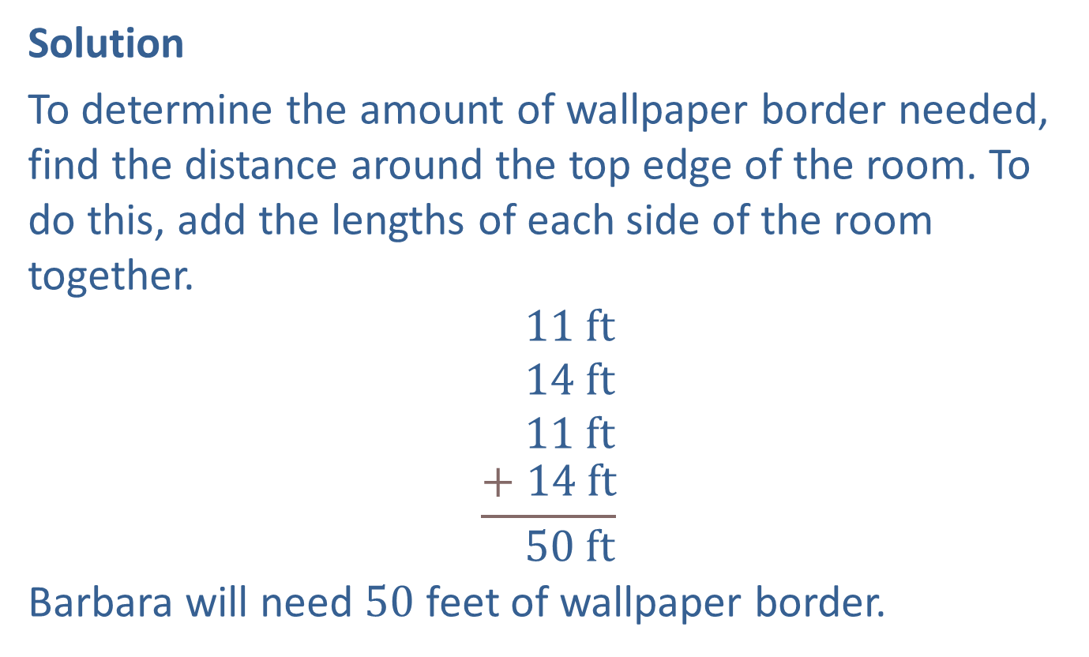
Example 4: Application: Calculating the Perimeter of a Rectangle (cont.)
Solution
To determine the amount of wallpaper border needed, find the distance around the top edge of the room. To do this, add the lengths of each side of the room together.
$$\begin{matrix} 11 ft \\ 14 ft \\ 11 ft \\ \frac{+ 14 ft}{ 50 ft}\end{matrix}$$
Barbara will need $50$ feet of wallpaper border.
$$1$$
Perimeter

Slide 13
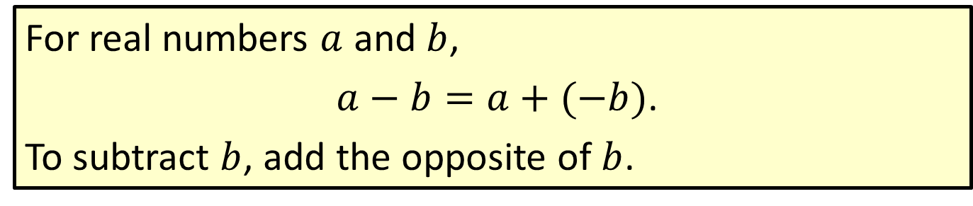
Procedure: Rule for Subtraction with Real Numbers
For real numbers $a$ and $b$,
$a−b=a+(−b)$.
To subtract $b$, add the opposite of $b$.

Slide 14
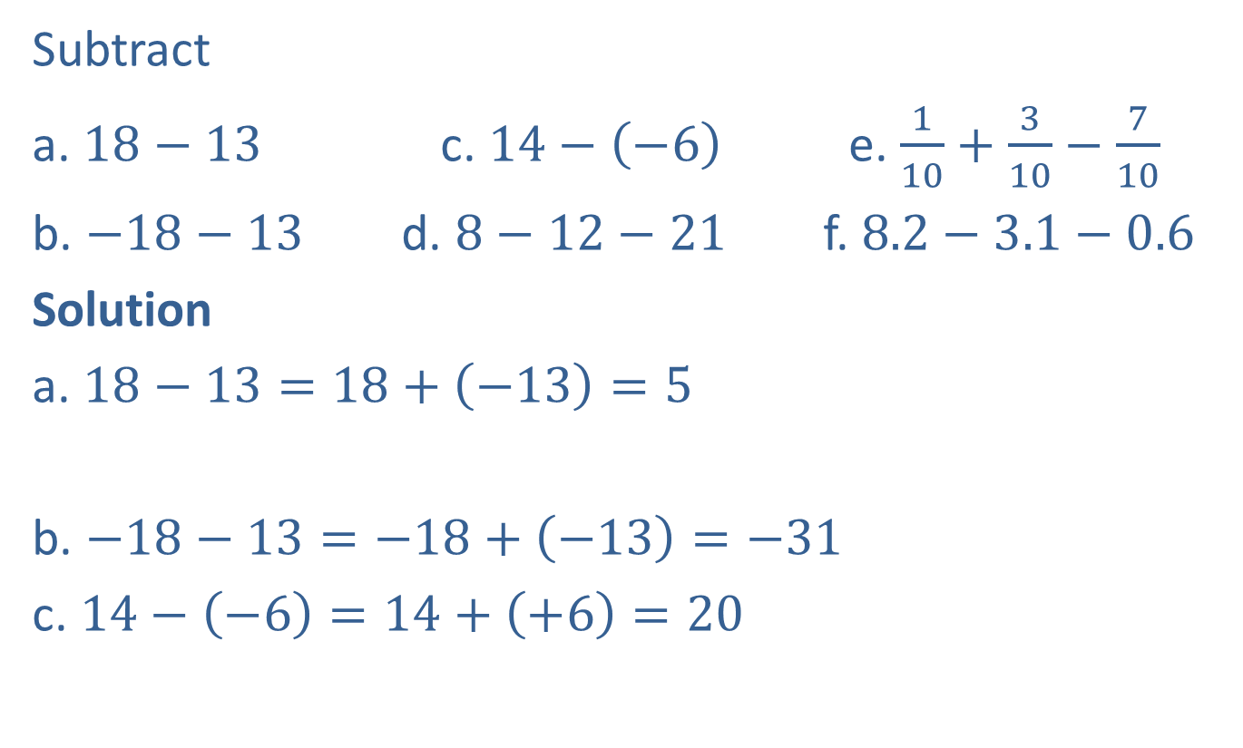
Example 5: Subtraction with Real Numbers
Subtract
a. $18−13$ c. $14−\left(−6\right)$ e. $\frac{1}{10}+\frac{3}{10}−\frac{7}{10}$
b. $−18−13$ d. $8−12−21$ f. $8.2−3.1−0.6$
Solution
a. $18−13=18+\left(−13\right)=5$
b. $−18−13=−18+\left(−13\right)=−31$
c. $14−\left(−6\right)=14+\left(+6\right)=20$
Subtracting $13$ is the same as adding $−13$.
Subtracting $−6$ is the same as adding $+6$.

Slide 15
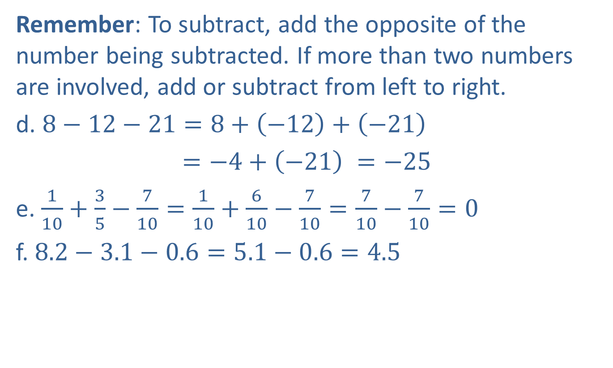
Example 5: Subtraction with Real Numbers (cont.)
Remember: To subtract, add the opposite of the number being subtracted. If more than two numbers are involved, add or subtract from left to right.
d. $8−12−21=8+\left(−12\right)+\left(−21\right)$
$=−4+\left(−21\right) =−25$
e. $\frac{1}{10}+\frac{3}{5}−\frac{7}{10}=\frac{1}{10}+\frac{6}{10}−\frac{7}{10}=\frac{7}{10}−\frac{7}{10}=0$
f. $8.2−3.1−0.6=5.1−0.6=4.5$

Slide 16
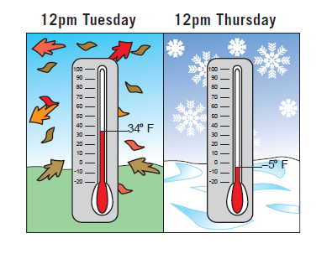

Example 6: Application: Calculating Change in Value
At noon on Tuesday the temperature was $34℉$. By noon on Thursday the temperature had dropped to $−5℉$. How much did the temperature drop between Tuesday and Thursday?

Slide 17
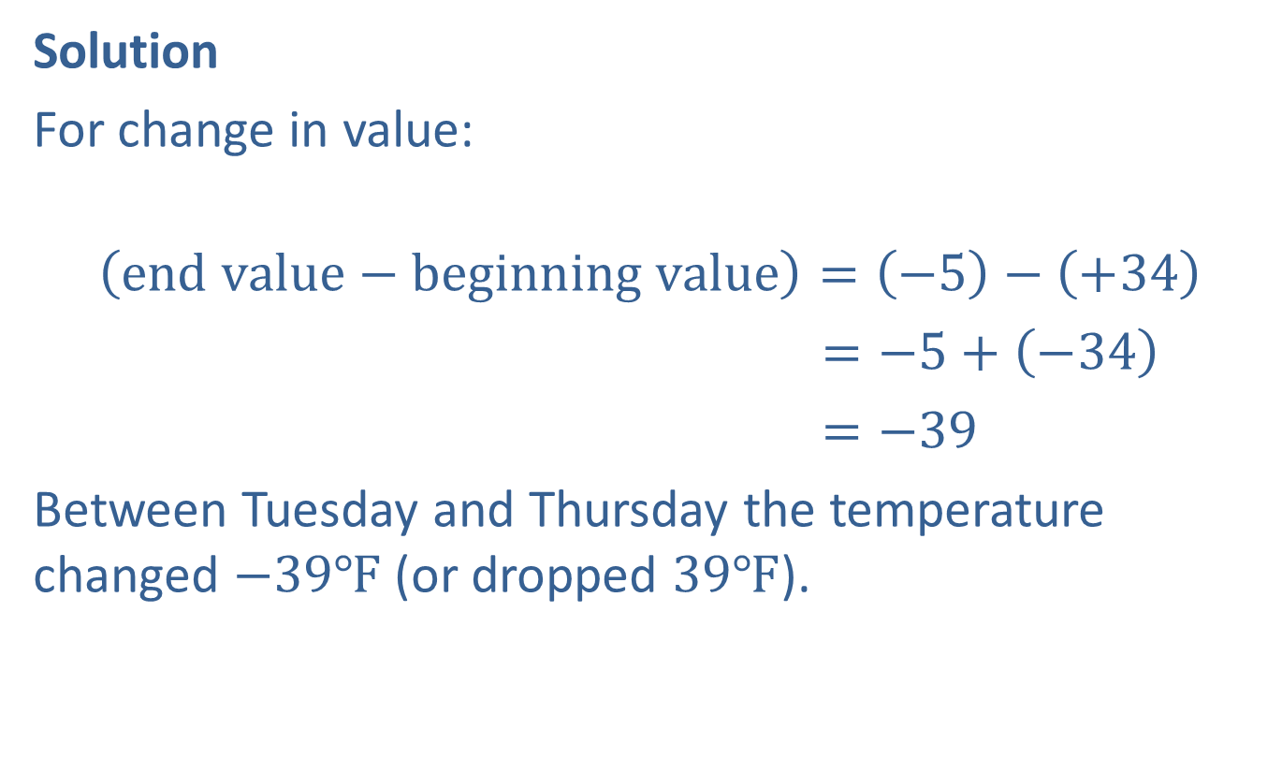
Example 6: Application: Calculating Change in Value (cont.)
Solution
For change in value:
$$\left(end value−beginning value\right)=\left(−5\right)−\left(+34\right)$$
$=−5+\left(−34\right)$
$=−39$
Between Tuesday and Thursday the temperature changed $−39℉$ (or dropped $39℉$).

Slide 18
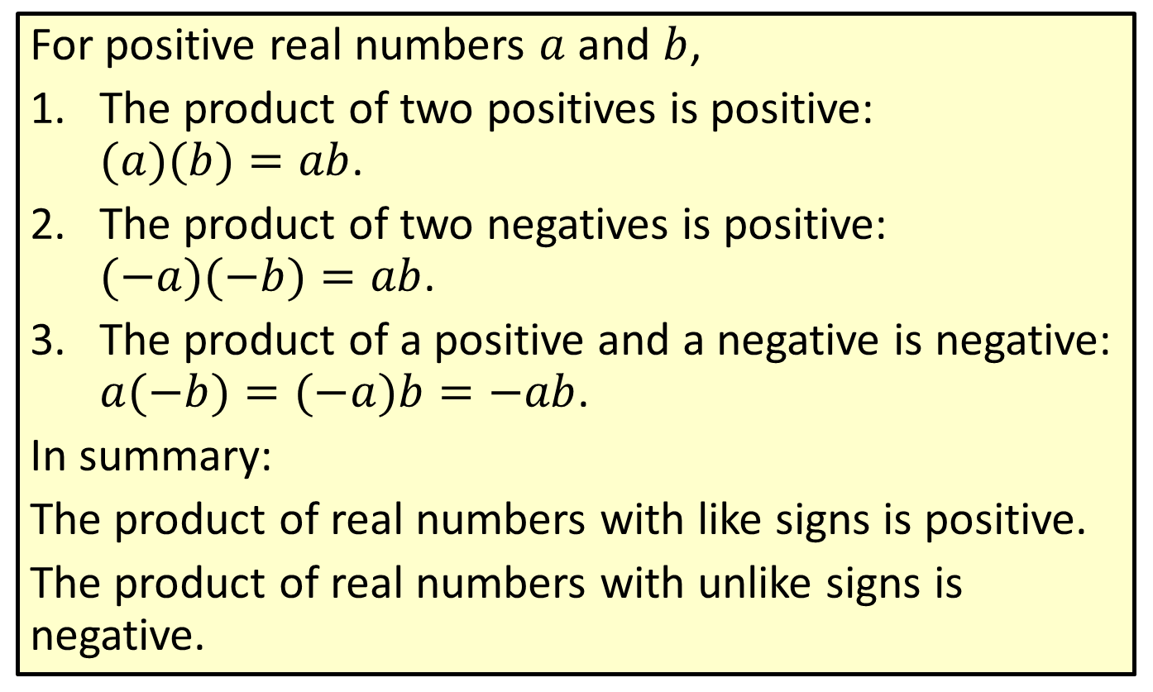
Procedure: Rules for Multiplying Positive and Negative Real Numbers
For positive real numbers $a$ and $b$,
​The product of two positives is positive: $(a)(b)=ab$.
​The product of two negatives is positive: $(−a)(−b)=ab$.
​The product of a positive and a negative is negative: $a(−b)=(−a)b=−ab$.
In summary:
The product of real numbers with like signs is positive.
The product of real numbers with unlike signs is negative.

Slide 19
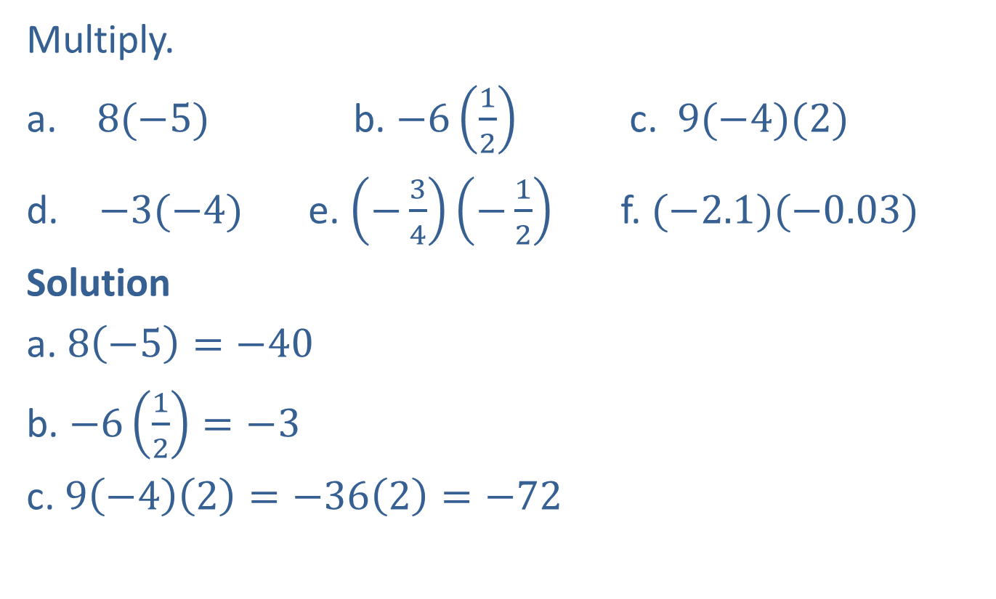
Example 7: Multiplication with Positive and Negative Real Numbers
Multiply.
​ $8(−5)$ b. ​$−6\left(\frac{1}{2}\right)$ c. ​$9(−4)(2)$
$−3(−4)$ e. ​$\left(−\frac{3}{4}\right)\left(−\frac{1}{2}\right)$ f. ​$(−2.1)(−0.03)$
Solution
a. $8\left(−5\right)=−40$
b. $−6\left(\frac{1}{2}\right)=−3$
c. $9\left(−4\right)\left(2\right)=−36\left(2\right)=−72$
Product of a positive and a negative is negative.

Slide 20

Example 7: Multiplication with Positive and Negative Real Numbers (cont.)
d. $−3\left(−4\right)=12$
e. $\left(−\frac{3}{4}\right)\left(−\frac{1}{2}\right)=\frac{3}{8}$
f. $\left(−2.1\right)\left(−0.03\right)=0.063$
Product of two negatives is positive.

Slide 21
Definition: Area of a Rectangle
The area of a rectangle (measured in square units) is found by multiplying its length by its width.

Slide 22
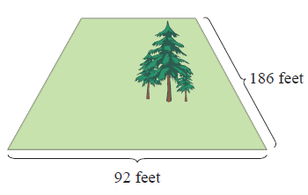
Example 8: Application: Calculating the Area of a Rectangle
Calculate the area of a rectangular plot of land with the dimensions shown here.

Slide 23
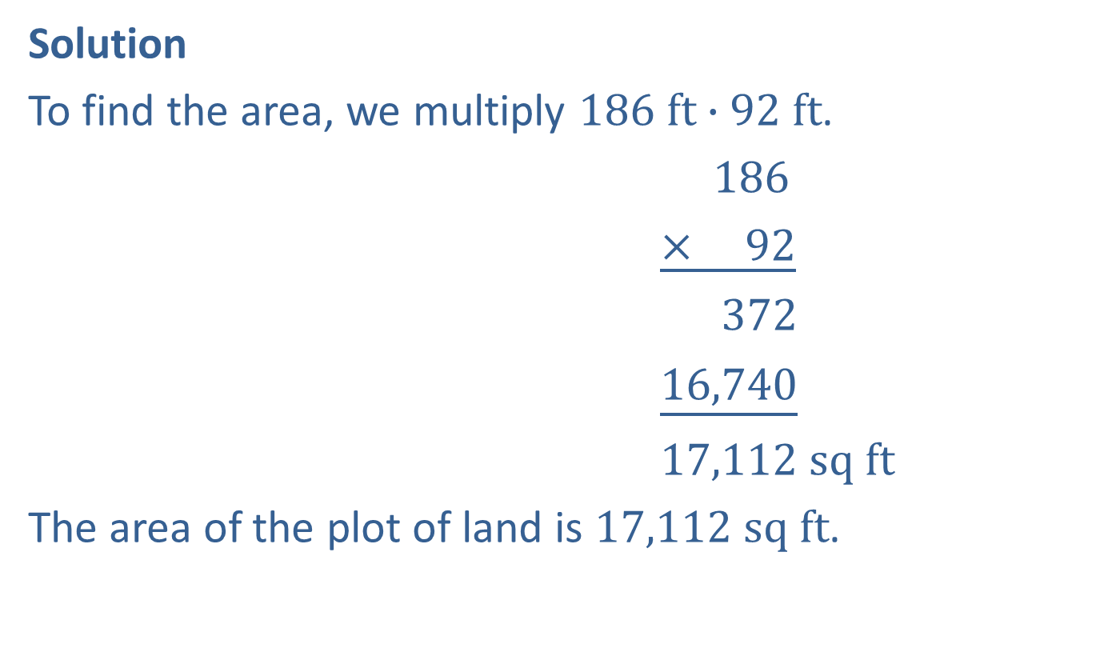
Example 8: Application: Calculating the Area of a Rectangle (cont.)
Solution
To find the area, we multiply $186 ft∙92 ft$.
$186$
$\underline{× 92}$
$372$
$\underline{16,740}$
$17,112 sq ft$
The area of the plot of land is $17,112 sq ft$.

Slide 24
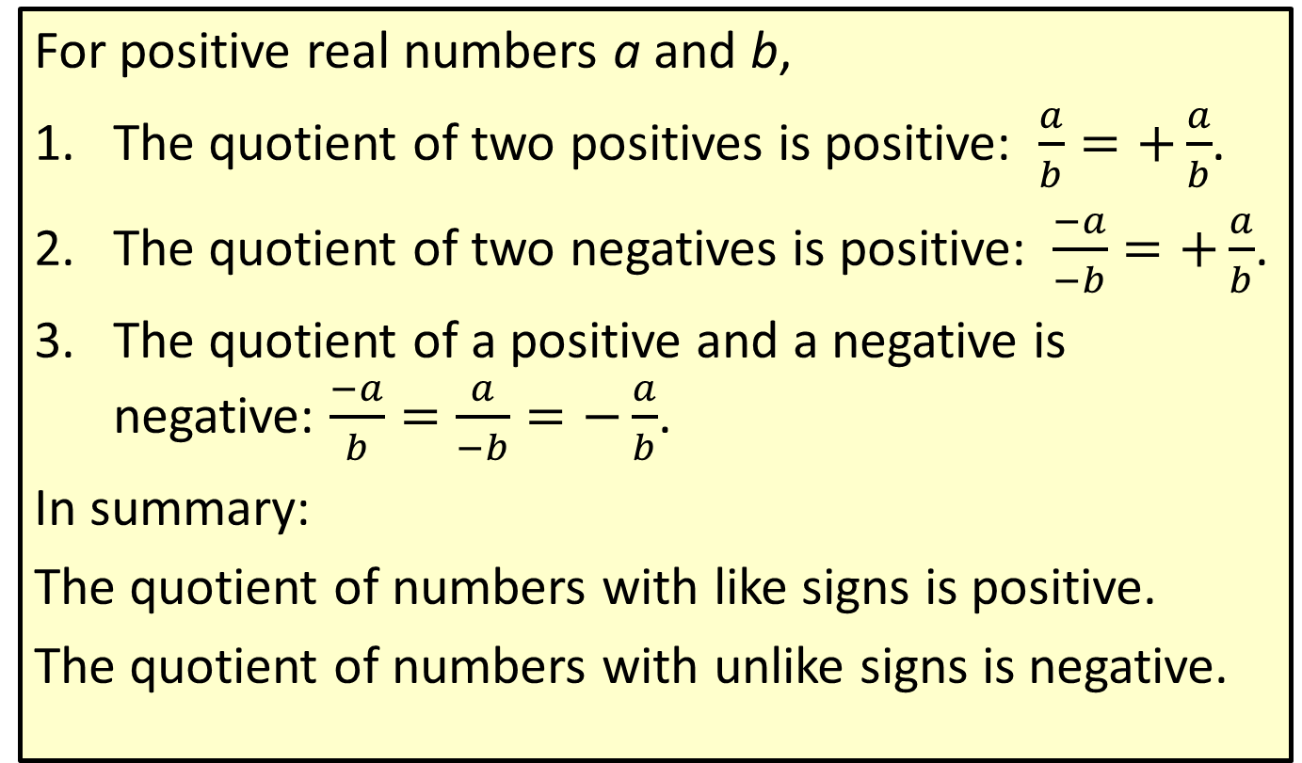
Procedure: Rules for Dividing Positive and Negative Real Numbers
For positive real numbers a and b,
​The quotient of two positives is positive: $\frac{a}{b}=+\frac{a}{b}$.
​The quotient of two negatives is positive: $\frac{−a}{−b}=+\frac{a}{b}$.
​The quotient of a positive and a negative is negative: $\frac{−a}{b}=\frac{a}{−b}=−\frac{a}{b}$.
In summary:
The quotient of numbers with like signs is positive.
The quotient of numbers with unlike signs is negative.

Slide 25

Example 9: Division with Positive and Negative Real Numbers
Divide.
​$\frac{30.6}{−2}$ b. ​$\frac{−18}{−6}$​ c. $−\frac{51}{3}$
Solution
a. $\frac{30.6}{−2}=−15.3$ b. $\frac{−18}{−6}=3$ c. $−\frac{51}{3}=−17$

Slide 26
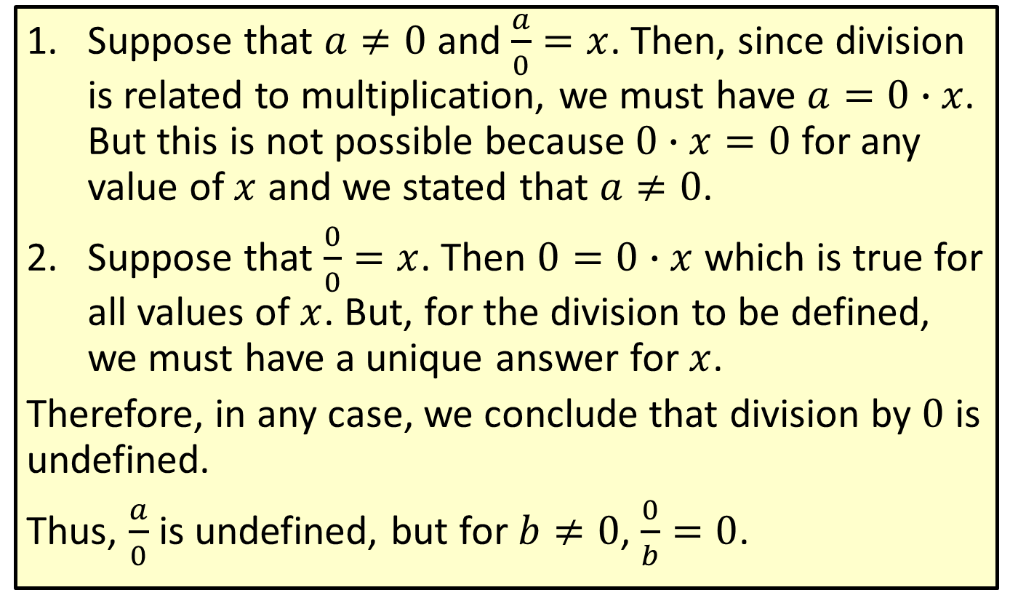

Definition: Division by $0$ is Undefined
​Suppose that $a≠0$ and $\frac{a}{0}=x$. Then, since division is related to multiplication, we must have $a=0∙x$. But this is not possible because $0∙x=0$ for any value of $x$ and we stated that $a≠0$.
Suppose that $\frac{0}{0}=x$. Then $0=0∙x$ which is true for all values of $x$. But, for the division to be defined, we must have a unique answer for $x$.
Therefore, in any case, we conclude that division by $0$ is undefined.
Thus, $\frac{a}{0}$ is undefined, but for $b≠0$, $\frac{0}{b}=0$.

Slide 27

Example 10: Division with 0
Divide.
​$\frac{0}{−7}$ b. ​$\frac{9}{0}$
Solution
a. $\frac{0}{−7}=0$ b. $\frac{9}{0}$ is undefined.

