Slide 1
Section 1.3
Problem Solving with Real Numbers

Slide 2
Procedure: Basic Strategy for Solving Word Problems
​READ: Read the problem carefully.
​SET UP: Draw any type of figure or diagram that might be helpful and decide what operations are needed.
​SOLVE: Perform the operations to solve the problem.
​CHECK: Check your work and check that your answer seems reasonable.

Slide 3
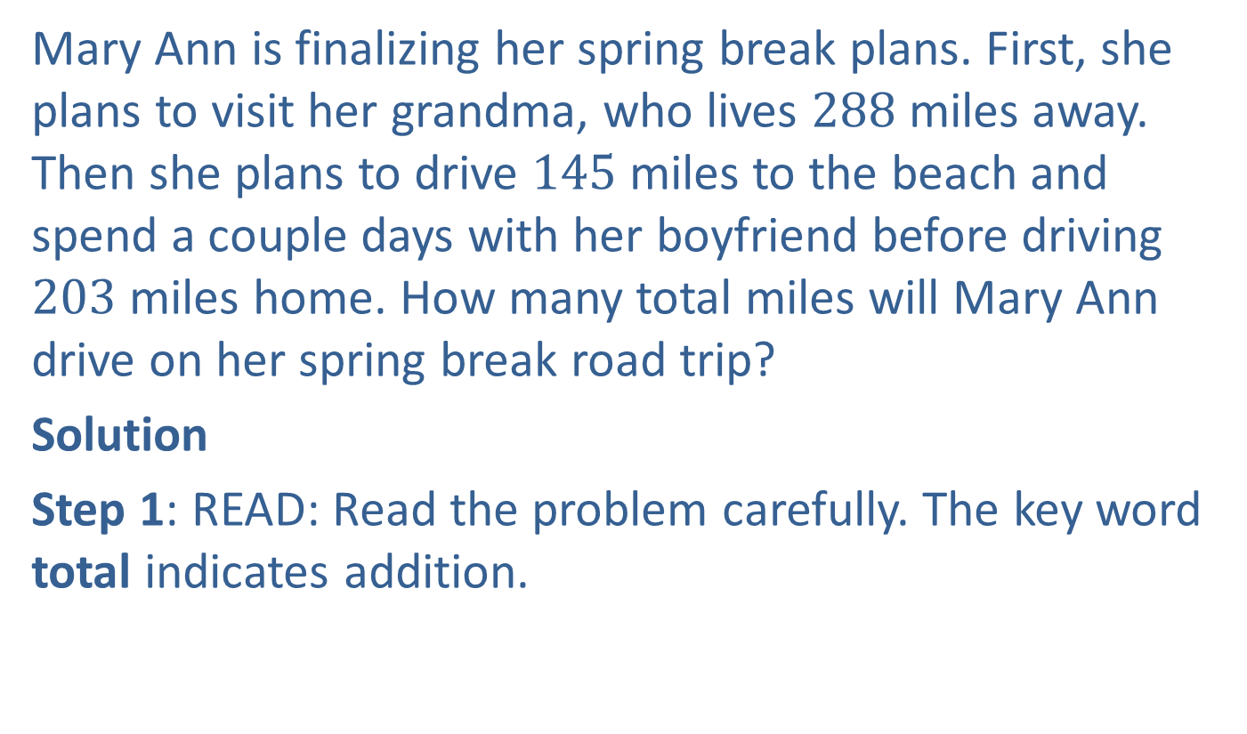
Example 1: Application: Adding Whole Numbers
Mary Ann is finalizing her spring break plans. First, she plans to visit her grandma, who lives $288$ miles away. Then she plans to drive $145$ miles to the beach and spend a couple days with her boyfriend before driving $203$ miles home. How many total miles will Mary Ann drive on her spring break road trip?
Solution
Step 1: READ: Read the problem carefully. The key word total indicates addition.

Slide 4

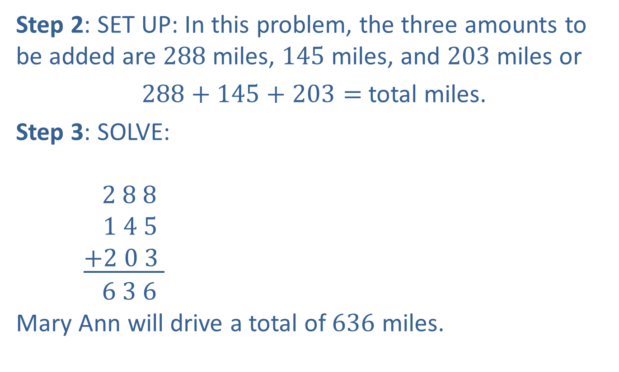
Example 1: Application: Adding Whole Numbers (cont.)
Step 2: SET UP: In this problem, the three amounts to be added are $288$ miles, $145$ miles, and $203$ miles or
$288+145+203=$ total miles.
Step 3: SOLVE:
$2 8 8$
$$1 4 5$$
$\underline{+2 0 3 }$
$6 3 6$
Mary Ann will drive a total of $636$ miles.
$$1$$
$$1$$
Total miles driven

Slide 5

Example 1: Application: Adding Whole Numbers (cont.)
Step 4: CHECK: Mary Ann will drive about $300$ miles to her grandma’s house, $100$ miles to the beach, and $200$ miles home and
$300+100+200=600,$
so a total of $636$ miles seems reasonable.

Slide 6
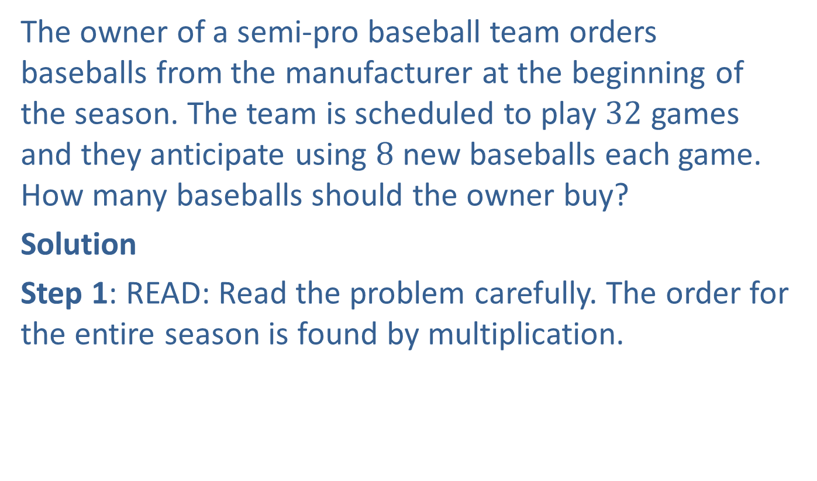
Example 2: Application: Multiplying Whole Numbers
The owner of a semi-pro baseball team orders baseballs from the manufacturer at the beginning of the season. The team is scheduled to play $32$ games and they anticipate using $8$ new baseballs each game. How many baseballs should the owner buy?
Solution
Step 1: READ: Read the problem carefully. The order for the entire season is found by multiplication.

Slide 7

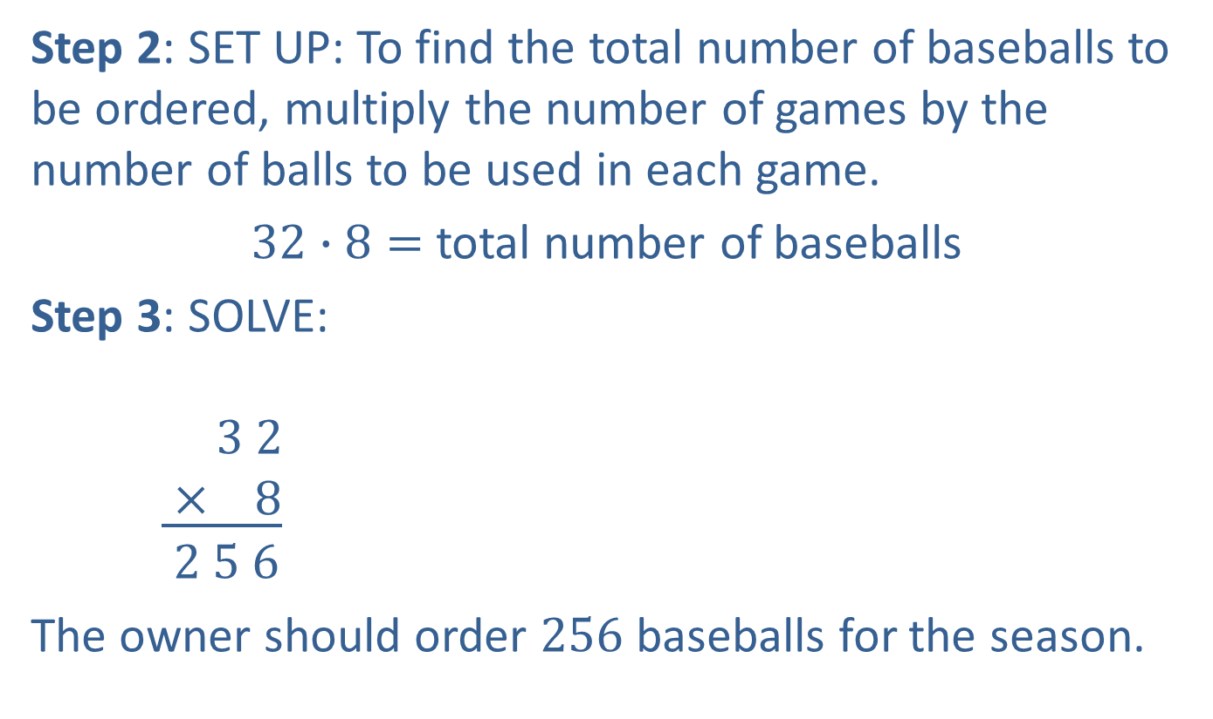
Example 2: Application: Multiplying Whole Numbers (cont.)
Step 2: SET UP: To find the total number of baseballs to be ordered, multiply the number of games by the number of balls to be used in each game.
$32∙8=$ total number of baseballs
Step 3: SOLVE:
$3 2$
$\underline{ × 8}$
$2 5 6$
The owner should order $256$ baseballs for the season.
$$1$$
Games
Balls for each game
Total to be ordered

Slide 8

Example 2: Application: Multiplying Whole Numbers (cont.)
Step 4: CHECK: The team plays about $30$ games and uses about $10$ balls per game and
$$30∙10=300,$$
so a total order of $256$ balls seems reasonable.

Slide 9
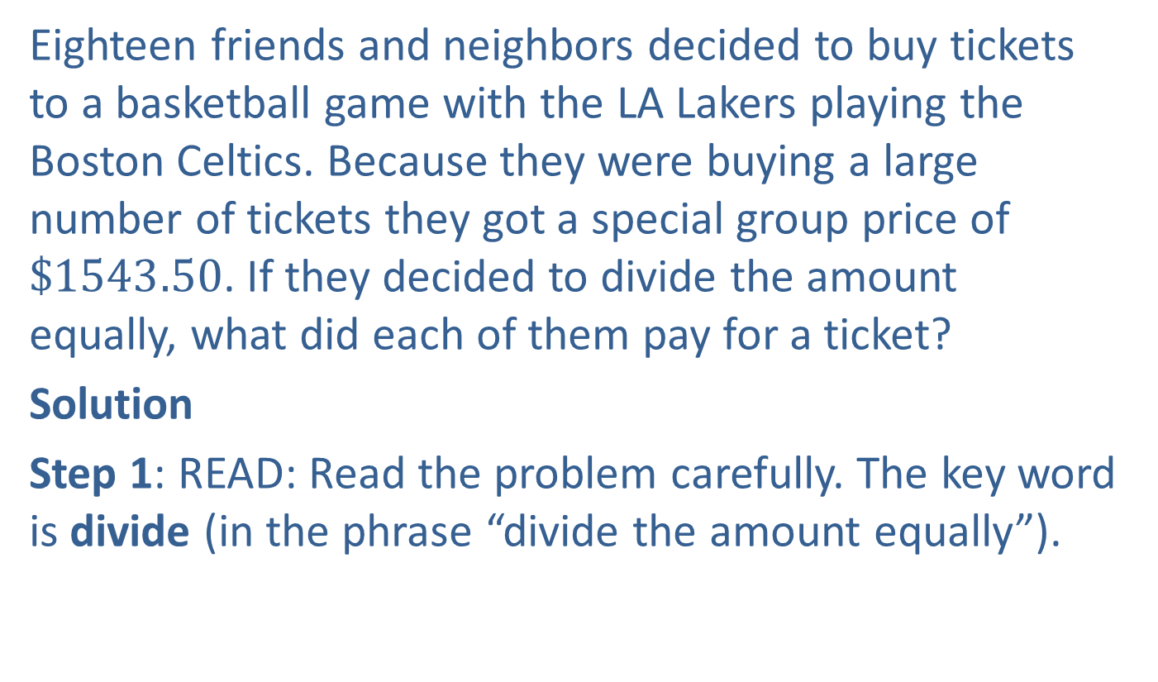
Example 3: Application: Dividing Whole Numbers
Eighteen friends and neighbors decided to buy tickets to a basketball game with the LA Lakers playing the Boston Celtics. Because they were buying a large number of tickets they got a special group price of $\$1543.50$. If they decided to divide the amount equally, what did each of them pay for a ticket?
Solution
Step 1: READ: Read the problem carefully. The key word is divide (in the phrase “divide the amount equally”).

Slide 10
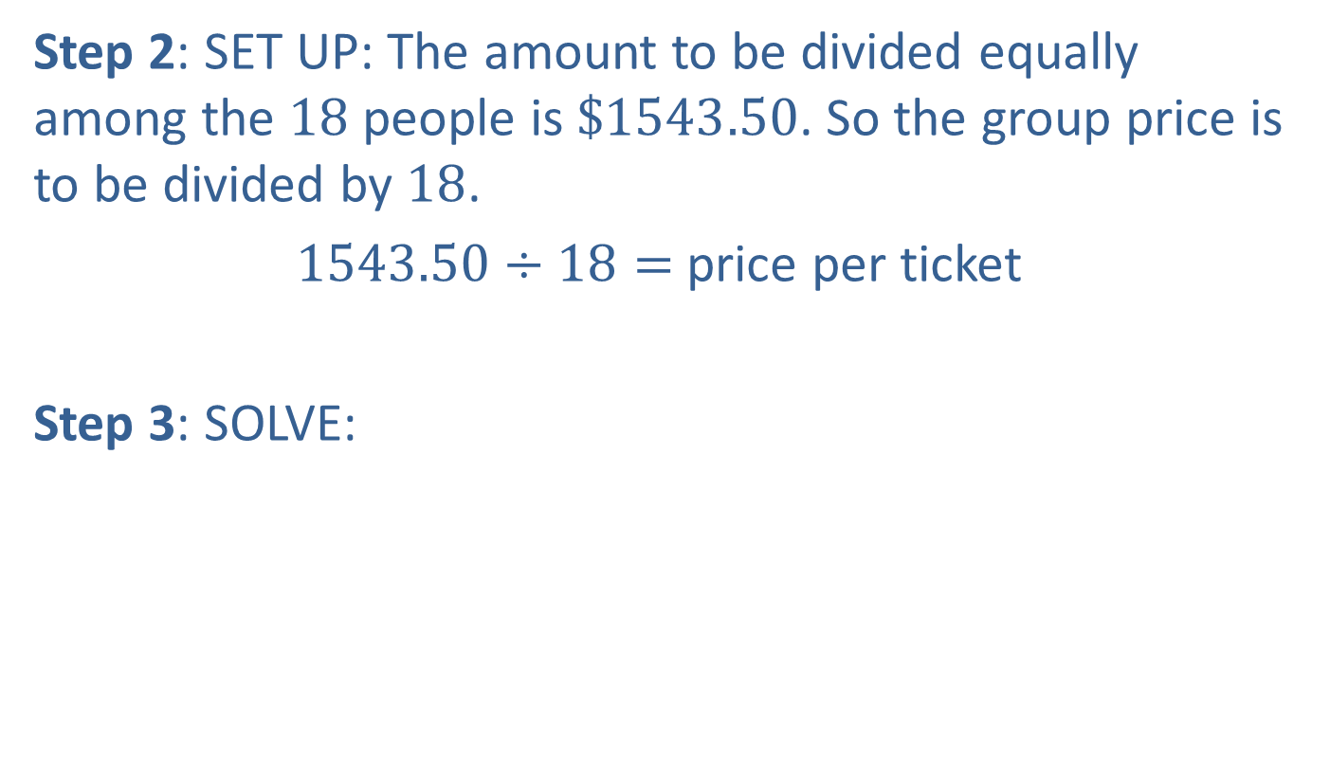
Example 3: Application: Dividing Whole Numbers (cont.)
Step 2: SET UP: The amount to be divided equally among the $18$ people is $\$1543.50$. So the group price is to be divided by $18$.
$1543.50÷18=$ price per ticket
Step 3: SOLVE:

Slide 11

Example 3: Application: Dividing Whole Numbers (cont.)
$85.75$
$$18\text{⟌}\overline{1543.50}$$
$\underline{−144}$
$103$
$\underline{− 90}$
$13 5$
$\underline{ − 12 6}$
$90$
$\underline{− 90}$
$0$
Each person paid $\$85.75$for a ticket.

Slide 12

Example 3: Application: Dividing Whole Numbers (cont.)
Step 4: CHECK: Because there are almost $20$ people in the group and $20⋅80=1600$, the individual price of $\$85.75$seems reasonable. This can be checked directly by multiplication.
$$18∙\$85.75=\$1543.50$$

Slide 13
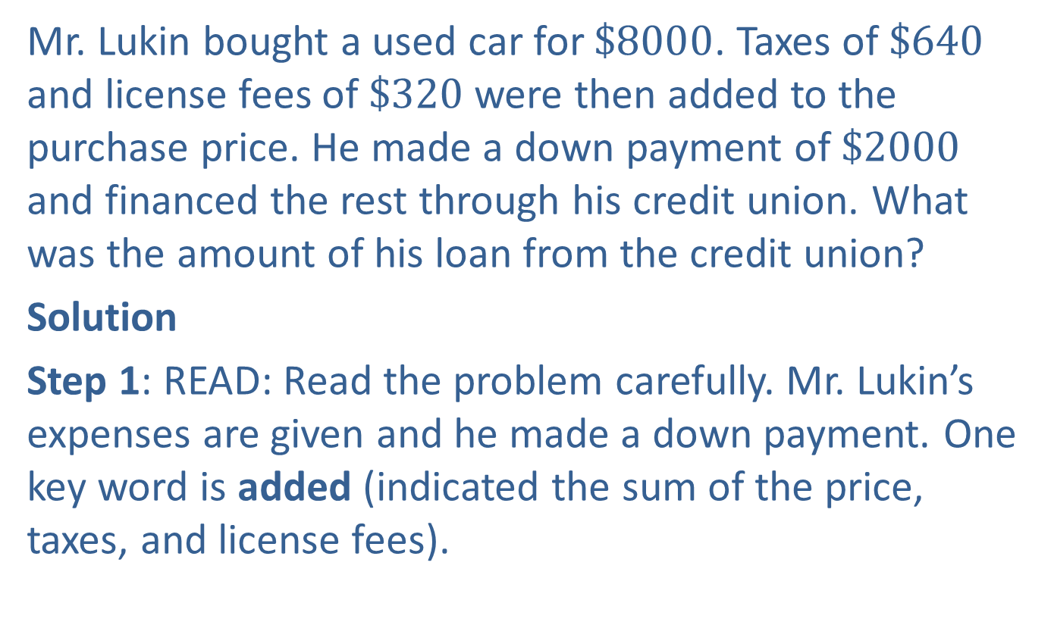
Example 4: Application: Calculating Loan Amounts
Mr. Lukin bought a used car for $\$8000$. Taxes of $\$640$ and license fees of $\$320$ were then added to the purchase price. He made a down payment of $\$2000$ and financed the rest through his credit union. What was the amount of his loan from the credit union?
Solution
Step 1: READ: Read the problem carefully. Mr. Lukin’s expenses are given and he made a down payment. One key word is added (indicated the sum of the price, taxes, and license fees).

Slide 14
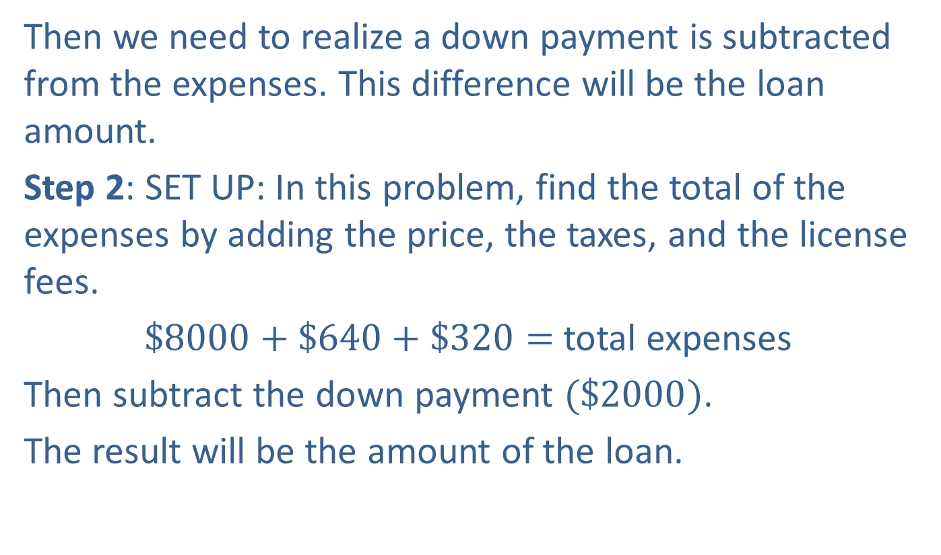
Example 4: Application: Calculating Loan Amounts (cont.)
Then we need to realize a down payment is subtracted from the expenses. This difference will be the loan amount.
Step 2: SET UP: In this problem, find the total of the expenses by adding the price, the taxes, and the license fees.
$\$8000+\$640+\$320=$total expenses
Then subtract the down payment $(\$2000)$.
The result will be the amount of the loan.

Slide 15
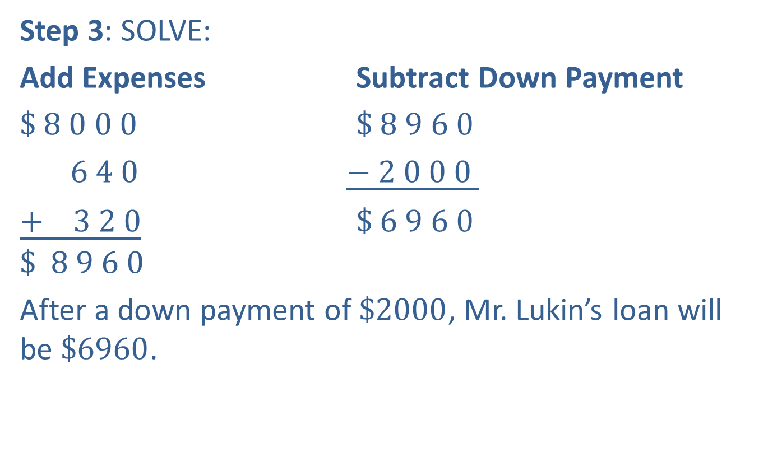
Example 4: Application: Calculating Loan Amounts (cont.)
Step 3: SOLVE:
Add Expenses Subtract Down Payment
$\$ 8 0 0 0$ $\$ 8 9 6 0$
$6 4 0$ $\underline{− 2 0 0 0 }$
$\underline{+ 3 2 0}$ $\$ 6 9 6 0$
$$\$ 8 9 6 0$$
After a down payment of $\$2000$, Mr. Lukin’s loan will be $\$6960$.
Price
Total expenses
Taxes
Down payment
License fees
Amount of loan
Total expenses

Slide 16

Example 4: Application: Calculating Loan Amounts (cont.)
Step 4: CHECK: With a price of $\$8000$and a down payment of $\$2000$, the loan amount should be close to $\$6000$. Because of the extra fees, the actual loan amount of $\$6960$seems reasonable.

Slide 17
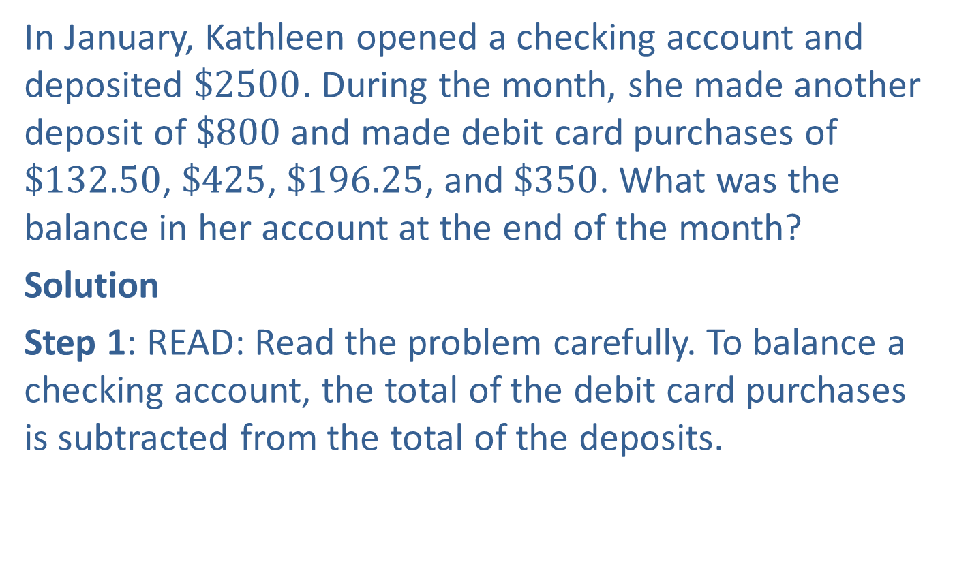
Example 5: Application: Balancing a Checking Account
In January, Kathleen opened a checking account and deposited $\$2500$. During the month, she made another deposit of $\$800$ and made debit card purchases of $\$132.50$, $\$425$, $\$196.25$, and $\$350$. What was the balance in her account at the end of the month?
Solution
Step 1: READ: Read the problem carefully. To balance a checking account, the total of the debit card purchases is subtracted from the total of the deposits.

Slide 18

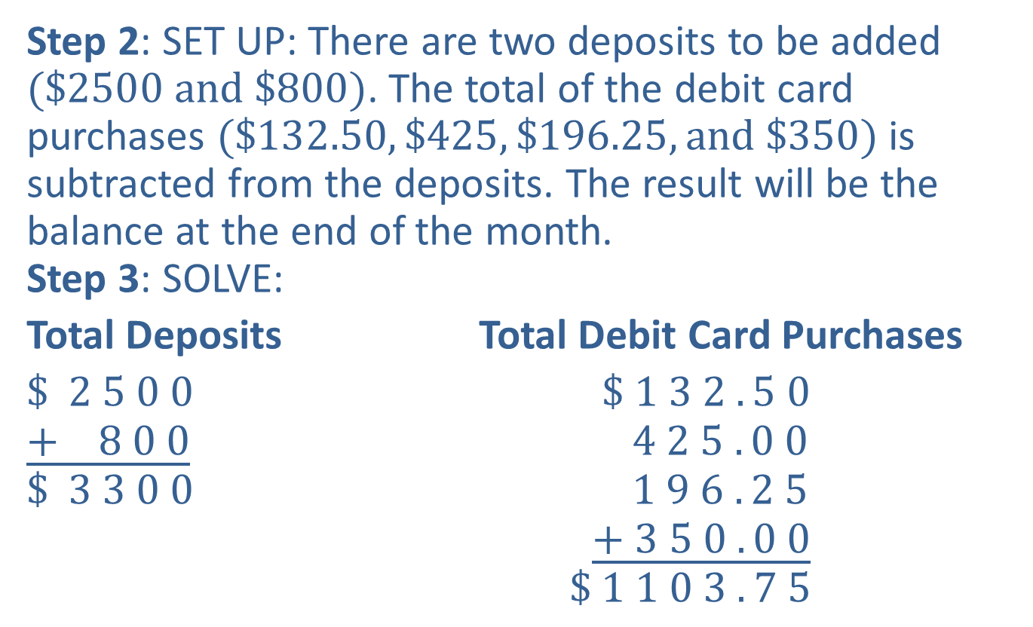


Example 5: Application: Balancing a Checking Account (cont.)
Step 2: SET UP: There are two deposits to be added $(\$2500 and \$800)$. The total of the debit card purchases $(\$132.50, \$425, \$196.25, and \$350)$is subtracted from the deposits. The result will be the balance at the end of the month.
Step 3: SOLVE:
Total Deposits Total Debit Card Purchases
$\$ 2 5 0 0$ $\$ 1 3 2 . 5 0$
$\underline{+ 8 0 0}$ $4 2 5 . 0 0$
$\$ 3 3 0 0$ $1 9 6 . 2 5$
$\underline{+ 3 5 0 . 0 0}$
$\$ 1 1 0 3 . 7 5$
$$1$$
$$2$$
$$1$$
Total deposits
Total of checks

Slide 19

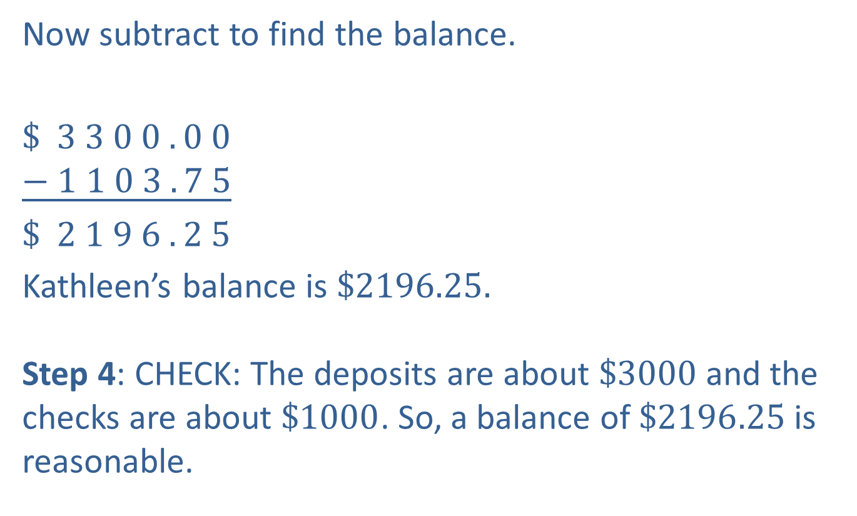

Example 5: Application: Balancing a Checking Account (cont.)
Now subtract to find the balance.
$\$ 3 3 0 0 . 0 0$
$\underline{− 1 1 0 3 . 7 5}$
$\$ 2 1 9 6 . 2 5$
Kathleen’s balance is $\$2196.25.$
Step 4: CHECK: The deposits are about $\$3000$and the checks are about $\$1000$. So, a balance of $\$2196.25$is reasonable.
$$9$$
$$9$$
$$9$$
$$2$$
10
10
10
10
Balance
Total of checks

Slide 20
Procedure: To Find the Average of a Set of Numbers
​Find the sum of the given set of numbers.
​Divide this sum by the number of numbers in the set. This quotient is called the average of the given set of numbers.

Slide 21

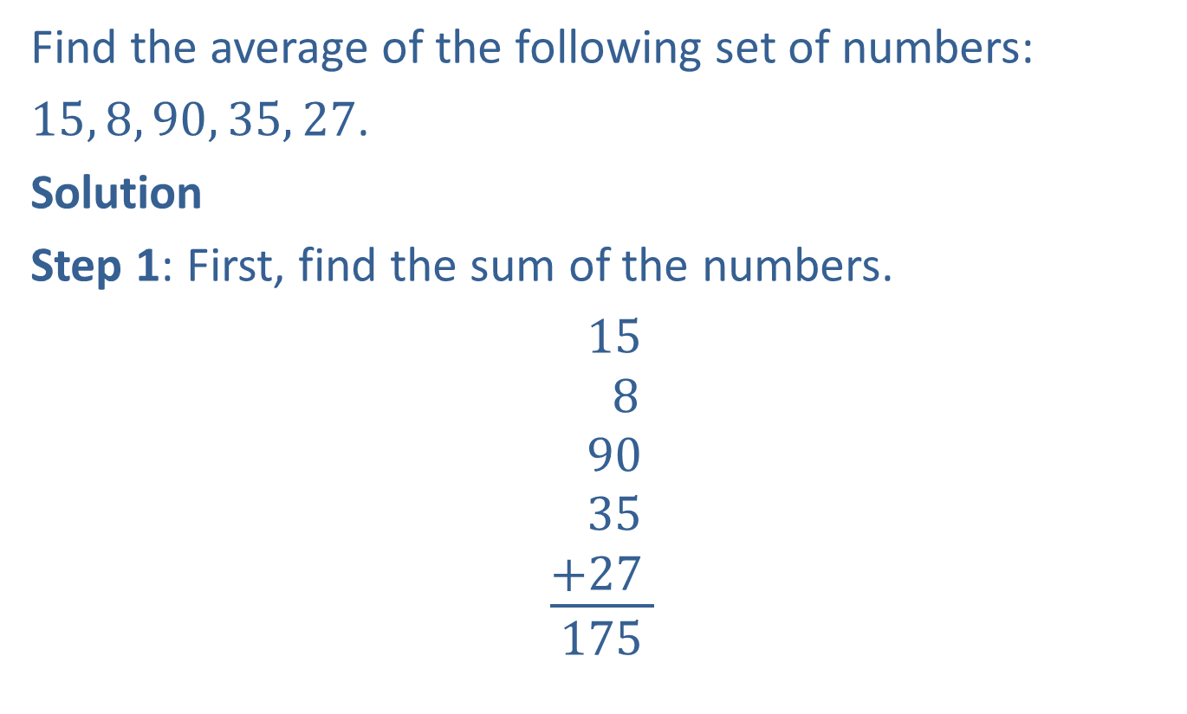
Example 6: Calculating an Average
Find the average of the following set of numbers:
$15, 8, 90, 35, 27$.
Solution
Step 1: First, find the sum of the numbers.
$$\begin{matrix} \\ \frac{{\begin{aligned} 15 \\ 8 \\ 90 \\ 35 \\ +27\end{aligned}}_{ }^{ }}{175}\end{matrix}$$
$$2$$
Sum

Slide 22
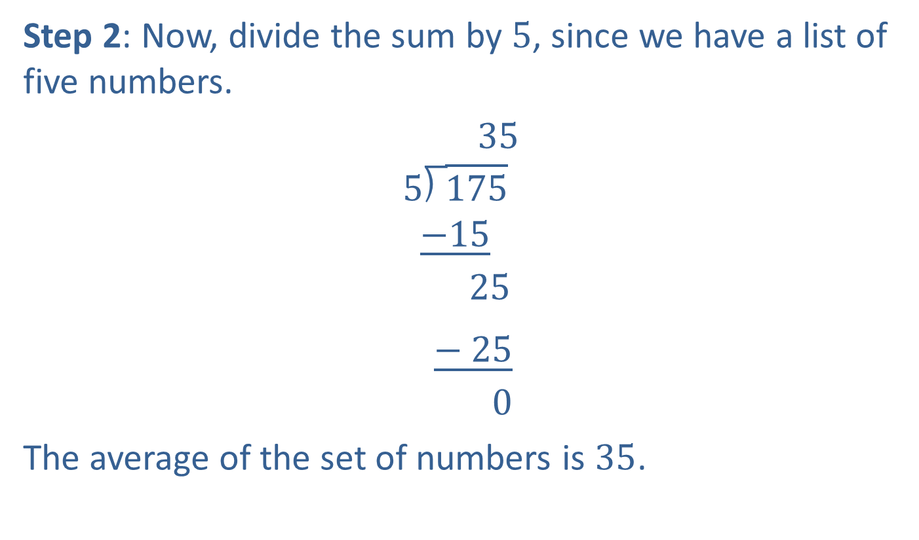
Example 6: Calculating an Average (cont.)
Step 2: Now, divide the sum by $5$, since we have a list of five numbers.
$35$
$$5\text{⟌}\overline{175}$$
$$\underline{−15}$$
$$25$$
$\underline{− 25}$
$$0$$
The average of the set of numbers is $35$.
Average

Slide 23
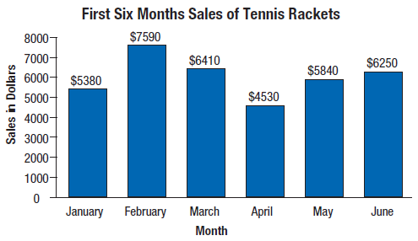
Example 7: Application: Calculating an Average
Top-Notch Sporting Goods recorded its profits for tennis rackets for six months. The following bar graph indicates the profits for each of the months from January to June.

Slide 24
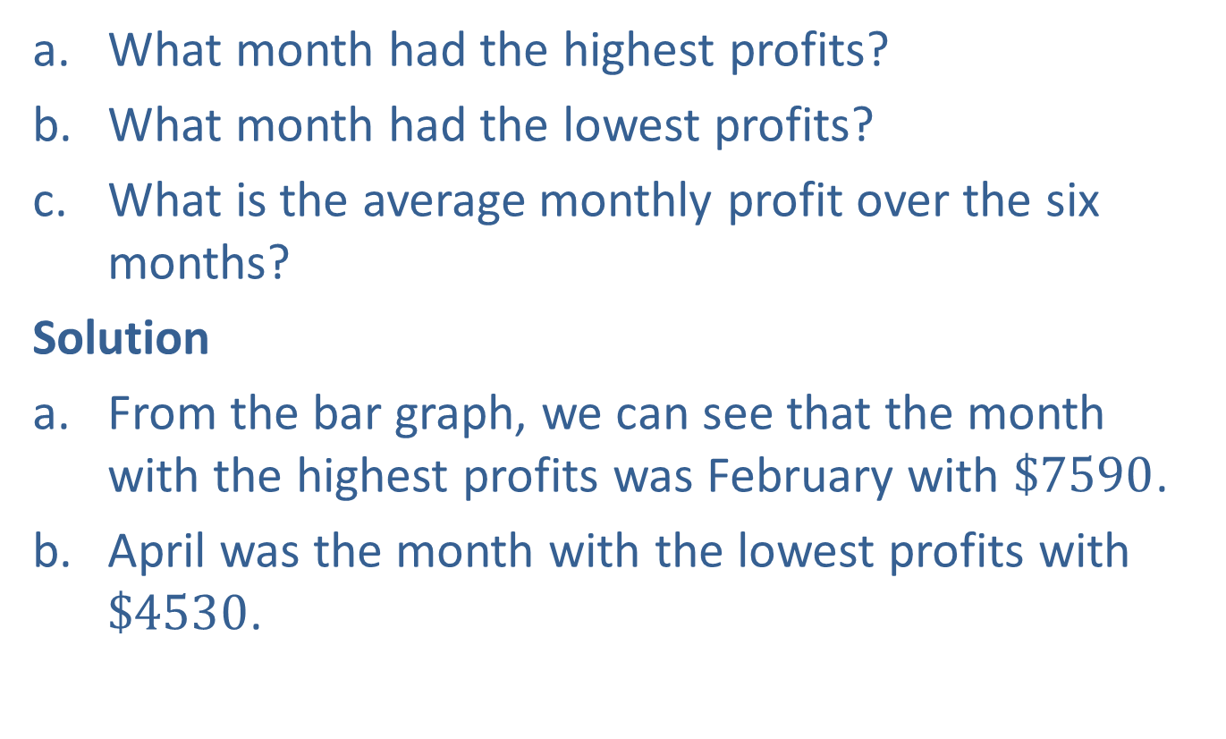
Example 7: Application: Calculating an Average (cont.)
​What month had the highest profits?
What month had the lowest profits?
What is the average monthly profit over the six months?
Solution
From the bar graph, we can see that the month with the highest profits was February with $\$7590$.
April was the month with the lowest profits with $\$4530$.

Slide 25

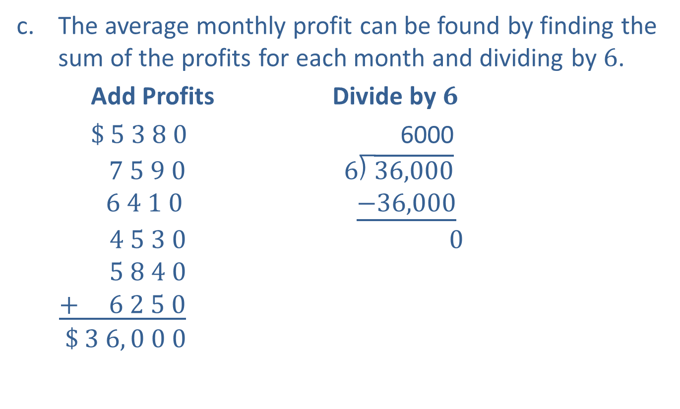
Example 7: Application: Calculating an Average (cont.)
The average monthly profit can be found by finding the sum of the profits for each month and dividing by $6$.
Add Profits Divide by $6$
$\$ 5 3 8 0$ 6000
$7 5 9 0$ $6\text{⟌}\overline{36,000}$
$6 4 1 0$ $\underline{−36,000}$
$4 5 3 0$ $0$
$5 8 4 0$
$\underline{+ 6 2 5 0}$
$\$ 3 6, 0 0 0$
$$3$$
$$3$$
Average
Sum

Slide 26

Example 7: Application: Calculating an Average (cont.)
The average monthly profit for the six months was $\$6000$per month.
(In this case, we see that the average can be very useful. The store manager can use the monthly profits for planning and budgeting.)

Slide 27

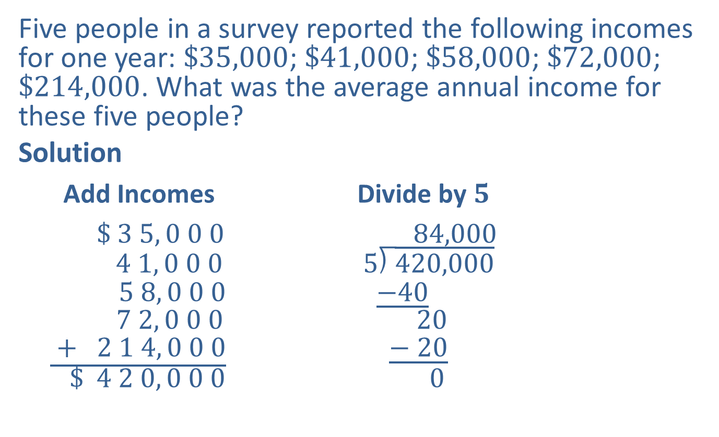
Example 8: Application: Calculating an Average
Five people in a survey reported the following incomes for one year: $\$35,000$; $\$41,000$; $\$58,000$; $\$72,000$; $\$214,000$. What was the average annual income for these five people?
Solution
Add Incomes Divide by $5$
$\$ 3 5, 0 0 0$ $84,000$
$4 1, 0 0 0$ $5\text{⟌}\overline{420,000}$
$5 8, 0 0 0$ $\underline{−40}$
$7 2, 0 0 0$ $20$
$\underline{ + 2 1 4, 0 0 0}$ $\underline{− 20}$
$\$ 4 2 0, 0 0 0$ $0$
$$2$$
$$2$$
Average
Sum

Slide 28
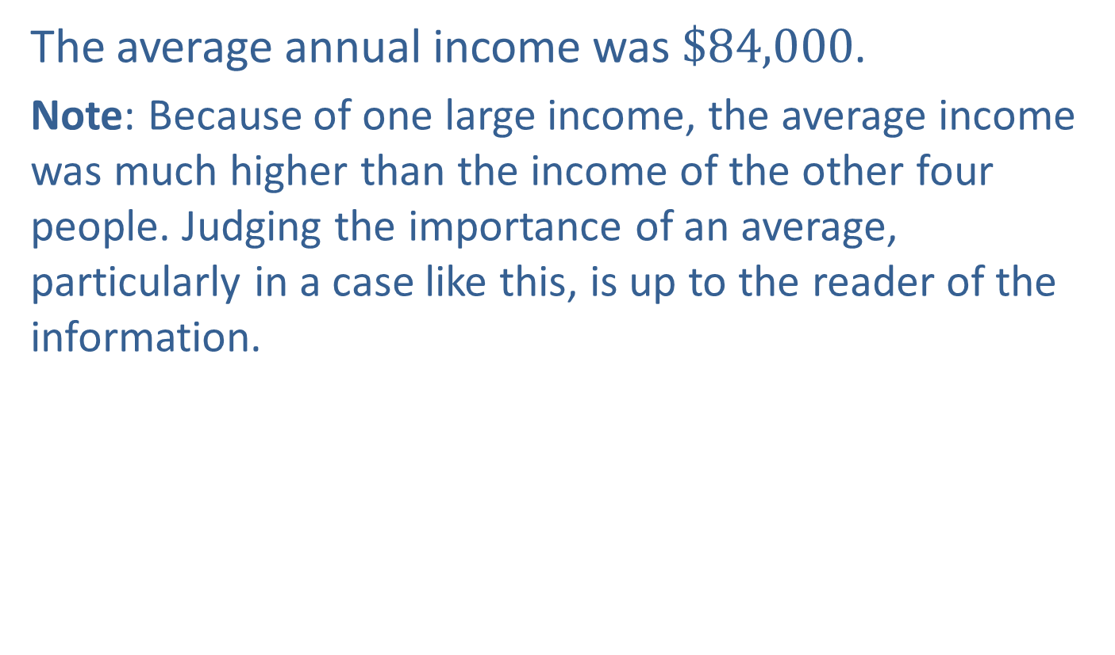
Example 8: Application: Calculating an Average (cont.)
The average annual income was $\$84,000$.
Note: Because of one large income, the average income was much higher than the income of the other four people. Judging the importance of an average, particularly in a case like this, is up to the reader of the information.

Slide 29

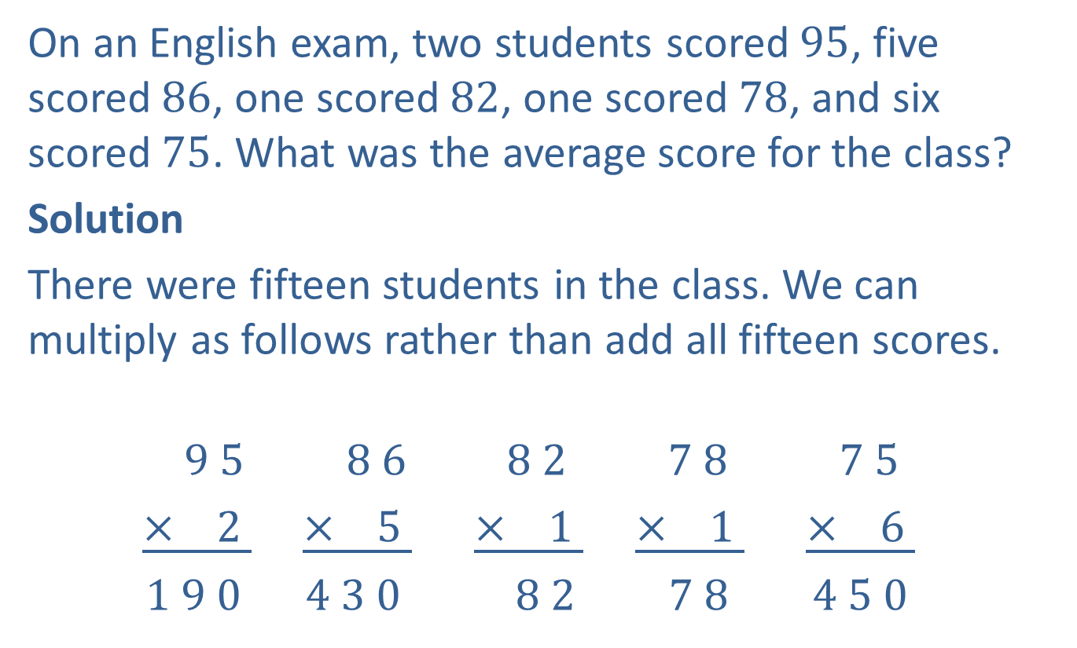

Example 9: Application: Calculating an Average
On an English exam, two students scored $95$, five scored $86$, one scored $82$, one scored $78$, and six scored $75$. What was the average score for the class?
Solution
There were fifteen students in the class. We can multiply as follows rather than add all fifteen scores.
$$9 5 8 6 8 2 7 8 7 5$$
$\underline{× 2 }$ $\underline{× 5 }$ $\underline{× 1 }$ $\underline{× 1 }$ $\underline{× 6 }$
$1 9 0$ $4 3 0$ $8 2$ $7 8$ $4 5 0$
$$1$$
$$3$$
$$3$$

Slide 30

Example 9: Application: Calculating an Average (cont.)
Next, we add the five products to find the sum of all of the scores.
$$\frac{{\begin{aligned} 1 9 0 \\ 4 3 0 \\ 8 2 \\ 7 8 \\ +4 5 0\end{aligned}}_{ }^{ }}{1 2 3 0}$$
$$3$$
$$1$$
Sum

Slide 31
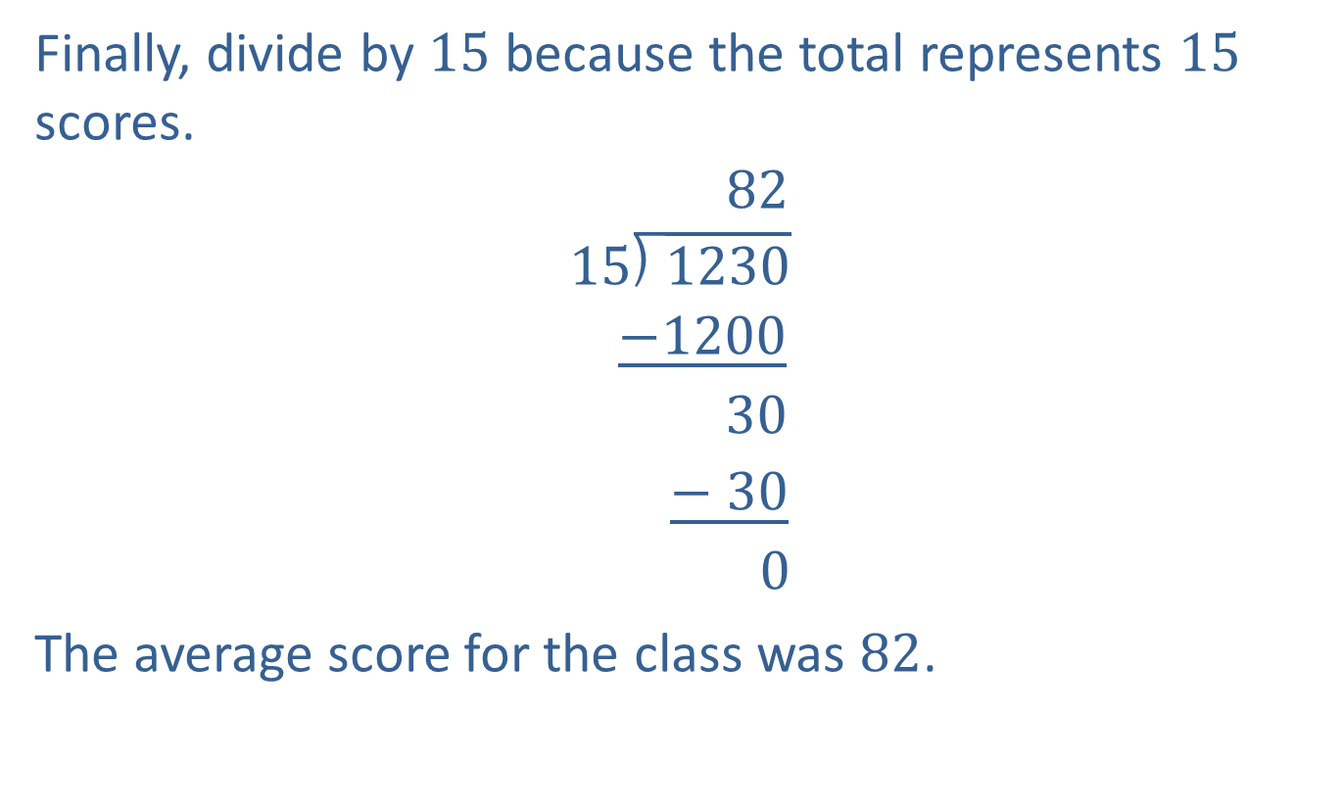
Example 9: Application: Calculating an Average (cont.)
Finally, divide by $15$ because the total represents $15$ scores.
$82$
$$\text{15}\text{⟌}\overline{1230}$$
$\underline{−1200}$
$$30$$
$\underline{− 30}$
$$0$$
The average score for the class was $82$.
Average

