Slide 1
Section 1.4
Square Roots and Order of Operations with Real Numbers

Slide 2
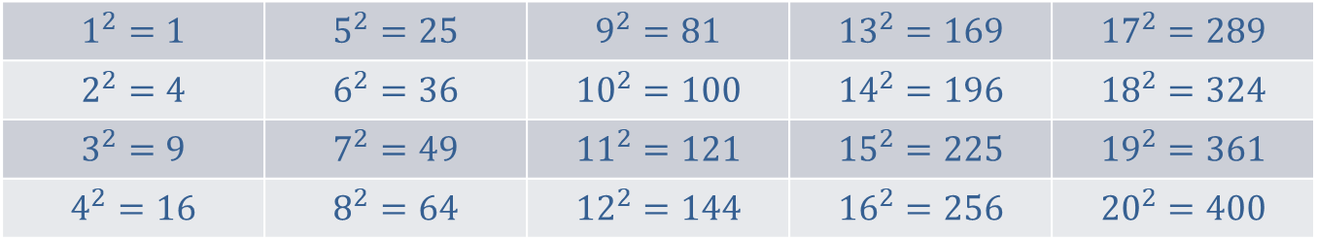

Squares of Whole Numbers from $1$ to $20$
$$1^{2}=1$$ | $$5^{2}=25$$ | $$9^{2}=81$$ | $${13}^{2}=169$$ | $${17}^{2}=289$$
$$2^{2}=4$$ | $$6^{2}=36$$ | $${10}^{2}=100$$ | $${14}^{2}=196$$ | $${18}^{2}=324$$
$$3^{2}=9$$ | $$7^{2}=49$$ | $${11}^{2}=121$$ | $${15}^{2}=225$$ | $${19}^{2}=361$$
$$4^{2}=16$$ | $$8^{2}=64$$ | $${12}^{2}=144$$ | $${16}^{2}=256$$ | $${20}^{2}=400$$
Table 1

Slide 3
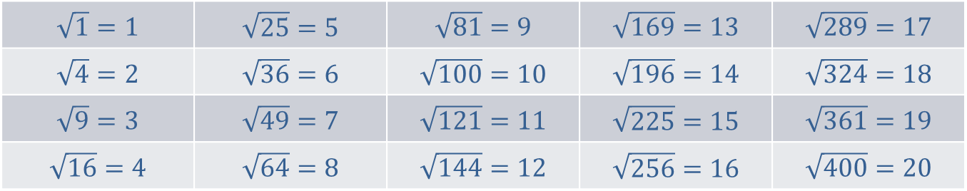
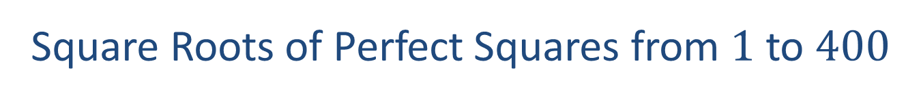
Square Roots of Perfect Squares from $1$ to $400$
$$\sqrt{1}=1$$ | $$\sqrt{25}=5$$ | $$\sqrt{81}=9$$ | $$\sqrt{169}=13$$ | $$\sqrt{289}=17$$
$$\sqrt{4}=2$$ | $$\sqrt{36}=6$$ | $$\sqrt{100}=10$$ | $$\sqrt{196}=14$$ | $$\sqrt{324}=18$$
$$\sqrt{9}=3$$ | $$\sqrt{49}=7$$ | $$\sqrt{121}=11$$ | $$\sqrt{225}=15$$ | $$\sqrt{361}=19$$
$$\sqrt{16}=4$$ | $$\sqrt{64}=8$$ | $$\sqrt{144}=12$$ | $$\sqrt{256}=16$$ | $$\sqrt{400}=20$$
Table 2

Slide 4
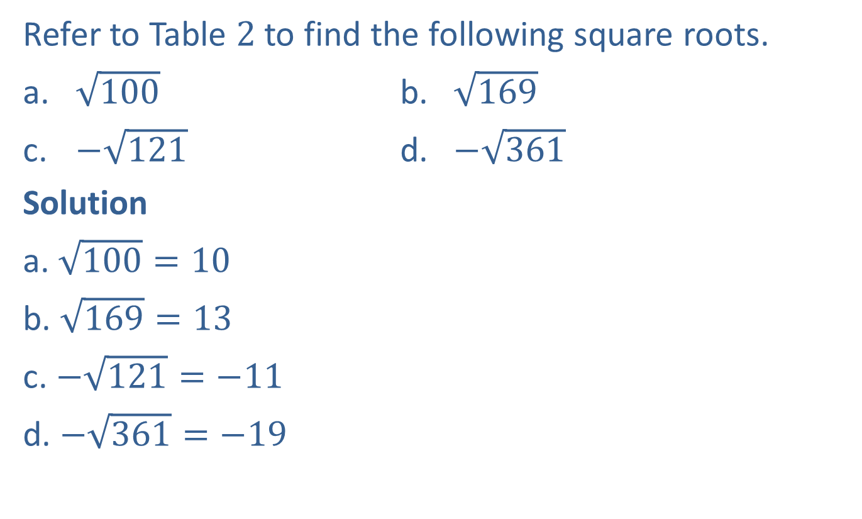
Example 1: Finding Square Roots
Refer to Table $2$ to find the following square roots.
​$\sqrt{100}$ b. ​$\sqrt{169}$
​$−\sqrt{121}$ d. ​$−\sqrt{361}$
Solution
a. $\sqrt{100}=10$
b. $\sqrt{169}=13$
c. $−\sqrt{121}=−11$
d. $−\sqrt{361}=−19$

Slide 5
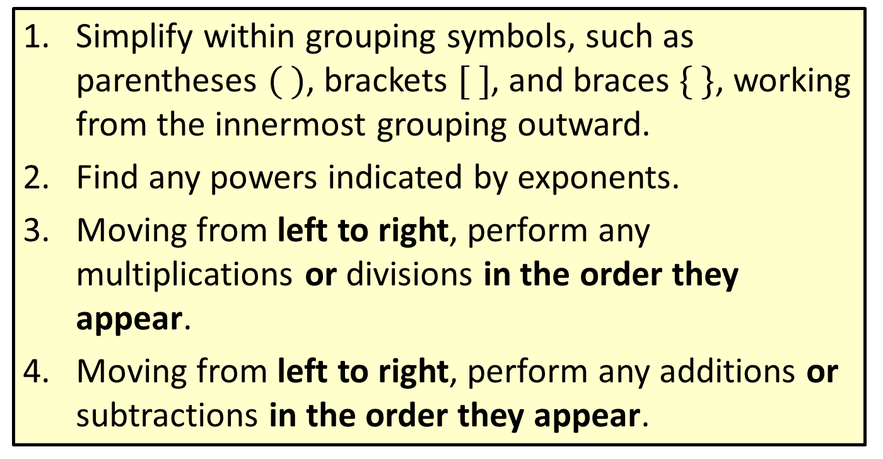
Procedure: Rules for Order of Operations
​Simplify within grouping symbols, such as parentheses $( )$, brackets $[ ]$, and braces $\{ \}$, working from the innermost grouping outward.
​Find any powers indicated by exponents.
​Moving from left to right, perform any multiplications or divisions in the order they appear.
​Moving from left to right, perform any additions or subtractions in the order they appear.

Slide 6
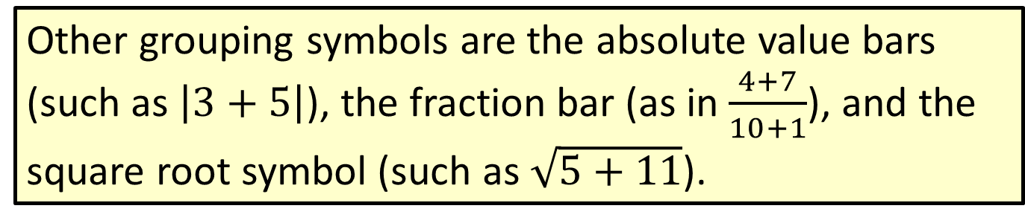
Note
Other grouping symbols are the absolute value bars (such as $\left|3+5\right|$), the fraction bar (as in $\frac{4+7}{10+1}$), and the square root symbol (such as$\sqrt{5+11}$).

Slide 7

Example 2: Using the Order of Operations with Real Numbers
Simplify: $36÷4−\sqrt{36}⋅2^{2}$
Solution
$$36÷4−\sqrt{36}∙2^{2}=36÷4−6∙4$$
$=9−24$
$=−15$
Simplify square roots
and exponents.
Divide and multiply, left to right.
Subtract.

Slide 8

Example 3: Using the Order of Operations with Real Numbers
Simplify: $2\left(3^{2}−1\right)−3⋅2^{3}$
Solution
$$2\left(3^{2}−1\right)−3∙2^{3}=2\left(9−1\right)−3∙8$$
$=2\left(8\right)−3∙8$
$=16−24$
$=−8$
Simplify exponents.
Subtract inside the parentheses.
Multiply.
Subtract (or add algebraically).

Slide 9

Example 4: Using the Order of Operations with Real Numbers
Simplify: ${\left(2−5\right)}^{2}+\left|2−5^{2}\right|−2^{3}$
Solution
$$\left(2−5\right) ^{2}+\left|2−5^{2}\right|−2^{3}$$
$={\left(−3\right)}^{2}+$ $\left|2−5^{2}\right|−2^{3}$
$=9+\left|2−25\right|−8$
$=9+\left|−23\right|−8$
$=9+23−8$
$=24$
Add inside the parentheses.
Simplify exponents.
Add inside the absolute value bars.
Evaluate the absolute value.
Add and subtract.

Slide 10
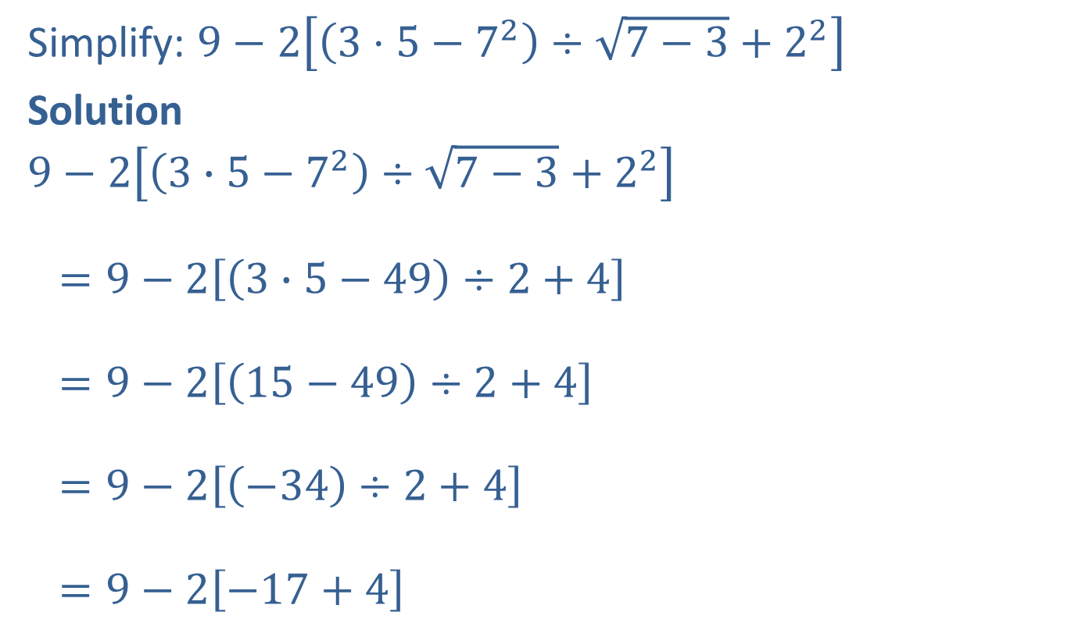
Example 5: Using the Order of Operations with Real Numbers
Simplify: $9−2\left[\left(3⋅5−7^{2}\right)÷\sqrt{7−3}+2^{2}\right]$
Solution
$$9−2\left[\left(3∙5−7^{2}\right)÷\sqrt{7−3}+2^{2}\right]$$
$=9−2\left[\left(3∙5−49\right)÷2+4\right]$
$=9−2\left[\left(15−49\right)÷2+4\right]$
$=9−2\left[\left(−34\right)÷2+4\right]$
$=9−2\left[−17+4\right]$
Simplify exponents;
subtract inside the square root.
Multiply inside the parentheses;
simplify the square root.
Subtract inside the parentheses.
Divide inside the brackets.

Slide 11
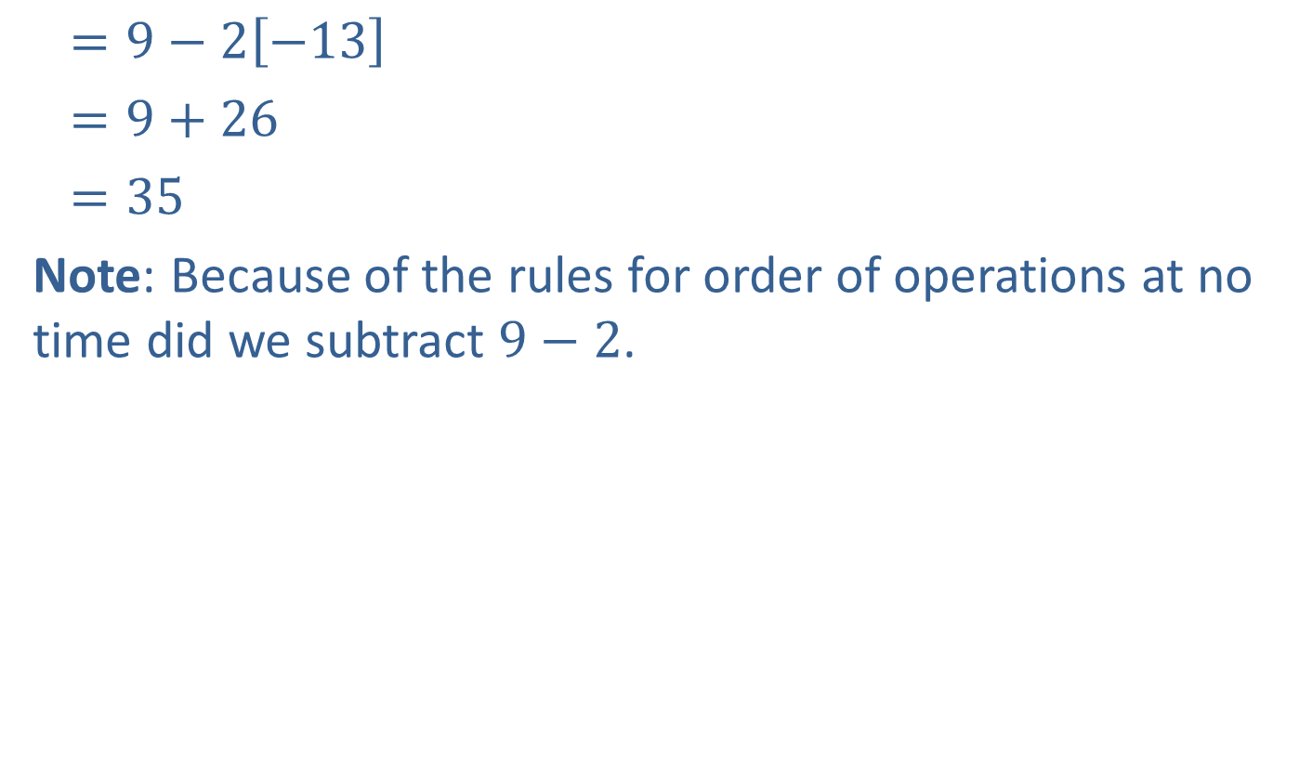
Example 5: Using the Order of Operations with Real Numbers (cont.)
$=9−2\left[−13\right]$
$=9+26$
$=35$
Note: Because of the rules for order of operations at no time did we subtract $9−2$.
Add inside the brackets.
Multiply.
Add.

Slide 12

Completion Example 6: Using the Order of Operations
Simplify: $6{\left(5^{2}−4^{2}\right)}^{ }−2∙3^{3}$
Solution
$$6\left(5^{2}−4^{2}\right)−2∙3^{3}=6\left(\underline{25}−\underline{16}\right)−2∙\underline{27}$$
$=6\left(\underline{9}\right)−2∙27$
$= \underline{54}−$ $\underline{54}$
$= \underline{0}$
Simplify exponents.
Simplify within parentheses.
Multiply.
Subtract.

Slide 13
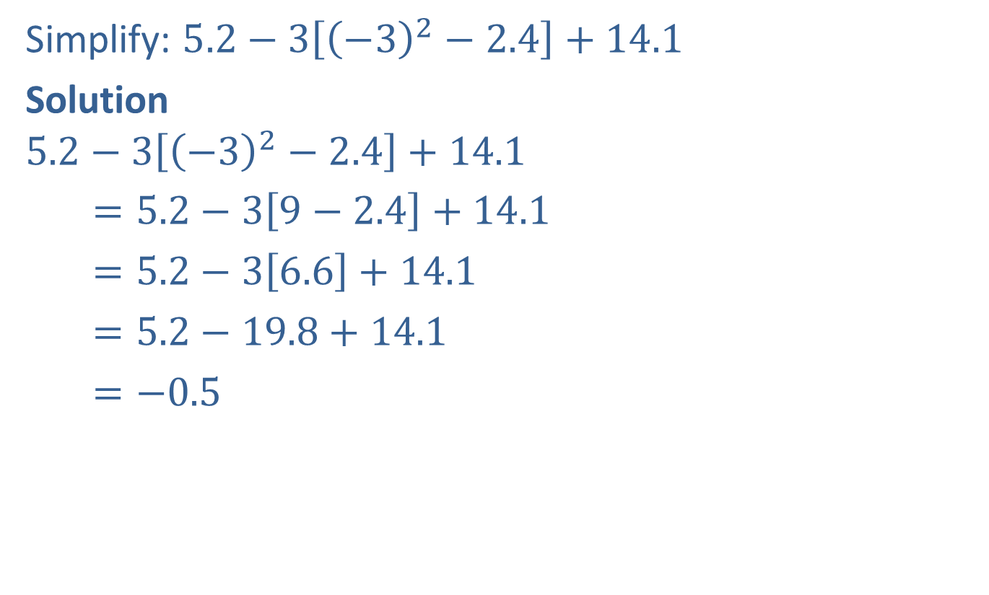
Example 7: Using the Order of Operations with Real Numbers
Simplify: $5.2−3\left[{\left(−3\right)}^{2}−2.4\right]+14.1$
Solution
$$5.2−3\left[{\left(−3\right)}^{2}−2.4\right]+14.1$$
$=5.2−3\left[9−2.4\right]+14.1$
$=5.2−3\left[6.6\right]+14.1$
$=5.2−19.8+14.1$
$=−0.5$
Simplify exponents.
Subtract within parentheses.
Multiply.
Add and subtract.

Slide 14


Example 8: Using the Order of Operations with Real Numbers
Simplify: $\left|−\frac{3}{5}∙\frac{5}{6}\right|−\frac{1}{4}÷{\left(\frac{5}{2}\right)}^{2}$
Solution
$\left|−\frac{3}{5}∙\frac{5}{6}\right|−\frac{1}{4}÷{\left(\frac{5}{2}\right)}^{2}=$ $\left|−\frac{3}{5}∙\frac{5}{6}\right|−\frac{1}{4}$ $÷{\left(\frac{25}{4}\right)}^{ }$
$=\left|−\frac{3}{5}∙\frac{5}{6}\right|−\frac{1}{4}∙\frac{4}{25}$
$=\left|−\frac{1}{2}\right|−\frac{1}{25}$
Exponents
Divide, then multiply
and reduce.
$$2$$

Slide 15

Example 8: Using the Order of Operations with Real Numbers (cont.)
$=\frac{1}{2}−\frac{2}{50}$
$=$ $\frac{25}{50}−\frac{2}{50}$
$=$ $\frac{23}{50}$
Evaluate the absolute value.
Find the LCD.
Subtract.

