Slide 1
Section 1.5
Properties of Real Numbers

Slide 2
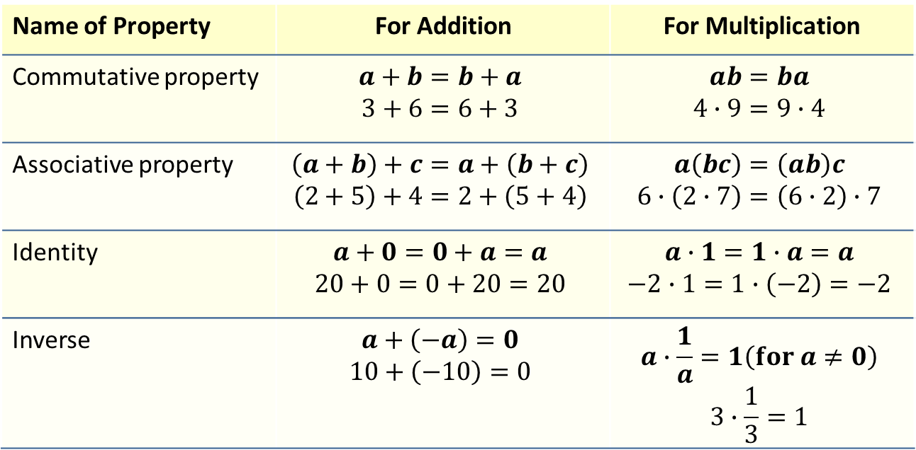
Properties: Properties of Addition and Multiplication
In this table 𝑎, 𝑏, and 𝑐 are real numbers.
Name of Property | For Addition | For Multiplication
Commutative property | $$a+b=b+a$$ $$3+6=6+3$$ | $$ab=ba$$ $$4∙9=9∙4$$
Associative property | $$\left(a+b\right)+c=a+\left(b+c\right)$$ $$\left(2+5\right)+4=2+\left(5+4\right)$$ | $$a\left(bc\right)=\left(ab\right)c$$ $$6∙\left(2∙7\right)=\left(6∙2\right)∙7$$
Identity | $$a+0=0+a=a$$ $$20+0=0+20=20$$ | $$a∙1=1∙a=a$$ $$−2∙1=1∙\left(−2\right)=−2$$
Inverse | $$a+\left(−a\right)=0$$ $$10+\left(−10\right)=0$$ | $$a∙\frac{1}{a}=1\left(for a≠0\right)$$ $$3∙\frac{1}{3}=1$$

Slide 3
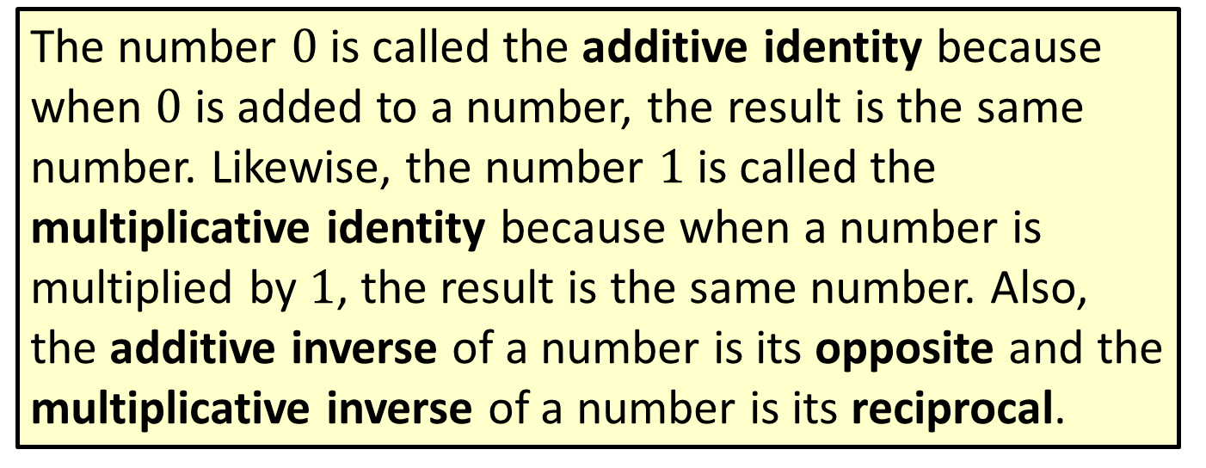
Note
The number $0$ is called the additive identity because when $0$ is added to a number, the result is the same number. Likewise, the number $1$ is called the multiplicative identity because when a number is multiplied by $1$, the result is the same number. Also, the additive inverse of a number is its opposite and the multiplicative inverse of a number is its reciprocal.

Slide 4
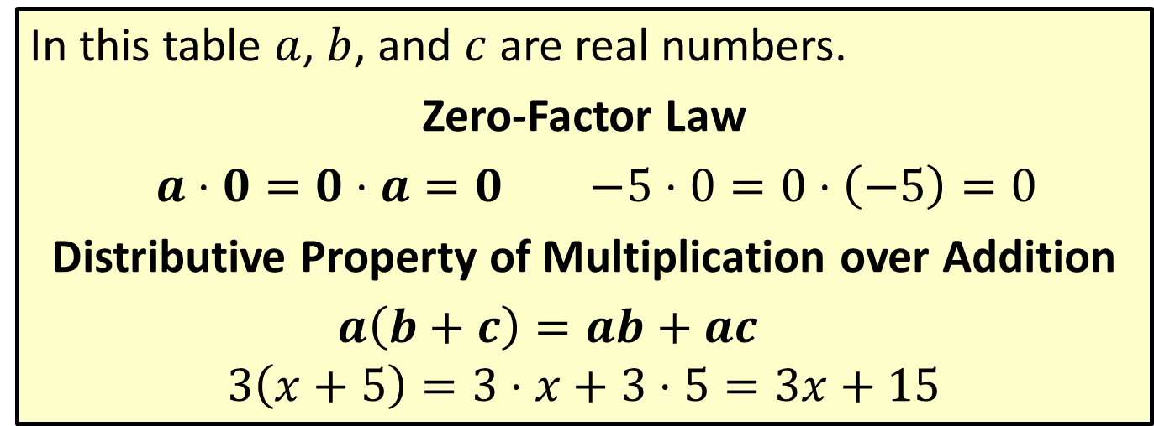
Properties: Properties of Addition and Multiplication (cont.)
In this table $a$, $b$, and $c$ are real numbers.
Zero-Factor Law
$a⋅0=0⋅a=0$ $−5⋅0=0⋅\left(−5\right)=0$
Distributive Property of Multiplication over Addition
$a\left(b+c\right)=ab+ac$
$$3\left(x+5\right)=3⋅x+3⋅5=3x+15$$

Slide 5
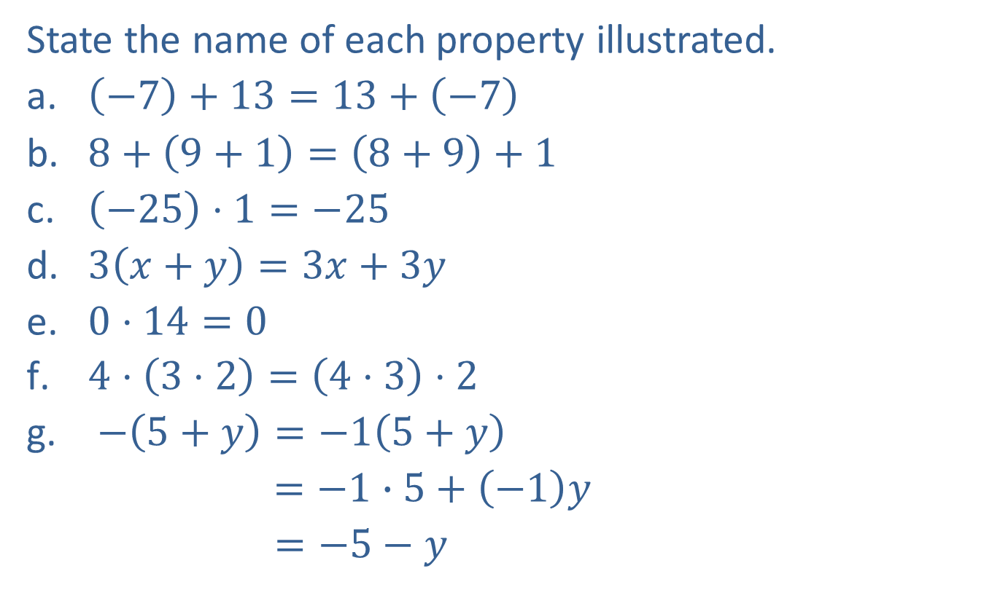
Example 1: Identifying Properties of Addition and Multiplication
State the name of each property illustrated.
​$\left(−7\right)+13=13+\left(−7\right)$
​$8+\left(9+1\right)=\left(8+9\right)+1$
​$\left(−25\right)⋅1=−25$
​$3\left(x+y\right)=3x+3y$
​$0⋅14=0$
​$4⋅\left(3⋅2\right)=\left(4⋅3\right)⋅2$
$−\left(5+y\right)=−1\left(5+y\right)$
$=−1∙5+\left(−1\right)y$
$=−5−y$

Slide 6
Example 1: Identifying Properties of Addition and Multiplication (cont.)
Solution
commutative property of addition
associative property of addition
multiplicative identity
distributive property
zero-factor law
associative property of multiplication
distributive property

Slide 7
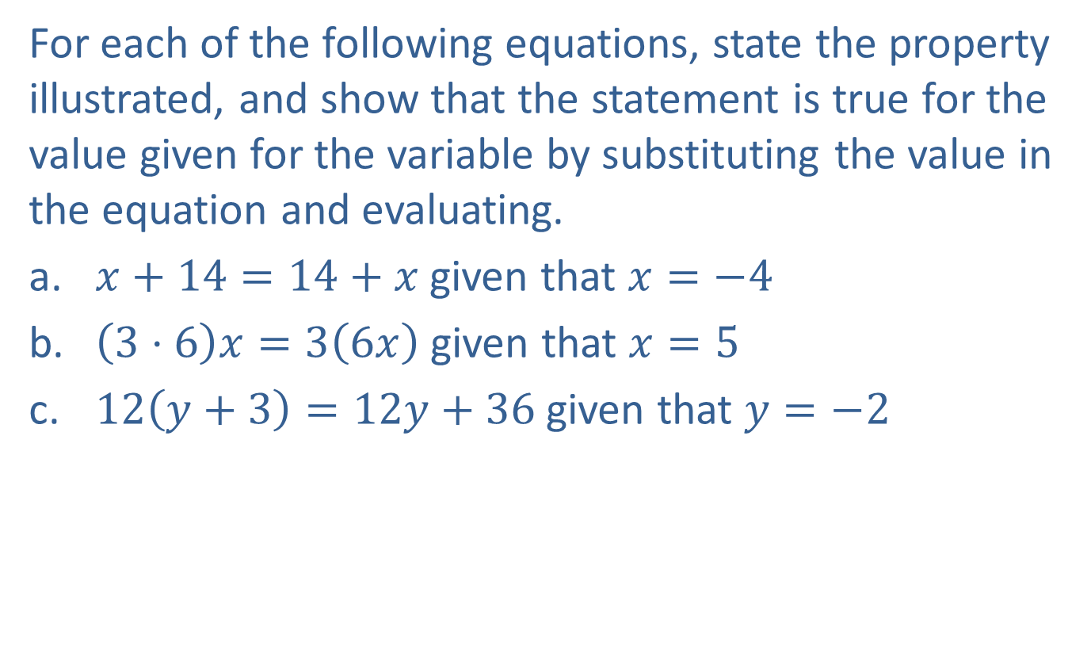
Example 2: Identifying Properties of Addition and Multiplication
For each of the following equations, state the property illustrated, and show that the statement is true for the value given for the variable by substituting the value in the equation and evaluating.
​$x+14=14+x$ given that $x=−4$
​$\left(3⋅6\right)x=3\left(6x\right)$ given that $x=5$
​$12\left(y+3\right)=12y+36$ given that $y=−2$

Slide 8
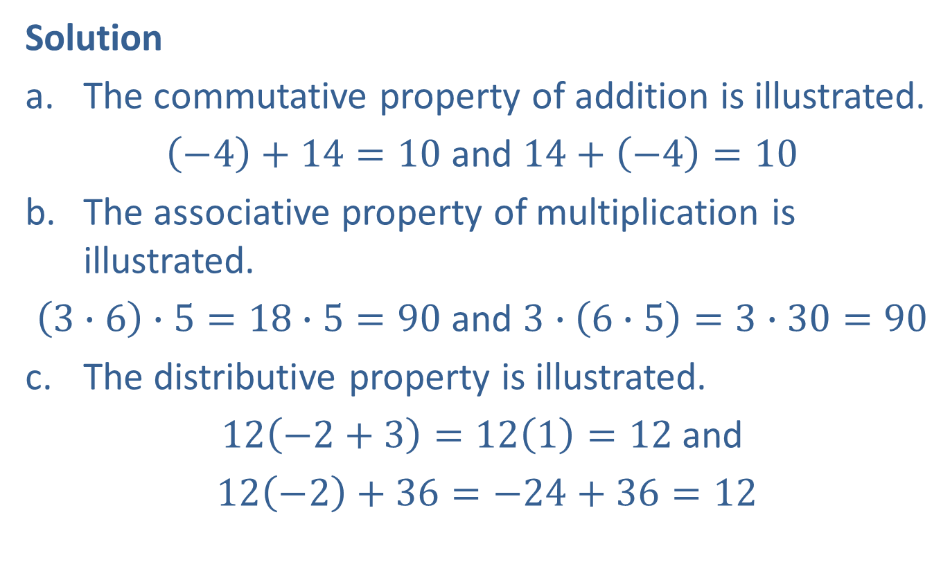
Example 2: Identifying Properties of Addition and Multiplication (cont.)
Solution
The commutative property of addition is illustrated.
$\left(−4\right)+14=10$ and $14+\left(−4\right)=10$
The associative property of multiplication is illustrated.
$\left(3∙6\right)∙5=18∙5=90$ and $3∙\left(6∙5\right)=3∙30=90$
The distributive property is illustrated.
$12\left(−2+3\right)=12\left(1\right)=12$ and
$12\left(−2\right)+36=−24+36=12$

