Slide 1
Section 1.6
Simplifying and Evaluating Algebraic Expressions

Slide 2
Definition: Like Terms
Like terms (or similar terms) are terms that are constants or are terms that contain the same variables (if any) raised to the same powers.

Slide 3
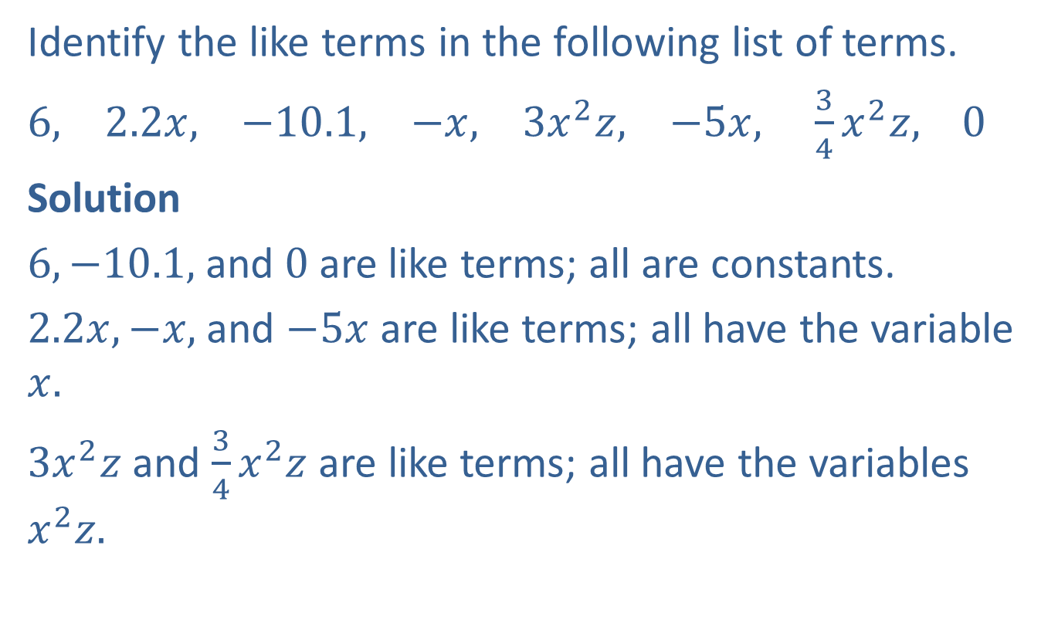
Example 1: Identifying Like Terms
Identify the like terms in the following list of terms.
$6,$ $2.2x,$ $−10.1,$ $−x,$ $3x^{2}z,$ $−5x, \frac{3}{4}x^{2}z,$ $0$
Solution
$6, −10.1,$and $0$ are like terms; all are constants.
$2.2x, −x,$ and $−5x$ are like terms; all have the variable $x.$
$3x^{2}z$ and $\frac{3}{4}x^{2}z$ are like terms; all have the variables $x^{2}z.$

Slide 4
Definition: Combining Like Terms
To combine like terms, add (or subtract) the coefficients and keep the common variable expression.

Slide 5
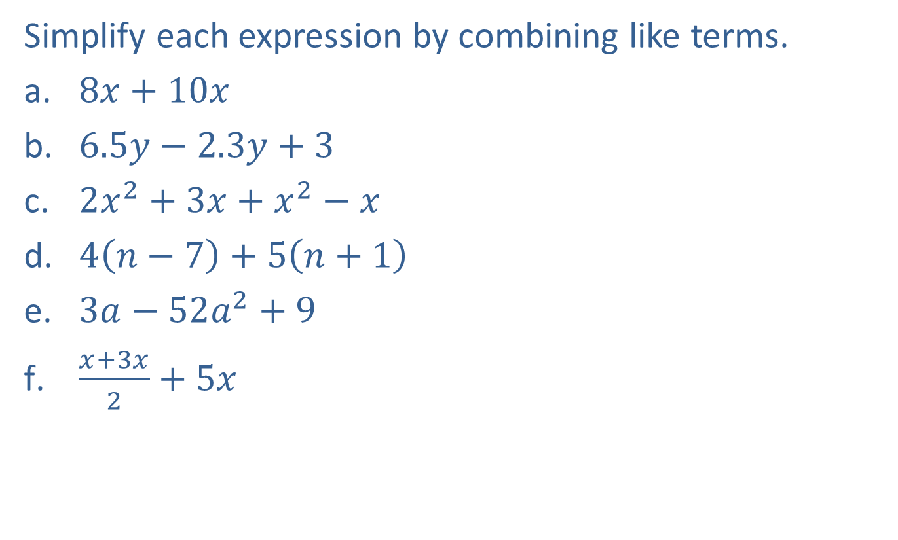
Example 2: Combining Like Terms
Simplify each expression by combining like terms.
​$8x+10x$
​$6.5y−2.3y+3$
​$2x^{2}+3x+x^{2}−x$
​$4\left(n−7\right)+5\left(n+1\right)$
​$3a−52a^{2}+9$
​$\frac{x+3x}{2}+5x$

Slide 6

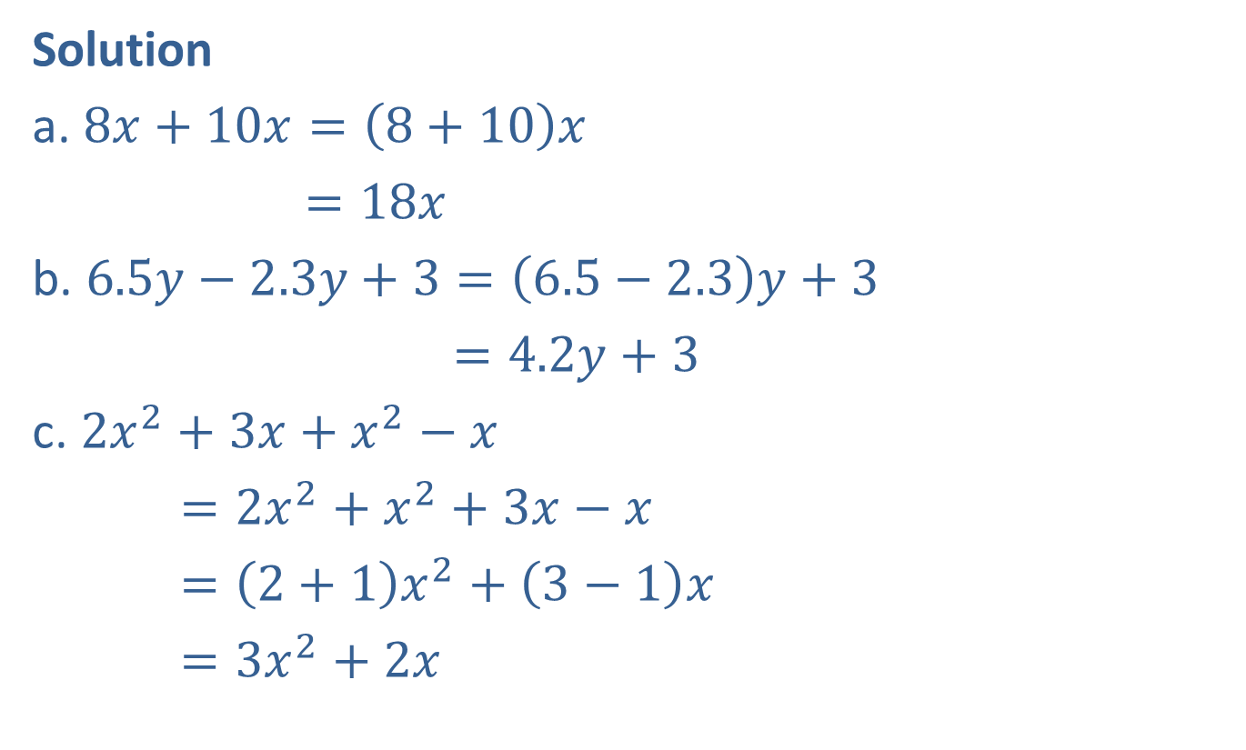
Example 2: Combining Like Terms (cont.)
Solution
a. $8x+10x=\left(8+10\right)x$
$=18x$
b. $6.5y−2.3y+3=\left(6.5−2.3\right)y+3$
$=4.2y+3$
c. $2x^{2}+3x+x^{2}−x$
$=2x^{2}+x^{2}+3x−x$
$=\left(2+1\right)x^{2}+\left(3−1\right)x$
$=3x^{2}+2x$
Distributive property
Distributive property
Commutative property of addition
Note: $+x^{2}=1x^{2}$ and $−x=−1x$

Slide 7
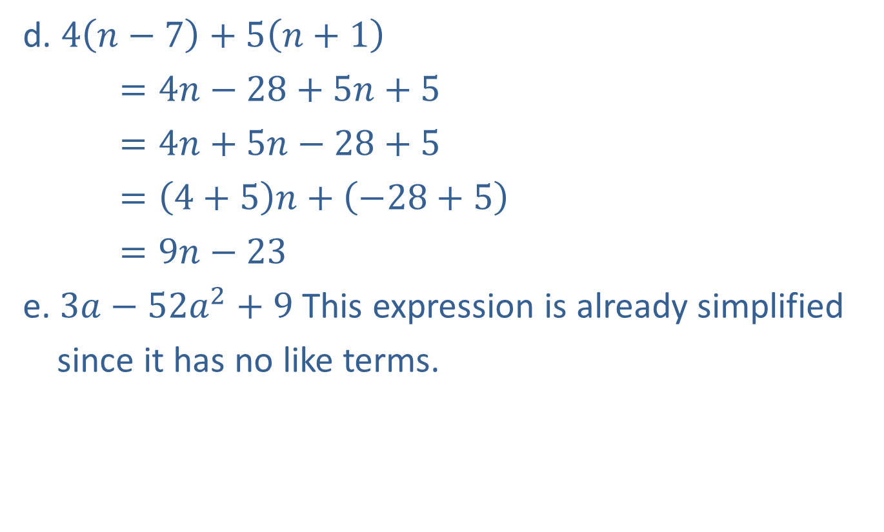
Example 2: Combining Like Terms (cont.)
d. $4\left(n−7\right)+5\left(n+1\right)$
$=4n−28+5n+5$
$=4n+5n−28+5$
$=\left(4+5\right)n+\left(−28+5\right)$
$=9n−23$
e. $3a−52a^{2}+9$ This expression is already simplified
since it has no like terms.
Simplify by using the distributive property twice.
Commutative property of addition
Distributive property
Combine like terms.

Slide 8
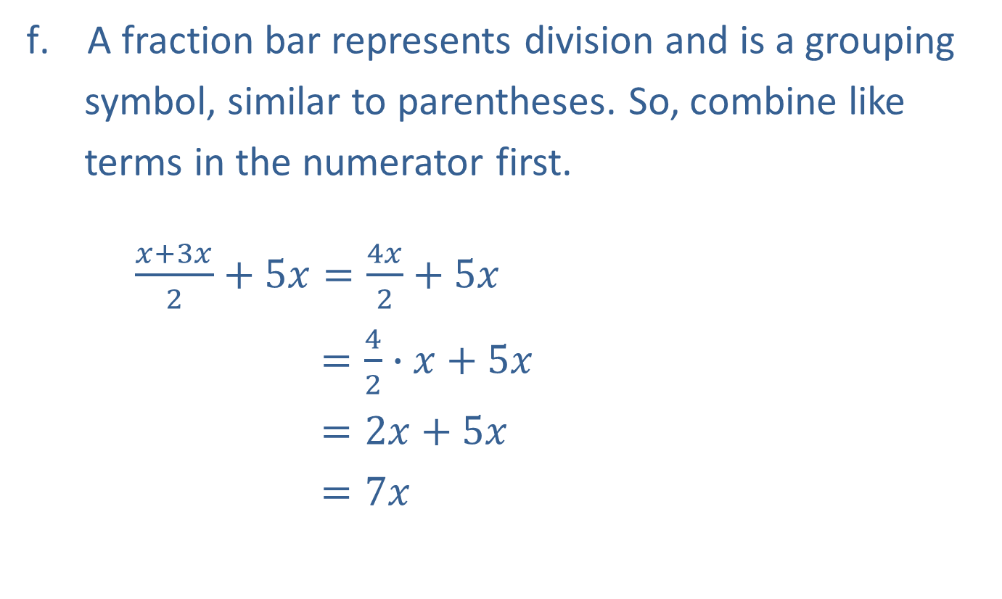
Example 2: Combining Like Terms (cont.)
A fraction bar represents division and is a grouping
symbol, similar to parentheses. So, combine like
terms in the numerator first.
$\frac{x+3x}{2}+5x=\frac{4x}{2}+5x$
$=\frac{4}{2}∙x+5x$
$=2x+5x$
$=7x$
Reduce the fraction.
Combine like terms.

Slide 9
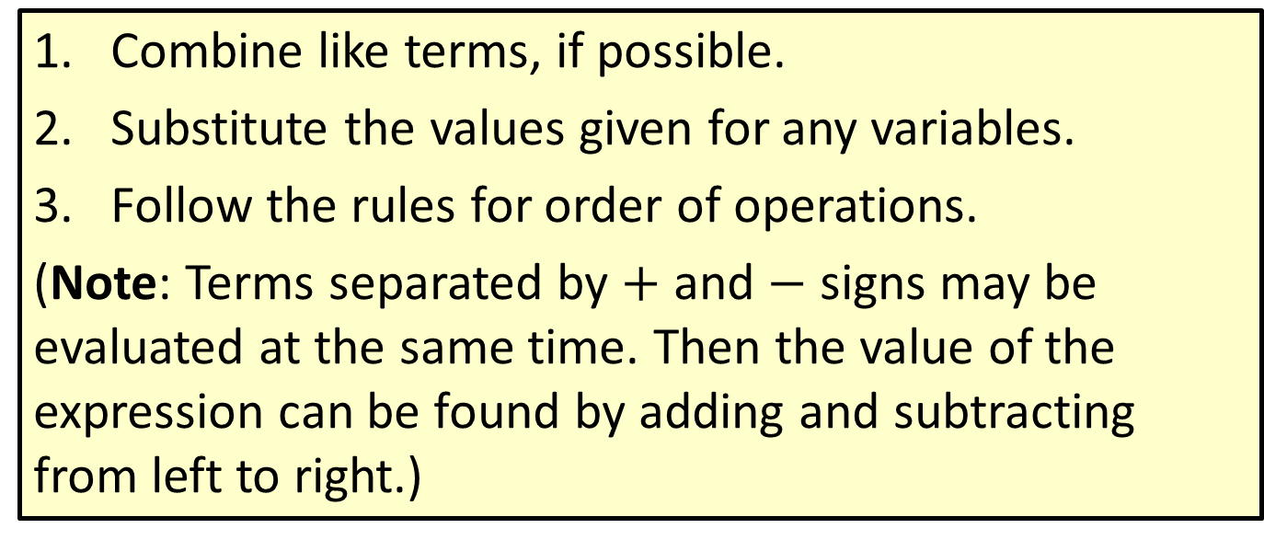
Procedure: To Evaluate an Algebraic Expression
​Combine like terms, if possible.
​Substitute the values given for any variables.
​Follow the rules for order of operations.
(Note: Terms separated by $+$ and $−$ signs may be evaluated at the same time. Then the value of the expression can be found by adding and subtracting from left to right.)

Slide 10
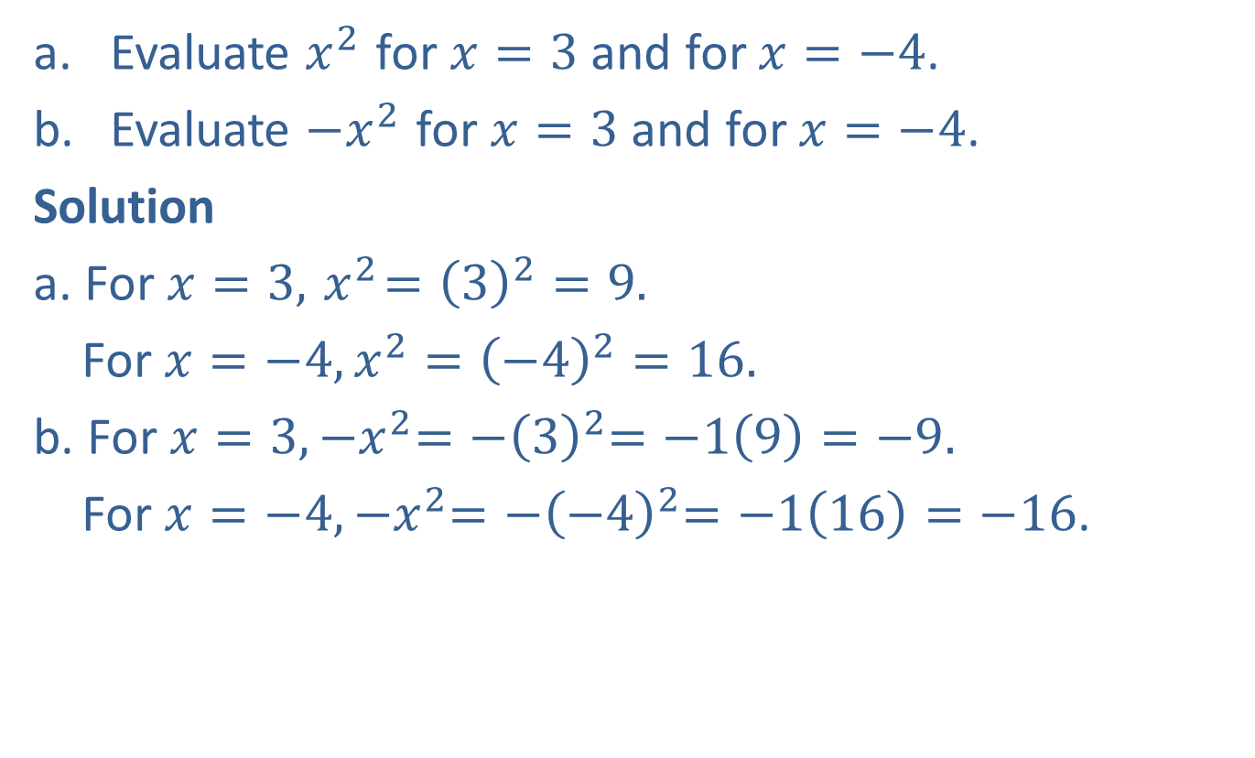
Example 3: Evaluating Algebraic Expressions
​Evaluate $x^{2}$ for $x=3$ and for $x=−4$.
​Evaluate $−x^{2}$ for $x=3$ and for $x=−4$.
Solution
a. For $x=3, { x}^{2}={\left(3\right)}^{2}=9.$
For $x=−4, x^{2}={\left(−4\right)}^{2}=16.$
b. For $x=3, {−x}^{2}={−\left(3\right)}^{2}=−1\left(9\right)=−9.$
For $x=−4, {−x}^{2}={−\left(−4\right)}^{2}=−1\left(16\right)=−16$.

Slide 11

Example 4: Simplifying and Evaluating Algebraic Expressions
Simplify and evaluate $2x+5+7x$ for $x=−3$.
Solution
First, simplify the expression by combining like terms.
$$2x+5+7x=2x+7x+5$$
$=9x+5$

Slide 12
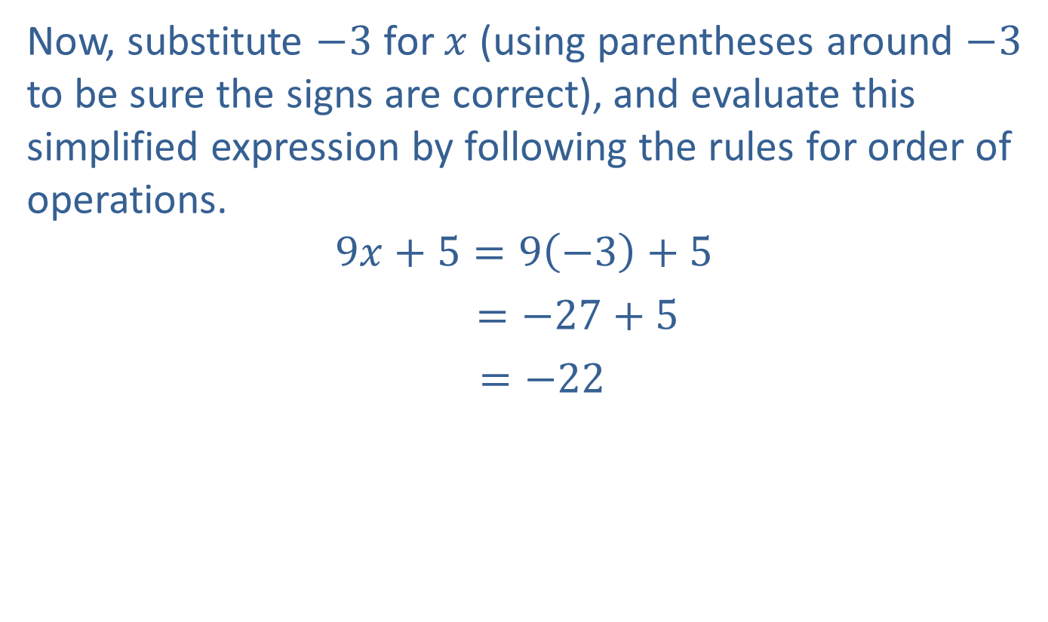
Example 4: Simplifying and Evaluating Algebraic Expressions (cont.)
Now, substitute $−3$ for $x$ (using parentheses around $−3$ to be sure the signs are correct), and evaluate this simplified expression by following the rules for order of operations.
$$9x+5=9\left(−3\right)+5$$
$=−27+5$
$=−22$

Slide 13

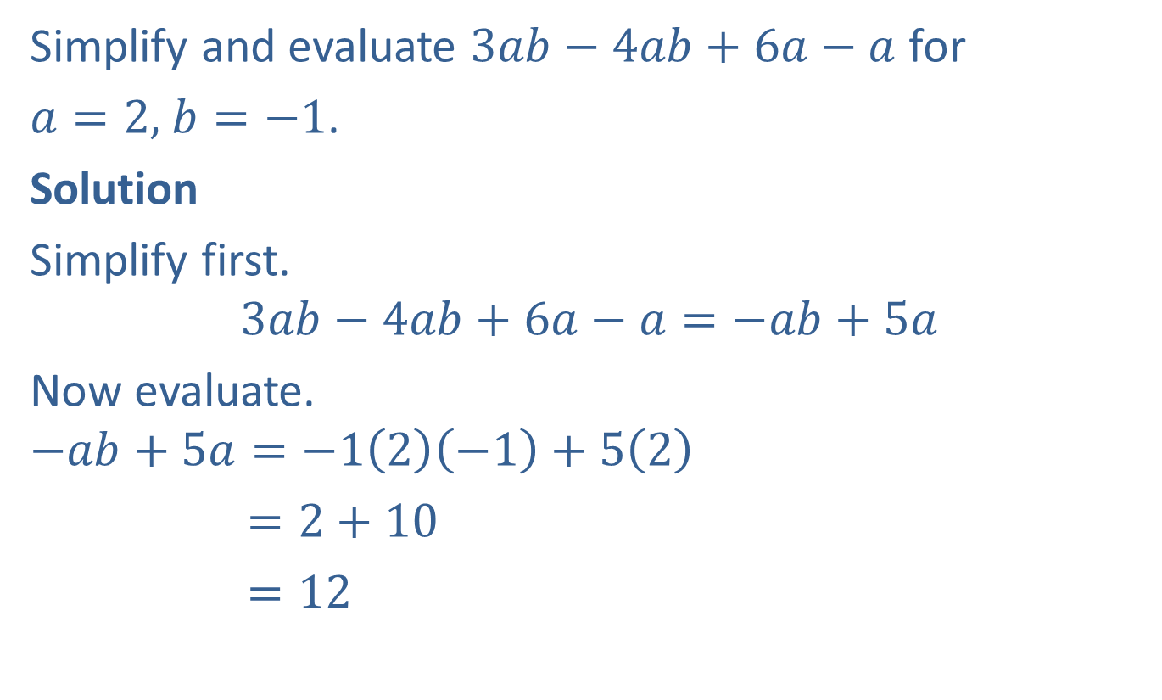
Example 5: Simplifying and Evaluating Algebraic Expressions
Simplify and evaluate $3ab−4ab+6a−a$ for
$a=2,$ $b=−1$.
Solution
Simplify first.
$$3ab−4ab+6a−a=−ab+5a$$
Now evaluate.
$$−ab+5a=−1\left(2\right)\left(−1\right)+5\left(2\right)$$
  $=2+10$
  $=12$
Note: $−ab=−1ab$

Slide 14
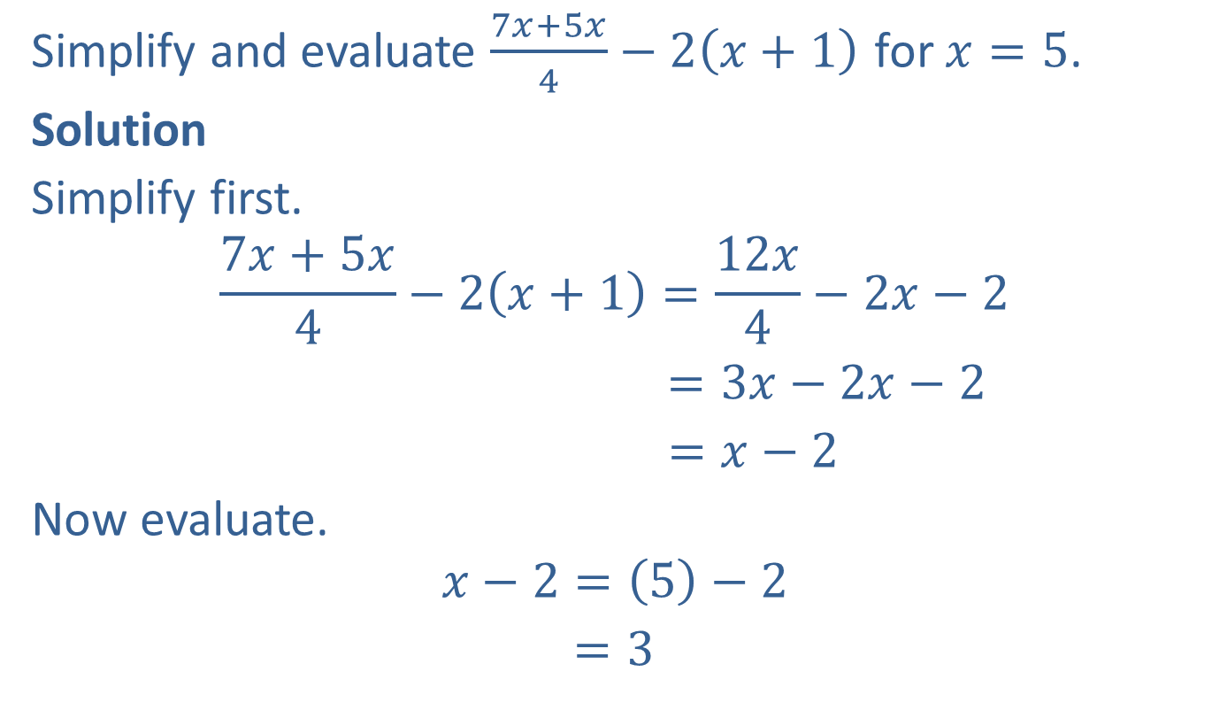
Example 6: Simplifying and Evaluating Algebraic Expressions
Simplify and evaluate $\frac{7x+5x}{4}−2\left(x+1\right)$ for $x=5$.
Solution
Simplify first.
$$\frac{7x+5x}{4}−2\left(x+1\right)=\frac{12x}{4}−2x−2$$
$=3x−2x−2$
$=x−2$
Now evaluate.
$$x−2=\left(5\right)−2$$
$=3$

Slide 15
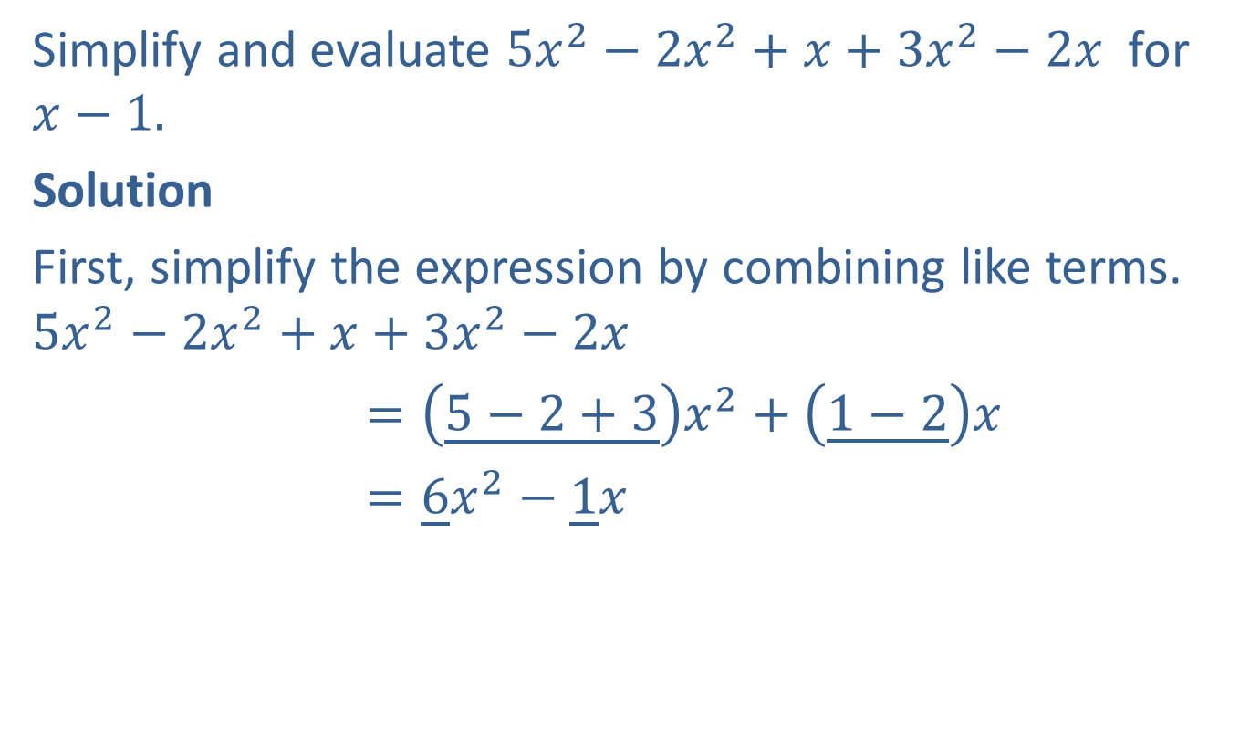
Completion Example 7: Simplifying and Evaluating Expressions
Simplify and evaluate $5x^{2}−2x^{2}+x+3x^{2}−2x$ for $x−1.$
Solution
First, simplify the expression by combining like terms.
$$5x^{2}−2x^{2}+x+3x^{2}−2x$$
$=\left(\underline{5−2+3}\right)x^{2}+\left(\underline{1−2}\right)x$
$=\underline{6}x^{2}−\underline{1}x$

Slide 16

Completion Example 7: Simplifying and Evaluating Expressions (cont.)
Now, substitute $−1$ for $x$ and evaluate.
$6x^{2}−x=6{\left(\underline{−1}\right)}^{2}−\left(\underline{−1}\right)$ $=6\left(\underline{1}\right)−\left(\underline{−1}\right)$
$= \underline{6}+\underline{1}$
$=\underline{7}$

