Slide 1
Section 1.7
Translating English Phrases and Algebraic Expressions

Slide 2
Key Words To Look For When Translating Phrases
Addition | Subtraction | Multiplication | Division | Exponent (Powers)
add | subtract (from) | multiply | divide | square of
sum | difference | product | quotient | cube of
plus | minus | times | ratio
more than | less than | twice, double
increased by | decreased by | triple
total | less
Table 1

Slide 3
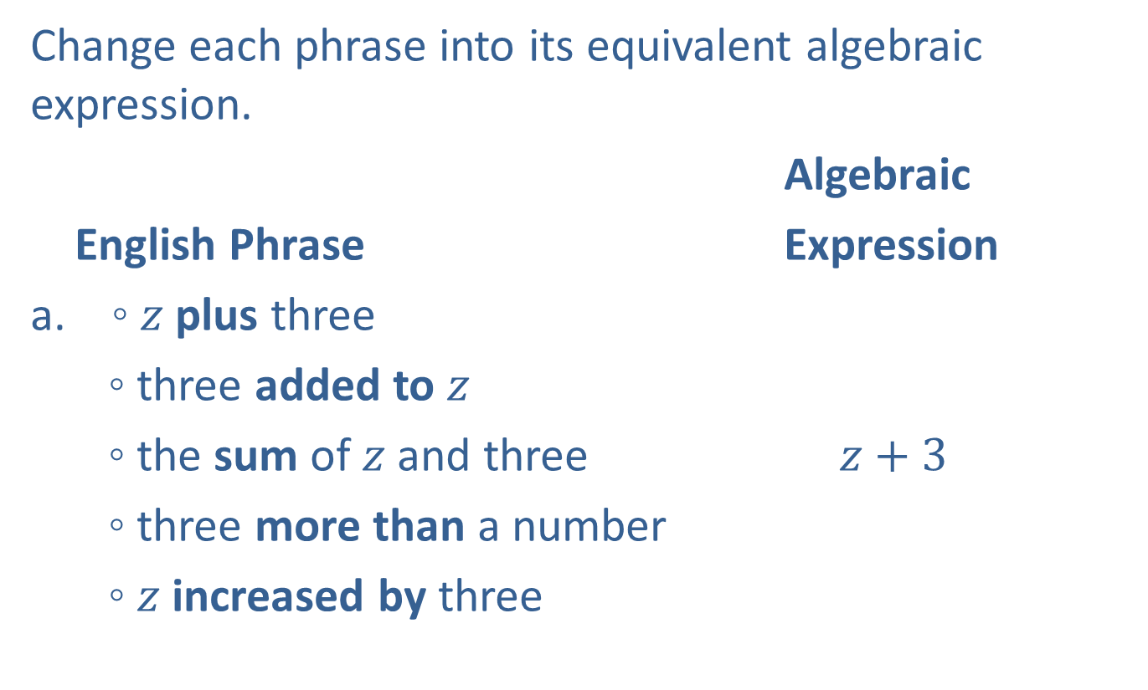
Example 1: Translating English Phrases into Algebraic Expressions
Change each phrase into its equivalent algebraic expression.
Algebraic
English Phrase Expression
◦ $z$ plus three
◦ three added to $z$
◦ the sum of $z$ and three $z+3$
◦ three more than a number
◦ $z$ increased by three

Slide 4
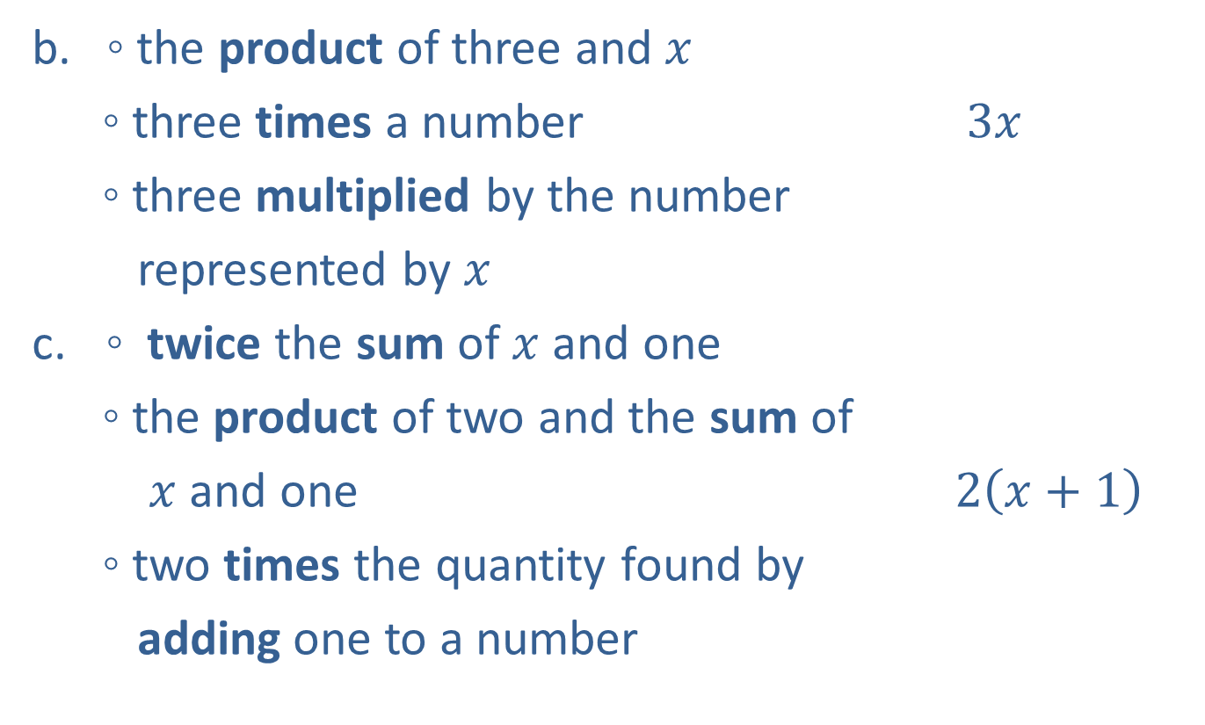
Example 1: Translating English Phrases into Algebraic Expressions (cont.)
b. ◦ the product of three and $x$
◦ three times a number $3x$
◦ three multiplied by the number
represented by $x$
◦ twice the sum of $x$ and one
◦ the product of two and the sum of
$x$ and one $2\left(x+1\right)$
◦ two times the quantity found by
adding one to a number

Slide 5

Example 1: Translating English Phrases into Algebraic Expressions (cont.)
◦ twice $x,$ plus one
◦ the sum of twice $x$and one
◦ two times $x,$ increased by one $2x+1$
◦ one more than the product of two
and a number

Slide 6
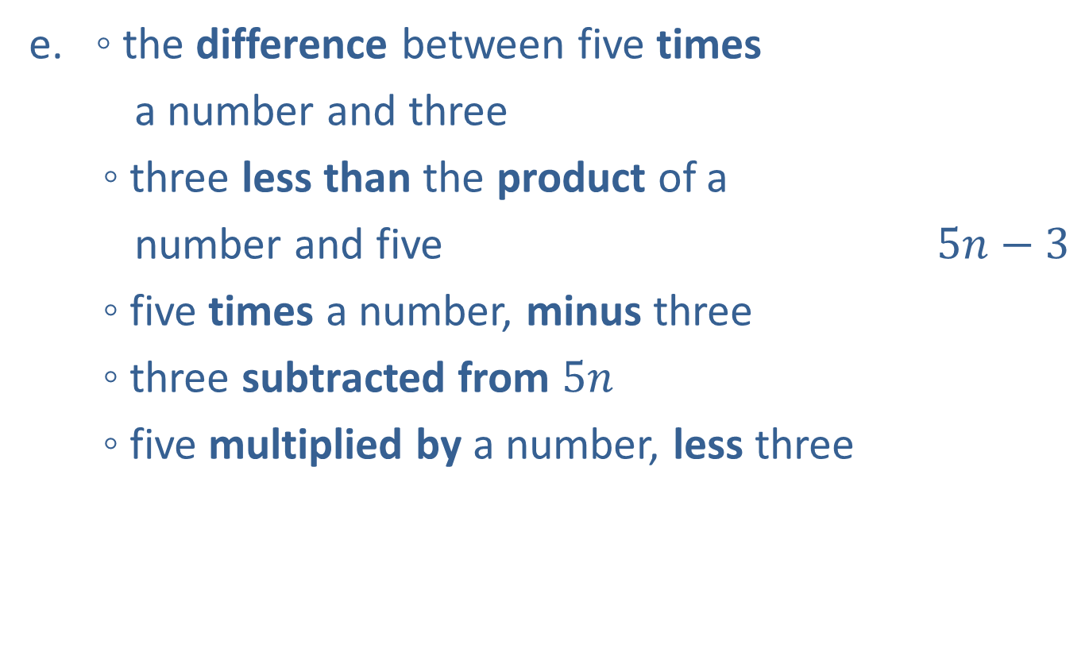
Example 1: Translating English Phrases into Algebraic Expressions (cont.)
◦ the difference between five times
a number and three
◦ three less than the product of a
number and five $5n−3$
◦ five times a number, minus three
◦ three subtracted from $5n$
◦ five multiplied by a number, less three

Slide 7
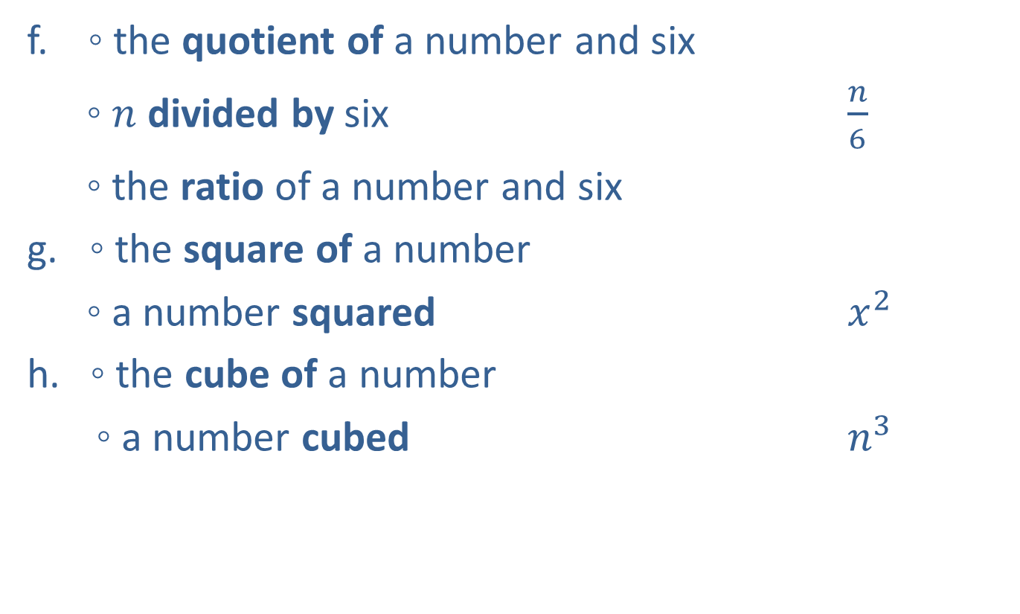
Example 1: Translating English Phrases into Algebraic Expressions (cont.)
f. ◦ the quotient of a number and six
◦ $n$ divided by six $\frac{n}{6}$
◦ the ratio of a number and six
◦ the square of a number
◦ a number squared $x^{2}$
h. ◦ the cube of a number
◦ a number cubed $n^{3}$

Slide 8

Example 2: Application: Translating English Phrases
Change each phrase into its equivalent algebraic expression.
the number of minutes in $h$ hours
the cost of renting a truck for one day and driving $x$ miles if the rate is $\$30$per day plus $\$0.25$per mile

Slide 9
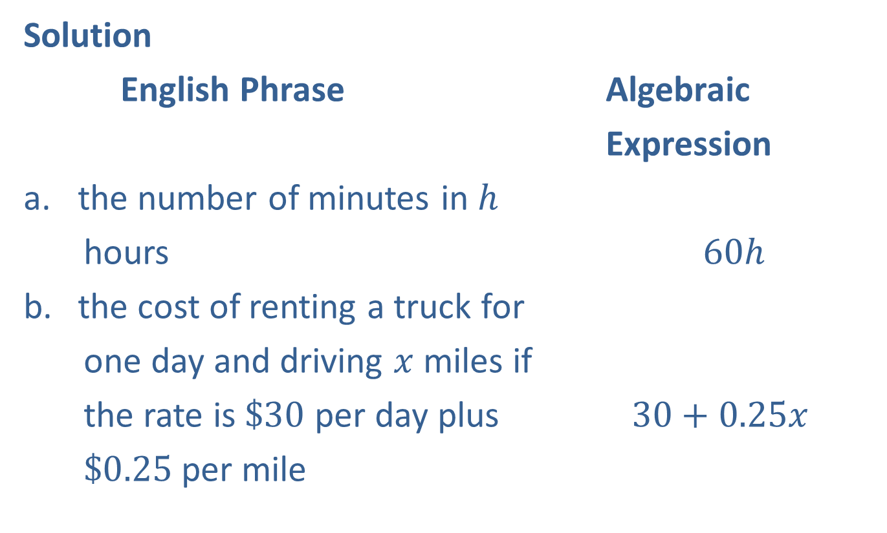
Example 2: Application: Translating English Phrases (cont.)
Solution
English Phrase Algebraic
Expression
the number of minutes in $h$
hours $60h$
the cost of renting a truck for
one day and driving $x$ miles if
the rate is $\$30$ per day plus $30+0.25x$
$\$0.25$per mile

Slide 10
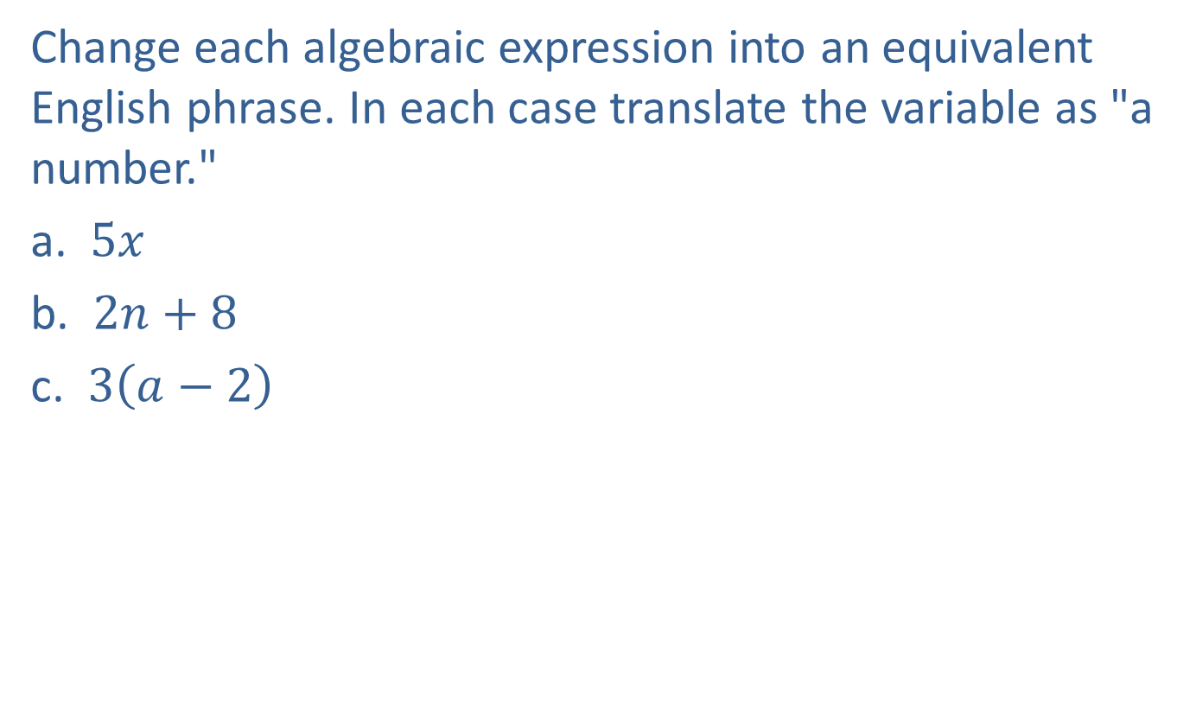
Example 3: Translating Algebraic Expressions into English Phrases
Change each algebraic expression into an equivalent English phrase. In each case translate the variable as "a number."
a. $5x$
b. $2n+8$
c. $3\left(a−2\right)$

Slide 11

Example 3: Translating Algebraic Expressions into English Phrases (cont.)
Solution
Algebraic Expression
a. $5x$
b. $2n+8$
c. $3\left(a−2\right)$
Possible English Phrase
the product of five and a number
twice a number, increased by eight
three times the difference between a number and two

Slide 12
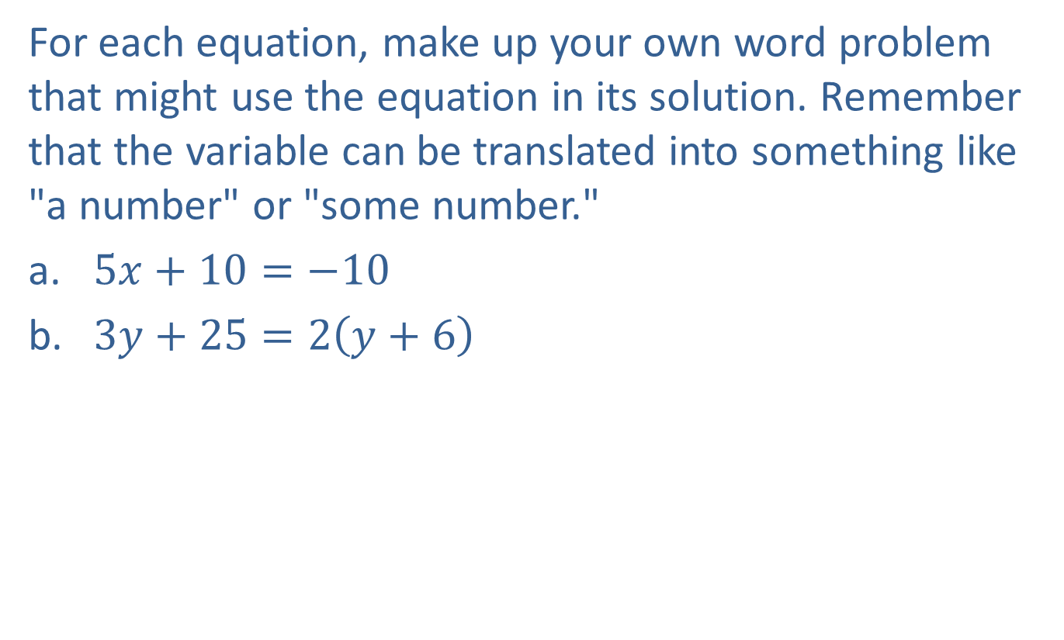
Example 4: Translating Equations into Word Problems
For each equation, make up your own word problem that might use the equation in its solution. Remember that the variable can be translated into something like "a number" or "some number."
​$5x+10=−10$
​$3y+25=2\left(y+6\right)$

Slide 13
Note
In Example 4, the “translations” are not unique. In fact, there are many ways to make up a problem for each equation. However, all word problems should result in the same equation. You should be able to show your “word problem” to your classmates and have them
agree that the related equation will give the solution to the problem.

Slide 14
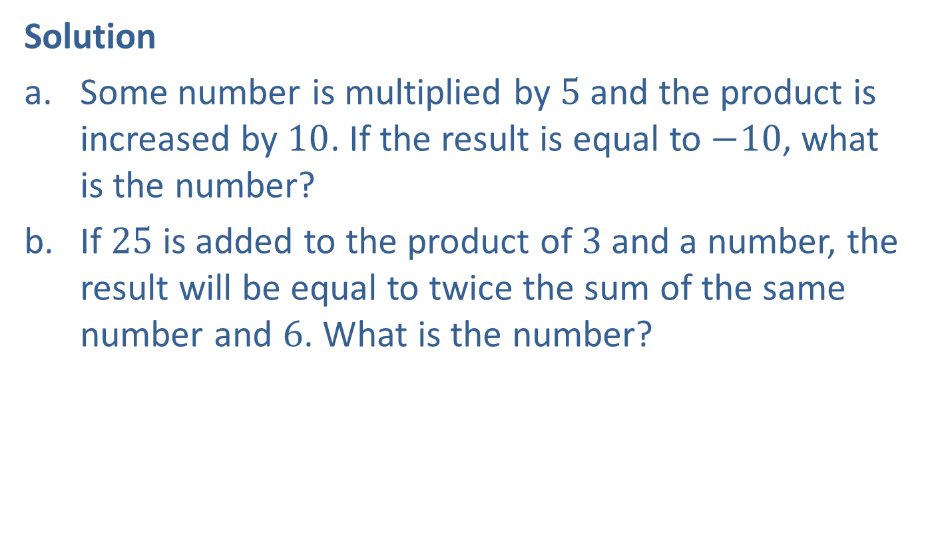
Example 4: Translating Equations into Word Problems (cont.)
Solution
Some number is multiplied by $5$ and the product is increased by $10$. If the result is equal to $−10$, what is the number?
If $25$ is added to the product of $3$ and a number, the result will be equal to twice the sum of the same number and $6$. What is the number?

