Slide 1
Section 10.1
Collecting Data

Slide 2
Definition: Statistical Terms
Statistics is the collection, organization, and communication of data.
Data are the pieces of information that are collected.
A population is the group of interest that is to be studied.
A population parameter is a number that describes a particular characteristic of a population.
A census is when data are collected from all members of a population.
A sample is a subset of the population.

Slide 3
Definition: Statistical Terms (cont.)
A sample statistic is a number that describes a particular characteristic of a sample.

Slide 4
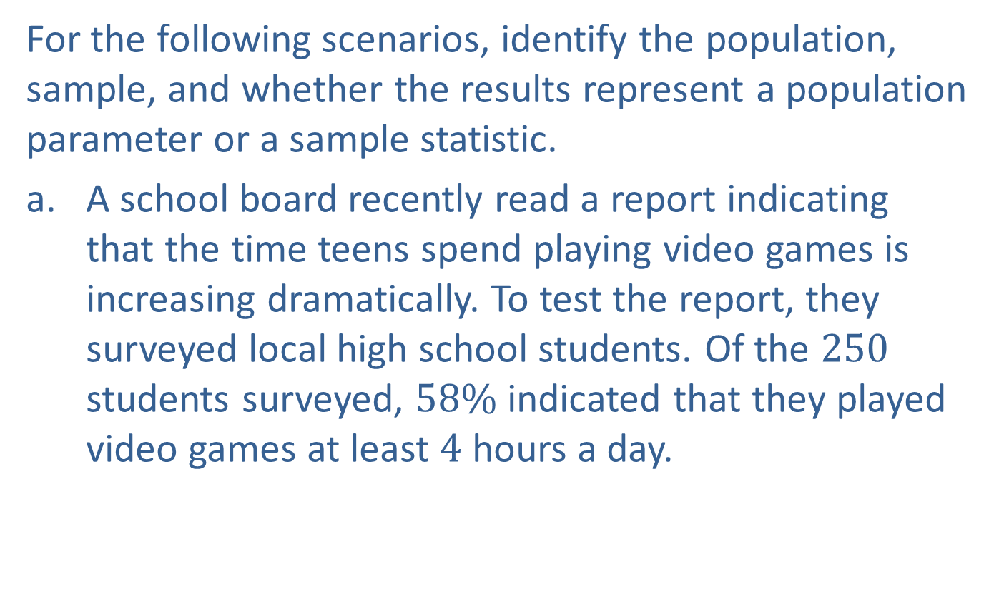
Example 1: Identifying Populations and Samples
For the following scenarios, identify the population, sample, and whether the results represent a population parameter or a sample statistic.
​A school board recently read a report indicating that the time teens spend playing video games is increasing dramatically. To test the report, they surveyed local high school students. Of the $250$ students surveyed, $58\%$ indicated that they played video games at least $4$ hours a day.

Slide 5
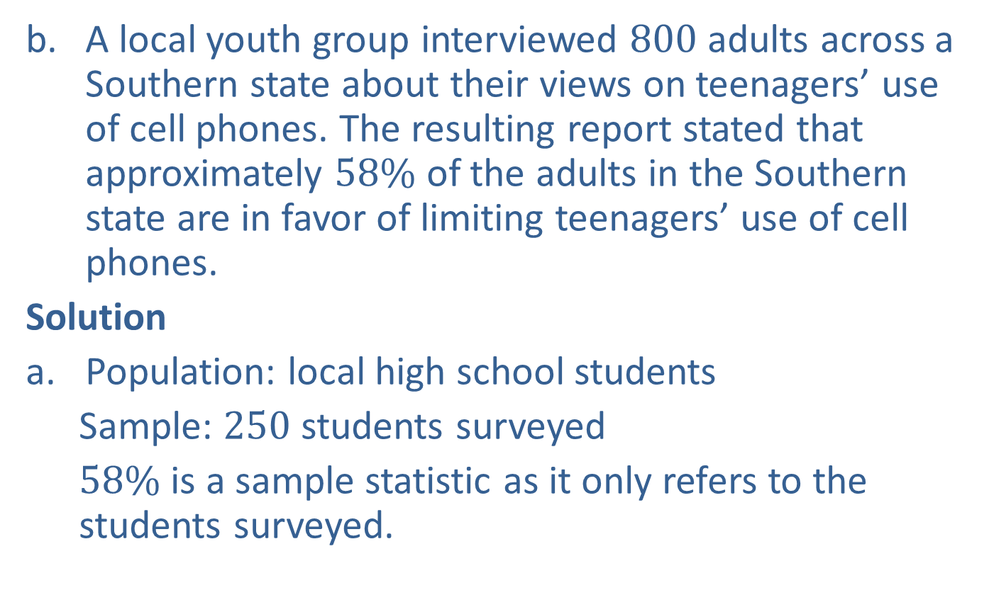
Example 1: Identifying Populations and Samples (cont.)
​A local youth group interviewed $800$ adults across a Southern state about their views on teenagers’ use of cell phones. The resulting report stated that approximately $58\%$ of the adults in the Southern state are in favor of limiting teenagers’ use of cell phones.
Solution
Population: local high school students
  Sample: $250$ students surveyed
  $58\%$ is a sample statistic as it only refers to the students surveyed.

Slide 6
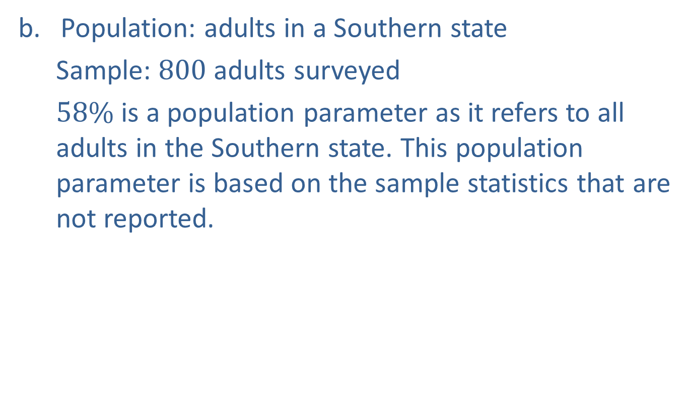
Example 1: Identifying Populations and Samples (cont.)
Population: adults in a Southern state
  Sample: $800$ adults surveyed
  $58\%$ is a population parameter as it refers to all adults in the Southern state. This population parameter is based on the sample statistics that are not reported.

Slide 7
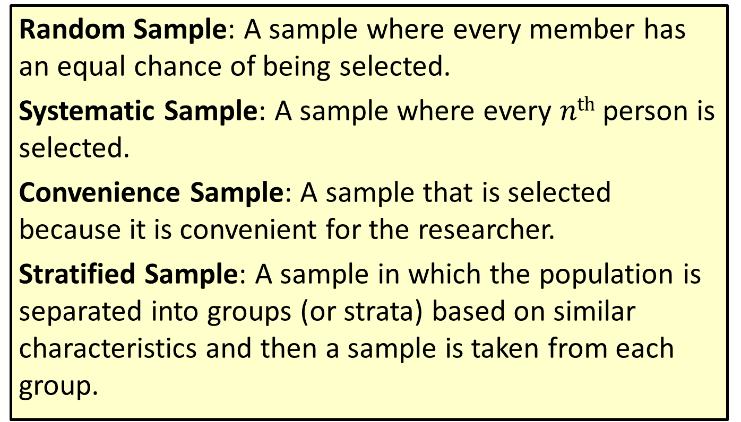
Definition: Sampling Techniques
Random Sample: A sample where every member has an equal chance of being selected.
Systematic Sample: A sample where every $nth$ person is selected.
Convenience Sample: A sample that is selected because it is convenient for the researcher.
Stratified Sample: A sample in which the population is separated into groups (or strata) based on similar characteristics and then a sample is taken from each group.

Slide 8
Definition: Sampling Techniques (cont.)
Cluster Sample: A sample in which the population is separated into clusters, some of the clusters are randomly selected, and then data are gathered from each member in the selected clusters.

Slide 9
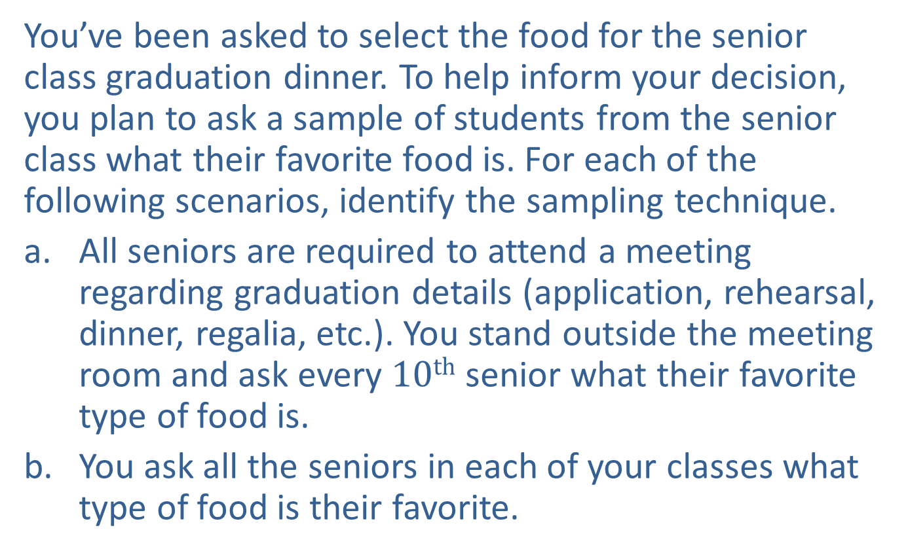
Example 2: Identifying Sampling Techniques
You’ve been asked to select the food for the senior class graduation dinner. To help inform your decision, you plan to ask a sample of students from the senior class what their favorite food is. For each of the following scenarios, identify the sampling technique.
​All seniors are required to attend a meeting regarding graduation details (application, rehearsal, dinner, regalia, etc.). You stand outside the meeting room and ask every $10th$ senior what their favorite type of food is.
​You ask all the seniors in each of your classes what type of food is their favorite.

Slide 10
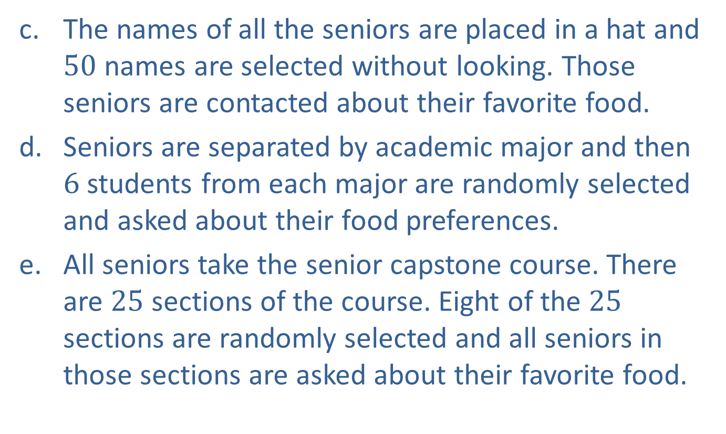
Example 2: Identifying Sampling Techniques (cont.)
The names of all the seniors are placed in a hat and $50$ names are selected without looking. Those seniors are contacted about their favorite food.
​Seniors are separated by academic major and then $6$ students from each major are randomly selected and asked about their food preferences.
​All seniors take the senior capstone course. There are $25$ sections of the course. Eight of the $25$ sections are randomly selected and all seniors in those sections are asked about their favorite food.

Slide 11
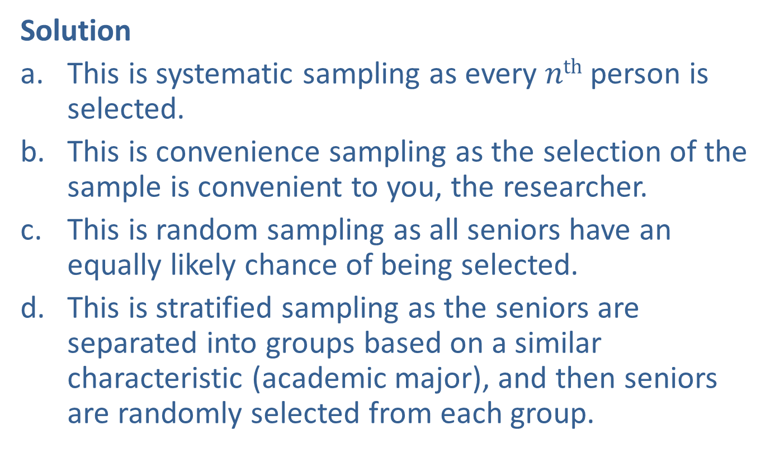
Example 2: Identifying Sampling Techniques (cont.)
Solution
This is systematic sampling as every $nth$ person is selected.
This is convenience sampling as the selection of the sample is convenient to you, the researcher.
This is random sampling as all seniors have an equally likely chance of being selected.
​This is stratified sampling as the seniors are separated into groups based on a similar characteristic (academic major), and then seniors are randomly selected from each group.

Slide 12
Example 2: Identifying Sampling Techniques (cont.)
This is cluster sampling as the seniors are separated into sections of the course (clusters), and then entire clusters are randomly selected.

