Slide 1
Section 10.2
Organizing and Displaying Data

Slide 2
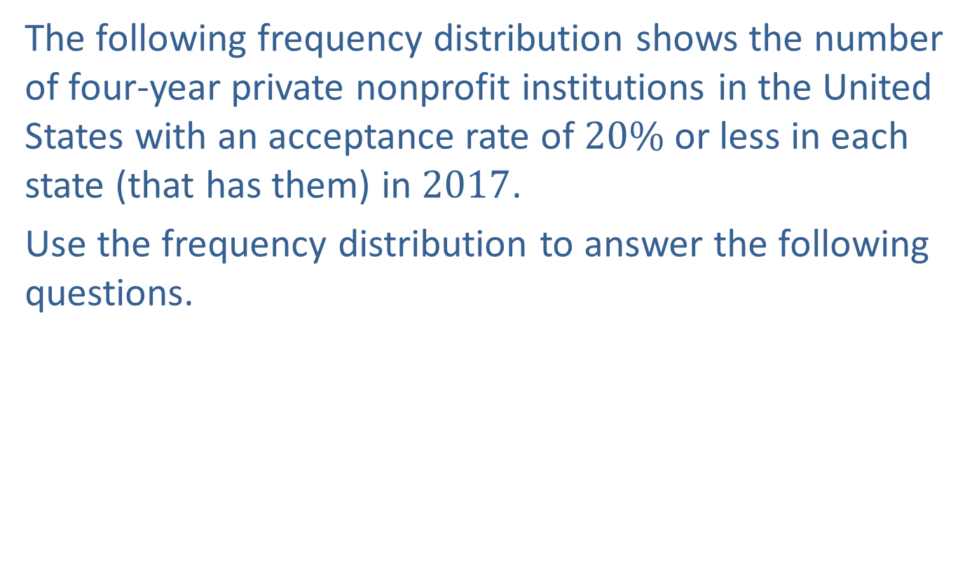
Example 1: Reading a Frequency Distribution
The following frequency distribution shows the number of four-year private nonprofit institutions in the United States with an acceptance rate of $20\%$ or less in each state (that has them) in $2017$.
Use the frequency distribution to answer the following questions.

Slide 3

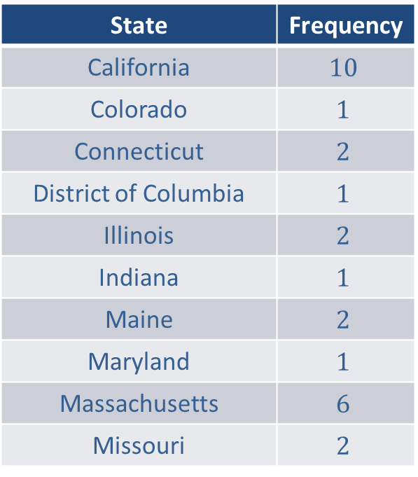
Example 1: Reading a Frequency Distribution (cont.)
States with Four-Year Private Nonprofit Institutions with an Acceptance Rate of $20\%$or Less in $2017$
State | Frequency
California | $$10$$
Colorado | $$1$$
Connecticut | $$2$$
District of Columbia | $$1$$
Illinois | $$2$$
Indiana | $$1$$
Maine | $$2$$
Maryland | $$1$$
Massachusetts | $$6$$
Missouri | $$2$$

Slide 4
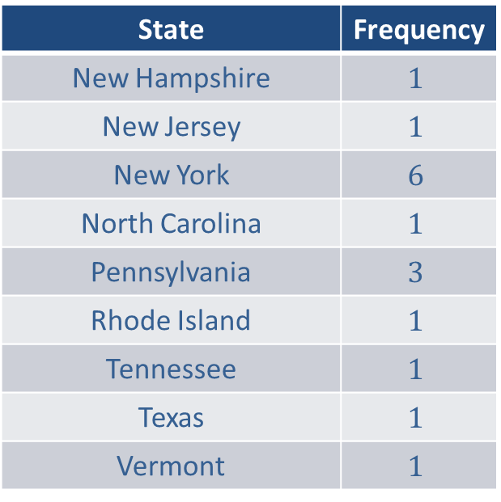
Example 1: Reading a Frequency Distribution (cont.)
Source: National Center for Education Statistics
https://nces.ed.gov/collegenavigator/
State | Frequency
New Hampshire | $$1$$
New Jersey | $$1$$
New York | $$6$$
North Carolina | $$1$$
Pennsylvania | $$3$$
Rhode Island | $$1$$
Tennessee | $$1$$
Texas | $$1$$
Vermont | $$1$$

Slide 5
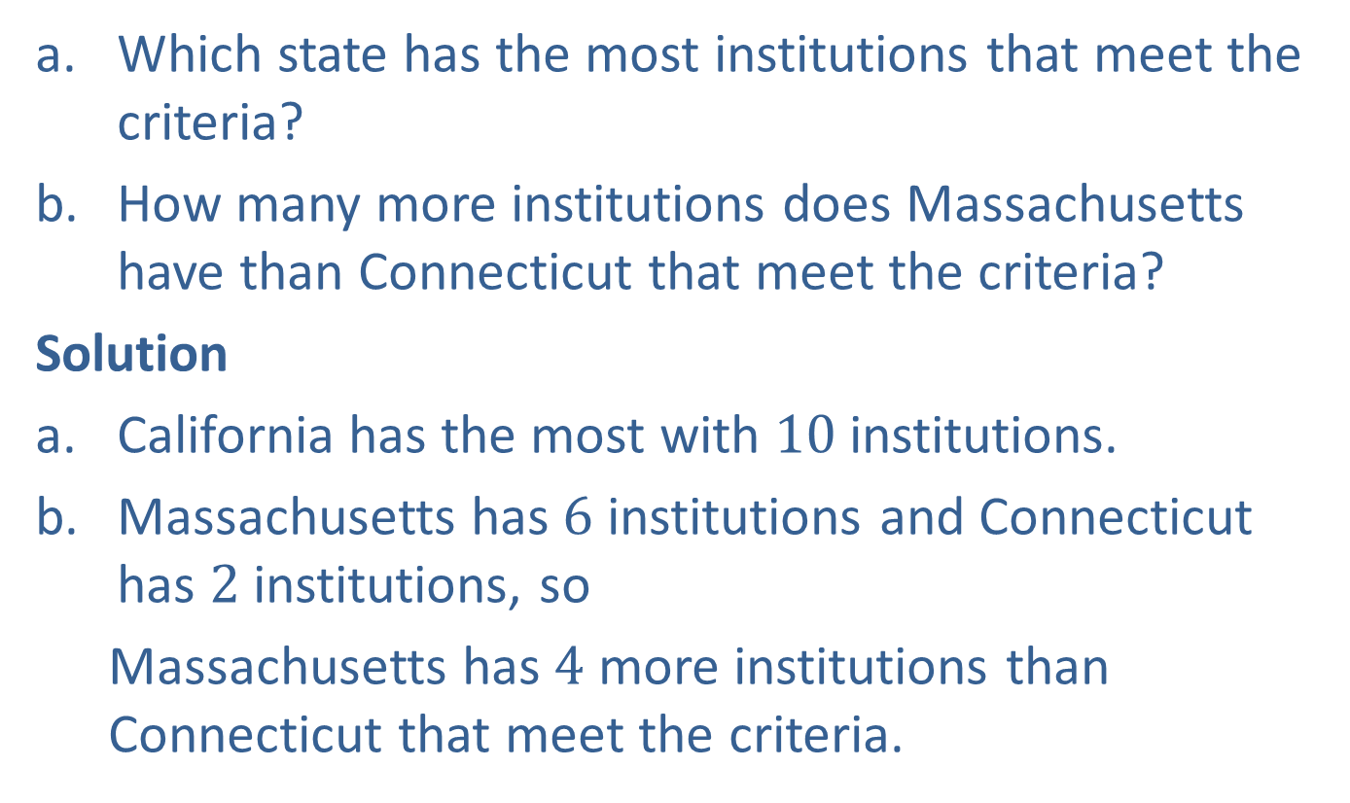
Example 1: Reading a Frequency Distribution (cont.)
​Which state has the most institutions that meet the criteria?
​How many more institutions does Massachusetts have than Connecticut that meet the criteria?
Solution
California has the most with $10$institutions.
Massachusetts has $6$ institutions and Connecticut has $2$ institutions, so
  Massachusetts has $4$ more institutions than Connecticut that meet the criteria.

Slide 6
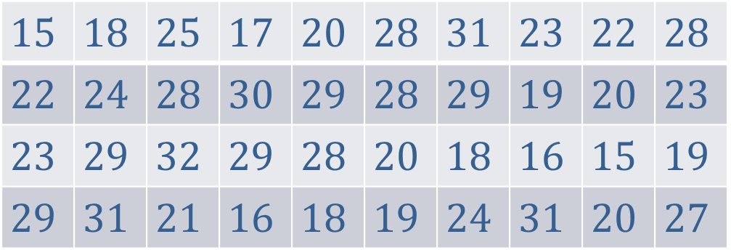

Example 2: Constructing a Frequency Distribution
The wait times (in minutes) of patrons at the $DMV$ are recorded here.
Construct a frequency distribution of the data collected.
$$15$$ | $$18$$ | $$25$$ | $$17$$ | $$20$$ | $$28$$ | $$31$$ | $$23$$ | $$22$$ | $$28$$
$$22$$ | $$24$$ | $$28$$ | $$30$$ | $$29$$ | $$28$$ | $$29$$ | $$19$$ | $$20$$ | $$23$$
$$23$$ | $$29$$ | $$32$$ | $$29$$ | $$28$$ | $$20$$ | $$18$$ | $$16$$ | $$15$$ | $$19$$
$$29$$ | $$31$$ | $$21$$ | $$16$$ | $$18$$ | $$19$$ | $$24$$ | $$31$$ | $$20$$ | $$27$$

Slide 7
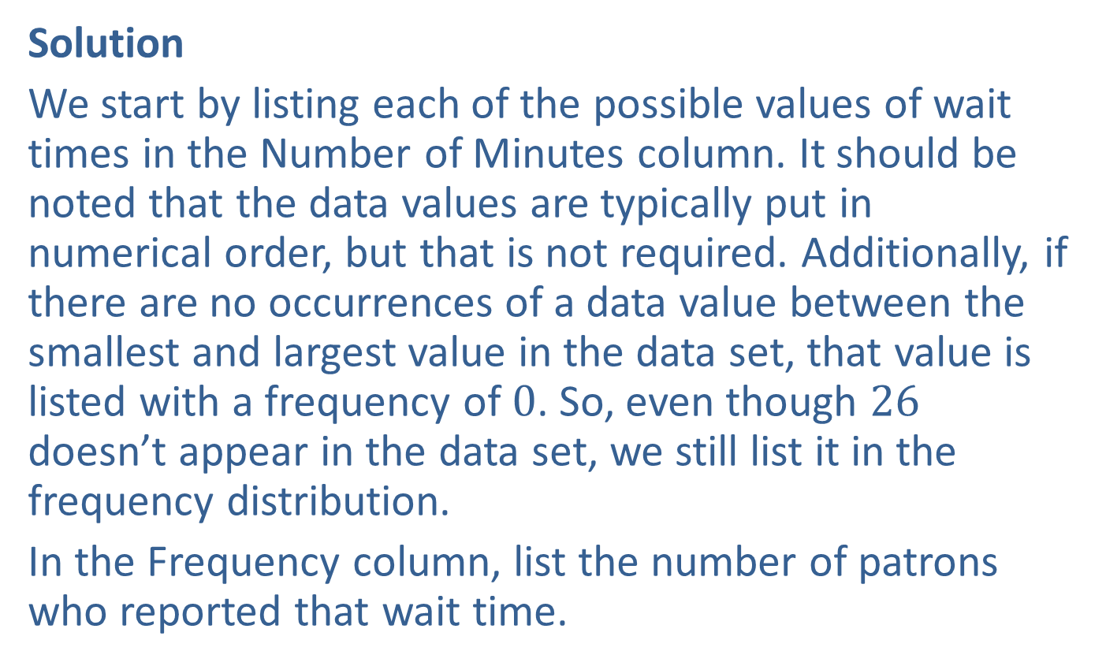
Example 2: Constructing a Frequency Distribution (cont.)
Solution
We start by listing each of the possible values of wait times in the Number of Minutes column. It should be noted that the data values are typically put in numerical order, but that is not required. Additionally, if there are no occurrences of a data value between the smallest and largest value in the data set, that value is listed with a frequency of $0$. So, even though $26$ doesn’t appear in the data set, we still list it in the frequency distribution.
In the Frequency column, list the number of patrons who reported that wait time.

Slide 8
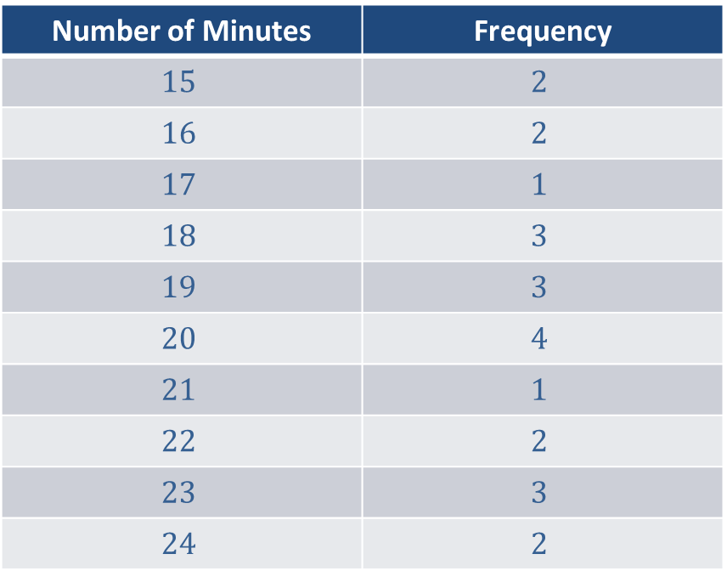
Example 2: Constructing a Frequency Distribution (cont.)
Wait Times at the DMV
Number of Minutes | Frequency
$$15$$ | $$2$$
$$16$$ | $$2$$
$$17$$ | $$1$$
$$18$$ | $$3$$
$$19$$ | $$3$$
$$20$$ | $$4$$
$$21$$ | $$1$$
$$22$$ | $$2$$
$$23$$ | $$3$$
$$24$$ | $$2$$

Slide 9
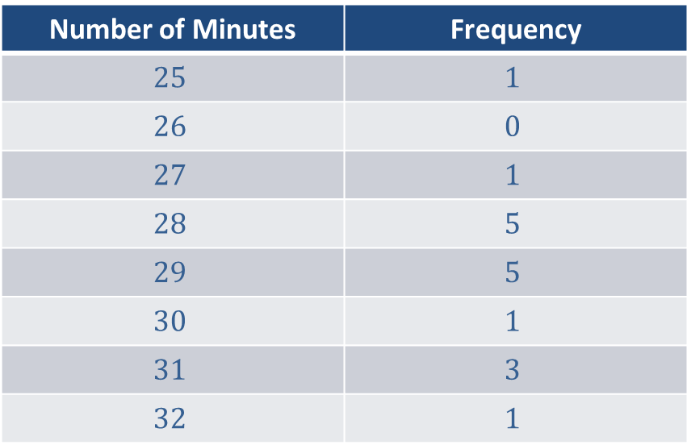
Example 2: Constructing a Frequency Distribution (cont.)
Wait Times at the DMV (cont.)
Number of Minutes | Frequency
$$25$$ | $$1$$
$$26$$ | $$0$$
$$27$$ | $$1$$
$$28$$ | $$5$$
$$29$$ | $$5$$
$$30$$ | $$1$$
$$31$$ | $$3$$
$$32$$ | $$1$$

Slide 10
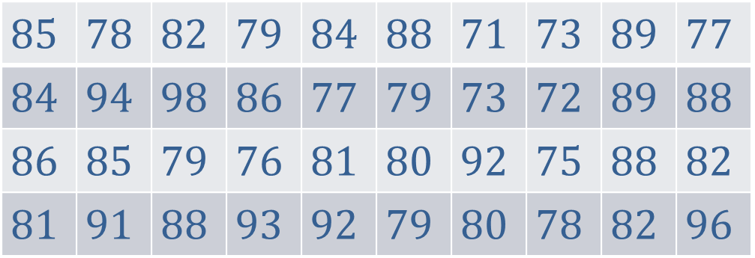

Example 3: Constructing a Grouped Frequency Distribution
The exam scores from two sections of a statistics course are recorded here.
Construct a grouped frequency distribution of the data collected with a first class of $71–76$.
$$85$$ | $$78$$ | $$82$$ | $$79$$ | $$84$$ | $$88$$ | $$71$$ | $$73$$ | $$89$$ | $$77$$
$$84$$ | $$94$$ | $$98$$ | $$86$$ | $$77$$ | $$79$$ | $$73$$ | $$72$$ | $$89$$ | $$88$$
$$86$$ | $$85$$ | $$79$$ | $$76$$ | $$81$$ | $$80$$ | $$92$$ | $$75$$ | $$88$$ | $$82$$
$$81$$ | $$91$$ | $$88$$ | $$93$$ | $$92$$ | $$79$$ | $$80$$ | $$78$$ | $$82$$ | $$96$$

Slide 11
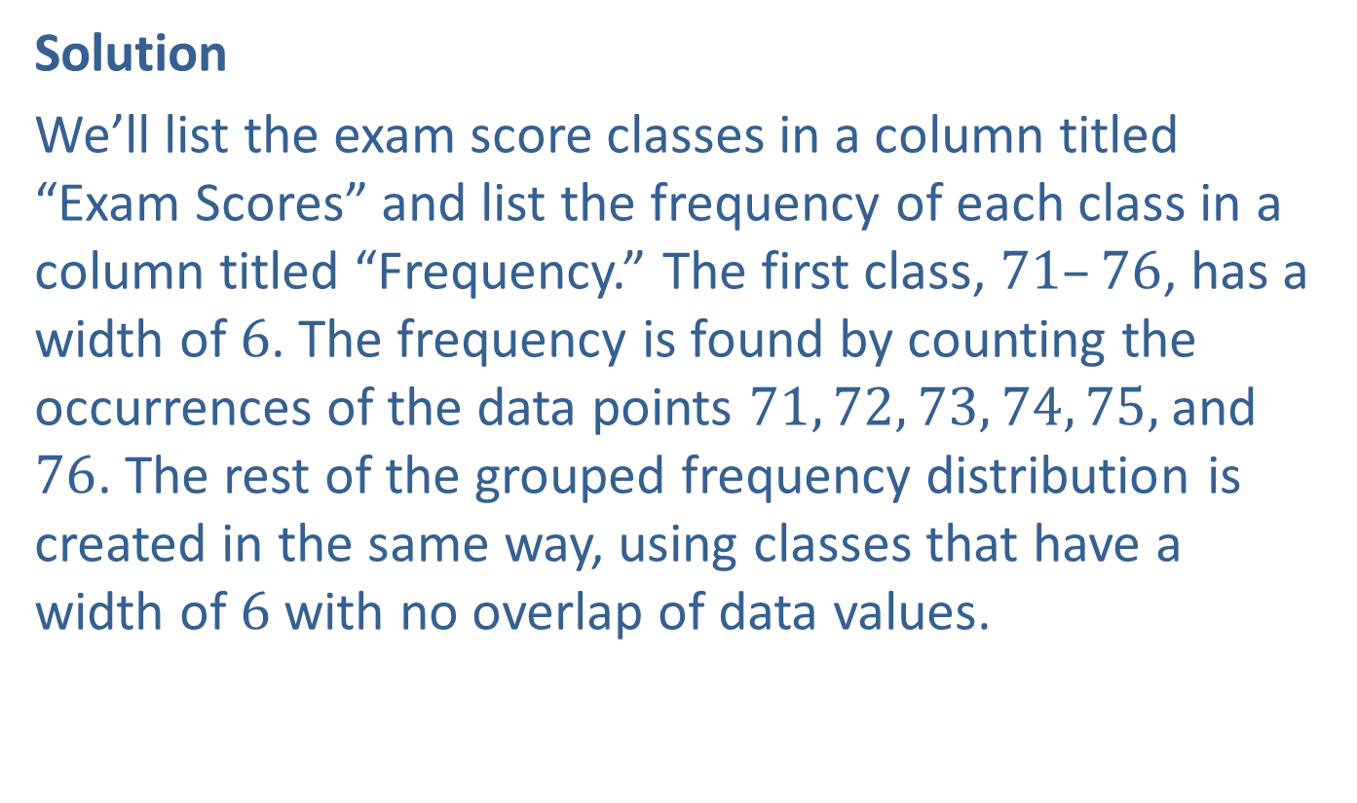
Example 3: Constructing a Grouped Frequency Distribution (cont.)
Solution
We’ll list the exam score classes in a column titled “Exam Scores” and list the frequency of each class in a column titled “Frequency.” The first class, $71–76$, has a width of $6$. The frequency is found by counting the occurrences of the data points $71, 72, 73, 74, 75,$and $76$. The rest of the grouped frequency distribution is created in the same way, using classes that have a width of $6$ with no overlap of data values.

Slide 12
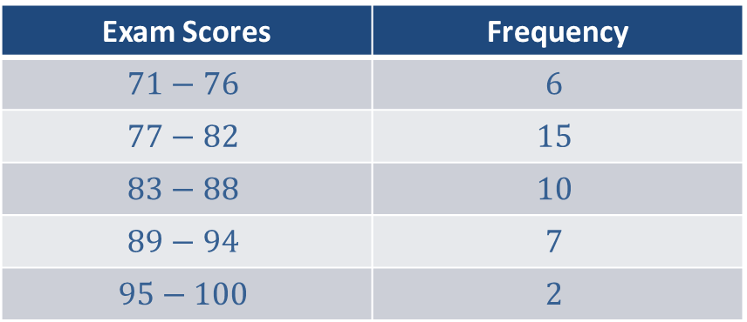
Example 3: Constructing a Grouped Frequency Distribution (cont.)
Exam Scores in a Statistics Course
Exam Scores | Frequency
$$71−76$$ | $$6$$
$$77−82$$ | $$15$$
$$83−88$$ | $$10$$
$$89−94$$ | $$7$$
$$95−100$$ | $$2$$

Slide 13
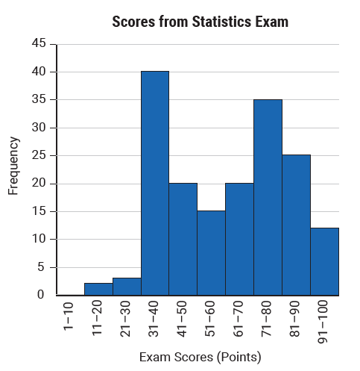
Example 4: Reading a Histogram
The following histogram displays the exam scores from a recent statistics exam.

Slide 14
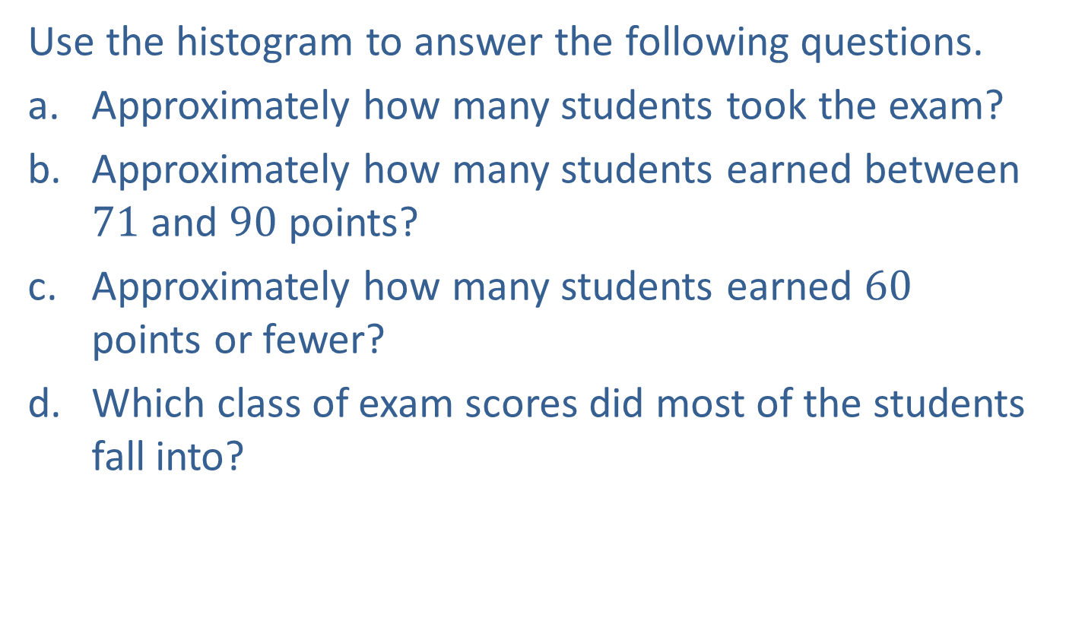
Example 4: Reading a Histogram (cont.)
Use the histogram to answer the following questions.
​Approximately how many students took the exam?
​Approximately how many students earned between $71$ and $90$ points?
​Approximately how many students earned $60$ points or fewer?
​Which class of exam scores did most of the students fall into?

Slide 15
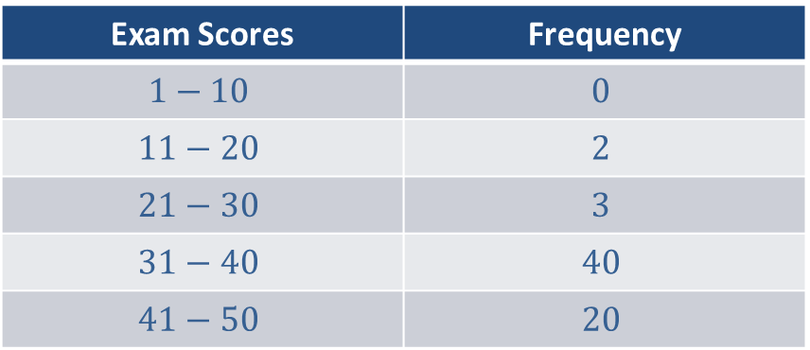
Example 4: Reading a Histogram (cont.)
Solution
To determine the number of students who took the statistics exam, add together the frequencies of each of the classes. We’ll need to approximate the frequencies for each class from the graph, and then add them together.
Exam Scores | Frequency
$$1−10$$ | $$0$$
$$11−20$$ | $$2$$
$$21−30$$ | $$3$$
$$31−40$$ | $$40$$
$$41−50$$ | $$20$$

Slide 16
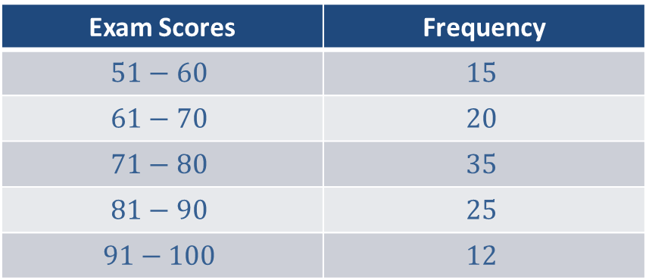
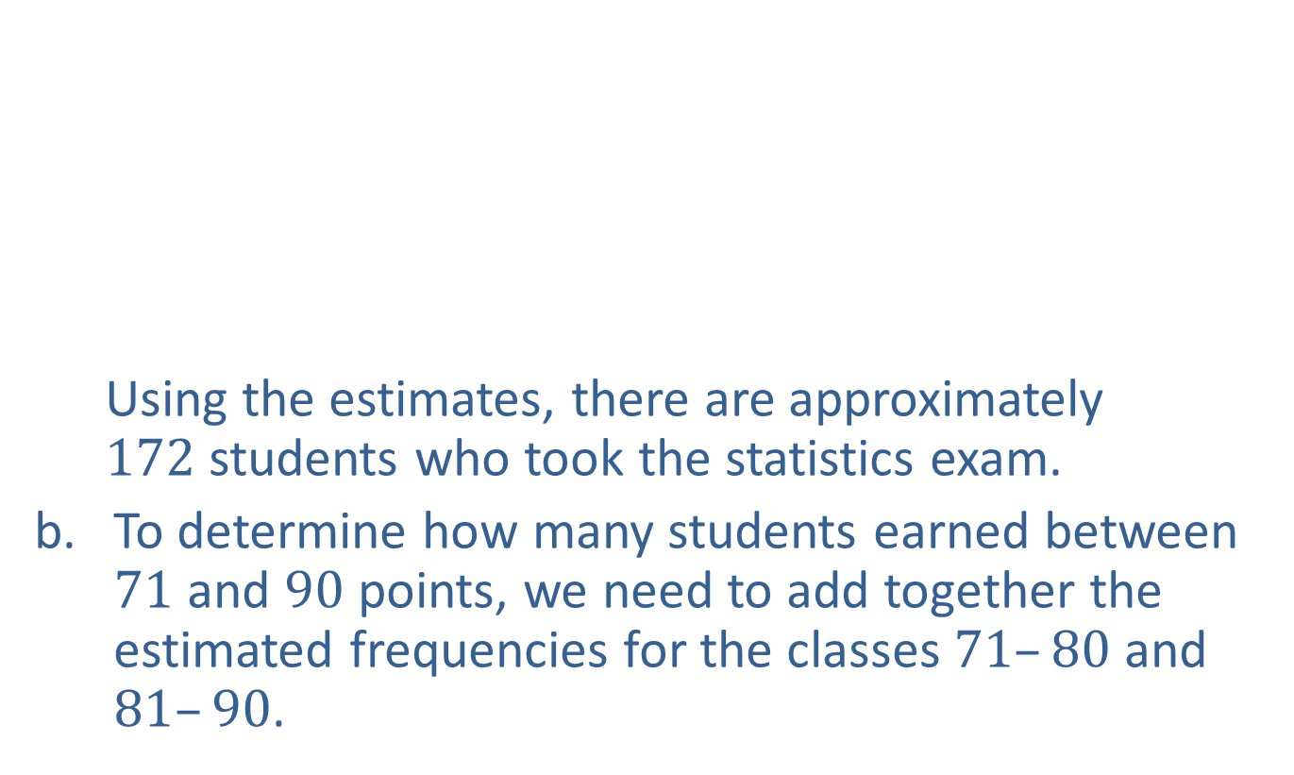
Example 4: Reading a Histogram (cont.)
  Using the estimates, there are approximately $172$students who took the statistics exam.
To determine how many students earned between $71$ and $90$ points, we need to add together the estimated frequencies for the classes $71–80$ and $81–90$.
Exam Scores | Frequency
$$51−60$$ | $$15$$
$$61−70$$ | $$20$$
$$71−80$$ | $$35$$
$$81−90$$ | $$25$$
$$91−100$$ | $$12$$

Slide 17
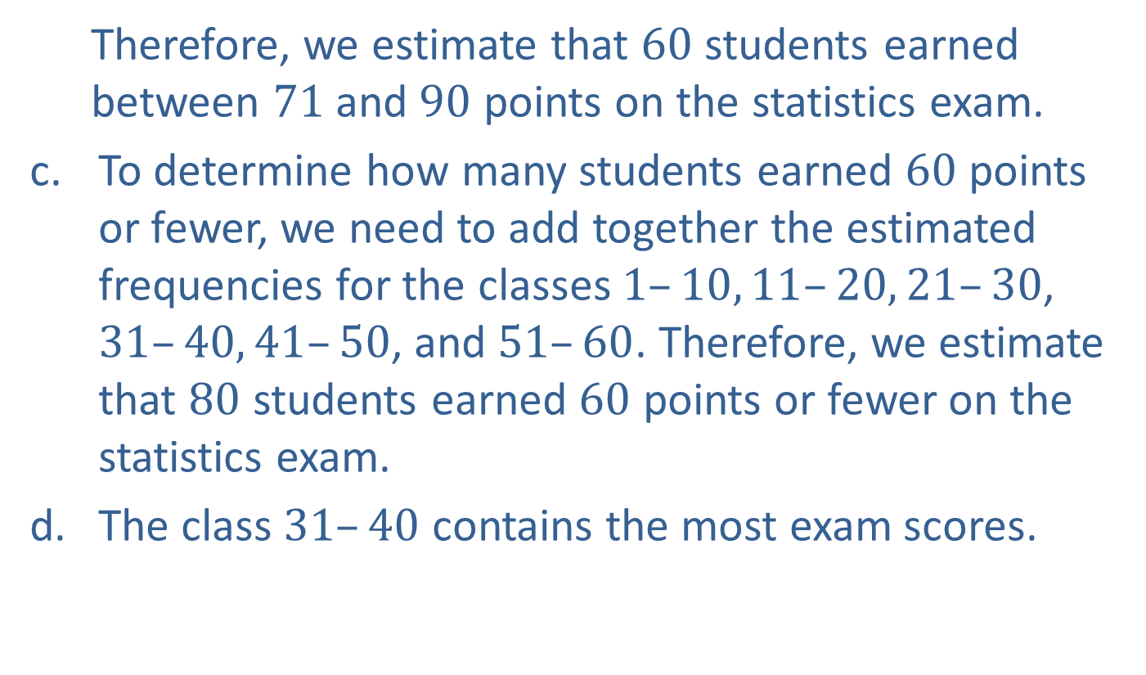
Example 4: Reading a Histogram (cont.)
  Therefore, we estimate that $60$ students earned between $71$and $90$ points on the statistics exam.
To determine how many students earned $60$ points or fewer, we need to add together the estimated frequencies for the classes $1–10, 11–20, 21–30$, $31–40, 41–50$, and $51–60$. Therefore, we estimate that $80$ students earned $60$ points or fewer on the statistics exam.
The class $31–40$ contains the most exam scores.

Slide 18
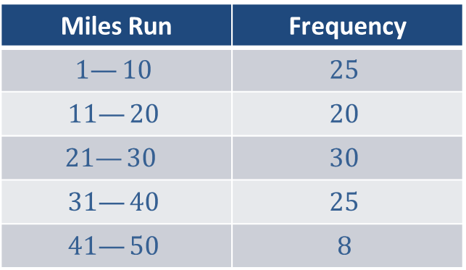
Example 5: Constructing a Histogram and Frequency Polygon
Given the following grouped frequency distribution, construct a histogram and the corresponding frequency polygon on the same set of axes.
Weekly Mileage of Running Club Members
Miles Run | Frequency
$$1—10$$ | $$25$$
$$11—20$$ | $$20$$
$$21—30$$ | $$30$$
$$31—40$$ | $$25$$
$$41—50$$ | $$8$$

Slide 19
Example 5: Constructing a Histogram and Frequency Polygon (cont.)
Solution
To create the histogram, each class (row) will represent a bar on the graph. The height of each bar corresponds to the frequency of that class. To create the frequency polygon, after creating the histogram, connect the midpoints of the tops of each bar with a line segment.

Slide 20
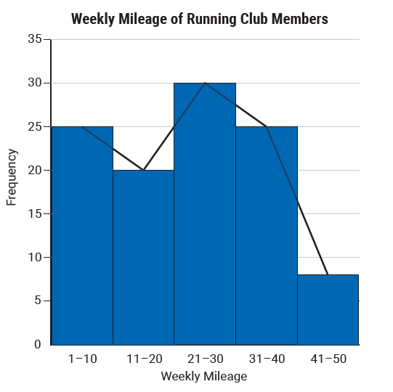
Example 5: Constructing a Histogram and Frequency Polygon (cont.)

Slide 21
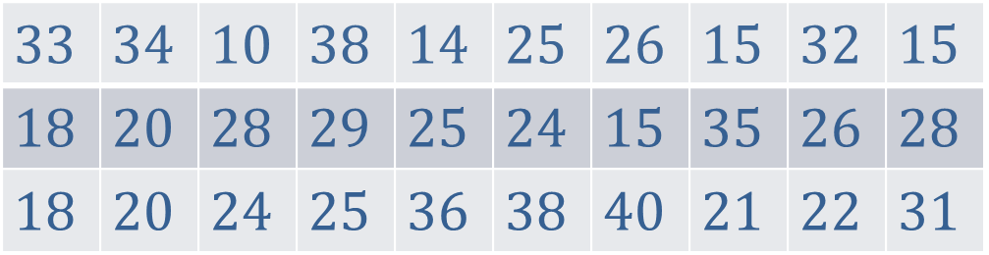
Example 6: Constructing a Stem-and-Leaf Plot
Use the following weekly mileages recorded by runners in a local running club to create a stem-and-leaf plot.
Solution
To create the stem-and-leaf plot we will use the tens digit for the values in the “stem” column and the ones values in the “leaf” column.
$$33$$ | $$34$$ | $$10$$ | $$38$$ | $$14$$ | $$25$$ | $$26$$ | $$15$$ | $$32$$ | $$15$$
$$18$$ | $$20$$ | $$28$$ | $$29$$ | $$25$$ | $$24$$ | $$15$$ | $$35$$ | $$26$$ | $$28$$
$$18$$ | $$20$$ | $$24$$ | $$25$$ | $$36$$ | $$38$$ | $$40$$ | $$21$$ | $$22$$ | $$31$$

Slide 22
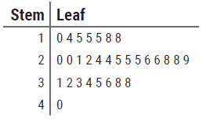
Example 6: Constructing a Stem-and-Leaf Plot (cont.)

