Slide 1
Section 10.4
Measures of Dispersion and Percentiles

Slide 2
Definition: Range
The range is the difference between the largest value and smallest value in a data set.

Slide 3
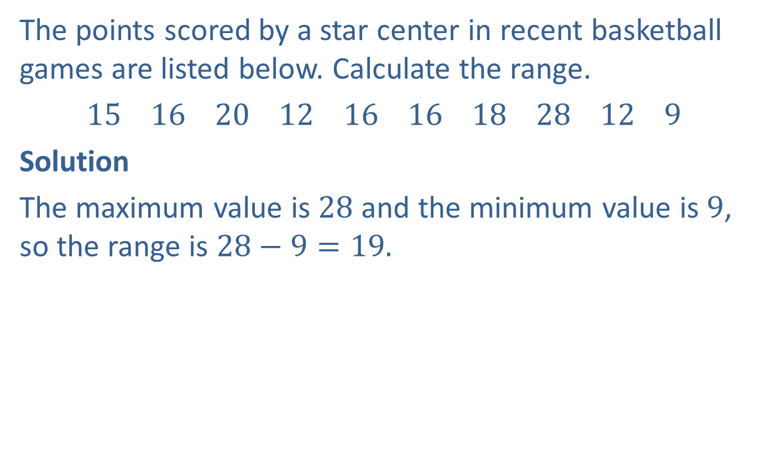
Example 1: Finding the Range
The points scored by a star center in recent basketball games are listed below. Calculate the range.
15 16 20 12 16 16 18 28 12 9
Solution
The maximum value is $28$ and the minimum value is $9$, so the range is $28−9=19.$

Slide 4
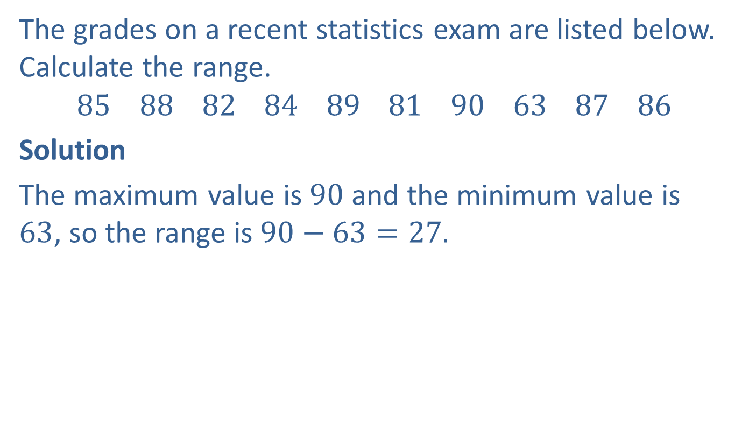
Example 2: Finding the Range
The grades on a recent statistics exam are listed below. Calculate the range.
$$85 88 82 84 89 81 90 63 87 86$$
Solution
The maximum value is $90$ and the minimum value is $63$, so the range is $90−63=27.$

Slide 5
Note
It is important to note that the formula for standard deviation differs for samples and populations. We will only consider samples here.

Slide 6
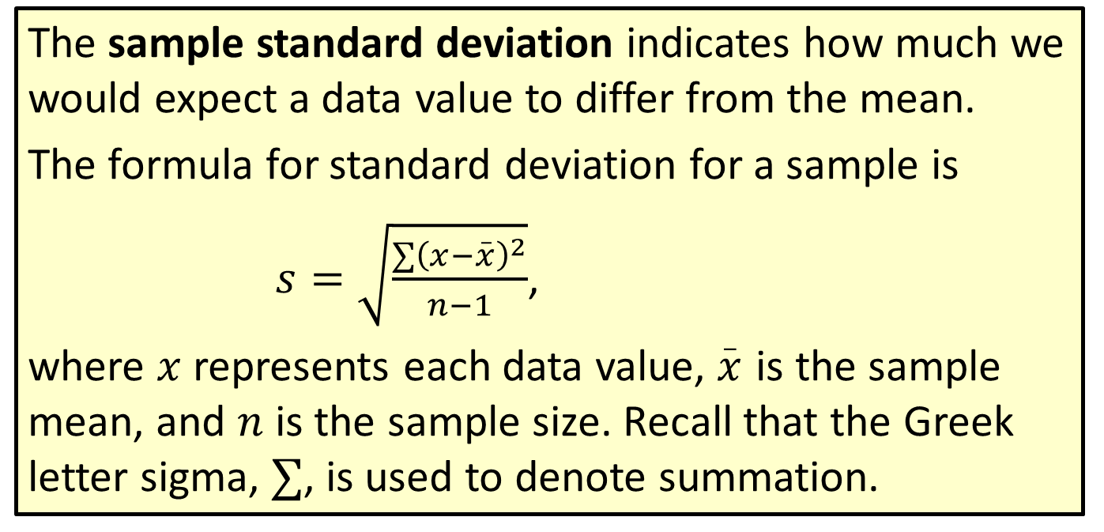
Formula: Sample Standard Deviation
The sample standard deviation indicates how much we would expect a data value to differ from the mean.
The formula for standard deviation for a sample is
$s=\sqrt{\frac{∑{\left(x−\overset{_}{x}\right)}^{2}}{n−1}}$,
where $x$ represents each data value, $\overset{_}{x}$ is the sample mean, and $n$ is the sample size. Recall that the Greek letter sigma, $∑$, is used to denote summation.

Slide 7
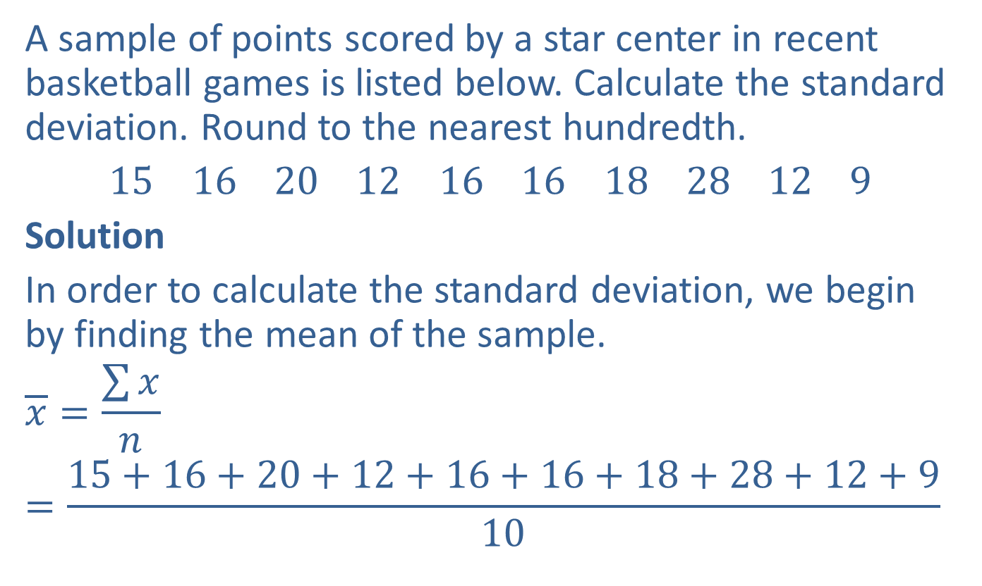
Example 3: Finding the Standard Deviation
A sample of points scored by a star center in recent basketball games is listed below. Calculate the standard deviation. Round to the nearest hundredth.
15 16 20 12 16 16 18 28 12 9
Solution
In order to calculate the standard deviation, we begin by finding the mean of the sample.
$$\overline{x}=\frac{\sum{x}}{n}=\frac{15+16+20+12+16+16+18+28+12+9}{10}$$

Slide 8
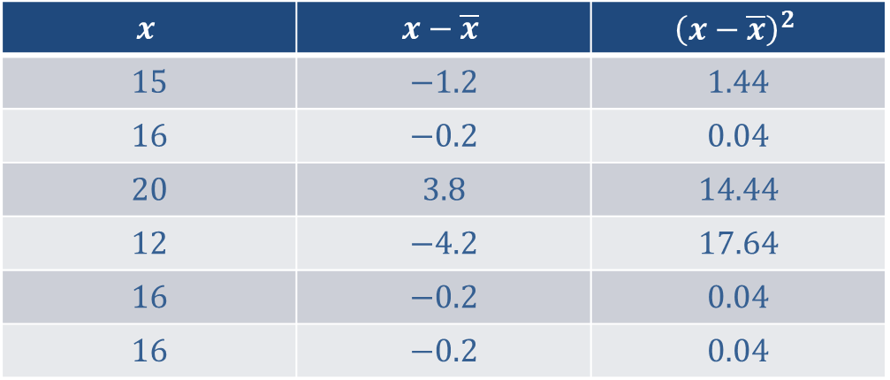

Example 3: Finding the Standard Deviation (cont.)
$$=\frac{162}{10}=16.2$$
The mean is $16.2.$
When calculating the standard deviation, it is helpful to use a table to keep the numbers organized.
$$x$$ | $$x−\overline{x}$$ | $${\left(x−\overline{x}\right)}^{2}$$
$$15$$ | $$−1.2$$ | $$1.44$$
$$16$$ | $$−0.2$$ | $$0.04$$
$$20$$ | $$3.8$$ | $$14.44$$
$$12$$ | $$−4.2$$ | $$17.64$$
$$16$$ | $$−0.2$$ | $$0.04$$
$$16$$ | $$−0.2$$ | $$0.04$$

Slide 9
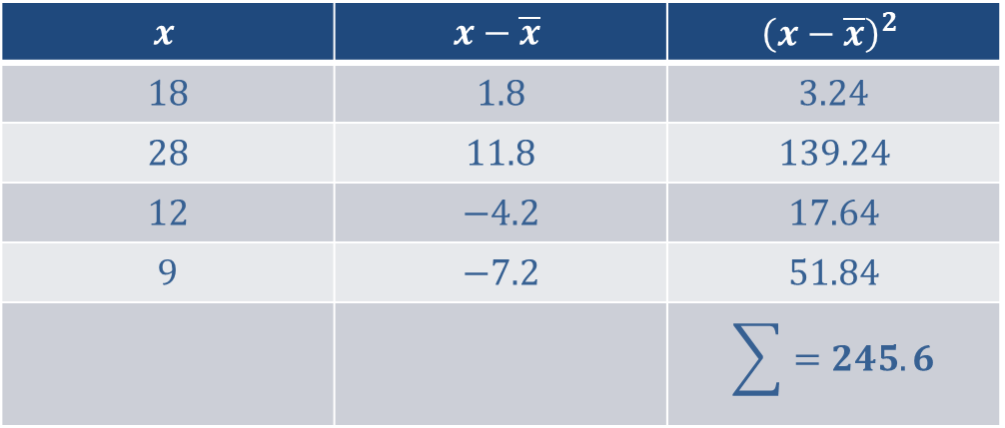

Example 3: Finding the Standard Deviation (cont.)
Now that the table is complete, we are ready to substitute values into the standard deviation formula.
$$s=\sqrt{\frac{\sum{{\left(x−\overline{x}\right)}^{2}}}{n−1}}$$
$$x$$ | $$x−\overline{x}$$ | $${\left(x−\overline{x}\right)}^{2}$$
$$18$$ | $$1.8$$ | $$3.24$$
$$28$$ | $$11.8$$ | $$139.24$$
$$12$$ | $$−4.2$$ | $$17.64$$
$$9$$ | $$−7.2$$ | $$51.84$$
 |  | $$\sum{=245.6}$$

Slide 10
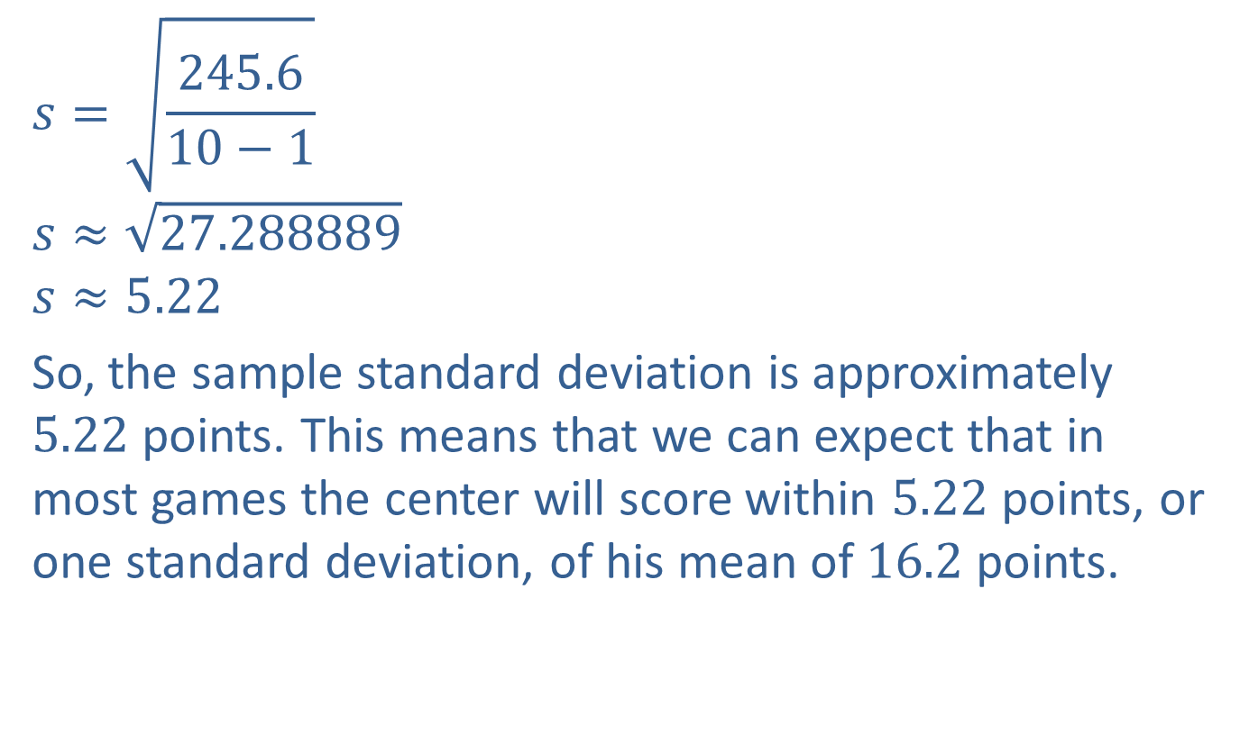
Example 3: Finding the Standard Deviation (cont.)
$$s=\sqrt{\frac{245.6}{10−1}}$$
$$s≈\sqrt{27.288889}$$
$$s≈5.22$$
So, the sample standard deviation is approximately $5.22$ points. This means that we can expect that in most games the center will score within $5.22$ points, or one standard deviation, of his mean of $16.2$ points.

Slide 11
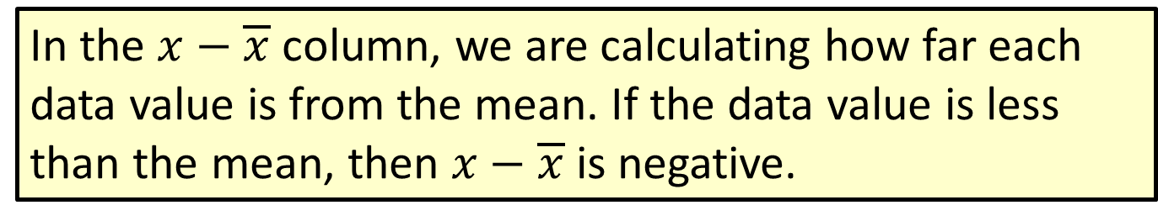
Note
In the $x−\overline{x}$ column, we are calculating how far each data value is from the mean. If the data value is less than the mean, then $x−\overline{x}$ is negative.

Slide 12
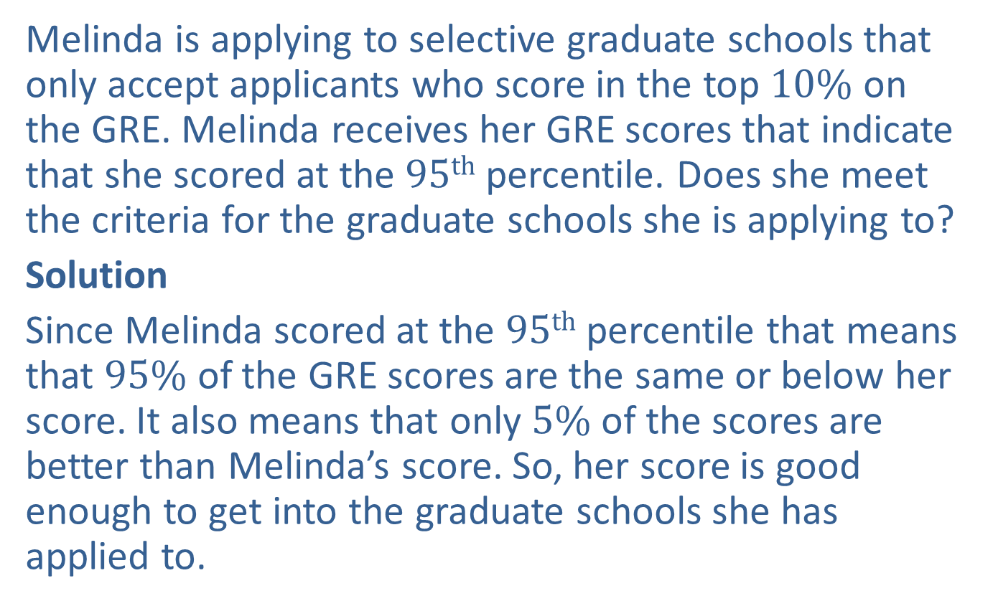
Example 4: Using Percentiles
Melinda is applying to selective graduate schools that only accept applicants who score in the top $10\%$ on the GRE. Melinda receives her GRE scores that indicate that she scored at the $95th$ percentile. Does she meet the criteria for the graduate schools she is applying to?
Solution
Since Melinda scored at the $95th$ percentile that means that $95\%$ of the GRE scores are the same or below her score. It also means that only $5\%$ of the scores are better than Melinda’s score. So, her score is good enough to get into the graduate schools she has applied to.

Slide 13
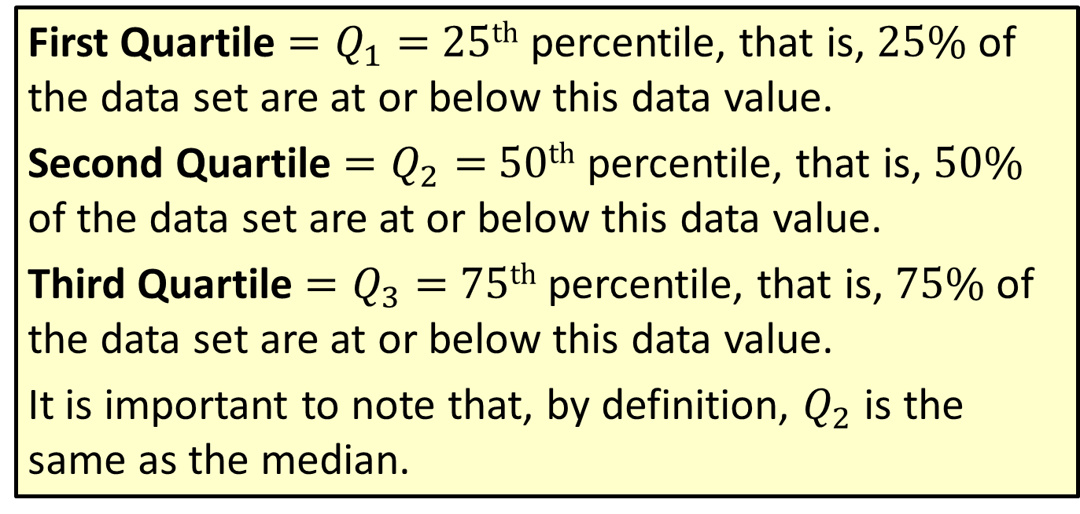
Definition: Quartiles
First Quartile $=Q_{1}=$ $25th$ percentile, that is, $25\%$ of the data set are at or below this data value.
Second Quartile $=Q_{2}=$ $50th$ percentile, that is, $50\%$ of the data set are at or below this data value.
Third Quartile $=Q_{3}=$ $75th$ percentile, that is, $75\%$ of the data set are at or below this data value.
It is important to note that, by definition, $Q_{2}$ is the same as the median.

Slide 14
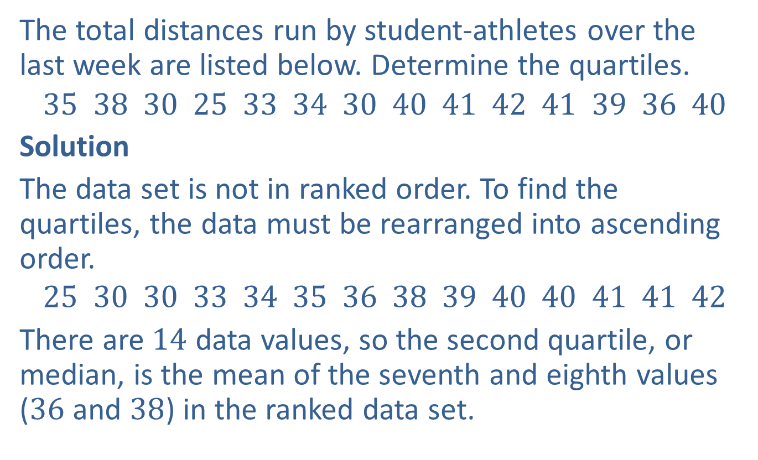
Example 5: Determining Quartiles
The total distances run by student-athletes over the last week are listed below. Determine the quartiles.
$$35 38 30 25 33 34 30 40 41 42 41 39 36 40$$
Solution
The data set is not in ranked order. To find the quartiles, the data must be rearranged into ascending order.
$$25 30 30 33 34 35 36 38 39 40 40 41 41 42$$
There are $14$ data values, so the second quartile, or median, is the mean of the seventh and eighth values ($36$ and $38$) in the ranked data set.

Slide 15
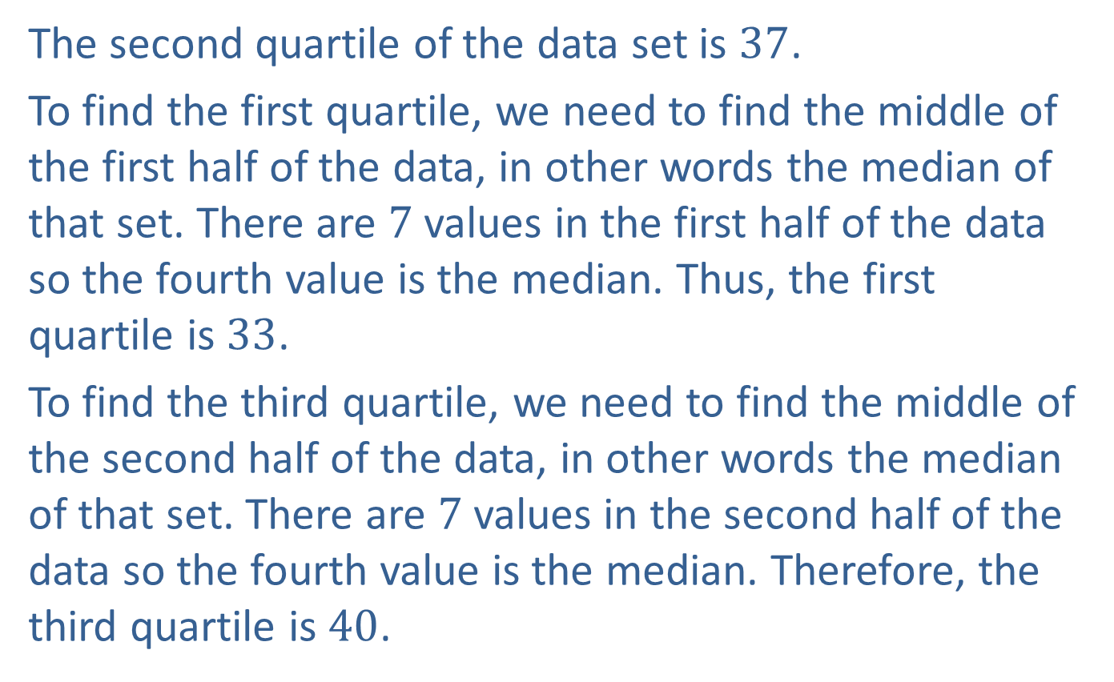
Example 5: Determining Quartiles (cont.)
The second quartile of the data set is $37$.
To find the first quartile, we need to find the middle of the first half of the data, in other words the median of that set. There are $7$ values in the first half of the data so the fourth value is the median. Thus, the first quartile is $33$.
To find the third quartile, we need to find the middle of the second half of the data, in other words the median of that set. There are $7$ values in the second half of the data so the fourth value is the median. Therefore, the third quartile is $40$.

Slide 16




Example 5: Determining Quartiles (cont.)
$$25 30 30 33 34 35 36 38 39 40 40 41 41 42$$
First Quartile = $33$
Second Quartile (Median) $=37$
Third Quartile $=40$
$$Q1$$
$$Q2$$
$$Q3$$

