Slide 1
Section 10.5
The Normal Distribution

Slide 2
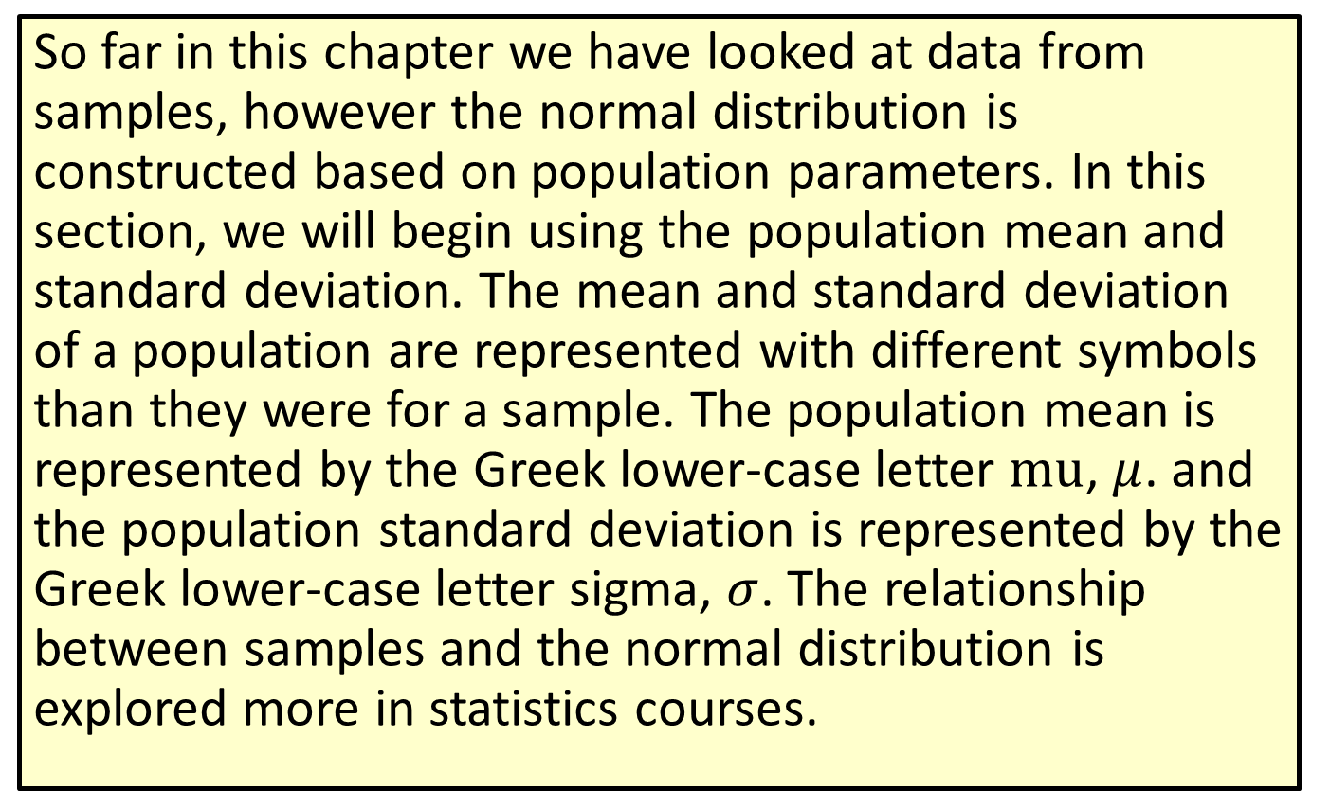
Note
​So far in this chapter we have looked at data from samples, however the normal distribution is constructed based on population parameters. In this section, we will begin using the population mean and standard deviation. The mean and standard deviation of a population are represented with different symbols than they were for a sample. The population mean is represented by the Greek lower-case letter $mu$, $μ$. and the population standard deviation is represented by the Greek lower-case letter sigma, $σ$. The relationship between samples and the normal distribution is explored more in statistics courses.

Slide 3
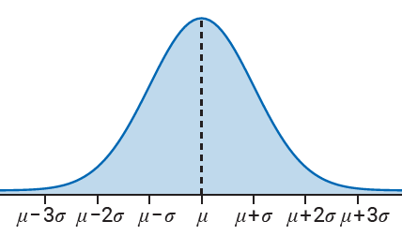
The Normal Distribution

Slide 4
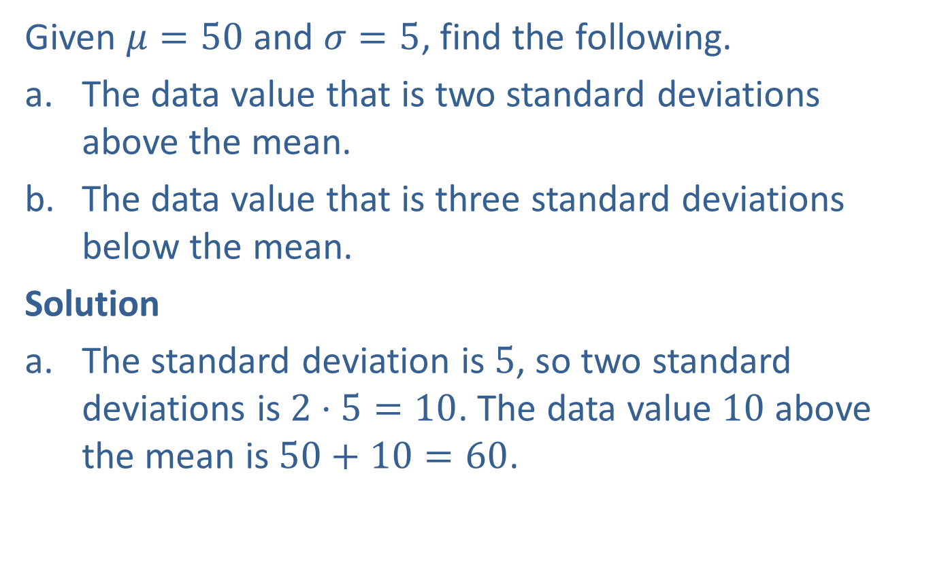
Example 1: Using Standard Deviation to Find a Data Value
Given $μ=50$ and $σ=5$, find the following.
​The data value that is two standard deviations above the mean.
​The data value that is three standard deviations below the mean.
Solution
The standard deviation is $5$, so two standard deviations is $2⋅5=10$. The data value $10$ above the mean is $50+10=60$.

Slide 5

Example 1: Using Standard Deviation to Find a Data Value (cont.)
The standard deviation is $5$, so three standard deviations is $3⋅5=15$. The data value $15$ below the mean is $50−15=35$.

Slide 6
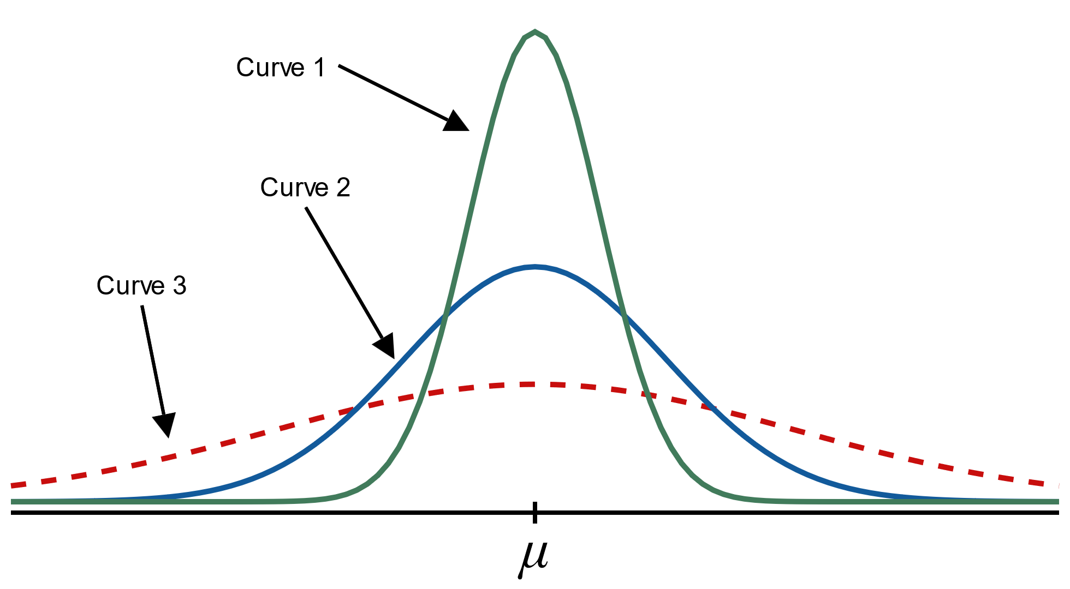
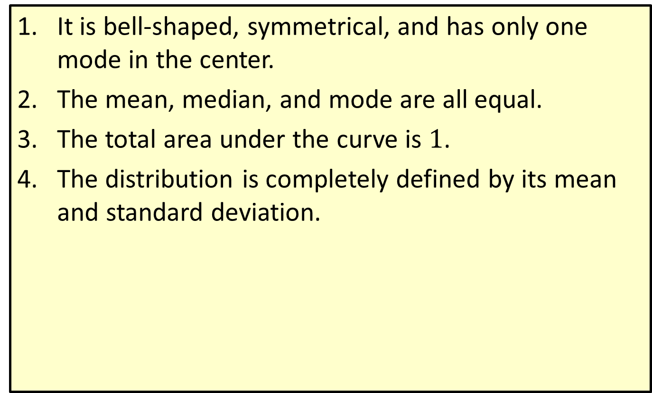
Properties: Characteristics of the Normal Distribution
It is bell-shaped, symmetrical, and has only one mode in the center.
​The mean, median, and mode are all equal.
​The total area under the curve is $1$.
​The distribution is completely defined by its mean and standard deviation.

Slide 7
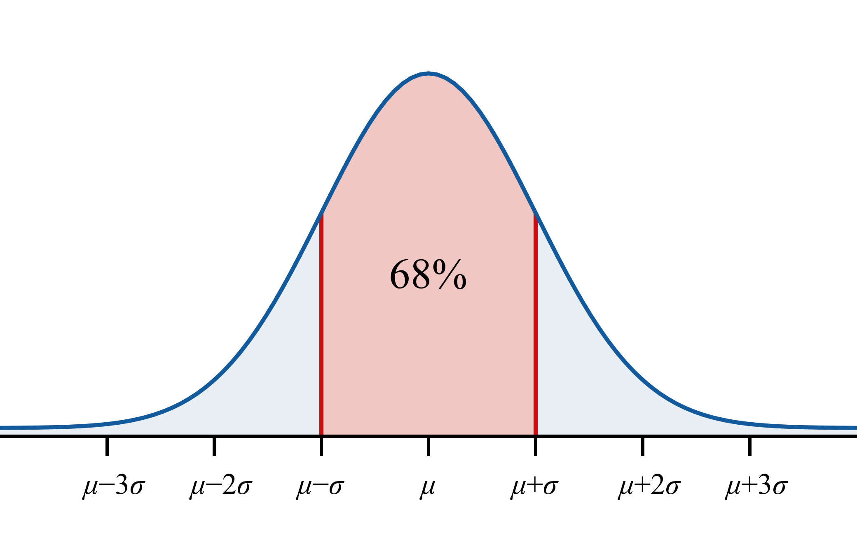

Properties: The Empirical Rule
​Approximately $68\%$ of the data values fall within $1$ standard deviation of the mean.

Slide 8
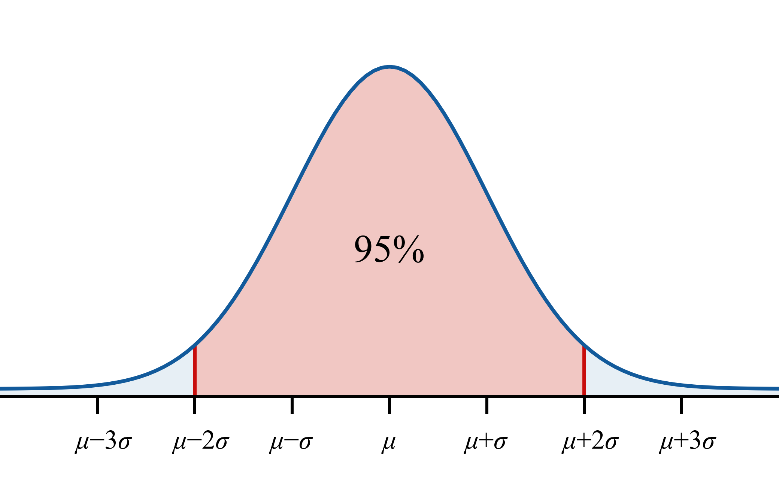

Properties: The Empirical Rule (cont.)
​Approximately $95\%$ of the data values fall within $2$ standard deviations of the mean.

Slide 9
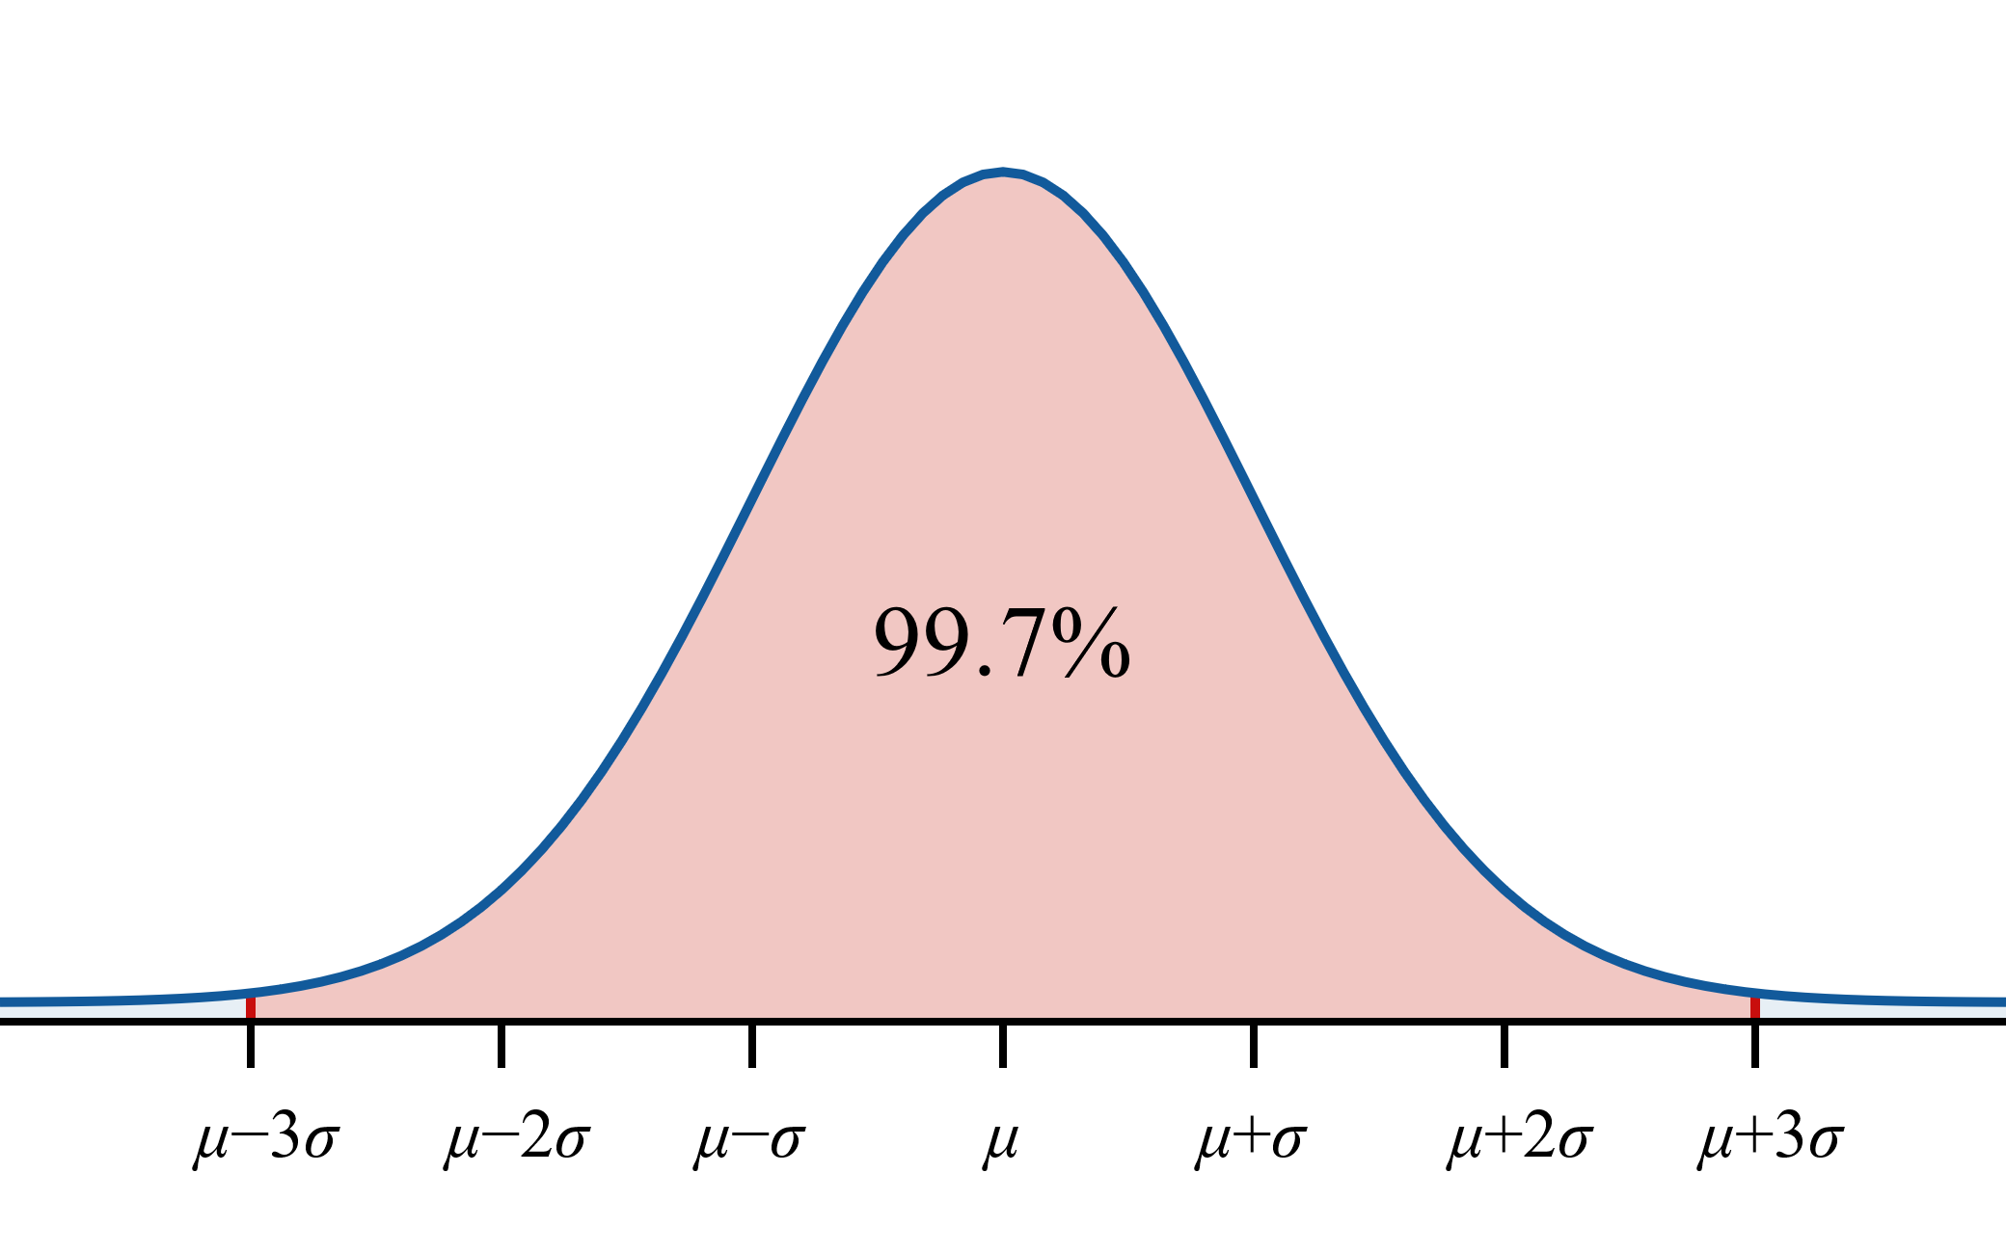

Properties: The Empirical Rule (cont.)
​Approximately $99.7\%$ of the data values fall within $3$ standard deviations of the mean.

Slide 10
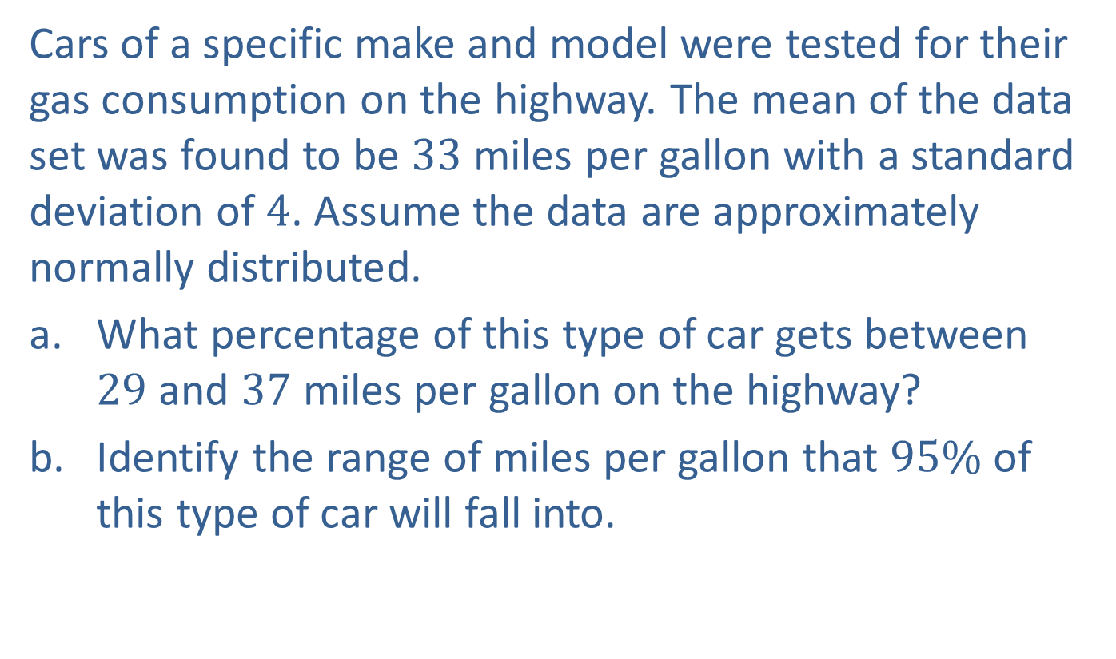
Example 2: Applying the Empirical Rule
Cars of a specific make and model were tested for their gas consumption on the highway. The mean of the data set was found to be $33$ miles per gallon with a standard deviation of $4$. Assume the data are approximately normally distributed.
​What percentage of this type of car gets between $29$ and $37$ miles per gallon on the highway?
​Identify the range of miles per gallon that $95\%$ of this type of car will fall into.

Slide 11
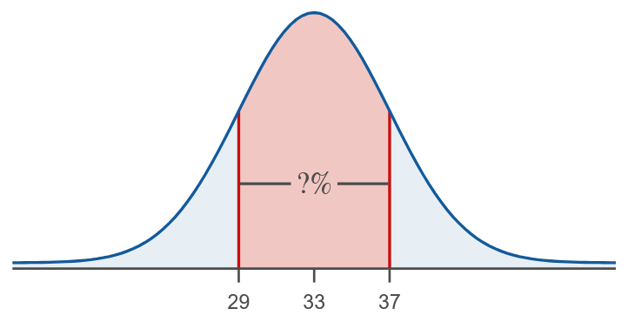
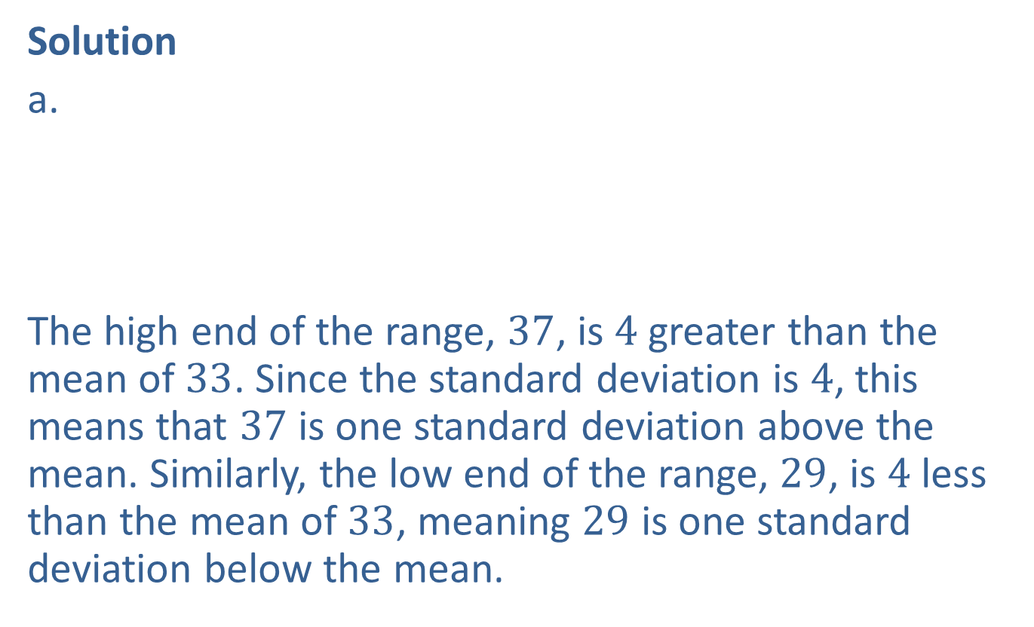
Example 2: Applying the Empirical Rule (cont.)
Solution
​
The high end of the range, $37$, is $4$ greater than the mean of $33$. Since the standard deviation is $4$, this means that $37$ is one standard deviation above the mean. Similarly, the low end of the range, $29$, is $4$ less than the mean of $33$, meaning $29$ is one standard deviation below the mean.

Slide 12
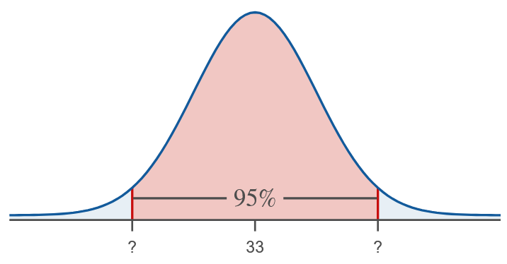
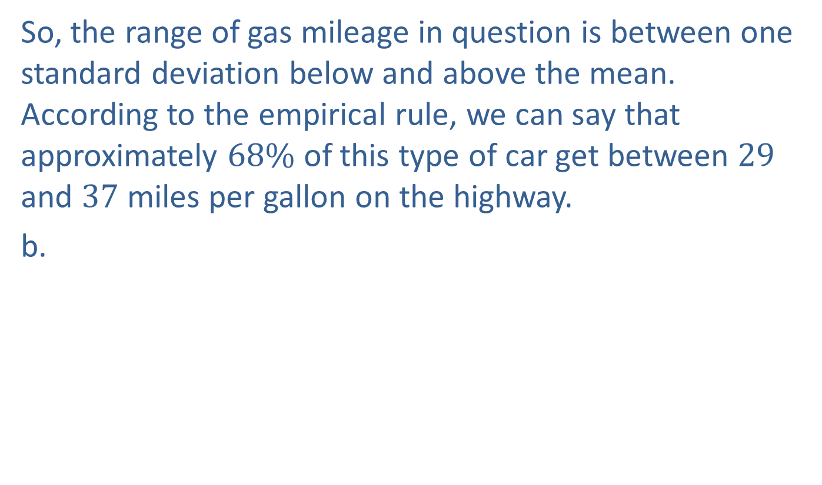
Example 2: Applying the Empirical Rule (cont.)
So, the range of gas mileage in question is between one standard deviation below and above the mean. According to the empirical rule, we can say that approximately $68\%$ of this type of car get between $29$ and $37$ miles per gallon on the highway.
b.

Slide 13
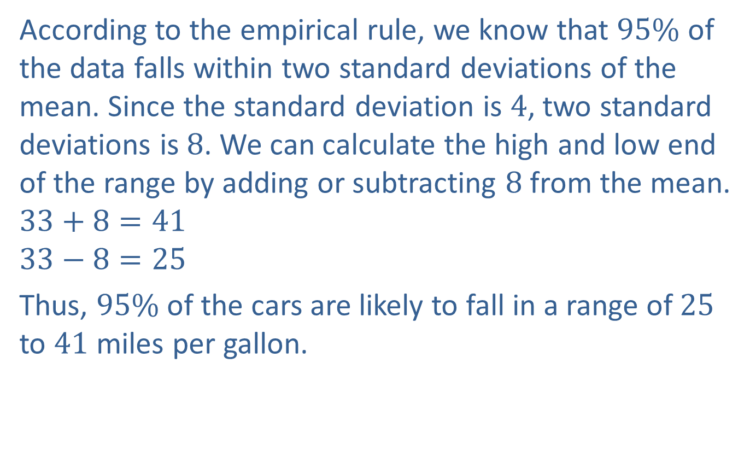
Example 2: Applying the Empirical Rule (cont.)
According to the empirical rule, we know that $95\%$ of the data falls within two standard deviations of the mean. Since the standard deviation is $4$, two standard deviations is $8$. We can calculate the high and low end of the range by adding or subtracting $8$ from the mean.
$$33+8=41$$
$$33−8=25$$
Thus, $95\%$ of the cars are likely to fall in a range of $25$ to $41$ miles per gallon.

Slide 14
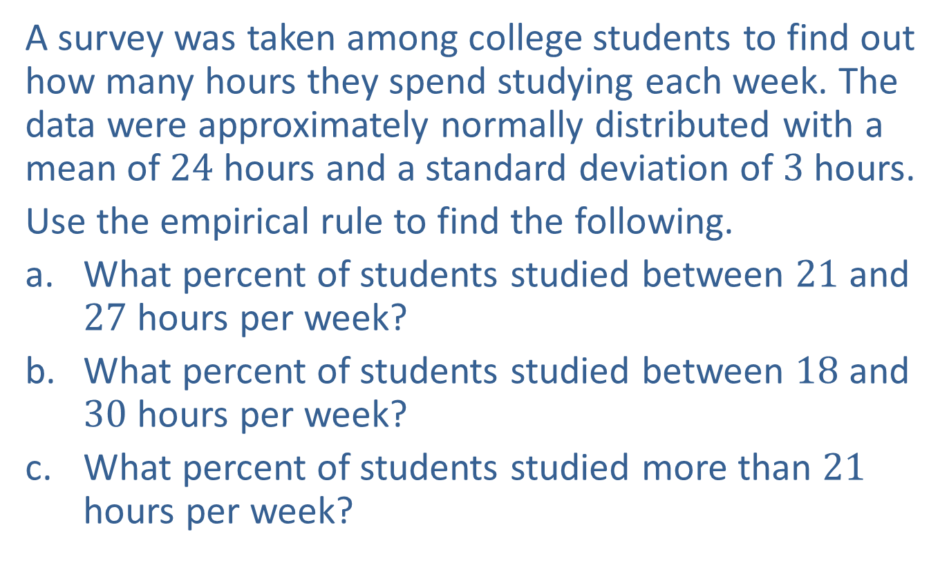
Example 3: Applying the Empirical Rule
A survey was taken among college students to find out how many hours they spend studying each week. The data were approximately normally distributed with a mean of $24$ hours and a standard deviation of $3$ hours.
Use the empirical rule to find the following.
​What percent of students studied between $21$ and $27$ hours per week?
​What percent of students studied between $18$ and $30$ hours per week?
​What percent of students studied more than $21$ hours per week?

Slide 15
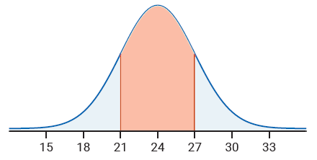
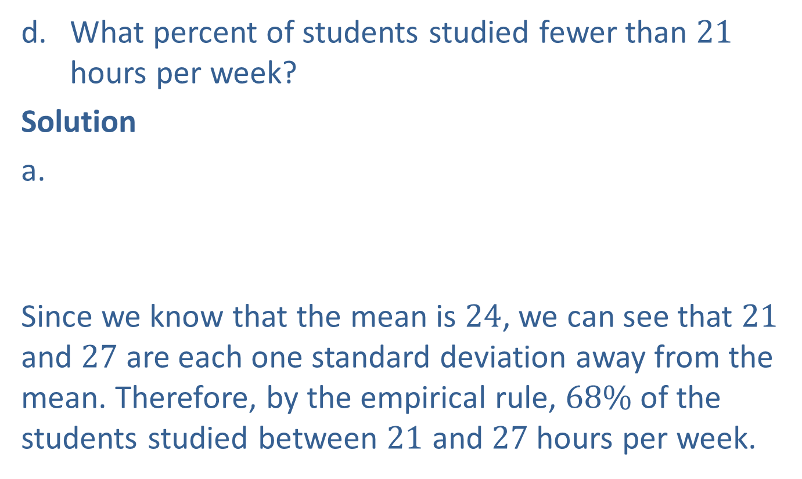
Example 3: Applying the Empirical Rule (cont.)
​What percent of students studied fewer than $21$ hours per week?
Solution
a.
Since we know that the mean is $24$, we can see that $21$ and $27$ are each one standard deviation away from the mean. Therefore, by the empirical rule, $68\%$ of the students studied between $21$ and $27$hours per week.

Slide 16
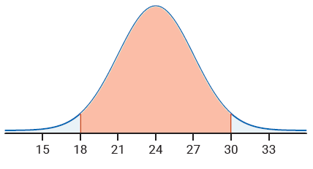
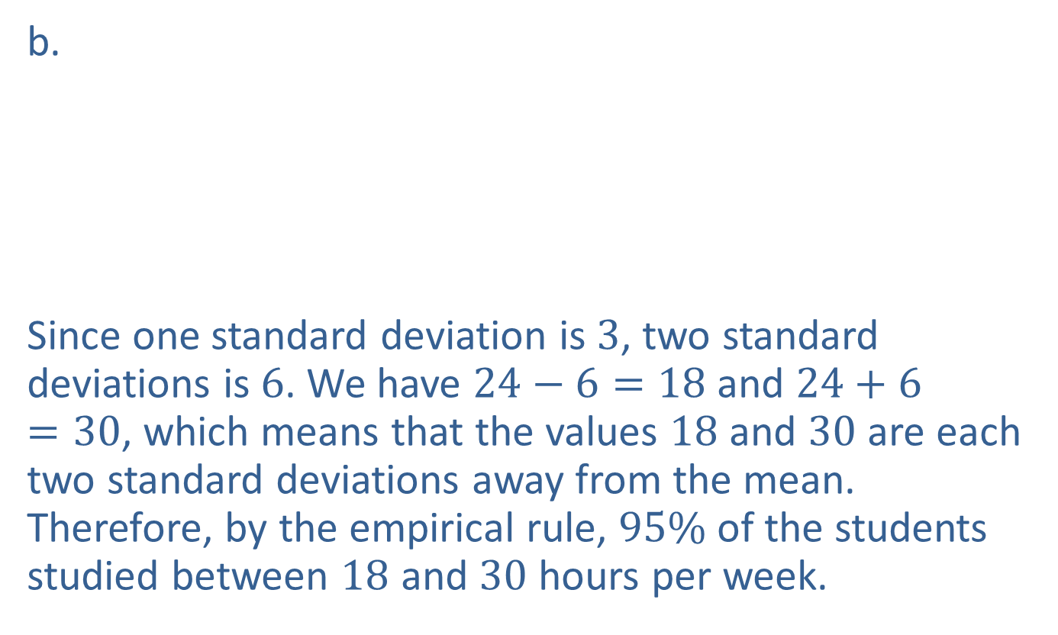
Example 3: Applying the Empirical Rule (cont.)
b.
Since one standard deviation is $3$, two standard deviations is $6$. We have $24−6=18$ and $24+6=30$, which means that the values $18$ and $30$ are each two standard deviations away from the mean. Therefore, by the empirical rule, $95\%$ of the students studied between $18$ and $30$ hours per week.

Slide 17
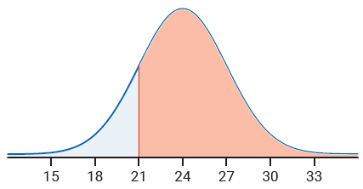
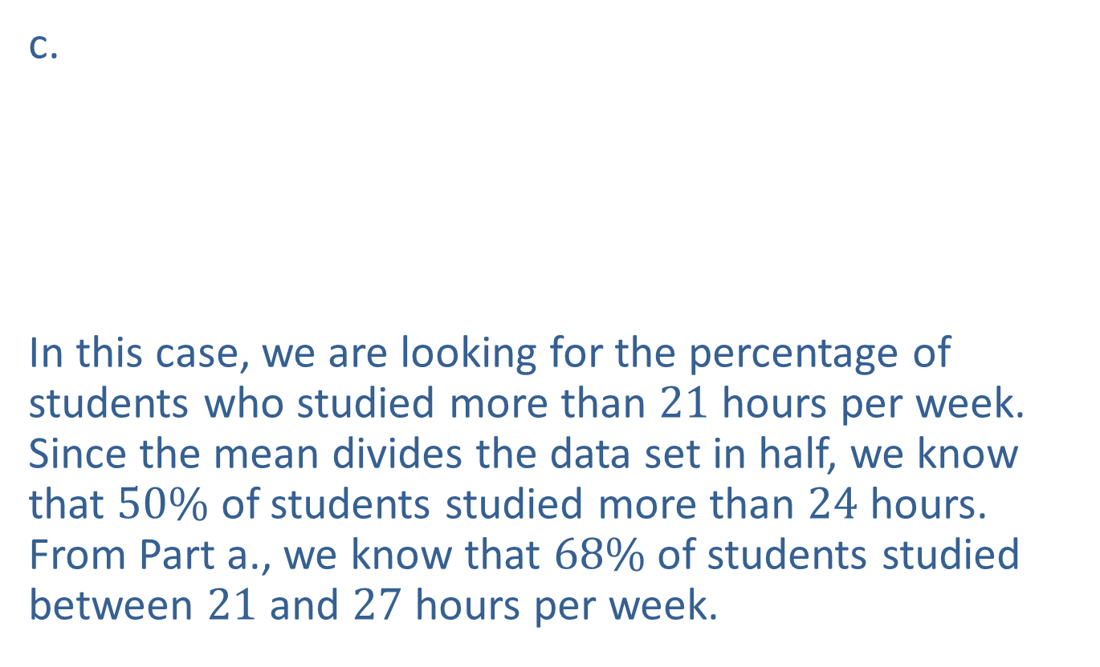
Example 3: Applying the Empirical Rule (cont.)
c.
In this case, we are looking for the percentage of students who studied more than $21$ hours per week. Since the mean divides the data set in half, we know that $50\%$ of students studied more than $24$ hours. From Part a., we know that $68\%$ of students studied between $21$ and $27$ hours per week.

Slide 18
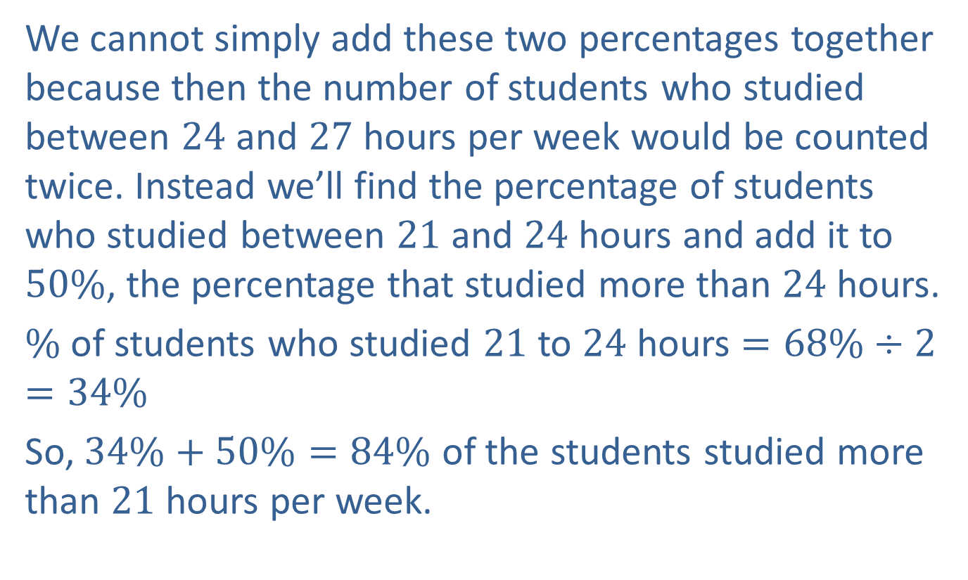
Example 3: Applying the Empirical Rule (cont.)
We cannot simply add these two percentages together because then the number of students who studied between $24$ and $27$ hours per week would be counted twice. Instead we’ll find the percentage of students who studied between $21$ and $24$ hours and add it to $50\%$, the percentage that studied more than $24$ hours.
$\%$ of students who studied $21$ to $24$ hours $=68\%÷2=34\%$
So, $34\%+50\%=84\%$ of the students studied more than $21$ hours per week.

Slide 19
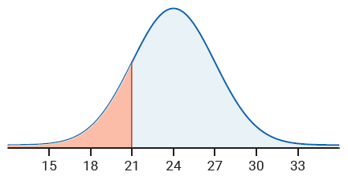
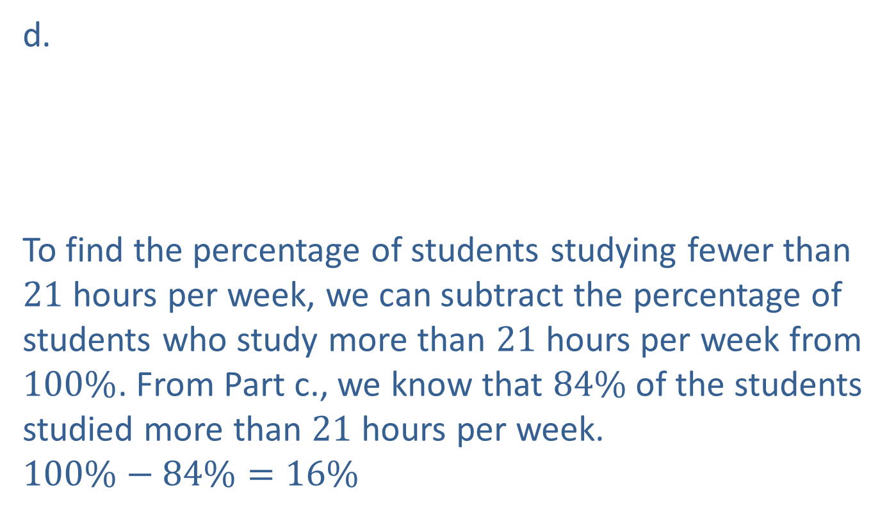
Example 3: Applying the Empirical Rule (cont.)
d.
To find the percentage of students studying fewer than $21$ hours per week, we can subtract the percentage of students who study more than $21$ hours per week from $100\%$. From Part c., we know that $84\%$ of the students studied more than $21$ hours per week.
$$100\%−84\%=16\%$$

Slide 20

Example 3: Applying the Empirical Rule (cont.)
Therefore, $16\%$ of the students studied fewer than $21$ hours per week.

Slide 21
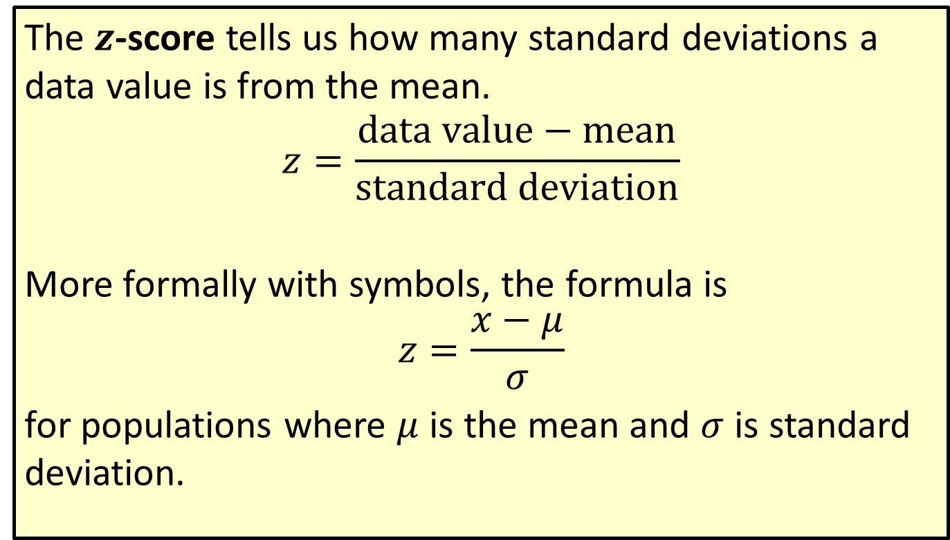

Formula: $z$-Score
The $z$-score tells us how many standard deviations a data value is from the mean.
$$z=\frac{data value−mean}{standard deviation}$$
More formally with symbols, the formula is
$$z=\frac{x−μ}{σ}$$
for populations where $μ$ is the mean and $σ$ is standard deviation.

Slide 22
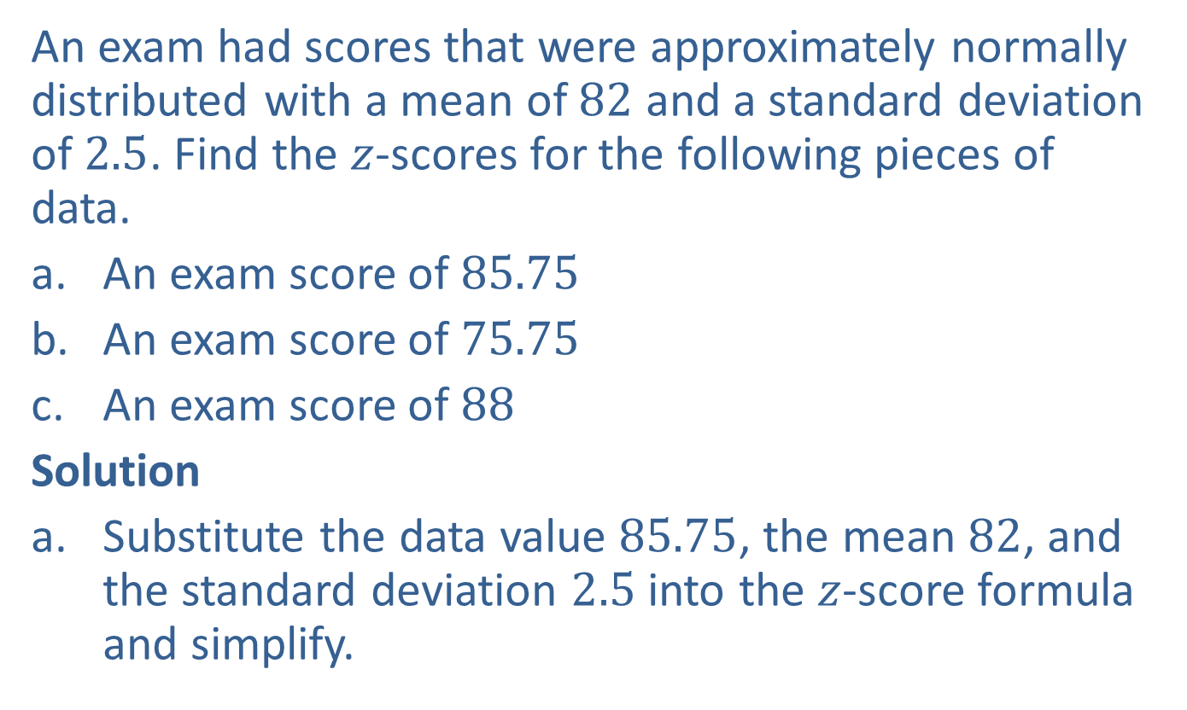
Example 4: Finding a 𝑧-Score
An exam had scores that were approximately normally distributed with a mean of $82$ and a standard deviation of $2.5$. Find the $z$-scores for the following pieces of data.
​An exam score of $85.75$
​An exam score of $75.75$
​An exam score of $88$
Solution
Substitute the data value $85.75$, the mean $82$, and the standard deviation $2.5$ into the $z$-score formula and simplify.

Slide 23
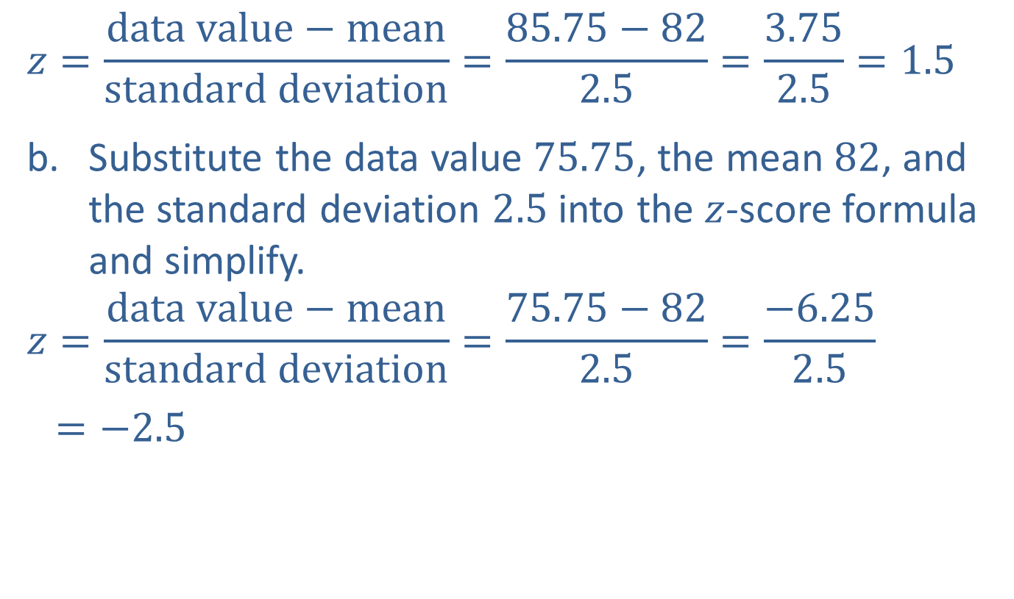
Example 4: Finding a 𝑧-Score (cont.)
$$z=\frac{data value−mean}{standard deviation}=\frac{85.75−82}{2.5}=\frac{3.75}{2.5}=1.5$$
Substitute the data value $75.75$, the mean $82$, and the standard deviation $2.5$ into the $z$-score formula and simplify.
$$z=\frac{data value−mean}{standard deviation}=\frac{75.75−82}{2.5}=\frac{−6.25}{2.5}$$
$=−2.5$

Slide 24

Example 4: Finding a 𝑧-Score (cont.)
Substitute the data value $88$, the mean $82$, and the standard deviation $2.5$ into the $z$-score formula and simplify.
$$z=\frac{data value−mean}{standard deviation}=\frac{88−82}{2.5}=\frac{6}{2.5}=2.4$$

Slide 25

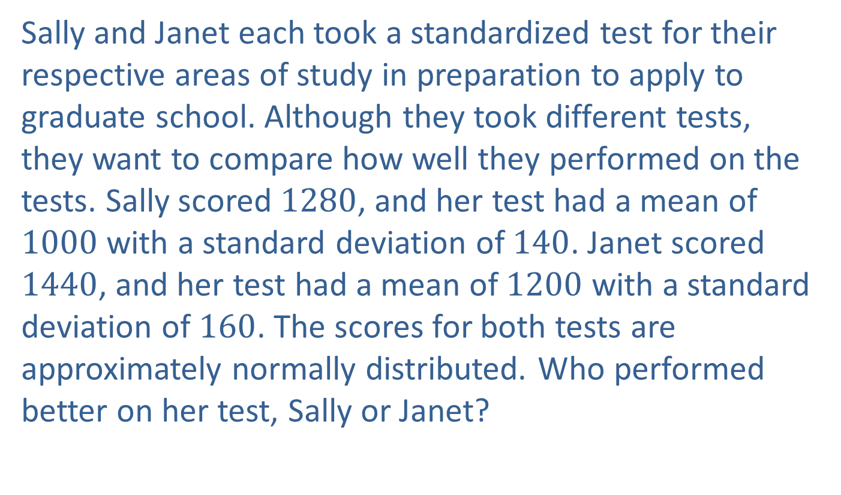
Example 5: Application: Interpreting the $z$-Score
Sally and Janet each took a standardized test for their respective areas of study in preparation to apply to graduate school. Although they took different tests, they want to compare how well they performed on the tests. Sally scored $1280$, and her test had a mean of $1000$ with a standard deviation of $140$. Janet scored $1440$, and her test had a mean of $1200$ with a standard deviation of $160$. The scores for both tests are approximately normally distributed. Who performed better on her test, Sally or Janet?

Slide 26
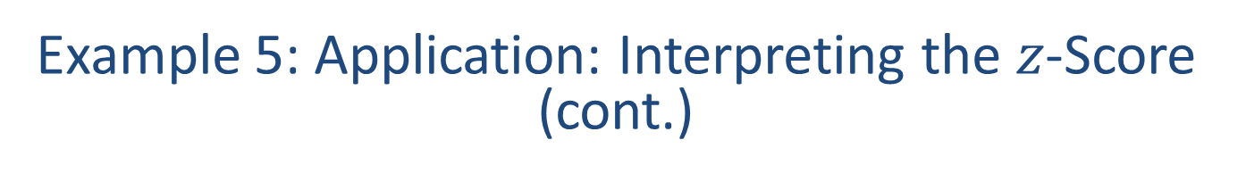
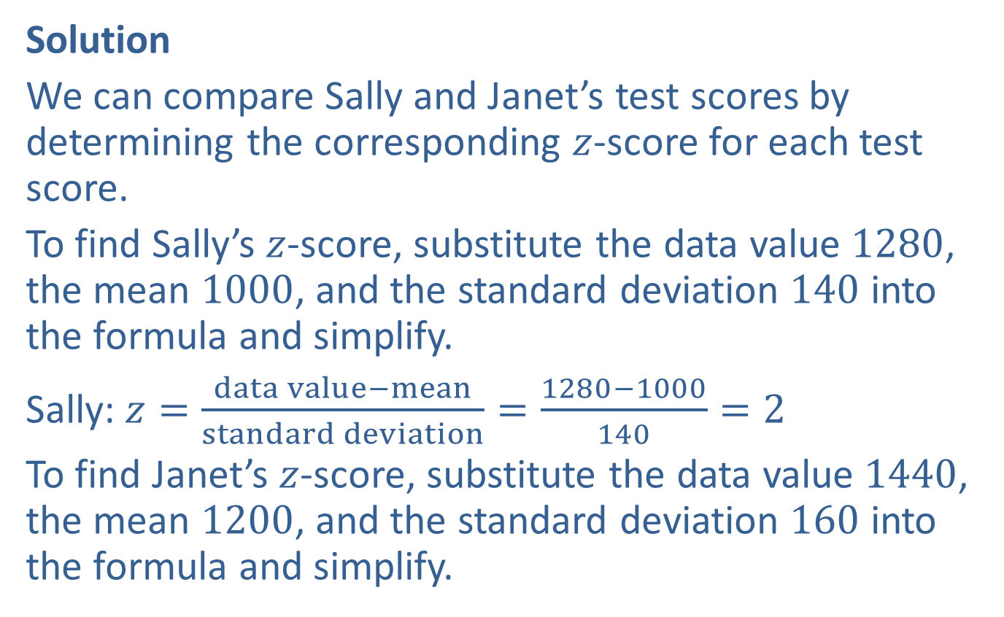
Example 5: Application: Interpreting the $z$-Score (cont.)
Solution
We can compare Sally and Janet’s test scores by determining the corresponding $z$-score for each test score.
To find Sally’s $z$-score, substitute the data value $1280$, the mean $1000$, and the standard deviation $140$ into the formula and simplify.
Sally: $z=\frac{data value−mean}{standard deviation}=\frac{1280−1000}{140}=2$
To find Janet’s $z$-score, substitute the data value $1440$, the mean $1200$, and the standard deviation $160$ into the formula and simplify.

Slide 27
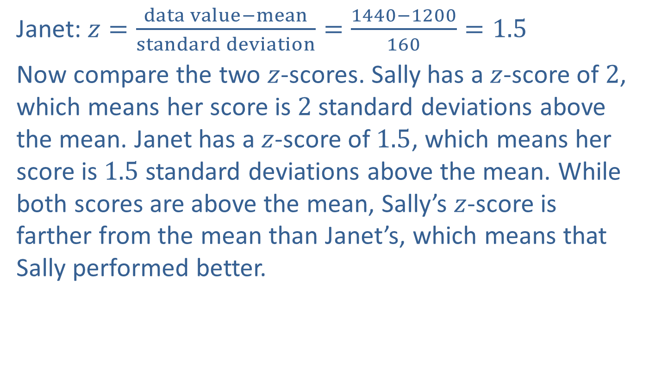
Example 5: Application: Interpreting the $z$-Score (cont.)
Janet: $z=\frac{data value−mean}{standard deviation}=\frac{1440−1200}{160}=1.5$
Now compare the two $z$-scores. Sally has a $z$-score of $2$, which means her score is $2$ standard deviations above the mean. Janet has a $z$-score of $1.5$, which means her score is $1.5$ standard deviations above the mean. While both scores are above the mean, Sally’s $z$-score is farther from the mean than Janet’s, which means that Sally performed better.

