Slide 1
Section 2.1
Solving One-Step Linear Equations

Slide 2
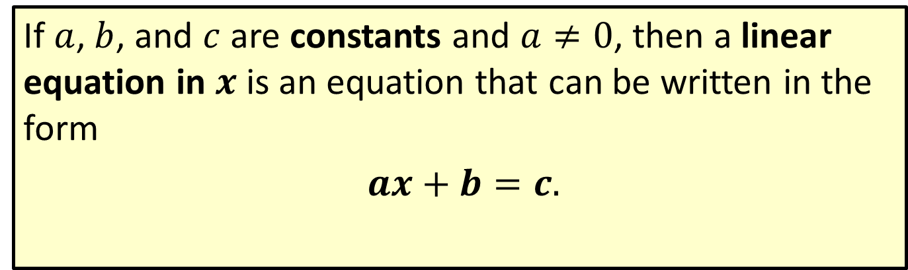

Definition: Linear Equation in $x$
If $a$, $b$, and $c$ are constants and $a≠0$, then a linear equation in $x$ is an equation that can be written in the form
$ax+b=c.$

Slide 3
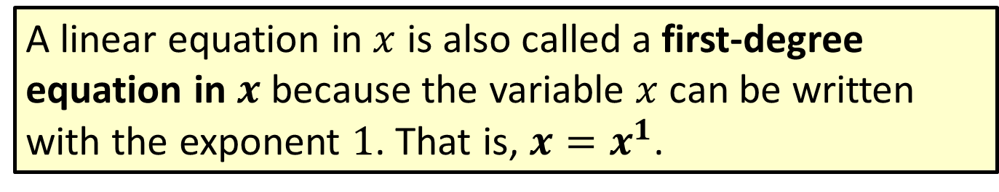
Note
A linear equation in $x$ is also called a first-degree equation in $x$ because the variable $x$ can be written with the exponent $1$. That is, $x=x^{1}$.

Slide 4
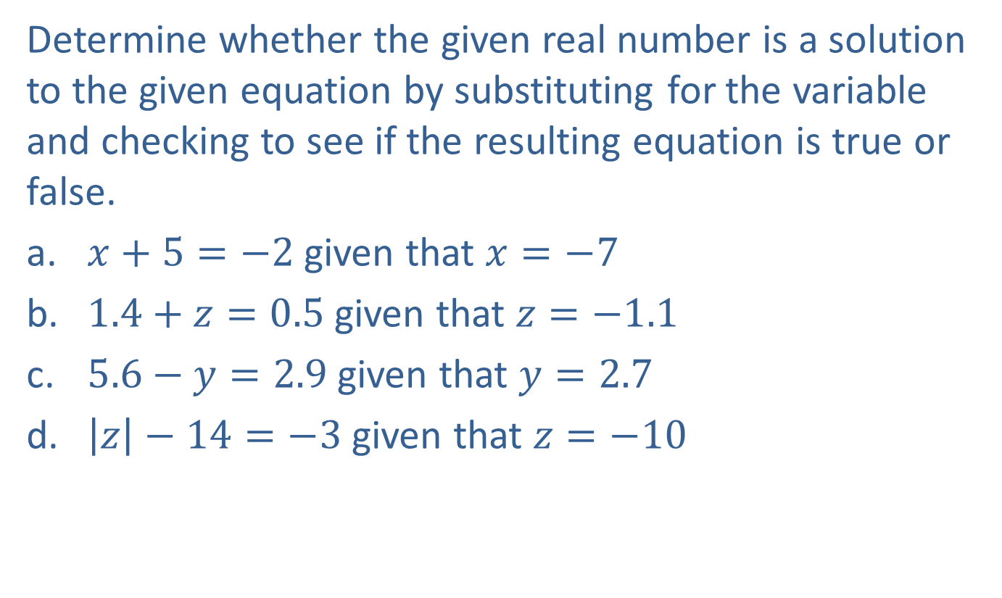
Example 1: Checking Given Solutions in Equations
Determine whether the given real number is a solution to the given equation by substituting for the variable and checking to see if the resulting equation is true or false.
​$x+5=−2$ given that $x=−7$
​$1.4+z=0.5$ given that $z=−1.1$
​$5.6−y=2.9$ given that $y=2.7$
​$\left|z\right|−14=−3$ given that $z=−10$

Slide 5
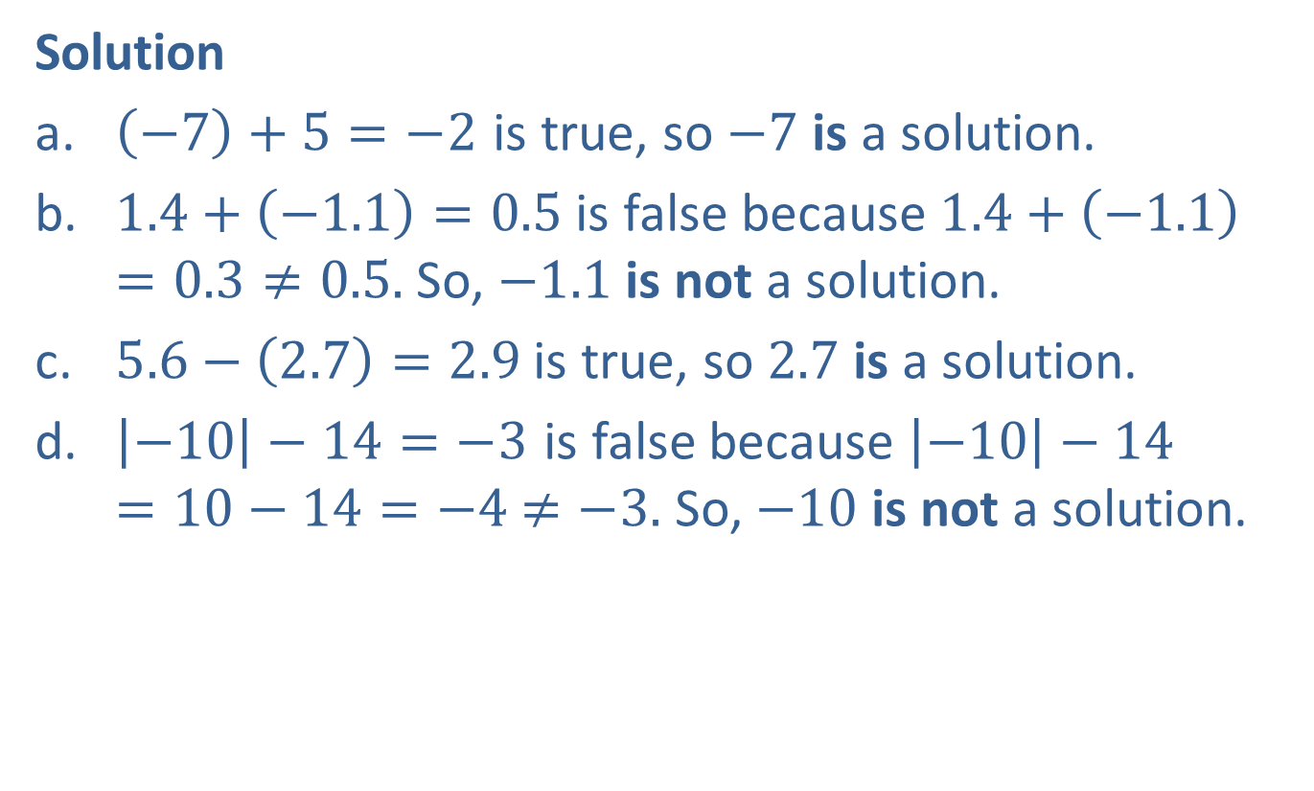
Example 1: Checking Given Solutions in Equations (cont.)
Solution
​$\left(−7\right)+5=−2$ is true, so $−7$ is a solution.
​$1.4+\left(−1.1\right)=0.5$ is false because $1.4+\left(−1.1\right)=0.3≠0.5.$ So, $−1.1$ is not a solution.
​$5.6−\left(2.7\right)=2.9$ is true, so $2.7$ is a solution.
​$\left|−10\right|−14=−3$ is false because $\left|−10\right|−14=10−14=−4$ $≠−3.$ So, $−10$ is not a solution.

Slide 6
Note
Notice that parentheses were used around negative numbers in the substitutions. This should be done to keep operations properly separated, particularly when negative numbers are involved.

Slide 7
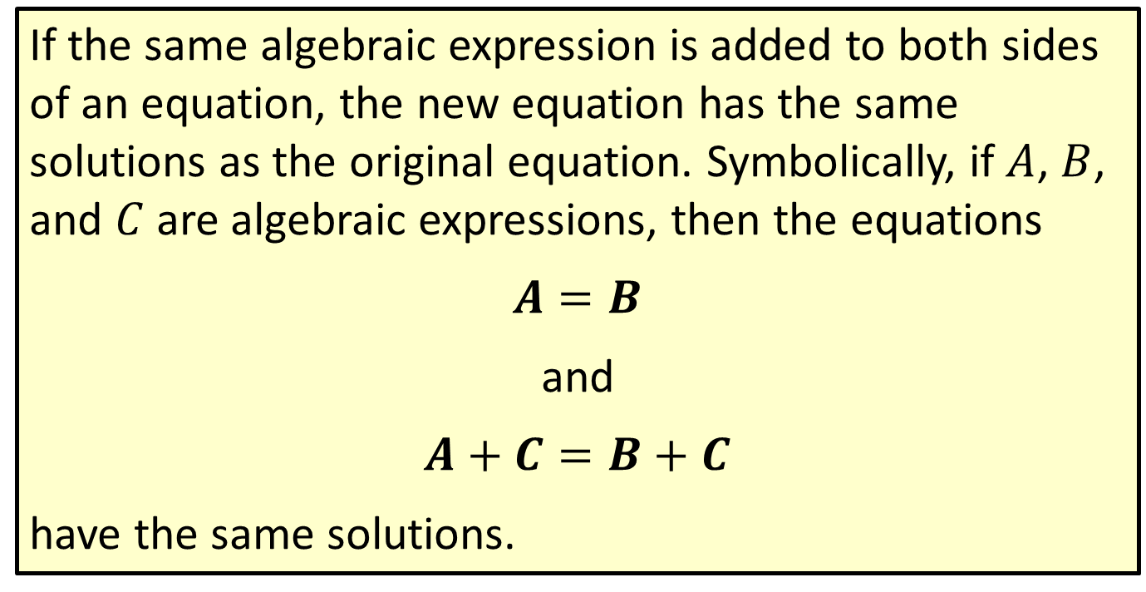
Properties: Addition Principle of Equality
If the same algebraic expression is added to both sides of an equation, the new equation has the same solutions as the original equation. Symbolically, if $A$, $B$, and $C$ are algebraic expressions, then the equations
$$A=B$$
and
$$A+C=B+C$$
have the same solutions.

Slide 8
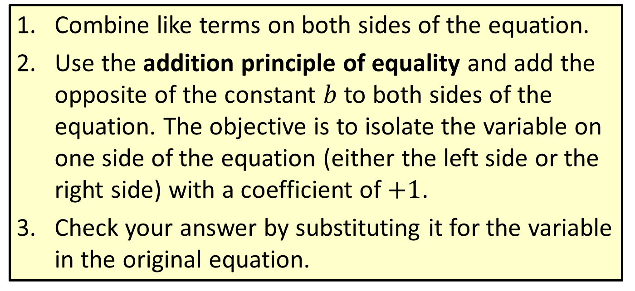
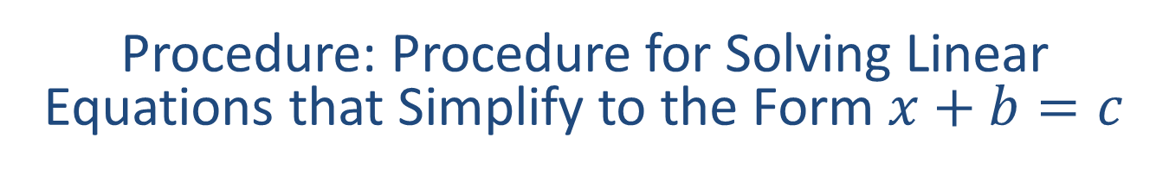
Procedure: Procedure for Solving Linear Equations that Simplify to the Form $x+b=c$
​Combine like terms on both sides of the equation.
​Use the addition principle of equality and add the opposite of the constant $b$ to both sides of the equation. The objective is to isolate the variable on one side of the equation (either the left side or the right side) with a coefficient of $+1$.
​Check your answer by substituting it for the variable in the original equation.

Slide 9




Example 2: Solving Linear Equations of the Form
$$x+b=c$$
Solve the equation: $x−3=7$
Solution
$x−3=7$
$x−3+3=7+3$
$x=10$
Check
$x−3=7$
$\left(10\right)−3=7$
$7=7$
Write the equation.
Add $3$ (the opposite of $−3$) to both sides.
Simplify.
?
Substitute $x=10$
True statement

Slide 10



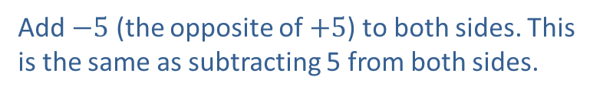
Example 3: Solving Linear Equations of the Form
$x+b=c$
Solve the equation: $−11=y+5$
Solution
$−11=y+5$
$−11−5=y+5−5$
$−16=y$
Check
$$−11=y+5$$
$$−11=\left(−16\right)+5$$
$$−11=−11$$
Write the equation. Note that the variable can be on the right side.
Add $−5$ (the opposite of $+5$) to both sides. This is the same as subtracting 5 from both sides.
Simplify.
?
Substitute $y=−16$
True statement

Slide 11




Example 4: Solving Linear Equations of the Form
$$x+b=c$$
Solve the equation: $−4.1+x=0$
Solution
$−4.1+x=0$
$$−4.1+x+4.1=0+4.1$$
$x=4.1$
Check
$−4.1+x=0$
$−4.1+\left(4.1\right)=0$
$0=0$
Write the equation.
Add $4.1$ (the opposite of $−4.1$) to both sides.
Simplify.
?
Substitute $x=4.1.$
True statement

Slide 12




Example 5: Solving Linear Equations of the Form
$$x+b=c$$
Solve the equation: $x−\frac{2}{5}=\frac{3}{10}$
Solution
$x−\frac{2}{5}=\frac{3}{10}$
$x−\frac{2}{5}+\frac{2}{5}=\frac{3}{10}+\frac{2}{5}$
$x=\frac{3}{10}+\frac{4}{10}$
$x=\frac{7}{10}$
Write the equation.
Add $\frac{2}{5}$ (the opposite of $−\frac{2}{5}$) to both sides.
Simplify. (The common denominator is $10.)$
Simplify.

Slide 13




Example 5: Solving Linear Equations of the Form
$x+b=c$ (cont.)
Check
$x−\frac{2}{5}=\frac{3}{10}$
$\left(\frac{7}{10}\right) −\frac{2}{5}=\frac{3}{10}$
$\frac{7}{10}−\frac{4}{10}=\frac{3}{10}$
$\frac{3}{10}=\frac{3}{10}$
?
Substitute $x=\frac{7}{10}.$
?
The common denominator is $10.$
True statement

Slide 14


Example 6: Simplifying and Solving Linear Equations
Simplify and solve: $3z−2z+2=3+8$
Solution
$$3z−2z+2=3+8$$
$z+2=11$
$z+2−2=11−2$
$z=9$
Write the equation
Combine like terms on both sides of the equation.
Add $−2$ (the opposite of $+2$) to both sides. This is the same as subtracting $2$ from both sides.
Simplify.

Slide 15


Example 6: Simplifying and Solving Linear Equations (cont.)
Check
$3z−2z+2=3+8$
$3\left(9\right)−2\left(9\right)+2=3+8$
$27−18+2=3+8$
$11=11$
?
Substitute $z=9.$
?
Simplify.
True statement

Slide 16

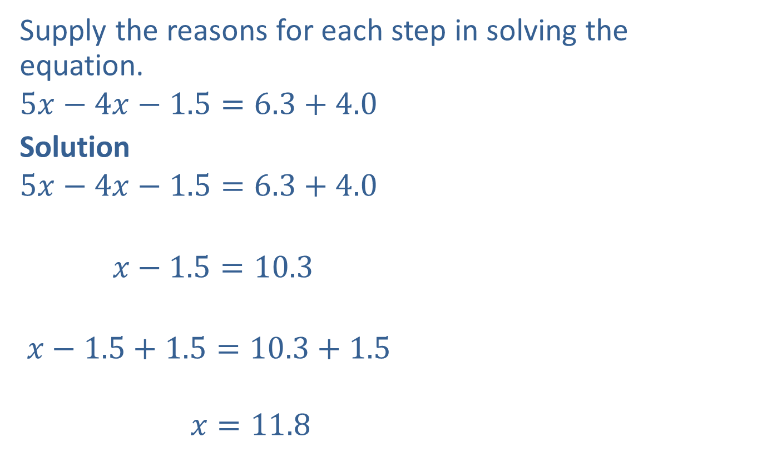

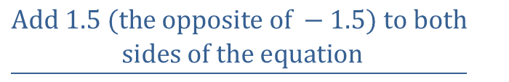

Completion Example 7: Simplifying and Solving Linear Equations
Supply the reasons for each step in solving the equation.
$$5x−4x−1.5=6.3+4.0$$
Solution
$$5x−4x−1.5=6.3+4.0$$
$$x−1.5=10.3$$
$$x−1.5+1.5=10.3+1.5$$
$$x=11.8$$
$$\underline{Write the equation.}$$
$$\underline{\begin{aligned} Combine like terms on both sides \\ of the equation.\end{aligned}}$$
$$\underline{\begin{aligned}Add 1.5 (the opposite of −1.5) to both \\ sides of the equation\end{aligned}}$$
$$\underline{Simplify.}$$

Slide 17
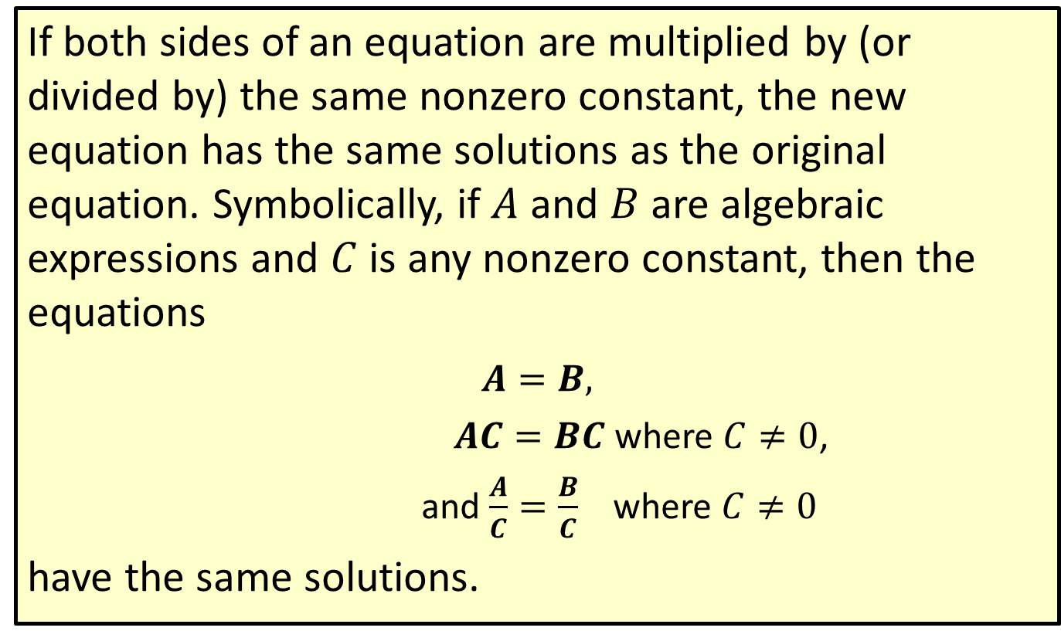
Properties: Multiplication (or Division) Principle of Equality
If both sides of an equation are multiplied by (or divided by) the same nonzero constant, the new equation has the same solutions as the original equation. Symbolically, if $A$ and $B$ are algebraic expressions and $C$ is any nonzero constant, then the equations
​$A=B,$
$AC=BC$ where $C≠0$,
and $\frac{A}{C}=\frac{B}{C}$ where $C≠0$
have the same solutions.

Slide 18
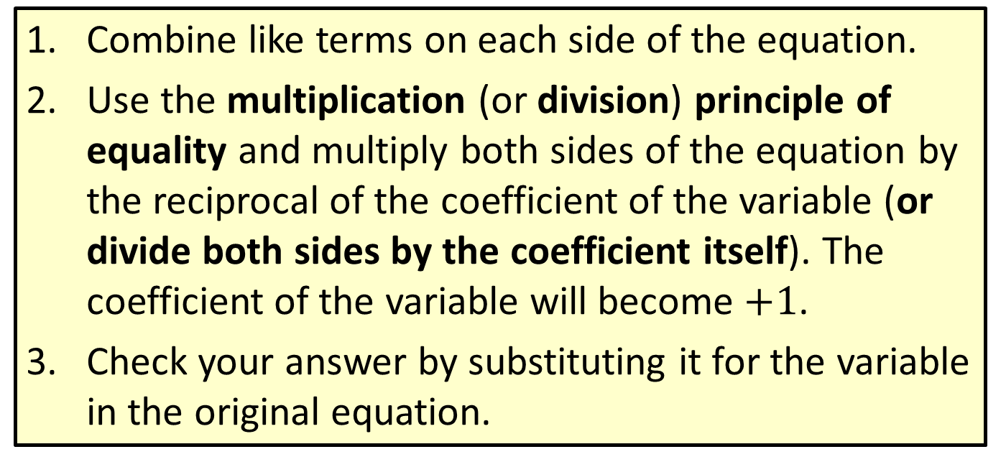
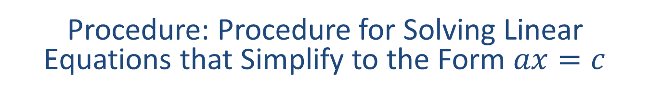
Procedure: Procedure for Solving Linear Equations that Simplify to the Form $ax=c$
​Combine like terms on each side of the equation.
​Use the multiplication (or division) principle of equality and multiply both sides of the equation by the reciprocal of the coefficient of the variable (or divide both sides by the coefficient itself). The coefficient of the variable will become $+1$.
​Check your answer by substituting it for the variable in the original equation.

Slide 19



Example 8: Solving Linear Equations of the Form
$$x+b=c$$
Solve the linear equation: $5x=20$
Solution
$5x=20$
$$\frac{1}{5}∙\left(5x\right)=\frac{1}{5}∙20$$
$$\left(\frac{1}{5}∙5\right)x=\frac{1}{5}∙\frac{20}{1}$$
$$1∙x=4$$
$x=4$
Write the equation.
Multiply both sides by $\frac{1}{5}$, the reciprocal of $5$.
Use the associative property of multiplication.
Simplify.

Slide 20

Example 8: Solving Linear Equations of the Form
$x+b=c$ (cont.)
Check
$5x=20$
$$5∙\left(4\right)=20$$
$$20=20$$
Multiplying by the reciprocal of the coefficient is the same as dividing by the coefficient itself. So, we can multiply both sides by $\frac{1}{5}$, as we did, or we can divide both sides by $5$. In either case, the coefficient of $x$ becomes $+1$.
?
Substitute $x=4.$
True statement

Slide 21
Example 8: Solving Linear Equations of the Form
$x+b=c$ (cont.)
$$5x=20$$
$$\frac{5x}{5}=\frac{20}{5}$$
$$x=4$$
Divide both sides by $5.$
Simplify.

Slide 22
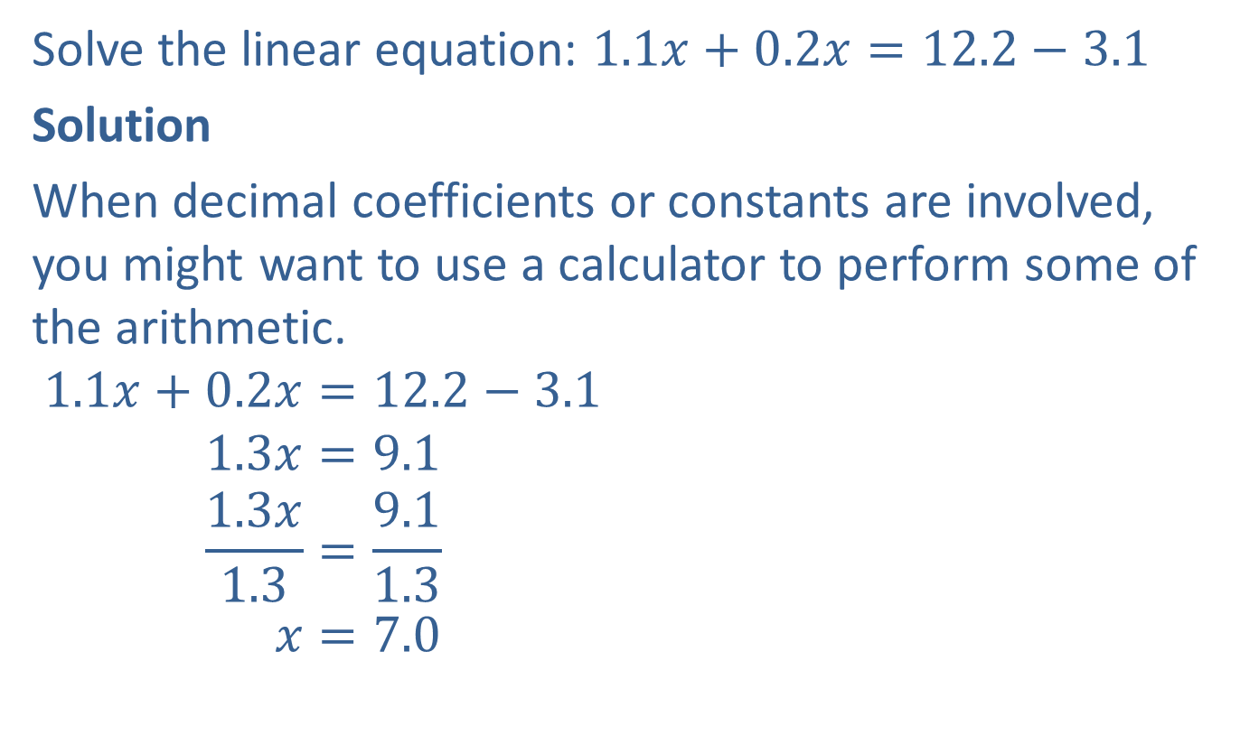
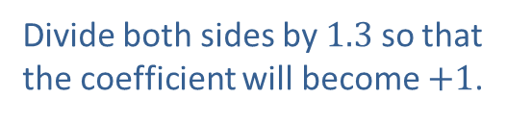
Example 9: Solving Linear Equations of the Form
$$ax=c$$
Solve the linear equation: $1.1x+0.2x=12.2−3.1$
Solution
When decimal coefficients or constants are involved, you might want to use a calculator to perform some of the arithmetic.
$$1.1x+0.2x=12.2−3.1$$
$$1.3x=9.1$$
$$\frac{1.3x}{1.3}=\frac{9.1}{1.3}$$
$$x=7.0$$
Write the equation.
Combine like terms.
Divide both sides by $1.3$ so that
the coefficient will become $+1$.
Use a calculator or pencil and paper
to divide.

Slide 23
Example 9: Solving Linear Equations of the Form
$ax=c$ (cont.)
Check
$$1.1x+0.2x=12.2−3.1$$
$$1.1\left(7\right)+0.2\left(7\right)=12.2−3.1$$
$$7.7+1.4=9.1$$
$$9.1=9.1$$
?
Substitute $x=7.$
?
Simplify.
True statement

Slide 24

Example 10: Solving Linear Equations of the Form $ax=c$
Solve the linear equation: $−x=4$
Solution
$$−x=4$$
$$−1x=4$$
$$\frac{−1x}{−1}=\frac{4}{−1}$$
$x=−4$
Check
$$−x=4$$
$$−\left(−4\right)=4$$
$$4=4$$
Write the equation.
$−1$ is the coefficient of $x$
Divide by $−1$ so that the coefficient will become $+1$.
?
Substitute $x=−4.$
True statement

Slide 25


Completion Example 11: Solving Equations of the Form $ax=c$
Supply the reasons for each step in solving the equation.
$$\frac{4x}{5}=\frac{3}{10}$$
Solution
$$\frac{4x}{5}=\frac{3}{10}$$
$$\frac{5}{4}∙\frac{4}{5}x=\frac{5}{4}∙\frac{3}{10}$$
$$1∙x=\frac{1∙5}{4}∙\frac{3}{2∙5}$$
$$x=\frac{3}{8}$$
(This could also be written $\frac{4}{5}x=\frac{3}{10}$ because $\frac{4}{5}x$ is the same as $\frac{4x}{5}$ .)
$$\underline{Write the equation.}$$
$\underline{Multiply both sides by}$ $\frac{5}{4}.$
$$\underline{Simplify.}$$

Slide 26

Example 12: Application: Solving Linear Equations
The original price of a Blu-Ray player was reduced by $\$45.50$. The sale price was $\$165.90$. Solve the equation $y−45.50=165.90$to determine the original price of the Blu-Ray player.
Solution
$$y−45.50=165.90$$
$$y−45.50+45.50=165.90+45.50$$
$$y=211.40$$
The original price of the Blu-ray player was $\$211.40$.
Use the addition principle by adding $45.50$ to both sides.
Simplify.

