Slide 1
Section 2.2
Solving Multi-Step Linear Equations

Slide 2
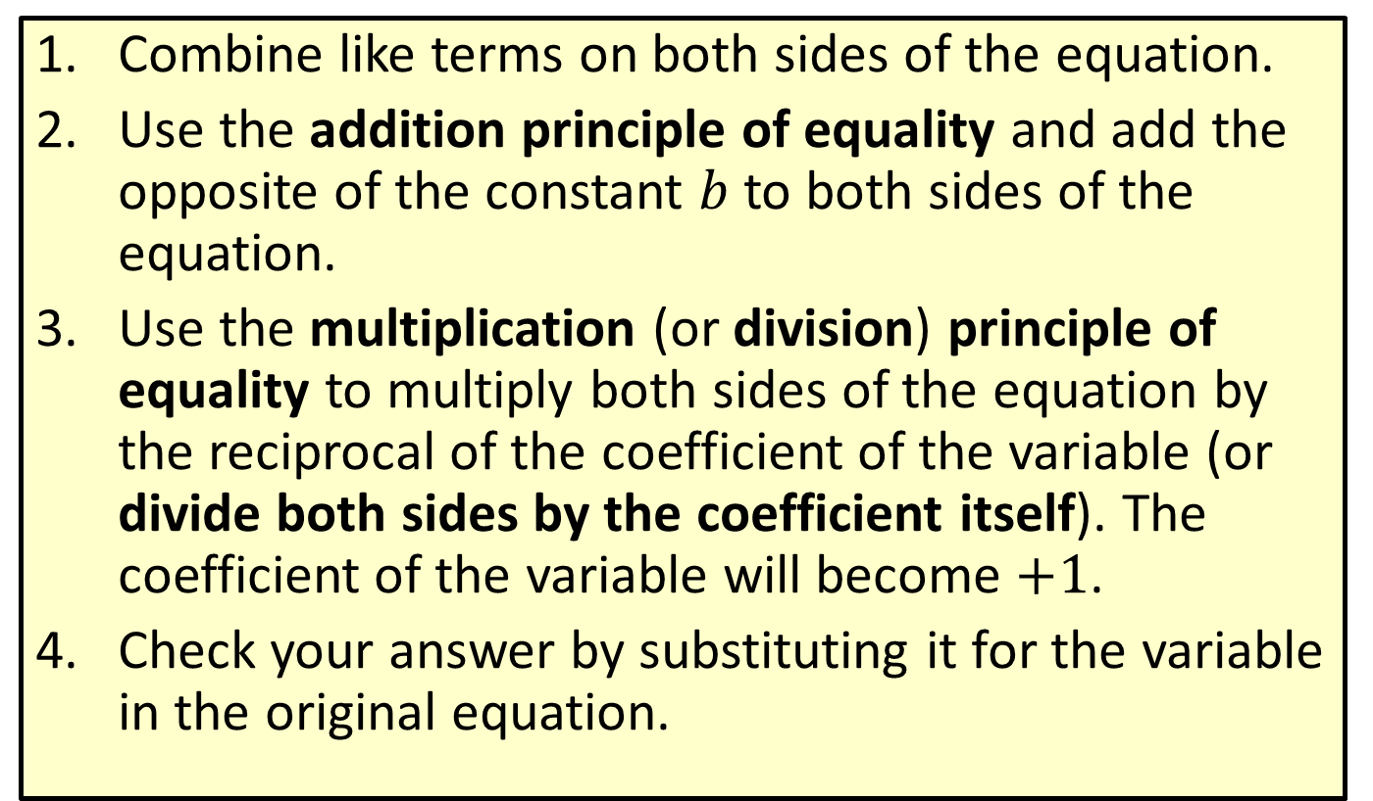
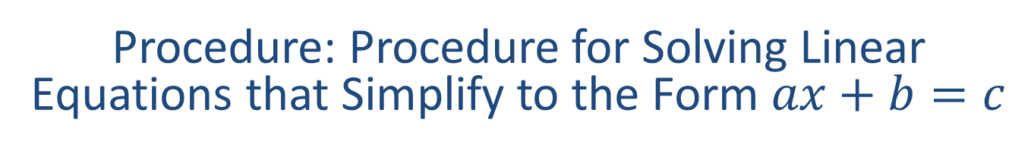
Procedure: Procedure for Solving Linear Equations that Simplify to the Form $ax+b=c$
​Combine like terms on both sides of the equation.
​Use the addition principle of equality and add the opposite of the constant $b$ to both sides of the equation.
​Use the multiplication (or division) principle of equality to multiply both sides of the equation by the reciprocal of the coefficient of the variable (or divide both sides by the coefficient itself). The coefficient of the variable will become $+1$.
​Check your answer by substituting it for the variable in the original equation.

Slide 3




Example 1: Solving Linear Equations of the Form $$ax+b=c$$
Solve the equation: $3x+3=−18$
Solution
$3x+3=−18$
$$3x+3−3=−18−3$$
$3x=−21$
$$\frac{3x}{3}=\frac{−21}{3}$$
$$x=−7$$
Write the equation.
Add $−3$ to both sides.
Simplify.
Divide both sides by $3.$
Simplify.

Slide 4



Example 1: Solving Linear Equations of the Form $ax+b=c$ (cont.)
Check
$3x+3=−18$
$$3(−7)+3=−18$$
$−21+3=−18$
$$−18=−18$$
?
Substitute $x=−7.$
?
Simplify.
True statement

Slide 5




Example 2: Solving Linear Equations of the Form $ax+b=c$
Solve the equation: $−26=2y−14−4y$
Solution
$$−26=2y−14−4y$$
$$−26=−2y−14$$
$$−26+14=−2y−14+14$$
$$−12=−2y$$
$$\frac{−12}{−2}=\frac{−2y}{−2}$$
$$6=y$$
Write the equation.
Combine like terms.
Add $14$ to both sides.
Simplify.
Divide both sides by $−2.$
Simplify.

Slide 6



Example 2: Solving Linear Equations of the Form $ax+b=c$ (cont.)
Check
$$−26=2y−14−4y$$
$$−26=2\left(6\right)−14−4(6)$$
$−26=12−14−4$
$$−26=−26$$
?
Substitute $y=6.$
?
Simplify.
True statement

Slide 7

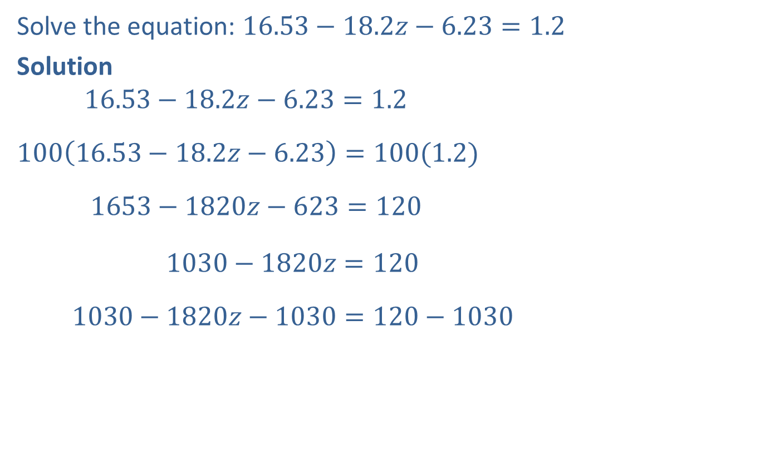

Example 3: Solving Linear Equations Involving Decimals
Solve the equation: $16.53−18.2z−6.23=1.2$
Solution
$$16.53−18.2z−6.23=1.2$$
$$100\left(16.53−18.2z−6.23\right)=100(1.2)$$
$$1653−1820z−623=120$$
$1030−1820z=120$
$$1030−1820z−1030=120−1030$$
Write the equation.
Multiply both sides by $100.$
(This results in integer coefficients.)
Simplify.
Combine like terms.
Add $−1030$ to both sides.

Slide 8



Example 3: Solving Linear Equations Involving Decimals (cont.)
$$−1820z=−910$$
$$\frac{−1820z}{−1820}=\frac{−910}{−1820}$$
$z=0.5$or$z=\frac{1}{2}$
Check
$$16.53−18.2z−6.23=1.2$$
$$16.53−18.2\left(0.5\right)−6.23=1.2$$
$$16.53−9.1−6.23=1.2$$
$$1.2=1.2$$
Simplify.
Divide both sides by $−1820.$
Simplify.
?
Substitute $z=0.5.$
?
Simplify.
True statement

Slide 9
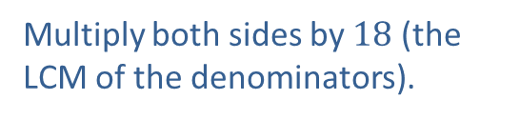
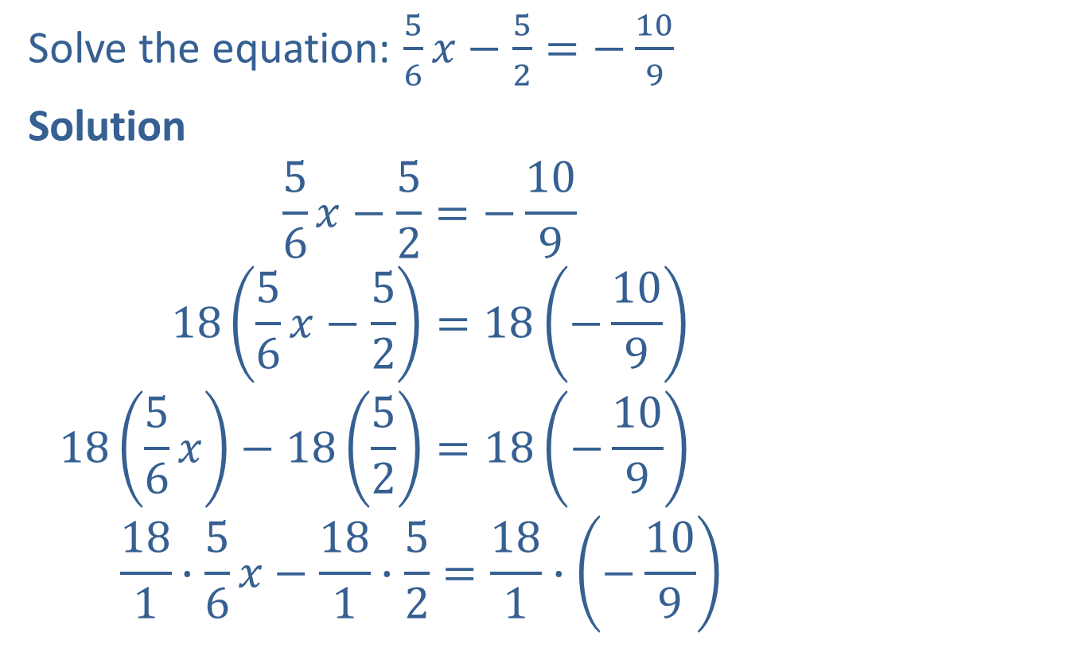
Example 4: Solving Linear Equations Involving Fractions
Solve the equation: $\frac{5}{6}x−\frac{5}{2}=−\frac{10}{9}$
Solution
$$\frac{5}{6}x−\frac{5}{2}=−\frac{10}{9}$$
$$18\left(\frac{5}{6}x−\frac{5}{2}\right)=18\left(−\frac{10}{9}\right)$$
$$18\left(\frac{5}{6}x\right)−18\left(\frac{5}{2}\right)=18\left(−\frac{10}{9}\right)$$
$$\frac{18}{1}∙\frac{5}{6}x−\frac{18}{1}∙\frac{5}{2}=\frac{18}{1}∙\left(−\frac{10}{9}\right)$$
Write the equation.
Multiply both sides by $18$ (the
LCM of the denominators).
Apply the distributive property.
3
9
2
Multiply.

Slide 10



Example 4: Solving Linear Equations Involving Fractions (cont.)
$$15x−45=−20$$
$$15x−45+45=−20+45$$
$$15x=25$$
$$\frac{15x}{15}=\frac{25}{15}$$
$$x=\frac{5}{3}$$
Simplify.
Add $45$ to both sides.
Simplify.
Divide both sides by $15.$
Simplify.

Slide 11


Example 4: Solving Linear Equations Involving Fractions (cont.)
Check
$$\frac{5}{6}x−\frac{5}{2}=−\frac{10}{9}$$
$$\frac{5}{6}\left(\frac{5}{3}\right)−\frac{5}{2}=−\frac{10}{9}$$
$$\frac{25}{18}−\frac{45}{18}=−\frac{20}{18}$$
$$−\frac{20}{18}=−\frac{20}{18}$$
?
Substitute $x=\frac{5}{3}.$
?
Simplify.
True statement

Slide 12
Note
About Checking:
​Checking can be quite time-consuming and need not be
done for every problem. This is particularly important on exams. You should check only if you have time after the entire exam is completed.

Slide 13

Procedure: Procedure for Solving Linear Equations that Simplify to the Form $ax+b=cx+d$
​Simplify each side of the equation by removing any grouping symbols and combining like terms on both sides of the equation.
​Use the addition principle of equality and add the opposite of a constant term and/or variable term to both sides of the equation so that variables are on one side and constants are on the other side.

Slide 14
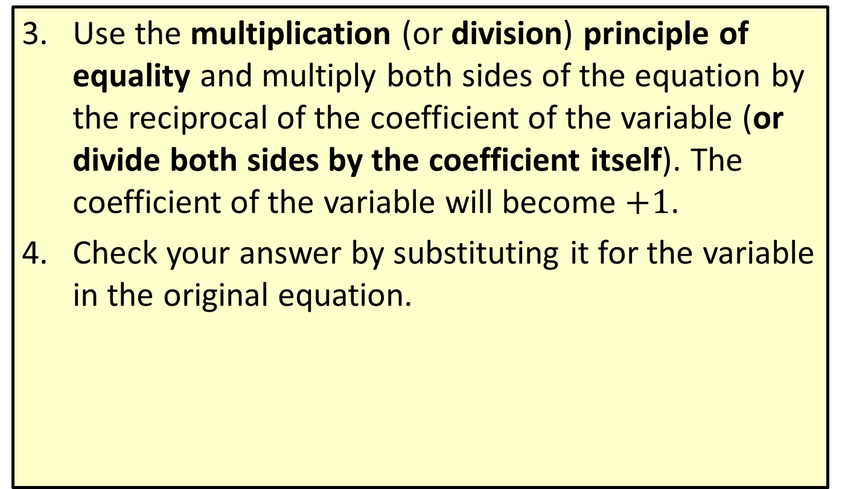
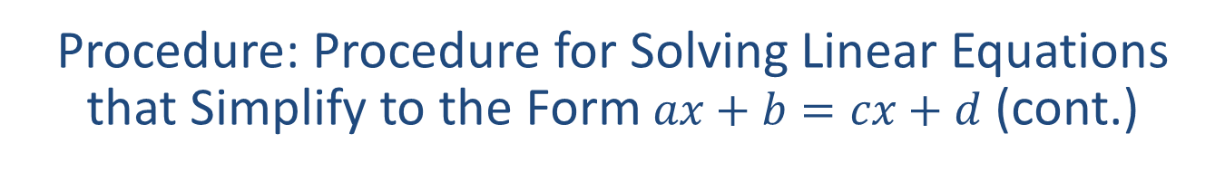
Procedure: Procedure for Solving Linear Equations that Simplify to the Form $ax+b=cx+d$ (cont.)
​Use the multiplication (or division) principle of equality and multiply both sides of the equation by the reciprocal of the coefficient of the variable (or divide both sides by the coefficient itself). The coefficient of the variable will become $+1$.
​Check your answer by substituting it for the variable in the original equation.

Slide 15
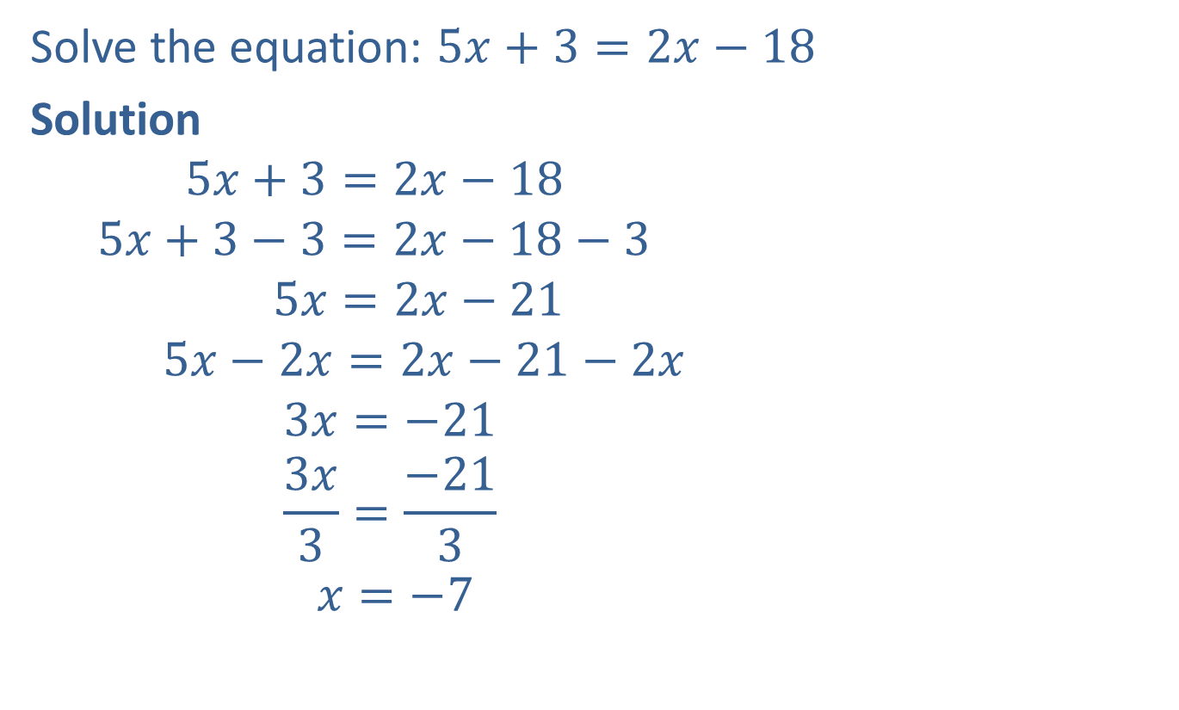




Example 5: Solving Linear Equations of the Form $$ax+b=cx+d$$
Solve the equation: $5x+3=2x−18$
Solution
$$5x+3=2x−18$$
$$5x+3−3=2x−18−3$$
$$5x=2x−21$$
$$5x−2x=2x−21−2x$$
$$3x=−21$$
$$\frac{3x}{3}=\frac{−21}{3}$$
$$x=−7$$
Write the equation.
Add $−3$ to both sides.
Simplify.
Add $−2x$ to both sides.
Simplify.
Divide both sides by $3.$
Simplify.

Slide 16



Example 5: Solving Linear Equations of the Form $ax+b=cx+d$ (cont.)
Check
$$5x+3=2x−18$$
$$5\left(−7\right)+3=2\left(−7\right)−18$$
$$−35+3=−14−18$$
$$−32=−32$$
?
Substitute $x=−7.$
?
Simplify.
True statement

Slide 17




Example 6: Solving Linear Equations of the Form $ax+b=cx+d$
Solve the equation: $4x+1−x=2x−13+5$
Solution
$$4x+1−x=2x−13+5$$
$$3x+1=2x−8$$
$$3x+1−1=2x−8−1$$
$$3x=2x−9$$
$$3x−2x=2x−9−2x$$
$$x=−9$$
Write the equation.
Combine like terms.
Add $−1$ to both sides.
Simplify.
Add $−2x$ to both sides.
Simplify.

Slide 18



Example 6: Solving Linear Equations of the Form $ax+b=cx+d$ (cont.)
Check
$$4x+1−x=2x−13+5$$
$$4\left(−9\right)+1−\left(−9\right)=2\left(−9\right)−13+5$$
$$−36+1+9=−18−13+5$$
$$−26=−26$$
?
Substitute $x=−9.$
?
Simplify.
True statement

Slide 19



Example 7: Solving Linear Equations Involving Decimals
Solve the equation: $6y+2.5=7y−3.6$
Solution
$$6y+2.5=7y−3.6$$
$$6y+2.5+3.6=7y−3.6+3.6$$
$$6y+6.1=7y$$
$$6y+6.1−6y=7y−6y$$
$$6.1=y$$
Write the equation.
Add $3.6$ to both sides.
Simplify.
Add $−6y$ to both sides.
Simplify.

Slide 20


Example 7: Solving Linear Equations Involving Decimals (cont.)
Check
$$6y+2.5=7y−3.6$$
$$6\left(6.1\right)+2.5=7\left(6.1\right)−3.6$$
$$36.6+2.5=42.7−3.6$$
$$39.1=39.1$$
?
Substitute $y=6.1.$
?
Simplify.
True statement

Slide 21
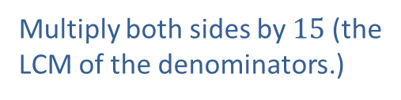
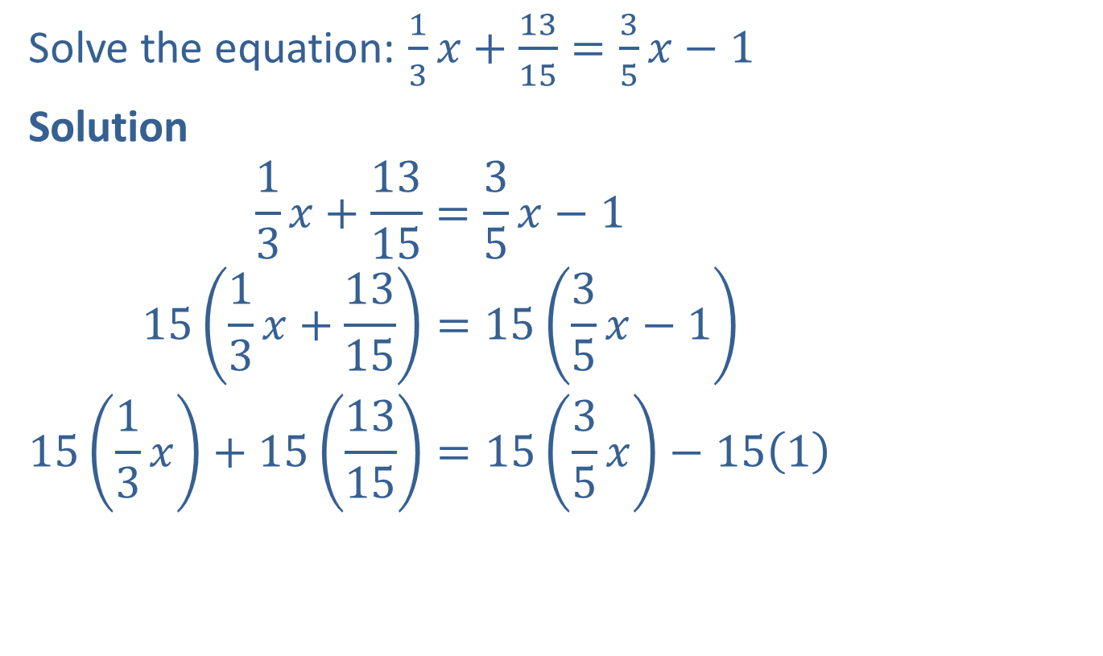
Example 8: Solving Linear Equations Involving Fractions
Solve the equation: $\frac{1}{3}x+\frac{13}{15}=\frac{3}{5}x−1$
Solution
$$\frac{1}{3}x+\frac{13}{15}=\frac{3}{5}x−1$$
$$15\left(\frac{1}{3}x+\frac{13}{15}\right)=15\left(\frac{3}{5}x−1\right)$$
$$15\left(\frac{1}{3}x\right)+15\left(\frac{13}{15}\right)=15\left(\frac{3}{5}x\right)−15\left(1\right)$$
Write the equation.
Multiply both sides by $15$(the
LCM of the denominators.)
Apply the distributive property.

Slide 22


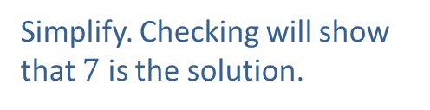


Example 8: Solving Linear Equations Involving Fractions (cont.)
$$5x+13=9x−15$$
$$5x+13−13=9x−15−13$$
$$5x=9x−28$$
$$5x−9x=9x−28−9x$$
$$−4x=−28$$
$$\frac{−4x}{−4}=\frac{−28}{−4}$$
$$x=7$$
Simplify.
Add $−13$ to both sides.
Simplify.
Add $−9x$ to both sides.
Simplify.
Divide both sides by $−4$.
Simplify. Checking will show that $7$ is the solution.

Slide 23

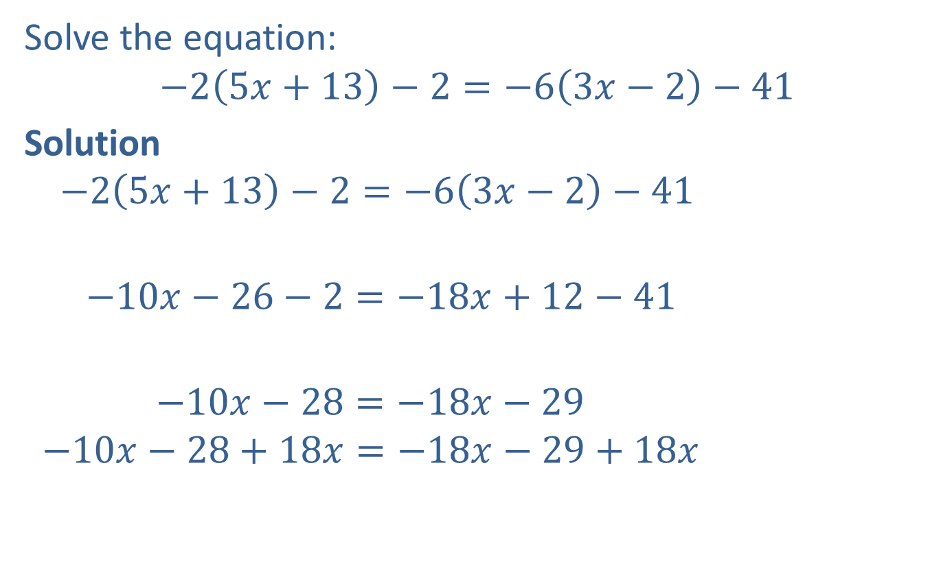
Example 9: Solving Linear Equations Involving Parentheses
Solve the equation:
$$−2\left(5x+13\right)−2=−6\left(3x−2\right)−41$$
Solution
$$−2\left(5x+13\right)−2=−6\left(3x−2\right)−41$$
$$−10x−26−2=−18x+12−41$$
$$−10x−28=−18x−29$$
$$−10x−28+18x=−18x−29+18x$$
Write the equation.
Use the distributive property.
Be careful with the signs.
Combine like terms.
Add $18x$to both sides.

Slide 24



Example 9: Solving Linear Equations Involving Parentheses (cont.)
$$8x−28=−29$$
$$8x−28+28=−29+28$$
$$8x=−1$$
$$\frac{8x}{8}=\frac{−1}{8}$$
$$x=−\frac{1}{8}$$
Simplify.
Add $28$ to both sides.
Simplify.
Divide both sides by $8$.
Simplify.

Slide 25

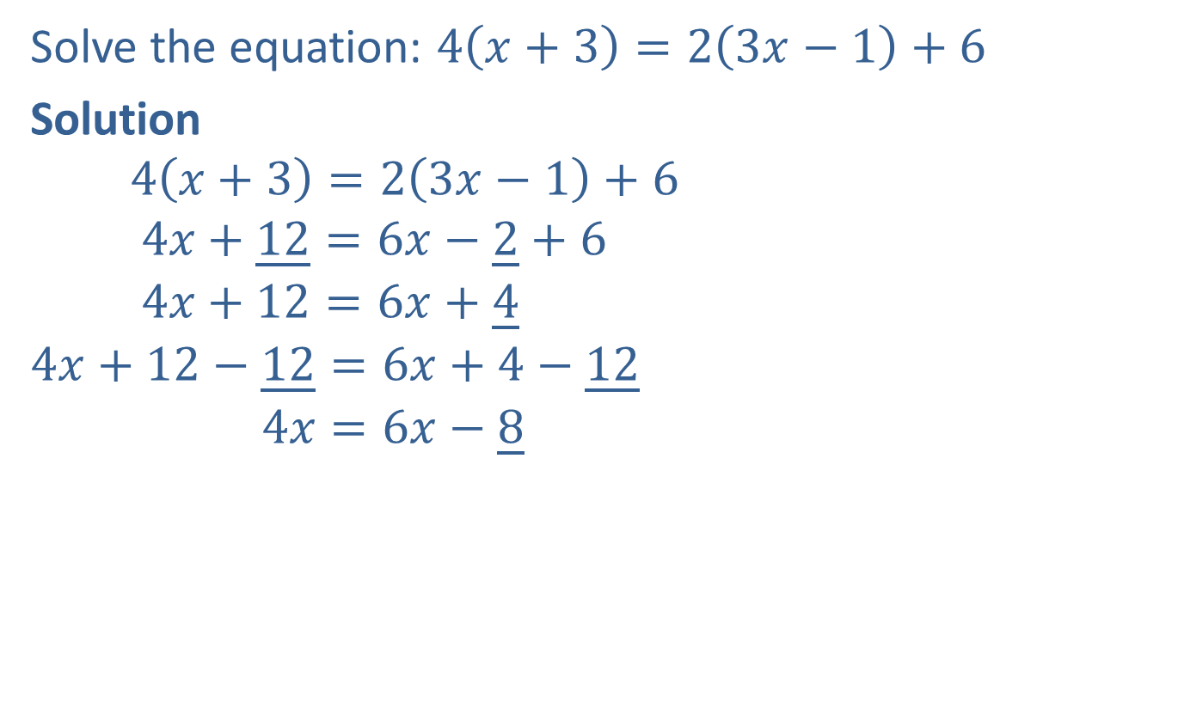
Completion Example 10: Solving Equations Involving Parentheses
Solve the equation: $4\left(x+3\right)=2\left(3x−1\right)+6$
Solution
$$4\left(x+3\right)=2\left(3x−1\right)+6$$
$$4x+\underline{12}=6x−\underline{2}+6$$
$$4x+12=6x+\underline{4}$$
$$4x+12−\underline{12}=6x+4−\underline{12}$$
$$4x=6x−\underline{8}$$
Write the equation.
Use the distributive property.
Combine like terms.
Subtract $\underline{12}$from both sides.
Simplify.

Slide 26



Completion Example 10: Solving Equations Involving Parentheses (cont.)
$$4x−\underline{6x}=6x−8−\underline{6x}$$
$$\underline{−2}x=−8$$
$$\underline{\frac{−2x}{−2}}=\underline{\frac{−8}{−2}}$$
$$x=\underline{4}$$
Subtract $\underline{6x}$from both sides.
Simplify.
Divide both sides by $\underline{−2}.$
Simplify.

Slide 27
Three Types of Equations
Type of Equation | Number of Solutions
Conditional | Finite number of solutions
Identity | Infinite number of solutions
Contradiction | No solution
Table 1

Slide 28

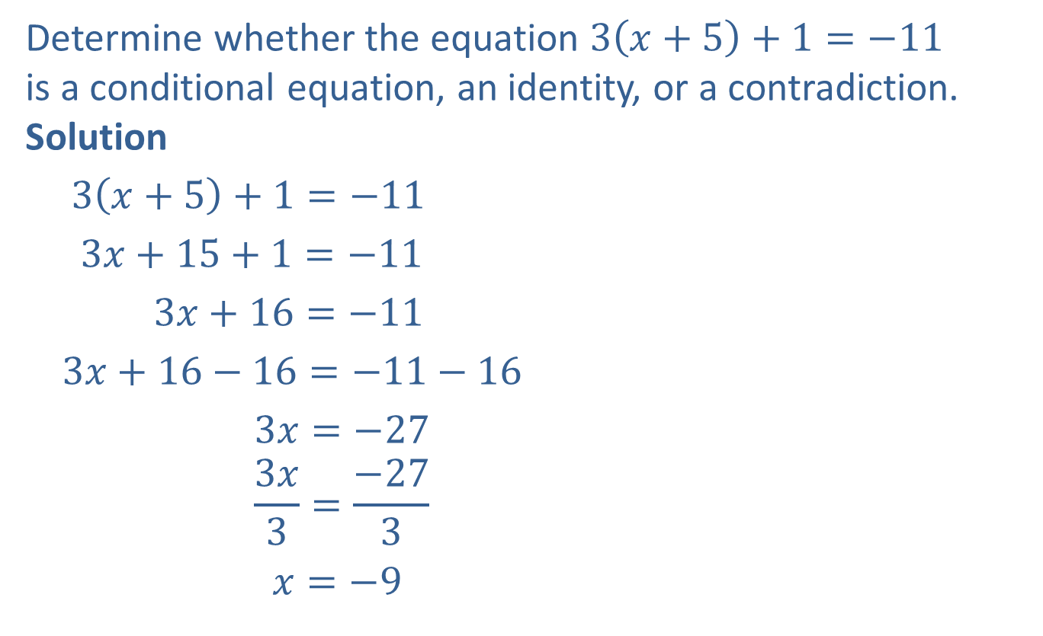

Example 11: Determining Types of Equations
Determine whether the equation $3\left(x+5\right)+1=−11$
is a conditional equation, an identity, or a contradiction.
Solution
$3\left(x+5\right)+1=−11$
$3x+15+1=−11$
$3x+16=−11$
$3x+16−16=−11−16$
$3x=−27$
$$\frac{3x}{3}=\frac{−27}{3}$$
$x=−9$
Write the equation.
Use the distributive property.
Combine like terms.
Add $−16$to both sides.
Simplify.
Divide both sides by $3$.
Simplify.

Slide 29
Example 11: Determining Types of Equations (cont.)
The equation has one solution. Therefore, it is a conditional equation.

Slide 30

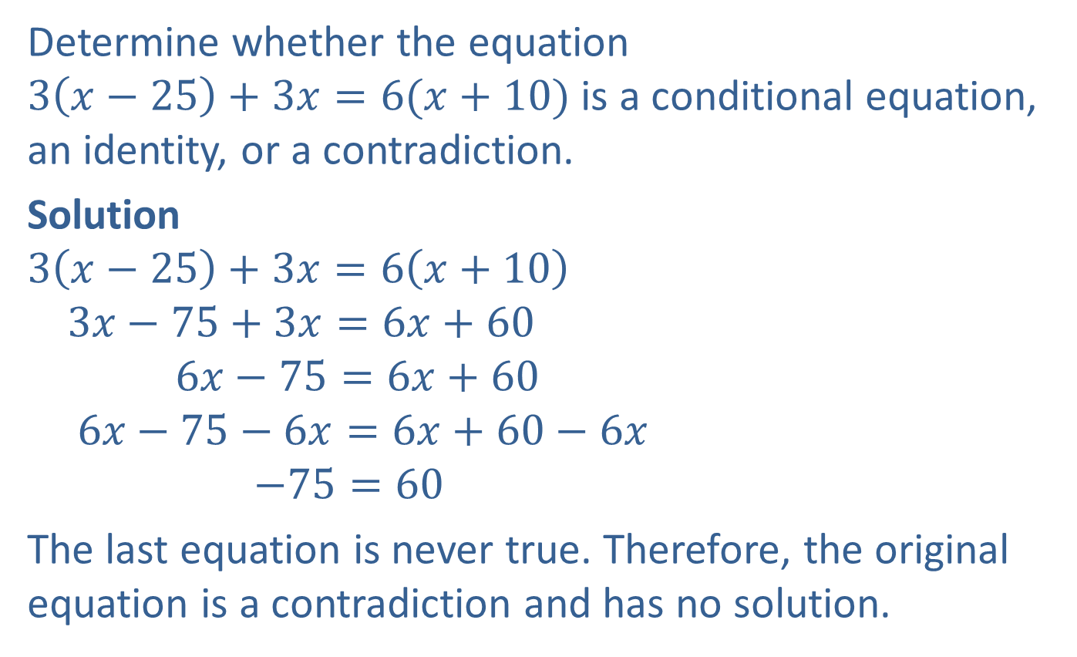
Example 12: Determining Types of Equations
Determine whether the equation $3\left(x−25\right)+3x=6(x+10)$ is a conditional equation, an identity, or a contradiction.
Solution
$$3\left(x−25\right)+3x=6\left(x+10\right)$$
$$3x−75+3x=6x+60$$
$$6x−75=6x+60$$
$$6x−75−6x=6x+60−6x$$
$$−75=60$$
The last equation is never true. Therefore, the original equation is a contradiction and has no solution.
Write the equation.
Use the distributive property.
Combine like terms.
Add $−6x$to both sides.
Simplify.

Slide 31

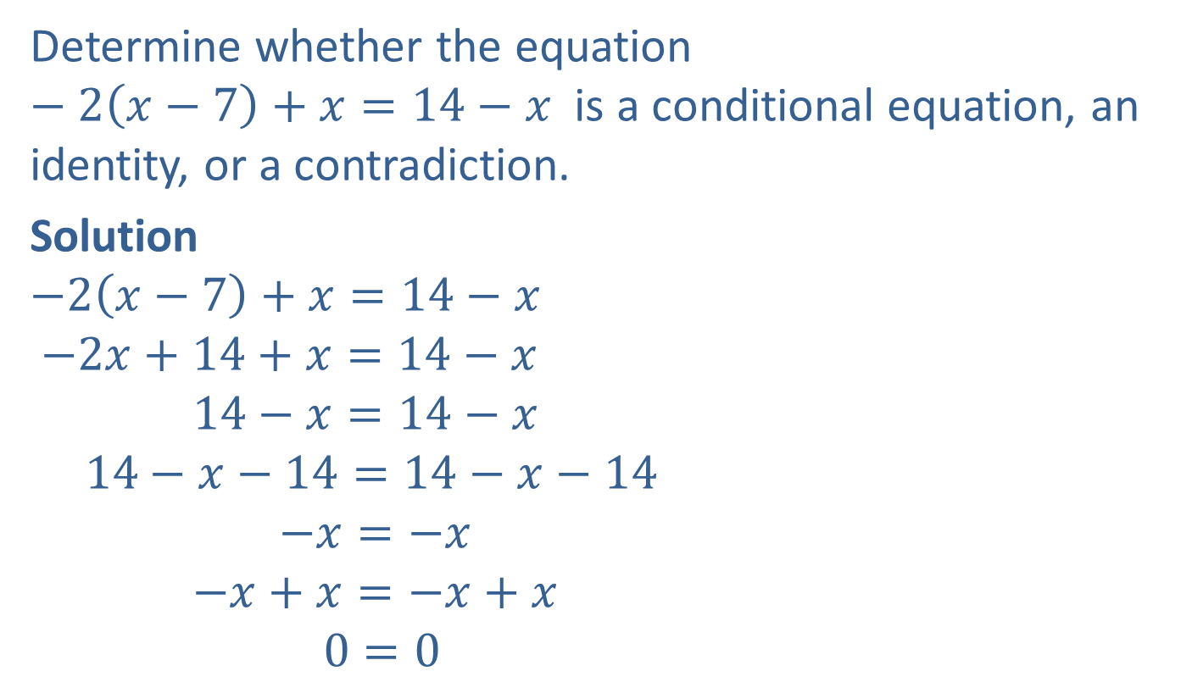

Example 13: Determining Types of Equations
Determine whether the equation $−2\left(x−7\right)+x=14−x$ is a conditional equation, an identity, or a contradiction.
Solution
$$−2\left(x−7\right)+x=14−x$$
$$−2x+14+x=14−x$$
$$14−x=14−x$$
$$14−x−14=14−x−14$$
$$−x=−x$$
$$−x+x=−x+x$$
$$0=0$$
Write the equation.
Use the distributive property.
Combine like terms.
Add $−14$to both sides.
Simplify.
Add $x$to both sides.
Simplify.

Slide 32
Example 13: Determining Types of Equations (cont.)
The last equation is always true. Therefore, the original equation is an identity and has an infinite number of solutions. Every real number is a solution.

