Slide 1
Section 2.3
Working with Formulas

Slide 2
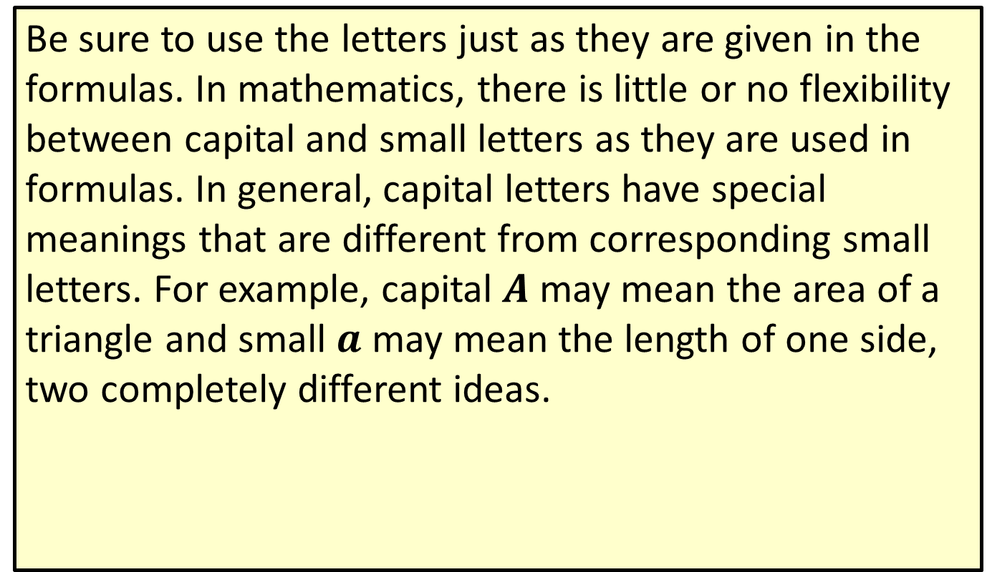
Note
Be sure to use the letters just as they are given in the formulas. In mathematics, there is little or no flexibility between capital and small letters as they are used in formulas. In general, capital letters have special meanings that are different from corresponding small letters. For example, capital $A$ may mean the area of a triangle and small $a$ may mean the length of one side, two completely different ideas.

Slide 3
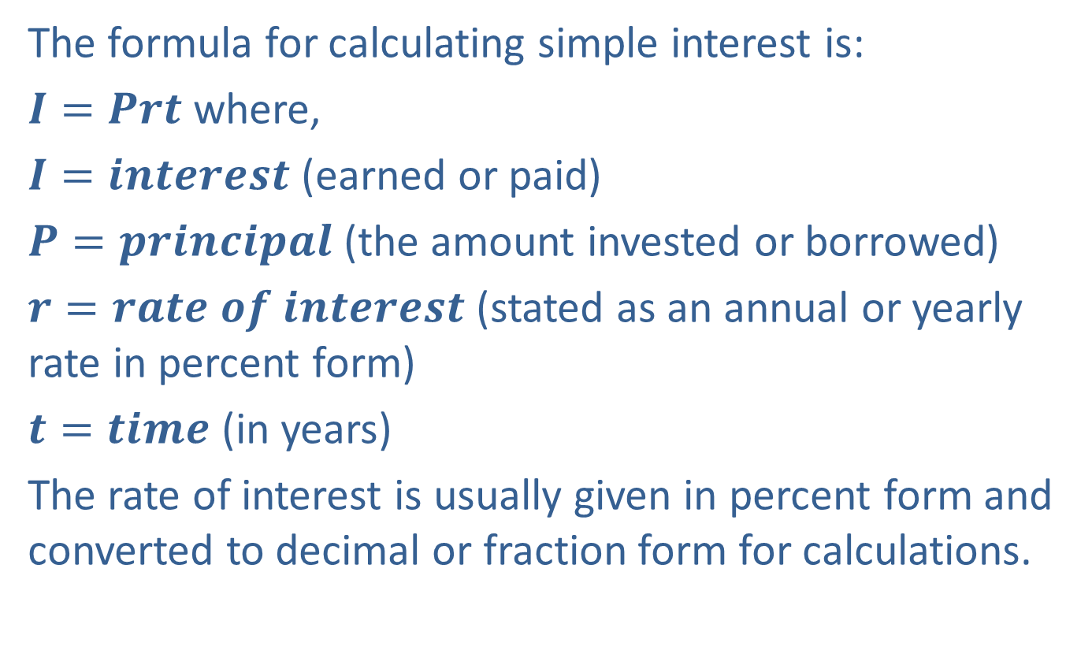
Example 1: Application: Evaluating Formulas
The formula for calculating simple interest is:
$I=Prt$ where,
$I=interest$ (earned or paid)
$P=principal$ (the amount invested or borrowed)
$r=rate of interest$ (stated as an annual or yearly rate in percent form)
$t=time$ (in years)
The rate of interest is usually given in percent form and converted to decimal or fraction form for calculations.

Slide 4
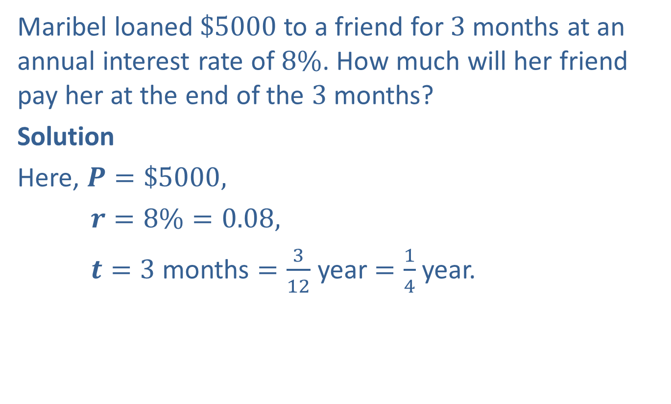
Example 1: Application: Evaluating Formulas (cont.)
Maribel loaned $\$5000$to a friend for $3$ months at an annual interest rate of $8\%$. How much will her friend pay her at the end of the $3$ months?
Solution
Here, $P=\$5000,$
$r=8\%=0.08,$
$t=3$ months $=\frac{3}{12}$ year $=\frac{1}{4}$ year.

Slide 5

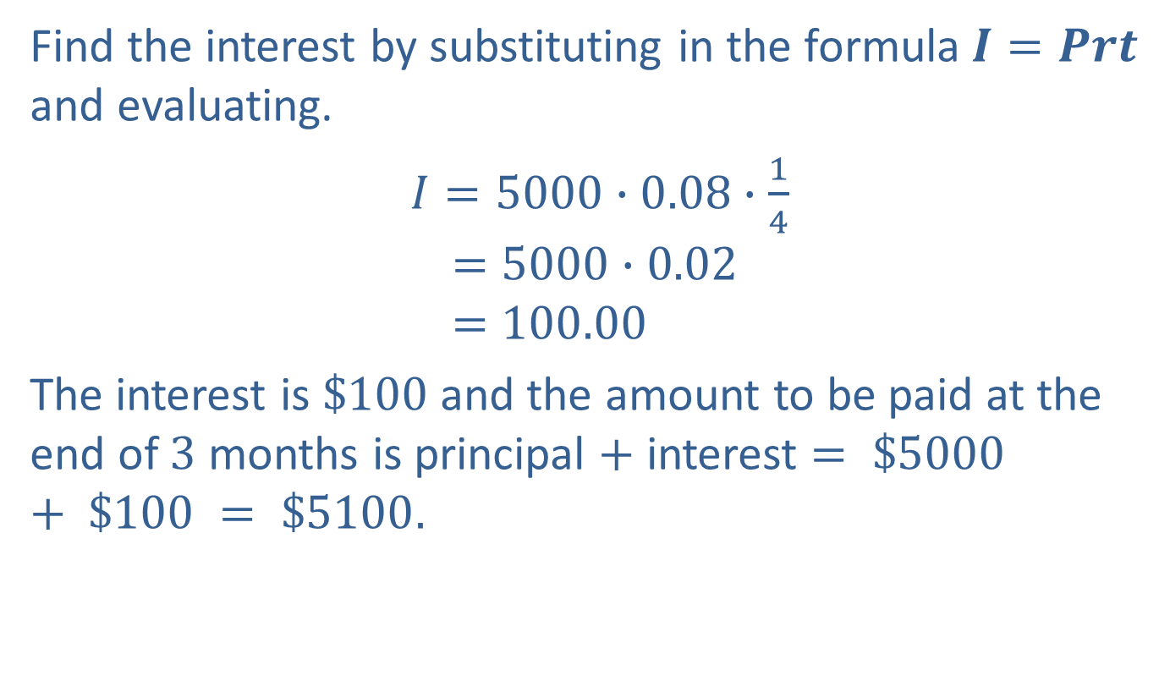
Example 1: Application: Evaluating Formulas (cont.)
Find the interest by substituting in the formula$I=Prt$ and evaluating.
$I=5000∙0.08∙\frac{1}{4}$
$$=5000∙0.02$$
$$=100.00$$
The interest is $\$100$and the amount to be paid at the end of $3$ months is principal $+$ interest $= \$5000 + \$100 = \$5100.$
$$0.02$$

Slide 6
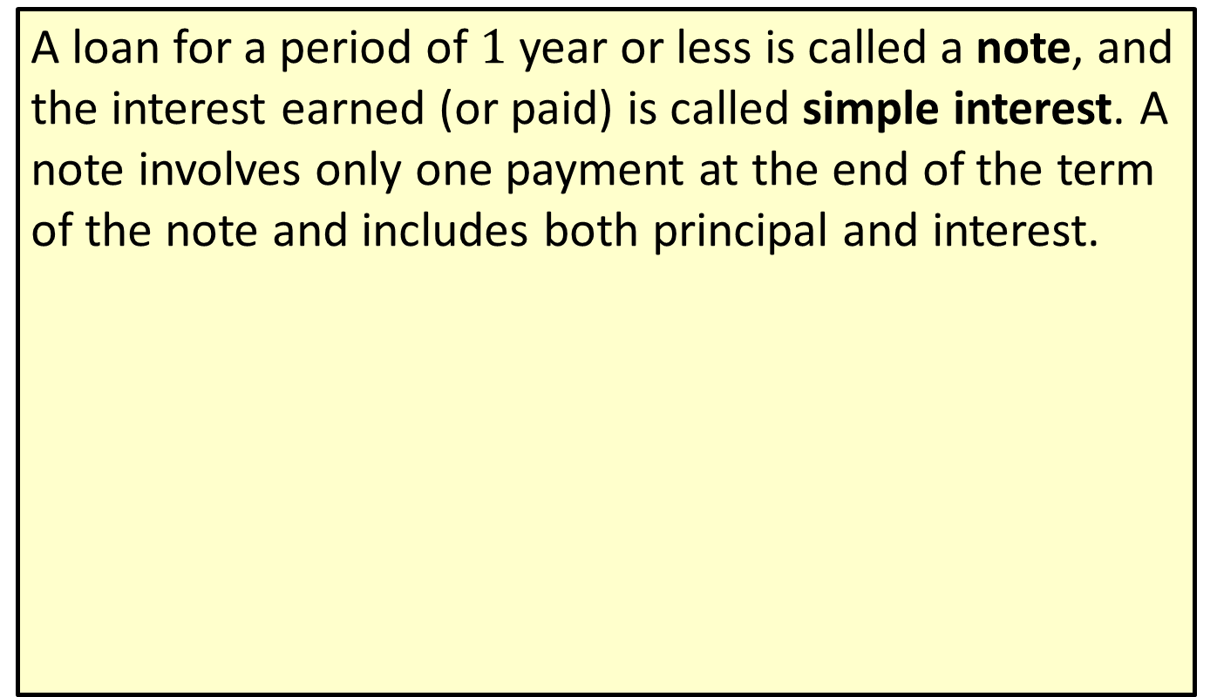
Note
A loan for a period of $1$ year or less is called a note, and the interest earned (or paid) is called simple interest. A note involves only one payment at the end of the term of the note and includes both principal and interest.

Slide 7
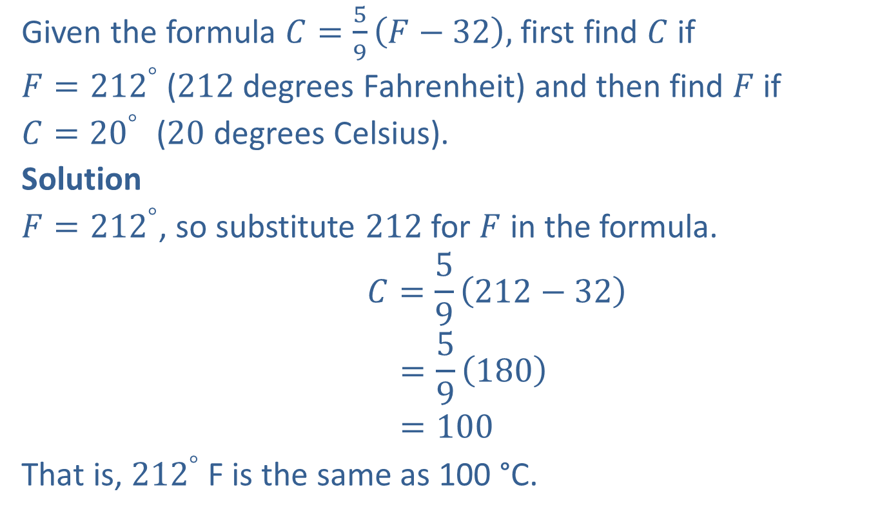
Example 2: Evaluating Formulas
Given the formula $C=\frac{5}{9}\left(F−32\right),$ first find $C$ if
$F={212}^{°}$ ($212$degrees Fahrenheit) and then find $F$ if
$C={20}^{°}$ ($20$ degrees Celsius).
Solution
$F={212}^{°}$, so substitute $212$ for $F$ in the formula.
$$C=\frac{5}{9}\left(212−32\right)$$
$$=\frac{5}{9}\left(180\right)$$
$$=100$$
That is, ${212}^{°}$F is the same as 100 °C.

Slide 8

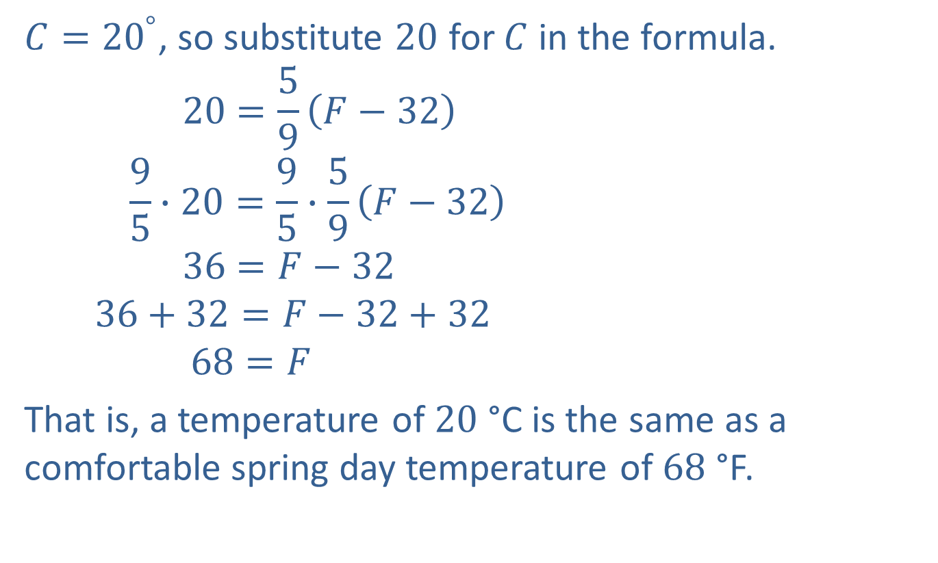


Example 2: Evaluating Formulas (cont.)
$C={20}^{°}$, so substitute $20$ for $C$ in the formula.
$$20=\frac{5}{9}\left(F−32\right)$$
$$\frac{9}{5}∙20=\frac{9}{5}∙\frac{5}{9}\left(F−32\right)$$
$$36=F−32$$
$$36+32=F−32+32$$
$$68=F$$
That is, a temperature of $20$ °C is the same as a comfortable spring day temperature of $68$ °F.
Now solve for $F.$
Multiply both sides by $\frac{9}{5}.$
Simplify.
Add $32$ to both sides.
Simplify.

Slide 9
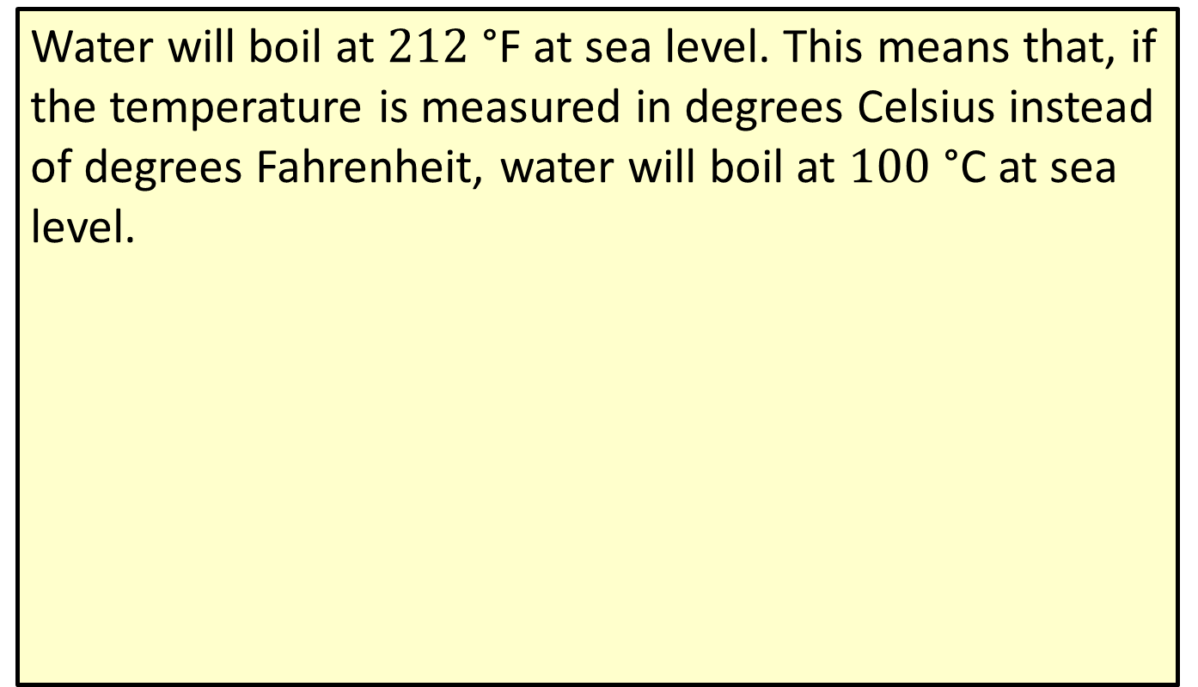
Note
Water will boil at $212$ °F at sea level. This means that, if the temperature is measured in degrees Celsius instead of degrees Fahrenheit, water will boil at $100$ °C at sea level.

Slide 10
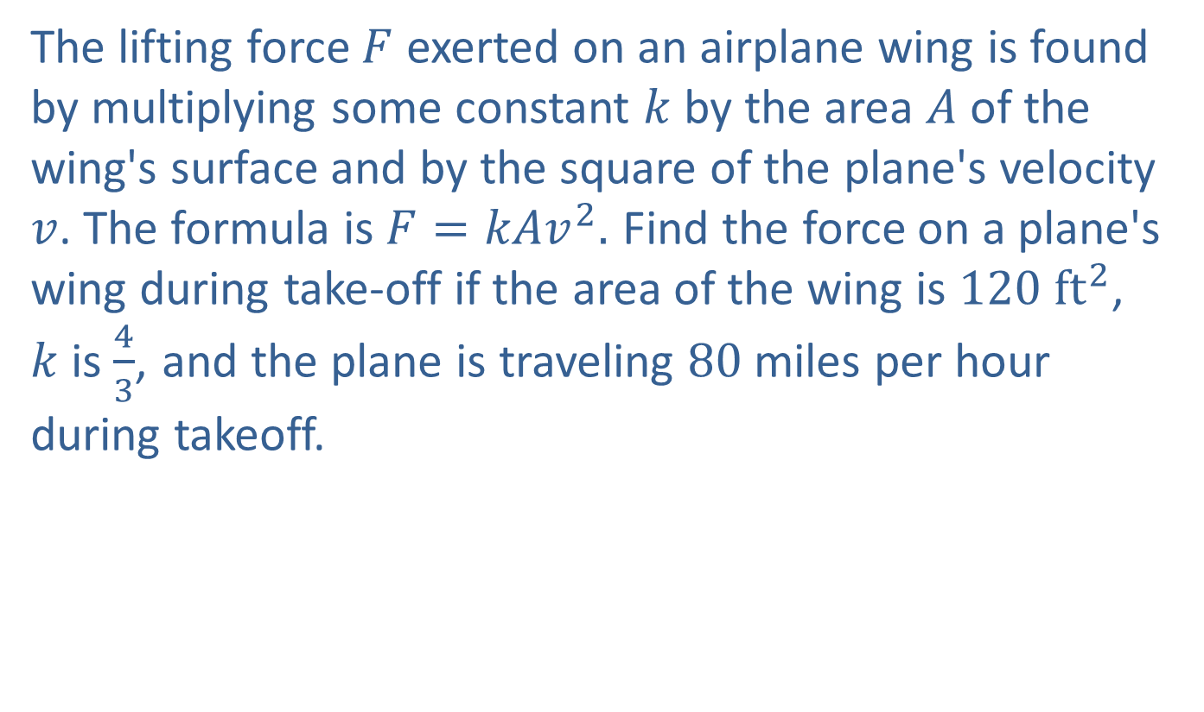
Example 3: Application: Evaluating Formulas
The lifting force $F$ exerted on an airplane wing is found by multiplying some constant $k$ by the area $A$ of the wing's surface and by the square of the plane's velocity $v$. The formula is $F=kAv^{2}.$ Find the force on a plane's wing during take-off if the area of the wing is $120 {ft}^{2}$, $k$is $\frac{4}{3}$, and the plane is traveling 80 miles per hour during takeoff.

Slide 11
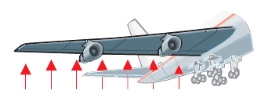
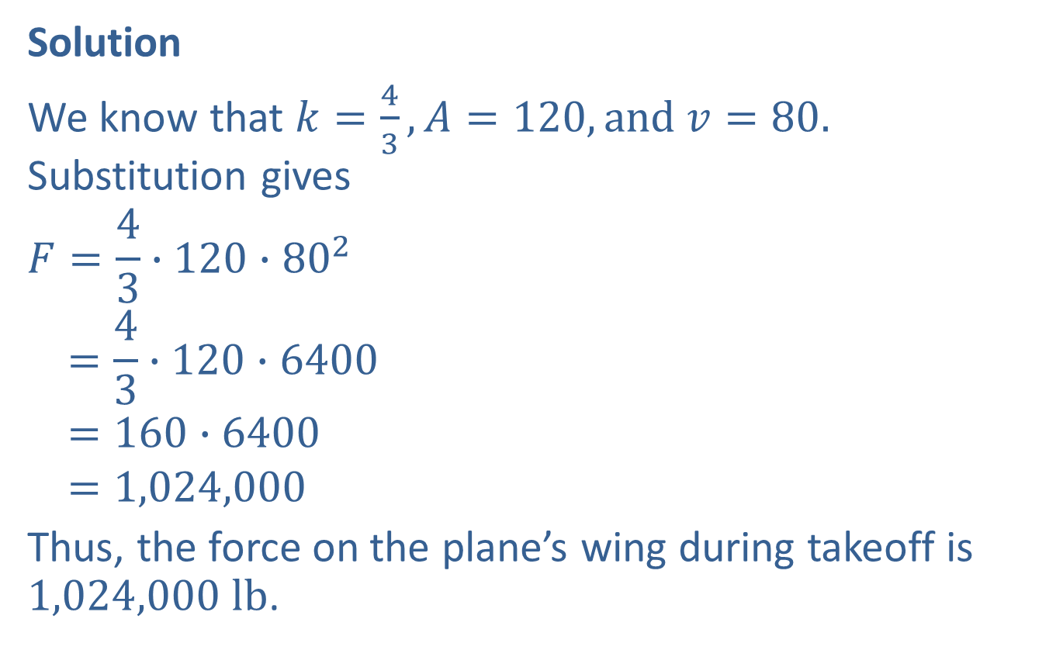
Example 3: Application: Evaluating Formulas (cont.)
Solution
We know that $k=\frac{4}{3}, A=120, and v=80.$ Substitution gives
$$F=\frac{4}{3}∙120∙{80}^{2}$$
$$=\frac{4}{3}∙120∙6400$$
$$=160∙6400$$
$$=1,024,000$$
Thus, the force on the plane’s wing during takeoff is $1,024,000 lb$.
The force is measured in pounds.

Slide 12
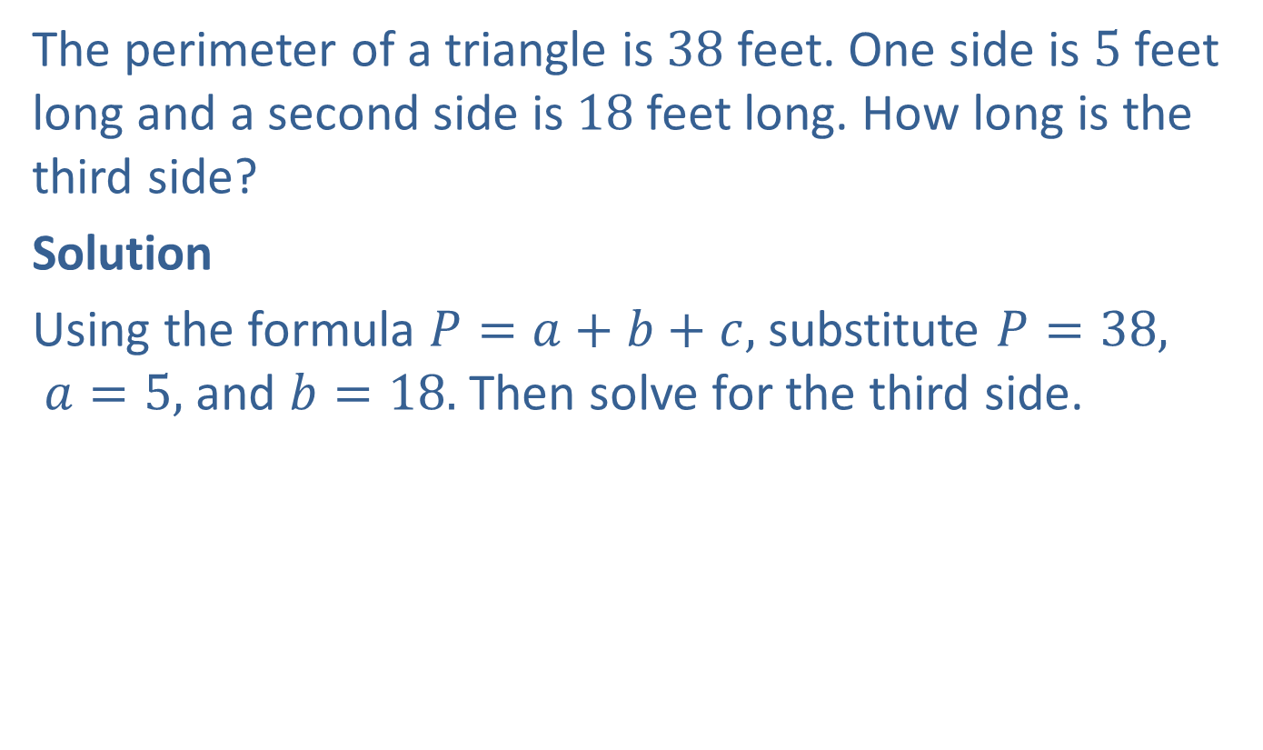
Example 4: Evaluating Formulas
The perimeter of a triangle is $38$ feet. One side is $5$ feet long and a second side is $18$feet long. How long is the third side?
Solution
Using the formula $P=a+b+c,$ substitute $P=38,$ $a=5,$ and $b=18.$ Then solve for the third side.

Slide 13
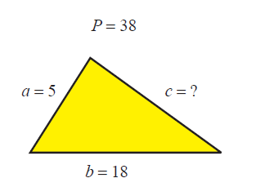

Example 4: Evaluating Formulas (cont.)
$$P=a+b+c$$
$$38=5+18+c$$
$$38=23+c$$
$$38−23=23+c−23$$
$$15=c$$
The third side is 15 feet long.

Slide 14

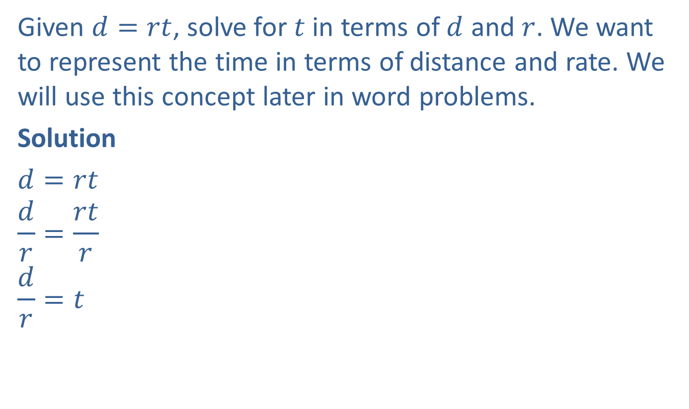

Example 5: Solving for Different Variables
Given $d=rt$, solve for $t$ in terms of $d$ and $r$. We want to represent the time in terms of distance and rate. We will use this concept later in word problems.
Solution
$d=rt$
$$\frac{d}{r}=\frac{rt}{r}$$
$$\frac{d}{r}=t$$
Treat $r$ and $d$as if they were constants.
Divide both sides by $r.$
Simplify.

Slide 15



Example 6: Solving for Different Variables
Given $V=\frac{k}{P}$, solve for $P$ in terms of $V$ and $k$.
Solution
$$V=\frac{k}{P}$$
$$P∙V=P∙\frac{k}{P}$$
$$PV=k$$
$$\frac{PV}{V}=\frac{k}{V}$$
$$P=\frac{k}{V}$$
Multiply both sides by $P.$
Simplify.
Divide both sides by $V.$
Simplify.

Slide 16

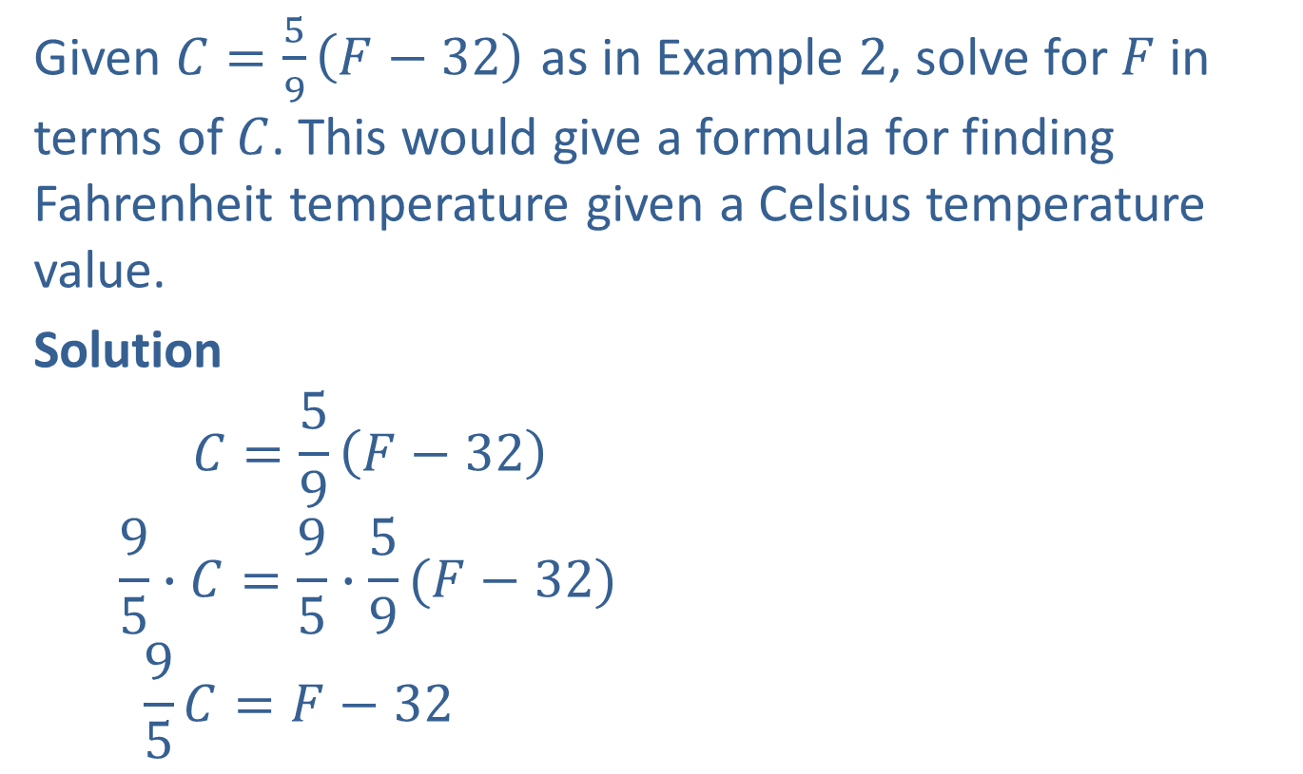

Example 7: Solving for Different Variables
Given $C=\frac{5}{9}\left(F−32\right)$ as in Example $2$, solve for $F$ in terms of $C$. This would give a formula for finding Fahrenheit temperature given a Celsius temperature value.
Solution
$$C=\frac{5}{9}\left(F−32\right)$$
$$\frac{9}{5}∙C=\frac{9}{5}∙\frac{5}{9}(F−32)$$
$$\frac{9}{5}C=F−32$$
Treat $C$ as a constant.
Multiply both sides by $\frac{9}{5}.$
Simplify.

Slide 17

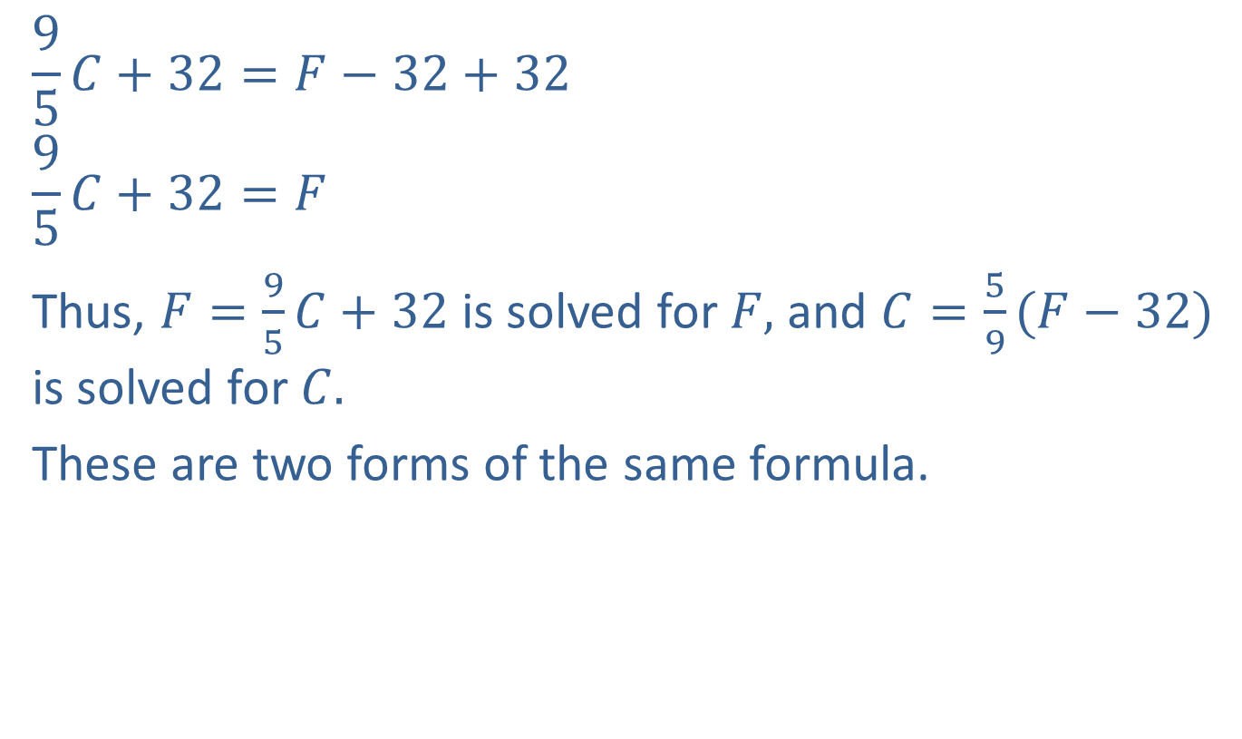
Example 7: Solving for Different Variables (cont.)
$$\frac{9}{5}C+32=F−32+32$$
$$\frac{9}{5}C+32=F$$
Thus, $F=\frac{9}{5}C+32$ is solved for $F,$ and $C=\frac{5}{9}(F−32)$ is solved for $C.$
These are two forms of the same formula.
Add $32$ to both sides.
Simplify.

Slide 18
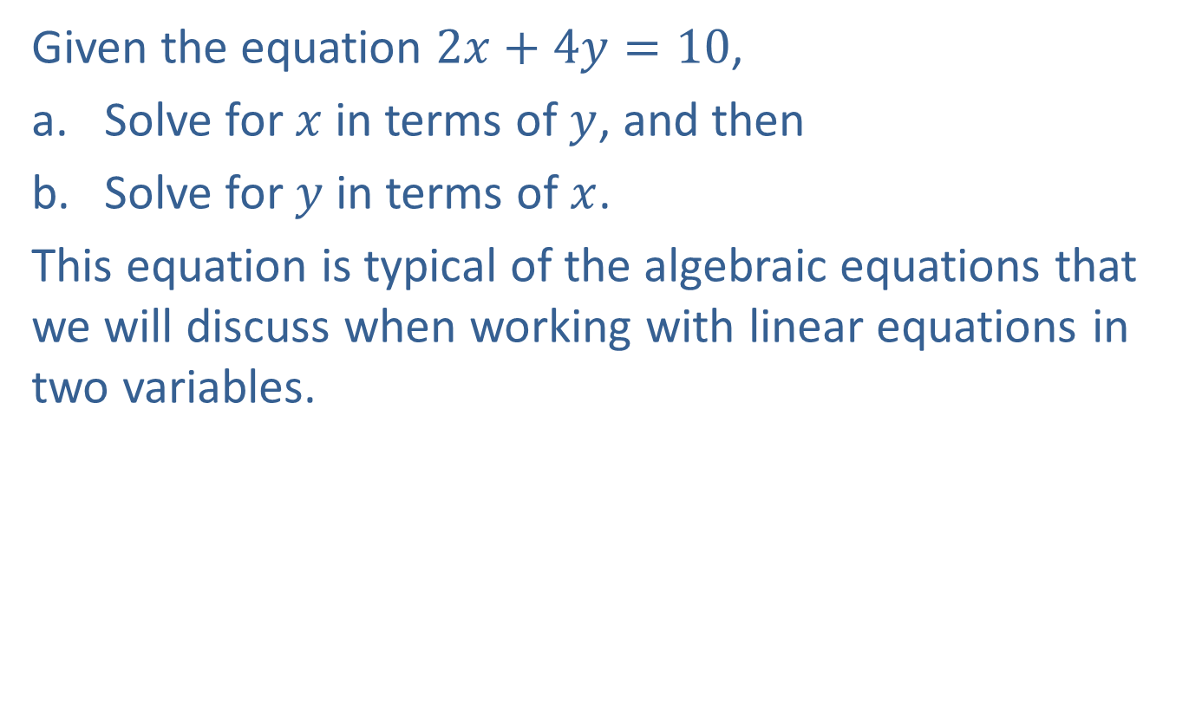
Example 8: Solving for Different Variables
Given the equation $2x+4y=10$,
Solve for $x$ in terms of $y$, and then
​Solve for $y$ in terms of $x$.
This equation is typical of the algebraic equations that we will discuss when working with linear equations in two variables.

Slide 19



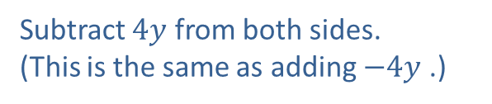
Example 8: Solving for Different Variables (cont.)
Solution
a. Solving for $x$ yields the following.
$2x+4y=10$
$$2x+4y−4y=10−4y$$
$2x=10−4y$
$$\frac{2x}{2}=\frac{10}{2}−\frac{4y}{2}$$
$$x=5−2y$$
Treat $4y$ as a constant.
Subtract $4y$ from both sides.
(This is the same as adding $−4y$ .)
Simplify.
Divide each term on both sides by $2$
Simplify.

Slide 20

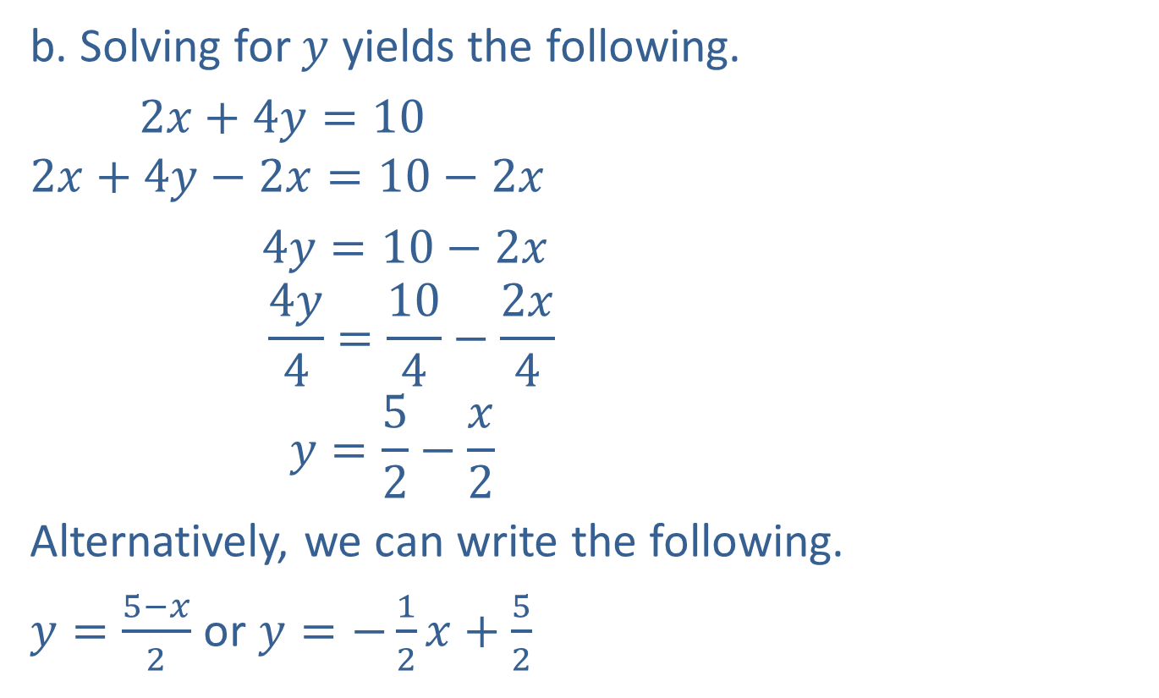


Example 8: Solving for Different Variables (cont.)
b. Solving for $y$ yields the following.
$2x+4y=10$
$$2x+4y−2x=10−2x$$
$4y=10−2x$
$$\frac{4y}{4}=\frac{10}{4}−\frac{2x}{4}$$
$$y=\frac{5}{2}−\frac{x}{2}$$
Alternatively, we can write the following.
$y=\frac{5−x}{2}$ or $y=−\frac{1}{2}x+\frac{5}{2}$
Treat $2x$ as a constant.
Subtract $2x$ from both sides.
Simplify.
Divide each term on both sides by $4$
Simplify.
All forms are correct.

Slide 21

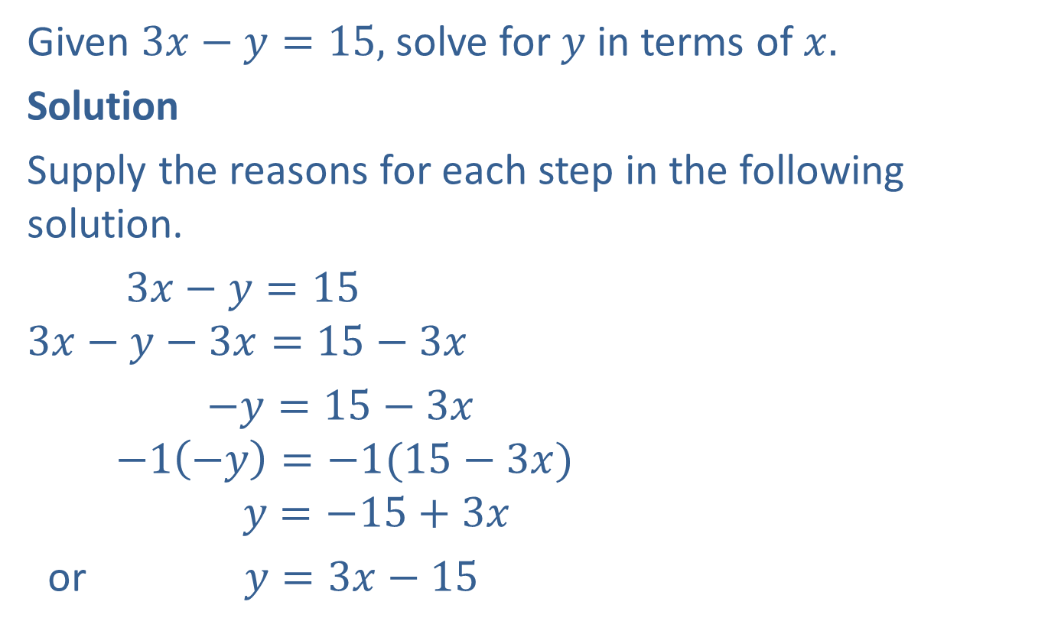

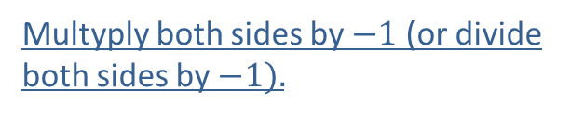
Completion Example 9: Solving for Different Variables
Given $3x−y=15,$ solve for $y$ in terms of $x.$
Solution
Supply the reasons for each step in the following solution.
$3x−y=15$
$$3x−y−3x=15−3x$$
$−y=15−3x$
$$−1\left(−y\right)=−1(15−3x)$$
$$y=−15+3x$$
or $y=3x−15$
Subtract $3x$ from both sides.
Multyply both sides by $−1$ (or divide both sides by $−1).$
Simplify using the distributive property$.$

