Slide 1
Section 2.4
Applications of Linear Equations

Slide 2
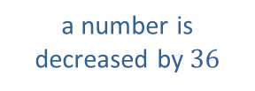
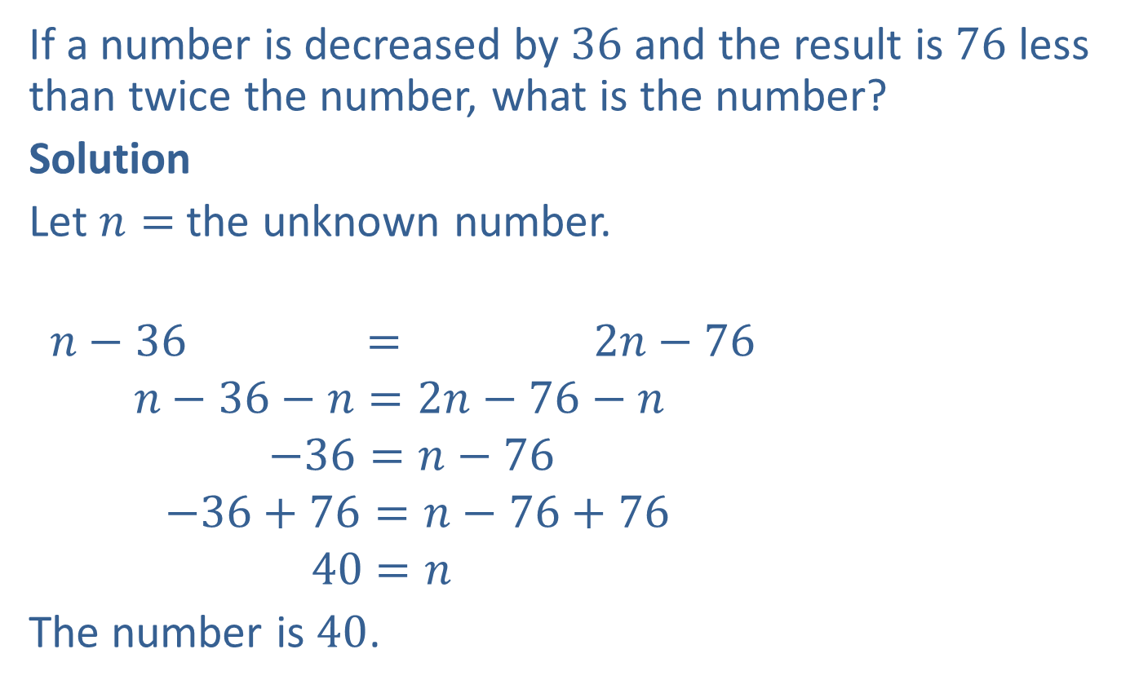
Example 1: Solving Number Problems
If a number is decreased by $36$ and the result is $76$ less than twice the number, what is the number?
Solution
Let $n=$ the unknown number.
$$n−36 = 2n−76$$
$$n−36−n=2n−76−n$$
$$−36=n−76$$
$$−36+76=n−76+76$$
$$40=n$$
The number is $40$.
a number is decreased by $36$
76 less than
twice the number
the result is

Slide 3
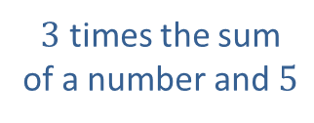
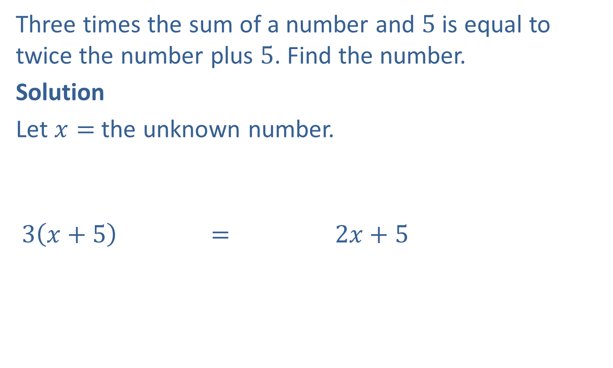

Example 2: Solving Number Problems
Three times the sum of a number and $5$ is equal to twice the number plus $5$. Find the number.
Solution
Let $x=$ the unknown number.
$$3\left(x+5\right) = 2x+5$$
$3$ times the sum of a number and $5$
is equal to
twice the number
plus $5$

Slide 4

Example 2: Solving Number Problems (cont.)
$$3x+15=2x+5$$
$$3x+15−2x=2x+5−2x$$
$$x+15=5$$
$$x+15−15=5−15$$
$$x=−10$$
The number is $−10$.

Slide 5
Procedure: Basic Strategy for Solving Word Problems
​READ: Read the problem carefully.
​SET UP: Draw any type of figure or diagram that might be helpful and decide what operations are needed.
​SOLVE: Perform the operations to solve the problem.
​CHECK: Check your work and check that your answer seems reasonable.

Slide 6

Example 3: Application: Calculating Living Expenses
Joe wants to budget $\frac{2}{5}$ of his monthly income for rent. He found an apartment he likes for $\$800$ a month. What monthly income does he need to be able to afford this apartment?

Slide 7
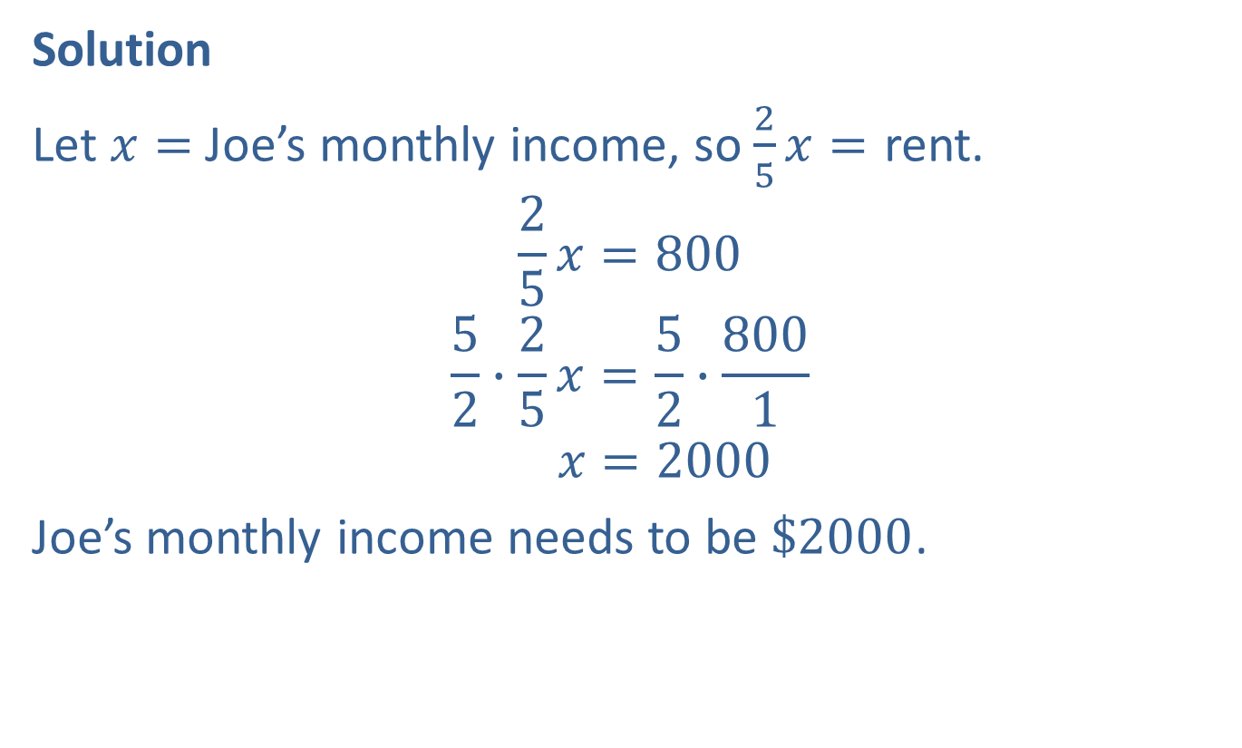
Example 3: Application: Calculating Living Expenses (cont.)
Solution
Let $x=$ Joe’s monthly income, so $\frac{2}{5}x=$ rent.
$$\frac{2}{5}x=800$$
$$\frac{5}{2}∙\frac{2}{5}x=\frac{5}{2}∙\frac{800}{1}$$
$$x=2000$$
Joe’s monthly income needs to be $\$2000$.

Slide 8
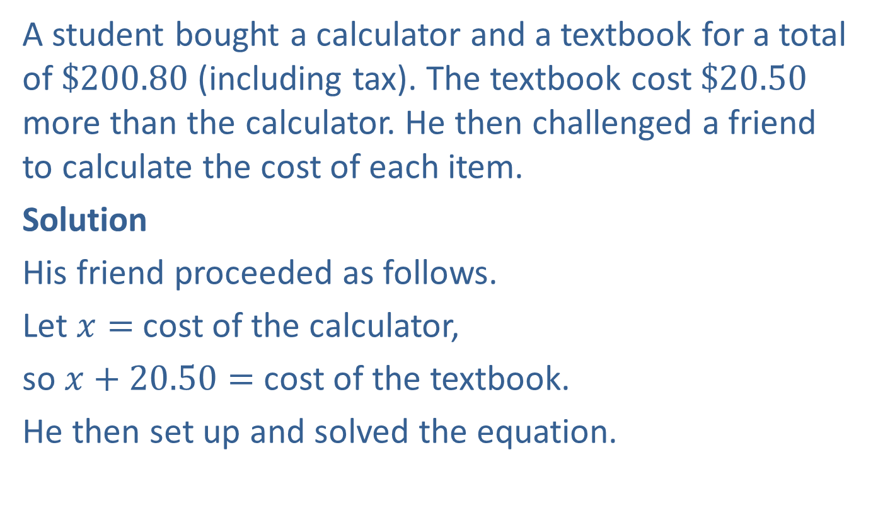
Example 4: Application: Calculating Costs of Purchases
A student bought a calculator and a textbook for a total of $\$200.80$ (including tax). The textbook cost $\$20.50$ more than the calculator. He then challenged a friend to calculate the cost of each item.
Solution
His friend proceeded as follows.
Let $x=$cost of the calculator,
so $x+20.50=$ cost of the textbook.
He then set up and solved the equation.

Slide 9
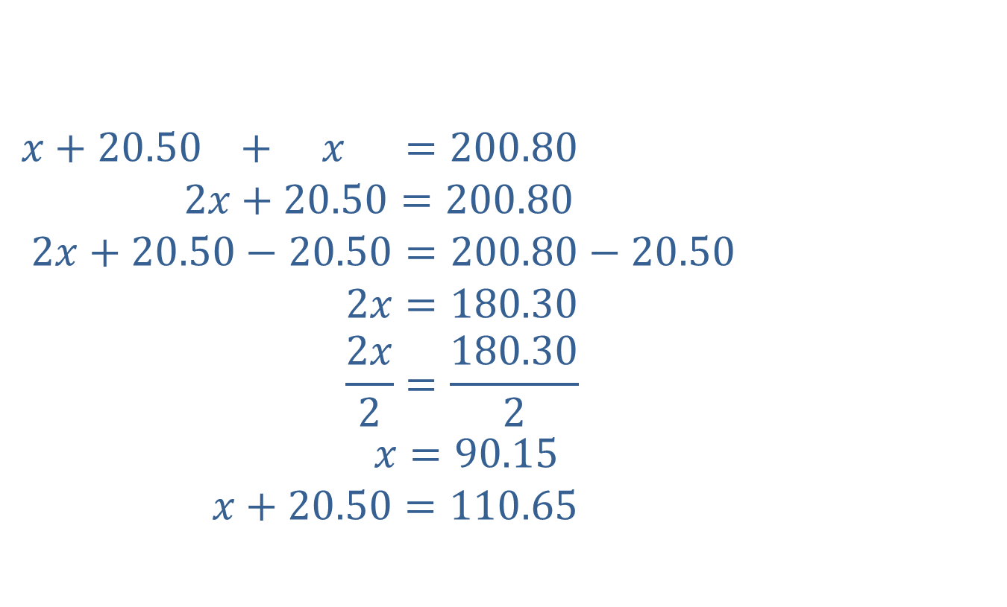
Example 4: Application: Calculating Costs of Purchases (cont.)
$$x+20.50 + x =200.80$$
$$2x+20.50=200.80$$
$$2x+20.50−20.50=200.80−20.50$$
$$2x=180.30$$
$$\frac{2x}{2}=\frac{180.30}{2}$$
$$x=90.15$$
$$x+20.50=110.65$$
Cost of textbook
Cost of calculator
Total spent
Cost of calculator
Cost of textbook

Slide 10

Example 4: Application: Calculating Costs of Purchases (cont.)
The calculator cost $\$90.15$ and the textbook costs $\$90.15+\$20.50=\$110.65,$ with tax included in each price.

Slide 11
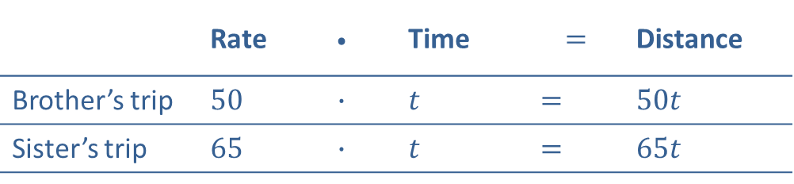
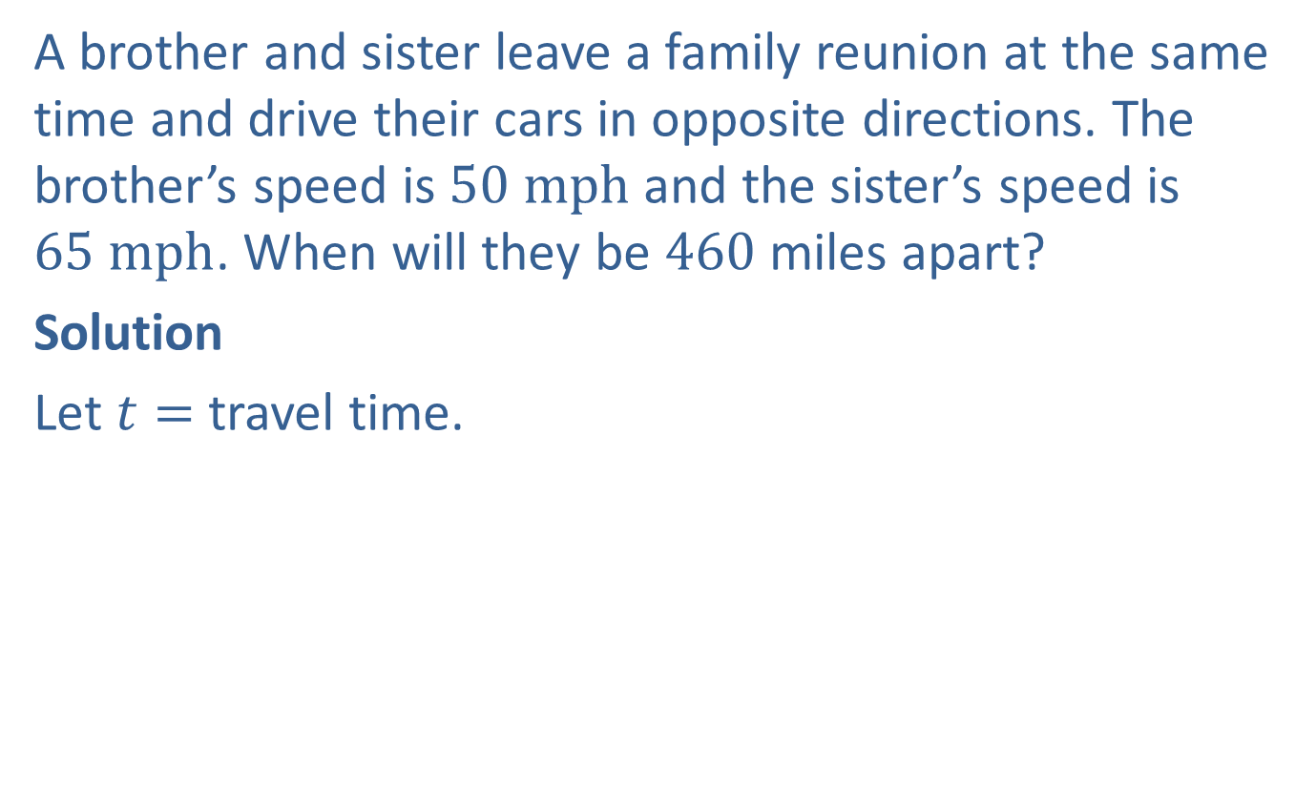
Example 5: Application: Solving Distance-Rate-Time Problems
A brother and sister leave a family reunion at the same time and drive their cars in opposite directions. The brother’s speed is $50 mph$ and the sister’s speed is $65 mph$. When will they be 460 miles apart?
Solution
Let $t=$ travel time.
 | Rate | $$∙$$ | Time | $$=$$ | Distance
Brother’s trip | $$50$$ | $$∙$$ | $$t$$ | $$=$$ | $$50t$$
Sister’s trip | $$65$$ | $$∙$$ | $$t$$ | $$=$$ | $$65t$$

Slide 12
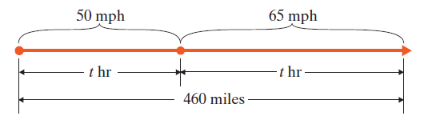

Example 5: Application: Solving Distance-Rate-Time Problems (cont.)
$$50t + 65t = 460$$
$$115t = 460$$
$$t = 4$$
The brother and sister will be $460$ miles apart in $4$ hours.
Brother’s distance $+$ Sister’s distance $=$ Total Distance
Form an equation relating the given information.
Solve the equation.
Travel time.

Slide 13

Example 5: Application: Solving Distance-Rate-Time Problems (cont.)
Check
$50\left(4\right)=200$ miles ($1st$ car)
$65\left(4\right)=260$ miles ($2nd$ car)
$200+260=460$ miles in total

Slide 14
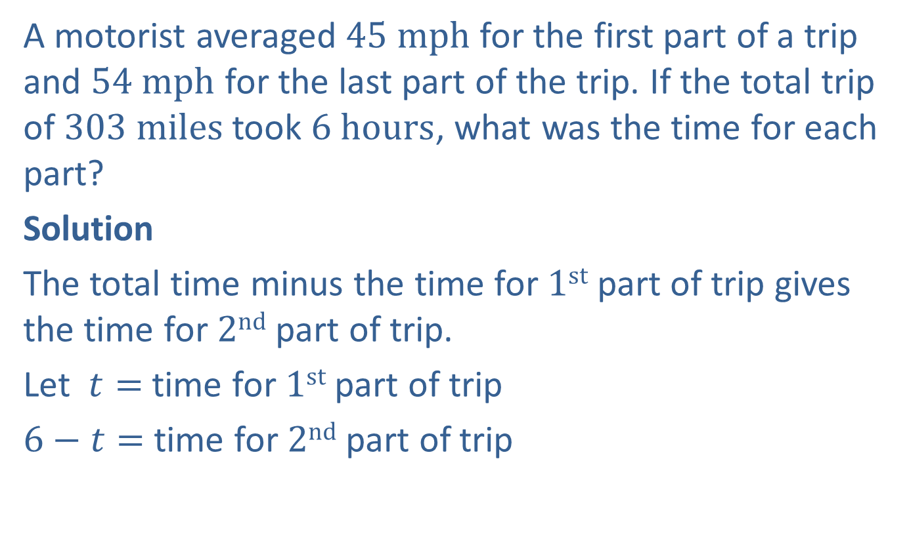
Example 6: Application: Solving Distance-Rate-Time Problems
A motorist averaged $45 mph$ for the first part of a trip and $54 mph$ for the last part of the trip. If the total trip of $303 miles$ took $6 hours$, what was the time for each part?
Solution
The total time minus the time for $1st$ part of trip gives the time for $2nd$ part of trip.
Let $t=$ time for $1st$ part of trip
$6−t=$ time for $2nd$ part of trip

Slide 15
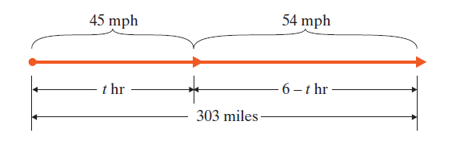
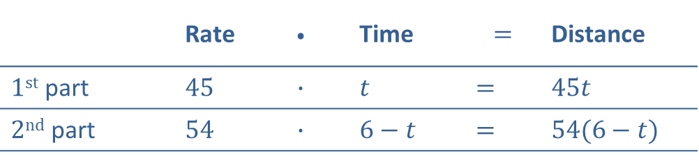
Example 6: Application: Solving Distance-Rate-Time Problems (cont.)
 | Rate | $$∙$$ | Time | $$=$$ | Distance
$1st$ part | $$45$$ | $$∙$$ | $$t$$ | $$=$$ | $$45t$$
$2nd$ part | $$54$$ | $$∙$$ | $$6−t$$ | $$=$$ | $$54(6−t)$$

Slide 16





Example 6: Application: Solving Distance-Rate-Time Problems (cont.)
$$45t + 54\left(6−t\right) = 303$$
$$45t + 324−54t = 303$$
$$324−9t = 303$$
$$−9t = −21$$
$$t = \frac{−21}{−9}=\frac{7}{3} hr$$
$$6−t =6−\frac{7}{3}=\frac{11}{3} hr$$
1st part distance
2nd part distance
Total distance
Form an equation relating the given information.
$$+$$
$$=$$
Solve the equation.
$1$^{st} part of the trip
$2$^{nd} part of the trip

Slide 17
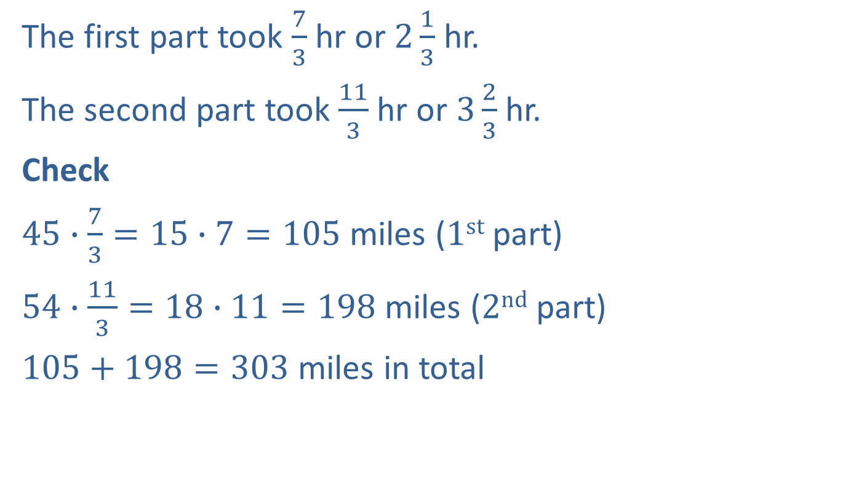
Example 6: Application: Solving Distance-Rate-Time Problems (cont.)
The first part took $\frac{7}{3}$hr or $2\frac{1}{3}$ hr.
The second part took $\frac{11}{3}$ hr or $3\frac{2}{3}$ hr.
Check
$45∙\frac{7}{3}=15∙7=105$ miles ($1st$part)
$54∙\frac{11}{3}=18∙11=198$ miles ($2nd$ part)
$105+198=303$ miles in total

Slide 18
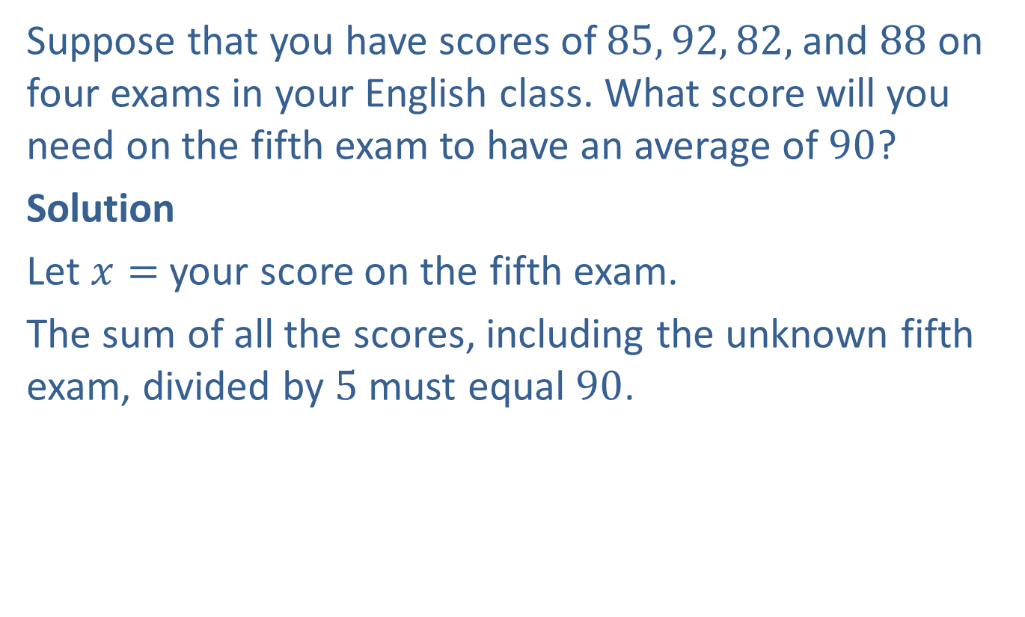
Example 7: Application: Finding the Average (or Mean)
Suppose that you have scores of $85, 92, 82,$and $88$ on four exams in your English class. What score will you need on the fifth exam to have an average of $90$?
Solution
Let $x=$ your score on the fifth exam.
The sum of all the scores, including the unknown fifth exam, divided by $5$ must equal $90$.

Slide 19
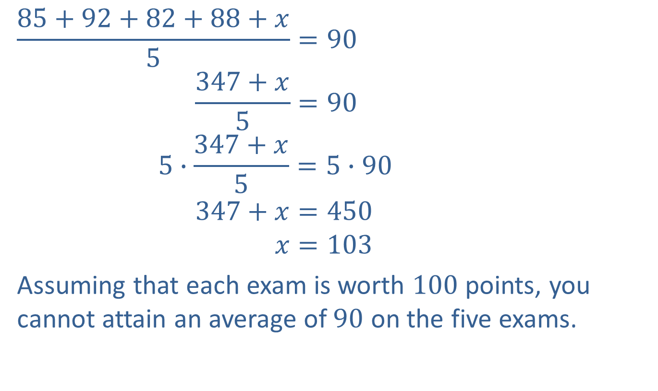
Example 7: Application: Finding the Average (or Mean) (cont.)
$$\frac{85+92+82+88+x}{5}=90$$
$$\frac{347+x}{5}=90$$
$$5∙\frac{347+x}{5}=5∙90$$
$$347+x=450$$
$$x=103$$
Assuming that each exam is worth $100$points, you cannot attain an average of $90$ on the five exams.

Slide 20

Example 8: Application: Calculating Cost
A jeweler paid $\$350$ for a ring. He wants to price the ring for sale so that he can give a $30\%$ discount on the marked selling price and still make a profit of $20\%$ on his cost. What should be the marked selling price of the ring?

Slide 21
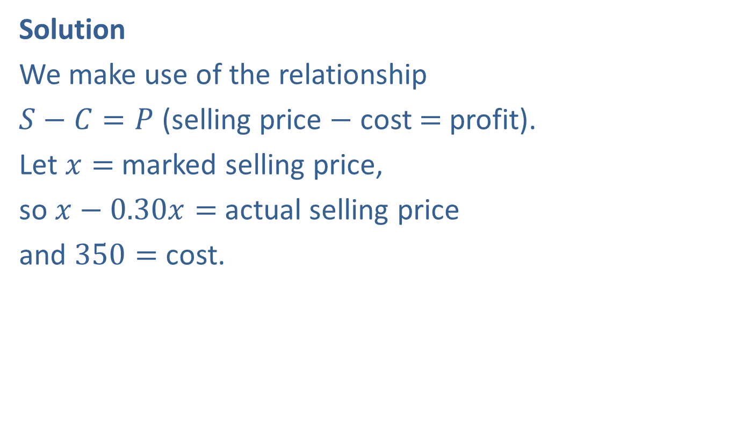
Example 8: Application: Calculating Cost (cont.)
Solution
We make use of the relationship
$S−C=P$ (selling price $−$ cost $=$ profit).
Let $x=$ marked selling price,
so $x−0.30x=$ actual selling price
and $350=$ cost.

Slide 22


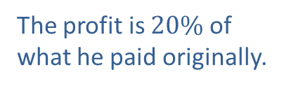
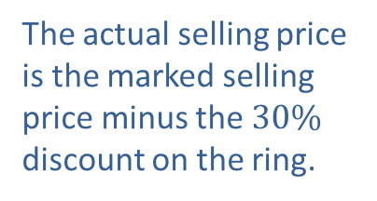

Example 8: Application: Calculating Cost (cont.)
$$x−0.30x − 350 = 0.20\left(350\right)$$
$$0.70x − 350 = 70$$
$$0.70x = 420$$
$$x = 600$$
The jeweler should set the selling price at $\$600$.
Actual selling price
The actual selling price is the marked selling price minus the $30\%$ discount on the ring.
$$−$$
Cost
$$=$$
Profit
The profit is $20\%$ of what he paid originally.

Slide 23


Example 8: Application: Calculating Cost (cont.)
Check
Step 1: Step 2:
$\$600$ $\$600$
$\underline{×0.30}$ $\underline{−\$180}$
$\$180$ $\$420$
Step 3:
$\$420$
$\underline{−\$350}$
$\$70$
Marked selling price
Marked selling price
Discount $\%$
Discount
Discount
Actual selling price
Actual selling price
Cost
Profit

Slide 24


Example 8: Application: Calculating Cost (cont.)
As a double check, $\$350$
$\underline{×0.20}$
$\$70$
Cost
Profit $\%$
Profit

