Slide 1
Section 2.5
Ratios, Rates, and Proportions

Slide 2
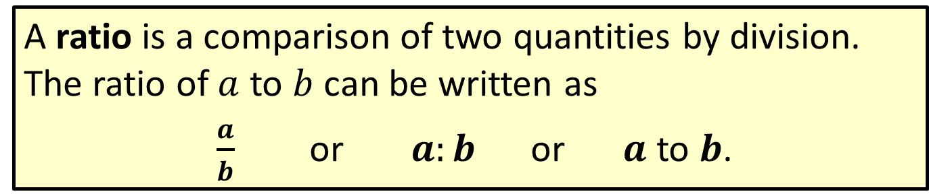
Definition: Ratios
A ratio is a comparison of two quantities by division. The ratio of $a$ to $b$ can be written as
$\frac{a}{b}$ or $a:b$ or $a$ to $b$.

Slide 3
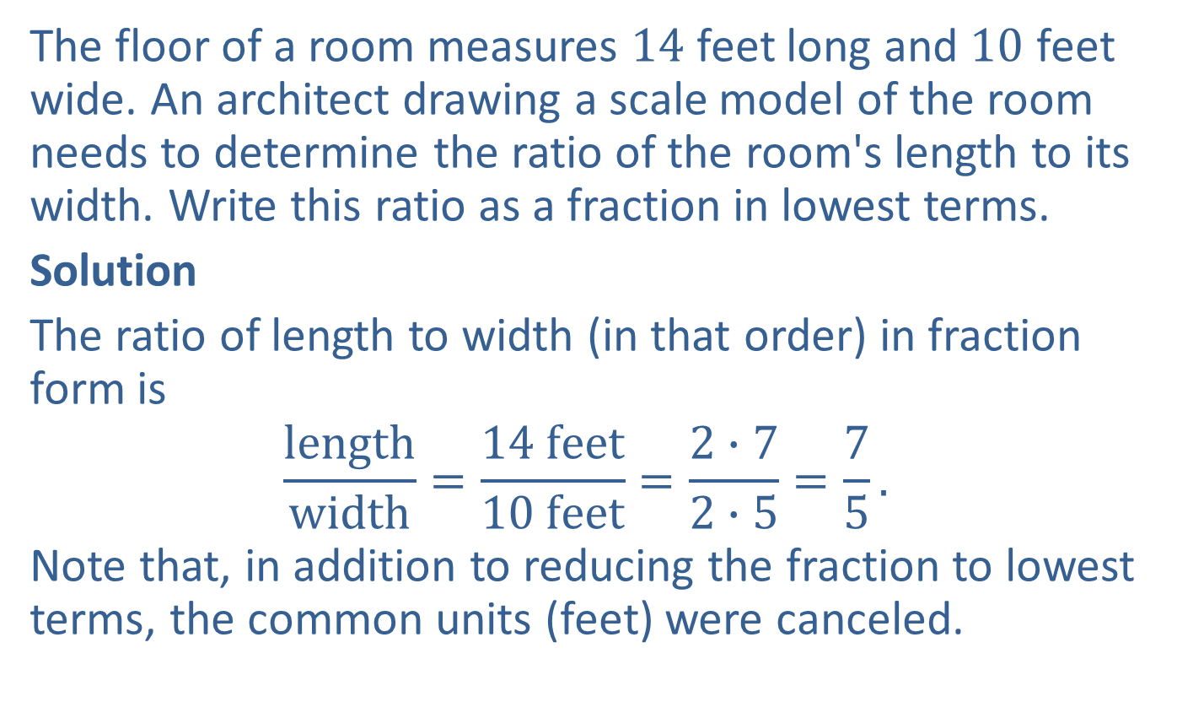
Example 1: Application: Writing Ratios
The floor of a room measures $14$ feet long and $10$ feet wide. An architect drawing a scale model of the room needs to determine the ratio of the room's length to its width. Write this ratio as a fraction in lowest terms.
Solution
The ratio of length to width (in that order) in fraction form is
$$\frac{length}{width}=\frac{14 feet}{10 feet}=\frac{2∙7}{2∙5}=\frac{7}{5}.$$
Note that, in addition to reducing the fraction to lowest terms, the common units (feet) were canceled.

Slide 4
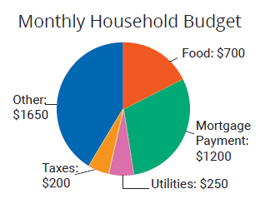
Example 2: Application: Writing Ratios from Graphs
The circle graph shown here illustrates a monthly budget with categories for food, mortgage payment, utilities, taxes, and other.
Use the information from the graph to
a. find the ratio of money budgeted for food to money budgeted for taxes and
b. find the ratio of the mortgage payment to the total budget.

Slide 5
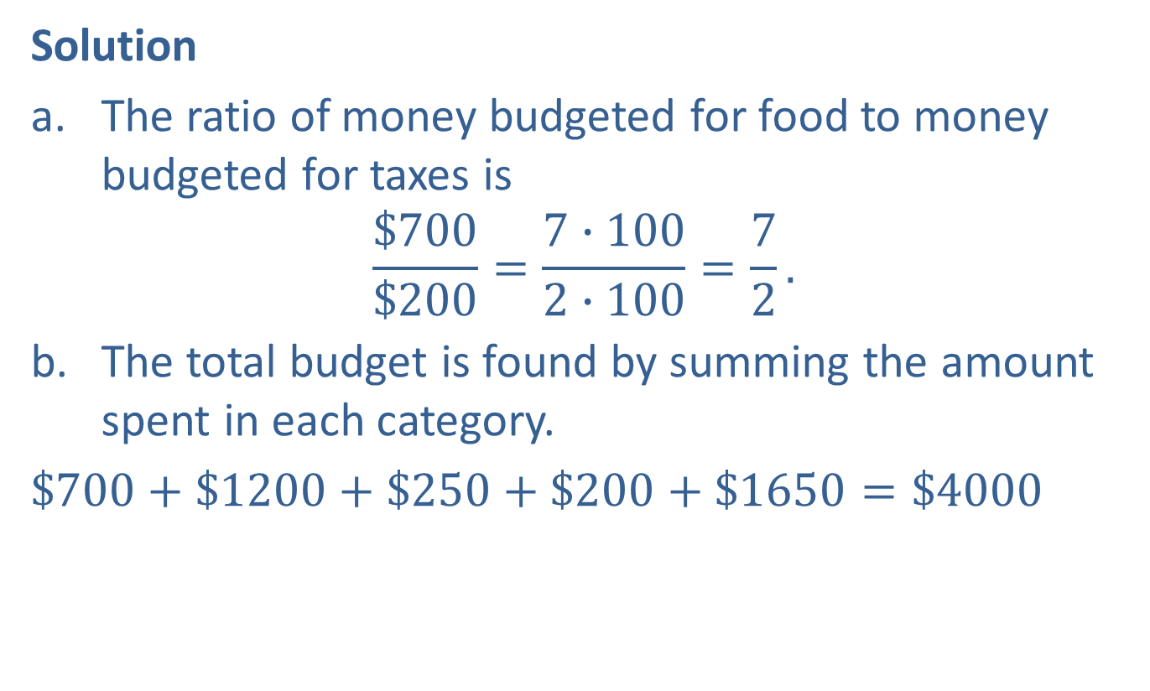
Example 2: Application: Writing Ratios from Graphs (cont.)
Solution
The ratio of money budgeted for food to money budgeted for taxes is
$$\frac{\$700}{\$200}=\frac{7∙100}{2∙100}=\frac{7}{2}.$$
The total budget is found by summing the amount spent in each category.
$\$700+\$1200+\$250+\$200+\$1650=\$4000$

Slide 6

Example 2: Application: Writing Ratios from Graphs (cont.)
So the ratio of the mortgage payment to the total budget is
$$\frac{\$1200}{\$4000}=\frac{400∙3}{400∙10}=\frac{3}{10}.$$

Slide 7
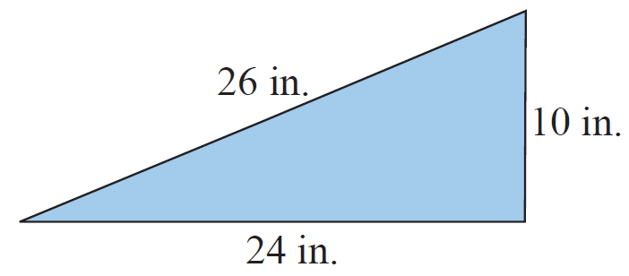
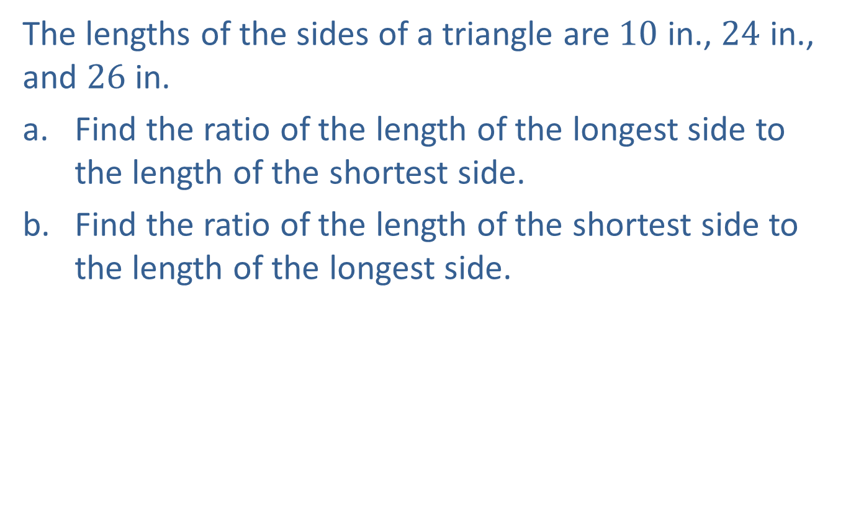
Example 3: Writing Ratios in Geometry
The lengths of the sides of a triangle are $10$ in., $24$ in., and $26$ in.
​Find the ratio of the length of the longest side to the length of the shortest side.
​Find the ratio of the length of the shortest side to the length of the longest side.

Slide 8
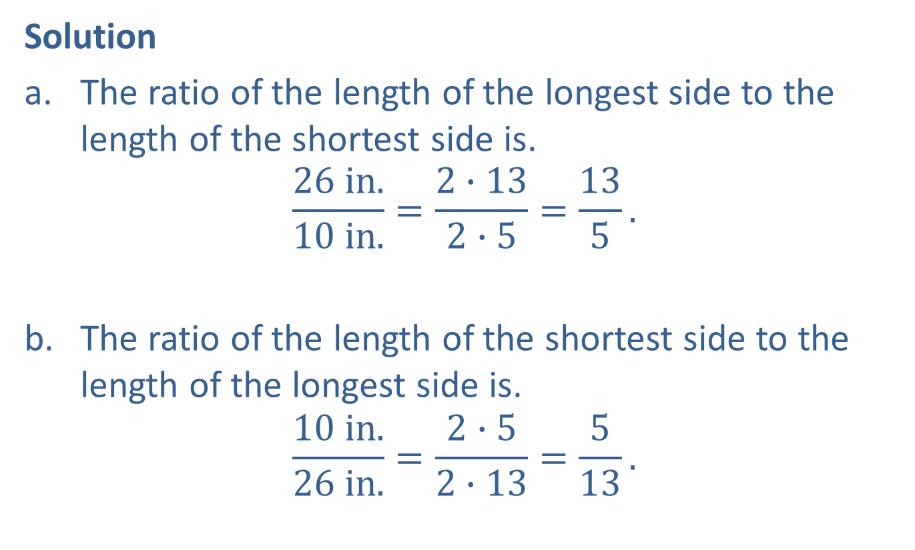
Example 3: Writing Ratios in Geometry (cont.)
Solution
​The ratio of the length of the longest side to the length of the shortest side is.
$$\frac{26 in.}{10 in.}=\frac{2∙13}{2∙5}=\frac{13}{5}.$$
The ratio of the length of the shortest side to the length of the longest side is.
$$\frac{10 in.}{26 in.}=\frac{2∙5}{2∙13}=\frac{5}{13}.$$

Slide 9
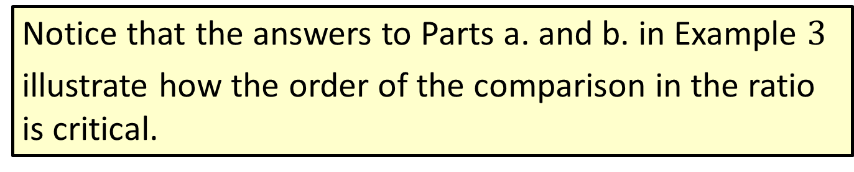
Note
Notice that the answers to Parts a. and b. in Example $3$
illustrate how the order of the comparison in the ratio is critical.

Slide 10

Example 4: Writing a Rate
Write the following rate as a fraction in lowest terms: 150 kilometers (km) to 8 gallons (gal) of gas.
Solution
$$\frac{150 km}{8 gal}=\frac{2∙75 km}{2∙4 gal}=\frac{75 km}{4 gal}$$

Slide 11
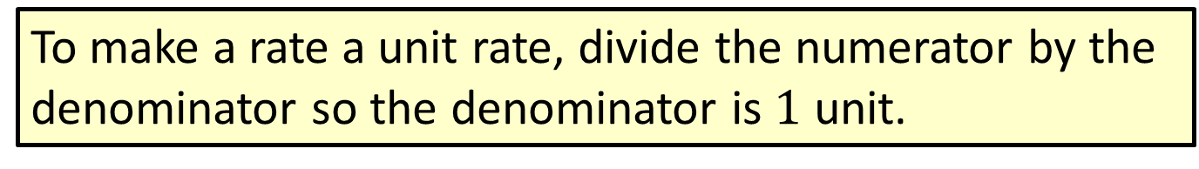
Procedure: Changing Rates to Unit Rates
To make a rate a unit rate, divide the numerator by the denominator so the denominator is $1$ unit.

Slide 12
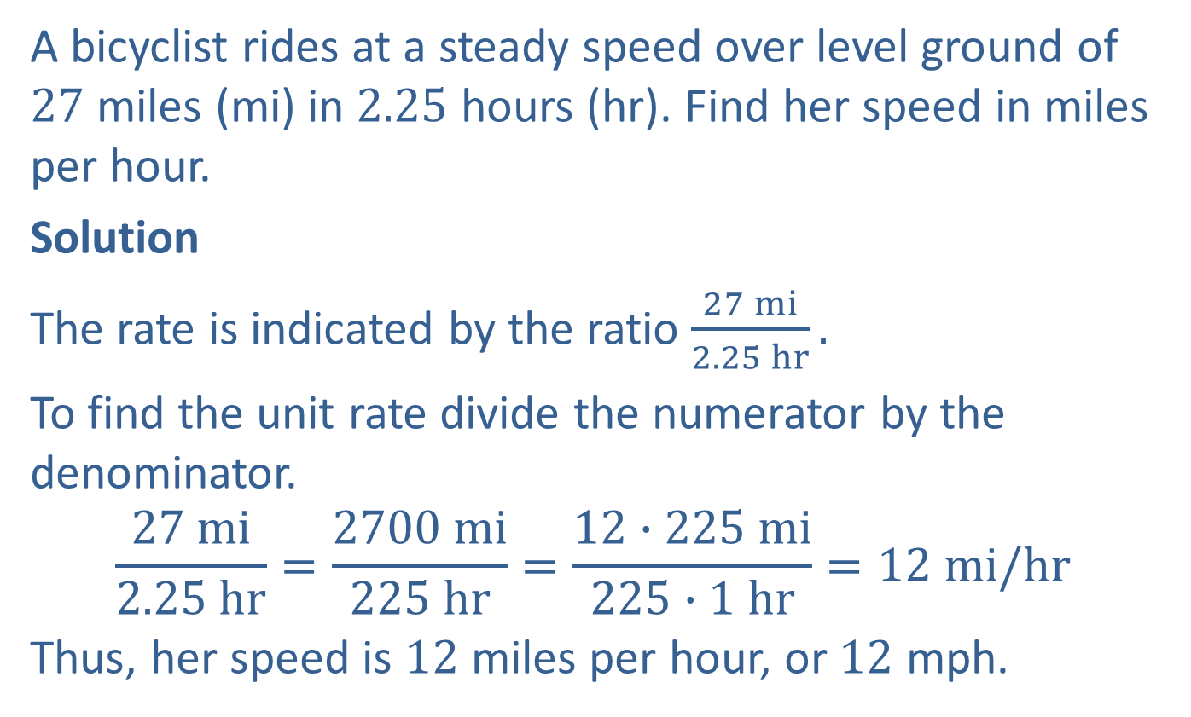
Example 5: Application: Writing a Unit Rate
A bicyclist rides at a steady speed over level ground of $27$ miles (mi) in $2.25$ hours (hr). Find her speed in miles per hour.
Solution
The rate is indicated by the ratio $\frac{27 mi}{2.25 hr}.$
To find the unit rate divide the numerator by the denominator.
$$\frac{27 mi}{2.25 hr}=\frac{2700 mi}{225 hr}=\frac{12∙225 mi}{225∙1 hr}=12 mi/hr$$
Thus, her speed is $12$ miles per hour, or $12$ mph.

Slide 13
Note
In the past, many consumers did not understand the concept of unit price or know how to determine such a number. Now, most states have a law that grocery stores must display the unit price for certain goods they sell so that consumers can be fully informed.

Slide 14
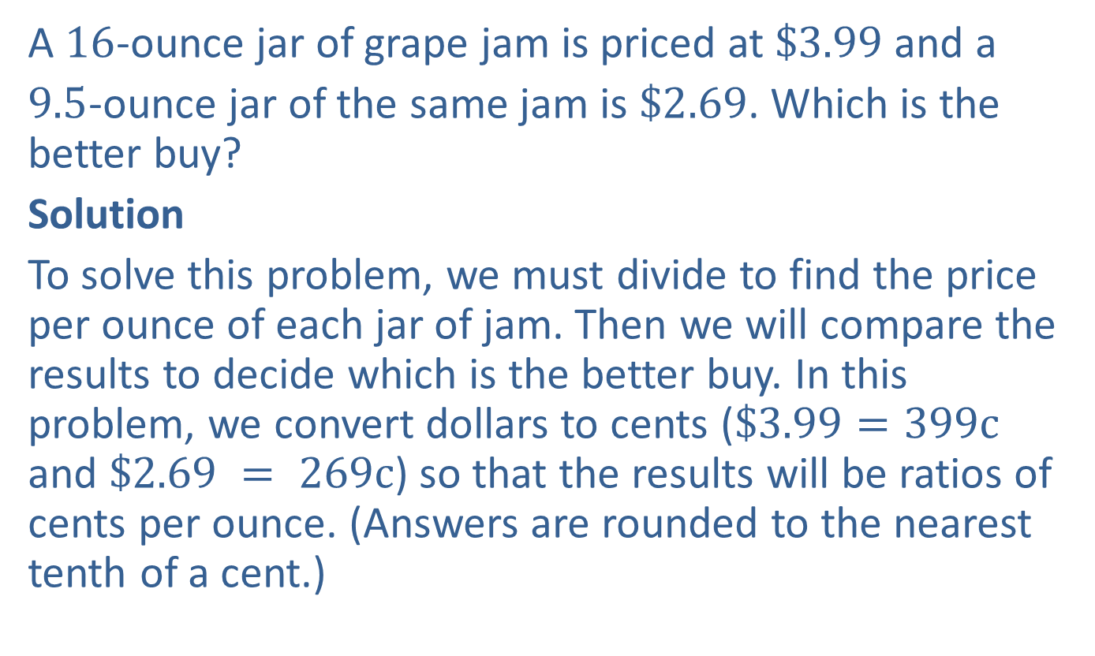
Example 6: Application: Comparing Unit Prices
A $16$-ounce jar of grape jam is priced at $\$3.99$and a
$9.5$-ounce jar of the same jam is $\$2.69$. Which is the better buy?
Solution
To solve this problem, we must divide to find the price per ounce of each jar of jam. Then we will compare the results to decide which is the better buy. In this problem, we convert dollars to cents ($\$3.99=399c$ and $\$2.69 = 269c$) so that the results will be ratios of cents per ounce. (Answers are rounded to the nearest tenth of a cent.)

Slide 15



Example 6: Application: Comparing Unit Prices (cont.)
$16$-ounce jar
$$\frac{399c}{16 oz} \text{16}\text{⟌}\overline{399.00}$$
$\underline{−320}$
$79$
$\underline{−64}$
$15 0$
$\underline{−14 4}$
$60$
$−48$
$\overline{ 12}$
The $16$-ounce jar costs $24.9c$ per ounce.
$$24.93$$
Or $24.9\text{¢}$ per ounce

Slide 16



Example 6: Application: Comparing Unit Prices (cont.)
$9.5$-ounce jar
$$\frac{269c}{9.5 oz}\text{ 9}\text{.}\text{5}\text{.}\text{⟌}\overline{269.0.00}$$
$\underline{−190}$
$79 0$
$\underline{−76 0}$
$3 0 0$
$\underline{ −2 8 5}$
$1 50$
$−95$
$\overline{ 55}$
$$28.31$$
Or $28.3$¢ per ounce

Slide 17

Example 6: Application: Comparing Unit Prices (cont.)
The $9.5$-ounce jar costs $28.3c$ per ounce.
Thus, the larger jar ($16$ ounces for $\$3.99$) is the better buy because the price per ounce is less.

Slide 18
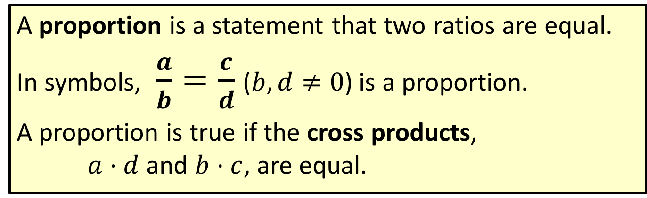
Definition: Proportions
A proportion is a statement that two ratios are equal.
In symbols, $\frac{a}{b}=\frac{c}{d}$ ($b,d≠0$) is a proportion.
A proportion is true if the cross products, $a⋅d$ and $b⋅c$, are equal.

Slide 19
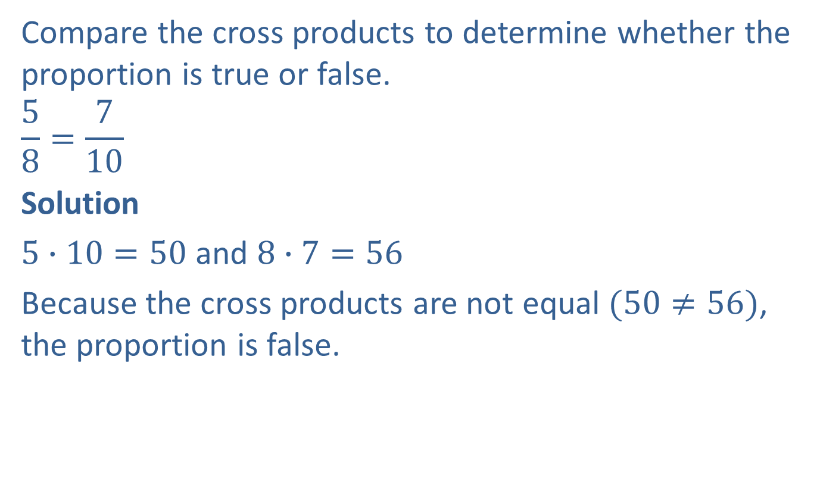
Example 7: Verifying Proportions
Compare the cross products to determine whether the proportion is true or false.
$$\frac{5}{8}=\frac{7}{10}$$
Solution
$5∙10=50$ and $8∙7=56$
Because the cross products are not equal $(50≠56)$, the proportion is false.

Slide 20
Procedure: To Solve a Proportion
​Find the cross products (or cross multiply) and then set the cross products equal to each other.
​Divide both sides of the equation by the coefficient of the variable.
​Simplify.

Slide 21


Example 8: Solving Proportions
Find the value of $x$ if $\frac{4}{8}=\frac{5}{x}$.
Solution
$$\frac{4}{8}=\frac{5}{x}$$
$$4∙x=8∙5$$
$$\frac{4∙x}{4}=\frac{40}{4}$$
$$x=10$$
Write the proportion.
Find the cross products and set them equal to each other.
Divide both sides by $4$.
Simplify.

Slide 22


Example 9: Solving Proportions
Find the value of $y$ if $\frac{6}{16}=\frac{y}{24}$.
Solution
$$\frac{6}{16}=\frac{y}{24}$$
$$6∙24=16∙y$$
$$\frac{144}{16}=\frac{16∙y}{16}$$
$$9=y$$
Write the proportion.
Find the cross products and set them equal to each other.
Divide both sides by $16$.
Simplify.

Slide 23

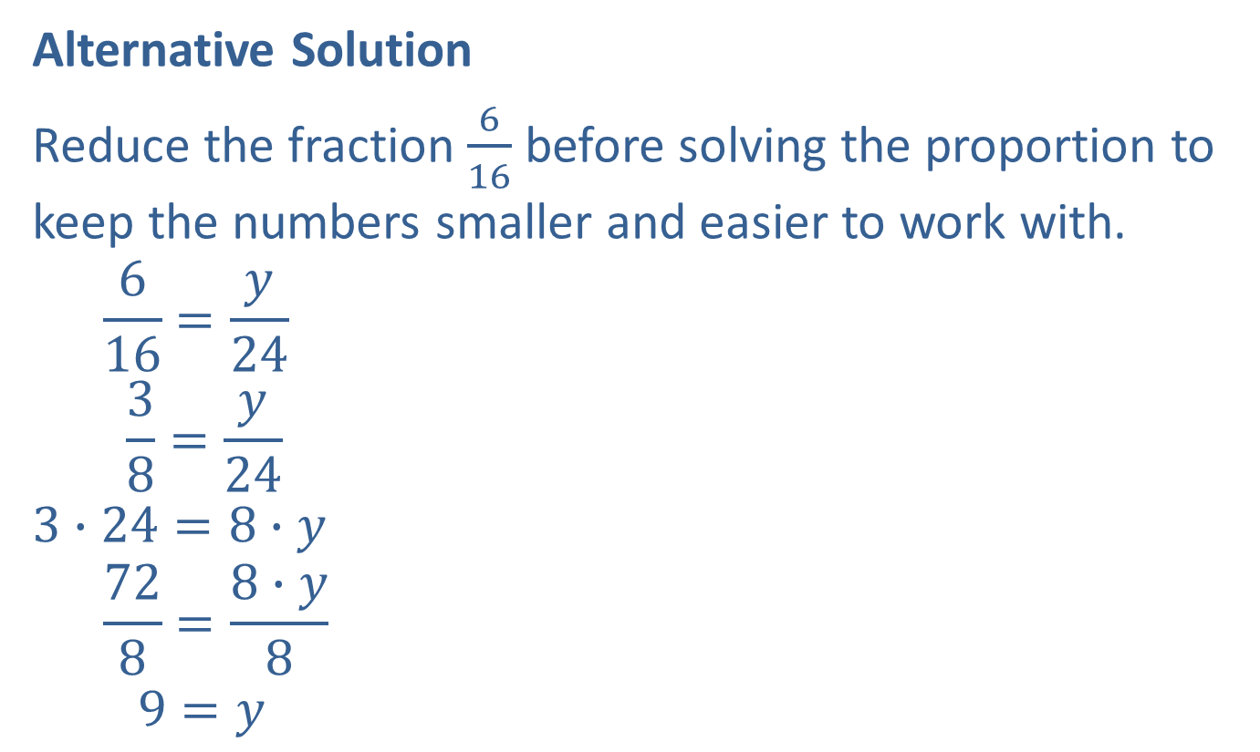
Example 9: Solving Proportions (cont.)
Alternative Solution
Reduce the fraction $\frac{6}{16}$ before solving the proportion to keep the numbers smaller and easier to work with.
$$\frac{6}{16}=\frac{y}{24}$$
$$\frac{3}{8}=\frac{y}{24}$$
$$3∙24=8∙y$$
$$\frac{72}{8}=\frac{8∙y}{8}$$
$$9=y$$
Write the proportion.
Reduce the fraction: $\frac{6}{16}=\frac{2 ∙ 3}{2 ∙ 8}=\frac{3}{8}.$
Proceed to solve as before.

Slide 24
Procedure: Solve an Application Using a Proportion
​Identify the unknown quantity and use a variable to represent this quantity.
​Set up a proportion in which the units are compared in the same order. (Make sure that the units are labeled so they can be seen in the right order.)
​Solve the proportion.

Slide 25
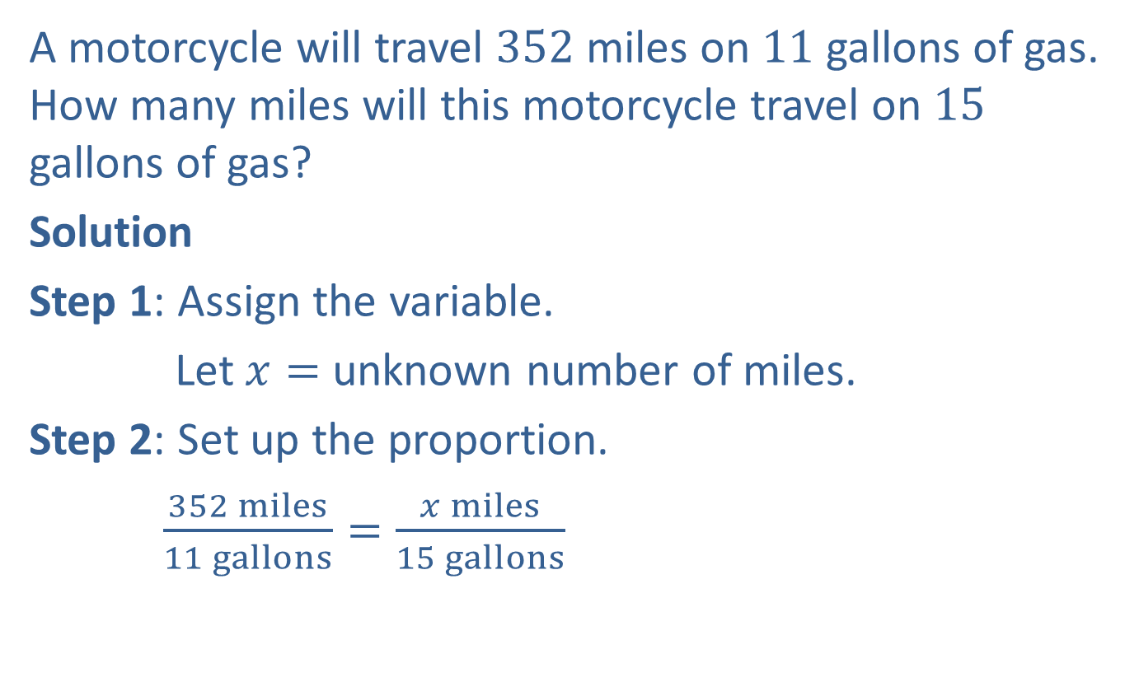
Example 10: Application: Solving Proportions
A motorcycle will travel 352 miles on 11 gallons of gas. How many miles will this motorcycle travel on 15 gallons of gas?
Solution
Step 1: Assign the variable.
Let $x=$ unknown number of miles.
Step 2: Set up the proportion.
$\frac{352 miles}{11 gallons}=\frac{x miles}{15 gallons}$
The units are in the same order (miles to gallons) in each ratio.

Slide 26
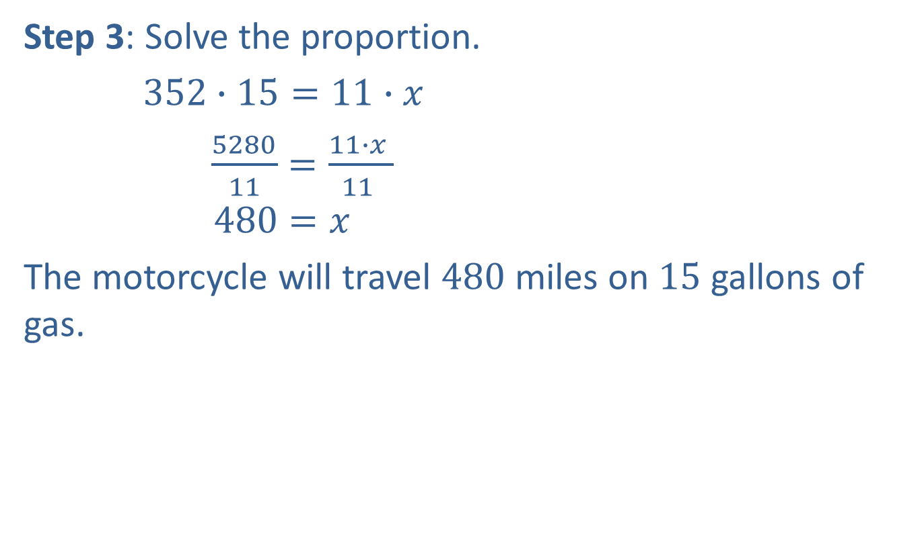
Example 10: Application: Solving Proportions (cont.)
Step 3: Solve the proportion.
$352∙15=11∙x$
$\frac{5280}{11}=\frac{11∙x }{11 }$
$$480=x$$
The motorcycle will travel $480$ miles on $15$ gallons of gas.

Slide 27
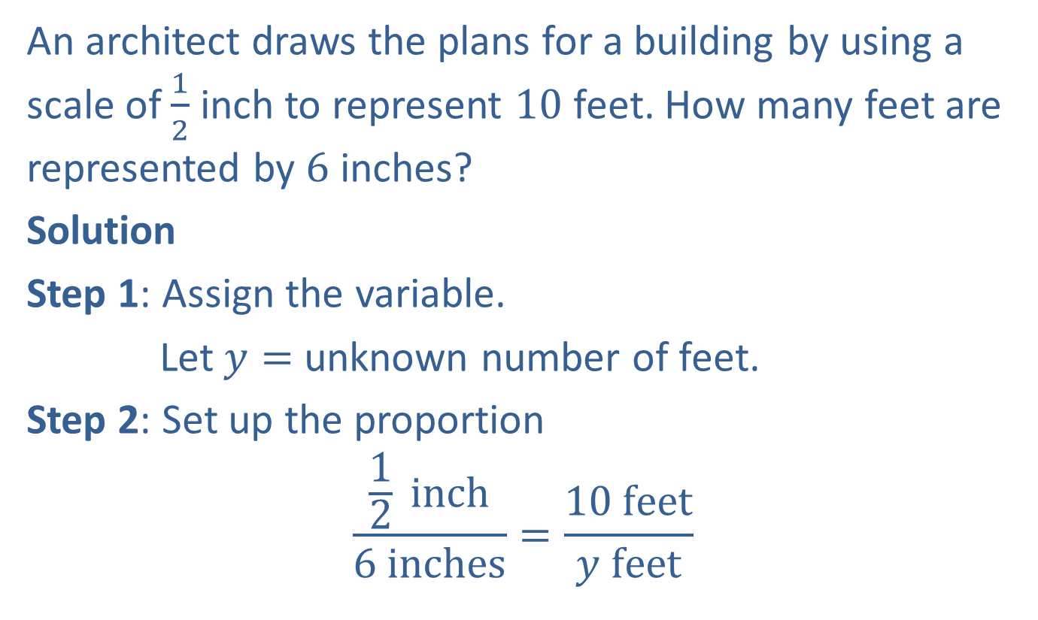
Example 11: Application: Solving Proportions
An architect draws the plans for a building by using a scale of $\frac{1}{2}$ inch to represent $10$ feet. How many feet are represented by $6$ inches?
Solution
Step 1: Assign the variable.
Let $y=$ unknown number of feet.
Step 2: Set up the proportion
$$\frac{\frac{1}{2} inch}{6 inches}=\frac{10 feet}{y feet}$$

Slide 28

Example 11: Application: Solving Proportions (cont.)
Step 3: Solve the proportion.
$$\frac{1}{2}∙y=10∙6$$
$$\frac{2}{1}∙\frac{1}{2}∙y=\frac{2}{1}∙60$$
$$y=120$$
On these plans, $6$ inches represents $120$ feet.

Slide 29
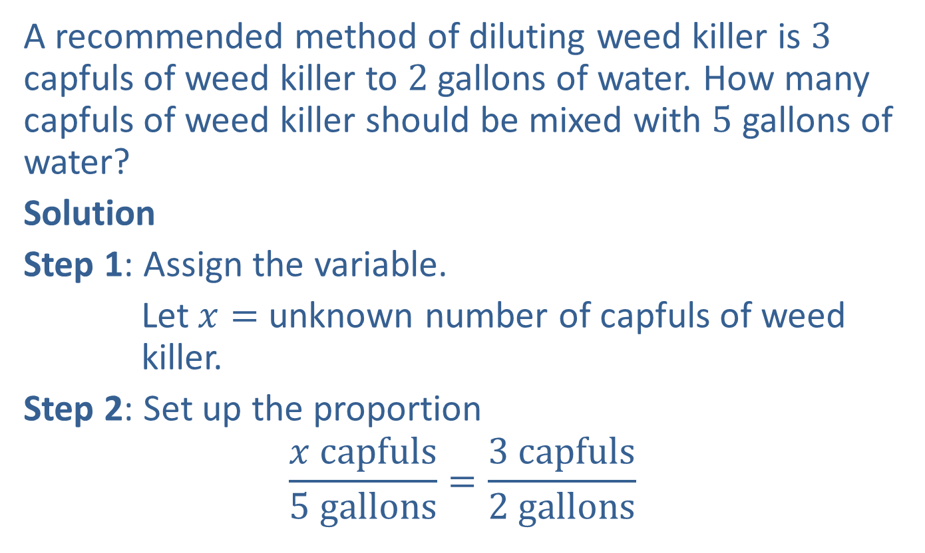
Completion Example 12: Application: Solving Proportions
A recommended method of diluting weed killer is $3$ capfuls of weed killer to $2$ gallons of water. How many capfuls of weed killer should be mixed with $5$ gallons of water?
Solution
Step 1: Assign the variable.
Let $x=$ unknown number of capfuls of weed killer.
Step 2: Set up the proportion
$$\frac{x capfuls}{5 gallons}=\frac{3 capfuls}{2 gallons}$$

Slide 30
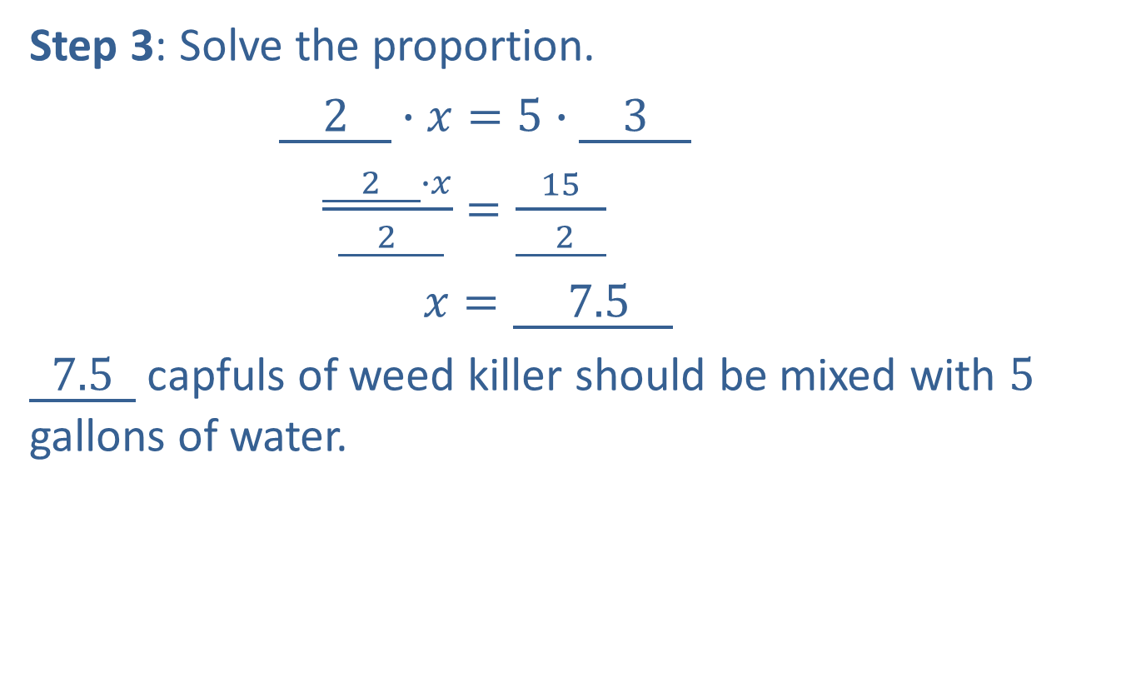
Completion Example 12: Application: Solving Proportions (cont.)
Step 3: Solve the proportion.
$\underline{ 2 }∙x=5∙\underline{ 3 }$
$\frac{\underline{ 2 }∙x}{ \underline{ 2 }}=\frac{15}{\underline{ 2 }}$
$x=\underline{ 7.5 }$
$\underline{ 7.5 }$ capfuls of weed killer should be mixed with $5$ gallons of water.

