Slide 1
Section 2.6
Modeling Using Variation

Slide 2
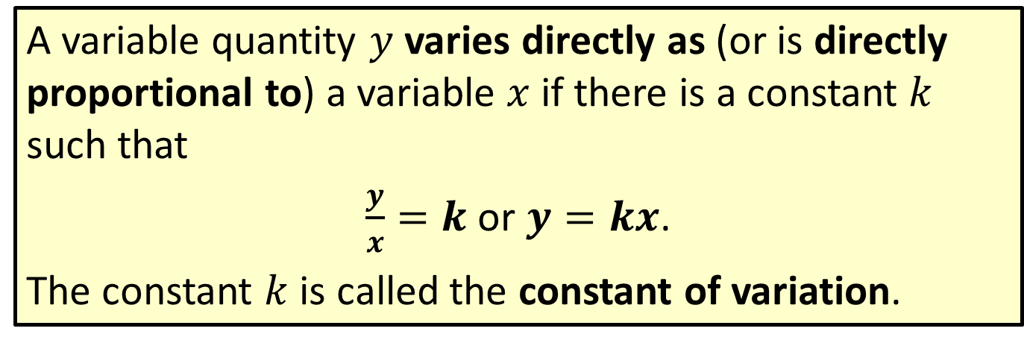
Definition: Direct Variation
A variable quantity $y$ varies directly as (or is directly proportional to) a variable $x$ if there is a constant $k$ such that
$\frac{y}{x}=k$ or $y=kx$.
The constant $k$ is called the constant of variation.

Slide 3



Example 1: Direct Variation
If $y$ varies directly as $x$, and $y=6$ when $x=2$,
find $y$ if $x=6$.
Solution
$$y=kx$$
$$6=2k$$
$$3=k$$
So $y=3x.$ Thus, if $x=6$, then $y=3∙6=18$.
The general formula for direct variation
Substitute the known values and solve for $k$.
Use this value for $k$ in the general formula.

Slide 4
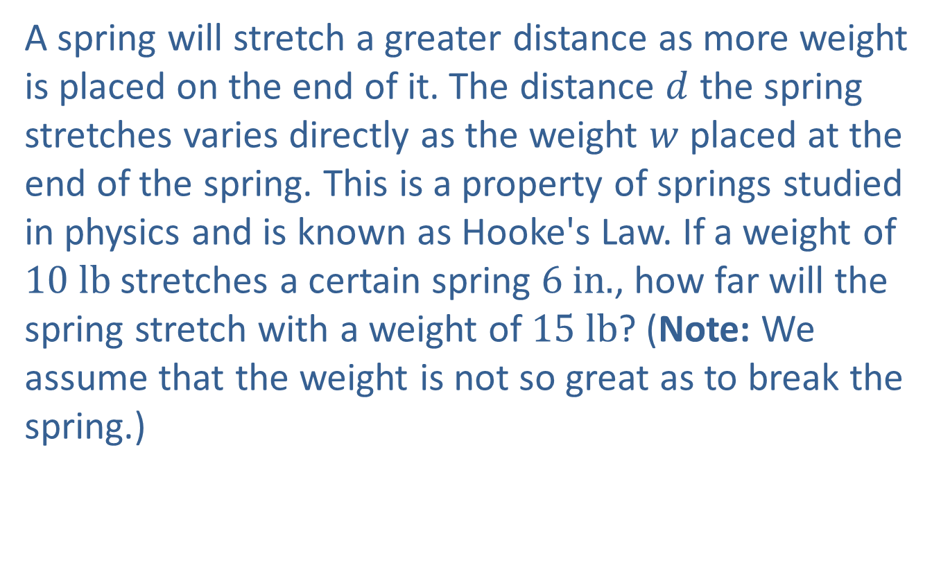
Example 2: Application: Direct Variation
A spring will stretch a greater distance as more weight is placed on the end of it. The distance $d$ the spring stretches varies directly as the weight $w$ placed at the end of the spring. This is a property of springs studied in physics and is known as Hooke's Law. If a weight of $10 lb$ stretches a certain spring $6 in.$, how far will the spring stretch with a weight of $15 lb$? (Note: We assume that the weight is not so great as to break the spring.)

Slide 5
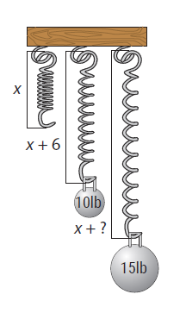
Example 2: Application: Direct Variation (cont.)

Slide 6
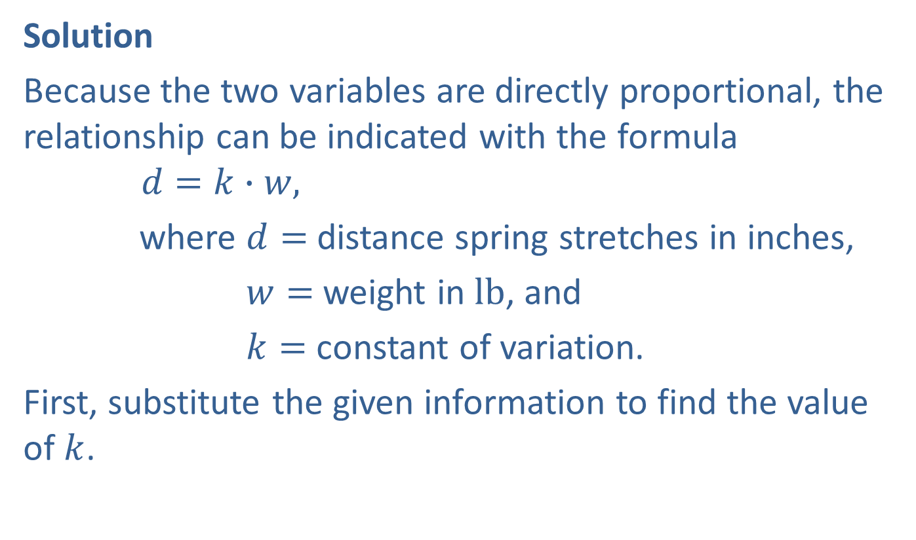
Example 2: Application: Direct Variation (cont.)
Solution
Because the two variables are directly proportional, the relationship can be indicated with the formula
$$d=k∙w,$$
where $d=$ distance spring stretches in inches,
$w=$ weight in $lb$, and
$k=$ constant of variation.
First, substitute the given information to find the value of $k$.

Slide 7

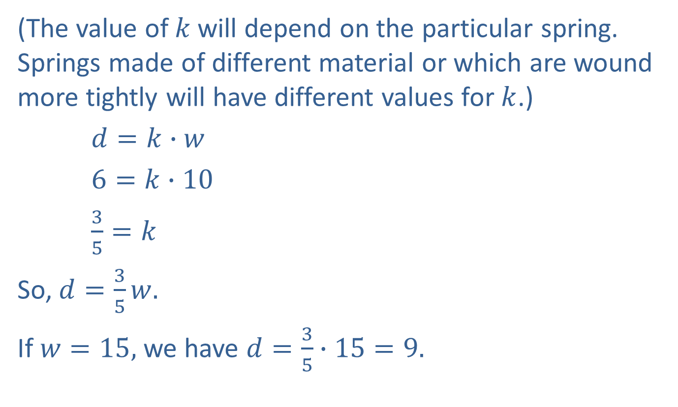

Example 2: Application: Direct Variation (cont.)
(The value of 𝑘 will depend on the particular spring. Springs made of different material or which are wound more tightly will have different values for $k$.)
$d=k∙w$
$6=k∙10$
$\frac{3}{5}=k$
So, $d=\frac{3}{5}w.$
If $w=15,$ we have $d=\frac{3}{5}∙15=9.$
Substitute the known values into the
formula.
The constant of variation is $\frac{3}{5} (or 0.6)$.
Use this value for $k$ in the general formula.

Slide 8

Example 2: Application: Direct Variation (cont.)
The spring will stretch $9$ $in$. if a weight of $15$ $lb$ is placed at its end.

Slide 9
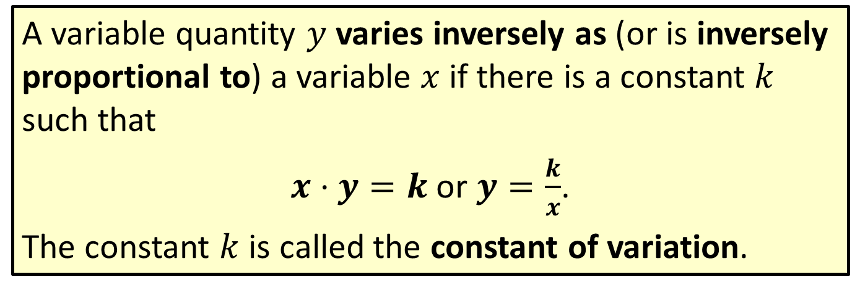
Definition: Inverse Variation
A variable quantity $y$ varies inversely as (or is inversely proportional to) a variable $x$ if there is a constant $k$ such that
$x⋅y=k$ or $y=\frac{k}{x}$.
The constant $k$ is called the constant of variation.

Slide 10



Example 3: Inverse Variation
If $y$ varies inversely as the cube of $x$, and $y=−1$ when $x=3$, find $y$ if $x=−3$.
Solution
$y=\frac{k}{x^{3}}$
$−1=\frac{k}{3^{3}}$
$−1=\frac{k}{27}$
$−27=k$
So $y=\frac{−27}{x^{3}}$.
The general formula for inverse variation
Substitute the known values and solve for $k$.
Use this value for $k$ in the general formula.

Slide 11

Example 3: Inverse Variation (cont.)
Thus, if $x=−3$, then $y=\frac{−27}{{(−3)}^{3}}=\frac{−27}{−27}=1$.

Slide 12
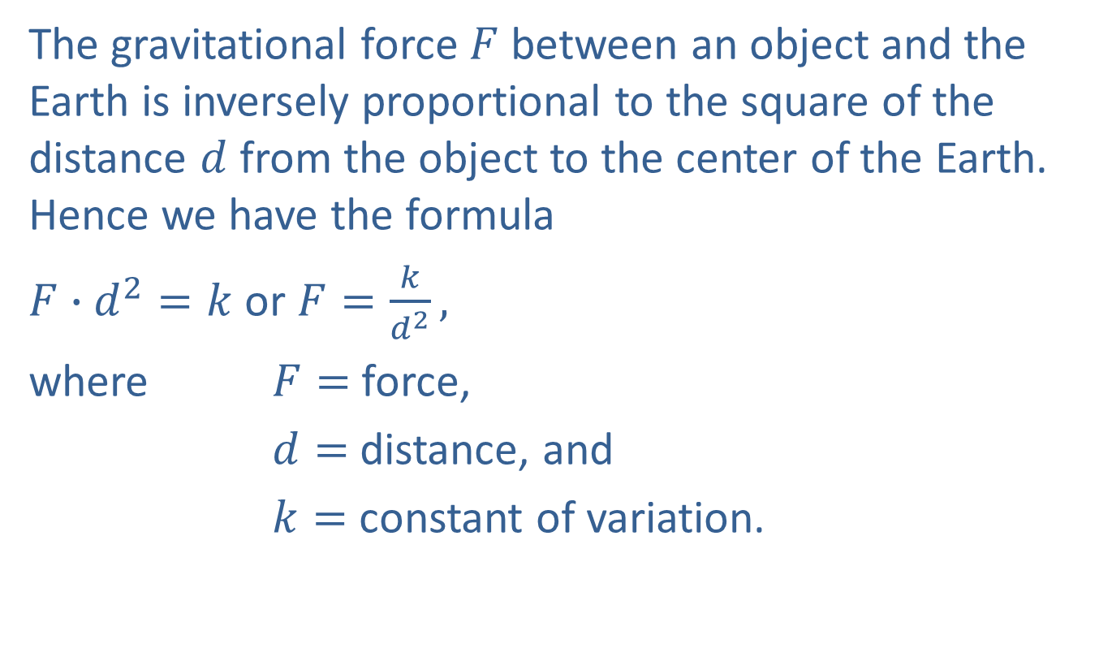
Example 4: Application: Inverse Variation
The gravitational force $F$ between an object and the Earth is inversely proportional to the square of the distance $d$ from the object to the center of the Earth. Hence we have the formula
$F∙d^{2}=k$ or $F=\frac{k}{d^{2}},$
where $F=$force,
$d=$ distance, and
$k=$ constant of variation.

Slide 13
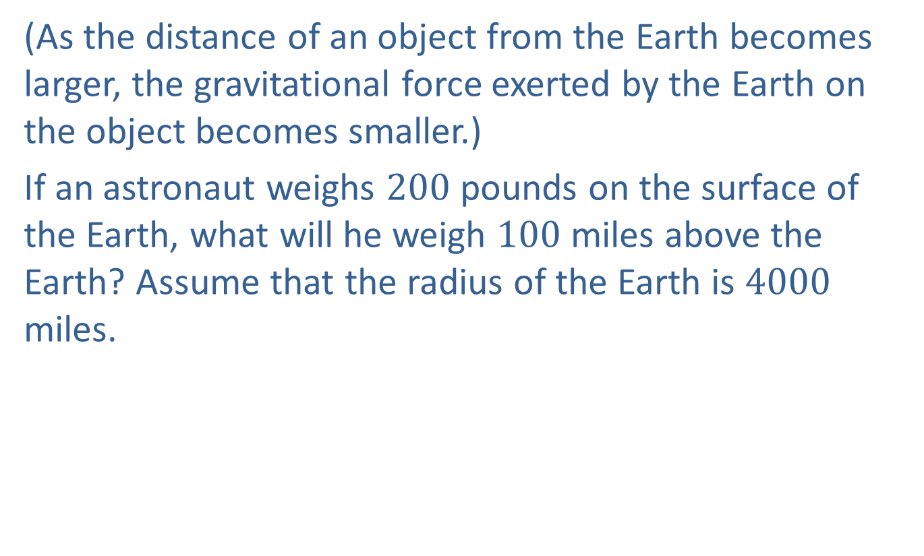
Example 4: Application: Inverse Variation (cont.)
(As the distance of an object from the Earth becomes larger, the gravitational force exerted by the Earth on the object becomes smaller.)
If an astronaut weighs $200$ pounds on the surface of the Earth, what will he weigh $100$ miles above the Earth? Assume that the radius of the Earth is $4000$ miles.

Slide 14

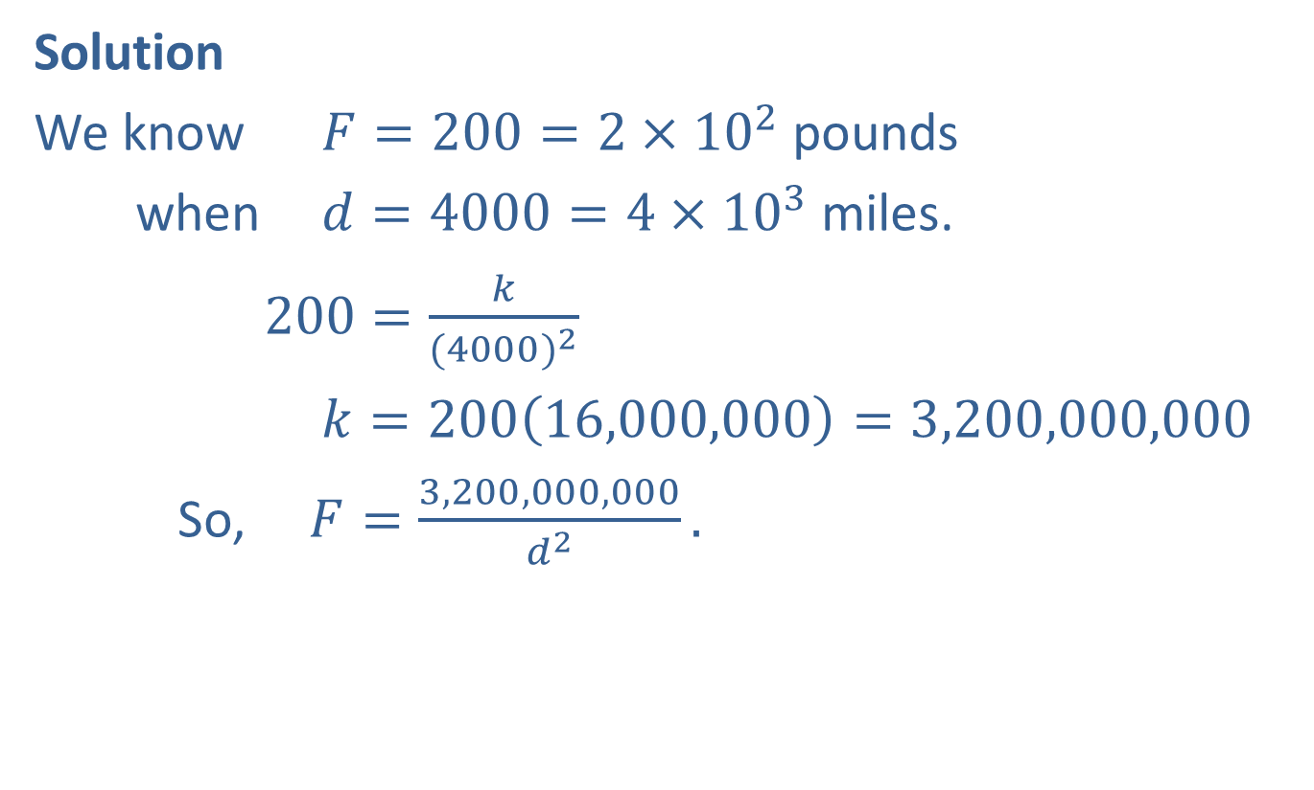
Example 4: Application: Inverse Variation (cont.)
Solution
We know $F=200=2×{10}^{2}$ pounds
when $d=4000=4×{10}^{3}$ miles.
$200=\frac{k}{{(4000)}^{2}}$
$k=200\left(16,000,000\right)=3,200,000,000$
So, $F=\frac{3,200,000,000}{d^{2}}.$
Substitute and solve for $k.$

Slide 15
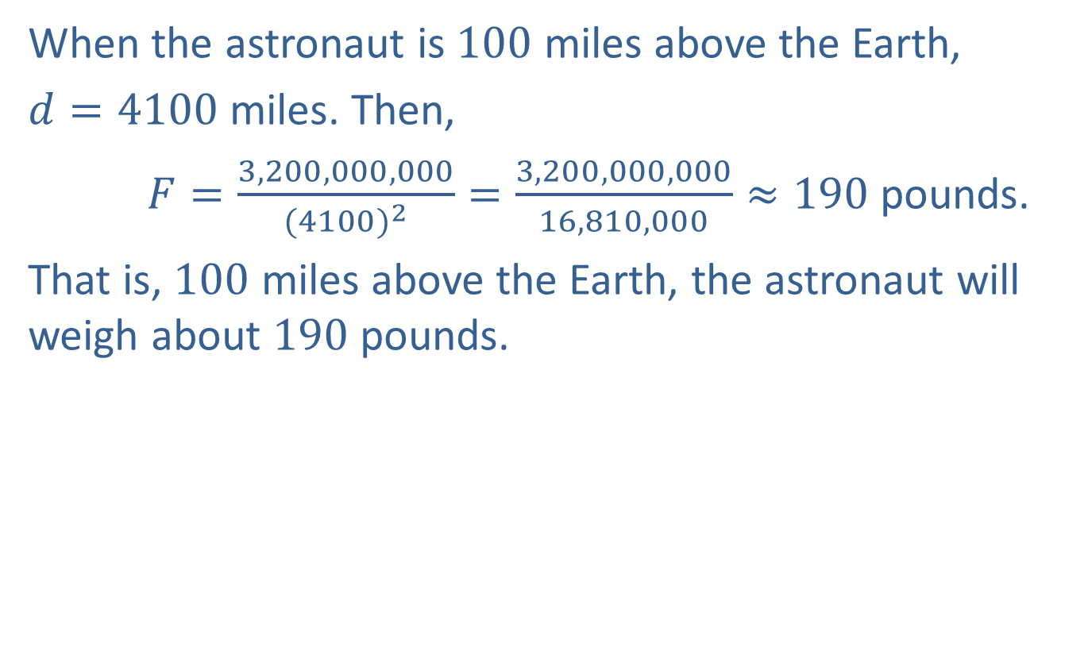
Example 4: Application: Inverse Variation (cont.)
When the astronaut is $100$ miles above the Earth,
$d=4100$ miles. Then,
$F=\frac{3,200,000,000}{{(4100)}^{2}}=\frac{3,200,000,000}{16,810,000}≈190$ pounds.
That is, $100$ miles above the Earth, the astronaut will weigh about $190$ pounds.

Slide 16

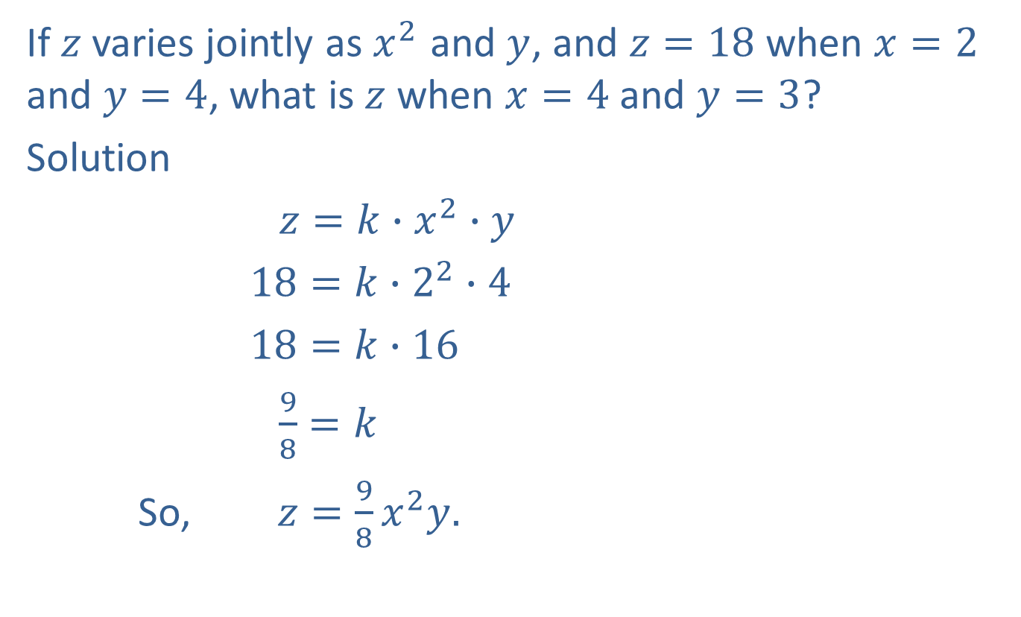

Example 5: Joint Variation
If $z$ varies jointly as $x^{2}$ and $y$, and $z=18$ when $x=2$ and $y=4$, what is $z$ when $x=4$ and $y=3$?
Solution
$z=k∙x^{2}∙y$
$18=k∙2^{2}∙4$
$18=k∙16$
$\frac{9}{8}=k$
So, $z=\frac{9}{8}x^{2}y.$
Substitute the known values and solve for $k$.
Substitute $\frac{9}{8}$ for $k$ in the general formula.

Slide 17

Example 5: Joint Variation (cont.)
If $x=4$ and $y=3,$ then
$$z=\frac{9}{8}∙4^{2}∙3$$
$$z=54.$$

Slide 18
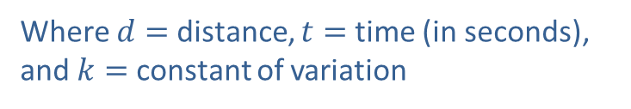
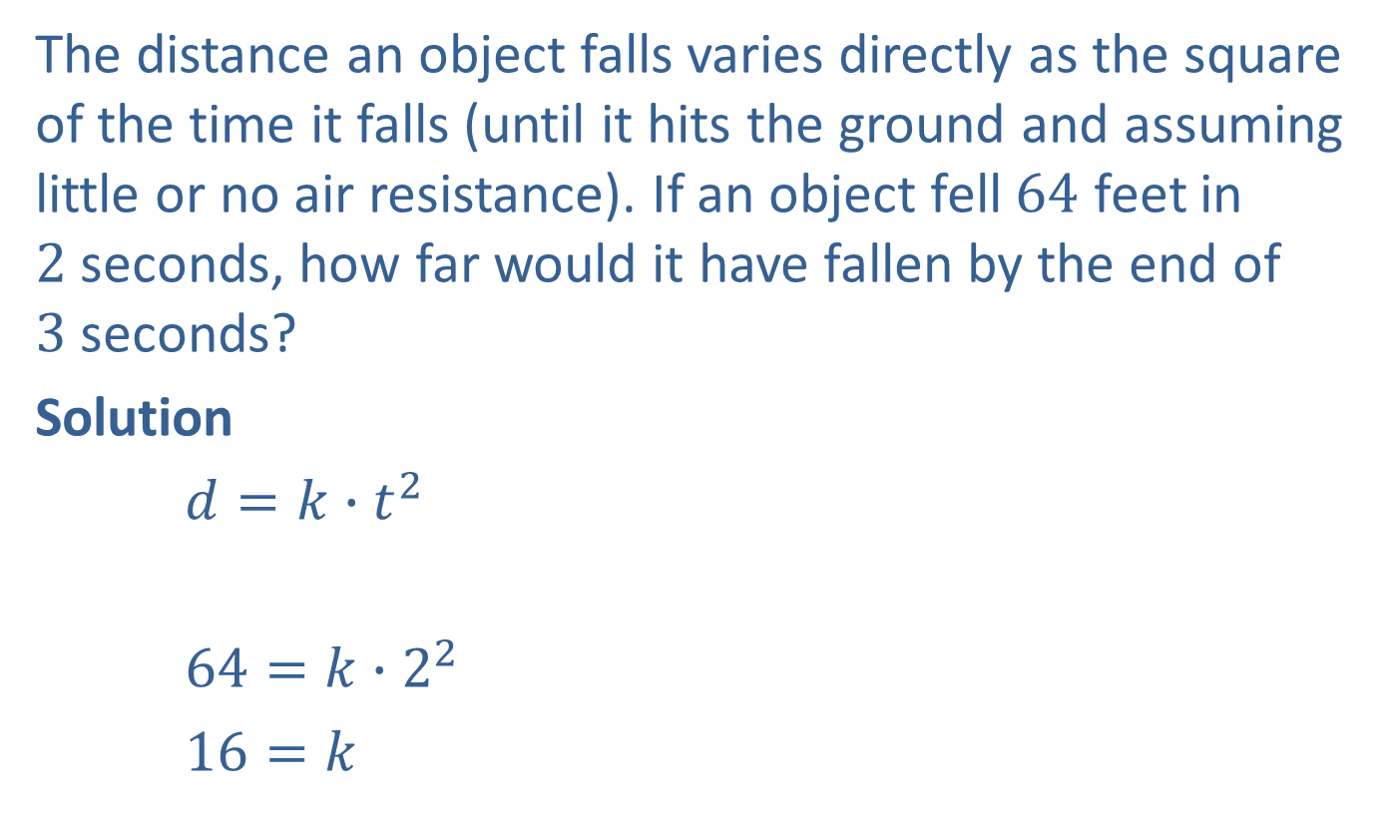

Example 6: Application: More Variation
The distance an object falls varies directly as the square of the time it falls (until it hits the ground and assuming little or no air resistance). If an object fell $64$ feet in
$2$ seconds, how far would it have fallen by the end of
$3$ seconds?
Solution
$d=k∙t^{2}$
$64=k∙2^{2}$
$16=k$
Where $d=$ distance, $t=$ time (in seconds),
and $k=$ constant of variation
Substitute the known values and solve for $k$.

Slide 19


Example 6: Application: More Variation (cont.)
So,$d=16t^{2}.$
If $t=3,$then
$d=16∙3^{2}$
$d=144.$
The object would have fallen $144$feet in $3$ seconds.
Substitute $16$ for $k$ in the general formula.

Slide 20
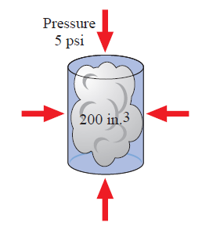

Example 7: Application: More Variation
The volume of a gas in a container varies inversely as the pressure on the gas. If a gas has a volume of
$200$ cubic inches under a pressure of $5$ pounds per square inch, what will be its volume if the pressure is increased to $8$ pounds per square inch?

Slide 21
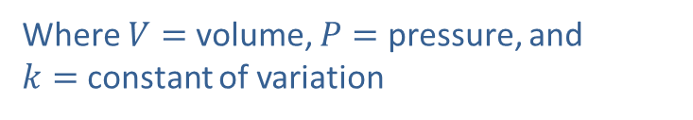



Example 7: Application: More Variation (cont.)
Solution
$V=\frac{k}{P}$
$200=\frac{k}{5}$
$k=1000$
So, $V=\frac{1000}{P}$
$V=\frac{1000}{8}=125.$
The volume will be $125$ cubic inches.
Where $V=$ volume, $P=$ pressure, and
$k=$ constant of variation
Substitute the known values and solve for $k$.
Substitute $1000$ for $k$ in the general formula.

Slide 22
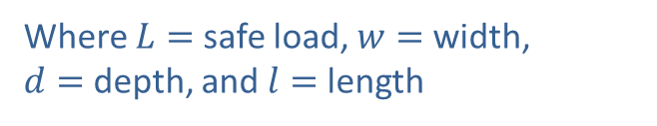
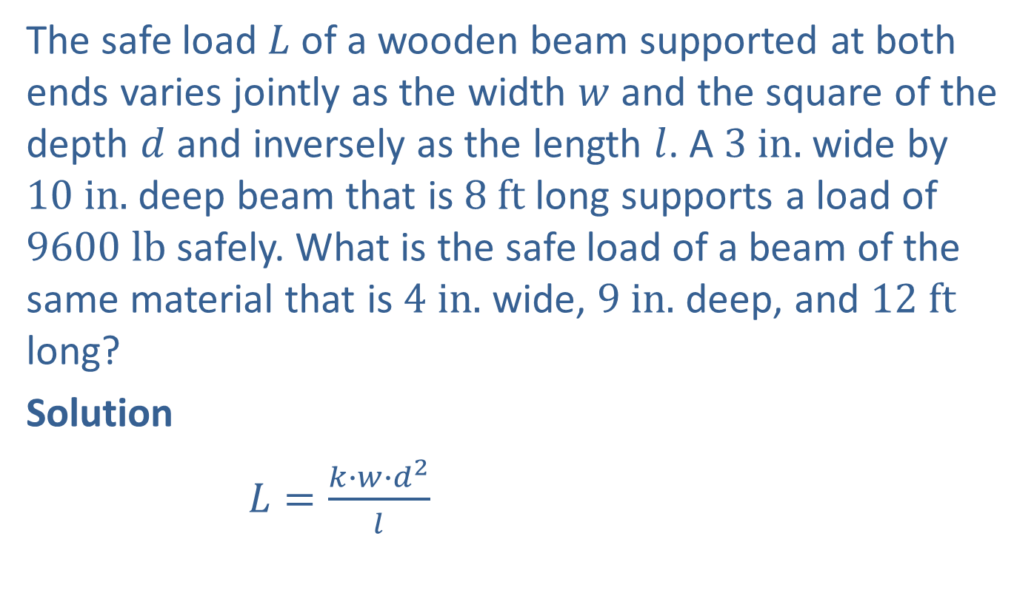
Example 8: Application: More Variation
The safe load $L$ of a wooden beam supported at both ends varies jointly as the width $w$ and the square of the depth $d$ and inversely as the length $l$. A $3 in.$ wide by $10 in.$ deep beam that is $8 ft$ long supports a load of $9600 lb$ safely. What is the safe load of a beam of the same material that is $4 in.$ wide, $9 in.$ deep, and $12 ft$ long?
Solution
$L=\frac{k∙w∙d^{2}}{l}$
Where $L=$ safe load, $w=$ width,
$d=$ depth, and $l=$length

Slide 23

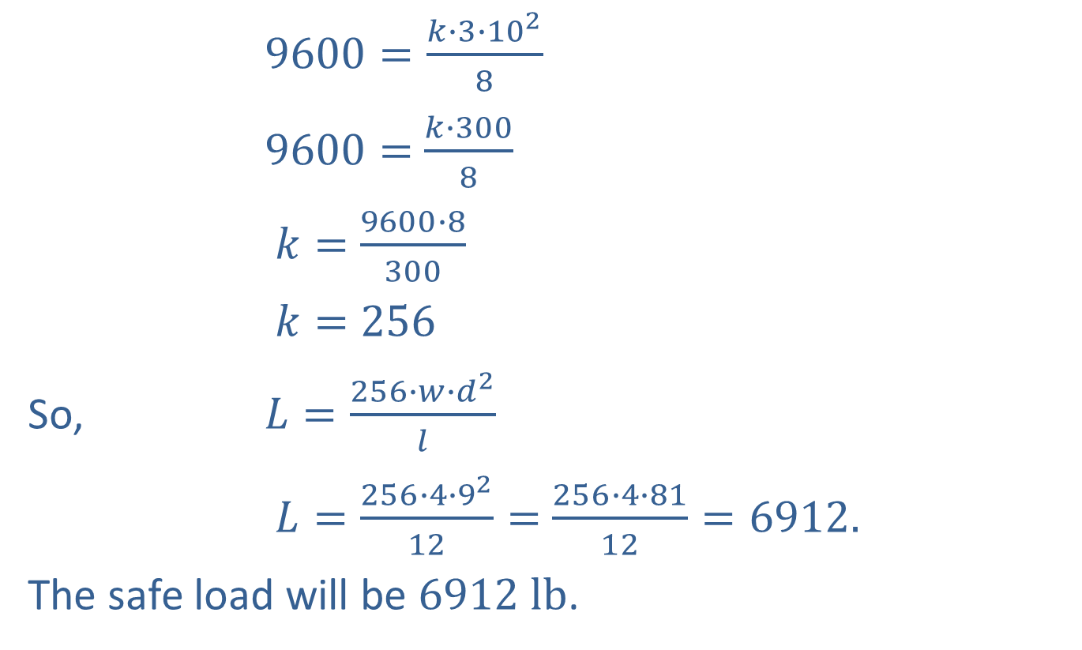

Example 8: Application: More Variation (cont.)
$9600=\frac{k∙3∙{10}^{2}}{8}$
$9600=$ $\frac{k∙300}{8}$
$k=$ $\frac{9600∙8}{300}$
$k=$ $256$
So, $L=\frac{256∙w∙d^{2}}{l}$
$L=\frac{256∙4∙9^{2}}{12}=$ $\frac{256∙4∙81}{12}=6912.$
The safe load will be $6912 lb$.
Substitute the known values and solve for $k$.
Substitute $256$ for $k$ in the general formula.

