Slide 1
Section 2.7
Solving Linear Inequalities in One Variable

Slide 2
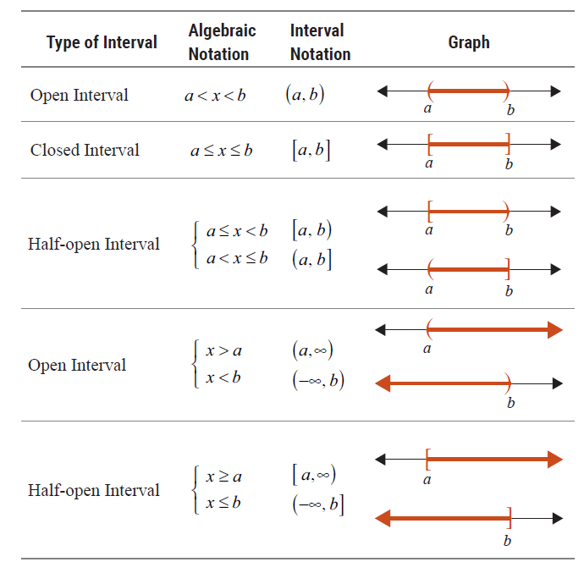
Table 1

Slide 3
Note
The symbol for infinity ∞ (or −∞ ) is not a number. It is used to indicate that the interval is to include all real numbers from some point on (either in the positive direction or the negative direction) without end.

Slide 4


Example 1: Graphing Intervals
Graph the open interval $(3,∞)$.
Solution

Slide 5


Example 2: Graphing Intervals
Graph the half-open interval $0<x≤4$.
Solution

Slide 6

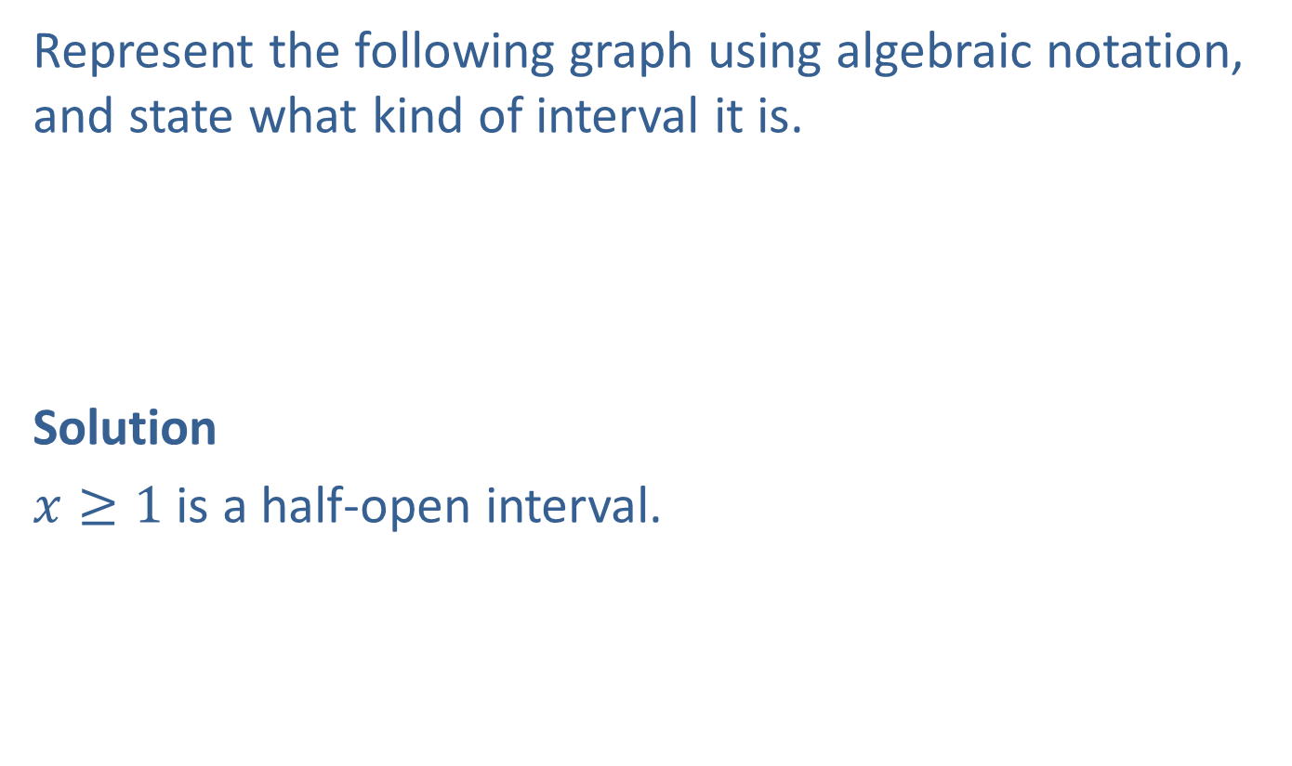
Example 3: Graphing Intervals
Represent the following graph using algebraic notation, and state what kind of interval it is.
Solution
$x≥1$ is a half-open interval.

Slide 7

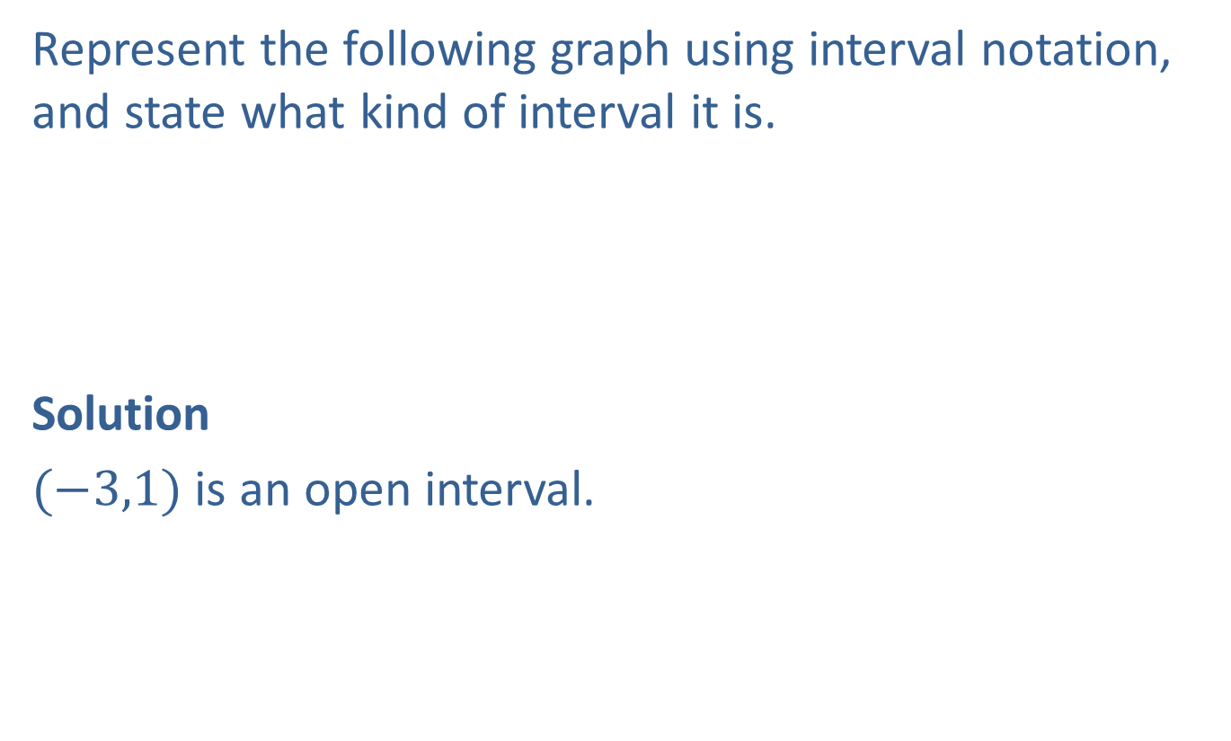
Example 4: Graphing Intervals
Represent the following graph using interval notation, and state what kind of interval it is.
Solution
$(−3,1)$ is an open interval.

Slide 8
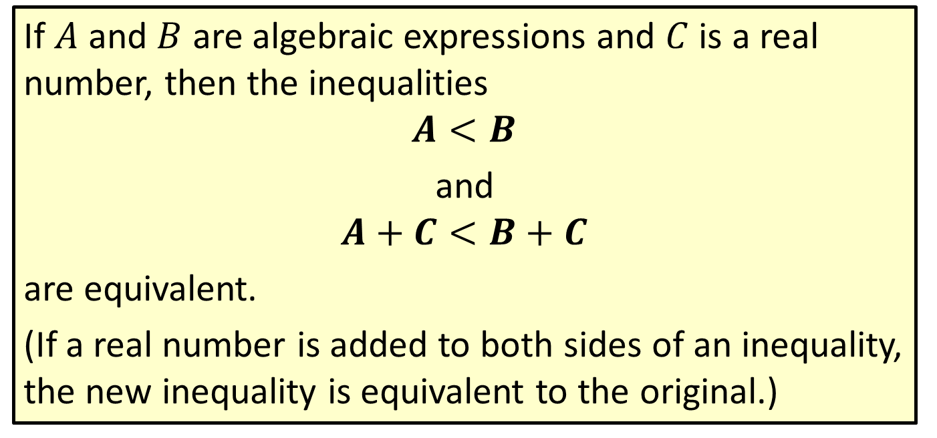
Properties: Addition Principle for Solving Linear Inequalities
If $A$ and $B$ are algebraic expressions and $C$ is a real number, then the inequalities
$$A<B$$
and
$$A+C<B+C$$
are equivalent.
(If a real number is added to both sides of an inequality, the new inequality is equivalent to the original.)

Slide 9

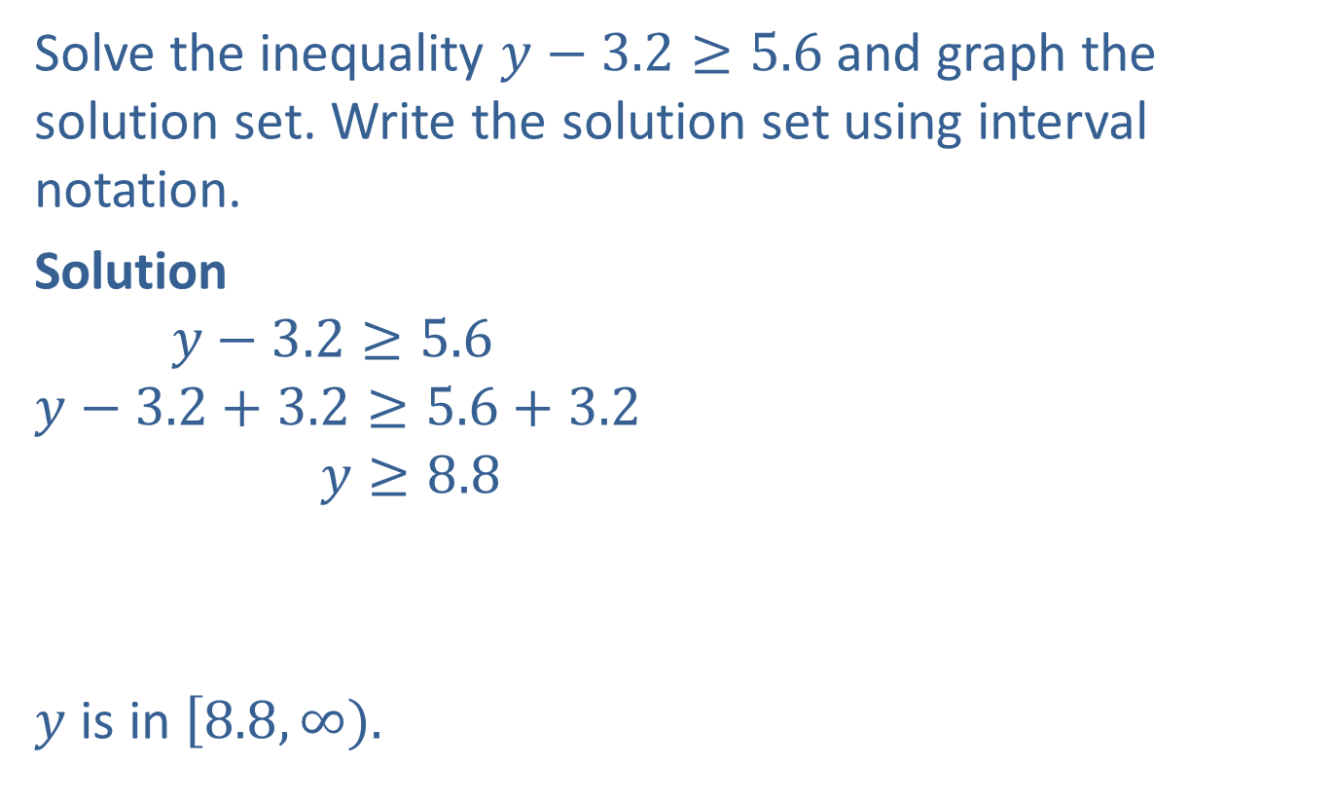

Example 5: Solving an Inequality and Graphing the Solution Set
Solve the inequality $y−3.2≥5.6$ and graph the solution set. Write the solution set using interval notation.
Solution
$$y−3.2≥5.6$$
$$y−3.2+3.2≥5.6+3.2$$
$$y≥8.8$$
$y$ is in $\left[8.8,∞).\right.$
Add $3.2$ to both sides.
Simplify.
Note that the interval is a half-open interval.

Slide 10


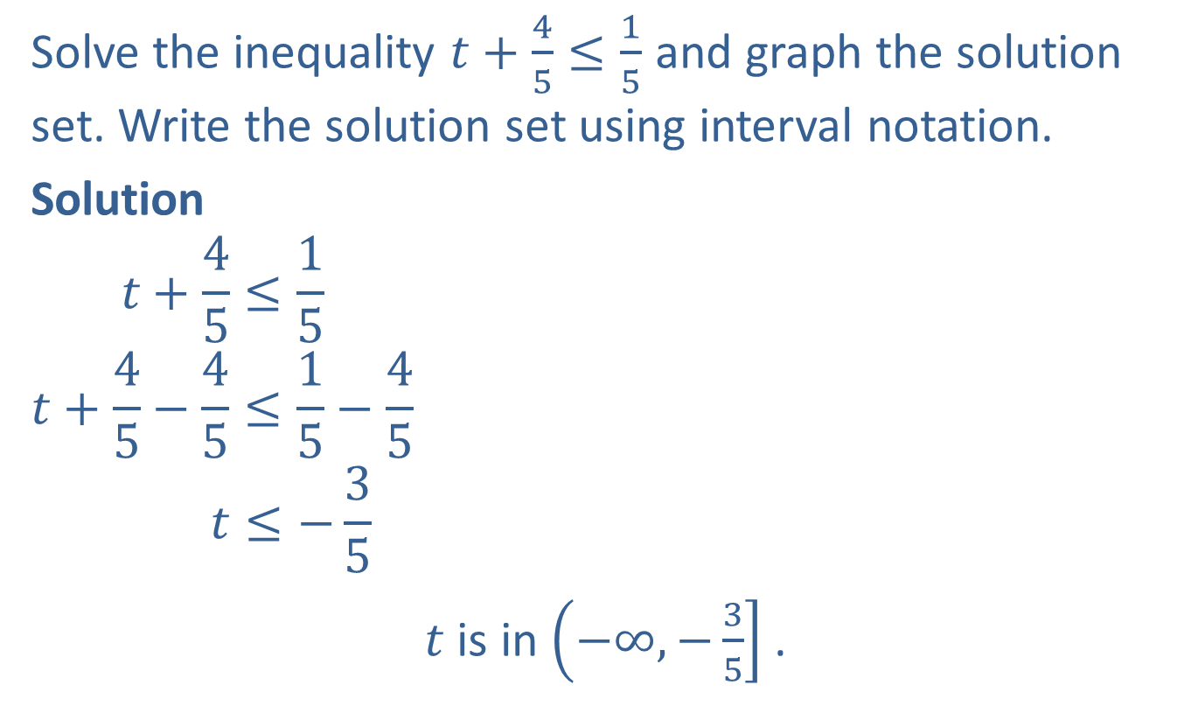
Example 6: Solving an Inequality and Graphing the Solution Set
Solve the inequality $t+\frac{4}{5}≤\frac{1}{5}$ and graph the solution set. Write the solution set using interval notation.
Solution
$$t+\frac{4}{5}≤\frac{1}{5}$$
$$t+\frac{4}{5}−\frac{4}{5}≤\frac{1}{5}−\frac{4}{5}$$
$$t≤−\frac{3}{5}$$
$t$ is in $\left(−∞,−\left.\frac{3}{5}\right] \right.$.
Add $−\frac{4}{5}$ to both sides.
Simplify.
Note that the interval is a half-open interval.

Slide 11
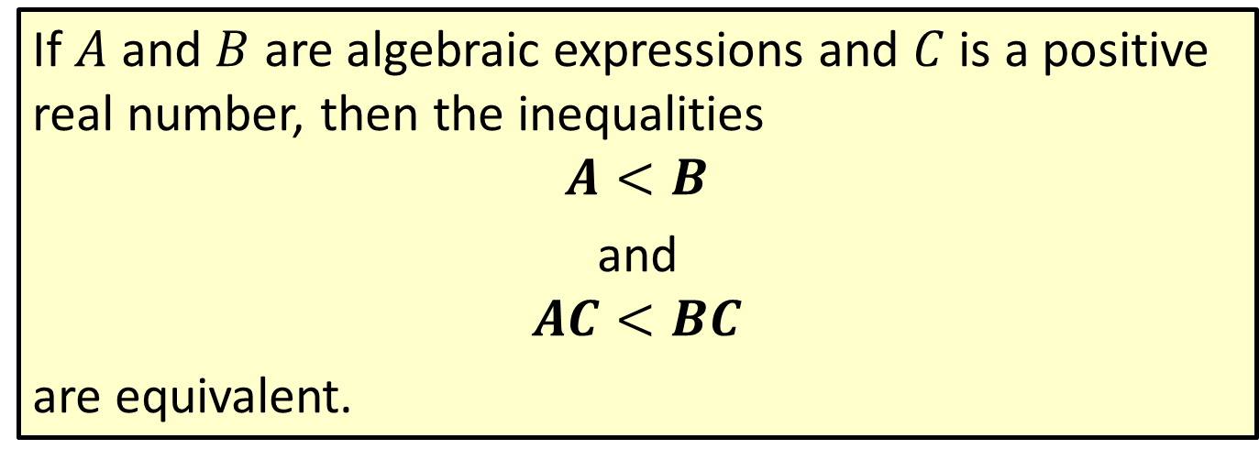
Properties: Multiplication Principle for Solving Linear Inequalities
If $A$ and $B$ are algebraic expressions and $C$ is a positive real number, then the inequalities
$$A<B$$
and
$$AC<BC$$
are equivalent.

Slide 12
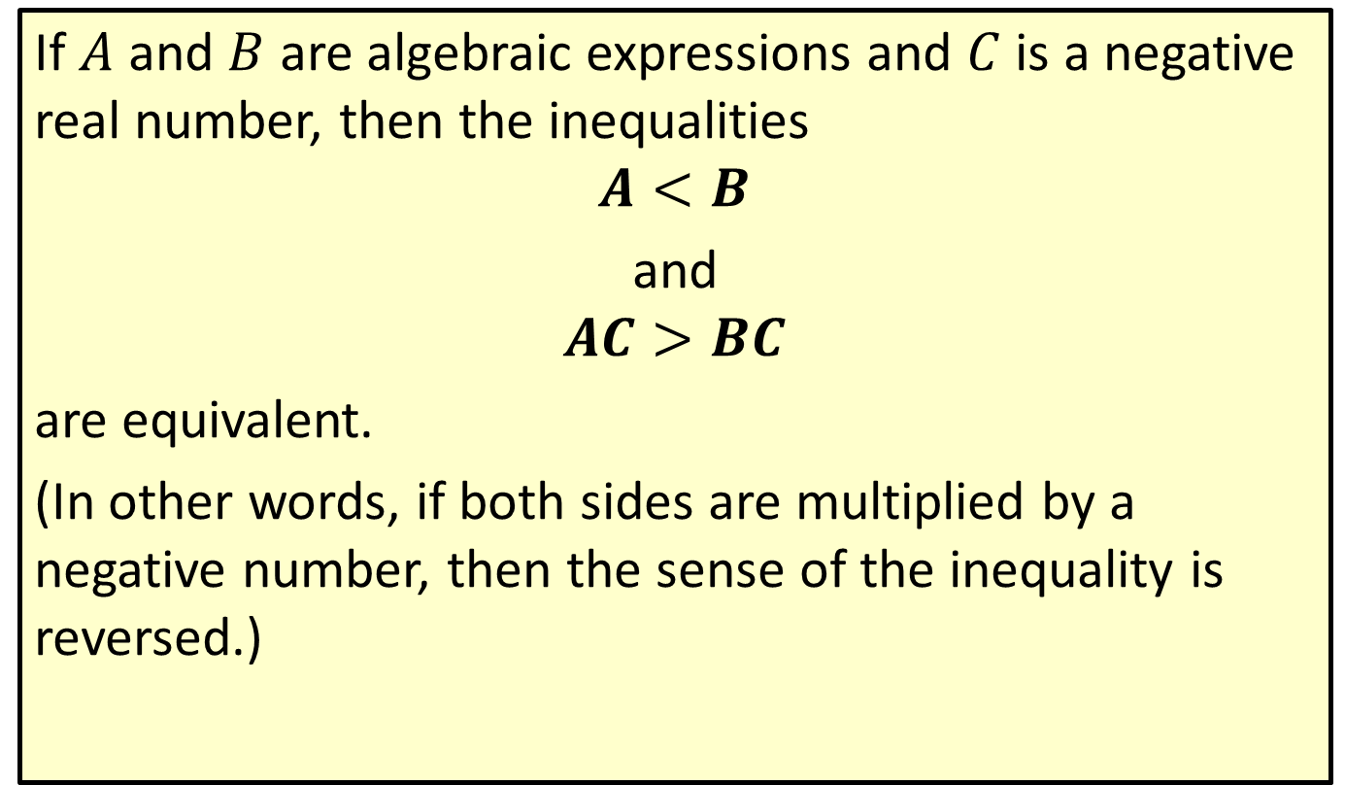
Properties: Multiplication Principle for Solving Linear Inequalities (cont.)
If $A$ and $B$ are algebraic expressions and $C$ is a negative real number, then the inequalities
$$A<B$$
and
$$AC>BC$$
are equivalent.
(In other words, if both sides are multiplied by a negative number, then the sense of the inequality is reversed.)

Slide 13


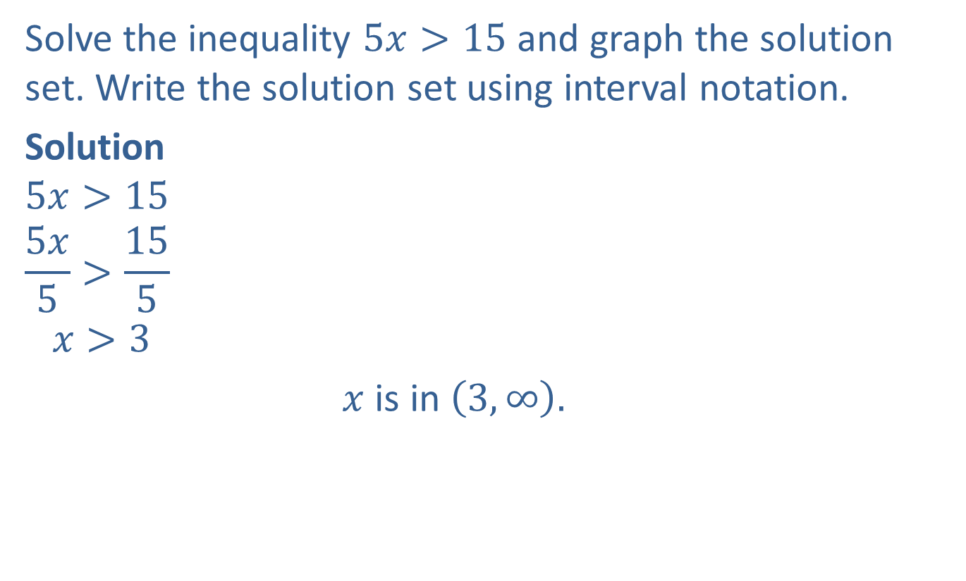
Example 7: Solving an Inequality and Graphing the Solution Set
Solve the inequality $5x>15$ and graph the solution set. Write the solution set using interval notation.
Solution
$$5x>15$$
$$\frac{5x}{5}>\frac{15}{5}$$
$$x>3$$
$x$ is in $\left(3,∞\right).$
Divide both sides by $5.$
Simplify.
Note that the interval is an open interval.

Slide 14


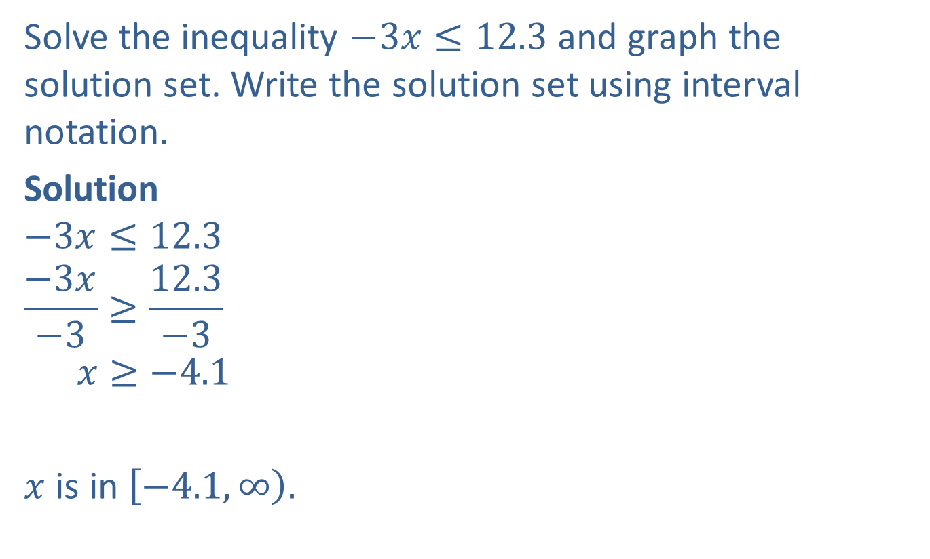
Example 8: Solving an Inequality and Graphing the Solution Set
Solve the inequality $−3x≤12.3$ and graph the solution set. Write the solution set using interval notation.
Solution
$$−3x≤12.3$$
$$\frac{−3x}{−3}≥\frac{12.3}{−3}$$
$$x≥−4.1$$
$x$ is in $\left[−4.1, \left.∞\right)\right..$
Divide both sides by $−3.$
Simplify.
Note that the interval is a half-open interval.

Slide 15
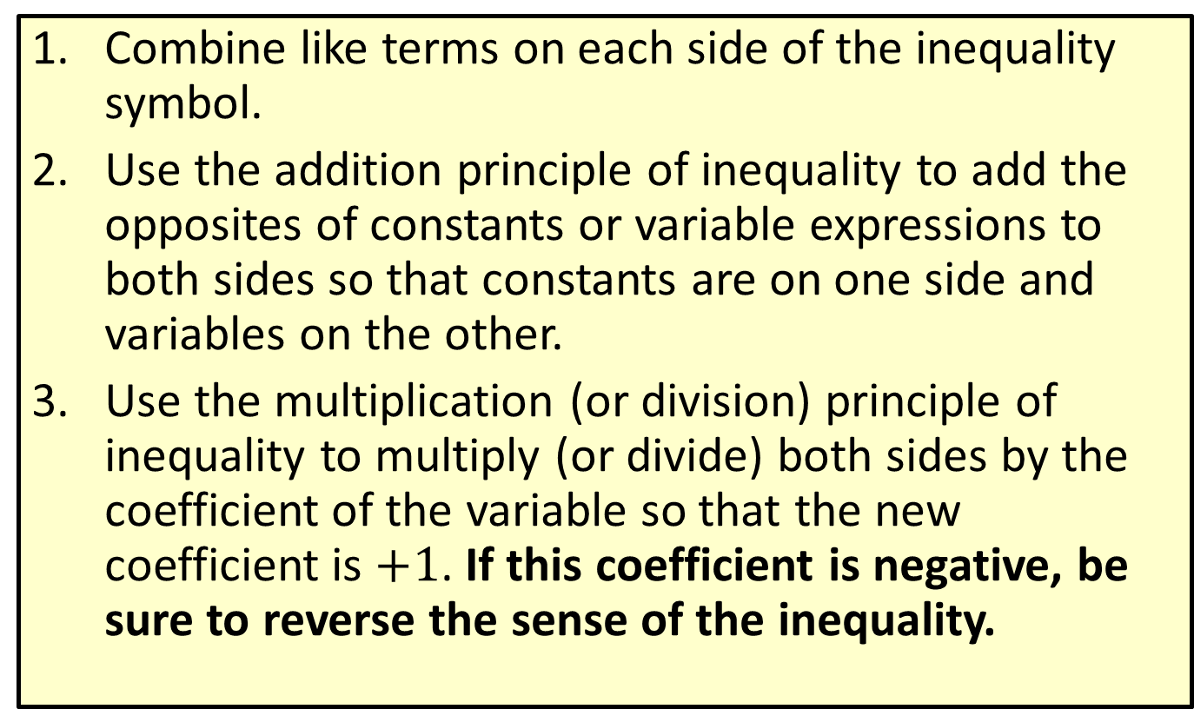
Procedure: Steps for Solving Linear Inequalities
​Combine like terms on each side of the inequality symbol.
Use the addition principle of inequality to add the opposites of constants or variable expressions to both sides so that constants are on one side and variables on the other.
​Use the multiplication (or division) principle of inequality to multiply (or divide) both sides by the coefficient of the variable so that the new coefficient is $+1$. If this coefficient is negative, be sure to reverse the sense of the inequality.

Slide 16
Procedure: Steps for Solving Linear Inequalities (cont.)
​​A quick (and generally satisfactory) check is to select any one number in your solution set and substitute it into the original inequality. If the statement is false, you need to look for an error in your solution.

Slide 17

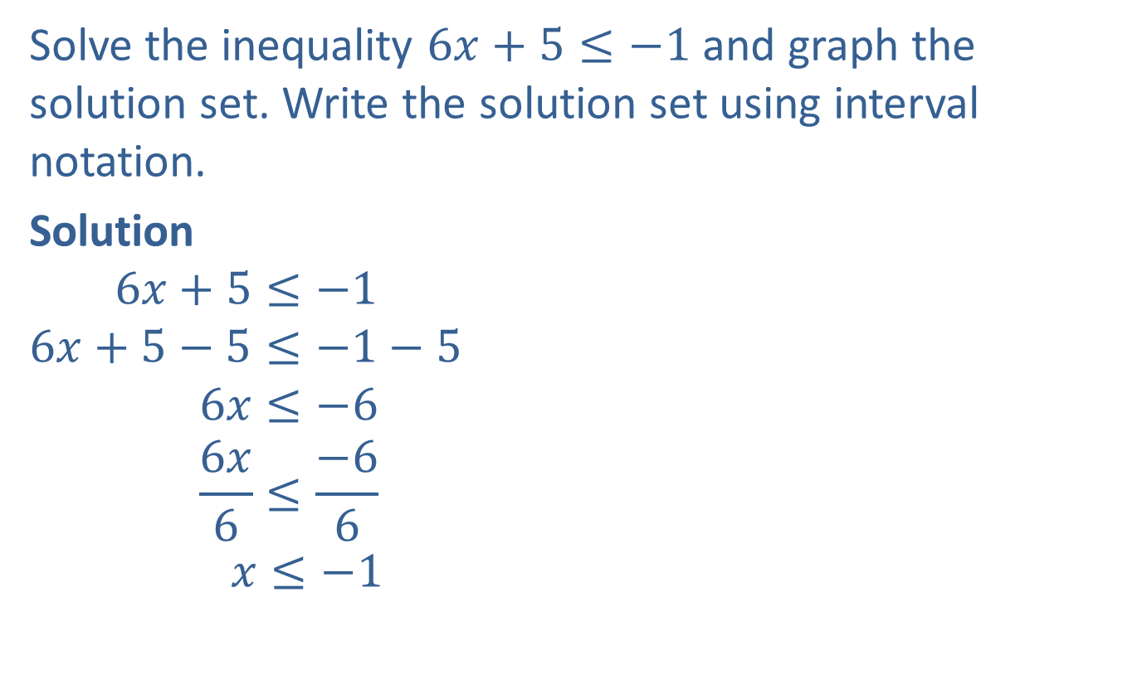

Example 9: Solving Linear Inequalities
Solve the inequality $6x+5≤−1$ and graph the solution set. Write the solution set using interval notation.
Solution
$$6x+5≤−1$$
$$6x+5−5≤−1−5$$
$$6x≤−6$$
$$\frac{6x}{6}≤\frac{−6}{6}$$
$$x≤−1$$
Write the inequality.
Add $−5$ to both sides.
Simplify.
Divide both sides by $6$.
Simplify.

Slide 18

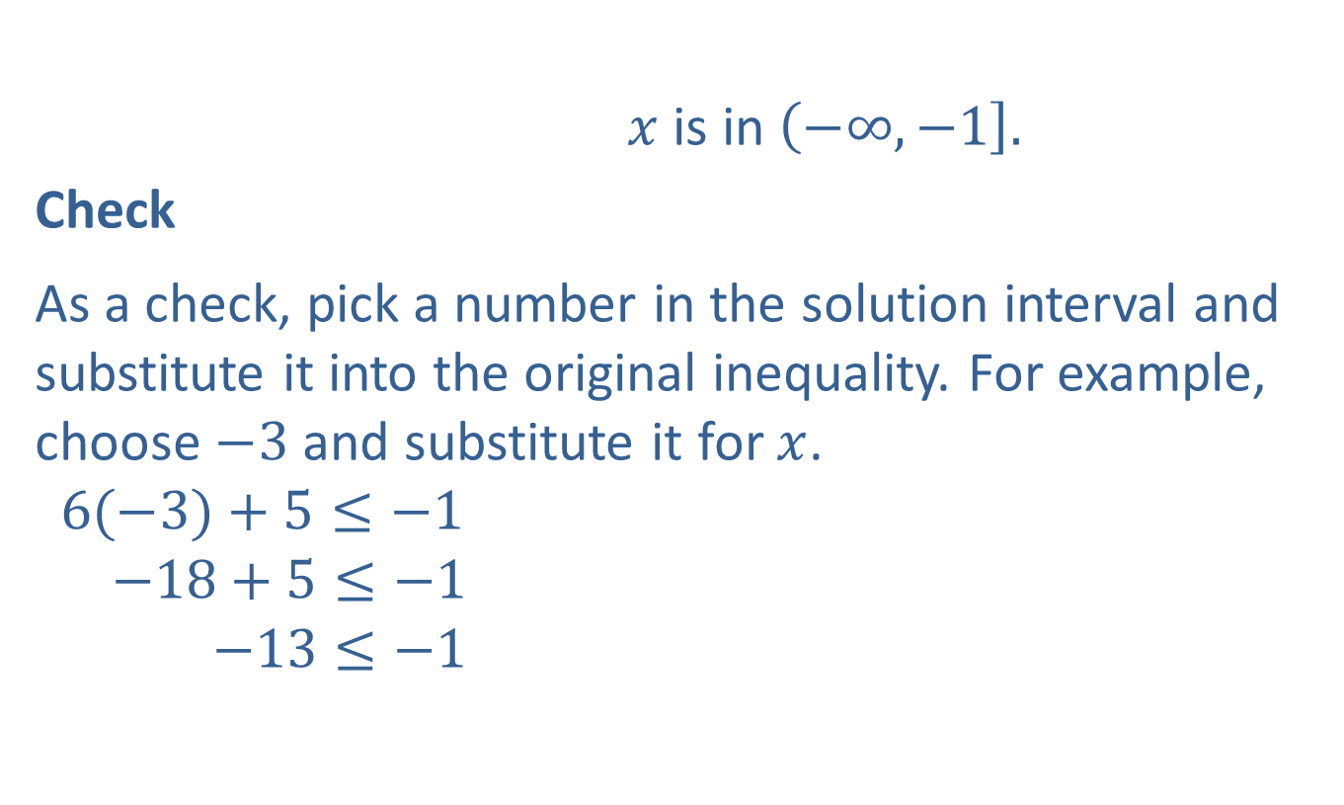
Example 9: Solving Linear Inequalities (cont.)
$x$ is in $\left(−∞,\left.−1\right].\right.$
Check
As a check, pick a number in the solution interval and substitute it into the original inequality. For example, choose $−3$ and substitute it for $x$.
$$6(−3)+5≤−1$$
$$−18+5≤−1$$
$$−13≤−1$$
?
Note that not every number in the interval can be checked, but a true result, as shown here, does give some confidence in the solution interval.
?
True statement

Slide 19

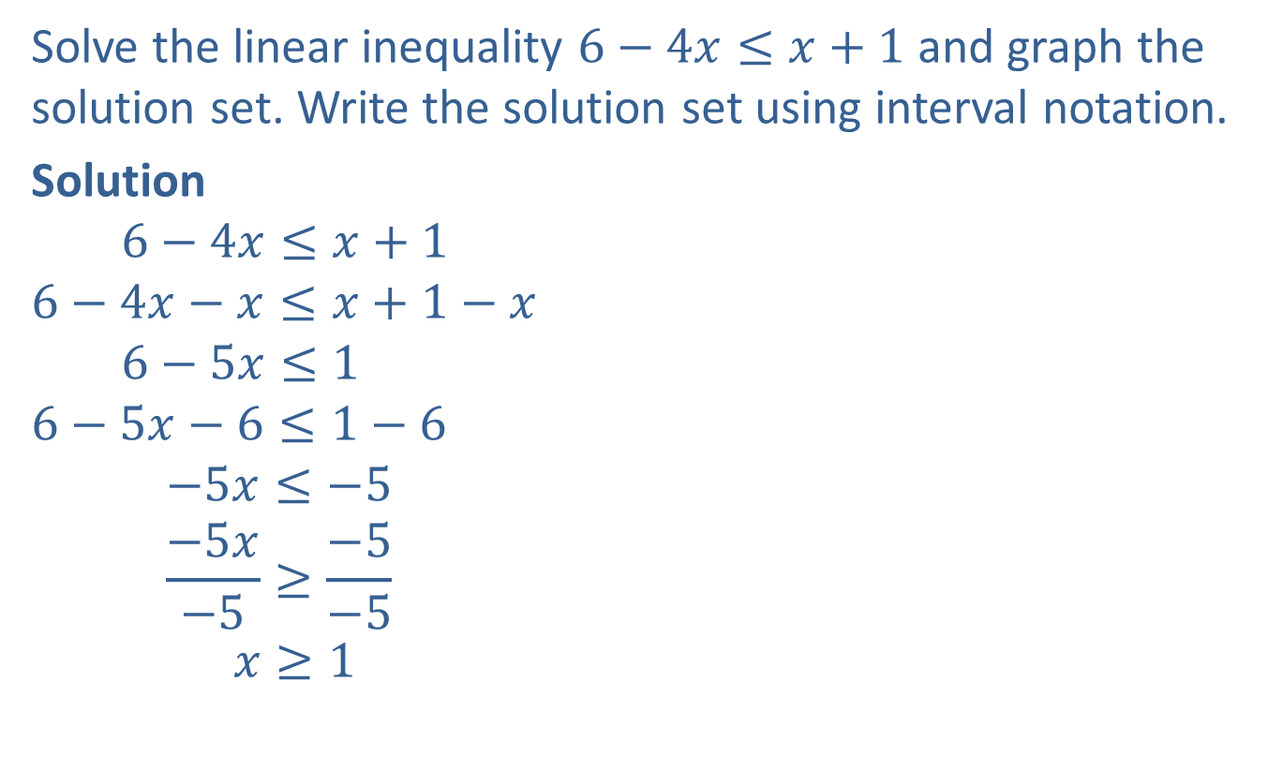


Example 10: Solving Linear Inequalities
Solve the linear inequality $6−4x≤x+1$ and graph the solution set. Write the solution set using interval notation.
Solution
$$6−4x≤x+1$$
$$6−4x−x≤x+1−x$$
$$6−5x≤1$$
$$6−5x−6≤1−6$$
$$−5x≤−5$$
$$\frac{−5x}{−5}≥\frac{−5}{−5}$$
$$x≥1$$
Write the inequality.
Add $−x$ to both sides.
Simplify.
Add $−6$ to both sides.
Simplify.
Divide both sides by $−5$. Note that the inequality sign is reversed because of division by a negative number!
Simplify.

Slide 20


Example 10: Solving Linear Inequalities (cont.)
$x$ is in $\left[1,\left.∞\right).\right.$

Slide 21

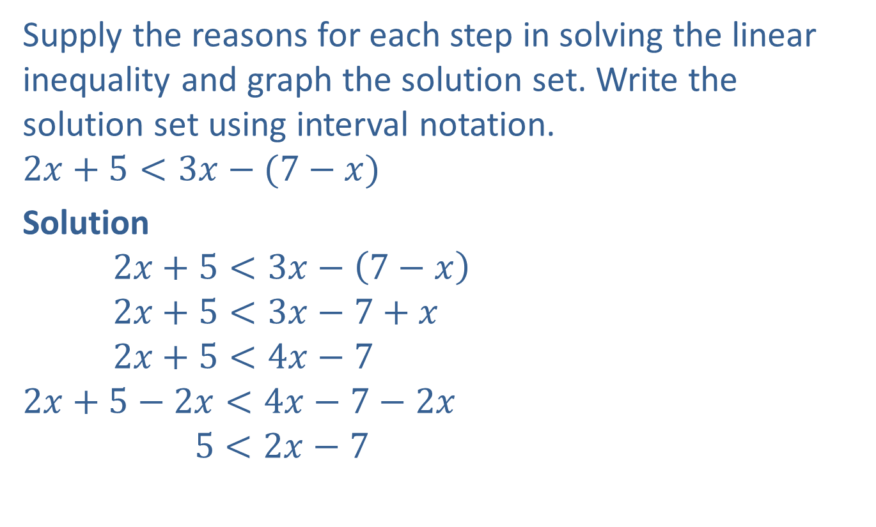
Completion Example 11: Solving Linear Inequalities
Supply the reasons for each step in solving the linear inequality and graph the solution set. Write the solution set using interval notation.
$$2x+5<3x−(7−x)$$
Solution
$$2x+5<3x−\left(7−x\right)$$
$$2x+5<3x−7+x$$
$$2x+5<4x−7$$
$$2x+5−2x<4x−7−2x$$
$$5<2x−7$$
Write the inequality.
Distribute the negative sign.
Combine like terms.
Add $−2x$to both sides.
Simplify.

Slide 22




Completion Example 11: Solving Linear Inequalities (cont.)
$$5+7<2x−7+7$$
$$12<2x$$
$$\frac{12}{2}<\frac{2x}{2}$$
$$6<x$$
Graph the interval on a number line.
$x$ is in $\underline{(6,∞)}.$
Add $7$to both sides.
Simplify.
Divide both sides by $2$.
Simplify.

Slide 23

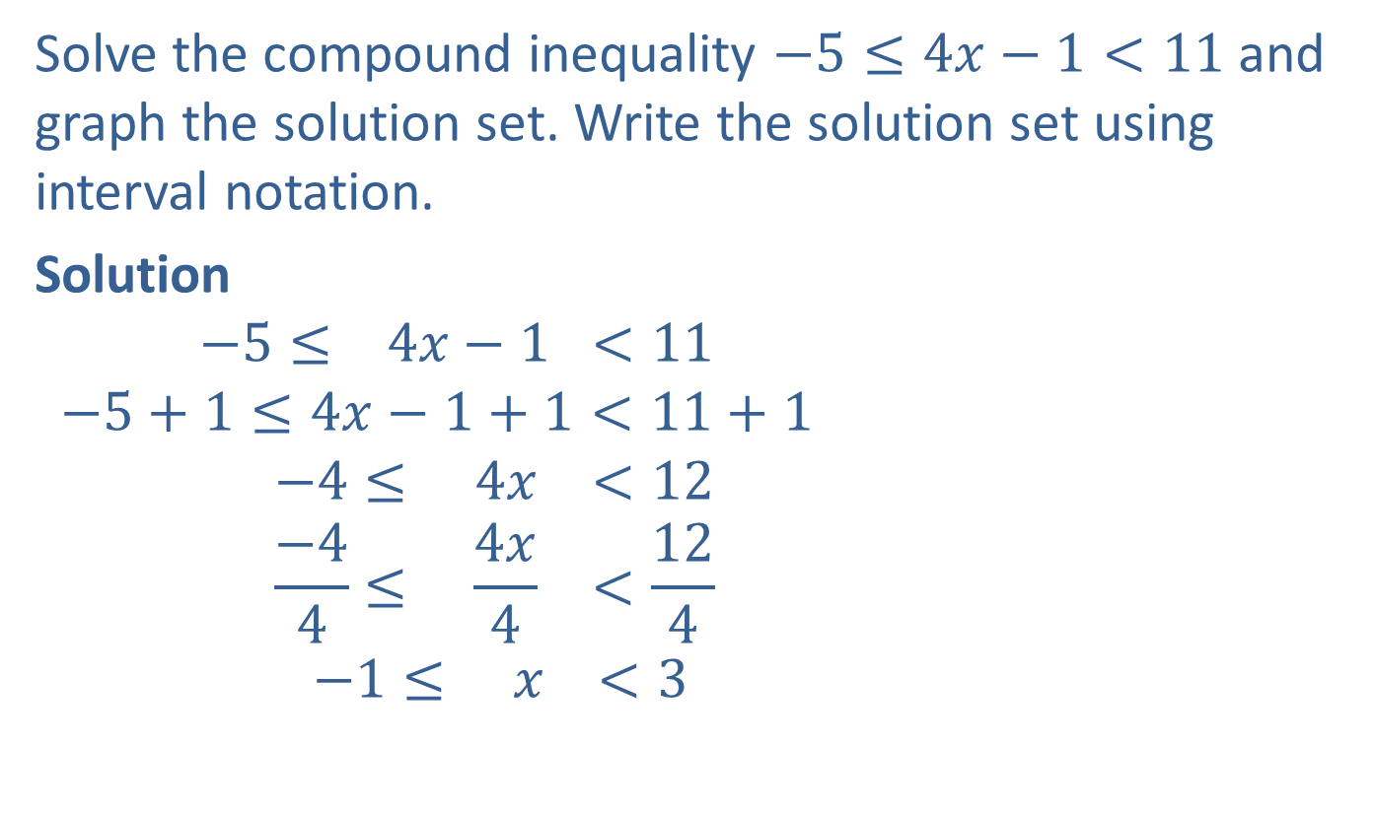
Example 12: Solving Compound Inequalities
Solve the compound inequality $−5≤4x−1<11$ and graph the solution set. Write the solution set using interval notation.
Solution
$$−5≤ 4x−1 <11$$
$$−5+1≤4x−1+1<11+1$$
$$−4≤ 4x <12$$
$$\frac{−4}{4}≤ \frac{4x}{4} <\frac{12}{4}$$
$$−1≤ x <3$$
Write the inequality.
Add 1 to each part.
Simplify.
Divide each part by $4$.
Simplify.

Slide 24


Example 12: Solving Compound Inequalities (cont.)
The solution set is the half-open interval $\left[−1,\left.3\right).\right.$

Slide 25
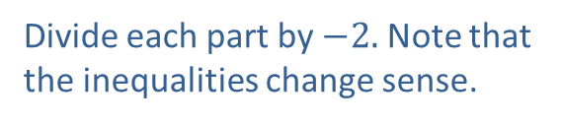
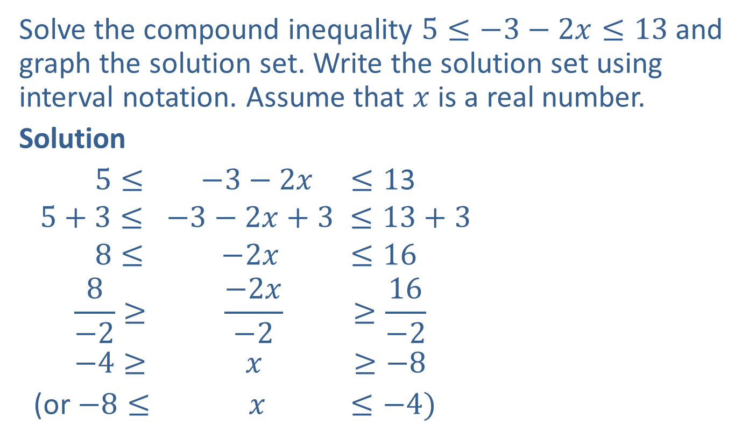
Example 13: Solving Compound Inequalities
Solve the compound inequality $5≤−3−2x≤13$and graph the solution set. Write the solution set using interval notation. Assume that $x$ is a real number.
Solution
$5≤ −3−2x ≤1$3
$$5+3≤ −3−2x+3 ≤13+3$$
$$8≤ −2x ≤16$$
$$\frac{8}{−2}≥ \frac{−2x}{−2} ≥\frac{16}{−2}$$
$$−4≥ x ≥−8$$
(or $−8≤ x ≤−4)$
Write the inequality.
Add 3 to each part.
Simplify.
Divide each part by $−2.$ Note that the inequalities change sense.
Simplify.

Slide 26


Example 13: Solving Compound Inequalities (cont.)
The solution set is the closed interval $\left[−8,−4\right]$.

Slide 27

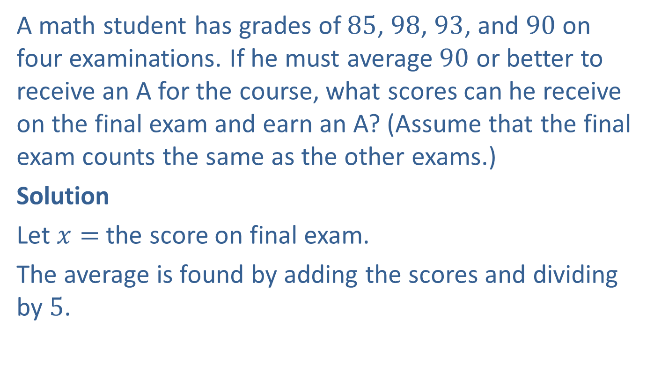
Example 14: Application: Using Inequalities
A math student has grades of $85$, $98$, $93$, and $90$ on four examinations. If he must average $90$ or better to receive an A for the course, what scores can he receive on the final exam and earn an A? (Assume that the final exam counts the same as the other exams.)
Solution
Let $x=$ the score on final exam.
The average is found by adding the scores and dividing by $5$.

Slide 28

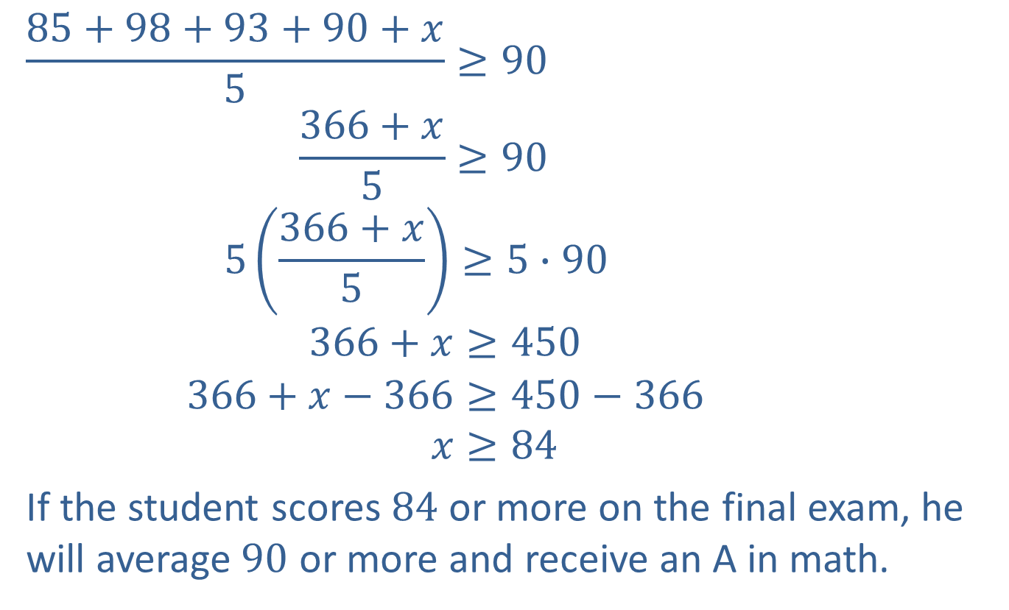

Example 14: Application: Using Inequalities (cont.)
$$\frac{85+98+93+90+x}{5}≥90$$
$$\frac{366+x}{5}≥90$$
$$5\left(\frac{366+x}{5}\right)≥5∙90$$
$$366+x≥450$$
$$366+x−366≥450−366$$
$$x≥84$$
If the student scores $84$ or more on the final exam, he will average $90$ or more and receive an A in math.
Simplify the numerator.
Multiply both sides by $5$.
Simplify.
Add $−366$to each side.

Slide 29

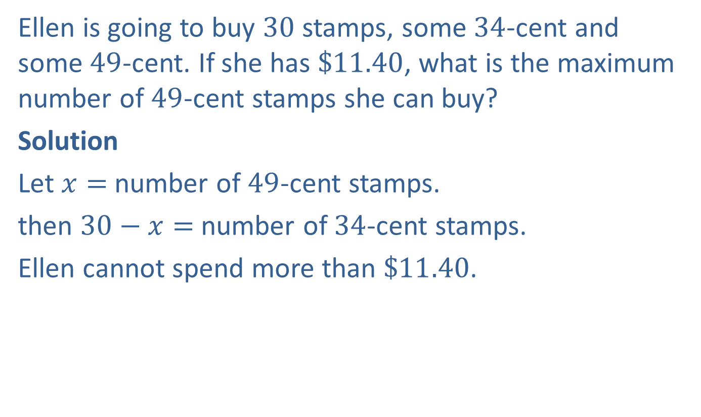
Example 15: Application: Using Inequalities
Ellen is going to buy $30$ stamps, some $34$-cent and some $49$-cent. If she has $\$11.40$, what is the maximum number of $49$-cent stamps she can buy?
Solution
Let $x=$ number of $49$-cent stamps.
then $30−x=$ number of $34$-cent stamps.
Ellen cannot spend more than $\$11.40$.

Slide 30
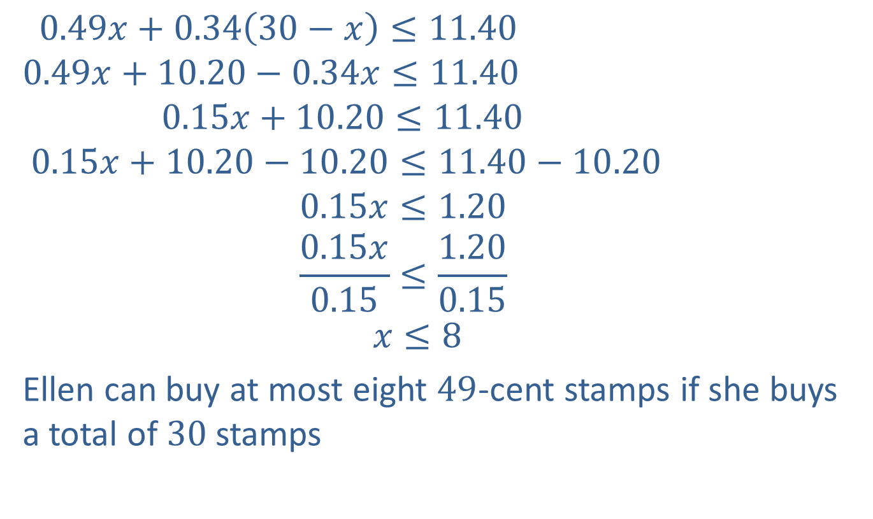
Example 15: Application: Using Inequalities (cont.)
$$0.49x+0.34\left(30−x\right)≤11.40$$
$$0.49x+10.20−0.34x≤11.40$$
$$0.15x+10.20≤11.40$$
$$0.15x+10.20−10.20≤11.40−10.20$$
$$0.15x≤1.20$$
$$\frac{0.15x}{0.15}≤\frac{1.20}{0.15}$$
$$x≤8$$
Ellen can buy at most eight $49$-cent stamps if she buys a total of $30$stamps

