Slide 1
Section 3.1
The Cartesian Coordinate System, Scatter Plots, and Linear Equations

Slide 2
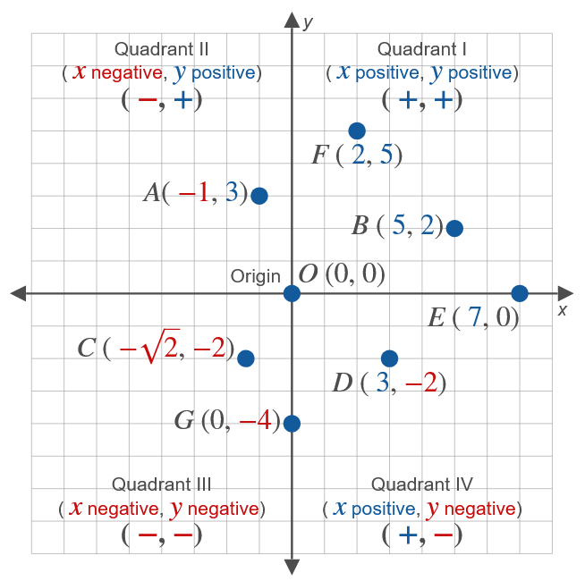
The Cartesian Coordinate System
Figure 1

Slide 3
Definition: One-to-One Correspondence
There is a one-to-one correspondence between points in a plane and ordered pairs of real numbers.

Slide 4
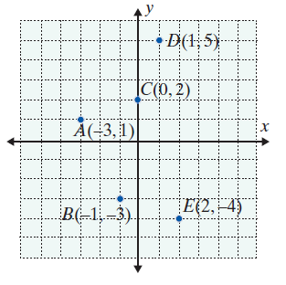
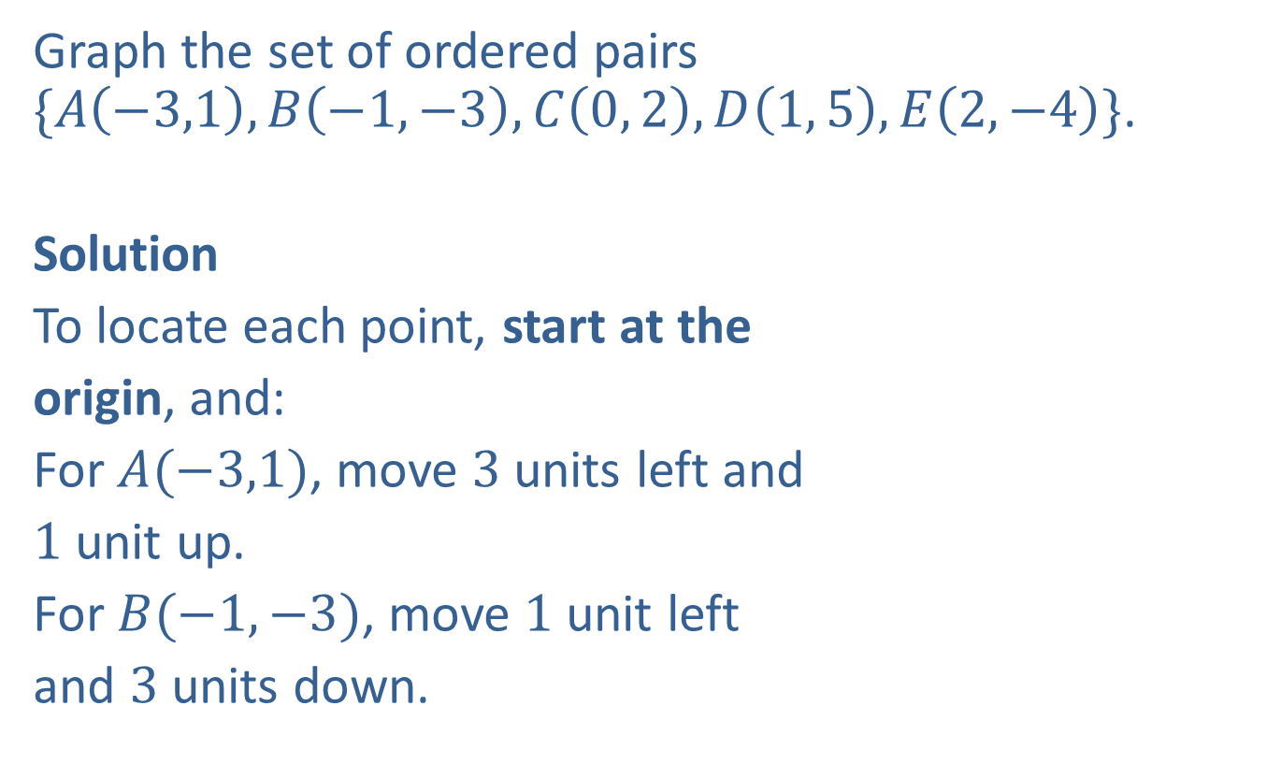
Example 1: Graphing Ordered Pairs
Graph the set of ordered pairs
$\{A\left(−3,1\right), B\left(−1,−3\right), C\left(0, 2\right), D\left(1, 5\right), E\left(2,−4\right)\}$.
Solution
To locate each point, start at the
origin, and:
For $A(−3,1)$, move $3$ units left and
$1$ unit up.
For $B(−1,−3)$, move $1$ unit left
and $3$ units down.
Note: The listing of ordered pairs within the braces can be in any order.

Slide 5
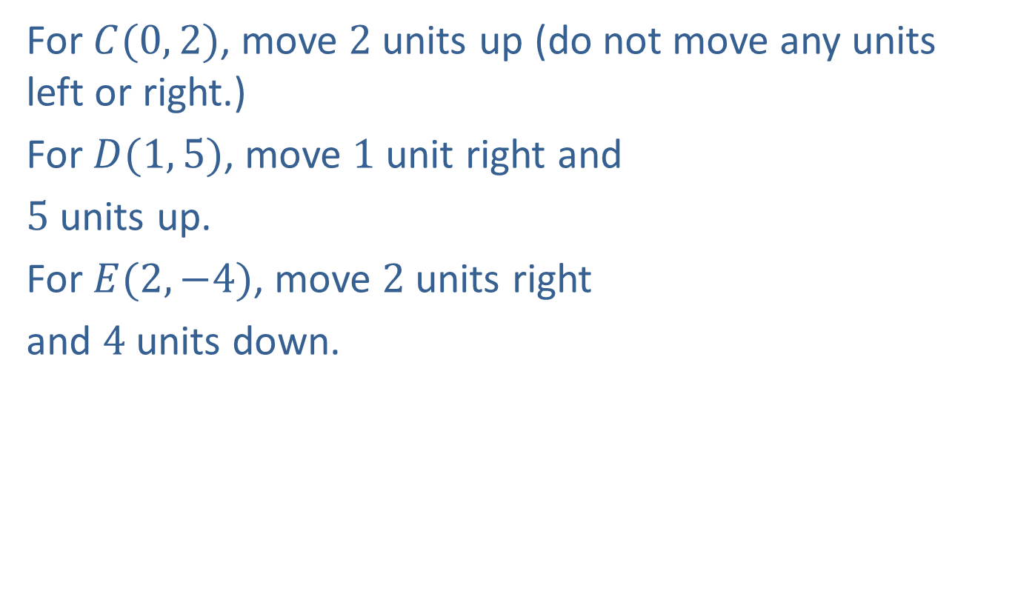
Example 1: Graphing Ordered Pairs (cont.)
For $C(0, 2)$, move $2$ units up (do not move any units left or right.)
For $D(1, 5)$, move $1$ unit right and
$5$ units up.
For $E(2, −4)$, move $2$ units right
and $4$ units down.

Slide 6
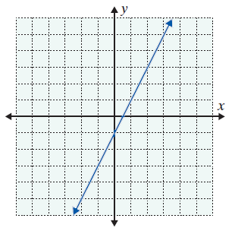
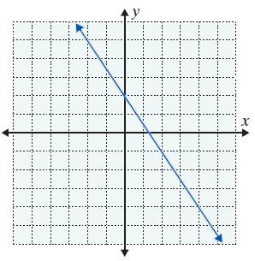
Example 2: Reading Points on a Graph
The graphs of two straight lines are given. Each line contains an infinite number of points. Use the grid to help you locate (or estimate) three points on each line.
b.

Slide 7
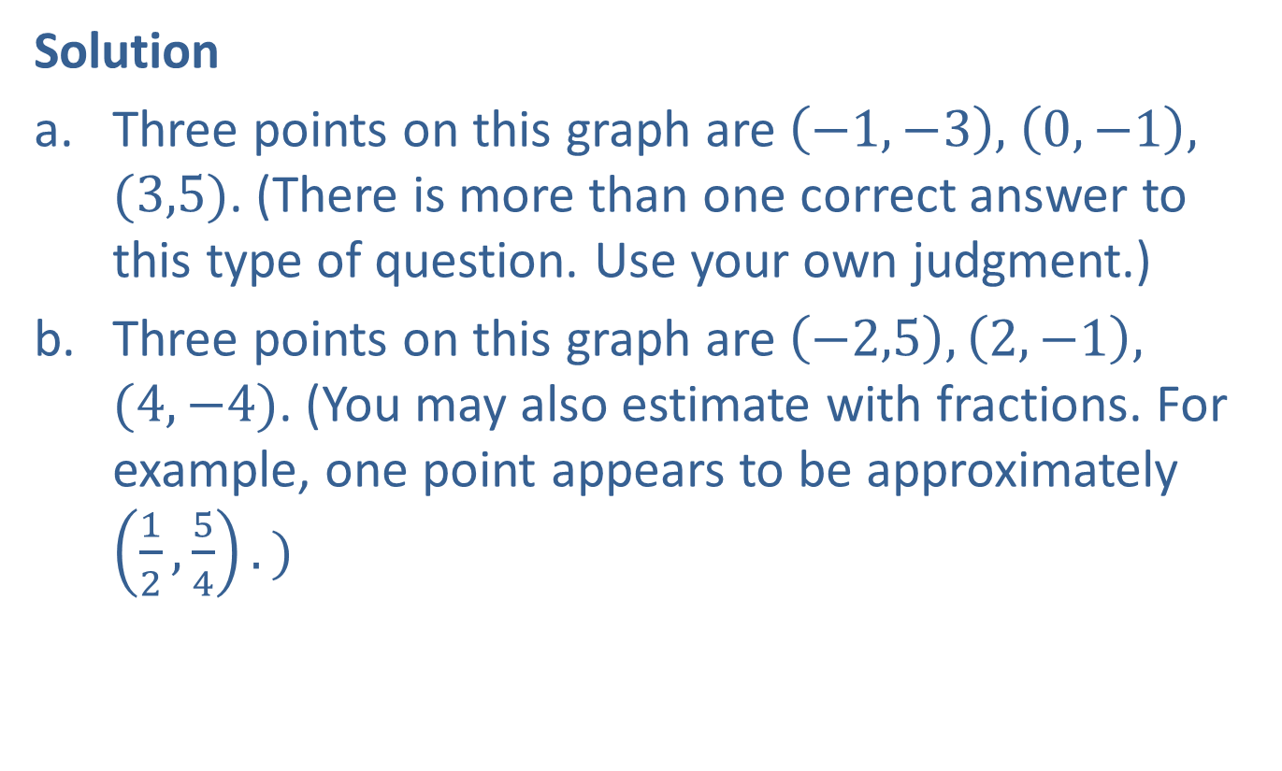
Example 2: Reading Points on a Graph (cont.)
Solution
Three points on this graph are$\left(−1,−3\right),$ $\left(0,−1\right),$ $(3,5)$. (There is more than one correct answer to this type of question. Use your own judgment.)
Three points on this graph are$\left(−2,5\right), \left(2,−1\right),$ $(4,−4)$. (You may also estimate with fractions. For example, one point appears to be approximately $\left(\frac{1}{2},\frac{5}{4}\right).)$

Slide 8
Example 3: Creating a Scatter Plot
The table gives estimated budget and opening weekend sales of top opening movies.
Budgets of Top Opening Movies and their Opening Sales
Budget (in millions) | Opening Weekend Sales (in millions)
321 | 257
245 | 248
150 | 208
220 | 207
200 | 202
250 | 191
200 | 182
250 | 179

Slide 9
Example 3: Creating a Scatter Plot (cont.)
Rewrite the data in the table as ordered pairs in the form (Budget, Opening Sales).
Use the data to create a scatter plot.
Budgets of Top Opening Movies and their Opening Sales (cont.)
Budget (in millions) | Opening Weekend Sales (in millions)
160 | 174
200 | 174
Source: IMDB

Slide 10
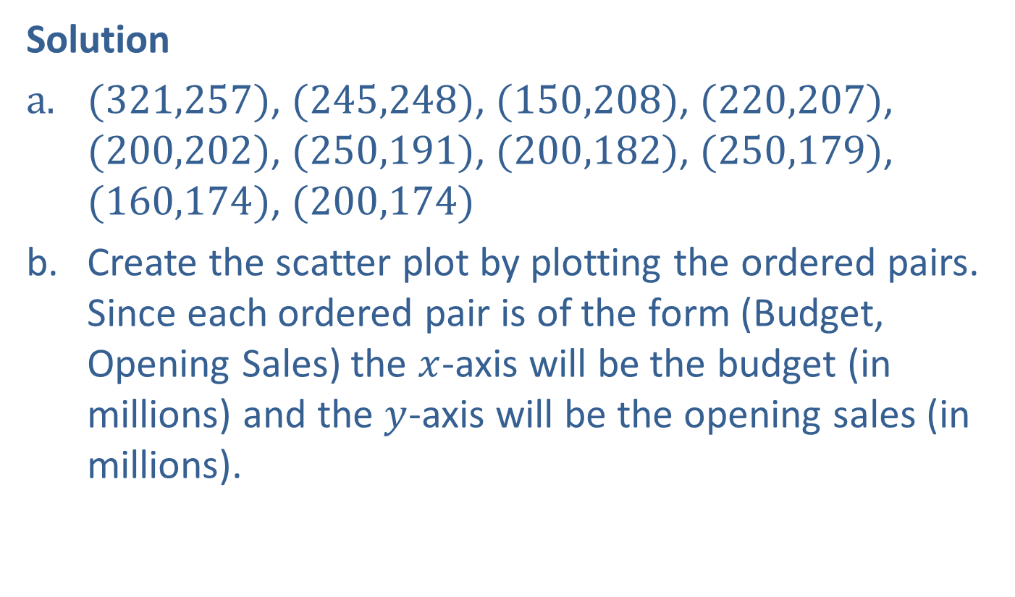
Example 3: Creating a Scatter Plot (cont.)
Solution
$(321,257)$, $(245,248)$, $(150,208)$, $(220,207)$, $(200,202)$, $(250,191)$, $(200,182)$, $(250,179)$, $(160,174)$, $(200,174)$
Create the scatter plot by plotting the ordered pairs. Since each ordered pair is of the form (Budget, Opening Sales) the $x$-axis will be the budget (in millions) and the $y$-axis will be the opening sales (in millions).

Slide 11
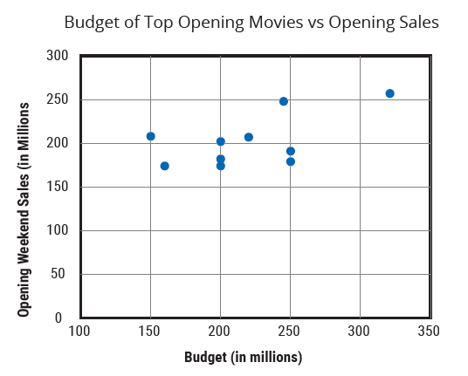
Example 3: Creating a Scatter Plot (cont.)

Slide 12
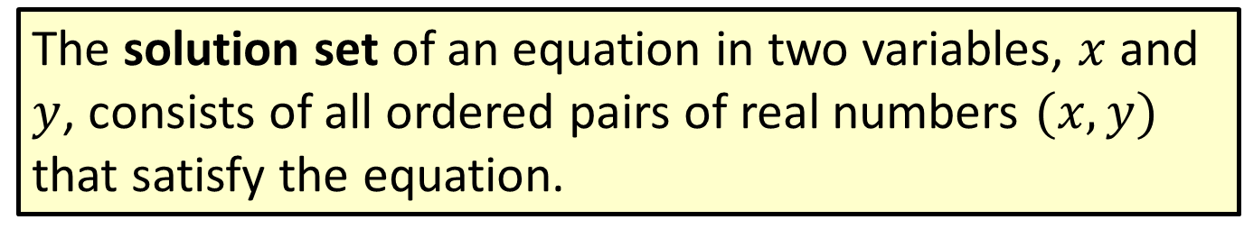
Definition: Solution Set of an Equation in Two Variables
The solution set of an equation in two variables, $x$ and $y$, consists of all ordered pairs of real numbers $(x, y)$ that satisfy the equation.

Slide 13
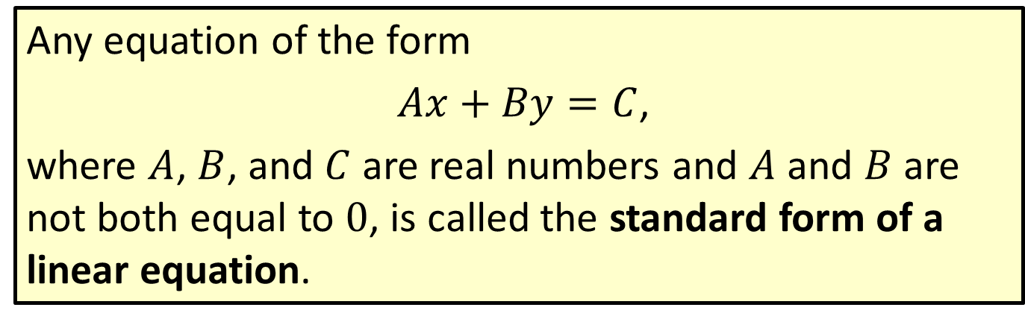
Definition: Standard Form of a Linear Equation
Any equation of the form
$Ax+By=C$,
where $A$, $B$, and $C$ are real numbers and $A$ and $B$ are not both equal to 0, is called the standard form of a linear equation.

Slide 14
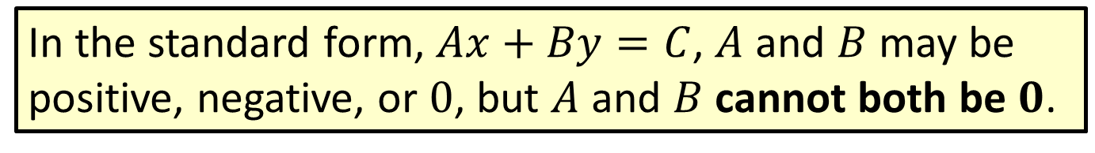
Note
In the standard form, $Ax+By=C$, $A$ and $B$ may be positive, negative, or $0$, but $A$ and $B$ cannot both be $0$.

Slide 15
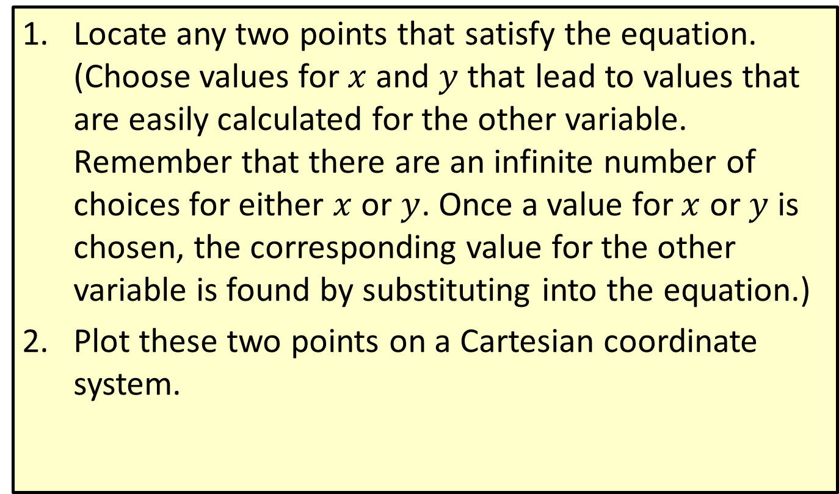
Procedure: To Graph a Linear Equation in Two Variables
​Locate any two points that satisfy the equation. (Choose values for $x$ and $y$ that lead to values that are easily calculated for the other variable. Remember that there are an infinite number of choices for either $x$ or $y$. Once a value for $x$ or $y$ is chosen, the corresponding value for the other variable is found by substituting into the equation.)
​Plot these two points on a Cartesian coordinate system.

Slide 16
Procedure: To Graph a Linear Equation in Two Variables (cont.)
​Draw a straight line through these two points. (Note: Every point on that line will satisfy the equation.)
​To check: Locate a third point that satisfies the equation and check to see that it does indeed lie on the line.

Slide 17
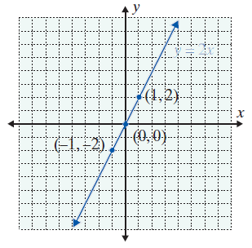

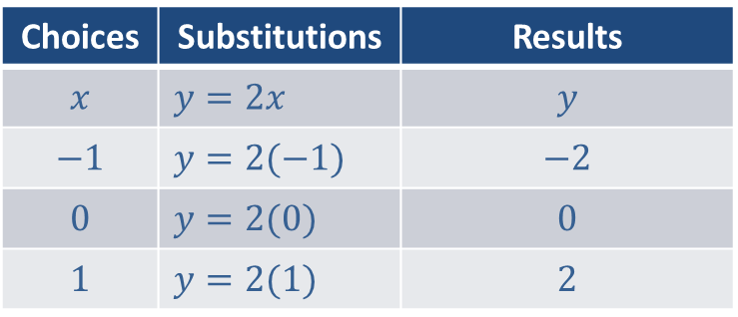
Example 4: Graphing a Linear Equation in Two Variables
Graph: $y=2x$
Solution
Substitute $−1, 0,$ and $1$ for $x$
Choices | Substitutions | Results
$$x$$ | $$y=2x$$ | $$y$$
$$−1$$ | $$y=2(−1)$$ | $$−2$$
$$0$$ | $$y=2(0)$$ | $$0$$
$$1$$ | $$y=2(1)$$ | $$2$$

Slide 18
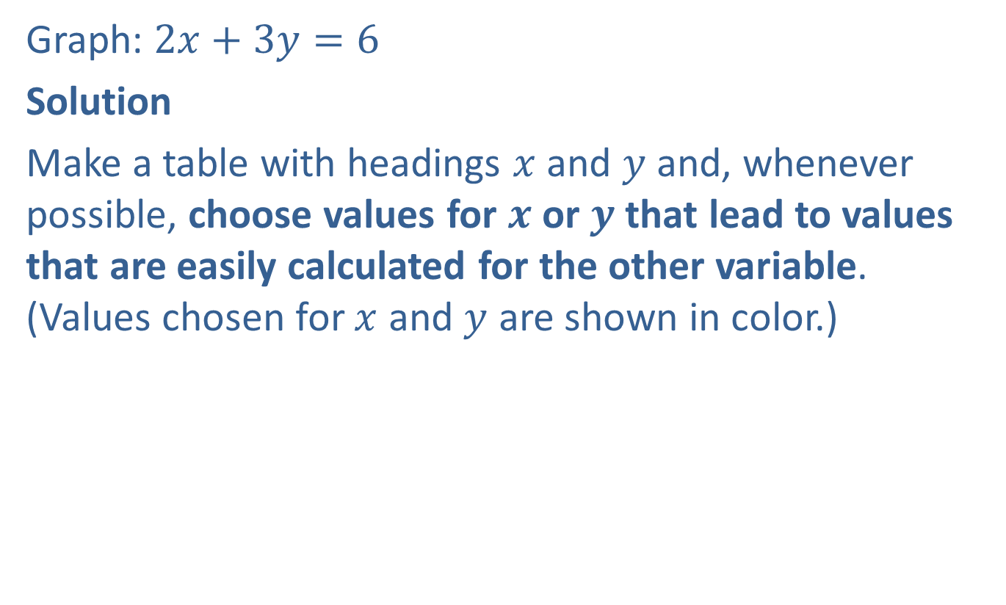
Example 5: Graphing a Linear Equation in Two Variables
Graph: $2x+3y=6$
Solution
Make a table with headings $x$ and $y$ and, whenever possible, choose values for $x$ or $y$ that lead to values that are easily calculated for the other variable. (Values chosen for $x$ and $y$ are shown in color.)

Slide 19
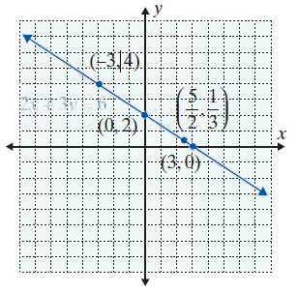
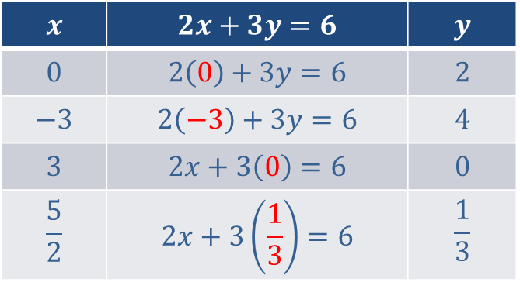
Example 5: Graphing a Linear Equation in Two Variables (cont.)
$$x$$ | $$2x+3y=6$$ | $$y$$
$$0$$ | $$2\left(0\right)+3y=6$$ | $$2$$
$$−3$$ | $$2\left(−3\right)+3y=6$$ | $$4$$
$$3$$ | $$2x+3\left(0\right)=6$$ | $$0$$
$$\frac{5}{2}$$ | $$2x+3\left(\frac{1}{3}\right)=6$$ | $$\frac{1}{3}$$

Slide 20
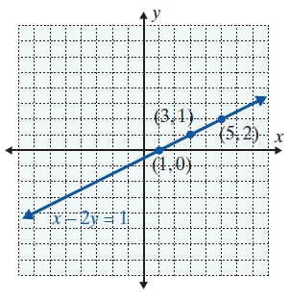

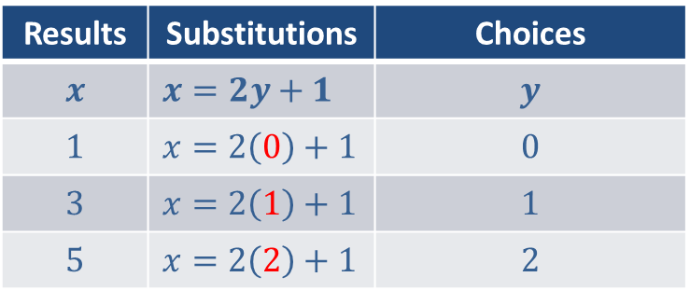
Example 6: Graphing a Linear Equation in Two Variables
Graph: $x−2y=1$
Solution
Solve the equation $x=2y+1$ for $x$ and substitute $0, 1, and 2$ for $y$.
Results | Substitutions | Choices
$$x$$ | $$x=2y+1$$ | $$y$$
$$1$$ | $$x=2\left(0\right)+1$$ | $$0$$
$$3$$ | $$x=2\left(1\right)+1$$ | $$1$$
$$5$$ | $$x=2\left(2\right)+1$$ | $$2$$

Slide 21
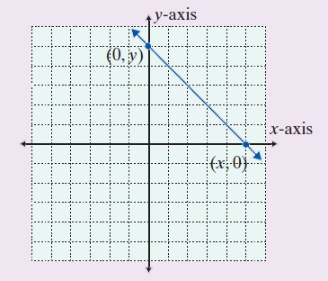
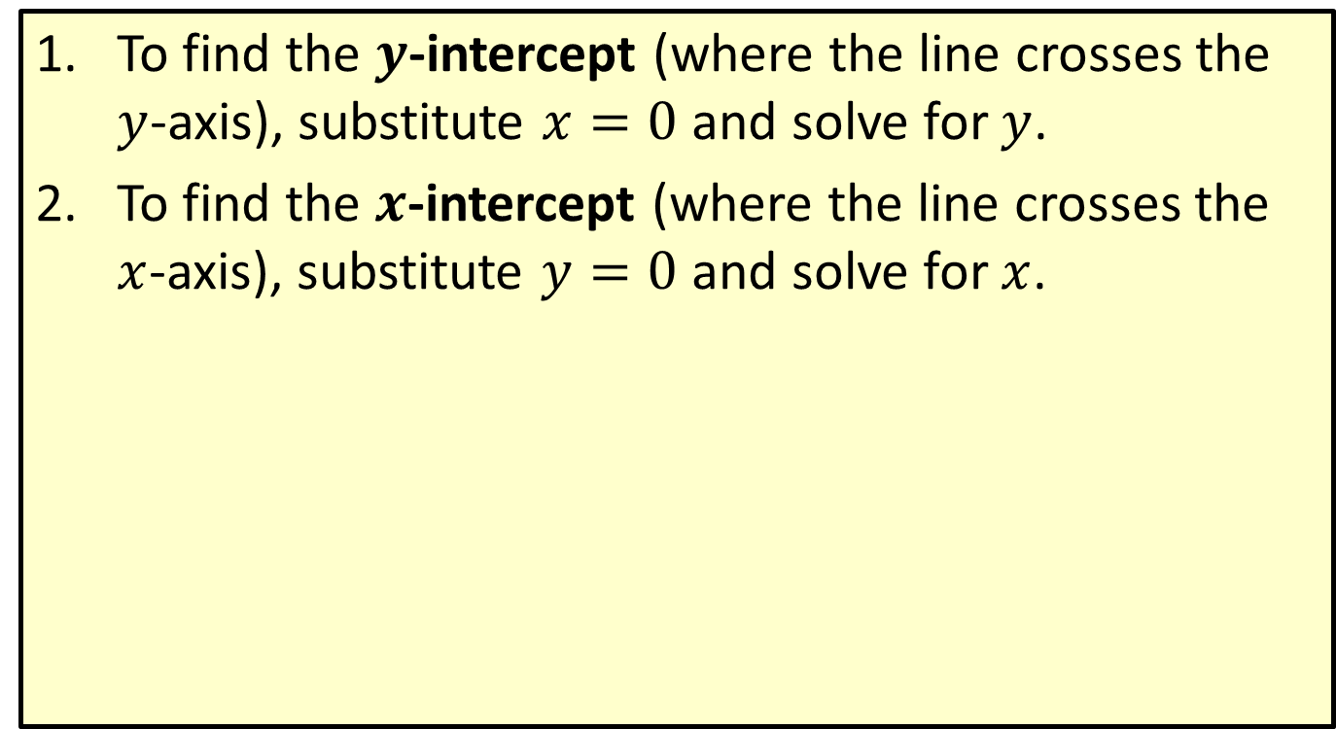
Procedure: Intercepts
​To find the $y$-intercept (where the line crosses the $y$-axis), substitute $x=0$ and solve for $y$.
​To find the $x$-intercept (where the line crosses the $x$-axis), substitute $y=0$ and solve for $x$.

Slide 22
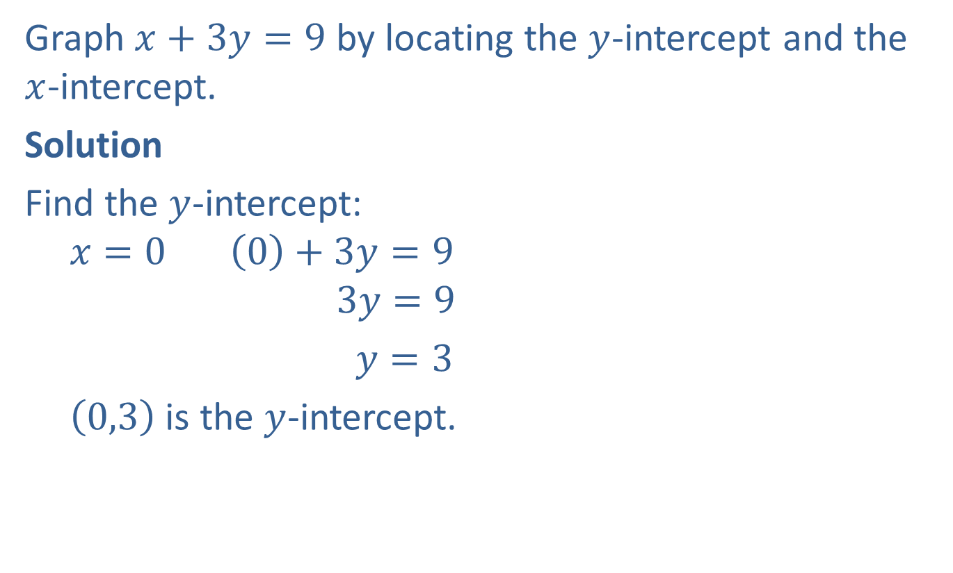
Example 7: Using Intercepts to Graph Linear Equations
Graph $x+3y=9$ by locating the $y$-intercept and the $x$-intercept.
Solution
Find the $y$-intercept:
$$x=0 \left(0\right)+3y=9$$
$$3y=9$$
$y=3$
$\left(0,3\right)$ is the $y$-intercept.

Slide 23
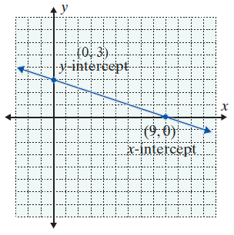

Example 7: Using Intercepts to Graph Linear Equations (cont.)
Find the $x$-intercept:
$$y=0 x+3\left(0\right)=9$$
$$x=9$$
$\left(9, 0\right)$ is the $x$-intercept.
Plot the two intercepts and
draw the line that contains
them.

Slide 24
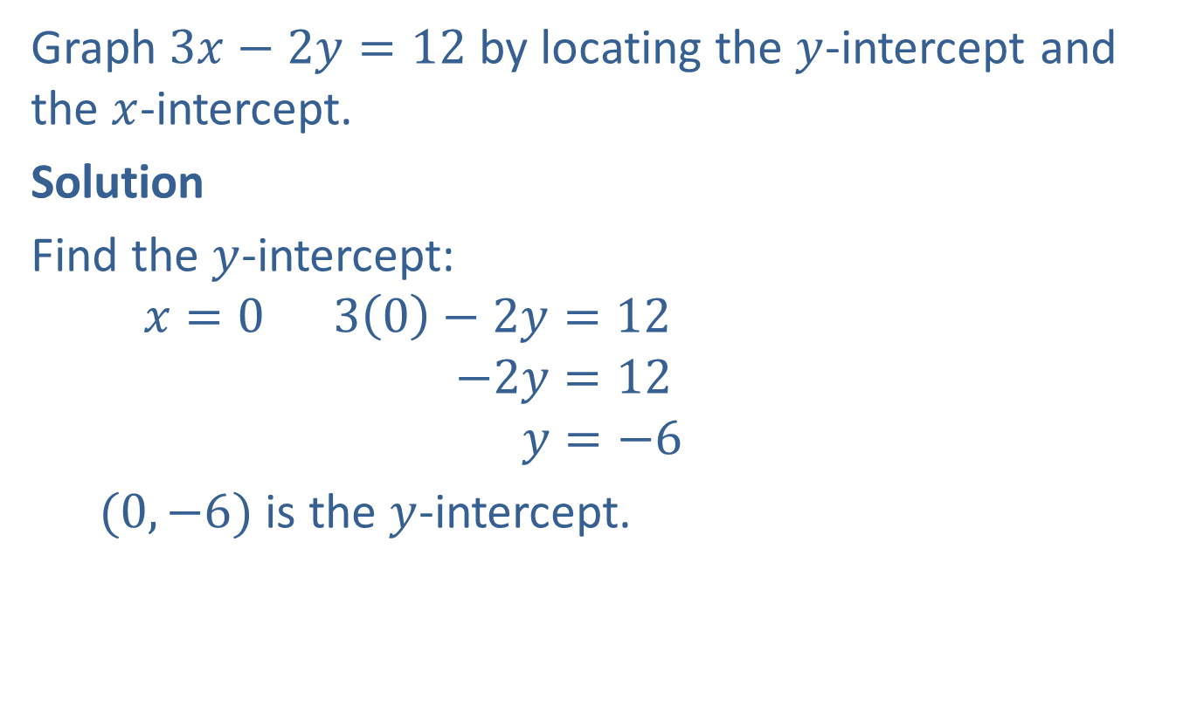
Example 8: Using Intercepts to Graph Linear Equations
Graph $3x−2y=12$ by locating the $y$-intercept and the $x$-intercept.
Solution
Find the $y$-intercept:
$$x=0 3\left(0\right)−2y=12$$
$$−2y=12$$
$$y=−6$$
$(0,−6)$ is the $y$-intercept.

Slide 25
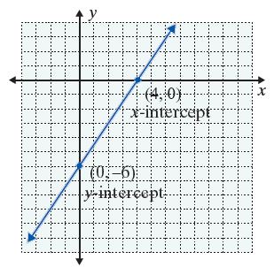
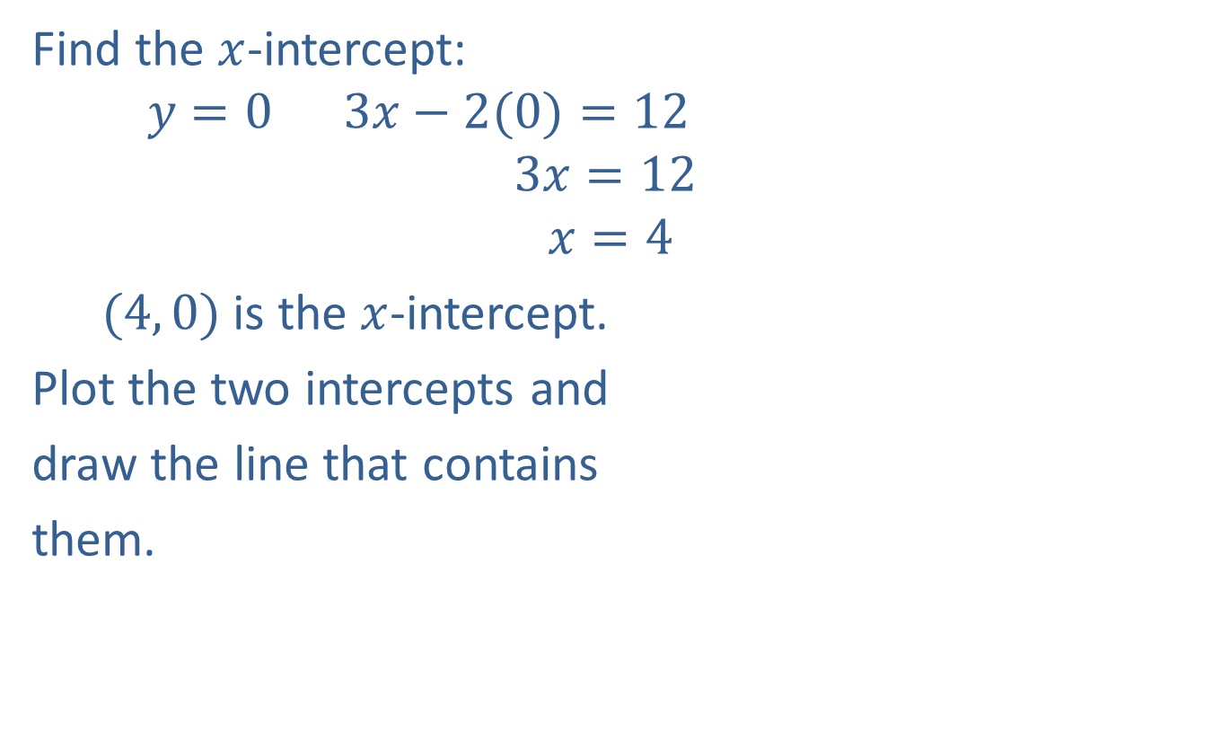
Example 8: Using Intercepts to Graph Linear Equations (cont.)
Find the $x$-intercept:
$$y=0 3x−2(0)=12$$
$$3x=12$$
$$x=4$$
$(4, 0)$ is the $x$-intercept.
Plot the two intercepts and
draw the line that contains
them.

Slide 26
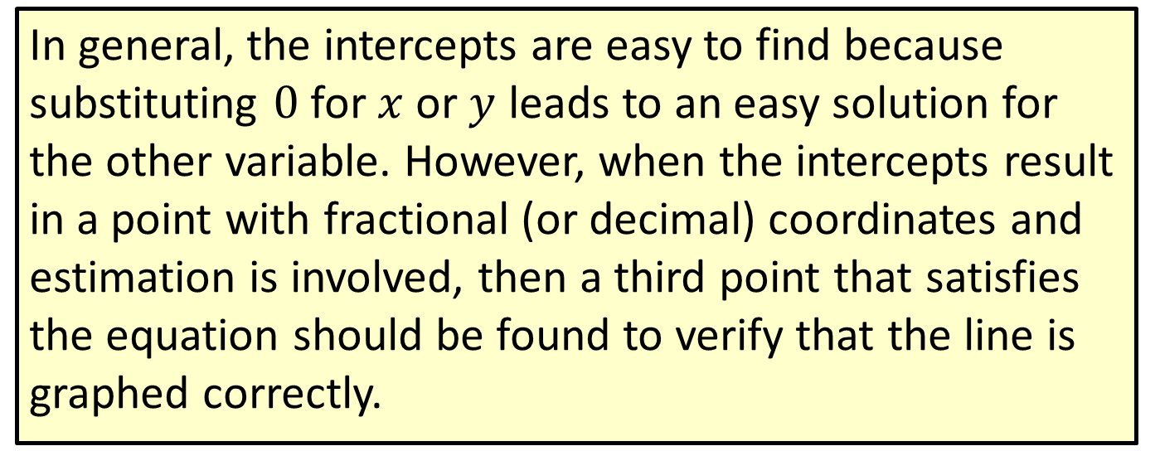
Note
In general, the intercepts are easy to find because substituting $0$ for $x$ or $y$ leads to an easy solution for the other variable. However, when the intercepts result in a point with fractional (or decimal) coordinates and estimation is involved, then a third point that satisfies the equation should be found to verify that the line is graphed correctly.

