Slide 1
Section 3.2
Slope-Intercept Form

Slide 2
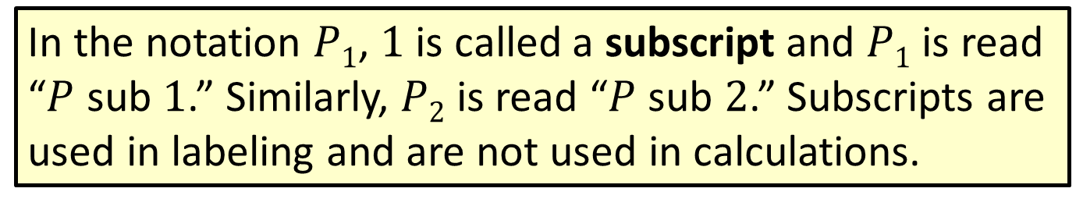
Note
In the notation $P1$, $1$ is called a subscript and $P1$ is read “$P$ sub $1$.” Similarly, $P2$ is read “$P$ sub $2$.” Subscripts are used in labeling and are not used in calculations.

Slide 3
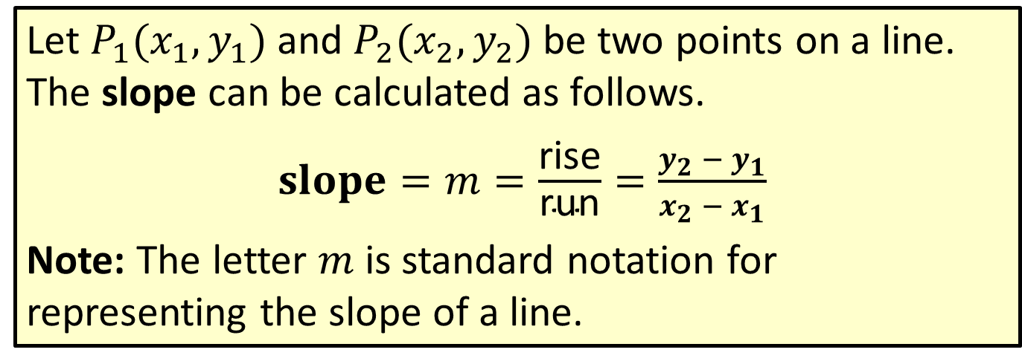
Formula: Slope
Let $P_{1}(x_{1},y_{1})⁡$and $P_{2}(x_{2},y_{2})$be two points on a line. The slope can be calculated as follows.
$slope=m=\frac{\text{rise}}{\text{run}}=\frac{y_{2} − y_{1}}{x_{2} − x_{1}}$
Note: The letter $m$ is standard notation for representing the slope of a line.

Slide 4
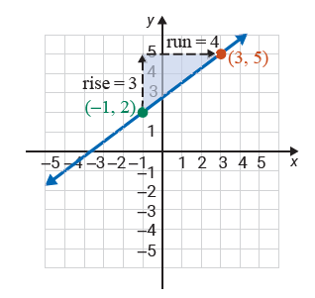
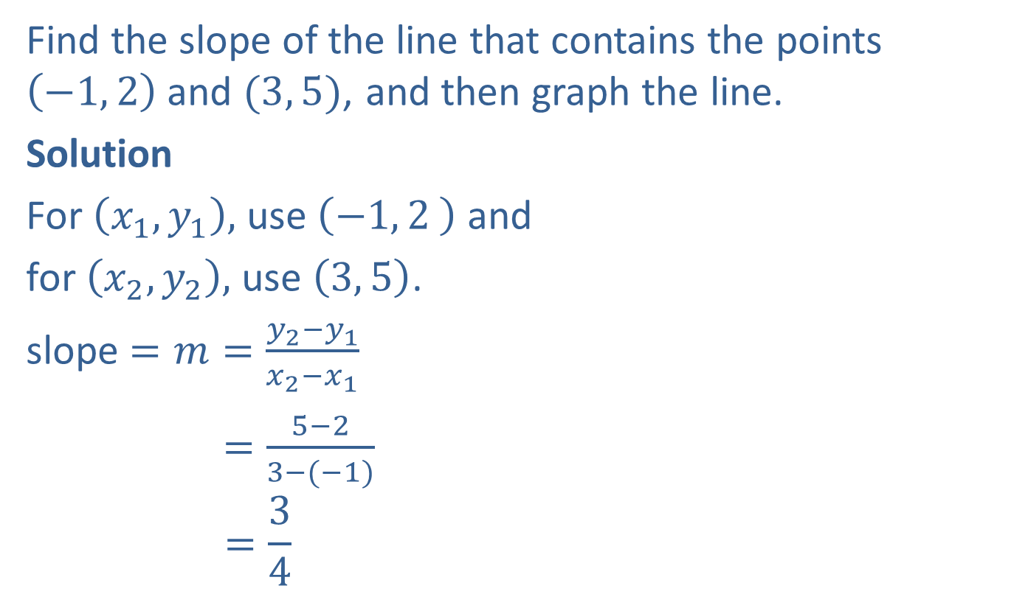
Example 1: Finding the Slope of a Line
Find the slope of the line that contains the points $\left(−1, 2\right)$ and $(3, 5)$, and then graph the line.
Solution
For $\left(x_{1},y_{1}\right),$ use $\left({−1, 2}_{ }\right)$ and
for $\left(x_{2},y_{2}\right),$ use $\left(3, 5\right)$.
slope $=m=\frac{y_{2}−y_{1}}{x_{2}−x_{1}}$
$=\frac{5−2}{3−(−1)}$
$$=\frac{3}{4}$$

Slide 5
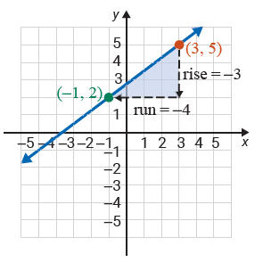

Example 1: Finding the Slope of a Line (cont.)
Or, for $\left(x_{1},y_{1}\right),$ use $\left({3, 5}_{ }\right)$ and
for $\left(x_{2},y_{2}\right),$ use $\left(−1, 2\right)$.
slope $=m=\frac{y_{2}−y_{1}}{x_{2}−x_{1}}$
$$=\frac{2−5}{−1−3}$$
$$=\frac{−3}{−4}$$
$$=\frac{3}{4}$$

Slide 6
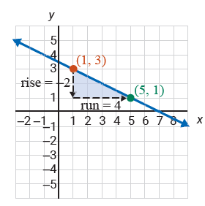
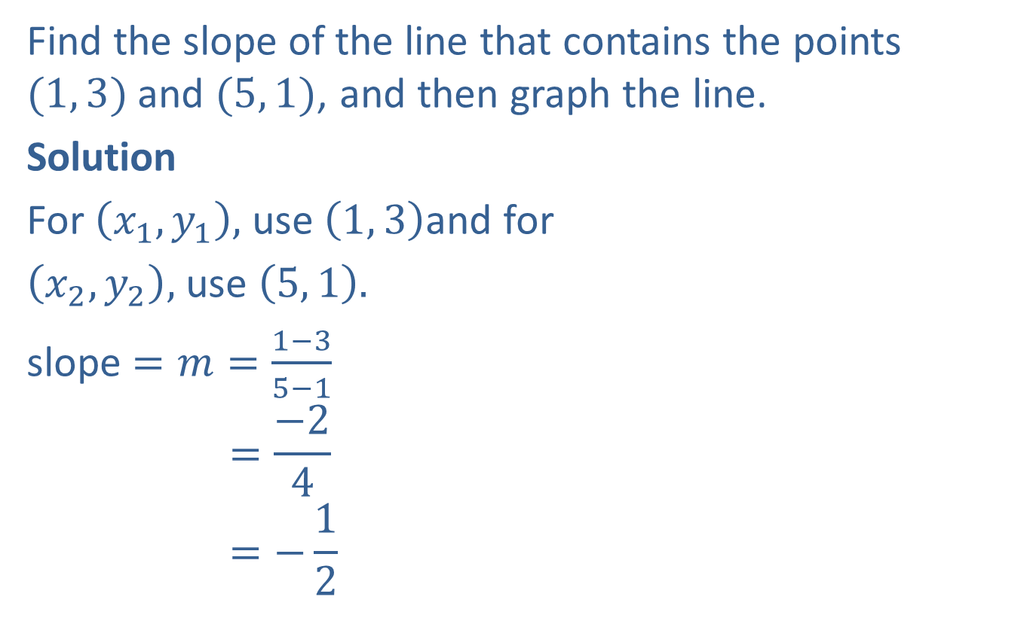
Example 2: Finding the Slope of a Line
Find the slope of the line that contains the points $(1, 3)$and $(5, 1)$, and then graph the line.
Solution
For $\left(x_{1},y_{1}\right),$ use $\left(1, 3\right)$and for
$\left(x_{2},y_{2}\right),$ use $\left(5, 1\right).$
slope $=m=\frac{1−3}{5−1}$
$$=\frac{−2}{4}$$
$$=−\frac{1}{2}$$

Slide 7
Definition: Positive and Negative Slopes
Lines with positive slope go up (increase) as we move along the line from left to right.
Lines with negative slope go down (decrease) as we move along the line from left to right.

Slide 8
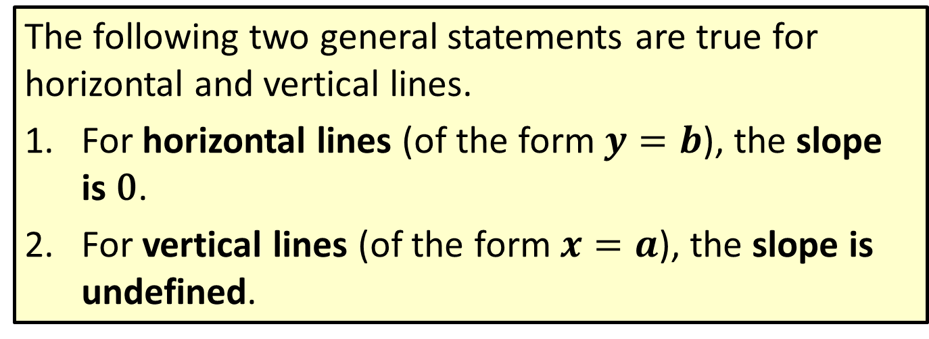
Definition: Horizontal and Vertical Lines
The following two general statements are true for horizontal and vertical lines.
​For horizontal lines (of the form $y=b$), the slope is 0.
​For vertical lines (of the form $x=a$), the slope is undefined.

Slide 9
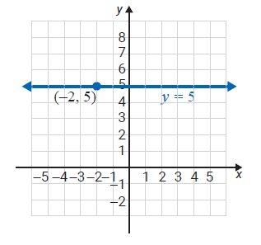

Example 3: Finding the Slope of a Horizontal Line
Find the equation and slope of the horizontal line through the point $(−2, 5)$.
Solution
The equation is $y=5$ and the slope is $0.$

Slide 10
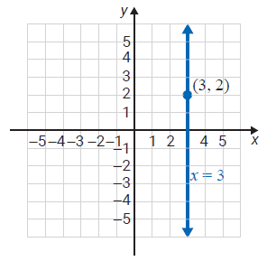

Example 4: Finding the Slope of a Vertical Line
Find the equation and slope of the vertical line through the point $(3, 2)$.
Solution
The equation is $x=3$ and the slope is undefined.

Slide 11
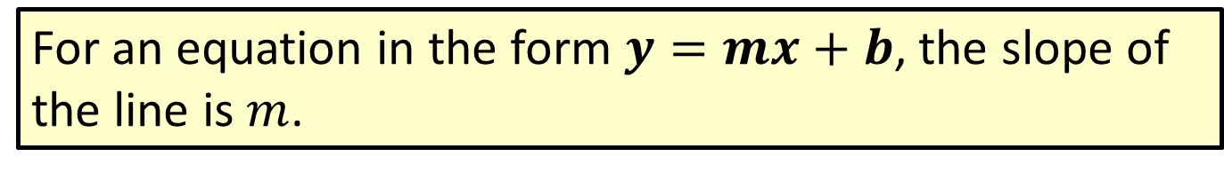

Definition: The Slope $m$
For an equation in the form $y=mx+b$, the slope of the line is $m$.

Slide 12
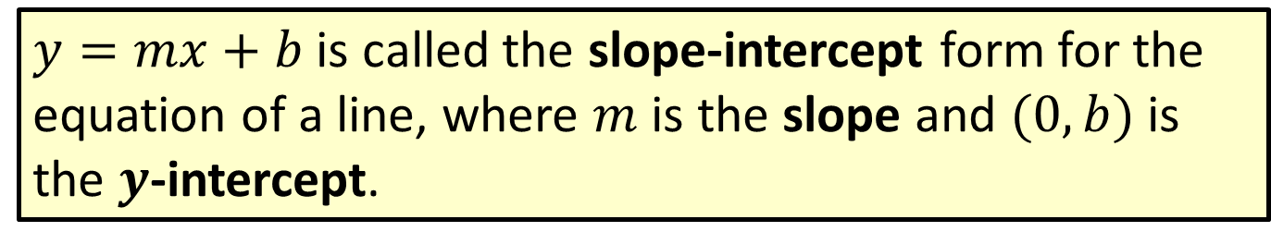
Definition: Slope-Intercept Form
$y=mx+b$ is called the slope-intercept form for the equation of a line, where $m$ is the slope and $(0, b)$ is the $y$-intercept.

Slide 13
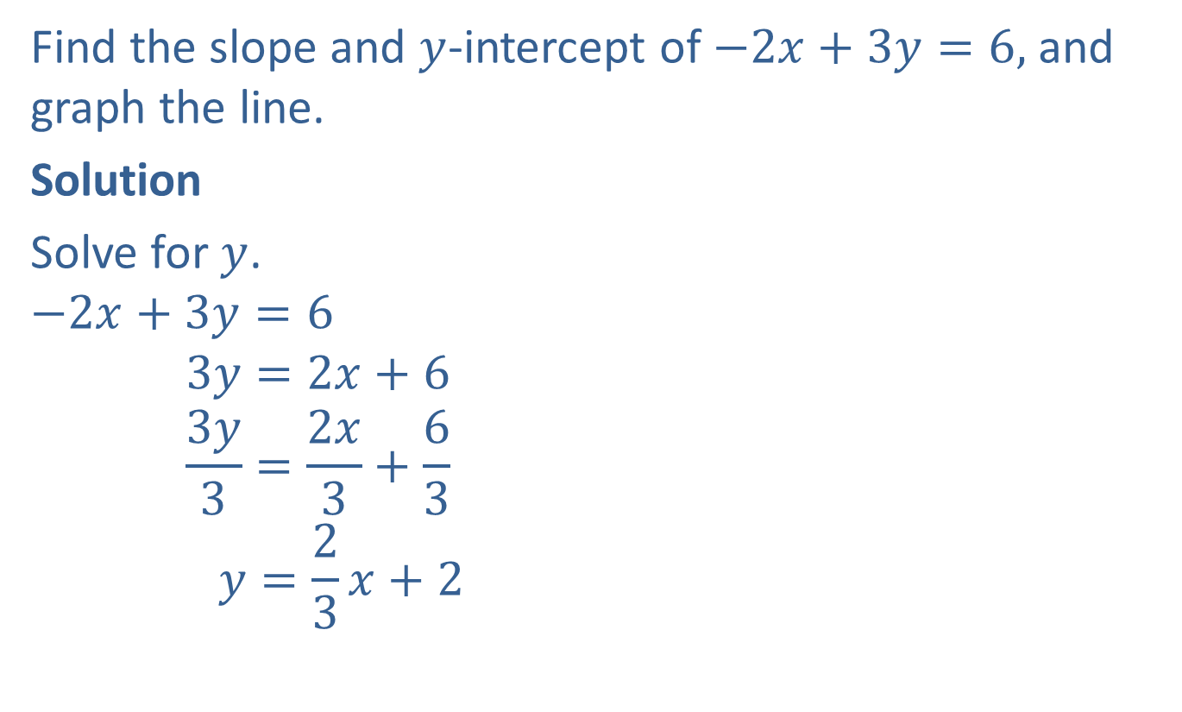
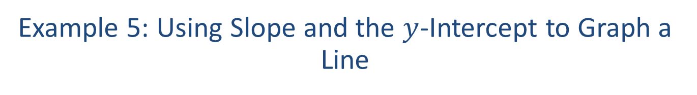
Example 5: Using Slope and the $y$‑Intercept to Graph a Line
Find the slope and $y$-intercept of $−2x+3y=6,$ and graph the line.
Solution
Solve for $y$.
$$−2x+3y=6$$
$$3y=2x+6$$
$$\frac{3y}{3}=\frac{2x}{3}+\frac{6}{3}$$
$$y=\frac{2}{3}x+2$$

Slide 14
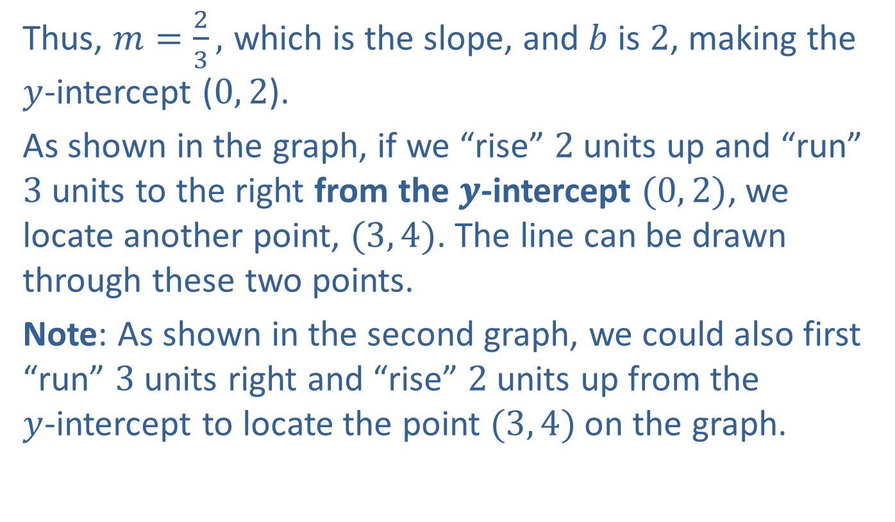
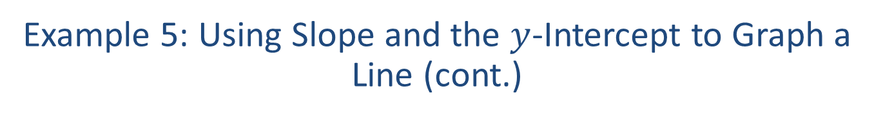
Example 5: Using Slope and the $y$‑Intercept to Graph a Line (cont.)
Thus, $m=\frac{2}{3},$ which is the slope, and $b$ is $2$, making the $y$-intercept ($0, 2$).
As shown in the graph, if we “rise” $2$ units up and “run” $3$ units to the right from the 𝒚‑intercept $(0, 2)$, we locate another point, $(3, 4)$. The line can be drawn through these two points.
Note: As shown in the second graph, we could also first “run” $3$ units right and “rise” $2$ units up from the $y$‑intercept to locate the point $(3, 4)$on the graph.

Slide 15
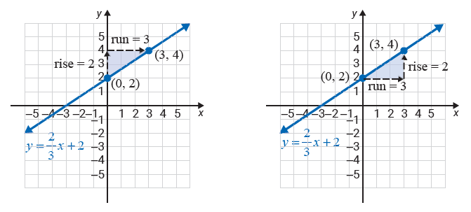
Example 5: Using Slope and the $y$‑Intercept to Graph a Line (cont.)

Slide 16
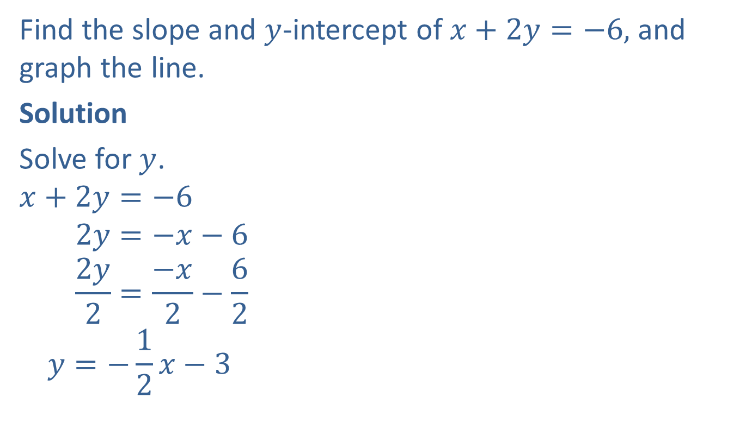
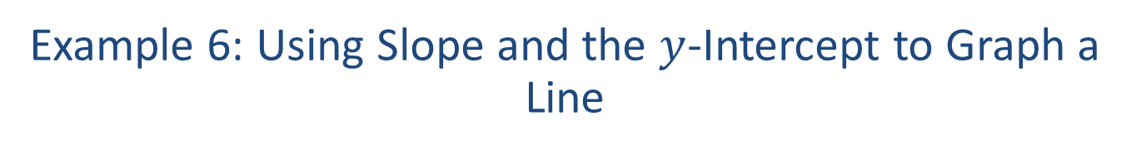
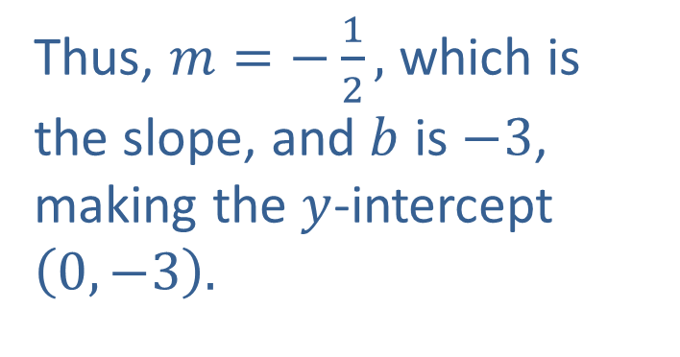
Example 6: Using Slope and the $y$-Intercept to Graph a Line
Find the slope and $y$-intercept of $x+2y=−6,$ and graph the line.
Solution
Solve for $y$.
$$x+2y=−6$$
$$2y=−x−6$$
$$\frac{2y}{2}=\frac{−x}{2}−\frac{6}{2}$$
$$y=−\frac{1}{2}x−3$$
Thus, $m=−\frac{1}{2},$ which is the slope, and $b$ is $−3$, making the $y$-intercept $\left(0,−3\right).$

Slide 17
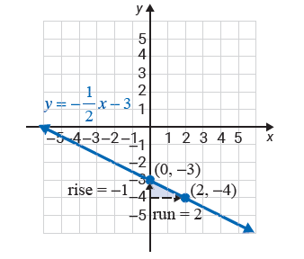

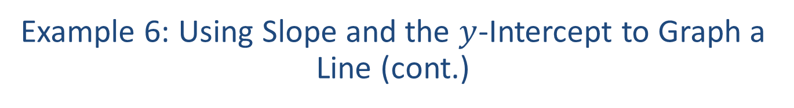
Example 6: Using Slope and the $y$-Intercept to Graph a Line (cont.)
We can treat $m=−\frac{1}{2}$ as $m=\frac{−1}{2}$ and the “rise” as $−1$ and the “run” as $2$. Moving from $\left(0,−3\right)$ as shown in the graph, we locate another point $\left(2,−4\right)$ on the graph and draw the line.

Slide 18
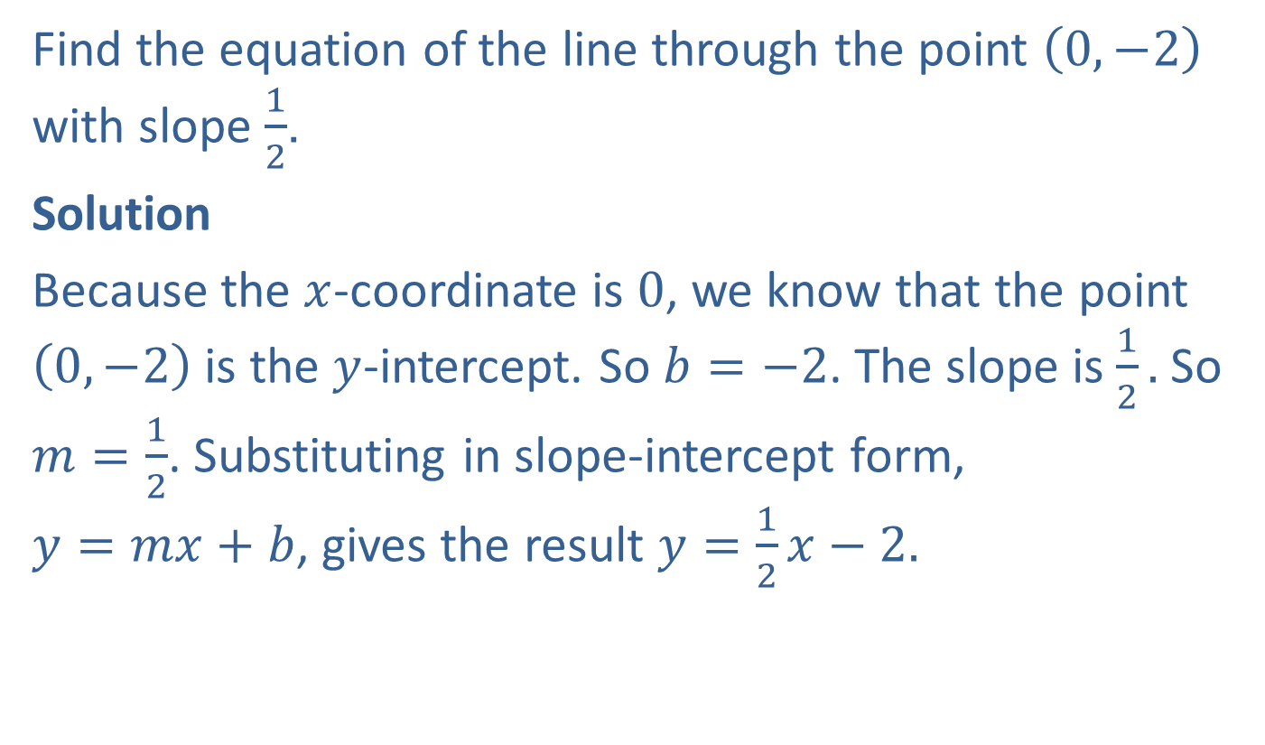

Example 7: Finding Equations Given the Slope and the $y$‑Intercept
Find the equation of the line through the point $\left(0,−2\right)$ with slope $\frac{1}{2}$.
Solution
Because the $x$-coordinate is $0$, we know that the point $\left(0,−2\right)$ is the $y$-intercept. So $b=−2$. The slope is $\frac{1}{2}.$ So $m=\frac{1}{2}$. Substituting in slope-intercept form, $y=mx+b$, gives the result $y=$ $\frac{1}{2}x−2.$

