Slide 1
Section 3.3
Point-Slope Form

Slide 2
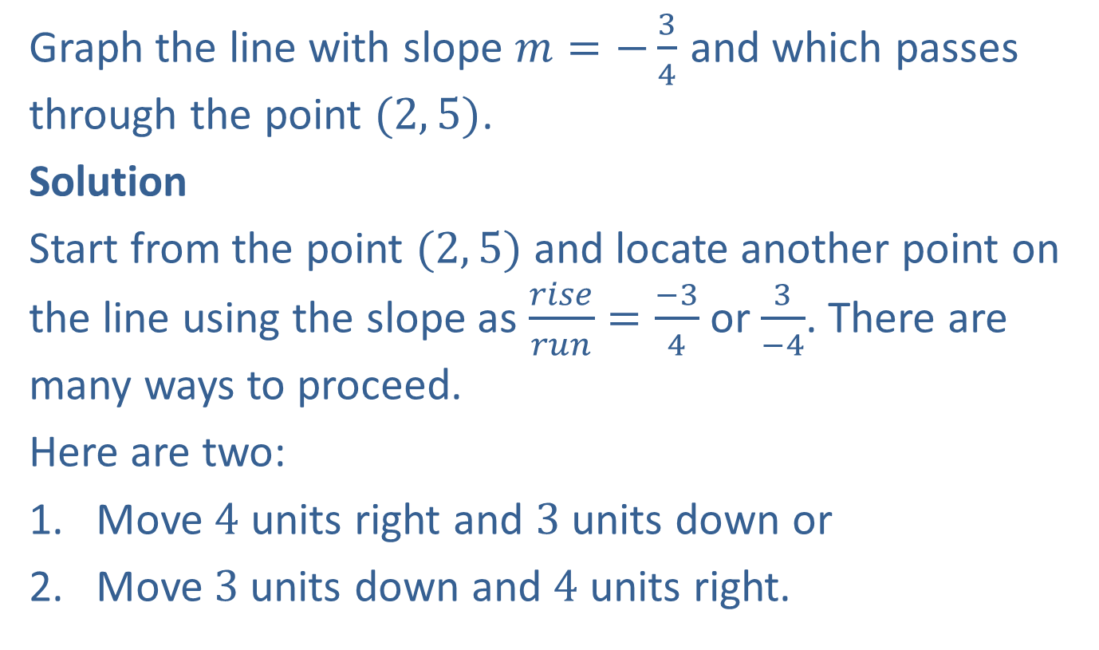
Example 1: Graphing a Line Given a Point and the Slope
Graph the line with slope $m=−\frac{3}{4}$ and which passes through the point $(2, 5)$.
Solution
Start from the point $(2, 5)$ and locate another point on the line using the slope as $\frac{rise}{run}=\frac{−3}{4}$ or $\frac{3}{−4}$. There are many ways to proceed.
Here are two:
Move $4$ units right and $3$ units down or
Move $3$units down and $4$ units right.

Slide 3
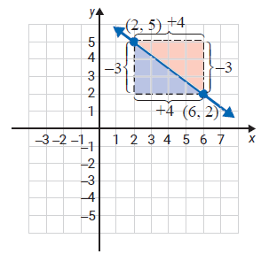

Example 1: Graphing a Line Given a Point and the Slope (cont.)
Either way, you arrive at the same point $(6, 2).$
This means that we can move from the given point either with the rise first or the run first.
Note: Any numbers in the ratio of $−3$ to $4$ can be used for the moves, such as $−6$ to $8$ or $9$ to $−12$.

Slide 4
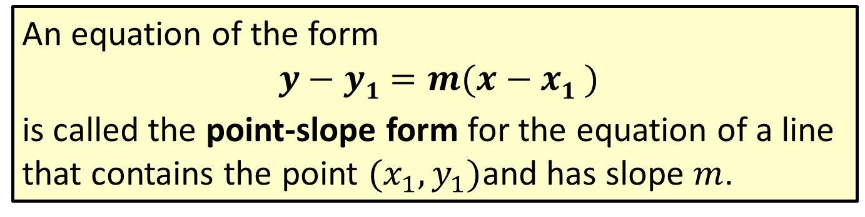
Formula: Point-Slope Form
An equation of the form
$$y−y1=m(x−x1 )$$
is called the point-slope form for the equation of a line that contains the point $(x_{1}, y_{1})$and has slope $m$.

Slide 5
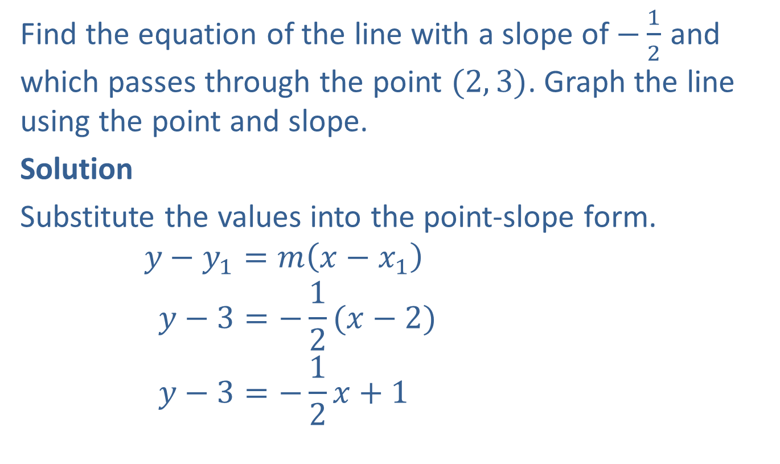
Example 2: Finding Equations of Lines Using a Point and Slope
Find the equation of the line with a slope of $−\frac{1}{2}$ and which passes through the point $(2, 3)$. Graph the line using the point and slope.
Solution
Substitute the values into the point-slope form.
$$y−y_{1}=m\left(x−x_{1}\right)$$
$$y−3=−\frac{1}{2}(x−2)$$
$$y−3=−\frac{1}{2}x+1$$
Point-slope form

Slide 6
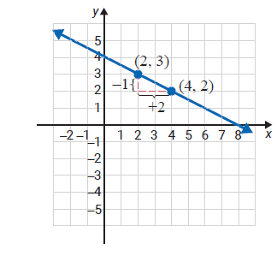


Example 2: Finding Equations of Lines Using a Point and Slope (cont.)
$$y=−\frac{1}{2}x+4$$
or $2y=−x+8$
$$x+2y=8$$
Slope-intercept form
Standard form
The point one unit down and two units right from $(2,3)$ will be on the line because the slope is $m=\frac{rise}{run}=\frac{−1}{2}=−\frac{1}{2}.$

Slide 7
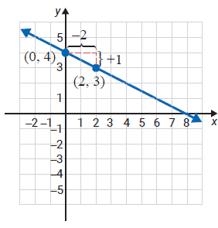

Example 2: Finding Equations of Lines Using a Point and Slope (cont.)
With a negative slope, either the rise is negative and the run is positive, or the rise is positive and the run is negative. In either case, as the previous figure and the following figure illustrate, the line is the same.
The point one unit up and two units to the left from $(2,3)$ is on the line because the slope is $m=\frac{rise}{run}=\frac{1}{−2}=−\frac{1}{2}.$

Slide 8
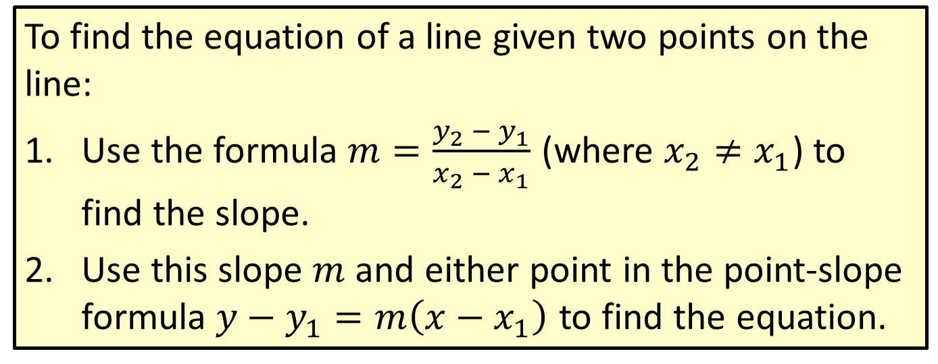
Procedure: Finding the Equation of a Line Given Two Points
To find the equation of a line given two points on the line:
​Use the formula $m=\frac{y_{2} − y_{1}}{x_{2} − x_{1}}$ (where $x_{2}≠x_{1}$) to find the slope.
​Use this slope $m$ and either point in the point-slope formula $y−y_{1}=m\left(x−x_{1}\right)$ to find the equation.

Slide 9
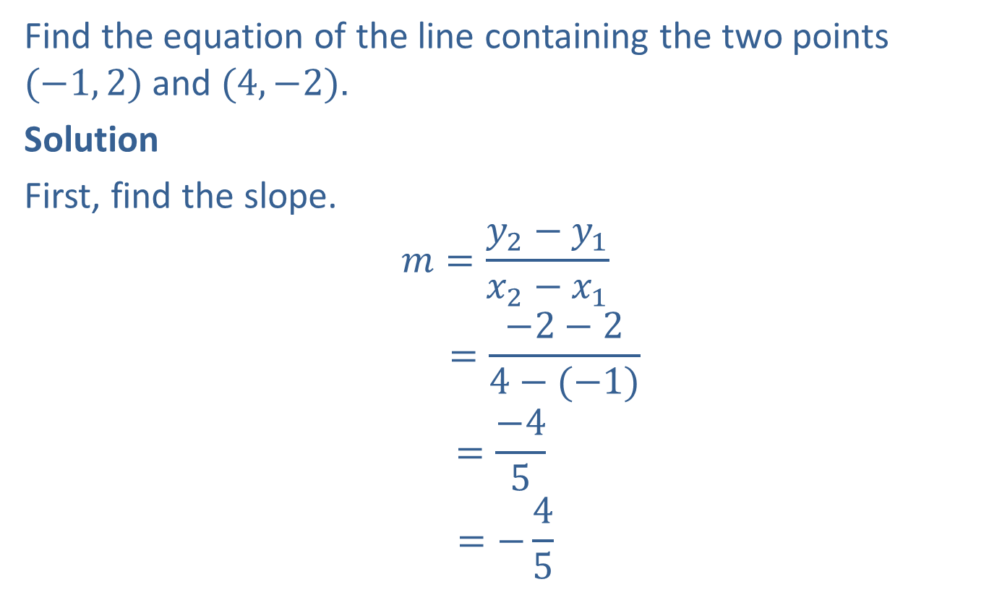
Example 3: Finding Equations Given Two Points
Find the equation of the line containing the two points $(−1, 2)$ and $(4,−2)$.
Solution
First, find the slope.
$$m=\frac{y_{2}−y_{1}}{x_{2}−x_{1}}$$
$$=\frac{−2−2}{4−(−1)}$$
$$=\frac{−4}{5}$$
$$=−\frac{4}{5}$$

Slide 10

Example 3: Finding Equations Given Two Points (cont.)
Now use one of the given points and the point-slope form for the equation of a line.
(Note: $(−1, 2)$ and $(4, −2)$are used on the next page to illustrate that either point may be used.)

Slide 11


Example 3: Finding Equations Given Two Points (cont.)
$Using \left(−1, 2\right)$
$y−y_{1}=m(x−x_{1})$
$y−2=−\frac{4}{5}\left[x−\left(−1\right)\right]$
$$y−2=−\frac{4}{5}x−\frac{4}{5}$$
$$y=−\frac{4}{5}x−\frac{4}{5}+2$$
$$y=−\frac{4}{5}x+\frac{6}{5}$$
or $4x+5y=6$
Point-slope form
Substitute.
Distributive property
Solve for $y$.
Slope-intercept form
Standard form

Slide 12


Example 3: Finding Equations Given Two Points (cont.)
$Using \left(4,−2\right)$
$y−y_{2}=m(x−x_{2})$
$y−\left(−2\right)=−\frac{4}{5}(x−4)$
$$y+2=−\frac{4}{5}x+\frac{16}{5}$$
$$y=−\frac{4}{5}x+\frac{16}{5}−2$$
$$y=−\frac{4}{5}x+\frac{6}{5}$$
or$4x+6y=6$
Point-slope form
Substitute.
Distributive property
Solve for $y$.
Slope-intercept form
Standard form

Slide 13
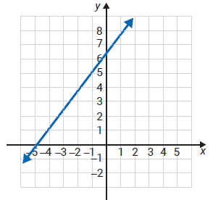
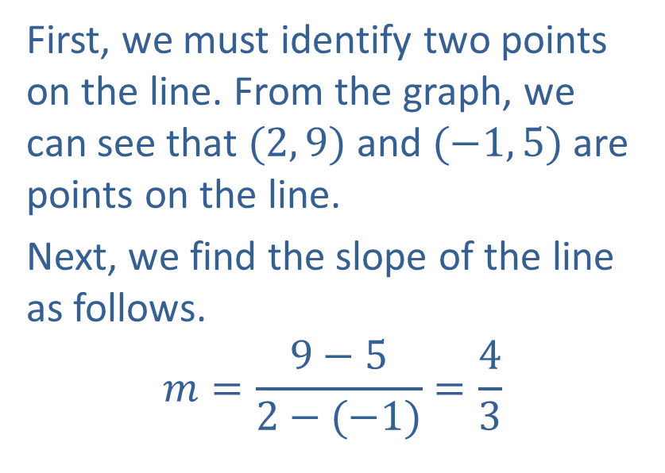
Example 4: Finding Equations of Lines Using a Graph
Write an equation in standard form for the following line.
Solution
First, we must identify two points on the line. From the graph, we can see that $(2, 9)$ and $(−1, 5)$are points on the line.
Next, we find the slope of the line as follows.
$$m=\frac{9−5}{2−(−1)}=\frac{4}{3}$$

Slide 14

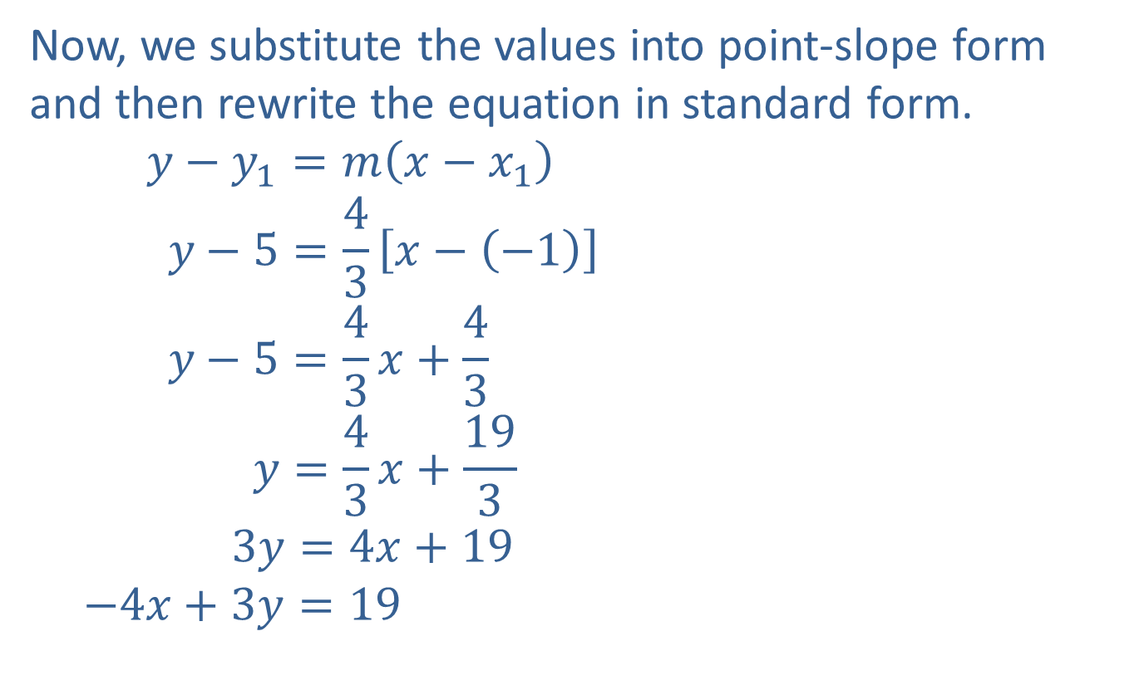

Example 4: Finding Equations of Lines Using a Graph (cont.)
Now, we substitute the values into point-slope form and then rewrite the equation in standard form.
$$y−y_{1}=m\left(x−x_{1}\right)$$
$$y−5=\frac{4}{3}\left[x−\left(−1\right)\right]$$
$$y−5=\frac{4}{3}x+\frac{4}{3}$$
$$y=\frac{4}{3}x+\frac{19}{3}$$
$$3y=4x+19$$
$$−4x+3y=19$$
Point-slope form
Substitute.
Distributive property
Add $5$ to both sides and simplify.
Multiply both sides by the LCD, $3$.
Standard form

Slide 15
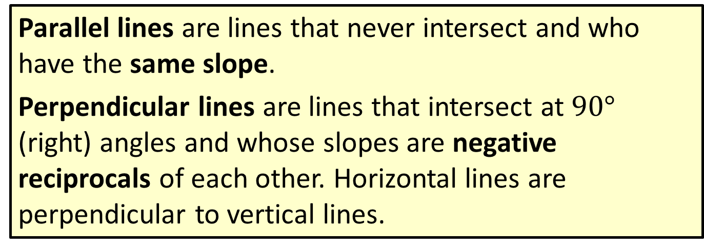
Definition: Parallel and Perpendicular Lines
Parallel lines are lines that never intersect and who have the same slope.
Perpendicular lines are lines that intersect at $90°$ (right) angles and whose slopes are negative reciprocals of each other. Horizontal lines are perpendicular to vertical lines.

Slide 16
Note
All vertical lines (undefined slopes) are parallel to one another. All horizontal lines (zero slopes) are also parallel to one another.

Slide 17

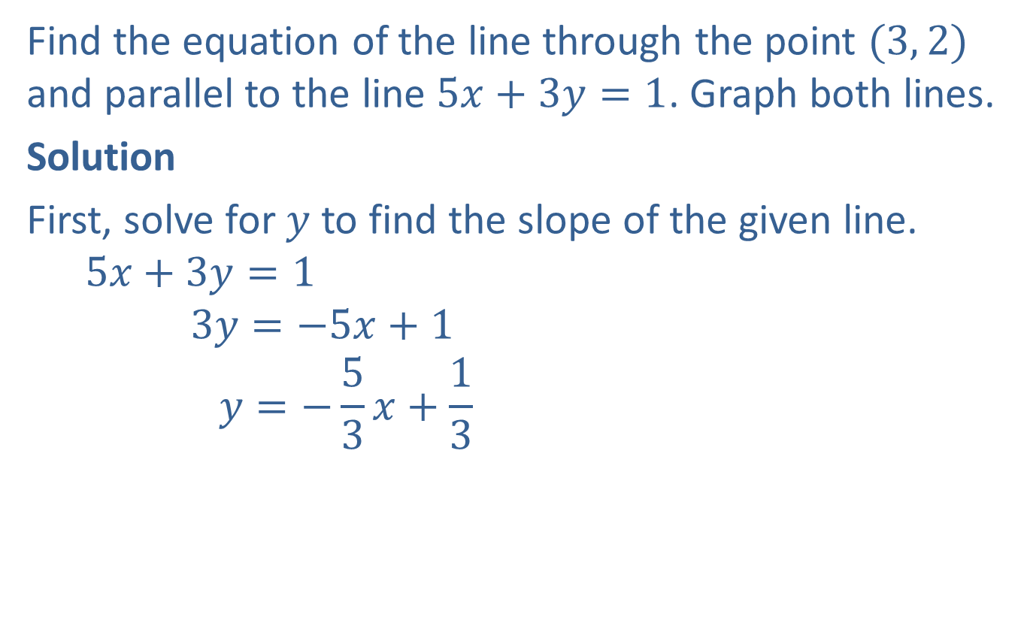
Example 5: Finding Equations of Parallel Lines
Find the equation of the line through the point $(3, 2)$ and parallel to the line $5x+3y=1$. Graph both lines.
Solution
First, solve for $y$ to find the slope of the given line.
$$5x+3y=1$$
$$3y=−5x+1$$
$$y=−\frac{5}{3}x+\frac{1}{3}$$
Thus, any line parallel to this line has slope $−\frac{5}{3}.$

Slide 18

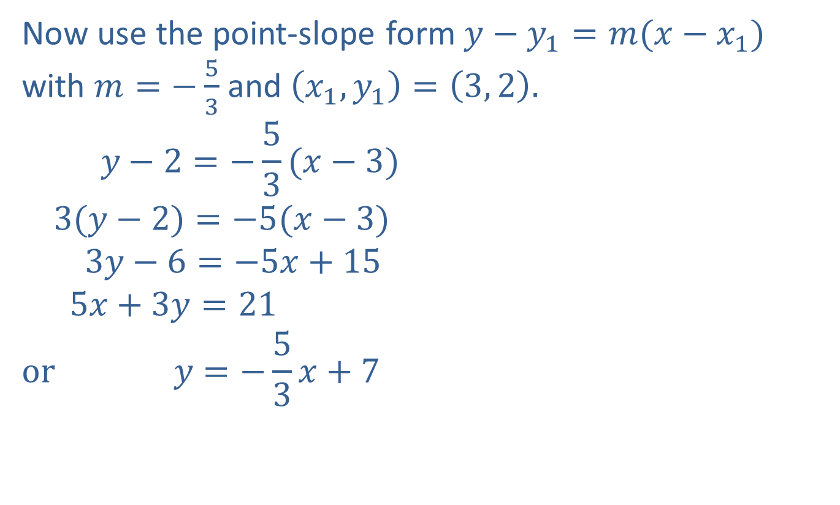
Example 5: Finding Equations of Parallel Lines (cont.)
Now use the point-slope form $y−y_{1}=m(x−x_{1})$ with $m=−\frac{5}{3}$ and $\left(x_{1},y_{1}\right)=\left(3, 2\right).$
$$y−2=−\frac{5}{3}(x−3)$$
$$3(y−2)=−5(x−3)$$
$$3y−6=−5x+15$$
$$5x+3y=21$$
$$or y=−\frac{5}{3}x+7$$
Point-slope form
Multiply both sides by the LCD, $3$
Simplify.
Standard form
Slope-intercept form

Slide 19
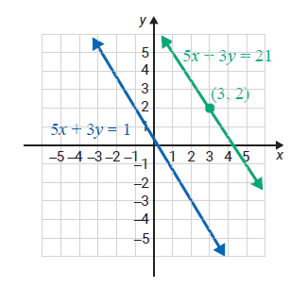
Example 5: Finding Equations of Parallel Lines (cont.)

Slide 20
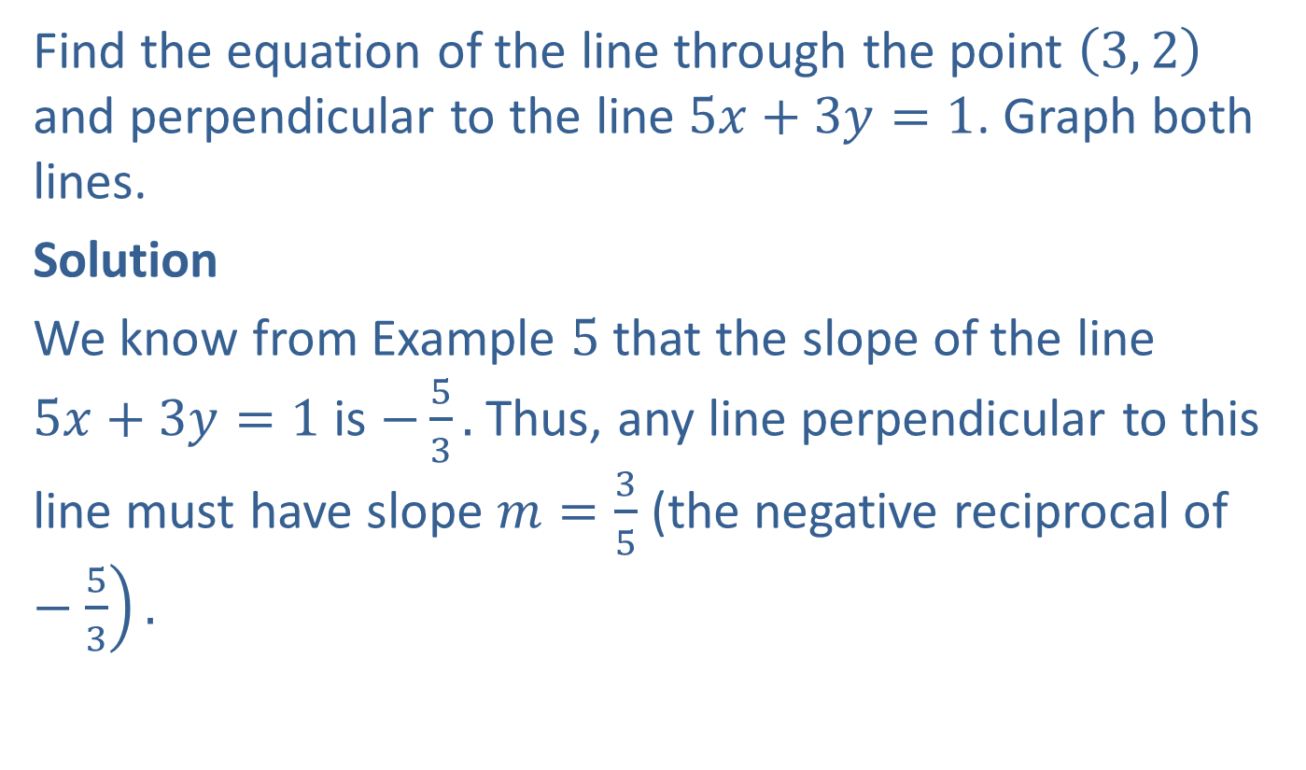
Example 6: Finding Equations of Perpendicular Lines
Find the equation of the line through the point $\left(3, 2\right)$ and perpendicular to the line $5x+3y=1$. Graph both lines.
Solution
We know from Example $5$ that the slope of the line $5x+3y=1$ is $−\frac{5}{3}.$ Thus, any line perpendicular to this line must have slope $m=\frac{3}{5}$ (the negative reciprocal of $−\left.\frac{5}{3}\right).$

Slide 21

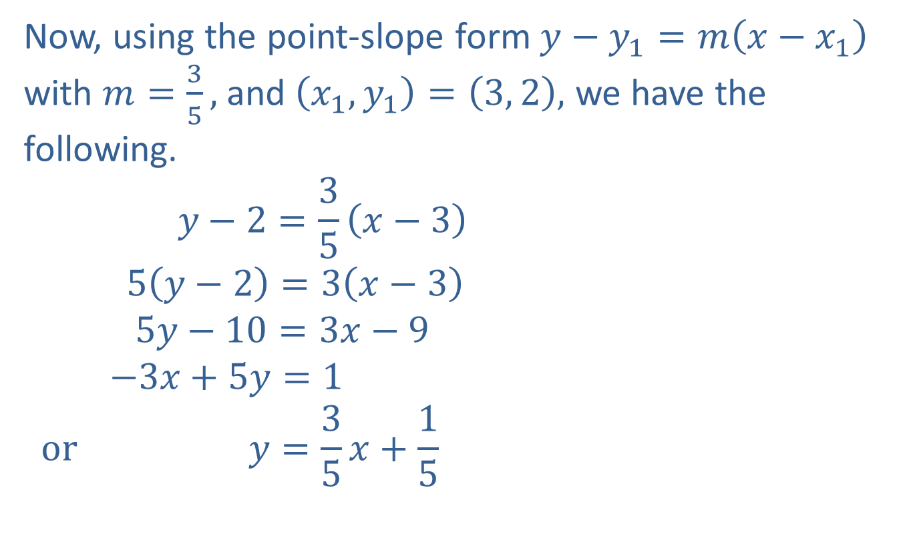
Example 6: Finding Equations of Perpendicular Lines (cont.)
Now, using the point-slope form $y−y_{1}=m\left(x−x_{1}\right)$ with $m=\frac{3}{5},$ and $\left(x_{1},y_{1}\right)=\left(3, 2\right),$ we have the following.
$$y−2=\frac{3}{5}\left(x−3\right)$$
$$5\left(y−2\right)=3\left(x−3\right)$$
$$5y−10=3x−9$$
$$−3x+5y=1$$
$$or y=\frac{3}{5}x+\frac{1}{5}$$
Point-slope form
Multiply both sides by the LCD, $5$.
Simplify.
Standard form
Slope-intercept form

Slide 22
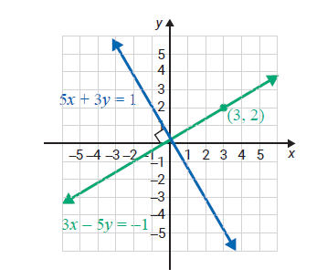
Example 6: Finding Equations of Perpendicular Lines (cont.)

Slide 23

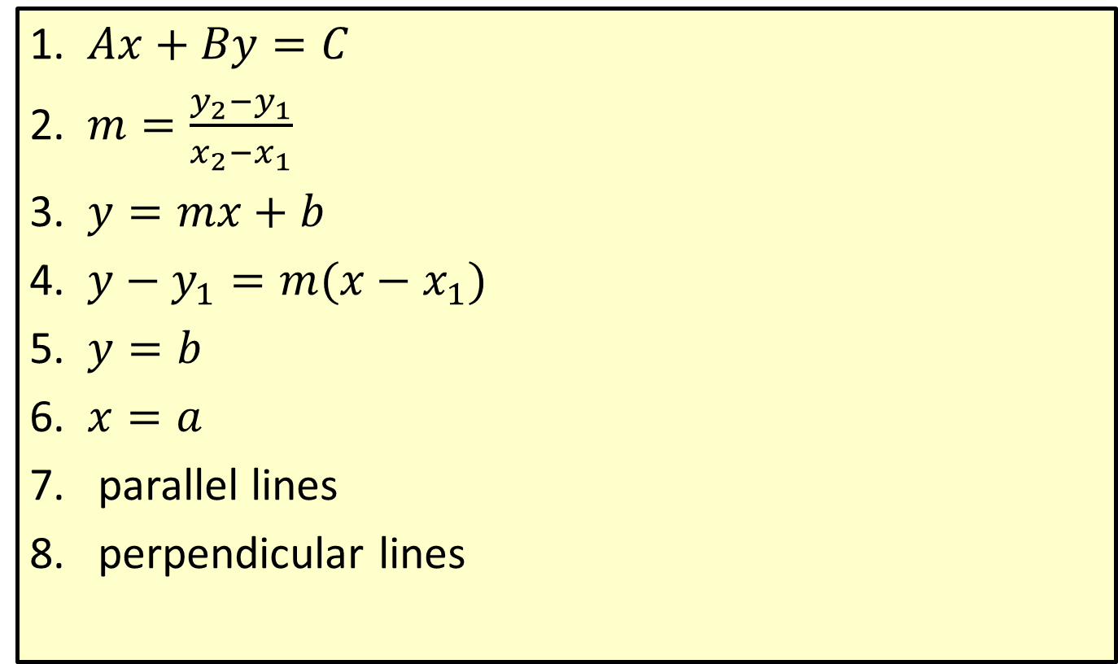
Properties: Summary of Formulas and Properties of Lines
1. $Ax+By=C$
2. $m=\frac{y_{2}−y_{1}}{x_{2}−x_{1}}$
3. $y=mx+b$
4. $y−y_{1}=m(x−x_{1})$
5. $y=b$
6. $x=a$
parallel lines
perpendicular lines
standard form
slope of a line
slope-intercept form
point-slope form
horizontal line, slope $0$
vertical line, undefined slope
have the same slope
have slopes that are negative reciprocals of each other

